Slide 1
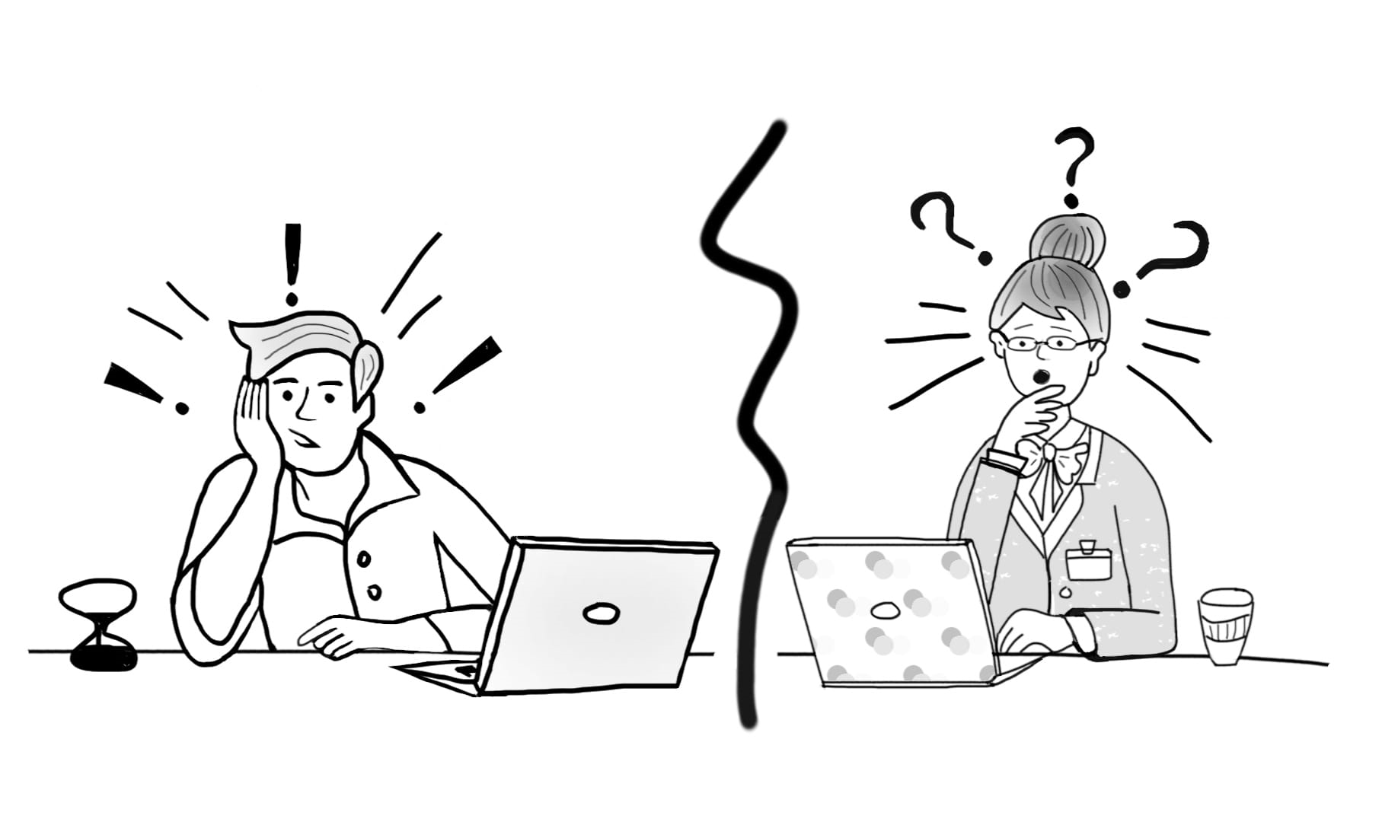

Pre-application Doctoral Communications:
A Participatory Workshop Exploring Institutional Gatekeeping in Doctoral Admissions
Funded by the Research England Enhancing Research Culture Fund 2022-2023
James Burford (@jiaburford )
Emily Henderson (@EmilyFrascatore)
Sophia Kier-Byfield, Dangeni (@Dangeni_),
Ahmad Akkad (@AhmadAkkad)
Department of Education Studies, Warwick University
#PADC_project Project website: https://warwick.ac.uk/padc
EARLi 2023 Conference Thessaloniki, Greece, August 22-26, 2023
Illustration by Yara Aboasfour
Notes:
Twitter/illustration/funder/
Follow our researchers on Twitter to receive project updates @jiaburford @EmilyFrascatore @AhmadAkkad @Dangeni_ or follow the project hashtag #PADC_project

Slide 2
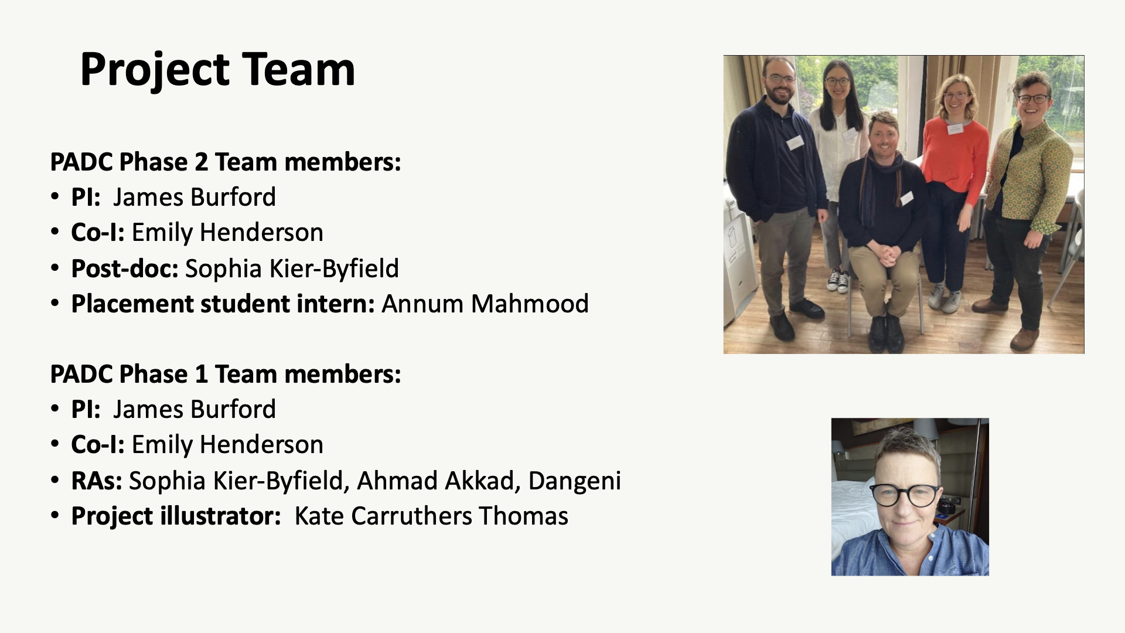

Slide 3
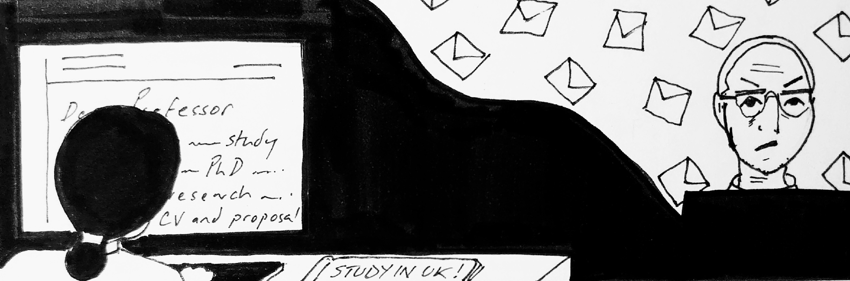
But first: what are pre-admissions doctoral communications (PADC)?
- Often emails from applicants to supervisors, Programme Officers (POs) or Director of Postgraduate Research (DPGRs)
- May include other forms too – video/phone calls, dropping by, approaches on social media, at conferences)
- May be forwarded communications within departments (e.g. from DPGR to supervisor)
- PADC (particularly to develop a research proposal) is expected in some disciplines and uncommon in others.
PADC defined as: communications that potential doctoral applicants may have with university staff prior to making a formal application to study.
Illustration by Dr Kate Carruthers Thomas

Slide 4
Why did you choose this session?
What were you hoping we might cover in today’s workshop?
Notes:
Why are you interested in attending this workshop? What are you hoping to gain?

Slide 5
Workshop objectives
(i) to introduce the pre-application stage as an important (if under considered) component of doctoral admissions with potential gatekeeping implications
(ii) to consider the roles of various stakeholders in the pre-application stage in one case of a UK university
(iii) to collectively refine understandings of this aspect of admissions
(iv) to consider potential channels of action that could ameliorate some of the inequalities that emerge in this stage of admissions and other ‘informal’ processes in doctoral education.

Slide 6
Workshop structure
A short presentation on pre-application stage (20 min)
  Wider context of doctoral admissions & EDI issues
  Introduction to our research project
Interactive activities (40 min)
  Discussion of sample pre-application emails
  Evaluation of pre-application webpage content
Engaging with project materials (10 min)
Open discussion (20 min)
  Do pre-application communications exist in the same way in your country and institutional context? If not, what happens? If yes, how do and/or your institution manage them?
  Are there any informal processes that may proceed admissions or other key doctoral education moments?

Slide 7

Diversity and the researcher workforce
Limited diversity of the researcher workforce is a national concern.
Doctoral education is integral to researcher training, often the ‘gateway’.
Wealth of research on challenges facing minoritised doctoral students in the UK (Mattocks & Briscoe-Palmer, 2016) – concern about participation of women in STEM, domiciled Black, Asian, and minority ethnic (BAME) students, and students who disclose a disability (Advance HE, 2022).
The vision for the strategy is: a more inclusive, dynamic, productive and sustainable UK R&D sector in which a diversity of people and ideas can thrive (p. 14)

Slide 8
EDI and doctoral admissions
Doctoral admissions: a key point of intervention to develop a more equitable, inclusive, and diverse research workforce.
Much EDI and doctoral admissions scholarship has a particular focus on exclusionary nature of admissions criteria (Mountford et al., 2007; Potvin et al., 2017; Cano et al., 2018; Ghost et al., 2018; Miller et al., 2019; Squire, 2020; Roberts et al., 2021).
Further studies on how academic staff identities influence decision-making (Squire 2020).
Many studies are US-focused, discipline-specific, few take an institutional approach.
As Julie Posselt has argued: professors play an underexamined role as gatekeepers of the professions, including the professoriate. One context in which this gatekeeping occurs is admission into graduate programs, which entails evaluative processes that are often opaque to outsiders and taken for granted by insiders (2014, p. 482).

Slide 9

Pre-application as a ‘gatekeeping’ moment
Our study focuses on one neglected element of the doctoral admissions process: pre-application communications.
For prospective doctoral applicants from underserved communities, the doctoral application process may be bewildering and difficult to navigate (see wealth of advice texts – YouTube videos, blog posts).
Equally, respondents to inquiries may make snap judgements, perhaps giving limited thought to their gatekeeping function.

Slide 10
Our project research objectives: PADC at Warwick
Emerges from our various roles/contexts as new supervisor in dept, and as DPGR who has led work in this area.
To understand how supervisors, DPGRs, and POs make decisions about responding to potential doctoral applicants at the pre-application stage, and to explore how these decisions may negatively impact the recruitment of diverse talent.
To evaluate the extent to which Doctoral College/departmental webpages on PGR admissions transparently describe the pre-application stage.
To identify changes at institutional and department levels to create a more transparent and inclusive doctoral admissions process, with a particular focus on enhancing inclusivity.
To produce a suite of professional development opportunities that facilitate the implementation of these changes.
To fill a gap in current research on PADC: explore how various institutional players think about ethics involved in PADC and what it might mean to make inclusivity-aligned judgements.

Slide 11
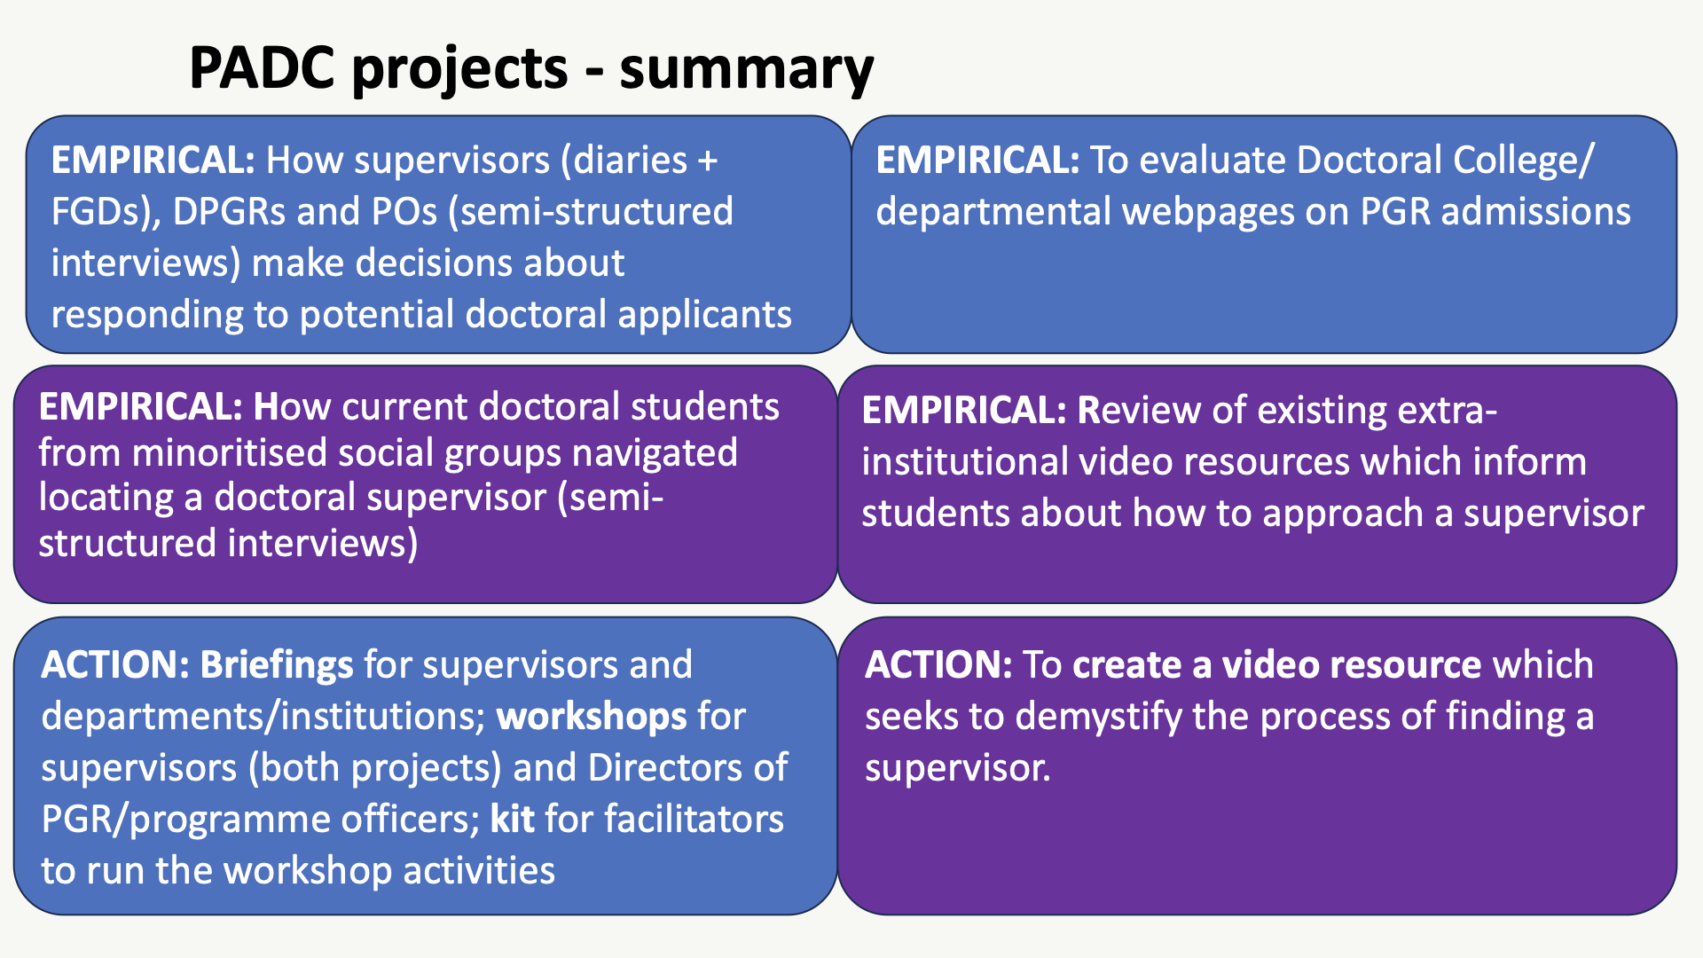

Slide 12
Participants and methods
Multi-method design
Semi-structured interviews | Solicited diaries & FGDs
Design 1-hour semi-structured interviews Participants 11 DPGRs, 8 doctoral programme officers, 15 minoritised doctoral students. All participants drawn from across Warwick faculties | Design Solicited diary forms with questions/prompts 6 weeks Online forms via Qualtrics Follow up FGDs Participants 19 doctoral supervisors All participants drawn from across Warwick faculties

Slide 13
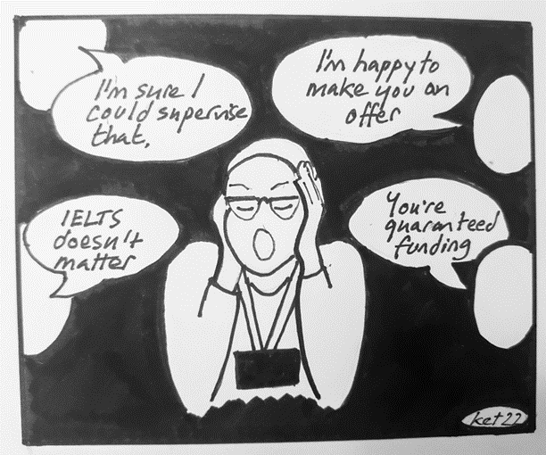
Stakeholders 1 & 2: Directors of PGR and Programme Officers
•The role of Director of PGR varies in terms of involvement in PADC/gatekeeping
•
•The role of Programme Officer varies in terms of PADC/ gatekeeping, e.g., filtering suitable applicants, sending rejection emails, deciding when to pass something on
•POs and DPGRs want to make more inclusive websites; websites are often a site of confusion for staff and applicants
•
•Broadly, POs and DPGRs often emphasised their 'equal' treatment of applicants – limited consideration of differentiated needs for information and communication.
Illustration by Dr Kate Carruthers Thomas

Slide 14
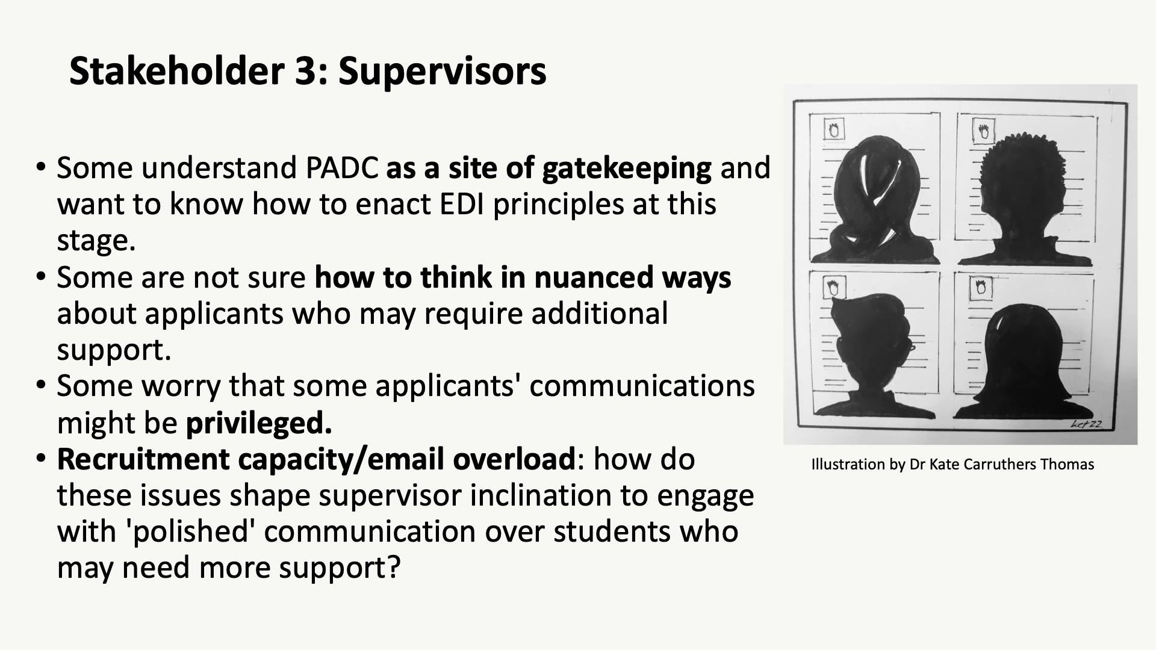

Slide 15
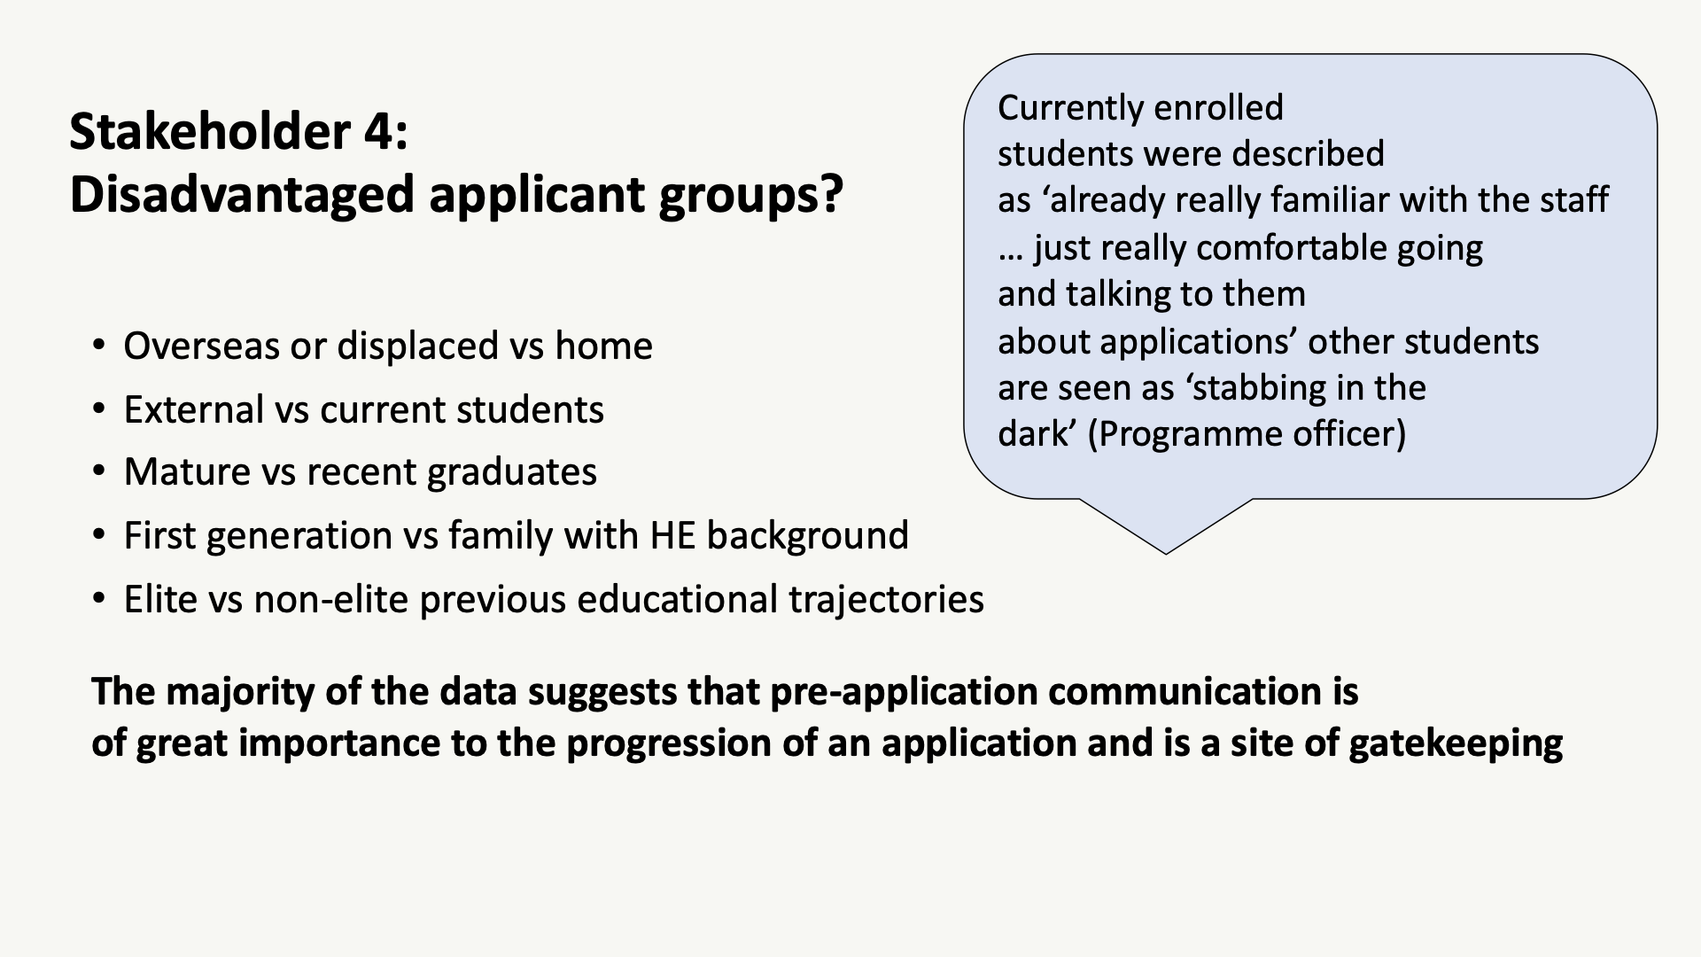

Slide 16
Activities
Split into groups (40 min)
  Option 1: focus on emails (JB)
  Option 2: focus on websites (D)
Group discussion to finish (30 min)
  Groups report back (10 min)
  Discussion of recommendations from the project (20 min)

Slide 17
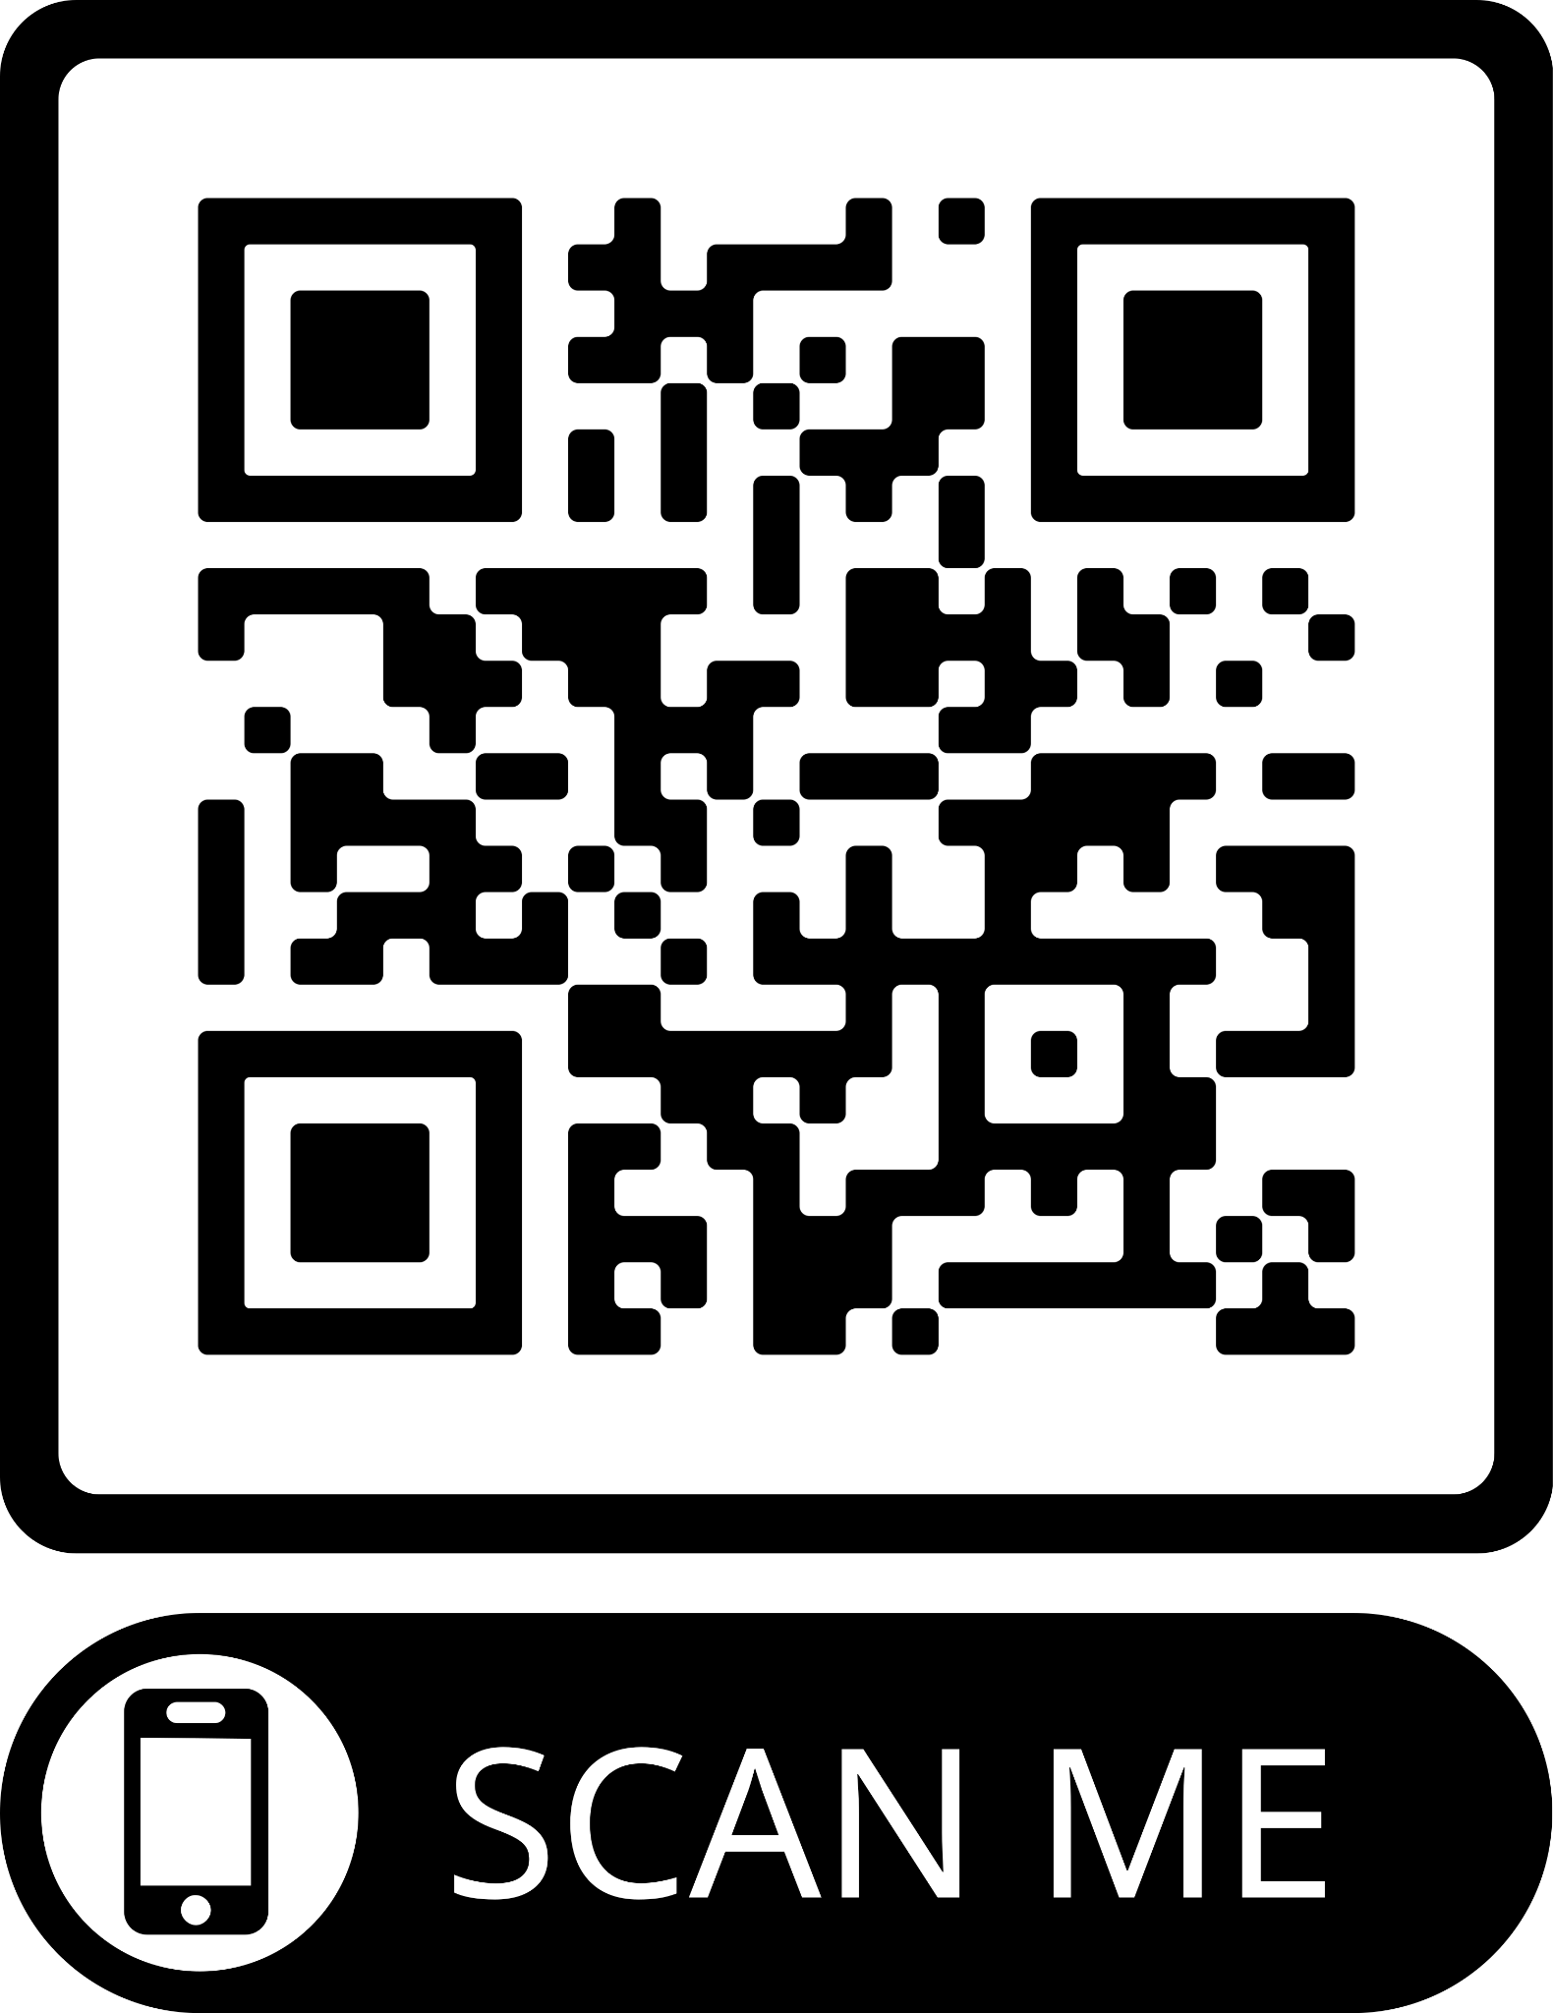
Activity: Email
https://shorturl.at/efrz1

Slide 18
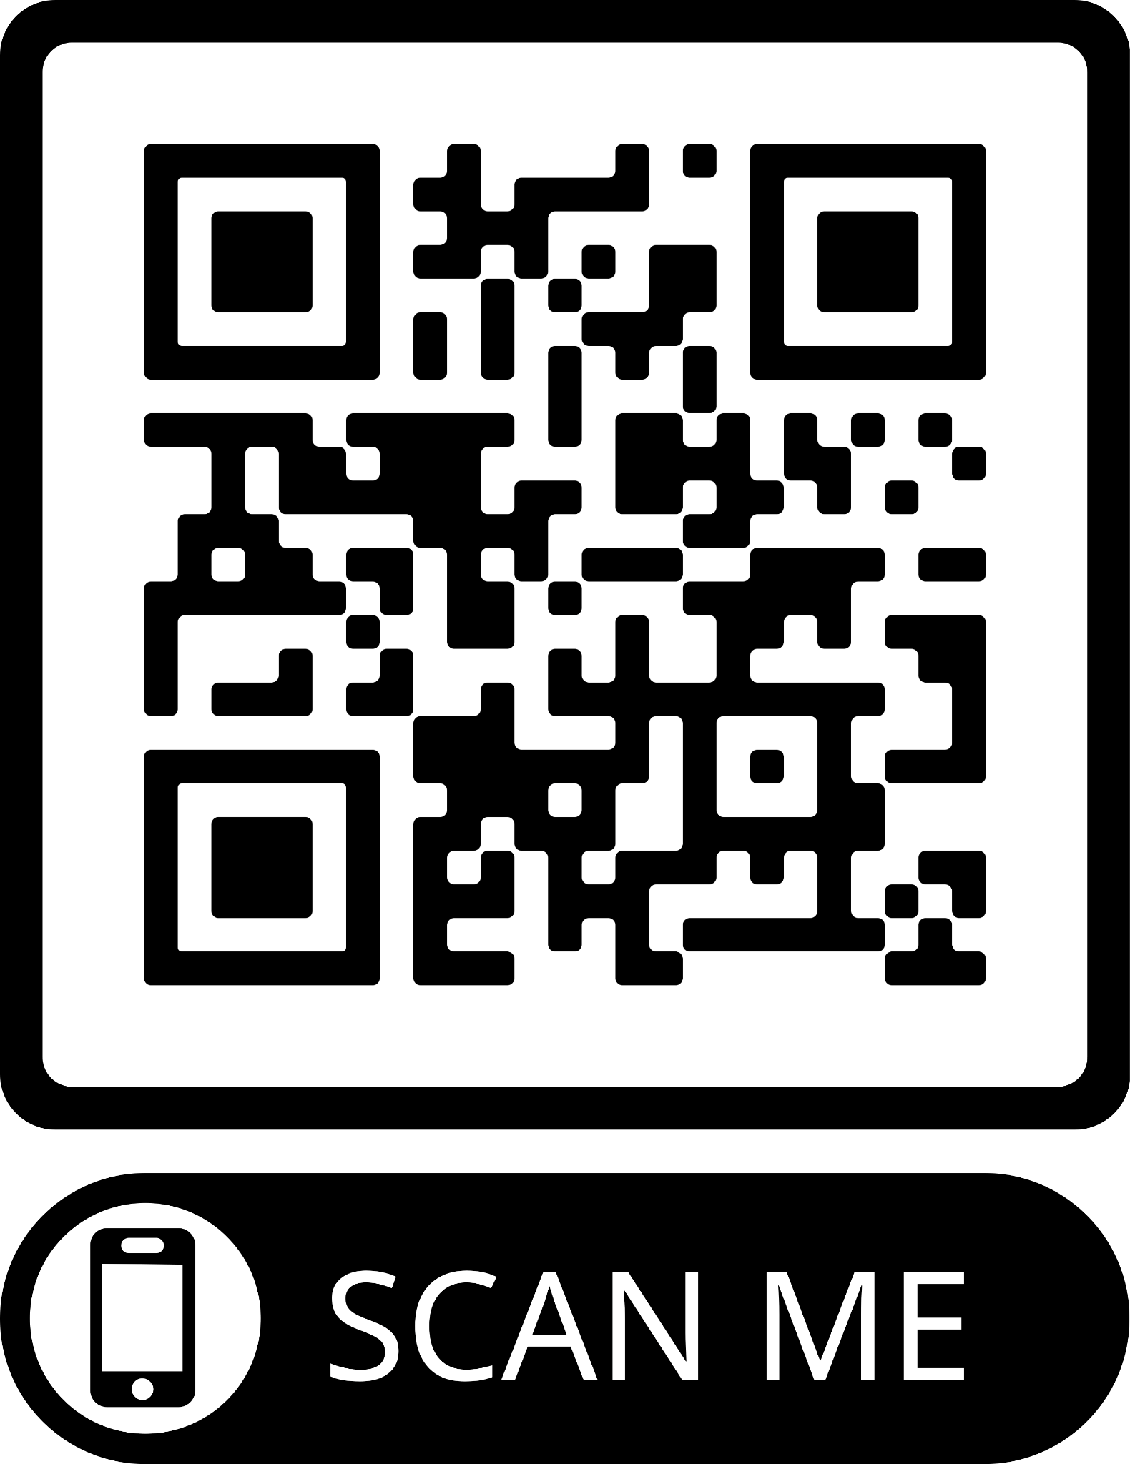
Activity: Webpage
https://shorturl.at/dfwFU

Slide 19
Thank you!

Slide 20

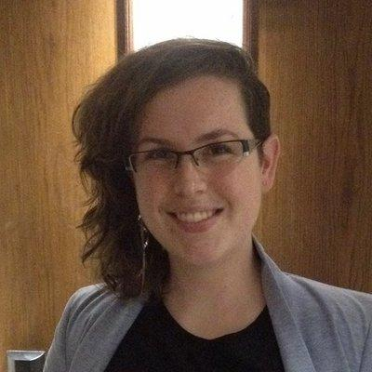
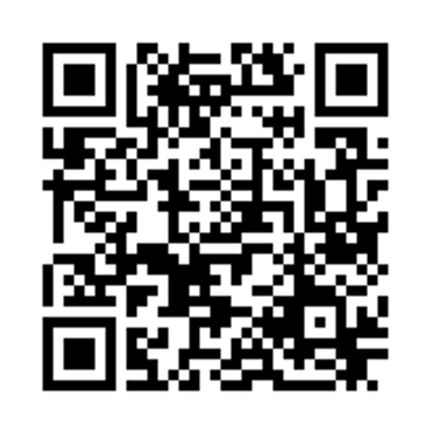
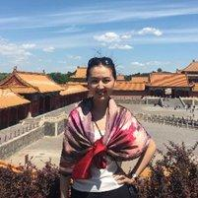
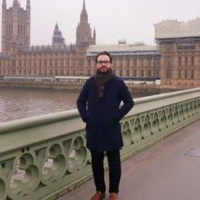
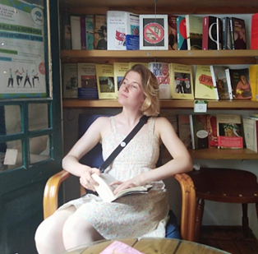
Where to find out more
Look at our website here https://warwick.ac.uk/padc
Follow along with the convo on Twitter using the hashtag #PADC_project
Follow us on Twitter: @EmilyFrascatore @AhmadAkkad_ @Dangeni_ @jiaburford

