Slide 1


Neurodiversity, challenges and positive experiences webinar

Slide 2


Health Promotion and Mindfulness: Nurturing Parents
Dr Karen E. Neil
Specialist Pharmacist, Health Promotion, Mindfulness teacher
Lived Experience Partner: Partners In Mind, Nottingham Neurodiversity Network
https://mindfulmedicine.co.uk/

Slide 3
A pause
‘The invitation is always to set the intention to prioritise self-care, and bring attitudes of kindness, curiosity and non-judgment to your experience, with core instincts or ‘gut feeling’ as your guide.’
Karen E. Neil

Slide 4
Health Promotion Meets Mindfulness
Health
‘a state of complete physical, mental and social well-being and not merely the absence of disease or infirmity.’
World Health Organization, 1948
Health Promotion
‘the process of enabling people to increase control over, and to improve, their health.’
World Health Organization, 1986
Awareness, or Mindfulness
‘a heightened and flexible attentiveness to perceptual impressions in one’s environment and internal cues, such as bodily sensations, thoughts, and emotions.’
Dahl, Wilson-Mendenhall and Davidson, 2020

Slide 5
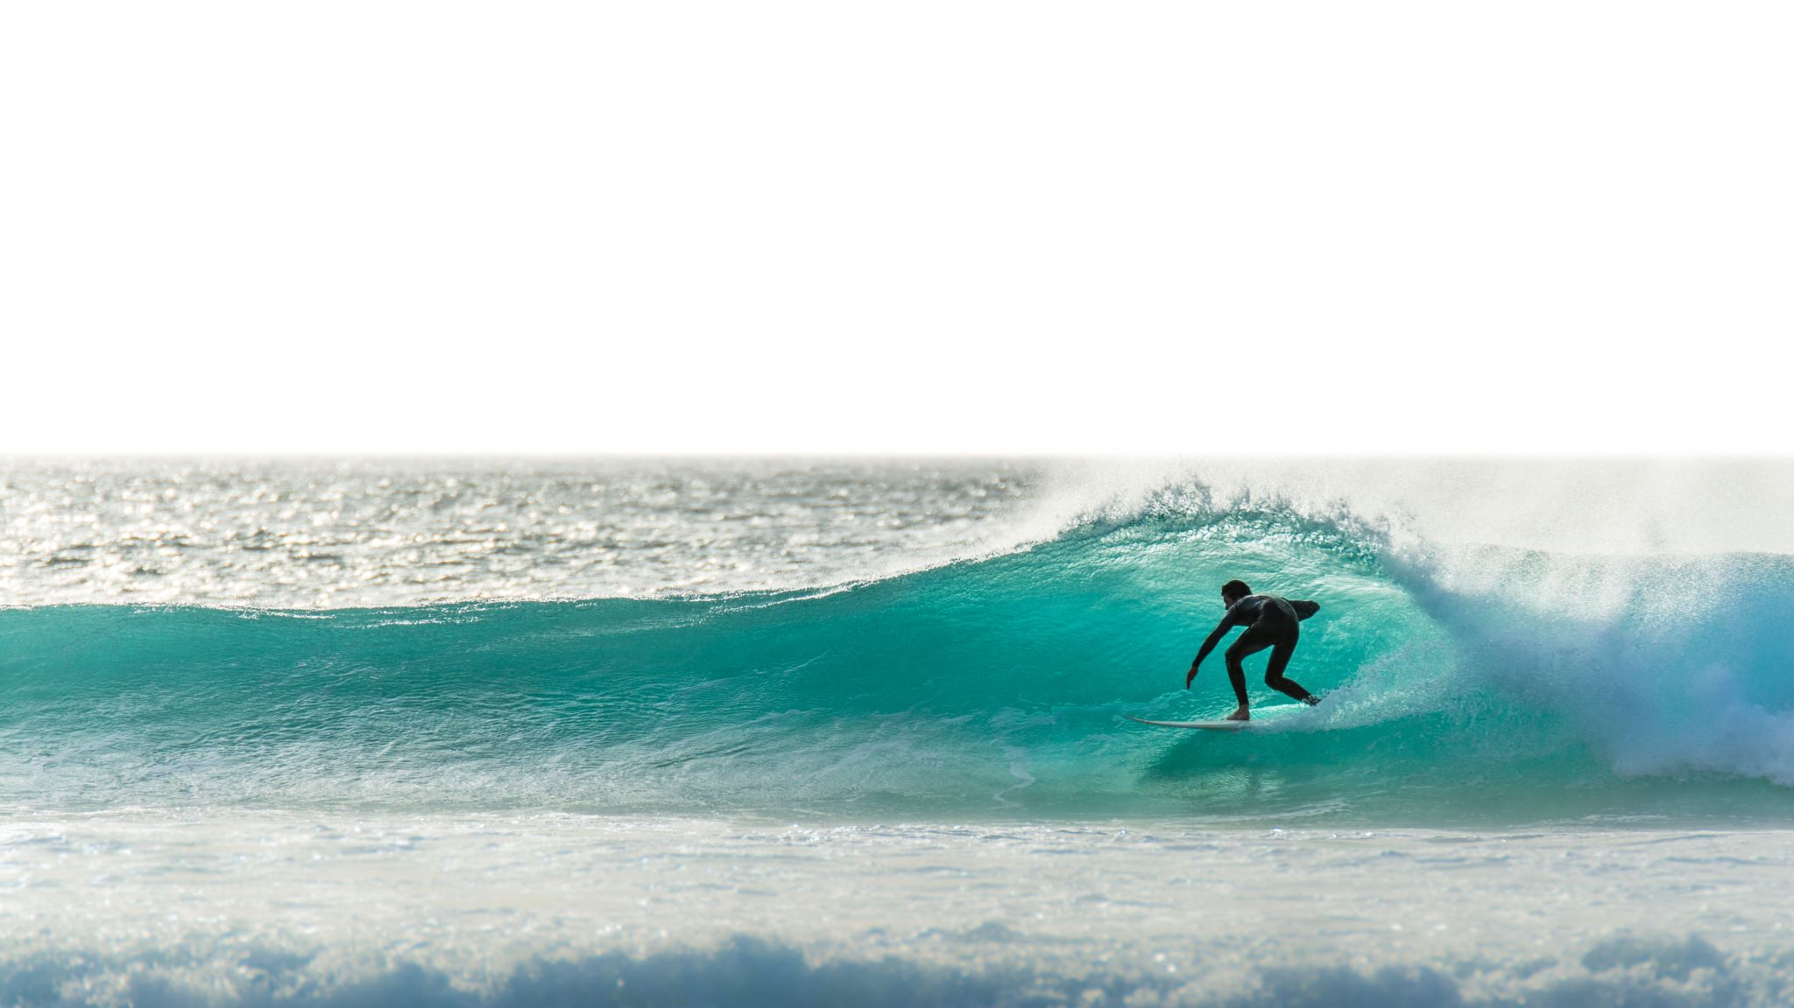
‘You can’t stop the waves,
but you can learn to surf’
Jon Kabat-Zinn

Slide 6
Health Promotion Principles and Neurodiversity
Meet people equally, where they are
Enable individuals and communities
Develop strengths and assets
Develop personal skills
Be an advocate
Create supportive environments

Slide 7
The Arts and Health The arts: ‘a recovery-focussed approach to wellbeing for children and young people experiencing poor mental health, unmet Special Educational Needs and other adverse childhood experiences.’ Neil and Watson 2024
Music
Creative writing
Dance and drama
Crafts, painting, photography

Slide 8
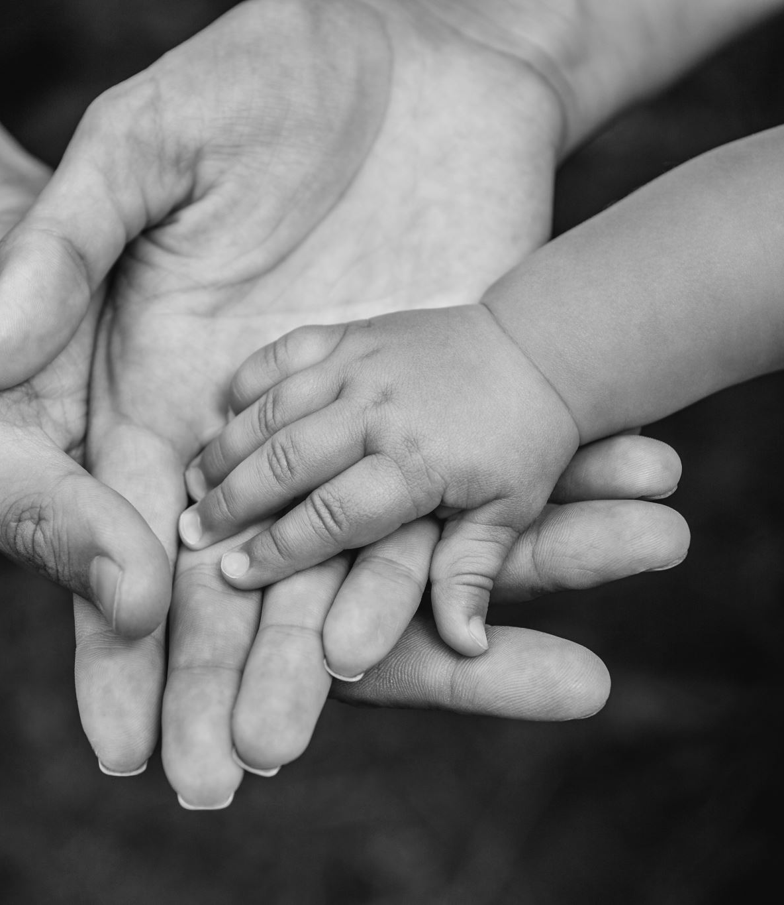
Nurturing Parents
‘a society that values its children should cherish their parents’
Bowlby, 1951
‘supporting the child starts with supporting the adult’
State of the Nation Survey, UK, 2020

Slide 9
Parental Wellbeing- early years
90% see parental mental health and wellbeing as critical to a child’s development.
Only 10% of expectant parents mentioned taking the time to look after their own wellbeing before baby arrived.
7 out of every 10 parents feel judged by others. Among these parents, almost half feel this negatively impacts their mental health.
State of the Nation Survey - Centre for Early Childhood Largest UK public study of early years- approx. 0.5 million people, 2020.

Slide 10

Stress is the ‘off-switch’ to connection
States of threat and ‘self-defense’ compete with caring systems, getting in the way of connection with our children
Dan Hughes, Brain-based Parenting
Mindfulness-based Stress Reduction
Full Catastrophe Living, Jon Kabat-Zinn

Slide 11
Awareness and Emotional Wellbeing
4 ‘core dimensions’ of emotional wellbeing:
Awareness or mindfulness- internal and external environment
Insight- self-knowledge
Connection- supportive relationships and caring interactions
Purpose- meaningful aims and values

Slide 12

Seeds of Kindness
Set intention to be kind to yourself.
Notice each day, where you are on the kindness barometer.
It can feel easier to be kind to others.
Notice the experience when you are kind to others.
Can you apply this to yourself?

Slide 13
Mindfulness of Thoughts- Parent Carer
PAST-
‘I did my best’
‘If only…’
‘The signs were all there’
PRESENT- Now
Noticing
Kindness
Curiosity
Meeting what is here
FUTURE–
‘He/she will find their niche’
‘What if…?’
‘How will they…?’

Slide 14

Anchors of Attention
Breath
Body
Sound
Taste
Smell
Vision
Touch
Note: mindfulness is not a solution for everything.

Slide 15

A Prayer for Serenity
‘May I find:
Serenity to accept the things I cannot change
Courage to change the things I can
Wisdom to know the difference.

Slide 16
Helpful Phrases
What is here and What does this need?
This too will pass
It is what it is

Slide 17

Just Washing the Dishes
Story- crisis situations

Slide 18
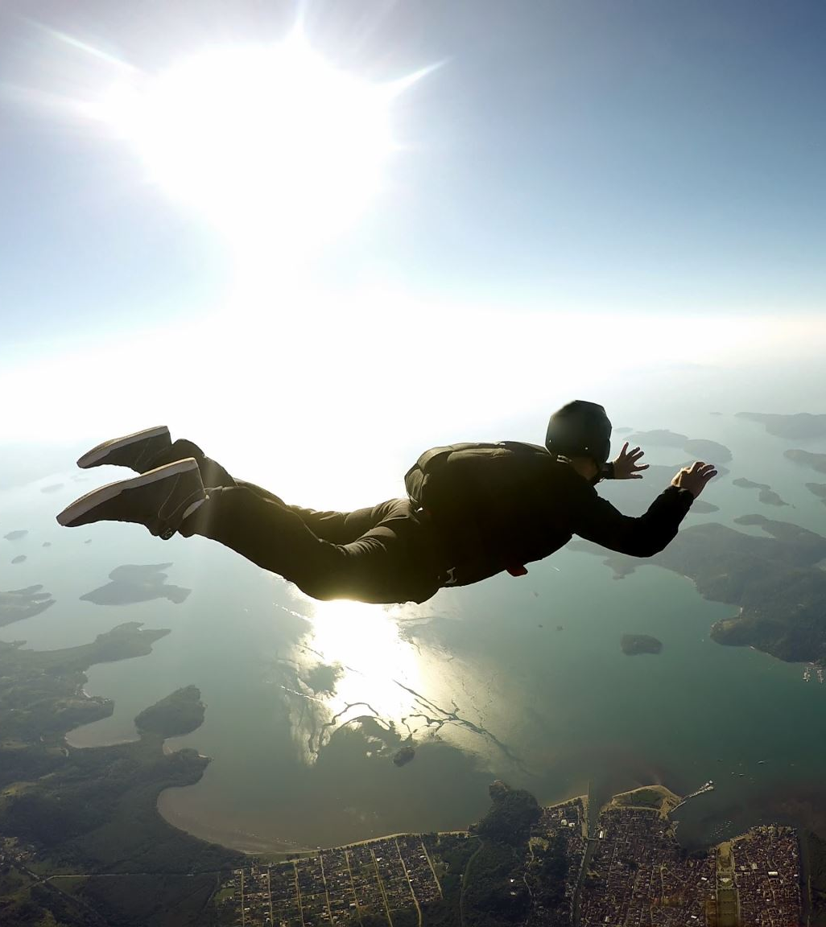

Imagery
Solid as a mountain
Swaying gently like bamboo
Rooted or anchored
Weave your parachute
Surf the waves

Slide 19
Summary Points
Awareness, or mindfulness, is a trainable skill for stress-reduction and emotional wellbeing.
Stress is the ‘off-switch’ to connection: Supporting the child starts with supporting the adult.
Health promotion principles provide a positive approach to health and wellbeing.
‘You can’t stop the waves, but you can learn to surf.’
Mindfulness includes bringing kindness, curiosity and non-judgment to your experience.

Slide 20
Further Information
Books
The Power of Neurodiversity: Unleashing the Advantages of Your Neurodivergent Brain (2nd Edition) by Thomas Armstrong.
Everyday Blessings: Mindfulness for Parents by Jon Kabat-Zinn and Myla Kabat-Zinn.
Asperger's Syndrome: Socialising and Social Energy: by the girl with the curly hair (The Visual Guides) by Alis Rowe.
Braving the Wilderness: The quest for true belonging and the courage to stand alone by Brené Brown.
The Mindful Child: How to Help Your Kid Manage Stress and Become Happier, Kinder, and More Compassionate by Susan Kaiser Greenland.
Apps: Headspace, Calm

Slide 21
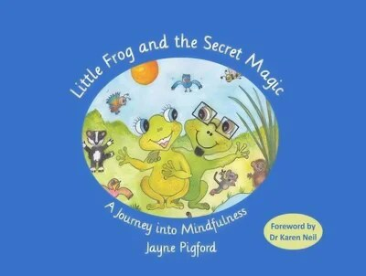
Little Frog and the Secret Magic – a children’s journey into mindfulness
Remembering Jayne Pigford – Mindful Medicine

Slide 22
Advocacy work
Resources | IHPE
Health-Promotion-and-Mindfulness.pdf
IPHE-Position-Statement-Autism-2021.pdf
IHPE-Position-Statement-Arts-and-Health-2024.pdf
IHPE-Position-Statement-Mindfulness-1.pdf
IHPE-Position-Statement-Health-Promotion-17th-May-2021.pdf
Children with autism and their families: greater support is needed | The BMJ
House of Lords Consultation 2025- Autism Act 2009 committees.parliament.uk/writtenevidence/144925/pdf/
IHPE-response-to-SEND-and-AP-green-paper-July-2022.pdf

Slide 23

Thank You :) May you feel connected and supported. May you live with kindness.

