Slide 1

Satnam Baley (Senior Lecturer Law - Newman University)
Bonnie Bullivant (Senior Lecturer H&SC – Newman University)
Autistic young women and legal challenges

Slide 2

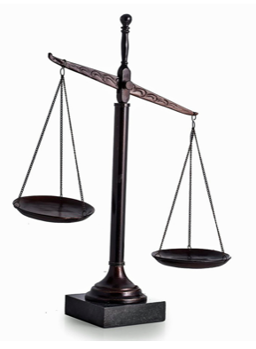
Case study : Lauren Bridges
Lauren (known to her family and friends as Lolly) was just a teenager when she died alone in a mental health facility hundreds of miles away from her home in 2022.
Her mum had been fighting to get her a placement closer to home, after she was detained under the Mental Health Act and sent to a facility six-hour’s drive away near Manchester , but her efforts were in vain.
Lauren was bright, compassionate, a straight-A student who dreamed of becoming a doctor or a paediatric nurse.
She was also autistic, and like many girls and young women with autism, she faced serious challenges in getting the right support.

Slide 3

Case
Lauren was misdiagnosed with a personality disorder and put on a treatment pathway that failed to recognise her challenges with autism.
Within months Lauren was dead. Let down by the very system designed to protect and support her.
Sadly, Lauren isn’t the only young woman to die in this facility in recent years.
Her death was not inevitable, it was preventable.
Laurens mum (Lindsay Bridges) campaigned for Lolly’s Law

Slide 4

Lolly’s Law
Lolly’s Law is centred around four urgent reforms informed by what Lauren would have benefited from to keep her safe:
Mandatory retraining for psychiatric professionals and support staff.
Reassessment of “personality disorder” diagnoses where autism might be missed.
Specialist suicide prevention and self-harm teams must be available in all mental health units for vulnerable young people.
These should be multidisciplinary teams trained specifically in females with autism.
Anti-ligature doors and safety infrastructure must be mandated across all inpatient mental health facilities.

Slide 5
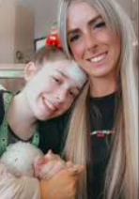
Legislation
Specialist Autism Act 2009
The Autism Act 2009 is the first piece of legislation in the UK specifically addressing the needs of autistic adults.
It mandates the government to develop and maintain a national autism strategy, which is reviewed every five years.
The strategy focuses on improving services and support for autistic individuals.

Slide 6
Legislation
Equality Act 2010
The Equality Act 2010 provides a broader framework for protecting individuals from discrimination based on disability, which includes autism.

Slide 7
Legislation
Human Rights Act 1998 (stems from the ECHR)
The Human Rights Act 1998 underpins the rights of all individuals in the UK, including autistic people. It ensures that everyone is treated fairly and without discrimination by public authorities
Our law, the Human Rights Act 1998 (HRA), guarantees these minimum standards across public services, including in health and care settings and justice system.

Slide 8
Legislation
Mental Capacity Act 2005
2 People who lack capacity
(1) For the purposes of this Act, a person lacks capacity in relation to a matter if at the material time he is unable to make a decision for himself in relation to the matter because of an impairment of, or a disturbance in the functioning of, the mind or brain.
3 Inability to make decisions
(1) For the purposes of section 2, a person is unable to make a decision for himself if he is unable;
(a)to understand the information relevant to the decision,
(b)to retain that information,
(c)to use or weigh that information as part of the process of making the decision, or
(d)to communicate his decision (whether by talking, using sign language or any other means).

Slide 9
Legislation
Care Act 2014
1 Promoting individual well-being
(1) The general duty of a local authority, in exercising a function under this Part in the case of an individual, is to promote that individual's well-being.
(2) “Well-being”, in relation to an individual, means that individual's well-being so far as relating to any of the following—
(a) personal dignity (including treatment of the individual with respect);
(b) physical and mental health and emotional well-being;
(c) protection from abuse and neglect;

Slide 10
Legislation
Mental Health Act 1983
Under the Mental Health Act 1983 (England and Wales) people can be detained if they are at risk of harming themselves or others due to a “mental disorder”.
This term is defined to include learning disability and autism, although these are not mental health conditions.
Mental Health Act 2025
The 2025 Act removes autism and learning disability as criteria for Section 3 detention in the absence of a co-occurring mental health condition.
Will be phased in over the coming years.
Detention: The bar for detention will be higher: under both section 2 and section 3
Learning disabilities and autism: Integrated care boards (ICBs) and local authorities will need to seek to ensure the needs of people with learning disabilities and autistic people can be met without having to detain them.
The updated MHA will make this a statutory duty.

Slide 11

Experience
Competing interests
Police investigation, Securing evidence, Defendants well being, Legal representation
There have been occasions when I have been called out as the duty solicitor to represent
During consultation with client – noticed somethings are not quite right – agitated, comprehension of facts limited, scared etc.
Safeguards in place - GP – General Practitioner – not qualified in mental health, learning difficulties, autism
Fit for interview – This is not the same as fit to answer questions!
To protect the individual’s rights, dignity, ensure they are not overwhelmed etc
No comment – submit a written statement – log my representations on the custody log.

Slide 12

Fitness to Plead
What Is “Fitness to Plead”?
It’s all about whether someone has the mental and cognitive ability to understand and take part in criminal proceedings. If a person can’t do this because of a mental disorder, brain injury, or learning disability, they may be found unfit to plead, meaning they cannot be fairly tried in the usual way.
Questions the court must ask
• Can the defendant understand the charges?
• Can they decide how to plead?
• Can they instruct their solicitor or barrister?
• Can they follow what’s happening in court?
• And could they give evidence if needed?
If the answer to several of these is no, the person may be deemed unfit to plead.
Why Fitness to Plead Matters
Fitness to plead is more than a legal technicality, it’s a reflection of how a just society treats people with mental health difficulties, learning difficulties, autism.
It ensures that the right to a fair trial, protected by Article 6 of the Human Rights Act 1998, is meaningful for everyone, regardless of their psychological condition.

Slide 13

Autistic women and legal challenges
Vulnerable autistic people are more likely to be victims of crime (Collins , 2022)
Despite vulnerable autistic individuals being less likely to engage in general criminal activity (Chester, 2022; Collins, 2023)
Autistic individuals are overrepresented in the Criminal Justice system (CJS) ~1% Population, but 3 - 48% psychiatric prison population ( Chester, 2022).

Slide 14

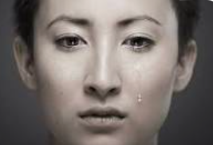
Autistic women are more likely to be victims of violence and crime (Pecora, 2019; Reuben 2021; Thrundle, 2023; Dike, 2025).
88.4% autistic women experience rape and over
60% before the age of 18 years (Cazalis, 2022)
50.4% of autistic children are subjected to sex abuse (Dike, 2025)
Key drivers include
communication differences
social naivety,
compliance,
limited sex education,
perpetrators actively target neurodivergent individuals. (Fisher & Taylor, 2016)

Slide 15
Difficulties encountered by autistic individuals in CJS
Easily intimidated due to sensory issues causing meltdowns and non-compliance (Slavny-Cross, 2022)
Literal Interpretation of legal Language, Police cautions, leading to misunderstandings and self-incrimination (Maras, 2021)
Impaired theory of mind – can’t infer intentions of others, vulnerable to exploitation and manipulation (Freckelton, 2013)
Atypical Behaviour – avoiding eye contact , stimming, emotionally flat indicating an apparent lack of remorse ( Freckelton, 2013, Vinter , 2019)
Executive functioning difficulties – sequential, recall difficulties (Maras and Bowler, 2012)
Compliance and acquiescence – comply authority figures agree with leading questions, false confessions ( Gudjonsson 2016: Bagnall, 2023)

Slide 16
Key Legislative and Policy Accommodations
Key Legislative and Policy Accommodations
Year | Legislation / Policy | Accommodation | Applies To | Year
1984 | PACE Act 1984, Code C | Appropriate Adult safeguard for vulnerable suspects | Suspects | 1984
1999 | Youth Justice and Criminal Evidence Act 1999 | Special measures; intermediaries for vulnerable witnesses | Witnesses | 1999
2005 | Mental Capacity Act 2005 | Decision-making framework for those lacking capacity | All parties | 2005
2008 | Witness Intermediary Scheme (national rollout) | Registered Intermediaries available nationally | Witnesses | 2008
2009 | Autism Act 2009 | First autism-specific legislation; national strategy required | All | 2009
2010 | Equality Act 2010 | Duty on all public services to make reasonable adjustments | All | 2010
2015 | Criminal Procedure Rules 2015, Rule 3.9 | Ground rules hearings for vulnerable defendants/witnesses made mandatory | Defendants, Witnesses | 2015
2018 | PACE Code C revision | Autism explicitly named as triggering the AA safeguard; voluntary interviews covered | Suspects | 2018
2021 | CJJI Review of Evidence; National Autism Strategy | Call for systemic reform; CJS identified as priority area | Policy | 2021
2022 | MoJ Neurodiversity Action Plan | NSMs piloted in prisons; Autism Accreditation promoted | Prisons | 2022
2023 | PACE Code C updated; MoJ Action Plan updated | NSMs to all public prisons; further clarification on vulnerability identification | Prisons, Police | 2023
2024 | Woodhouse et al. consensus statement | First multi-professional UK consensus guidance for CJS personnel | Policy/Practice | 2024

Slide 17
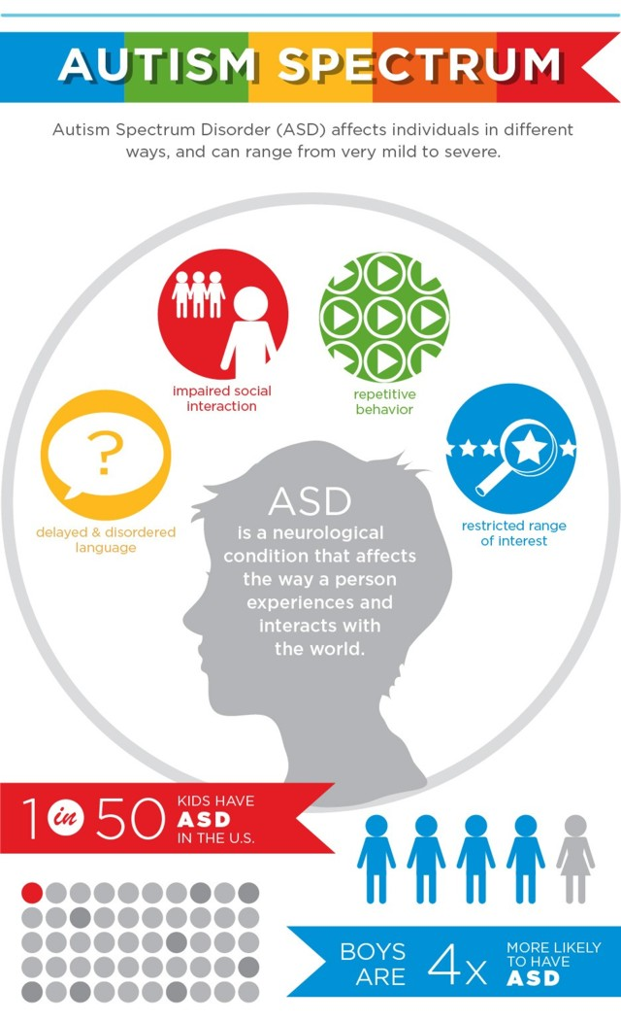
The Special Measures (Sections 23–30 YJCEA, 1999) for vulnerable and intimidated witnesses Purpose of Special Measures
1. Screens around the witness box (s.23)
A screen is placed so the witness cannot see the defendant.
The defendant, judge, and jury can still see the witness.
2. Live link (s.24)
The witness gives evidence from a separate room via video link.
Commonly used for children or vulnerable witnesses.
3. Evidence given in private (s.25)
The courtroom is cleared of the public.
Usually used in sexual offence cases or cases involving intimidation.
4. Removal of wigs and gowns (s.26)
Judges and barristers remove formal attire.
Makes the setting less intimidating, especially for children.
5. Video-recorded evidence-in-chief (s.27)
A pre-recorded interview with the witness is used as their main evidence.
Often used for children in abuse cases.
6. Video-recorded cross-examination or re-examination (s.28)
Cross-examination is recorded in advance and later played at trial.
Aimed at reducing stress from live court questioning.
7. Examination through an intermediary (s.29)
An intermediary helps facilitate communication between the witness and court.
Used where the witness has communication difficulties.
8. Aids to communication (s.30)
Witnesses can use tools such as:
  Communication boards
  Sign language interpreters
  Other assistive devices

Slide 18
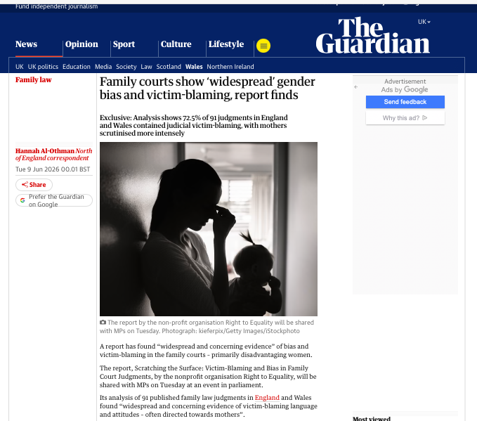
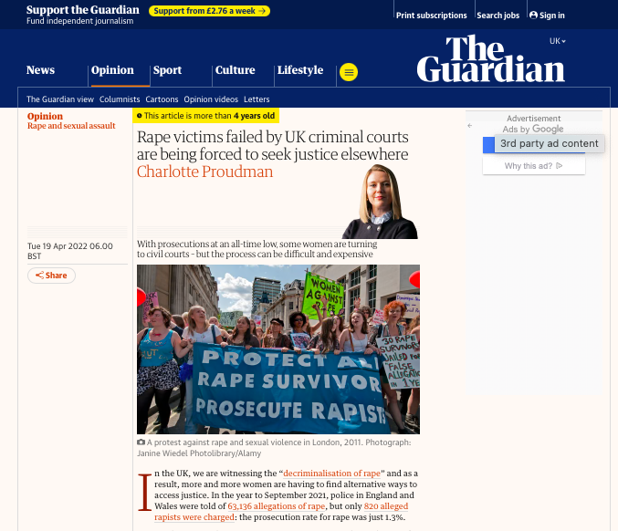
Intersectionality, legal bias, blame and Family / Criminal Courts
Real life scenarios
Christine – Autistic daughter gang raped
Megan – Lost custody of children
Lucy – falsely arrested when husband accused her of slapping children
Bethan – marital rape

Slide 19
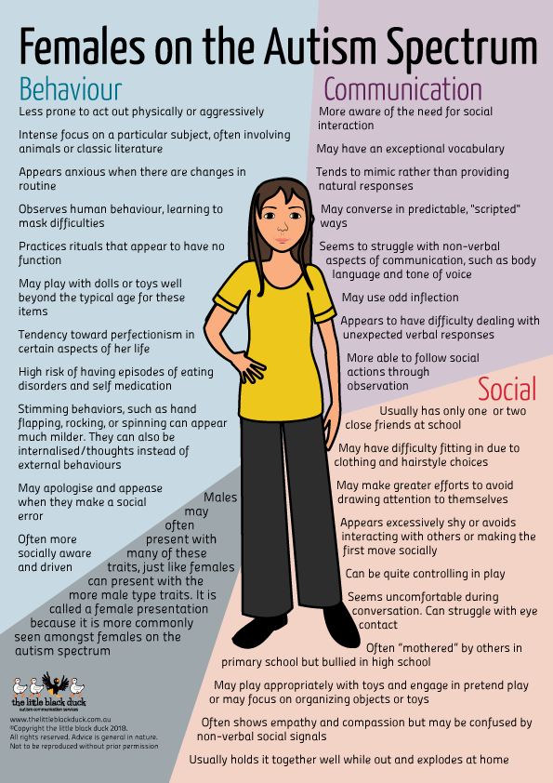
Practical Tips: Social deficits and managing stress
Explain what “Grooming” looks like
Discuss sex education issues objectively
Alexithymia (Pistula, 2015; Milosavljevic, 2015; Ketetaars, 2016) - Social skills training, priming and rehersal
Taxi service
Act as responsible adult – advocate effectively. Research and put things in writing.
Regular monitoring whilst at University (Visits every 2-4 weeks)
Join clubs (special interest)
When mistakes are made; ‘it is not the end of the world’
Encourage friendships with trusted autistic individuals
Exercise; reducing stress, balancing hormones
Utilize repetitive thought patterns for compliments and platitudes
Encourage good personal hygiene and appearance
Adolescent angst and parental loathing (Baldwin, 2014) - Mother ‘editing behaviour’
Affection
Failure is a survivable option

Slide 20
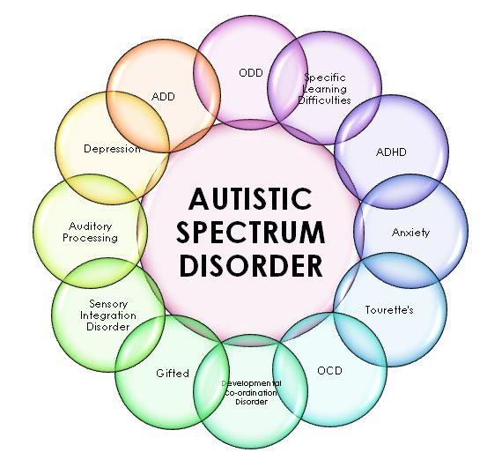

Case study Lolly’s Law
Legislation
Fitness to plead
Increased violence and sexual violence against autistic women
Real life examples
Practical strategies that could contribute to optimising safety and well-being
What have we
covered today?

Slide 21
References
Bagnall, R., Cadman, A., Russell, A., Brosnan, M., Otte, M. and Maras, K.L. (2023) Police suspect interviews with autistic adults: The impact of truth telling versus deception on testimony. Frontiers in Psychology, 14, p.1117415.
Care Act 2014, c.23. London: HMSO.
Cazalis, F., Reyes, E., Leduc, S. and Gourion, D. (2022) Evidence that nine autistic women out of ten have been victims of sexual violence. Frontiers in Behavioral Neuroscience, 16, p.852203.
Chester, V., Dobbinson, S. and Tromans, S. (2022) Autistic people within forensic psychiatric services and the criminal justice system: A systematic review. Journal of Intellectual Disabilities and Offending Behaviour, [online]. Available at: https://doi.org/10.1080/14789949.2025.2558833 [Accessed 16 June 2026].
Collins, J., Horton, K., Gale-St. Ives, E., Murphy, G. and Barnoux, M. (2023) A systematic review of autistic people and the criminal justice system: An update of King and Murphy (2014). Journal of Autism and Developmental Disorders, 53(8), pp.3151–3179.
Criminal Procedure Rules 2015, SI 2015/1490. London: HMSO.
Dike, J.E., DeLucia, E.A., Semones, O., Andrzejewski, T. and McDonnell, C.G. (2022) A systematic review of sexual violence experiences among individuals on the autism spectrum. Review Journal of Autism and Developmental Disorders, 10, pp.367–383.
Equality Act 2010, c.15. London: HMSO.
Fisher, M.H. and Taylor, J.L. (2016) Let's talk about it: Peer victimization experiences as reported by adolescents with autism spectrum disorder. Autism, 20(4), pp.402–411.
Freckelton, I. (2013) Autism spectrum disorder: Forensic issues and challenges for mental health professionals and courts. Journal of Applied Research in Intellectual Disabilities, 26(5), pp.420–434.
Gudjonsson, G.H., Sigurdsson, J.F., Sigfusdottir, I.D., Asgeirsdottir, B.B., Gonzalez, R. and Young, S. (2016) A national epidemiological study investigating risk factors for police interrogation and false confession among juveniles and young persons. Social Psychiatry and Psychiatric Epidemiology, 51(3), pp.359–367.
Human Rights Act 1998, c.42. London: HMSO.
Ketelaars, C., Mol, A., Swaab, H. and van Rijn, S. (2016) Emotion recognition and alexithymia in high functioning females with autism spectrum disorder. Research in Autism Spectrum Disorders, 21, pp.38–46.
Maras, K. (2021) Obtaining testimony from autistic people. Available at: https://www.autism.org.uk/advice-and-guidance/professional-practice/police-interviews [Accessed 16 June 2026].
Maras, K.L. and Bowler, D.M. (2012) Context reinstatement effects on eyewitness memory in autism spectrum disorder. British Journal of Psychology, 103(3), pp.330–342.
Mental Capacity Act 2005, c.9. London: HMSO.
Mental Health Act 1983, c.20. London: HMSO.
Mental Health Act 2025, c.18. London: HMSO.
Milosavljevic, B., Carter Leno, V., Simonoff, E., Jichi, F., Asherson, P., Plomin, R., Ronald, A., Sugden, K. and Happé, F. (2016) Alexithymia in adolescents with autism spectrum disorder: Its relationship to internalising difficulties, sensory modulation and social cognition. Journal of Autism and Developmental Disorders, 46(4), pp.1354–1367.
Ministry of Justice (2022) Neurodiversity Action Plan. London: Ministry of Justice.
Pecora, L.A., Hancock, G.I., Mesibov, G.B. and Stokes, M.A. (2019) Characterising the sexuality and sexual experiences of autistic females. Journal of Autism and Developmental Disorders, 49(12), pp.4834–4846.
Pisula, E., Danielewicz, D., Kawa, R. and Pisula, W. (2015) Autism spectrum quotient, coping with stress and quality of life in a non-clinical sample: An exploratory report. Health and Quality of Life Outcomes, 13(1), p.173.

Slide 22
References
Police and Criminal Evidence Act 1984 (Codes of Practice, Code C), revised 2018, 2023. London: HMSO.
Reuben, K.E., Stanzione, C.M. and Singleton, J.L. (2021) Interpersonal trauma and posttraumatic stress in autistic adults. Autism in Adulthood, 3(4), pp.355–364.
Slavny-Cross, R., Allison, C., Griffiths, S. and Baron-Cohen, S. (2022a) Autism and the criminal justice system: An analysis of 93 cases. Autism Research, 15(5), pp.904–914.
Slavny-Cross, R., Allison, C., Griffiths, S. and Baron-Cohen, S. (2022b) Are autistic people disadvantaged by the criminal justice system? A case comparison. Autism, 27(5), pp.1438–1448.
Specialist Autism Act 2009, c.15. London: HMSO.
Trundle, G., Jones, K.A., Ropar, D. and Egan, V. (2023) Prevalence of victimisation in autistic individuals: A systematic review and meta-analysis. Trauma, Violence, & Abuse, 24(4), pp.2282–2296
Witness Intermediary Scheme (2008) National rollout of registered intermediaries. London: Ministry of Justice.
Woodhouse, E., Hollingdale, J., Davies, L., Al-Attar, Z., Young, S., Vinter, L.P., Agyemang, K., Bartlett, C., Berryessa, C., Chaplin, E., Deeley, Q., Freckelton, I., Gerry, F., Gudjonsson, G., Maras, K., Mattison, M., McCarthy, J., Mills, R., Misch, P., Murphy, D. and Allely, C. (2024) Identification and support of autistic individuals within the UK Criminal Justice System: A practical approach based upon professional consensus with input from lived experience. BMC Medicine, 22(1), p.157.
Youth Justice and Criminal Evidence Act 1999, c.23. London: HMSO.

