Slide 1



Thinking differently about behaviour that challenges
Dr Hayley Crawford, Associate Professor, University of Warwick
Co-Director, Cerebra Network
NAP hybrid workshop | March 2026

Slide 2
Disclaimer
This presentation includes independent research funded by Great Ormond Street Hospital Charity and Cerebra. I also receive funding from the UK National Institute for Health and Social Care Research (NIHR) and Shionogi Pharmaceutical Company (not included in this presentation)
The views expressed in this presentation are those of the author(s), and not necessarily those of the Funders.

Slide 3
Roadmap
Summary
More resources
Behaviour that challenges
What is it?
Who are we?
The challenge
Everyone is different
The Behaviour Checklist Rationale
Development
Underpinning Research / theory
Acceptability

Slide 4

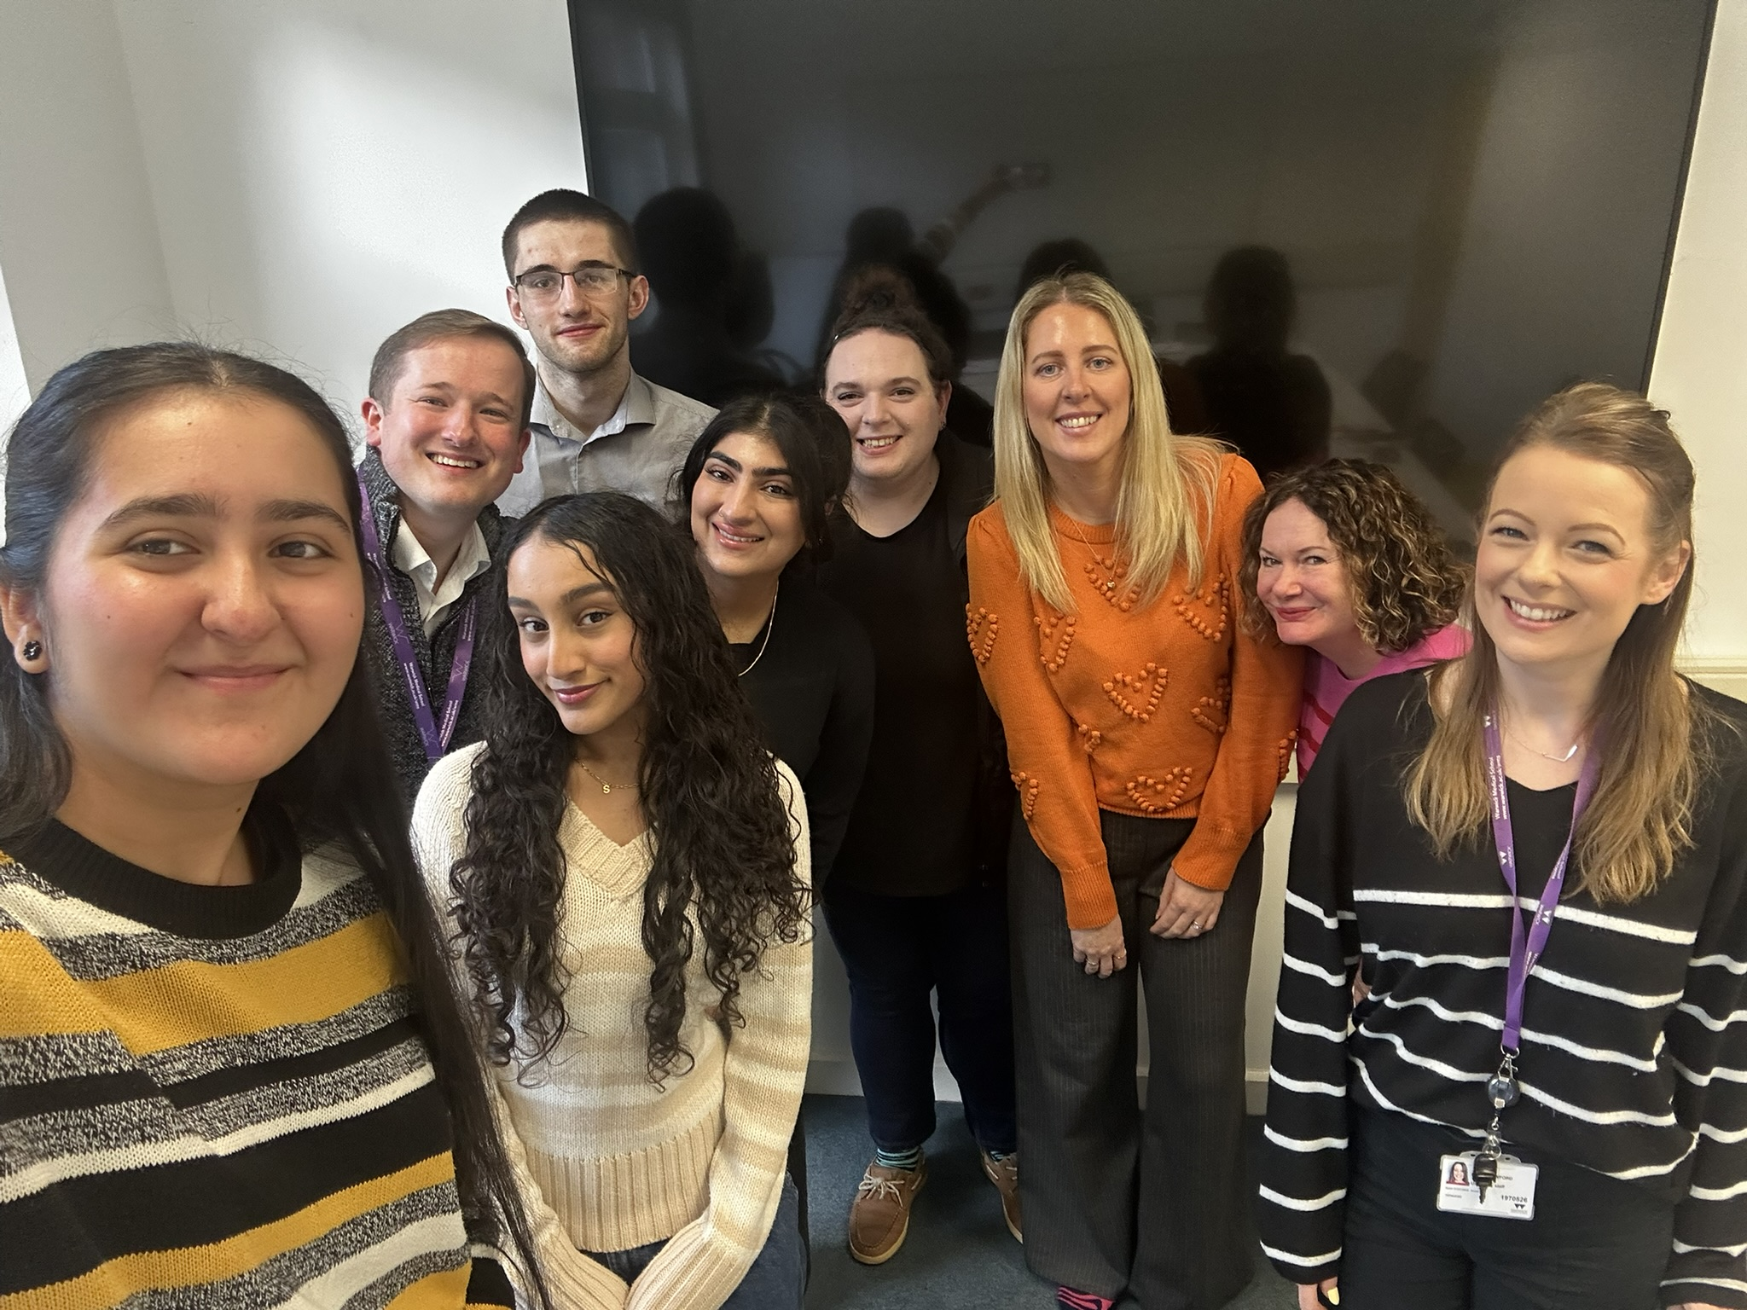



Who are we?
University of Birmingham
Prof Caroline Richards
Cerebra Network
2020-2024
2025-2029
Aston University
Dr Jane Waite
University of Warwick
Dr Hayley Crawford
University of Surrey
Dr Jo Moss

Slide 5
The challenge
There are 1.5 million children with an intellectual disability in the UK
Children with intellectual disabilities are at heightened risk for deleterious outcomes including:
Children with severe-profound intellectual disability and complex needs are often excluded from research due to the complexities of conducting rigorous studies in these groups
Despite high clinical need, there is a lack of suitable assessments and interventions to inform service provision.
Poor physical health
Poor child and family wellbeing
Compromised mental health and sleep
Elevated rates of behaviours that challenge

Slide 6

Everyone is different
Not all children/adults will have these characteristics or experiences

Slide 7
“Challenging behaviour is defined as "culturally abnormal behaviour(s) of such intensity, frequency or duration that the physical safety of the person or others is placed in serious jeopardy, or behaviour which is likely to seriously limit or deny access to the use of ordinary community facilities"
Aggression towards others
Behaviour that challenges: what is it?
Self-injurious behaviour
Screaming and shouting
Eric Emerson
Destroying the environment

Slide 8


Rationale for a behaviour checklist
1
High prevalence of behaviours of concern in children with intellectual disabilities.
Bowring, Painter and Hastings, 2019
Self-Injurious Behaviour
Aggressive Behaviour
Notes:
Define behaviours that challenge (SIB, aggressive behaviour, property destruction)
1 in every 5-6 people with ID
Higher prevalence in some genetic syndromes: 77% SIB 69% aggressive behaviour FXS

Slide 9
Rationale for a behaviour checklist
1
High prevalence of behaviours of concern in children with intellectual disability.
Parents often report not knowing where to begin or what questions to ask.
2

Slide 10

Rationale for a behaviour checklist
“(……..) only has challenging behaviours when in pain. This results in a complete change in personality, ripping lumps of hair out ……..
But we are not believed at hospital …….. We then have to go to our community consultant who found that acid reflux had burned her severely ……The hospital telling us that she had nothing wrong and it was behavioural or neurological. ………”
1
High prevalence of behaviours of concern in children with intellectual disability.
Parents often report not knowing where to begin or what questions to ask.
2
3
A checklist can reduce the likelihood of diagnostic overshadowing.

Slide 11

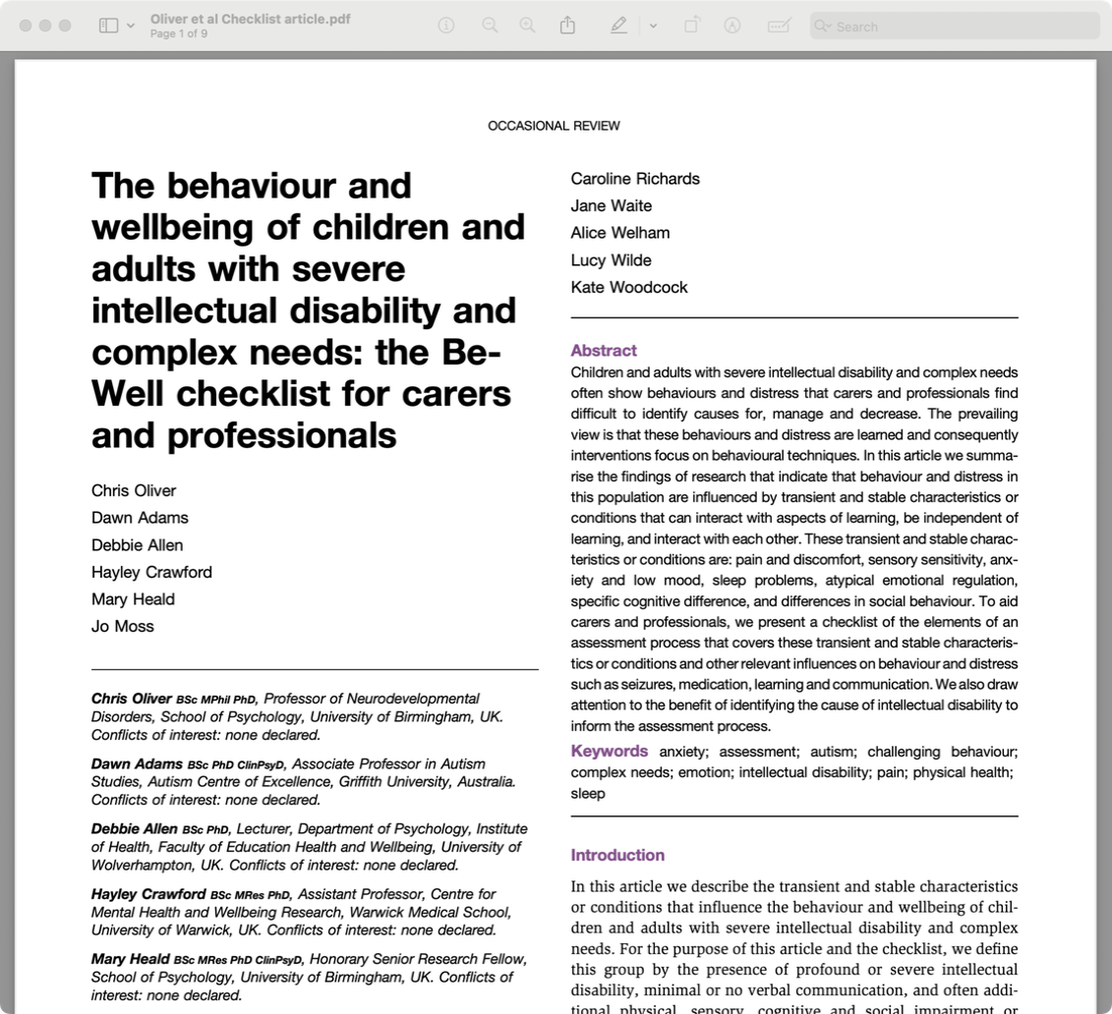
Rationale for a behaviour checklist
1
High prevalence of behaviours of concern in children with intellectual disability.
Parents often report not knowing where to begin or what questions to ask.
2
3
A checklist can reduce the likelihood of diagnostic overshadowing.

Slide 12


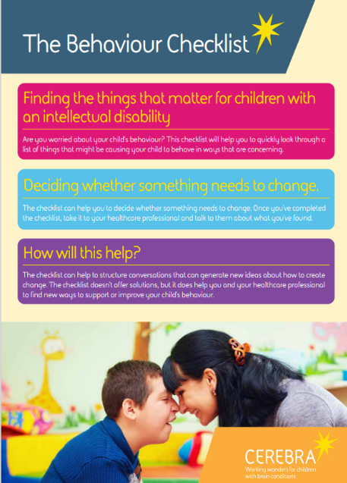



Phase 1: Development of The Behaviour Checklist Funding: Great Ormond Street Hospital Charity; 2021-2025
The co-produced checklist
Checklist Development Group: eight monthly meetings
One parent/carer of a child with Angelman syndrome.
One parent/carer of adult twins with fragile X syndrome.
Four researchers.
Two consultant child and adolescent psychiatrists.
One consultant paediatric dentist.
One paediatric clinical psychologist.
Two consultant paediatricians.
Two additional focus groups: parent carers and healthcare professionals
Dr Hayley Trower

Slide 13
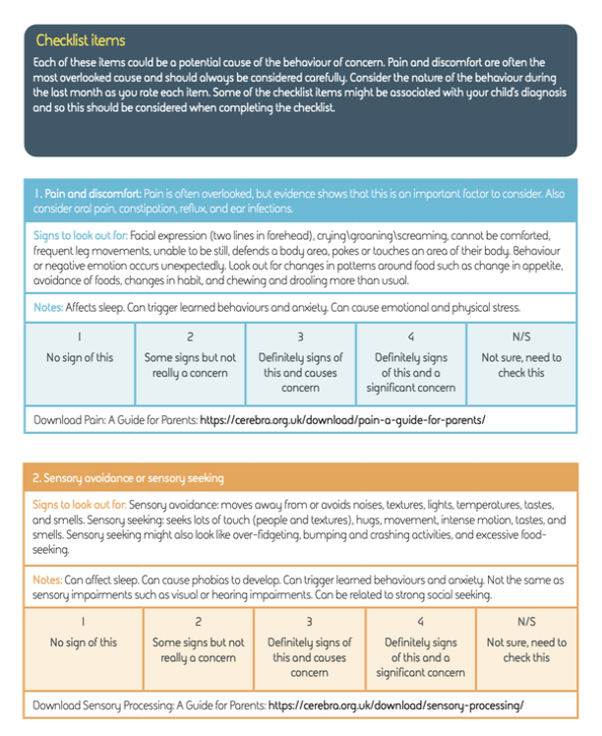
The Behaviour Checklist
Name the behaviour
The items:
Pain and discomfort
Sensory avoidance or sensory seeking
Anxiety
Low mood
Sleep difficulties
Impulsivity
Insists on sameness
Strong social seeking
Strong social avoidance
Communication
Learned behaviour

Slide 14

The Behaviour Checklist
Aims
Provide parent/carers with a list of common causes of behaviour to systematically consider.
Help monitor changes in behaviour over time.
Guide conversations between the parent/carer and their paediatrician or other health professional during routine appointments.
Streamline referrals and improve distress levels over time.

Slide 15
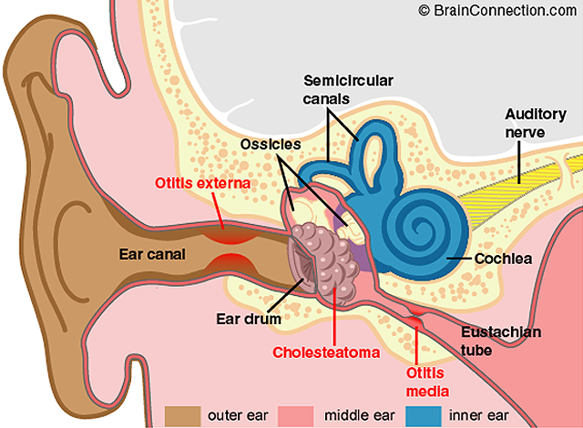
Underpinning research: item 1 – pain and discomfort
15% of all children bang their head between the ages of 1 and 4.
50% of these children have a middle ear infection.
Notes:
Now before I go on to discuss why challenging behaviour is more common in children with communication difficulties and how challenging behaviour can act as a form of communication I just want to discuss how pain is often overlooked and are linked to CB in many children. Discuss text on slides. For many children when pain related conditions are treated, behaviours that challenge reduce and no further intervention is needed.

Slide 16
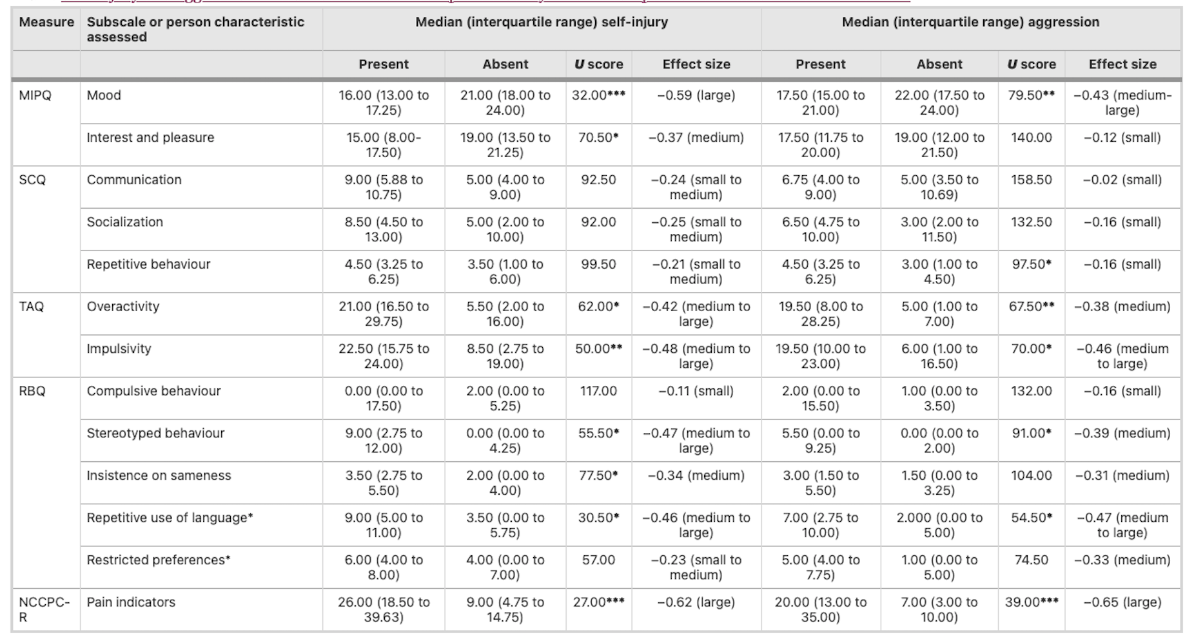
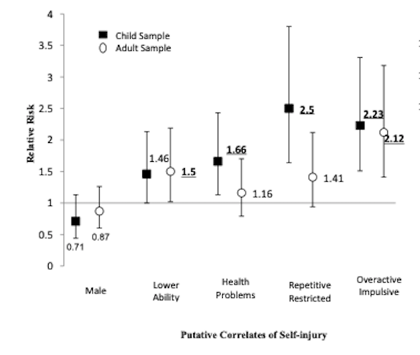
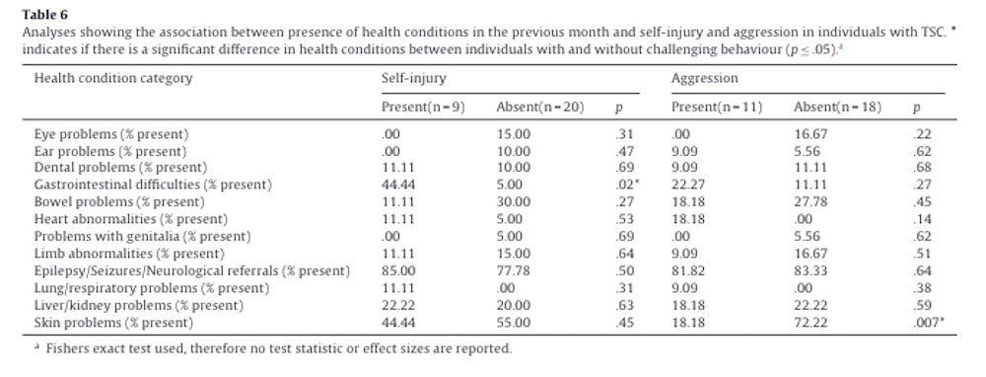
Underpinning research: item 1 – pain and discomfort
Eden et al., 2014. TSC
Richards et al., 2017. Autism + ID
Wilde et al., 2017. TSC.

Slide 17
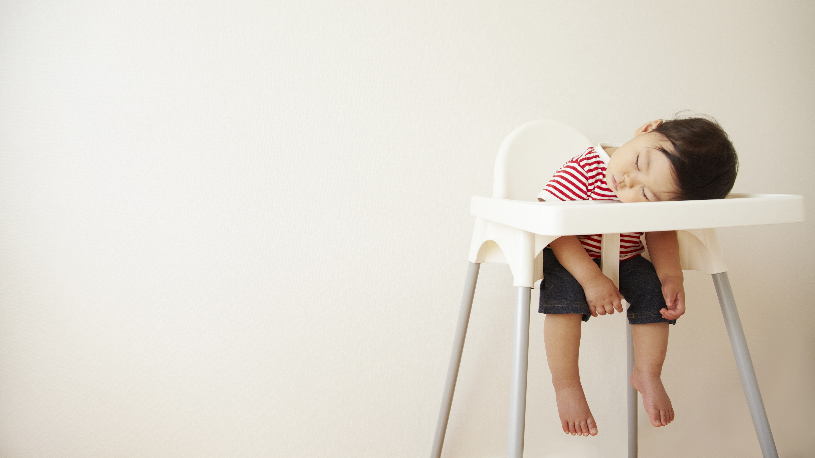
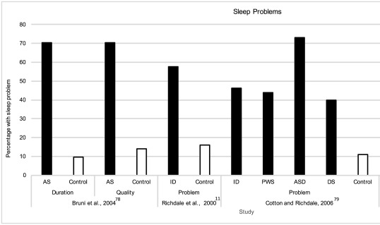
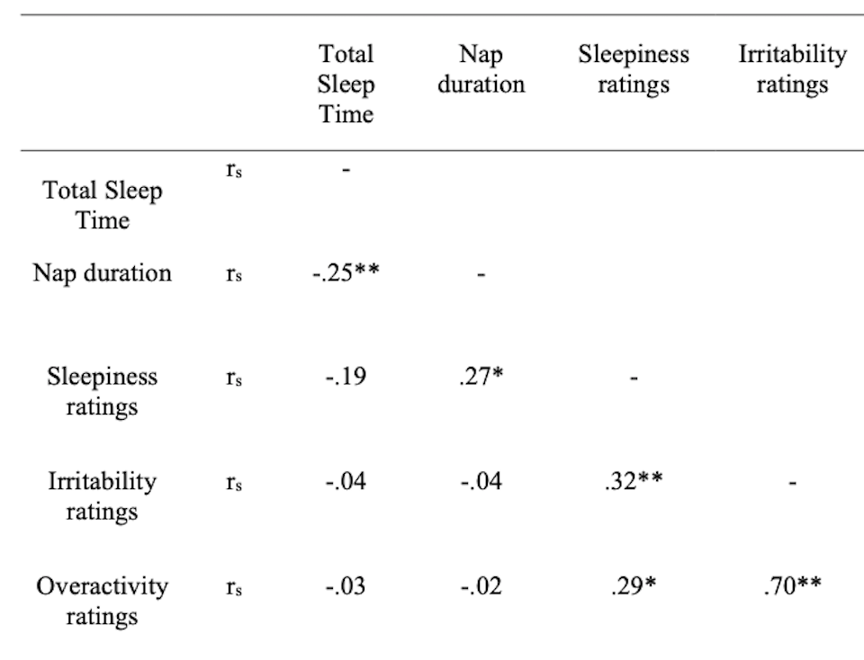
Underpinning research: item 5 – sleep
Common in intellectual disability
Surtees et al., 2018
Association with daytime behaviour
Trickett et al., 2020

Slide 18
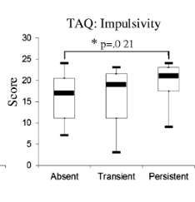
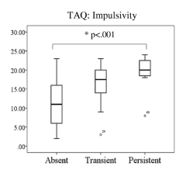
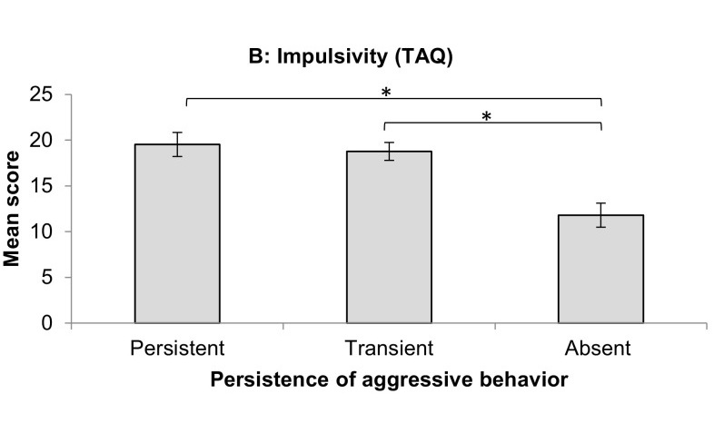
Underpinning research: item 6 – impulsivity
Crawford et al., 2018. 8 years. FXS.
Richards et al., 2016. 3 years. Autism. SIB.
Laverty et al., 2020. 10 years. Autism. SIB.

Slide 19
Communication
Waving
Standing and looking
Get peer help
Shouting
Tugging clothing
Speaking
Headbanging
Hitting
Do something else
Tapping on shoulder
Throwing something
Do it yourself
Smiling
Screaming
Hand in air
Notes:
How about children who aren’t in pain, why does CB start. On this slide discuss how we all have multiple ways of communicating our needs to others. However, in people with communication and mobility difficulties sometimes many of these are not available to us.

Slide 20
Communication
Waving
Standing and looking
Get peer help
Shouting
Tugging clothing
Speaking
Headbanging
Hitting
Do something else
Tapping on shoulder
Throwing something
Do it yourself
Smiling
Screaming
Hand in air
Notes:
This leaves the person with a very limited repertoire of behaviours that they can draw on.

Slide 21
Learned behaviour Social communicative function of behaviour that challenges: Positive reinforcement
Need for others to do or give something
BtC
AVERSIVE!
Concern
Frustration
Anxiety
Confusion
Distress
Increase in
chance of CB
ENGAGE
REWARD
Comfort
Reprimand
Offer
Keep safe
Occupy
Distract
Positive
Reinforcement
ACTION

Slide 22
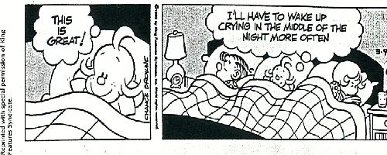
A rewarded person
Two other rewarded people

Slide 23
Learned behaviour Social communicative function of behaviour that challenges: Negative reinforcement
Need for others to stop something
BtC
AVERSIVE!
Concern
Frustration
Anxiety
Confusion
Distress
Increase in
chance of CB
REWARD
DISENGAGE
ACTION
Negative
Reinforcement
Removal of demand

Slide 24
Phase 2: Acceptability of The Behaviour Checklist
18 parent/carers & 7 clinicians consented
88 parent/carers consented
Complete checklist and
11 measures at home
Complete checklist and
11 measures at home
Complete checklist again one week later, alongside a feasibility questionnaire
Complete checklist again one week later
Take checklist to routine clinic appointment within NHS
Feasibility questionnaire
Feasibility interview with parent/carer and clinician, individually
Quantitative data from parent carers of 68 children with intellectual disabilities
Gender | Age years (mean, SD) | Has a genetic syndrome | Ethnicity |  | Adaptive behaviour |  | Mobility |  | Verbal ability |  | Engaged in at least 1 BtC in last month
Male |  |  | Caucasian | Other | Low | Moderately low | Mobile |  | Verbal |  | Yes | No
39 (57.4%) | 11, 3.77 | 41 (60.3%) | 57 (83.8%) | 11 (16.2%) | 73.5% | 17.6% | 58 (85.3%) |  | 41 (60.3%) |  | 50 (73.5%) | 18 (26.5%)

Slide 25
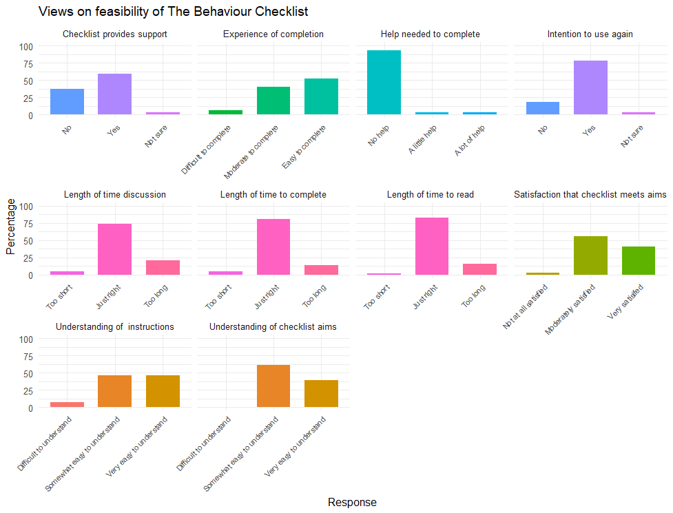
Phase 2: Acceptability of The Behaviour Checklist
Test-retest reliability: all correlations were significant at <.01 indicating good reliability
Construct validity: eight correlations were significant at <.01 indicating good validity

Slide 26
Phase 2: Acceptability of The Behaviour Checklist
Nine parent/carers and five clinicians
Design
Function
Outcomes
Usability

Slide 27
Phase 2: Acceptability of The Behaviour Checklist
“I feel confident to hound the professionals because you're the only person. Some people are kind of a bit more vocal in this group, but you're the only person that is going to advocate for them. So don't be afraid to keep checking through the list till you're happy...”
Function
Prompt and memory-aid
New perspectives about behaviour
Improved confidence
Helps reduce diagnostic overshadowing
Helps to focus
Reinforces existing knowledge
Supports conversations and relationships
Helps to monitor change
“It just it feels to ourselves and the psychologist that she keeps changing what she wants, what is her main behaviour of concern essentially. And then things have sort of changed and improved slightly and then she's moved on to something else. So, I don't know, maybe having something physical like this might help to go through. Yeah, just narrow it down.”

Slide 28
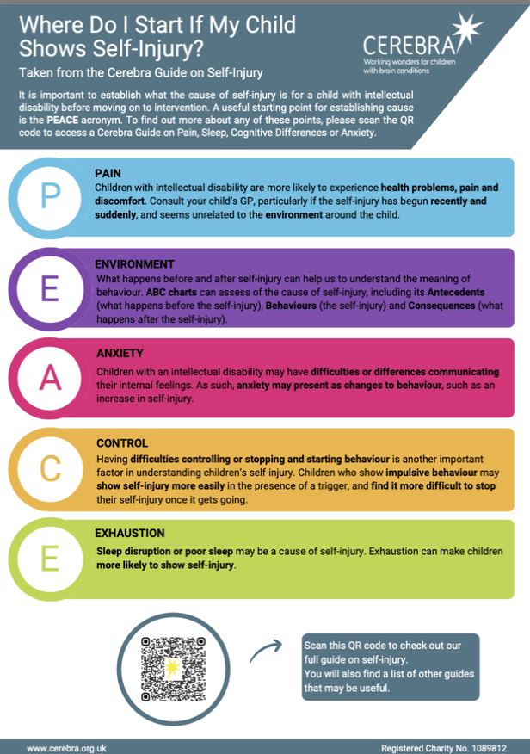
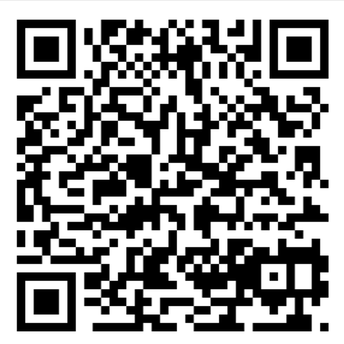
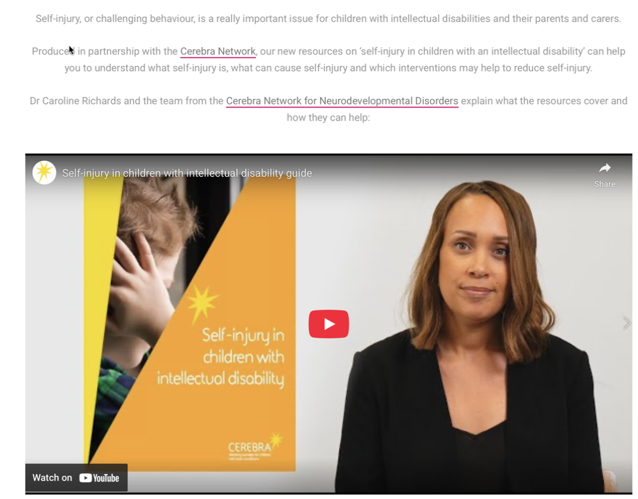
More resources for behaviour that challenges

Slide 29

When dealing with us professionals: Speak softly and carry a big stick.
(Theodore Roosevelt)
Thank you

