Slide 1


Pre-application Doctoral Communications: Exploring Institutional Gatekeeping in Doctoral Programme Admissions
Redefining cultures of excellence: Modelling change in research(er) agendas (Nottingham, June 2023)
PI: James Burford
Co-I: Emily Henderson
Department of Education Studies, Warwick University
#PADC_project
Project website: https://warwick.ac.uk/padc
Funded by: Research England Enhancing Research Culture Fund (March-July 2022; January-July 2023)
Illustration by Yara Aboasfour
Notes:
Twitter/illustration/funder/
Follow our researchers on Twitter to receive project updates @jiaburford @EmilyFrascatore @AhmadAkkad @Dangeni_ or follow the project hashtag #PADC_project

Slide 2
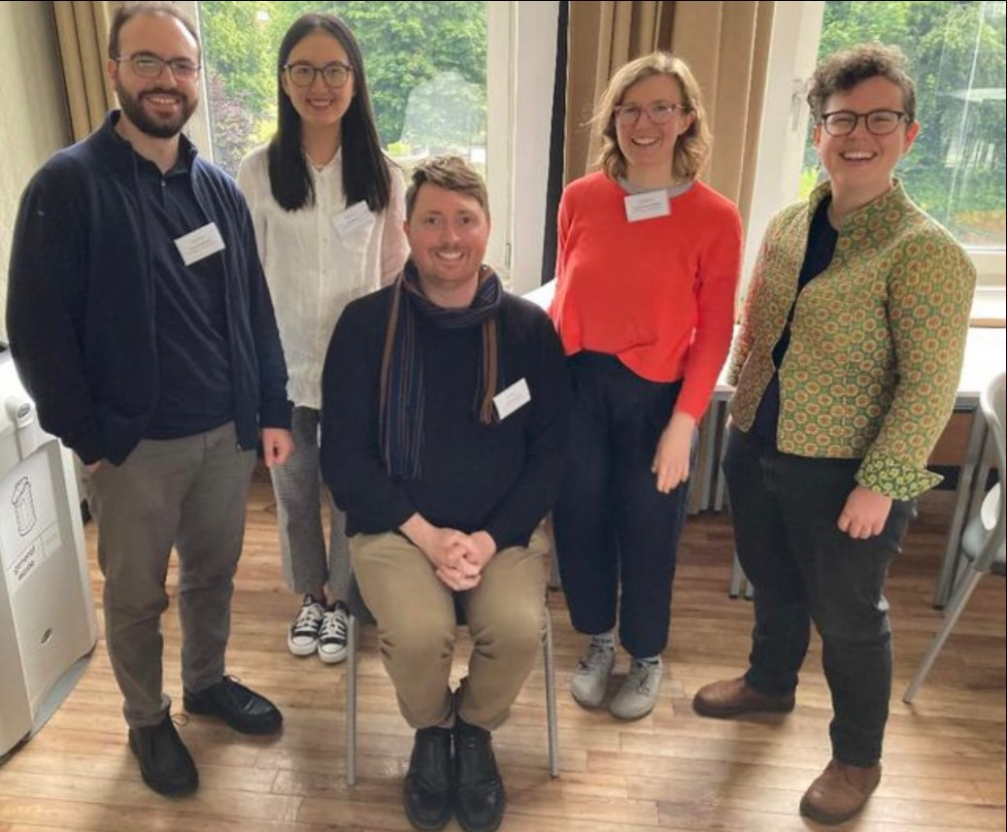

Project Team
PADC Phase 2 Team members:
PI: James Burford
Co-I: Emily Henderson
Post-doc: Sophia Kier-Byfield
Placement student intern: Annum Mahmood
PADC Phase 1 Team members:
PI: James Burford
Co-I: Emily Henderson
RAs: Sophia Kier-Byfield, Ahmad Akkad, Dangeni
Project illustrator: Kate Carruthers Thomas

Slide 3

What are pre-admissions doctoral communications (PADC)?
PADC defined as: communications that potential doctoral applicants have with university staff prior to making a formal application to study.
Illustration by Dr Kate Carruthers Thomas

Slide 4
What are pre-admissions doctoral communications (PADC)?
Often emails from applicants to supervisors, Programme Officers (POs) or Directors of Postgraduate Research (DPGRs)
May include other forms too – video/phone calls, dropping by, approaches on social media, at conferences)
May be forwarded communications within departments (e.g. from DPGR to supervisor)
Near ubiquitous in some disciplines in the UK (especially in social sciences and humanities), unheard of in others.

Slide 5
EDI and doctoral admissions
Much scholarship has a focus on exclusionary nature of admissions criteria (Mountford et al., 2007; Potvin et al., 2017; Cano et al., 2018; Ghost et al., 2018; Miller et al., 2019; Squire, 2020; Roberts et al., 2021).
Further studies on how academic staff identities influence admissions decision-making (Squire 2020)
Many studies are US-focused (GRE, deliberative bureaucracy, holistic admissions), discipline-specific, few take an institutional approach.

Slide 6

Pre-application as a ‘gatekeeping’ moment
Our study focuses on one neglected element of the doctoral admissions process: pre-application communications.
For prospective doctoral applicants from underserved communities, the doctoral application process may be bewildering and difficult to navigate (see wealth of advice texts – YouTube videos, blog posts).
Equally, respondents to inquiries may make snap judgements, perhaps giving limited thought to their gatekeeping function.

Slide 7
PADC projects - summary
EMPIRICAL: How supervisors (diaries + FGDs), DPGRs and POs (semi-structured interviews) make decisions about responding to potential doctoral applicants
EMPIRICAL: To evaluate Doctoral College/ departmental webpages on PGR admissions
EMPIRICAL: How current doctoral students from minoritised social groups navigated locating a doctoral supervisor (semi-structured interviews)
EMPIRICAL: Review of existing extra-institutional video resources which inform students about how to approach a supervisor
ACTION: Briefings for supervisors and departments/institutions; workshops for supervisors (both projects) and Directors of PGR/programme officers; kit for facilitators to run the workshop activities
ACTION: To create a video resource which seeks to demystify the process of finding a supervisor.

Slide 8
Web Review
Good practices identified in several departments:
clearly explained scholarship details and application procedures
explicit guidance for applicants to prepare/draft research proposals
a ‘research degree application checklist’ with essential steps and guidance for applicants prior to their formal application.
However, information on the decision-making process and EDI-related guidance and information have been rarely found on webpages.

Slide 9
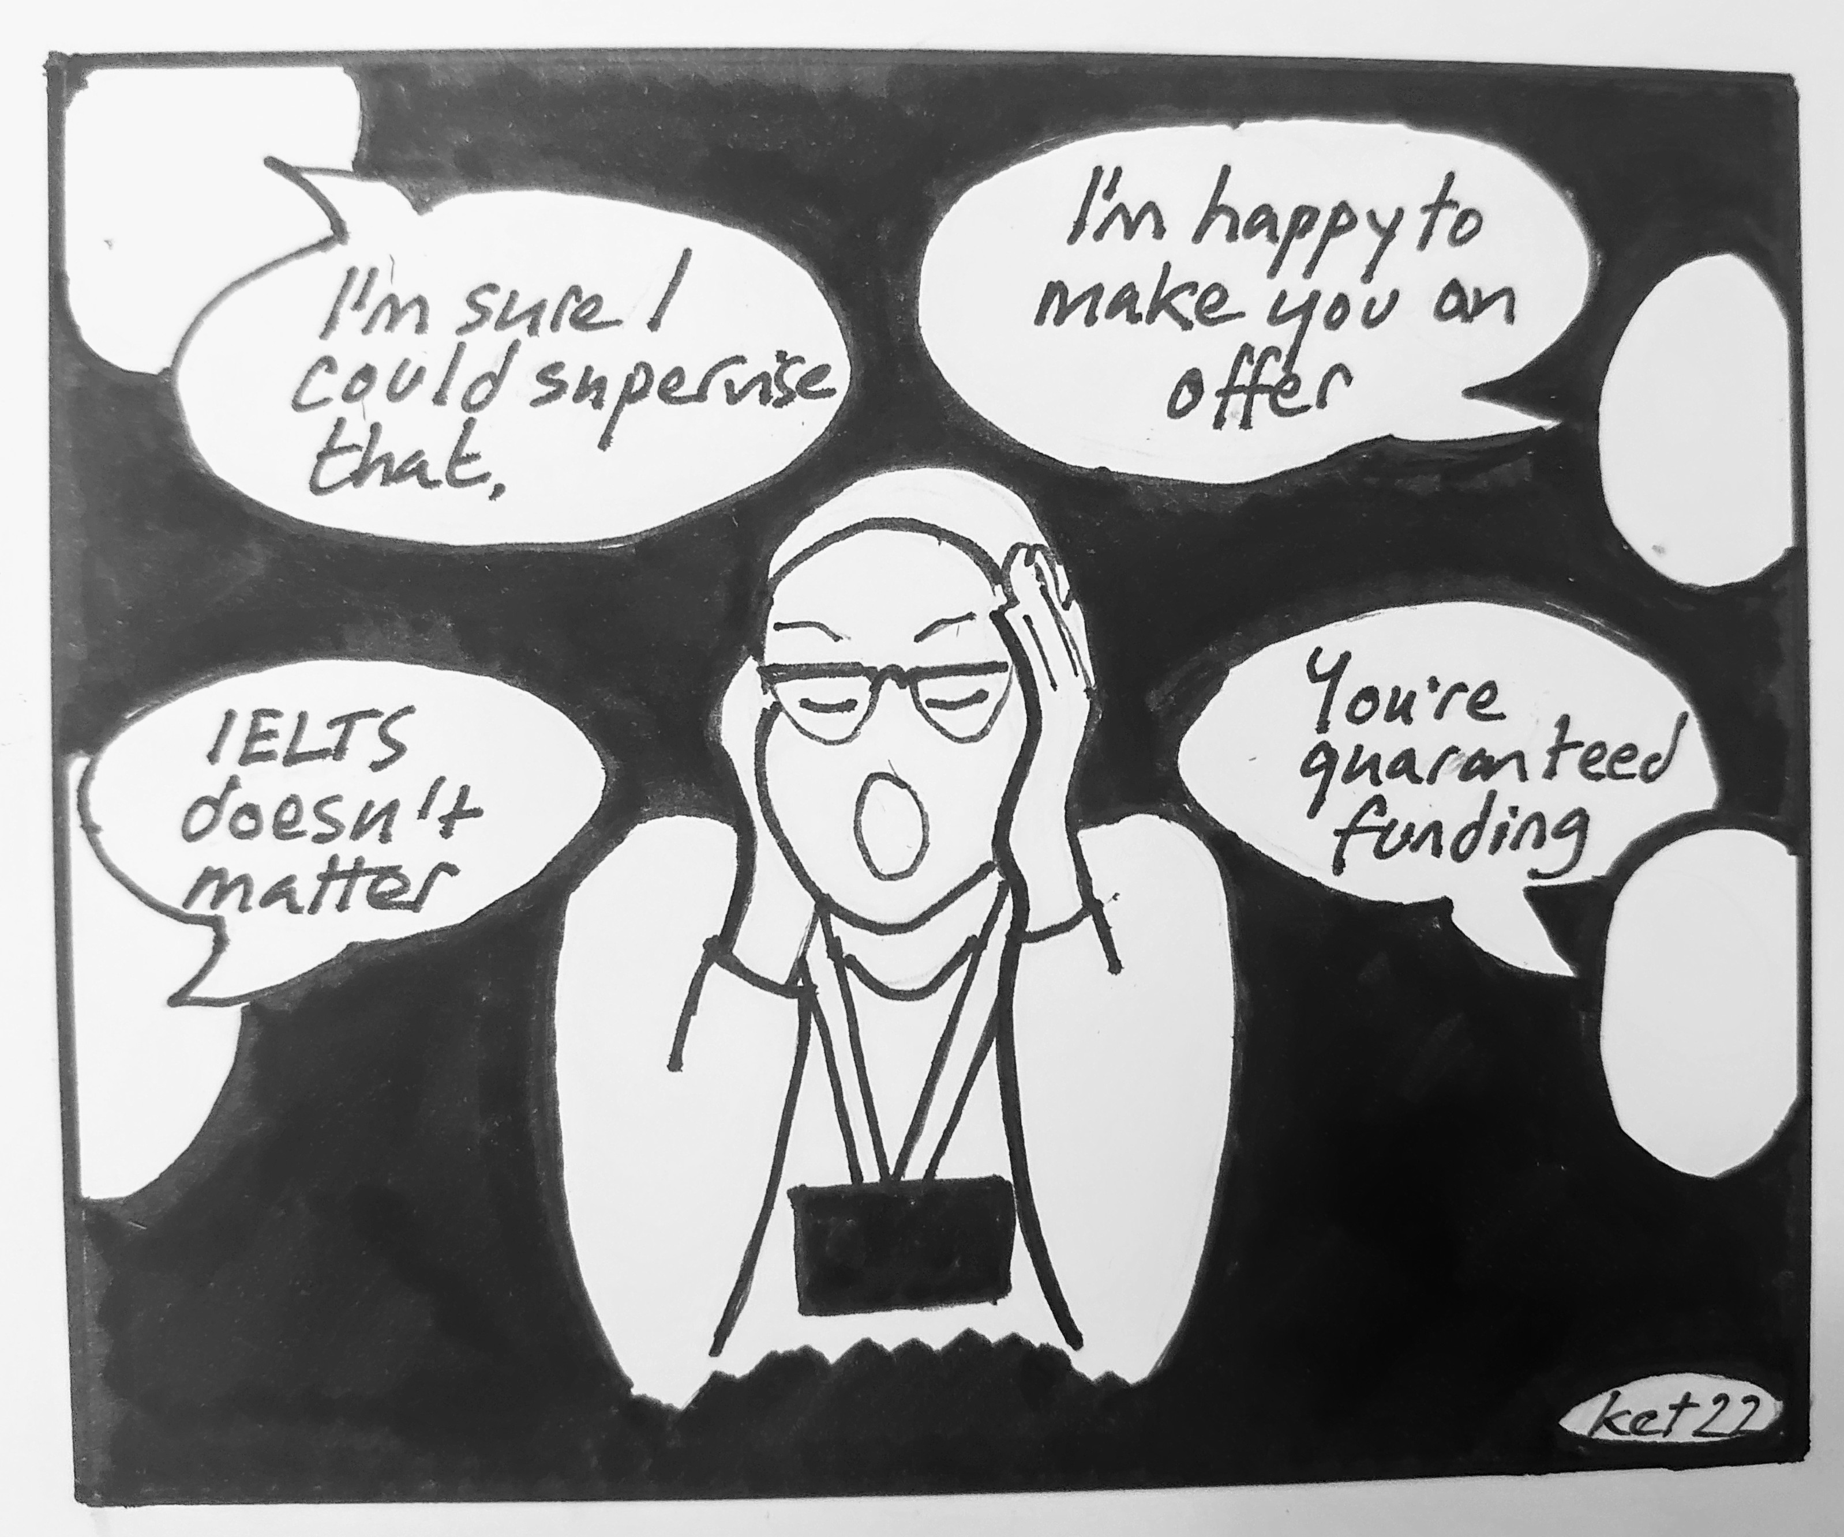
Stakeholders 1 & 2: Directors of PGR and Programme Officers
The role of Director of PGR varies in terms of involvement in PADC/gatekeeping
The role of Programme Officer varies in terms of PADC/ gatekeeping, e.g., filtering suitable applicants, sending rejection emails, deciding when to pass something on
POs and DPGRs want to make more inclusive websites; websites are often a site of confusion for staff and applicants
Broadly, POs and DPGRs often emphasised their 'equal' treatment of applicants – limited consideration of differentiated needs for information and communication.
Illustration by Dr Kate Carruthers Thomas
Notes:
Webpage: key site for info

Slide 10
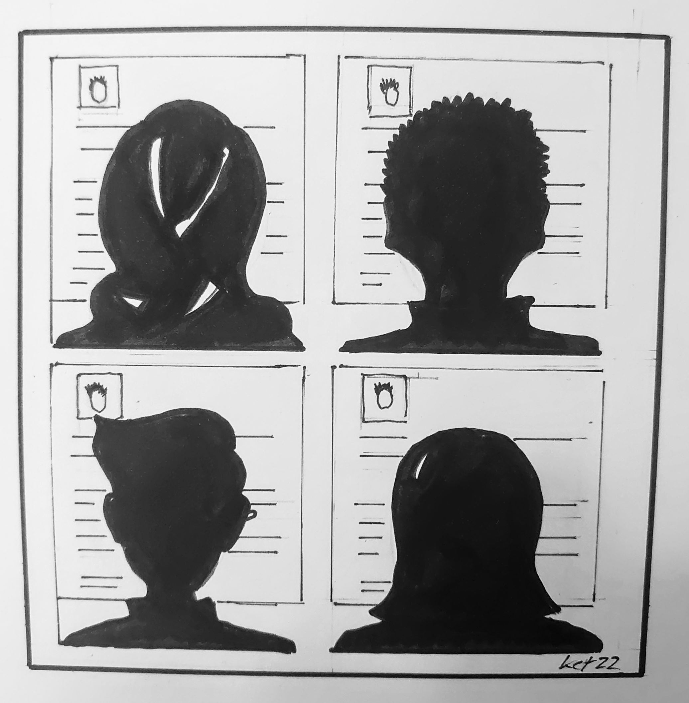
Stakeholder 3: Supervisors
Some understand PADC as a site of gatekeeping and want to know how to enact EDI principles at this stage.
Some are not sure how to think in nuanced ways about applicants who may require additional support.
Some worry that some applicants' communications might be privileged.
Recruitment capacity/email overload: how do these issues shape supervisor inclination to engage with 'polished' communication over students who may need more support?
Illustration by Dr Kate Carruthers Thomas

Slide 11
Stakeholder 4: Disadvantaged applicant groups?
Currently enrolled students were described as ‘already really familiar with the staff… just really comfortable going and talking to them about applications’ other students are seen as ‘stabbing in the dark’ (Programme officer)
Overseas or displaced vs home
External vs current students
Mature vs recent graduates
First generation vs family with HE background
Elite vs non-elite previous educational trajectories
The majority of the data suggests that pre-application communication is of great importance to the progression of an application and is a site of gatekeeping ​

Slide 12
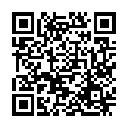
Final thoughts
In order to understand doctoral admissions from an inclusivity perspective, it is necessary to explore the role of supervisors, DPGRs and POs in pre-application communications.
PADC is an important admissions stage where many applicants are deterred from even submitting an application.
While it is difficult or even impossible to fully regulate the PADC stage, there are many actions that can be taken by institutions, departments and supervisors to enhance inclusivity in access to doctoral admissions.
www.warwick.ac.uk/padc

