Slide 1

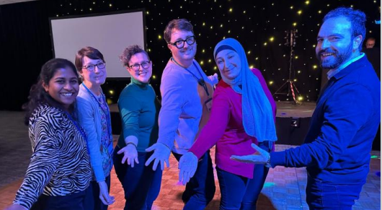
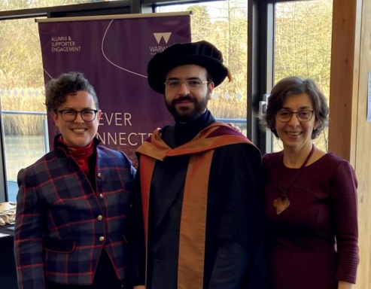
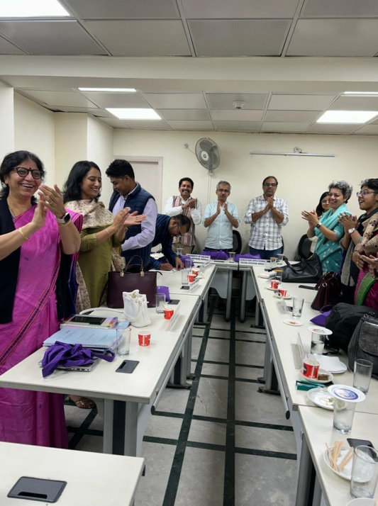
Doctoral Education and Academia Research Centre (DEAR)
Director: Professor Emily F. Henderson
Deputy Director: Dr James Burford

Slide 2

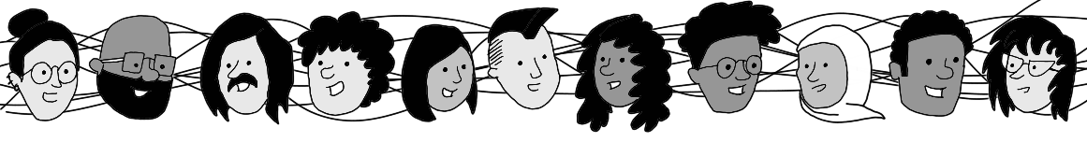
DEAR is a University Research Centre (Category 2, i.e.
cross-departmental)
DEAR was founded in October 2023 by
Emily Henderson & James Burford
DEAR specialises in research on doctoral education and the academic profession, especially:
Research on social inequalities
e.g. gender, race, caste, rurality, disability...
International research
(India, Thailand, NZ, Australia, South Africa...)
Impactful research
Making change to policy and practice

Slide 3
DEAR Centre Strategic Aims
Develop a dynamic specialist research environment for research on doctoral education and academia.
Become a recognised hub of expertise in the sector nationally and internationally, impacting on policy and practice.
Cultivate the field of research on doctoral education and academia, and curate an inclusive and supportive environment for emerging researchers.
Actively contribute to delivering and shaping University of Warwick strategic priorities.
Develop and share research-led practice in the development and leadership of research centres.

Slide 4
DEAR Centre: who are we?
Core team
Prof Emily Henderson (Director)
Dr James Burford (Deputy Director)
Matt Phillips (Coordinator)
Susan Deeb & Evan Zheng (PGR RAs)
DEAR Centre Collective
10 representatives from different departments/university units
2 representatives of the doctoral/postdoctoral group
Doctoral & Postdoctoral Group
21 members
International Advisory Board
20 members based in 10 countries

Slide 5
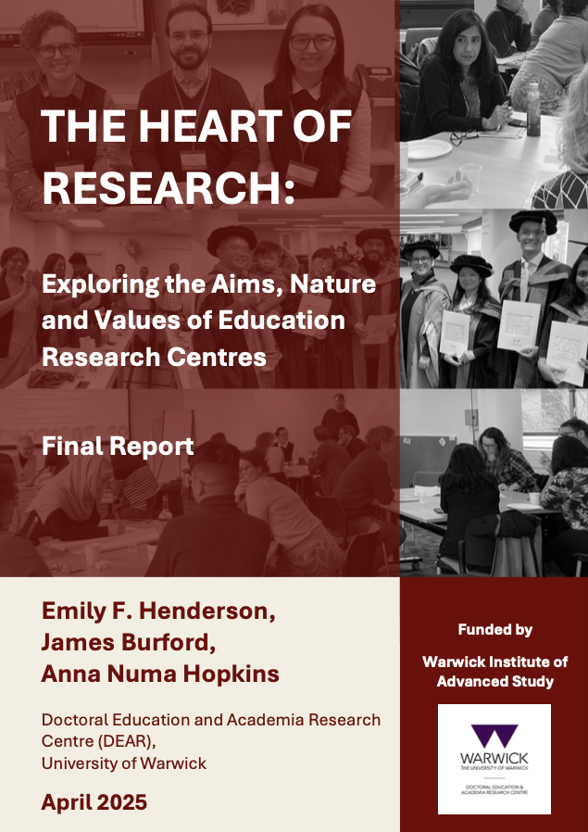
Research leaders or institutional mischief makers? Exploring research centre founders' narratives
Emily F. Henderson, Anna Numa Hopkins , and James Burford
DEAR Centre, Education Studies & Sociology, University of Warwick
18 June 2025
Education Studies Seminar Series (Co-hosted with DEAR Centre), University of Warwick

Slide 6

Project Team & Funder
PI:
Emily Henderson (Education Studies, DEAR Centre Director)
Co-Is:
James Burford (Education Studies, DEAR Centre Deputy Director)
Anna Numa Hopkins (Sociology, DEAR Centre Collective Member)
Outputs assistance:
Julie Mansuy (Active4Research)
Funder: Warwick Institute of Advanced Study
The study was conducted in 2024.
Note: Images used in the presentation are from DEAR Centre activities.

Slide 7
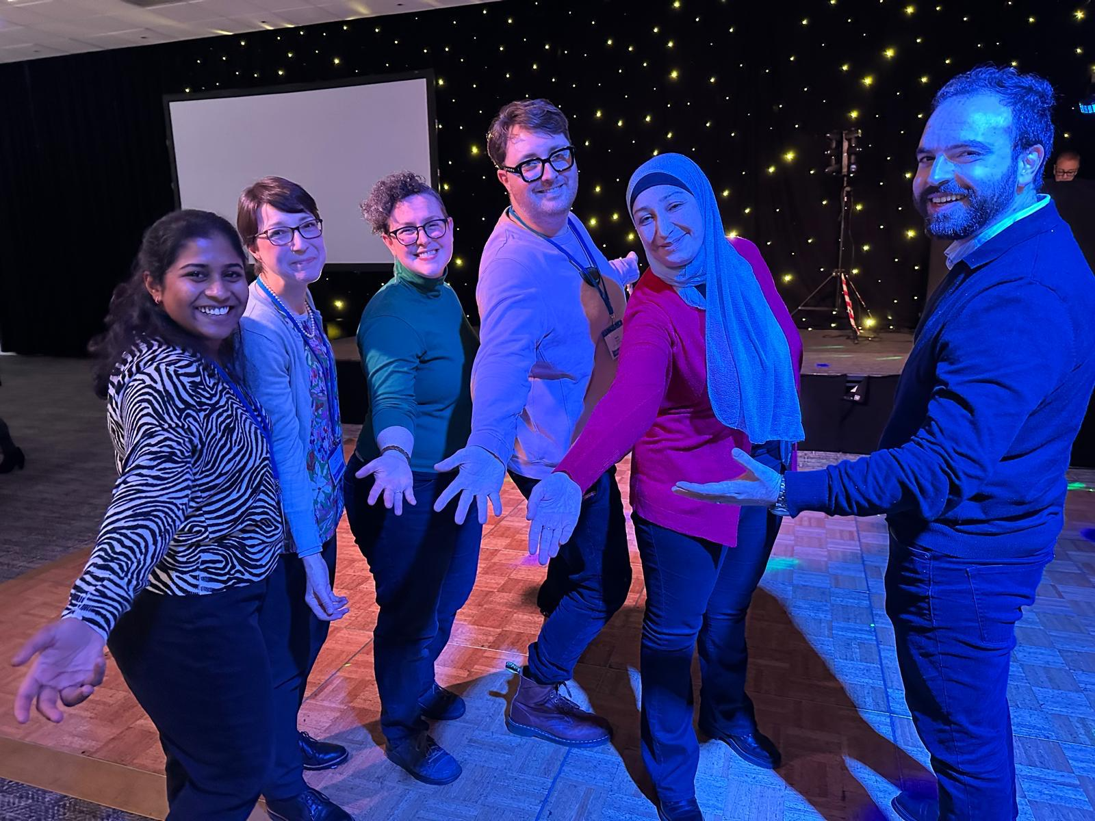
Presentation Overview
Rationale
Study Design
Findings
Recommendations

Slide 8
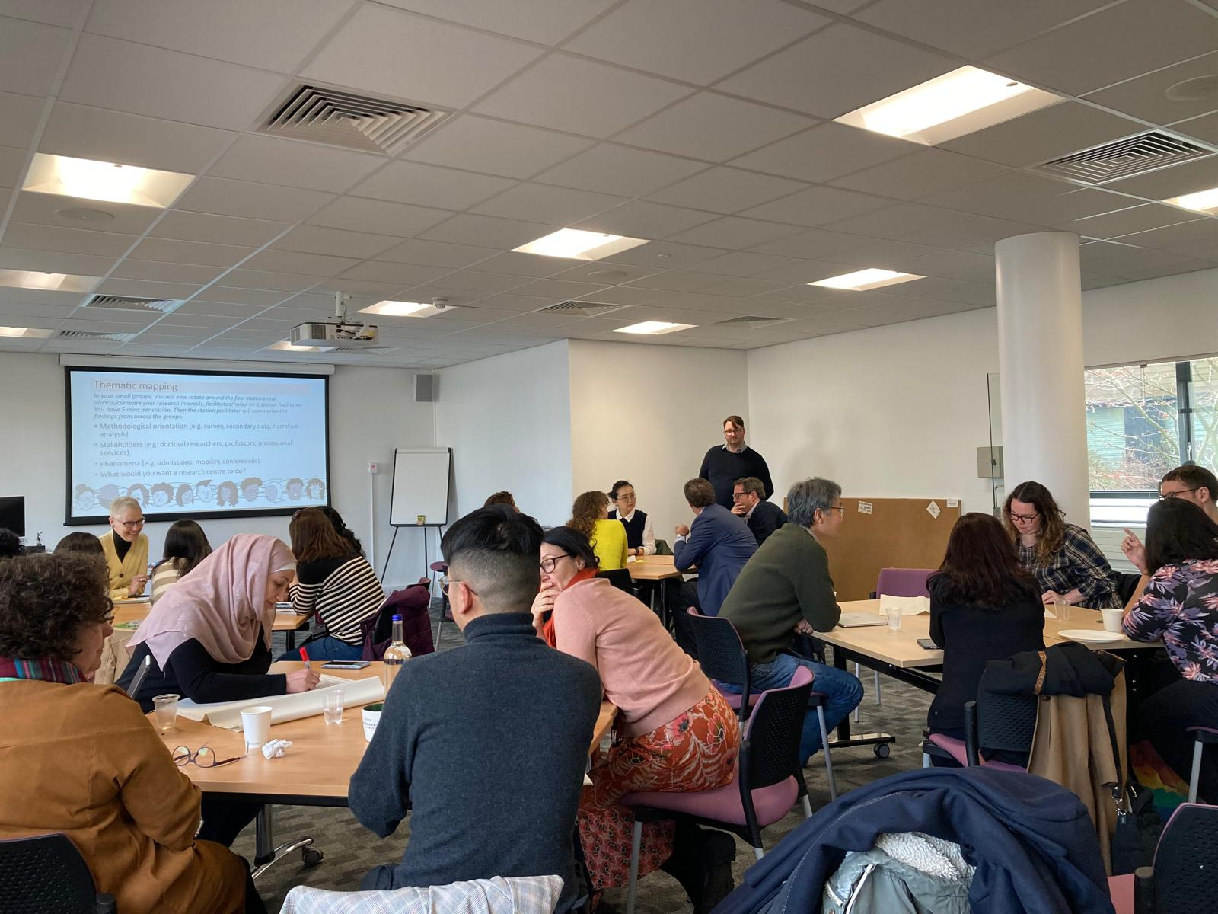
Rationale for the project
Main driver: founding of the Doctoral Education and Academia Research Centre (DEAR) in 2023.
Heart of Research project objectives:
To develop the mechanisms and mission of the DEAR Centre using a research-informed approach, and
To promote a research-informed approach with an orientation towards inclusivity, equity and social justice for the development of other research centres, including beyond the field of education and beyond the UK context.

Slide 9
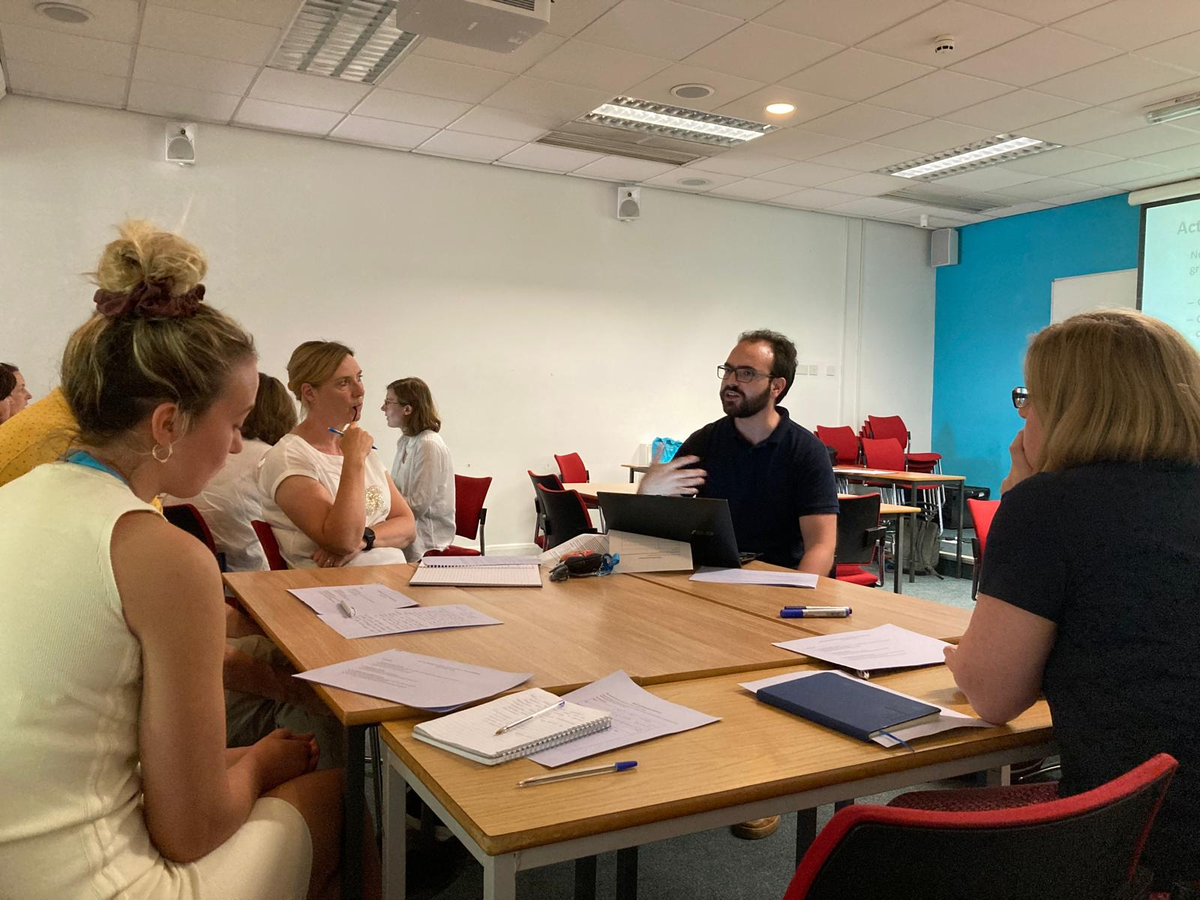
Literature on research centres (1)
There is limited extant literature on research centres. The available literature is disparately located across disciplines and there is limited cross-referencing across the literature, meaning there is no sense of a coherent body of literature on this phenomenon.
Research on centres is often framed by and directed to the field in question, such as van Heur’s (2023) study of urban studies research centres, and Connell and Hilton’s (2015) study of the Centre for Contemporary Cultural Studies (CCCS).
Some studies seek to understand the nature of work within centres, e.g.
Lind, Styhre and Aaboen’s (2013) study of centre-industry collaboration
Nyhagen and Baschung’s (2013) study of changes in academic work through the development of research centres in one Norwegian university.
From the literature it is clear that research centres vary hugely and ‘have no rigid set of common characteristics’ (Etzkowitz & Kemelgor 1998, 271).
How to research research centres? This is acknowledged to be challenging, given their dynamic and multi-faceted nature (Tiler & Boddington 1993).

Slide 10
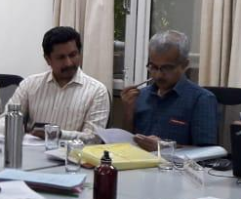
Literature on research centres (2)
Why are research centres founded?
Centres are initiated and/or led by individuals with ambitions for field-based innovation who recognise the need to lead collective research activities beyond their own individual capacities (Etzkowitz & Kemelgor 1998; Connell & Hilton 2015).
Centres are also driven by policy initiatives (e.g. Pereira-Puga and Sanz Menéndez 2024).
A centre may be considered necessary by a university in order to redress a gap in their research coverage (Tiler and Boddington 1993).
Our review found that research centres often sit somewhat uncomfortably in their host institutions, as they create an alternative organisational structure that in some senses competes with the authority of traditional university structures.
Researchers may be based across both a centre and a department, meaning there can be confusion about how their time and workload should be handled and where their funding should be located (Etzkowitz & Kemelgor 1998).
Nyhagen and Baschung (2013, 420) found that ‘in spite of formal structures which supposed to promote functions of “pure researchers”, academics working within research centres—sometimes informally—assume tasks related to both research and teaching’.
This confusion is exacerbated when centres are externally funded, as the funding ‘provides direct resources (mainly funding and prestige) to the centre, increasing its autonomy inside the university’ (Pereira-Puga & Sanz Menéndez 2024, 644).

Slide 11
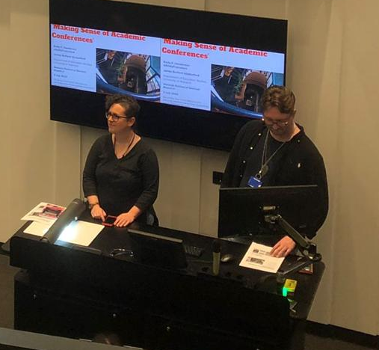
Literature on research centres (3)
The institutional position of research centres leads to competing concerns:
Securing resources versus the intellectual efforts at the heart of centres’ existence (Etzkowitz & Kemelgor 1998).
Centres are associated with overwork, with evidence that this may have an ‘impact on personal and family matters’ (Connell & Hilton 2015, 289).
There is a known reliance on rolling temporary contracts for research and support staff (Etzkowitz & Kemelgor 1998).
Research centres may exacerbate inequalities within the university at large
Etzkowitz and Kemelgor (1998) refer to contract researchers within research centres being in a disadvantageous position where they often do not access the same benefits and development opportunities as staff members on ongoing contracts; they note that these contract researchers have often been women spouses of men scientists.
Connell and Hilton (2015) discuss the impressive efforts to facilitate the democratisation of knowledge production and governance in CCCS, but at the same time reflect on accounts of sexism in the centre.
Centres can be seen as reproducing or tackling historical colonial patterns of global dominance in knowledge economies (van Heur 2023; Jowi & Mbwette 2017).
It is noteworthy that the necessity of competing for project funding has been discussed as creating challenges for research groups and centres aspiring to work with collective, collaborative or inclusive values (Franssen & de Rijcke 2019).

Slide 12
Study Design
Research Questions:
RQ1. What is the nature of education-related university research centres with an inclusivity/equity/social justice focus? What do they do?
RQ2. What are the inclusivity/equity/social justice values and practices of these research centres?
Focus of today's talk: RQ3. How are research centres founded? Who are the founders of these centres? What do they do and why?
A webpage review of 44 education-focused research centre with an inclusivity/equity/social justice orientation in UK universities was conducted, to establish the ways in which centres are represented.
Five in-depth narrative interviews with centre founders were undertaken, asking for their stories of:
how and why they established centres; and
how they had established the values of the centre.

Slide 13
Centre founders (narrative interviews)
Kit co-founded the centre with another colleague as part of a departmental restructure which resulted in the department being structured around research centres.
Leah set up the centre as a newly recruited professor at the university as a way of creating a space for developing her research area.
Lynne was recruited to the university where the centre was located in order to become director of a new centre; the centre was externally funded by a company.
Rose co-founded the centre along with other colleagues; she had been newly recruited to the university and this coincided with a restructure that had fragmented the research area – a group of colleagues set up the centre to provide visibility for the research area.
Sophie was recruited to a university as a professor with responsibility for strengthening research in her department; she founded the centre as part of her research strategy.

Slide 14
Findings: Founding research centres
Rationale & process: three principal catalysts: (1) institutional reconfiguration, (2) new staff recruitment, (3) funder priorities. Having a background in research centre leadership and the relationship between research centres and national research assessments were also discussed factors.
Actors involved a range of people; instigators of the centre (who were not always the founding directors); HoDs; institutional research leaders (e.g. Dean); senior leaders/managers (e.g. VC); funders; and other colleagues within or beyond the department.
Hopes and ambitions were broadly similar: creating an internal structure within an institution to foster belonging, connection and support research, whilst providing external presence and visibility.
Process: the people and bureaucratic processes involved in setting up centres varied widely from little formality to more bureaucratic.
Obstacles: agreeing on centre themes; changing processes; negotiation between funder and host department.
The research centre had ‘allowed me to feel supported and give support’ (Kit)

Slide 15
Findings: Impact on founders' careers
Impact on specialist areas: included internal impact (e.g. feelings of belonging, 4*REF case study), field impact, sector/policy/practice impact.
Impact on founders' careers: professional recognition (e.g. national accolades, promotions); a sense of research 'home', support and encouragement; containment and clarity of direction.
Negative aspects of research centre leadership: lack of positive recognition, promotion applications declined, and Rose was only hearing about how the centre was valued now that it was closing. The work burden of research centre leadership was also a cause for concern.
'relational aspects...have been important’ in terms of maintaining ‘passion about research’ (Kit)
It is ‘the development of my academic career that led to the setting up of the centre’ more than the centre ‘add[ing] to my career’ (Leah)

Slide 16
Discussion: leaders or mischief makers?
Research centres are often desired by institutions, bringing recognition and concentrating talent and opportunities for research success.
Research centre leadership is positioned as something that research leaders may do, and a space where research leadership is both enacted and developed.
At the same time, research centres can exceed university structures and logics, failing to map onto a normative grids of institutional recognisability. This can position institutional leaders and research centre founders in a somewhat antagonistic relationship.
Research centre leaders can be positioned as mischief-makers, stirring up trouble by not fitting clearly within (and sometimes being positioned between) institutional logics, and possibly having 'too much' autonomy.

Slide 17
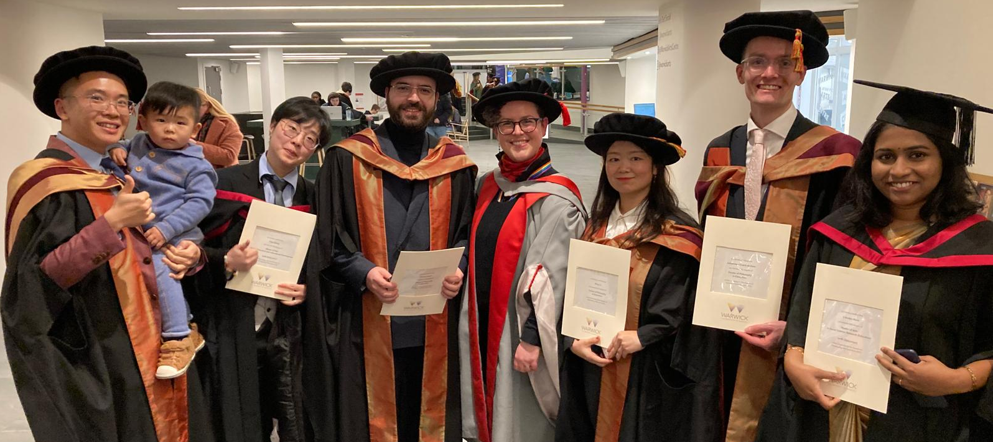
Selected Recommendations: Further Research on Centres
Comprehensive literature reviewing is required.
More research is needed on research centres across disciplines.
Research is needed on how research centres both perpetuate and challenge inequalities.
More research is needed to compare research centres across national contexts.
Research on research centres using a wider range of research methods is needed.
The role of the research centre founder/leader is worthy of further exploration.

Slide 18
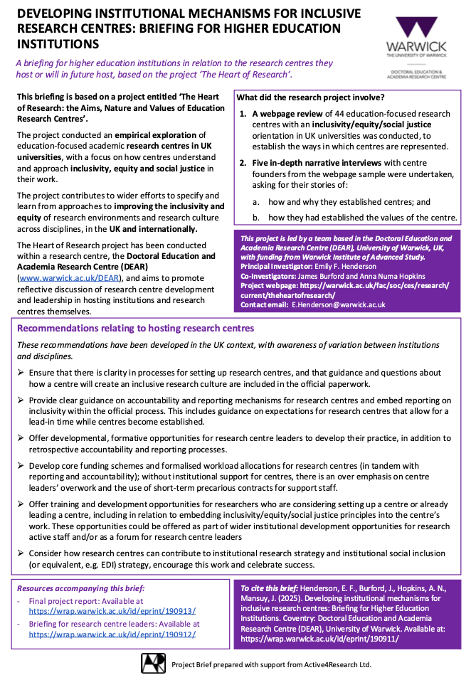
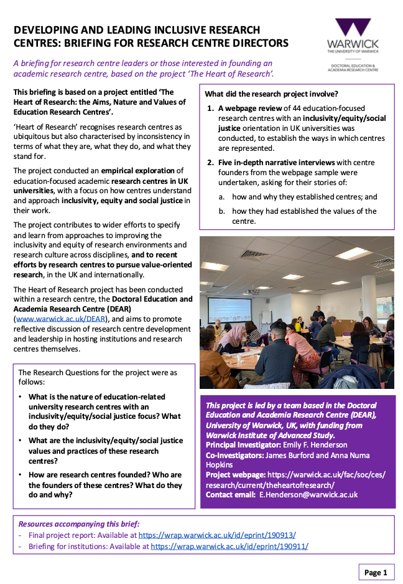
Project Outputs
Report: Henderson, E. F., Burford, J., and Hopkins, A. N., (2025). The Heart of Research - Exploring the Aims, Nature and Values of Education Research Centres: Final Report. Coventry: Doctoral Education and Academia Research Centre (DEAR), University of Warwick. Available at: https://wrap.warwick.ac.uk/id/eprint/190913/
Briefing for Research Centre Directors: Henderson, E. F., Burford, J., Hopkins, A. N. and Mansuy, J. (2025). Developing and leading inclusive research centres: Briefing for research centre directors. Coventry: Doctoral Education and Academia Research Centre (DEAR), University of Warwick. Available at: https://wrap.warwick.ac.uk/id/eprint/190912/
Briefing for Higher Education Institutions: Henderson, E. F., Burford, J., Hopkins, A. N., Mansuy, J. (2025). Developing institutional mechanisms for inclusive research centres: Briefing for Higher Education Institutions. Coventry: Doctoral Education and Academia Research Centre (DEAR), University of Warwick. Available at: https://wrap.warwick.ac.uk/id/eprint/190911/

Slide 19



Q&A
Thank you for attending this event!
Project webpage and resources are available here:
https://warwick.ac.uk/fac/soc/ces/research/ current/theheartofresearch/
Presentation prepared with support from Active4Research Ltd.

