Slide 1
Strategies for Interdisciplinary Working
25 June 2015
Sandy Sparks

Slide 2
Plan for session
Strategy discussion
Explore collaboration/interdisciplinary work
What can you do

Slide 3
Strategy
Why and how your plan will work in relation to all factors of influence upon the business entity and activity, particularly including competitors, customers and demographics, technology and communications.
Collaboration
Is working with others to do a task and to achieve shared goals.
Interdisciplinary
Involves the combining of two or more academic disciplines into one activity (e.g., a research project). It is about creating something new by crossing boundaries, and thinking across them

Slide 4
Top Tips
Effective networking
Asking lots of questions
Be prepared
Be responsive
Spot opportunities
Ask for help

Slide 5
Name | What can you give | What do you want? How can it benefit you? | By when? Measure of success. Impact | Priority A, B, C

Slide 6
Current
Next

Slide 7
Strategy
http://www2.warwick.ac.uk/about/strategy/
Strategic Analysis Tools
Pros – Cons
SWOT
PEST

Slide 8
Pros (for – advantages - positives) | Cons (against – disadvantages - negatives)

Slide 9
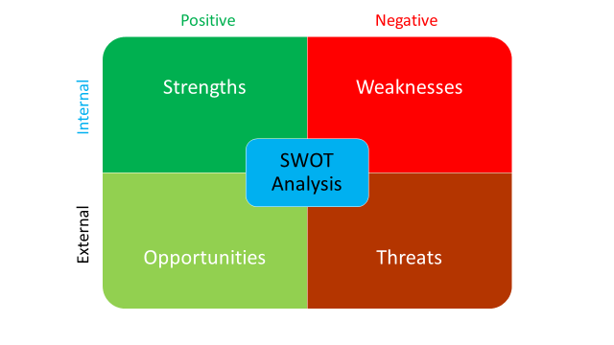

Slide 10
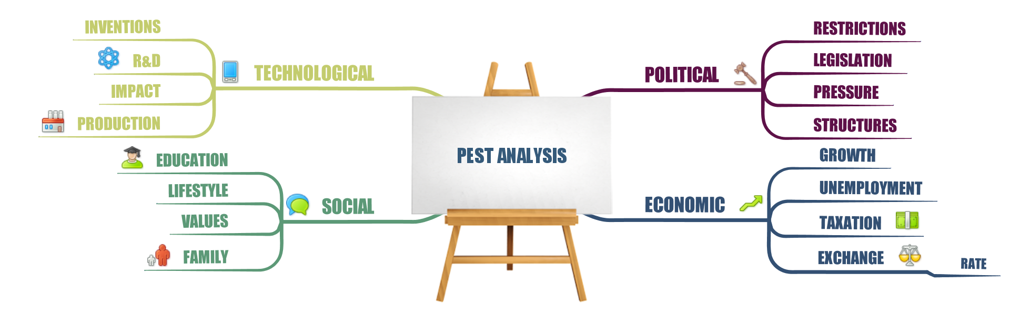
www.thinkbuzan.com

Slide 11
Your Strengths for Collaboration www. vitae.ac.uk
Provide Clarity
Could someone in your department (not your supervisor or close friend) describe your research in simple accurate terms?
Become Recognisable
Would a key researcher in your field who has attended the same meetings as you in the past be able to identify you by sight?
Build your Visibility
Does your name or work come up in a web search for your research topic?

Slide 12
Identify Ambassadors
Do the right people know you are interested in collaboration and would they feel comfortable approaching you?
Has your supervisor/mentor/PI introduced or recommended you to someone? What did you do?
Be Reliable
Could your colleagues recommend you as a potential collaborator based on your current performance?
Tune in
What do you think the main research question will be in your field in five years time?

Slide 13
Translate
Have your described research in interesting and relevant terms to someone from a different faculty in the last six months?
Be Interested
Do you make a habit of talking to other researchers about their work and do you find them interesting?
Remain Relevant and Current
Are your skills or knowledge in short supply?

Slide 14
Achieve Status
When people discuss your work, do they identify you as the architect of the research?
Turn on your Radar
Do you know who could fund your future research interests?
Create Opportunities
Can you think of three possible applications for your expertise outside your current project?

Slide 15
Collaboration
F
And what are the challenges, pit-falls?
What are the benefits and opportunities for you of collaborating on research?
F
And what are the challenges, pit-falls?
What are the benefits for Your Institution of research collaboration?
F
And what are the challenges, pit-falls?
What are the benefits for the Funders/RCUK of having collaborative research?

Slide 16
Institution Benefits/Opportunities | You Benefits/Opportunities | Funders/RCUK Benefits/Opportunities
Institution Challenges/pit-falls | You Challenges/pit-falls | Funders/RCUK Challenges/pit-falls

Slide 17
How to Create/Spot Opportunities

Slide 18
PURPOSE SUCCESS
PLAN
PREPARE
EVALUATE

