Slide 1
Theorising educational research
The application of habitus in academic practice

Slide 2
First step
Know your field of research well!
Read! Read! Read!
And question!

Slide 3
Find a focus
Looking at the change of scholarly practices with technology

Slide 4
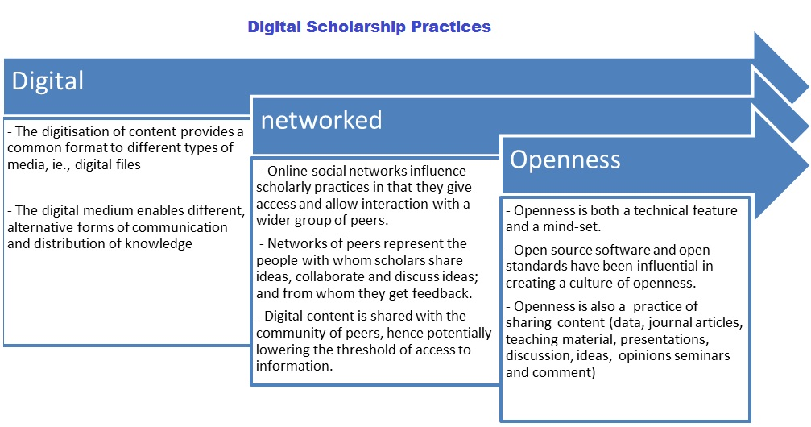
Digital scholarship practices. Adapted from Weller (2011), pp. 5–9.

Slide 5
Academics fighting for a new habitus
Find a focus
Looking at the change of scholarly practices with technology
Operationalising dispositions
(which ones?)
to capture habitus
(which method?)
What are practices?

Slide 6
Habitus Applied: Pierre Bourdieu and Social Theory

Slide 7
Habitus
Mental structures inscribed in the body
… represented (and externalised) by individuals’ dispositions
the habitus exploits the body’s readiness to take seriously the performative magic of the social (Bourdieu, 1990, p. 57)

Slide 8
Habitus…
a system of dispositions with a past, present, and a future
The notion of habitus has several virtues. (…) agents have a history and are the product of an individual history and an education associated with a milieu, and that they are also a product of a collective history, and that, in particular, their categories of thinking, categories of understanding, patterns of perception, systems of values, and so on, are the product of the incorporation of social structures’ (Bourdieu and Chartier, 2015, p.52)
Notes:
with which individuals’ strategies of practices are associated. These strategies are in continuous flow with the constraints and conditions that characterise participants’ existences and personal trajectories.

Slide 9
Habitus…
a system of dispositions with a past, present, and a future
Notes:
with which individuals’ strategies of practices are associated. These strategies are in continuous flow with the constraints and conditions that characterise participants’ existences and personal trajectories.

Slide 10
Habitus
Durable and transposable
Transformative and regenerative
Dispositions
Primary habitus
Secondary habitus

Slide 11
Through which mechanisms can we apply and conceptualise habitus as part of the research process?

Slide 12
In Outline of a Theory of Practice,
Bourdieu defends the flexibility of the research process as a form of challenging assumptions and rectifying taken for granted conceptions.
Notes:
Hence, the importance Bourdieu placed on the interdependence of theoretical and empirical work in continuously challenging and informing each other.

Slide 13
Narrative inquiry
Accessing personal trajectories
the longitudinal and lateral aspects of practices through reflective action
Knowledge does not merely depend (…) on a particular standpoint an observer “situated in space and time” takes up on the object. The knowing subject (…) constitutes practical activity as an object of observation and analysis, a representation (Bourdieu, 1977, p. 2).

Slide 14
The ontological and epistemological difference between their digital dispositions and their academic position encourages the discursive reflection of established practices as explicit criticism of dominating norms (Costa, 2015).
Notes:
The combination of habitus and narrative inquiry as a research method can result in both a tool and a lens for understanding the longitudinal and lateral aspects of practices through reflective action.

Slide 15
Dispositions as a representation of habitus can be regarded as a tacit understanding of the field
→ Crisis of meaning makes a (changing) habitus explicit

Slide 16
If habitus justifies and produces social actions and practices, then it must also account for change
the habitus makes possible the free production of all the thoughts, perceptions and actions inherent in the particular conditions of its production – and only those (Bourdieu, 1990, p.55)

Slide 17
Knowledge does not merely depend (…) on a particular standpoint an observer “situated in space and time” takes up on the object. The knowing subject (…) constitutes practical activity as an object of observation and analysis, a representation (Bourdieu, 1977, p. 2).

Slide 18

Bourdieu, habitus and social research: The art of application (Costa and Murphy, 2015)

Slide 19
