Slide 1
TEL Research Group
MOOCs
Friday 13 May 2016

Slide 2
Session outline
Scene setting
The global position on MOOCs and MOOCs at Warwick: Futurelearn and Moodle
Short presentations:
Principles of teaching and learning/flexibility Jane Sinclair
Pedagogical strategies and technologies for peer assessment in Massively Open Online Courses Robert O’Toole
Use of video content for online teaching and learning (emerging issues from MOOCs) Dot Powell
Self-regulated learning in MOOCs Danny Onah
BREAK FOR REFRESHMENTS
Discussion

Slide 3
MOOCs – some numbers
MOOC users: Coursera (> 22 m), Kahn Academy (>2.5 m),
Futurelearn (> 3.5m), edX (over 1 billion!)
MOOC growth: 450 starting this month - 154 in May 2015 (Course Central)
MOOC participants: “The average MOOC student is a young, white,
employed American man with a bachelor’s degree.” (Selingo, “MOOC U”)
MOOC completion rates: average generally quoted as around 7%
MOOC spending: c. £30,000 each 3 years ago (Uni. Of Edinburgh)
Notes:
Numbers registered with these sites. Bear in mind most have only been going a few years (Futurelearn 2013).
Who has enrolled on a MOOC?
Who has completed a MOOC?

Slide 4
“MOOC backlash”?
High profile failed MOOCs
Issues of pedagogy – issues of content (Khan Academy maths course)
Concerns raised by university staff about excuse to cut funding.
San Jose State University/Udacity remedial class MOOCs ended with failure rates over 70%
Sebastian Thrun (Udacity): “We have a lousy product”.
Solution: make people pay for it!
Notes:
Thrun – add service layer. Payment ensures commitment.

Slide 5
Different ways of using MOOCs
Open courseware
Distance learning – supported
Blended learning (flipping classroom?)
Continuing professional development
Notes:
Who has enrolled on a MOOC?
Who has completed a MOOC?

Slide 6
Computing for Teachers MOOC - Moodle
For a specific target audience and identified need
To help support UK teachers in preparation for the new computing curriculum
Previous twilight course – need to reach more people, provide more resources
Distinct advantages
- identified community
- competent autonomous learners
- might assume some relevant digital skills
- highly motivated
(Some) funding from Google
Notes:
Who has enrolled on a MOOC?
Who has completed a MOOC?

Slide 7
Decisions in planning the CFT MOOC
Moodle as a platform – Vimeo for video hosting
Course to cover Teaching Agency requirements for trainee teachers and to teach Python programming
Material divided into 8 main sessions - plus a “pre” session as an intro
Sessions to be released fortnightly (with a break over Christmas) (teachers very keen on this!)
Three strands – concepts, programming and teaching
Materials: header videos, teaching videos, slides, transcripts, quizzes, labs (and solutions), forums, lots of links to other resources
These materials all freely available to all registered – they can download, reuse etc.
Notes:
A long story and anguish behind each decision!
FutureLearn – we were a bit too soon but the intention is to migrate in the future.
Vimeo – a late decision but saved a lot of grief. Ask Russ.
We wanted to keep the materials under our control a little bit – registration required. Partly so we can evaluate.
We will be taking them down shortly after the end of the course – we have to rethink server space for videos then anyway – but teachers on the course can download and use them as Creative Commons.

Slide 8
Supported mode
To help students learn programming
“Real time” lab sessions with tutors online using Google hangout
Postgrad/postdoc tutors working with small groups of teachers
For this mode also – special forum, final assessment and workshop
Needs to be sustainable – we are charging a nominal amount for teachers on this mode
Access to all materials and other parts of the course – the same
Notes:
The supported mode didn’t make life easy – it’s perhaps caused our biggest headaches so far.
We did it because we thought it would be very useful (and perform a similar role to our own labs).
Also, wanted to investigate this – noone’s ever done it before.

Slide 9
How it went
First run started October 2013
Registration
Traditional 618
Supported 30
Total 648
Further requests to register turned down
73 never logged in
A tough timetable for both us and the students!
Second run in 2014 – but no supported mode.
Notes:
The supported mode didn’t make life easy – it’s perhaps caused our biggest headaches so far.
We did it because we thought it would be very useful (and perform a similar role to our own labs).
Also, wanted to investigate this – noone’s ever done it before.

Slide 10
Previous online learning experience
Notes:
From the first course – interesting that quite a high proportion – particularly for teachers in CS hadn’t experience.
It became apparent as we progreesed there was a wide range od skills and levels – and reasons for taking the course.

Slide 11
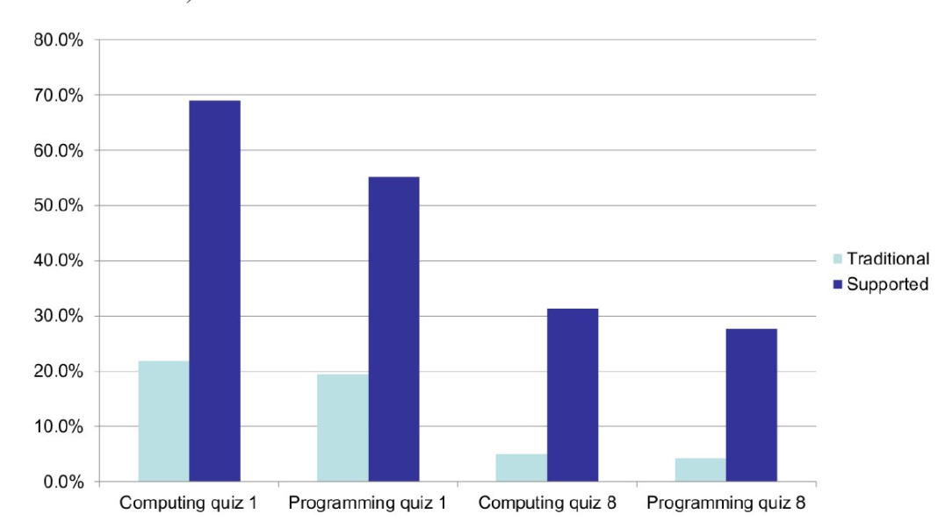
Comparing quiz submision

Slide 12
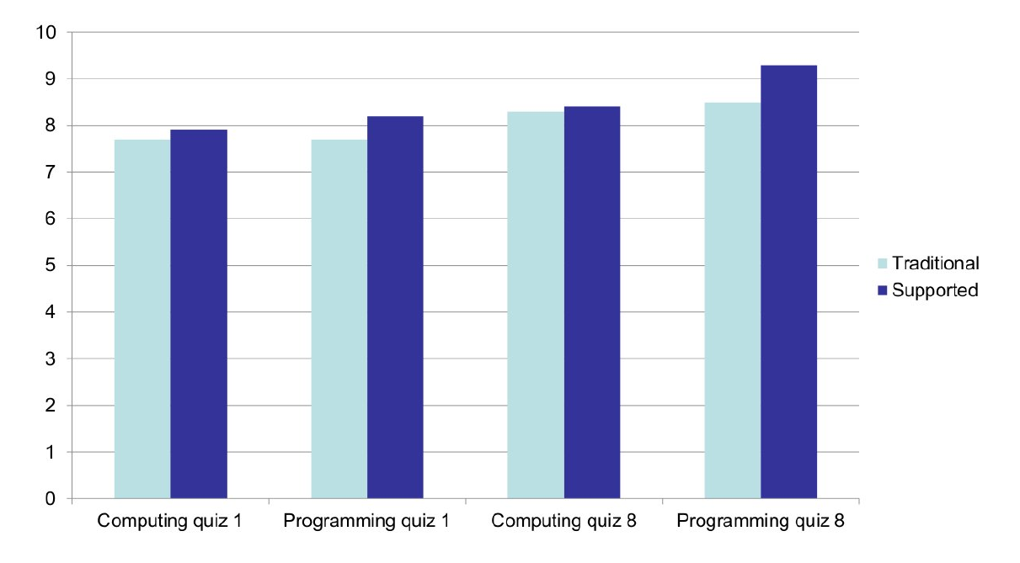
Comparing quiz scores
Notes:
Reasons

Slide 13
What we learned
It’s a great thing to do – but don’t underestimate the effort/resources
Get buy-in (and dedicated time, commitment to resources) from line management
Issues of platform – “doing it yourself” obviously means more effort
Project management needed!
We needed to develop skills (eg: making video recordings, different ways of teaching, subject/audience). Different way of working.
Our ideas may not be what is most useful for what teachers want or how they work – what do students find useful?
Notes:
The supported mode didn’t make life easy – it’s perhaps caused our biggest headaches so far.
We did it because we thought it would be very useful (and perform a similar role to our own labs).
Also, wanted to investigate this – noone’s ever done it before.

Slide 14
What we learned about the participants
Lack of (in general, schools are not releasing them, sometimes not even crediting the CPD)
Many didn’t keep up with the session structure – but said they were happy doing what they wanted at their own pace.
Even a number of those on the paid mode didn’t really engage from the start
The supported mode didn’t have many takers.
Wide range of abilities and existing skills
Assumptions about their preparedness/digital skills may not be right
Expectation of passive learning
Notes:
The supported mode didn’t make life easy – it’s perhaps caused our biggest headaches so far.
We did it because we thought it would be very useful (and perform a similar role to our own labs).
Also, wanted to investigate this – noone’s ever done it before.

Slide 15
Futurelearn at Warwick
First Warwick MOOC: The Mind is Flat (6 weeks, Nov 2013)
(5 runs, 71,936 joiners, 3,678 fully participating learners – roughly 5%)
Followed by:
Shakespeare and His World (10 weeks, March 2014)
(3 runs, 40,456 joiners, 4358 fully participating learners – roughly 10%)
Big Data (9 weeks, April 2015)
(2 runs, 27,680 joiners, 1886 fully participating learners – roughly 7%)
Babies in Mind (4 weeks, October 2015)
(2 runs, 22,428 joiners, 3158 fully participating learners – roughly 14%)
Literature and Mental Health (6 weeks, February 2016)
(1 run, 23,030 joiners, 3425 fully participating learners – roughly 15%)
Notes:
Explain
difference between joiners and fully completing learners (and FL reporting of this)
A couple have runs in progress
Discuss popularity vs completion
Mention the ones in development

Slide 16
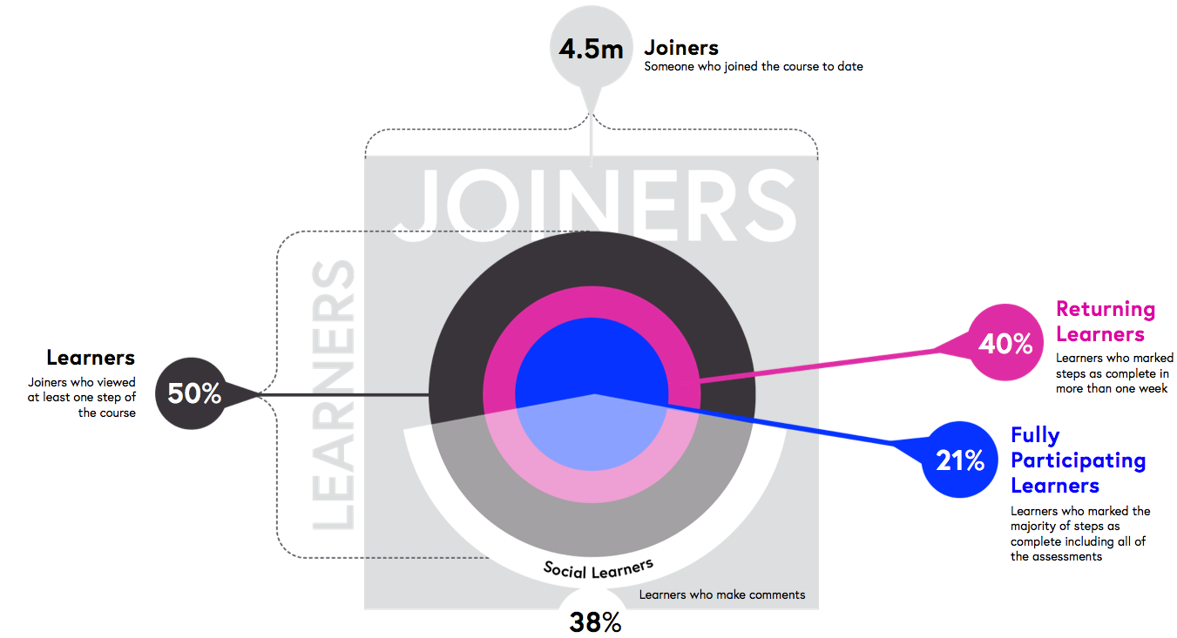
Futurelearn global statistics (2014-15)
Notes:
Point out the reticence about recording fpl as a proportion of joiners

Slide 17
Researching MOOC pedagogy

Slide 18


Does it really add up?
“What we’re doing is one instructor, 50,000 students. This is the way to bend the cost curves”
Daphne Koller, Coursera, 2012
“The questions of the confused majority will not be answered quickly enough, and the faculty are too outnumbered by the 100,000 students to keep up.”
Joseph Kern, MOOCer, 2012
What exactly are you doing with one instructor and 50,000 students?
Who is this type of learning suitable for?
Notes:
The whole premiss is that we can deliver education to thousands of people with few instructors.
But the reality is that while you can provide learning materials to millions, it’s another matter to provide support and widespread learning.
Those of us who teach would hope that we were more useful than the first quote suggests.
Indeed, in a number of places academic staff have become very upset at the idea of MOOCs because of the suggestion that they might be seen as an excuse to reduce faculty. And management might well think that. To speak up is not protectionism – it’s sanity!
What are you doing with 50000 to 1 – you’re providing learning materials.
Who is it suitable for – those with good motivation, independent learning skills and some digital nous.

Slide 19
Pedagogy – what pedagogy?
What teaching and learning strategies do most major MOOC platforms incorporate?
Why, with MOOCs, have we forgotten everything we ever knew about effective pedagogy?
Despite this – there are uses for them!
Notes:
Despite the fact that I’ve developed and run a MOOC, I am a sceptic!
Although there are problems if you look to MOOCs to replace traditional classes (partiularly introductory or remedial ones) with 10,000 to 1 they could be useful. MOOC-type technology for blended learning. CPD for professionals.

Slide 20
Some specific teaching and learning issues
Insufficient support and guidance
Lack of flexibility
Lack of self-regulation in learning
Student engagement

Slide 21
Stuff we’ve looked at: support
What we did
CFT MOOC in two modes
What we found
Low take-up
Improvement on completion, actual results similar
Thoughts
“Passive expectations” – difficult to engage active hangout engagement
Preference for bitesize resources – “fill me with knowledge”s
Notes:
Relates to other work we’ve been doing on active methods of teachers’ CPD. The vast majority of teachers CPD is very info-push.

Slide 22
Stuff we’ve looked at: flexibility
What we did
Platform to allow learner-directed paths (more from Danny later)
What we found
Most learners said they wanted such a facility
See self-regulation issues later!
Thoughts
Social aspects more difficult to organise in this format and need further development.
Allows redefinition of completion.

Slide 23
Things we’ve found: student engagement
The issue
Importance of international student engagement surveys.
Another area where it’s all of a sudden massively important
… but seemingly not for MOOCS!
What we did
Mapped current major xMOOC formats against the survey criteria
What we found
Social learning poor (some studies show > 30% of active participants never contribute in any way and around 90% never seek support)
Areas of strength: reflective learning; degree of challenge
Notes:
“Student engagement is concerned with the interaction between the time, effort
and other relevant resources invested by both students and their institutions
intended to optimise the student experience and enhance the learning outcomes and
development of students and the performance, and reputation of the institution
There are aspects of this that MOOCs can do well on – and maybe the conept itself can be further developed. But it’s not high on the agenda.

Slide 24
Stuff we’ve looked at: self-regulation
Characterised by reflection, strategic planning, self-evaluation (and feeding that back), motivation.
Autonomy – taking responsibility for one’s own learning
Why important: “Effective learners are effective self-regulators”
Conceptualised in different ways, but one element is setting own learning goals and directing study
More from Danny.
Notes:
Effective SRL don’t learn well in highly linearised, directed environments.
We don’t develop (implicitly
Contextualised – so good SRL n one context not necessarily good in another.

Slide 25
Where next?
We still don’t really know who and what they’re are useful for (CPD? Flipped classroom?)
Keep plugging the message that however they are used, pedagogy is paramount. Investigate ways to incorporate what we already know about good practice and try new approaches.
Notes:
If the university said to me “we want to push out more MOOCs, would you like to develop one of your modules as a MOOC” – I’d say no. I just don’t believe it is beneficial.
And we’ve got enough MOOCs on this that an the other to serve as interesting pass-times for educated professionals.
They don’t really seem to be useful (hardly surprisingly!) for the benefits originally promised (democratisation of education, access for those otherwise unable to participate, education for developing countries, free for all).

Slide 26
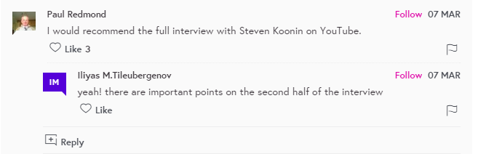
Video in online learning – what have we learnt from MOOCs?
Shorter is better (but…)
Reading: How Video Production Affects Student Engagement: An Empirical Study of MOOC Videos

Slide 27
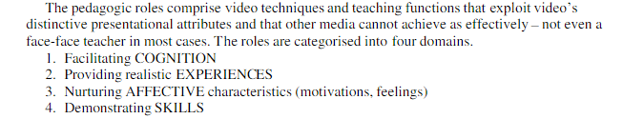
Video in online learning – what have we learnt from MOOCs?
Video is great for some sorts of learning (but…)
Reading: Potent Pedagogic Roles for Video
Notes:
Facilitating cognition – e.g. animated diagrams
Realistic experiences: simulations/people interacting (drama)
Affective characteristics: Alleviate isolation by showing the teacher, create a sense of importance (by using famous presenters)
Demonstrating skills – manual/craft, body movement etc

Slide 28
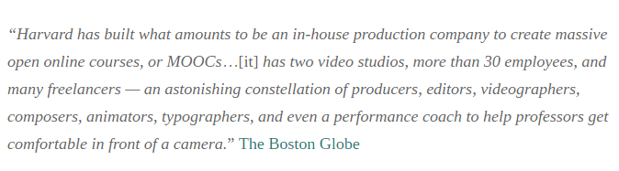
Video in online learning – what have we learnt from MOOCs?
Video is expensive (but…)
Moocs4all – Developing a MOOC on a budget
https://edge.edx.org/courses/course-v1:DelftX-Locomotion+MOOCs4ALL+2016/about

Slide 29

MOOCs & Self-Regulation
By Daniel Onah

Slide 30
Problem Statement
Massive Open Online Courses (MOOCs) have greatly evolved around the world. Even with this high publicity, a lot of participants are not completing the course hence leading to high dropout rates with low completion rate.
High level motivation
High dropout rates
Low completion
Some Reasons for participating
Curiosity
To make friends
To study the new trend
Participate in a course
Research investigation
Self-Regulated Learning

Slide 31

Research questions
The specific research questions addressed in this study:
(i) What levels of SRL skills are demonstrated within a diverse MOOC learner group and are there particular areas of weakness which MOOCs should seek to improve?
(ii) To what extent do learners choose to direct their own study path as opposed to following a guided course?
(iii) Is there correlation between SRL skills and the learning path chosen?

Slide 32
Self-regulated learning
Self-regulated learning refers to the ability of the learner to plan beforehand the pattern of their studying approaches before engaging with an online course . Effective e-learning can encourage learner autonomy by empowering students to set goals and plan a route to achieve them (Cunningham et al. 2003). Lack of self-regulated skills may prevent online learners from achieving expected learning tasks (Barnard et al. 2009).
How do we define success… not by completers….but by expectations met!!

Slide 33
Dimensions of Self-regulated learning
This study explores and investigates six dimensions of self-regulated learning.
Goal setting
Time management
Help seeking
Task strategies
Environment structuring
Self-evaluation

Slide 34
Goal setting
Goal setting in a brief definition is said to be the process of setting specific goal that will help in specifying the expected outcomes to attain in the task (Locke and Latham, 2002).
As a matter of fact, goal setting is described and classified to be more explicit cognitive ability of individual learner’s self-regulatory skills which was unique to each learner. Here the learners set specific goals for which they want to achieve and work toward attainment.

Slide 35
Time management
Another very important strategy to mention which is also one of the key strategies in this study is “time management” . Here in this case, in order not to hinder a better performance and outcome expectations, then learners have to incorporate enough skills to manage learning time. In addition, adequate time is imperative in preparing quality learning environment, structured with the disposition of learning resources and with no distraction in order for the learner to attain his/her set goals.

Slide 36
Help seeking
Another strategy used in this study is the “help seeking” , this strategy supports learners to obtain assistance from peers or tutors in order to understand and master areas of concerns within their studies. As a matter of fact, this self-regulated strategy helps students with low confident in their studies to get support from friends (peers) and also from the instructors.

Slide 37
Task strategies
It is however imperative to realize that task specific strategies decided by the learners helps to support learning reflection. In like manner, self-instruction as defined in the performance phase is said to be a strategy that helps the learner to self-direct their studies by reflecting during their learning process (Auvinen, 2015).

Slide 38
Environment structuring
Environment structuring tend to follow implicit behaviour, for instance, eliminating all elements of distractions from the preferred studying environment (Barnard, 2008).
Self-regulatory learning in the first place, has been seen to be the ability of exercising control over one’s learning behaviour and environment (Bandura , 1997).

Slide 39
Self-evaluation
Likewise self-evaluation as a component of self-judgement in the model refers to the learner’s personally assessing their performance based on specific criteria in collaboration with individual set goals (Auvinen , 2015)[193]. This process could be view from these dimensions; one, depend on whether the learner’s set goals were achieved and or not, which goes the other way round. This evaluation reflects our definition of success as whether the learner wants to complete the course or just to acquire specific area of interest.

Slide 40
Procedure
The modules are arranged in seven sessions (sessions 0 – 6). The learners have the option to decide route of study. The self-directed mode allows the learners to direct their learning. The instructor led mode On the contrary direct the learners to follow a structured module with prerequisites. The modes are inter-linked such that learners could decide to follow both modes. Learners could interact with the course surveys, quizzes and obtain course participation badges and certificate at the end of the course.

Slide 41
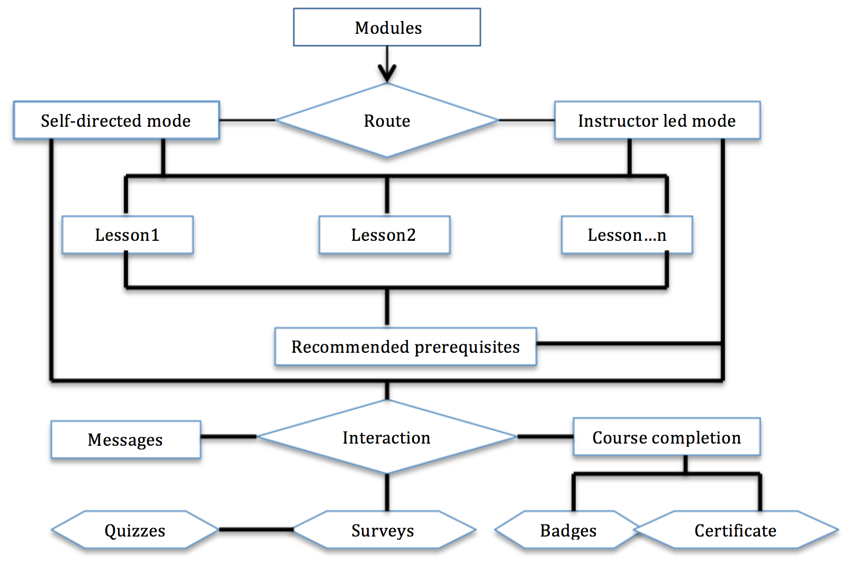
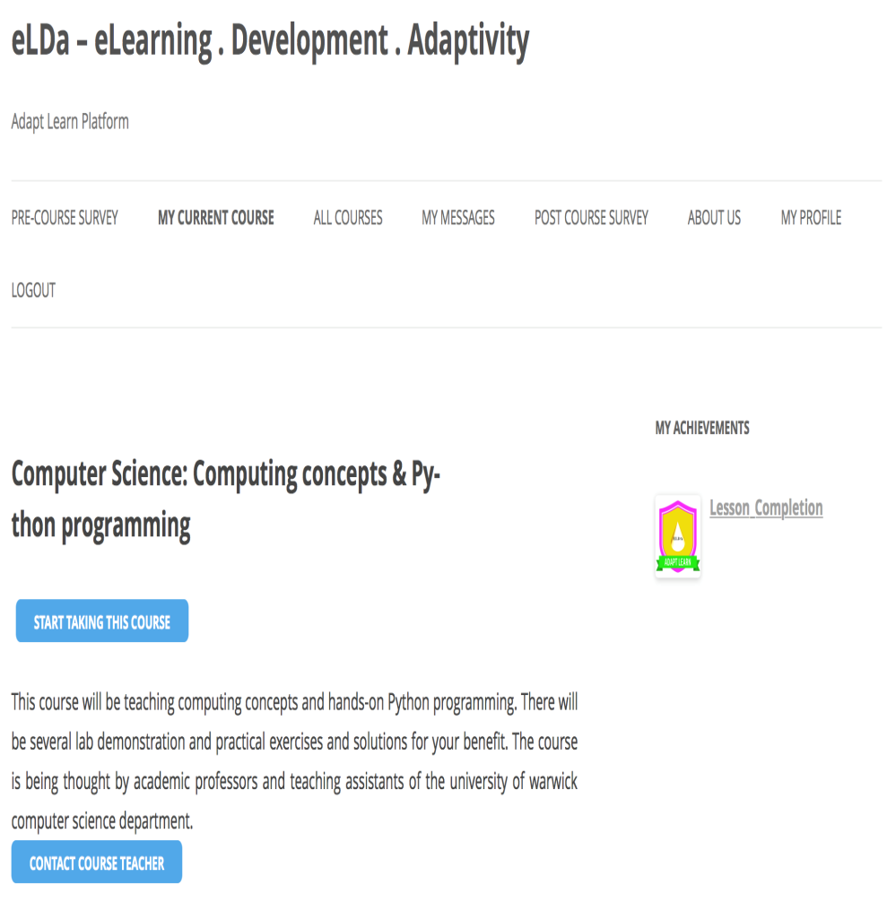
eLDa Tool – Novelty of the Research
Figure 1.The course architecture
Figure 2.Course interface
eLDaMOOC Platform :- http://eldamooc.org/

Slide 42

Support & Motivational Incentives
Progress bar
Visualization
Prerequisites
Discussion forum
Badges
Certificate
Private messages
Figure 3. Student-Tutor support discussion forum

Slide 43
Instrument
According to Barnard et al. [8], they developed an instrument to measure self-regulation in an online learning environment. This instrument is known as an “online self-regulated learning questionnaire” (OSLQ). They mentioned the OSLQ instrument was an acceptable measure for the self-regulated learning skills of their blended course students.

Slide 44
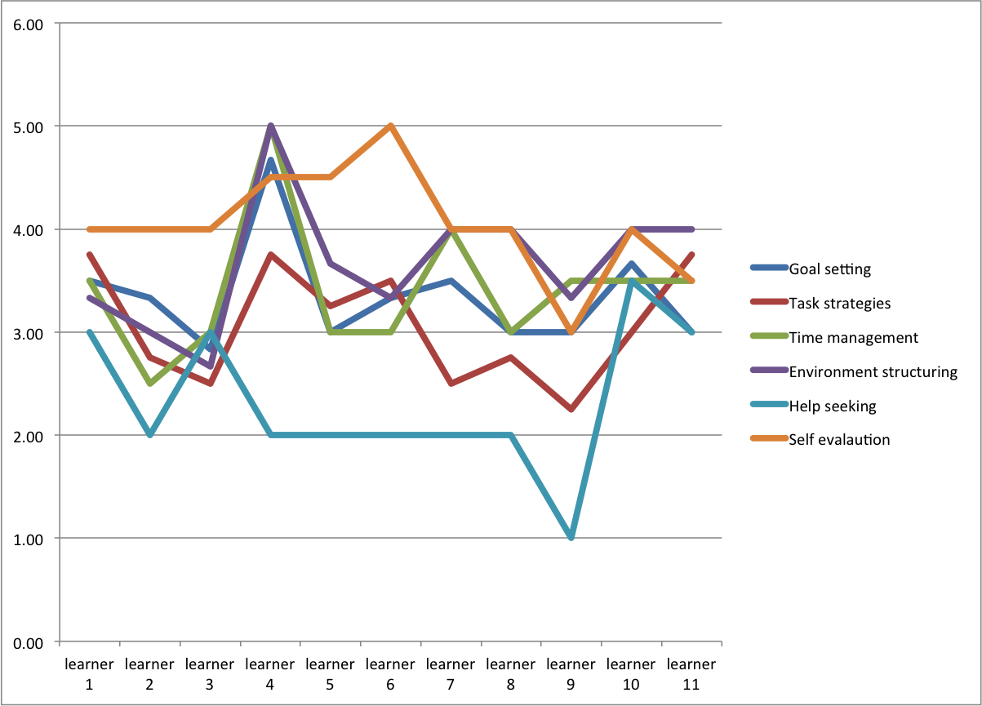
Result 1 : Learners’ SRL Dimensions
Figure 4. Overall Individual SRL dimensions

Slide 45
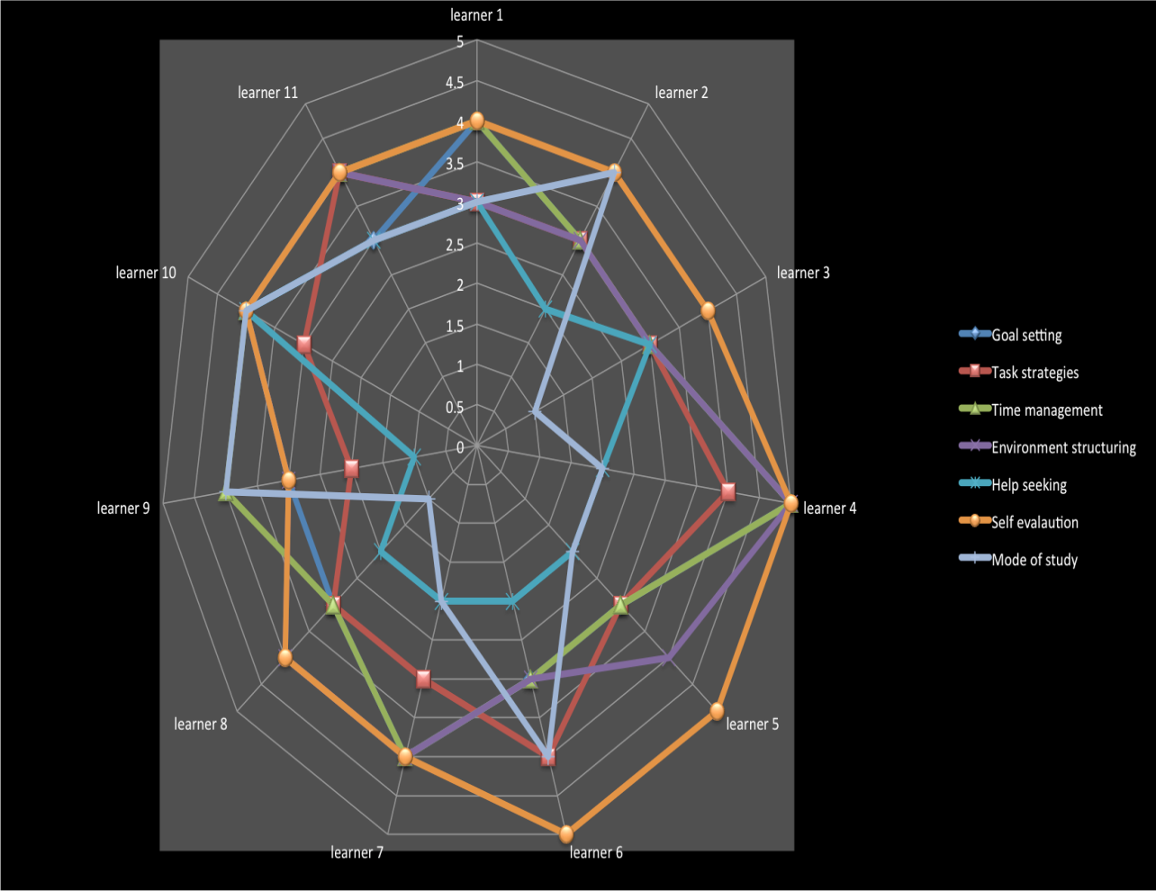
Result 2 : Learners’ SRL Dimensions
Figure 5. Learners’ SRL dimensions in relation to their preferred mode of study

Slide 46
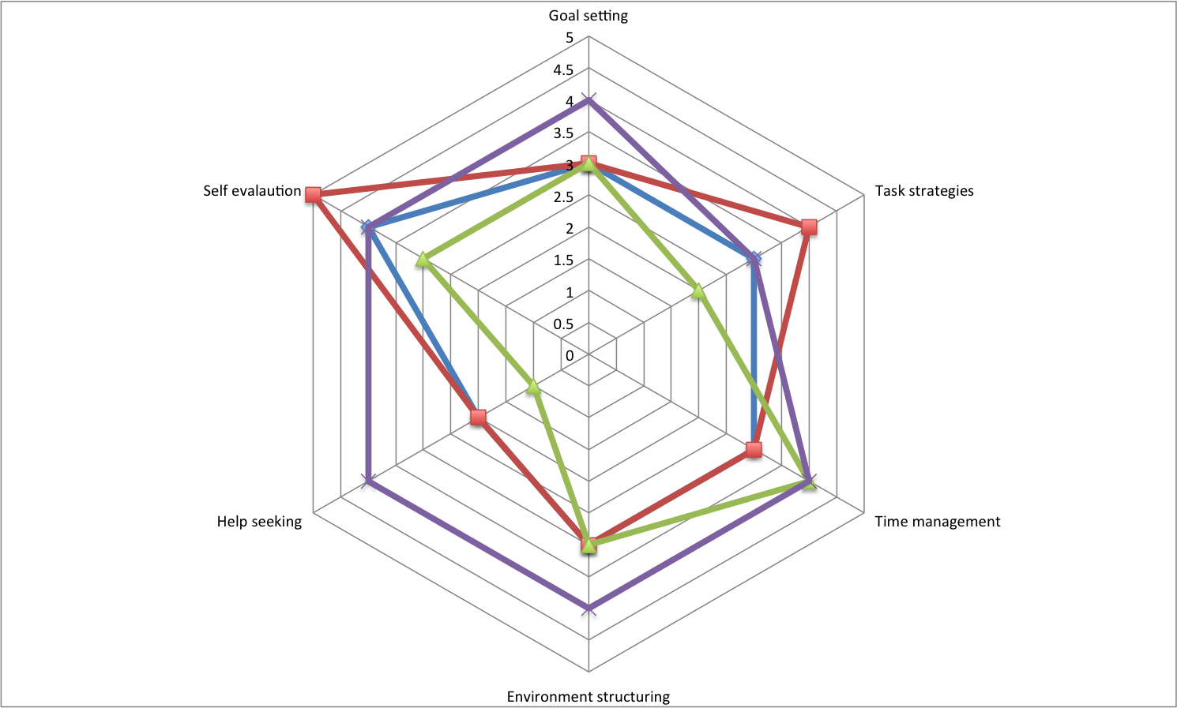
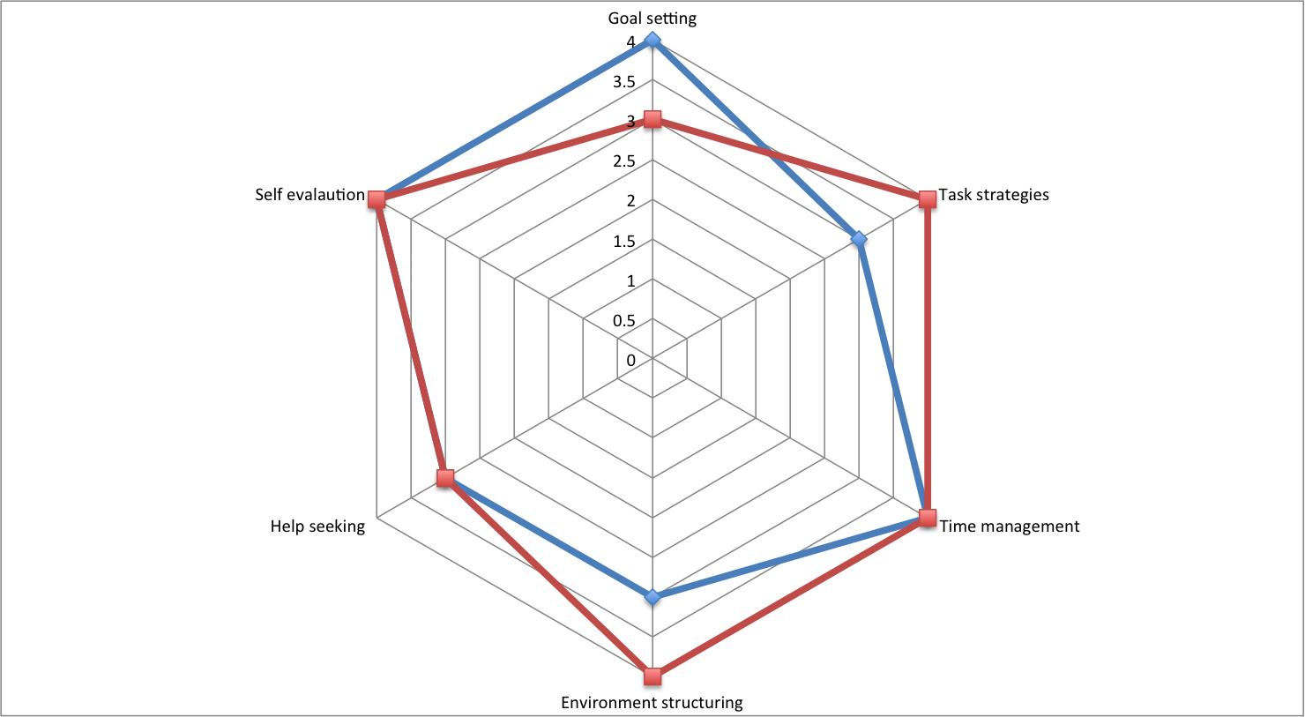
Result 3 : SRL Comparison
Self-study Mode
Self-study Mode
Guided Mode
Figure 6.Self-directed mode SRL dimensions
Figure 7.Instructor led mode SRL dimensions

Slide 47

Thank you

Slide 48
References
Auvinen, T. (2015). Educational Technologies for Supporting Self-Regulated Learning in Online Learning Environments. PhD Thesis Aalto University, Finland.
Bandura, A. (1997). Self-efﬁcacy: The exercise of control. New York: Freeman
Barnard, L., Lan, W. Y., To, Y. M., Paton, V. O., & Lai, S. L. (2009). Measuring self-regulation in online and blended learning environments. The Internet and Higher Education, 12(1), 1-6.
Barnard, L., Paton, V., & Lan, W. (2008). Online self-regulatory learning behaviors as a mediator in the relationship between online course perceptions with achievement. The International Review of Research in Open and Distributed Learning, 9(2).
Cunningham, C. A., & Billingsley, M. (2003). Curriculum Webs: A practical guide to weaving the web into teaching and learning. Boston: Allyn & Bacon.
Locke, E. A., & Latham, G. P. (2002). Building a practically useful theory of goal setting and task motivation: A 35-year odyssey. American psychologist, 57(9), 705.

Slide 49
Some possible discussion questions
How massive is massive?
Who in practice uses MOOCs?
Does it matter if so many drop out?
What typologies of MOOCs are there?
Are MOOCs and the study of MOOCs on the way out?
Where are the compelling cases showing the value of MOOCs?
Where are the causes for concern?
What is good pedagogy in a MOOC?
Can MOOCs really provide an effective form of education?

