Slide 1

Developing a critical approach to literacy
Using reading and writing as tools of critical thinking

Slide 2
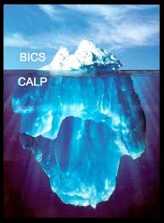
Why is critical literacy important?
Critical reading and critical writing belong in the CALP part of the iceberg.
Success in secondary school, college and university depend upon them.

Slide 3
Why is critical literacy important?
A short introduction to the study of Holocaust revisionism
By Arthur R. Butz
http://pubweb.acns.nwu.edu/~abutz/di/intro.html
I see three principal reasons for the widespread but erroneous belief in the legend of millions of Jews killed by the Germans during World War II: US and British troops found horrible piles of corpses in the west German camps they captured in 1945 (e.g. Dachau and Belsen), there are no longer large communities of Jews in Poland, and historians generally support the legend.
During both world wars Germany was forced to fight typhus, carried by lice in the constant traffic with the east. That is why all accounts of entry into the German concentration camps speak of shaving of hair and showering and other delousing procedures, such as treatment of quarters with the pesticide Zyklon. That was also the main reason for a high death rate in the camps, and the crematoria that existed in all.

Slide 4
Why is critical literacy important?
Chairman Committee On Foreign Contract And Inheritance fund
Payment Notification From United Nations And USA Government
Attn: Beneficiary
U.S.A Government, World Bank And United Nations Organization Official Has Approved To Pay You Part Payment Of Your Inheritance Fund And Lottrey/Award Winning Payment Valued Of USD8.5m.
The British Prime Minister in conjunction with U.S.A GOVERNMENT, WORLD BANK AND UNITED NATIONS ORGANIZATION do hereby give this irrevocable approval order with This Release Code: GNC/3480/02/08 In Your Favor For Your Contract Entitlement And Your Inheritance Fund Which You Have Not Received Yet, Now It Was Approved By The World Bank, That Your Contract/Inheritance Fund should be released through UNITED NATIONS ORGANIZATION. So You Are Advised To Present Any Of Your Choice, On How You Want To Receive Your Fund, Either By BANK DRAFT OR BY ATM CARD OR WIRE TRANSFER, So In Regards To The Transfer You Can Provide Any Of Your BANK ACCOUNT DETAILS For The Transfer Of Your Fund With Out Delay. I Am Contacting You In Regards To The Instruction Given By United Nations, Please I Will Urge You To Try And Indicate On How You Want Your Fund To Be Released To You From The Three Options Above.

Slide 5
What is critical literacy?
Shor (1992):
“analytic habits of thinking, reading, writing, speaking, or discussing which go beneath surface impressions, traditional myths, mere opinions, and routine clichés; understanding the social contexts and consequences of any subject matter; discovering the deep meaning of any event, text, technique, process, object, statement, image, or situation; applying that meaning to your own context.”

Slide 6
What is critical literacy?
Four assumptions:
Critical literacy rests on an assumption that language education can make a difference in children’s lives.
Secondly, critical literacy approaches assume that the meanings of words and texts cannot be separated from the cultural and social practices in which - and by which - they are constructed.
Thirdly, critical literacy is about analysing and evaluating texts.
Fourthly, critical literacy aims to produce socially aware and active citizens.

Slide 7
How to teach critical literacy?
Textual analysis
Text clustering
Texts for social action

Slide 8
Textual analysis
Extract from History can be fun by Munro Leaf.
“… now that you’ve read this far you’ll know what generally happened as soon as a new country was discovered. Two things, first, other nations came along and tried to get a share, second, the native people, like the Indians and ‘red’ Indians, found themselves being ruled by white men. With Australia and New Zealand things were better. No other European nation tried to take them, and in Australia there were only a very few black people so that colonists did not have to lead armies against them. In New Zealand there were splendid native people called Maoris and they fought against the British at first. But now the Maoris and the settlers who have come from Britain live peacefully side by side and there are Maori members of the New Zealand Parliament.”

Slide 9
Textual analysis
Key points to draw children’s attention to:
The suggestion that countries were unknown before Europeans set foot there: “… as soon as a new country was discovered …”.
The way the text provides the opinions or viewpoint of one group only: “With Australia and New Zealand things were better.” Better for whom?
The way it minimises the damage and distress caused by colonisation to indigenous peoples: “…the Indians and ‘red’ Indians found themselves being ruled by white men.” “But now the Maoris and the settlers… live peacefully side by side…”

Slide 10
Textual analysis
Key questions:
Why might the author have written this?
Who is it written for? How do you know?
What values does the author assume the reader holds? How do you know?
What knowledge does the reader need to bring to the text in order to understand it?
Who would feel ‘left out’ in this text and why? Who would feel that the claims made in the text clash with their own values, beliefs or experiences?
How is the reader ‘positioned’ in relation to the author (e.g. as a friend, as an opponent, as someone who needs to be persuaded, as invisible, as someone who agrees with the author’s views)?

Slide 11
The CARS checklist
Credibility
  Author’s credentials
  Quality control
  Metainformation
Accuracy
  Timeliness
  Comprehensiveness
  Audience / purpose
Reasonableness
  Fairness
  Moderateness
  Consistency
Support
  Documentation
  Corroboration
  External consistency

Slide 12
Text clustering
1. From the BBC News web site (http://news.bbc.co.uk/1/hi/sci/tech/992494.stm) (26 Oct, 2000)
Four new moons found circling Saturn
By BBC News Online science editor Dr David Whitehouse
Saturn has become the planet with the greatest number of known moons, 22, following the discovery of four new satellites around it.
The four, faint bodies were detected during the past few months by several telescopes around the world. Further studies in the next few months will establish the satellites' precise orbits around the ringed planet.

Slide 13
Text clustering
2. From the Ananova web site (http://www.ananova.com/news/story/sm_349369.html) (11 July, 2001)
New moons discovered around Saturn
Astronomers have discovered 12 new moons around Saturn, bringing the planet's tally to 30 - the largest satellite family in the Solar System.
The new moons are small, measuring between six and 30 kilometres in diameter, and move in irregular, tilted orbits.
They fall into several clusters, leading scientists to conclude that they are the remnants of larger moons fragmented by collisions. The moons probably began life as wandering bodies that were captured by Saturn's gravity.

Slide 14
Text clustering
3. From the Science Line web site (http://www.sciencenet.org.uk/database/phys/astronomy/solarsystem/Jupiter/p00958b.html) (undated)
Satellites orbiting Saturn (date discovered in brackets)
Pan (1990); Atlas (1980); Prometheus (1980); Janus (1966); Enceladus (1789); Tethys (1684); Telesto (1980); Pandora (1980); Epimetheus (1966); Mimas (1789); Calypso (1980); Dione (1684); Helene (1980); Rhea (1672); Titan (1655); Hyperion (1848); Iapetus (1671); Phoebe (1898).

Slide 15
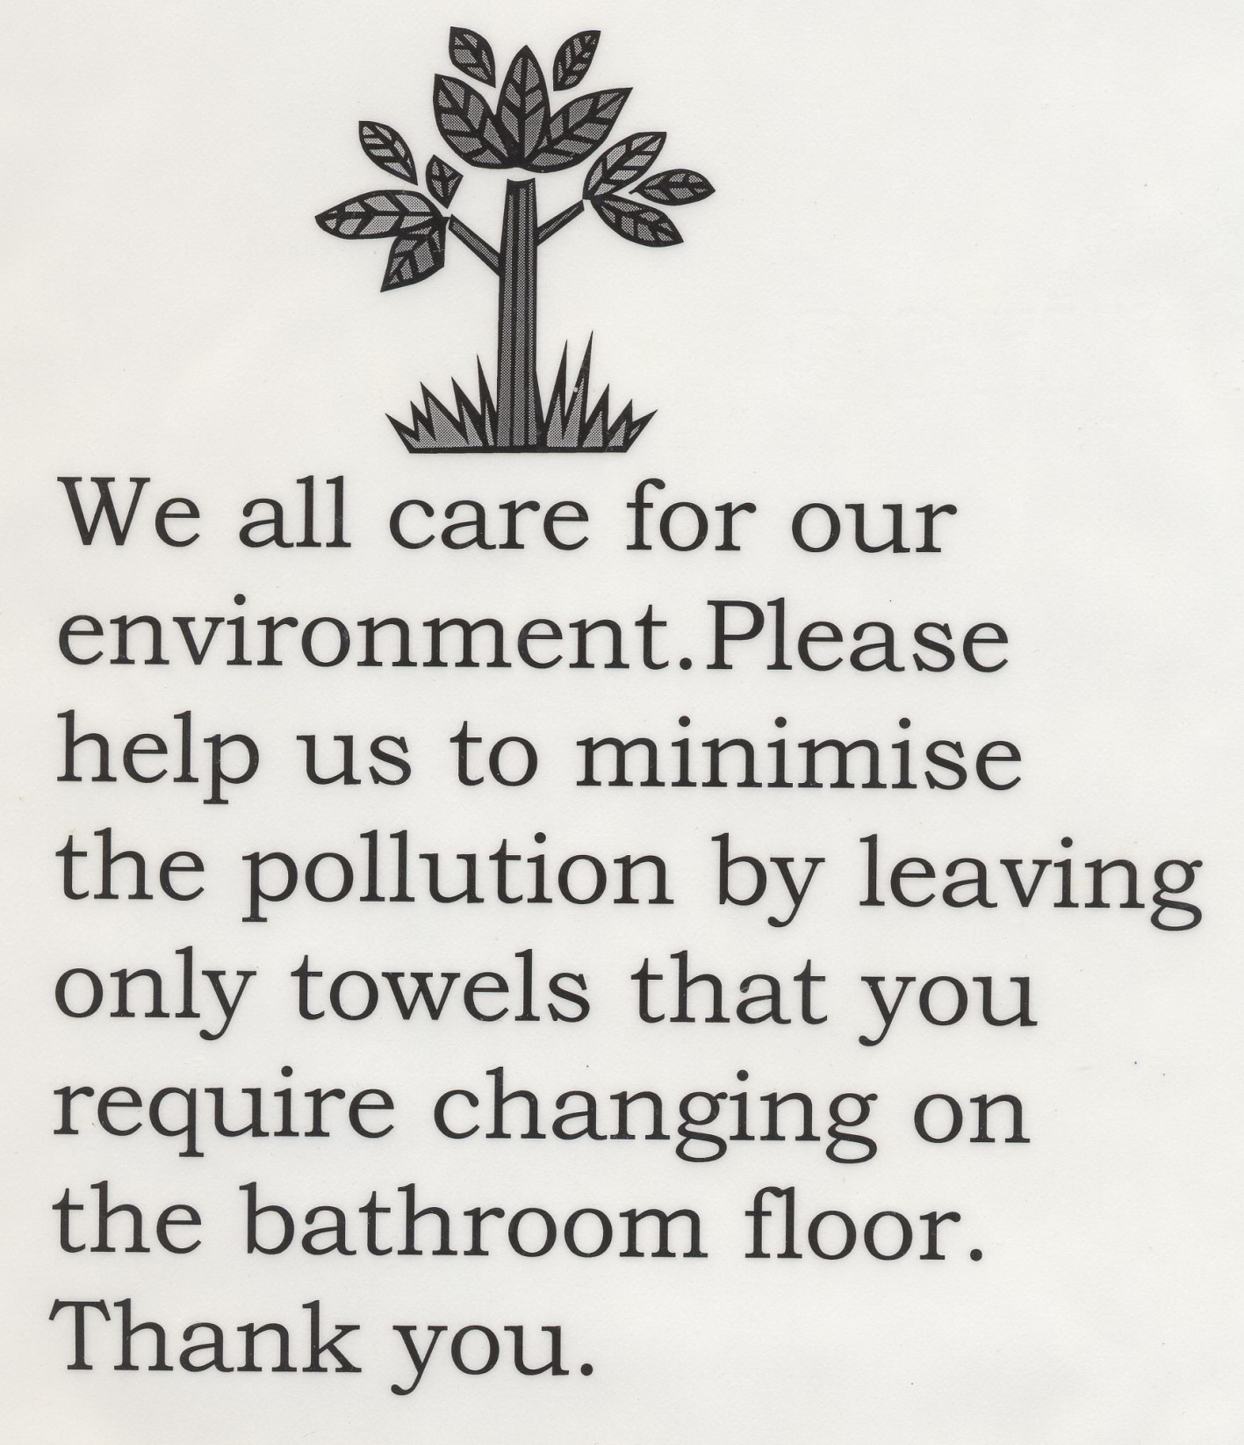
Everyday texts
1

Slide 16
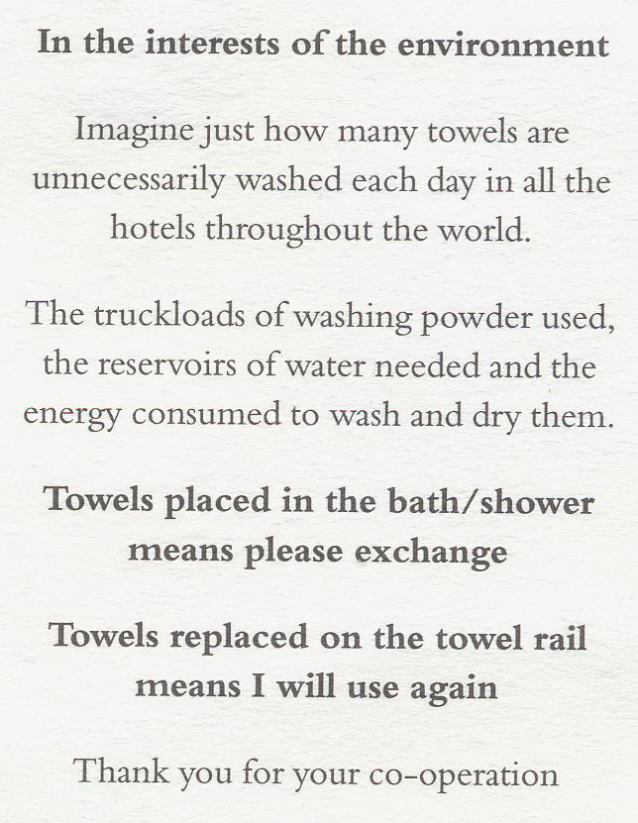
Everyday texts
2

Slide 17
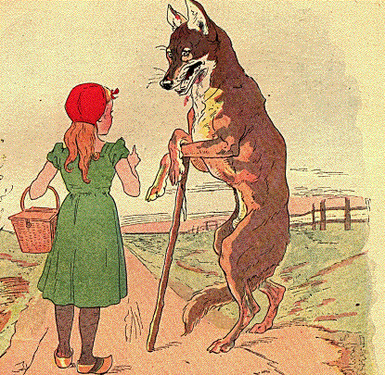
Stories

Slide 18
Stories
"Grandmother dear, what big ears you have!"
"The better to hear with, my child!"
"Grandmother dear, what big eyes you have!"
"The better to see with, my child!"
"Grandmother dear, what big teeth you have!"
"The better to eat you with!"
With these words the wicked Wolf leapt upon Little Red Riding Hood and gobbled her up.

Slide 19
Stories

Slide 20
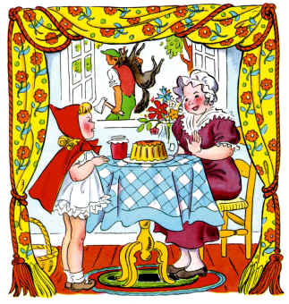
Stories
 | "Oh Grandma, I was so scared!" sobbed Little Red Riding Hood, "I'll never speak to strangers or dawdle in the forest again." "There, there, child. You've learned an important lesson. Thank goodness you shouted loud enough for this kind woodsman to hear you!" The woodsman knocked out the wolf and carried him deep into the forest where he wouldn't bother people any longer. Little Red Riding Hood and her Grandmother had a nice lunch and a long chat.

Slide 21
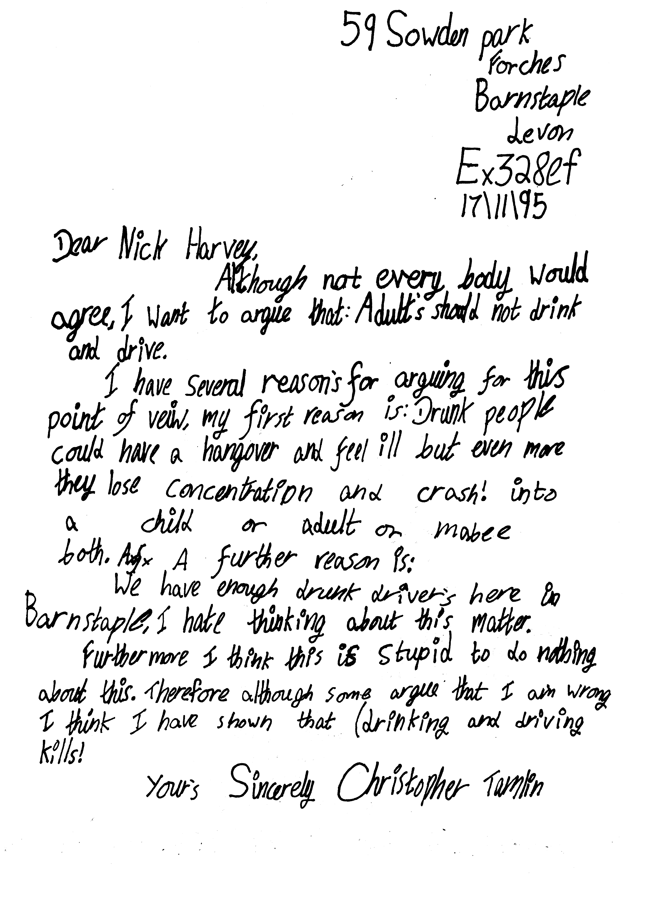
Texts for social action

Slide 22
Texts for social action
Harefield Middle School. Yeovil Chase, Harefield, Southampton. SO2 5NZ Dear Sir or Madam, You are very deceitful, just trying to do a good report, eh? Well I totally disagree with what that Lucy Wray has reported. How COULD she say that the dinner ladies glare down at you and make you eat all your dinner up? If you don't want it, you don't have to eat it. We have the best dinner ladies any school could ever wish for. Mrs Self and her dinner ladies cook the dinners as best they can. And Lucy said that the peas are mushy. Well of course they're mushy, thats why they're called MUSHY PEAS! As for soggy carrots, well they were tinned and grated carrots. If Lucy didn't like them she shouldn't have taken them. And how DARE she lie and say we had lumpy custard and gravy? We didn't even have any of them! In fact here's the menu: DINNER: Spaghetti Bolognaise, Fish, Burgers, Peas, Carrots, Sweet Corn, Salad, Beetroot, Coleslaw. PUDDING: Cream Bun, Biscuits, Fruit, Yoghurt, Fruit Juice. Healthy or what? Well that sly, dopey Lucy Wray should lose her job as far as Harefield Middle School and I are concerned. We are feeling extremely cross about it and most defiant. Yours Sincerely, Sophie Thomson

