Slide 1

Higher Order Thinking Primary Schools David Wray Professor of Literacy Education University of Warwick

Slide 2
Higher order thinking skills HOTS
Why? Why do we need to develop HOTS?
What? What are HOTS?
How? How can we develop HOTS?

Slide 3
Why HOTS?
The griney grollers grangled in the granchy gak.
1) What kind of grollers were they?
2) What did the grollers do?
3) Where did they do it?
4) In what kind of gak did they grangle?

Slide 4
Why HOTS?
Being asked low level questions requires only low level thinking.
The two thirds rule of classroom questions:
2/3 of classroom talk is by teachers
2/3 of teachers’ talk involves questions
2/3 of teachers’ questions are low level

Slide 5
Why HOTS?
Low level questions require only the recall of information.
Teachers already know this information.
Therefore their questions are ‘display’ questions – to check whether children know.
They do not stretch children’s thinking.

Slide 6
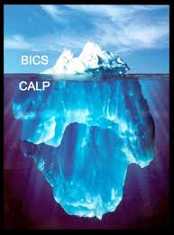
Why is this especially important in an ESL context?

Slide 7
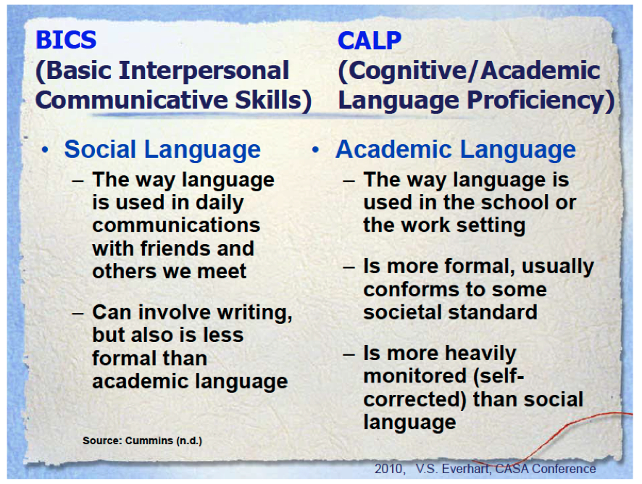
Why is this especially important in an ESL context?

Slide 8
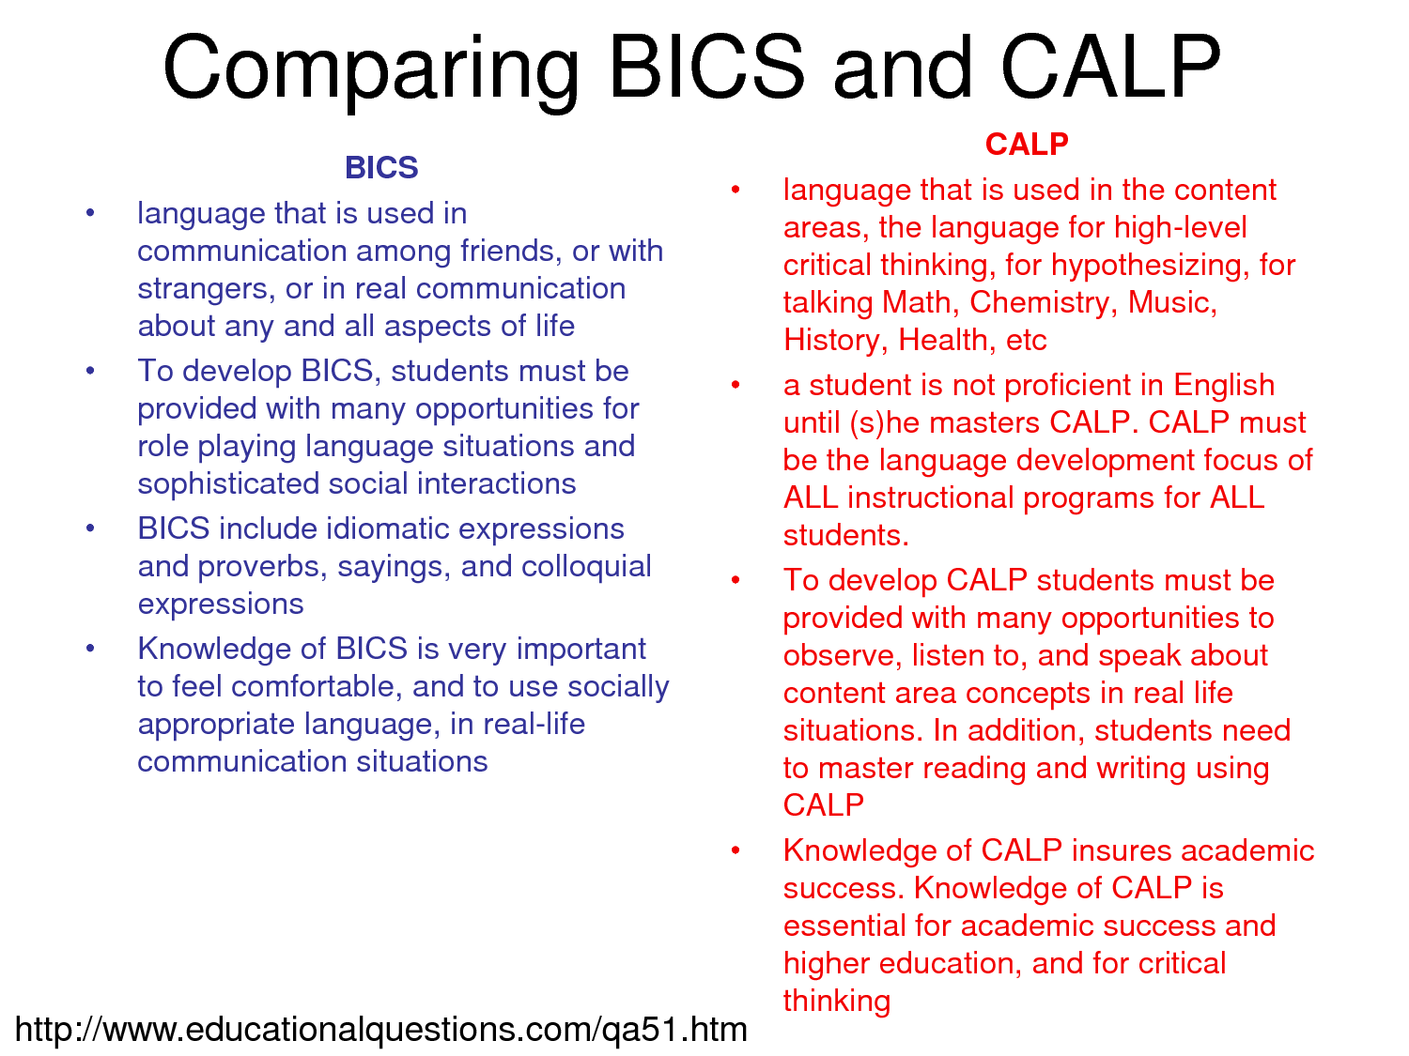

Slide 9
What are HOTS? Bloom’s Taxonomy
Old Version | Revised Version
Evaluate | Creating
Synthesis | Evaluating
Analysis | Analysing
Application | Applying
Comprehension | Understanding
Knowledge | Remembering

Slide 10
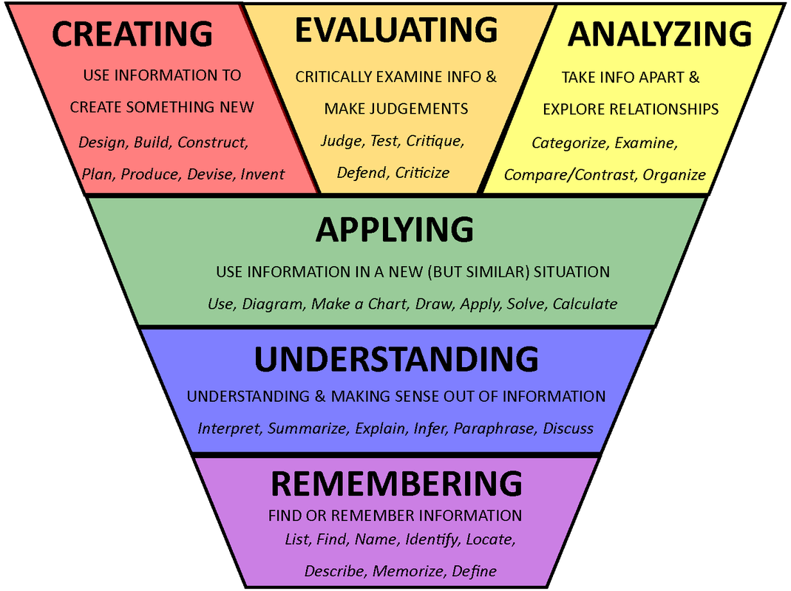

Slide 11
Creating | construct, create, design,
Evaluating | defend, judge, value
Analyzing | compare, contrast, criticize
Applying | interpret, illustrate, solve
Understanding | describe, discuss, explain
Remembering | define, duplicate, list

Slide 12
Key points about HOTS
Students need to be stretched by the questions they are asked and the activities they engage in.
Students need time to think more deeply.
Reading and writing are crucial activities to develop CALP.

