Slide 1

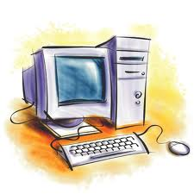
Higher order reading skills
Reading for learning

Slide 2
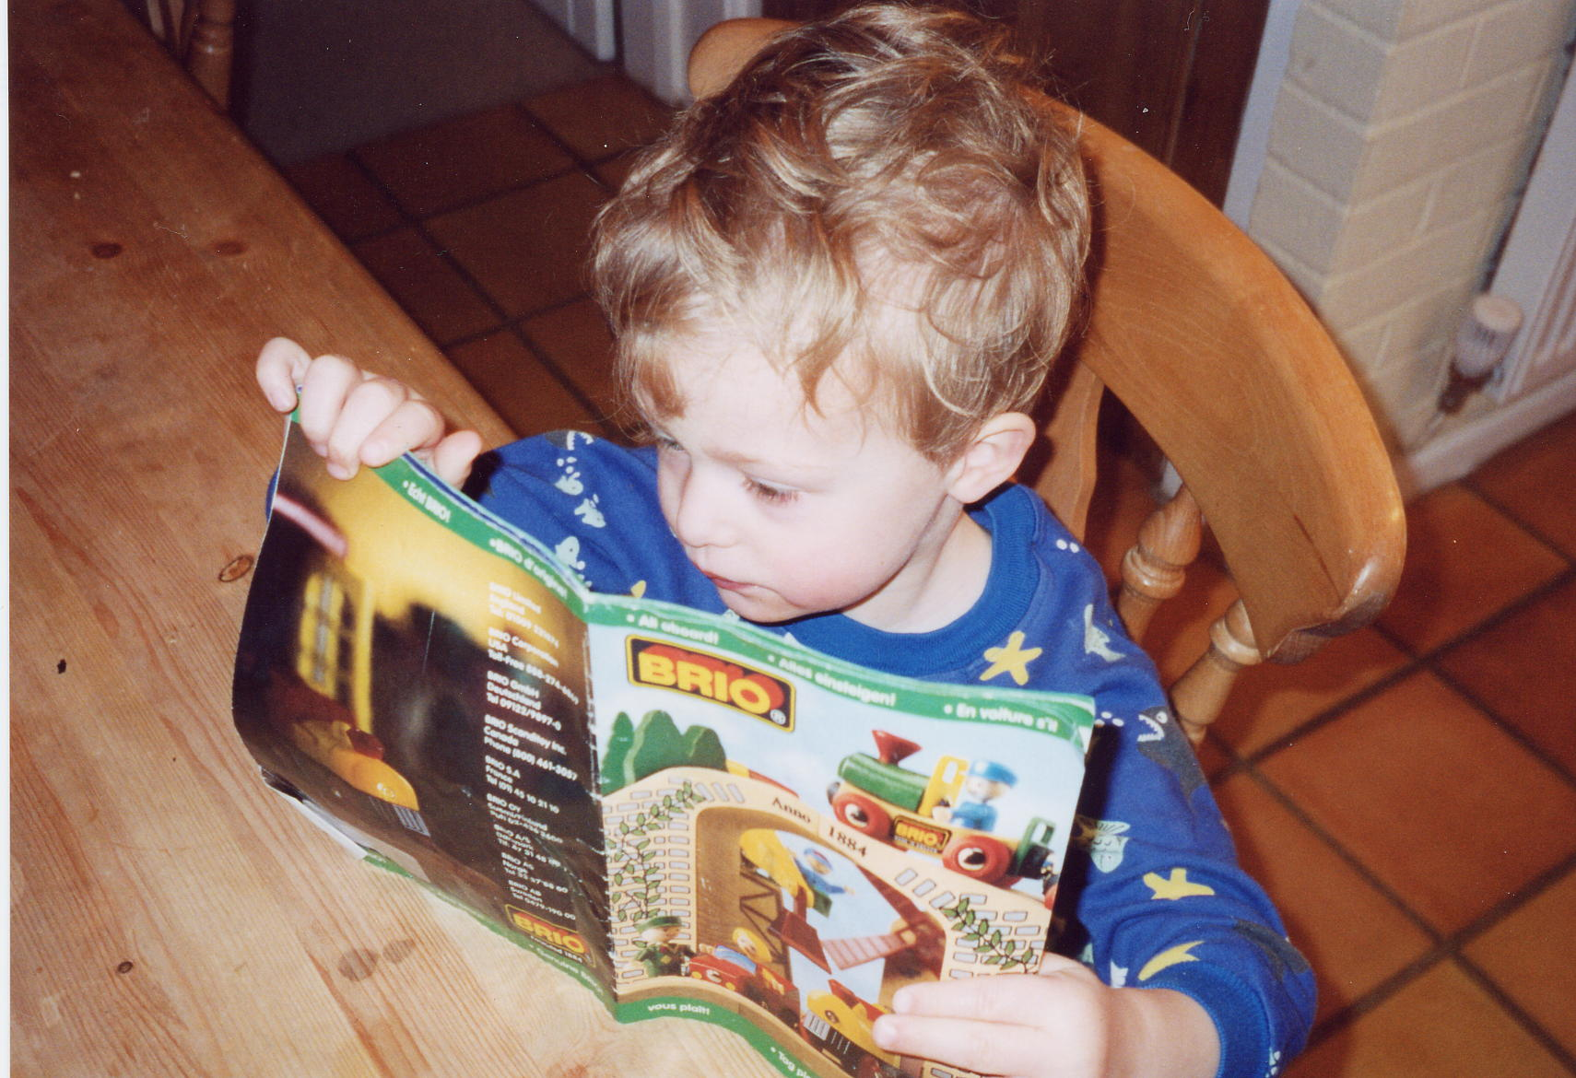
Why is non-fiction so important?

Slide 3
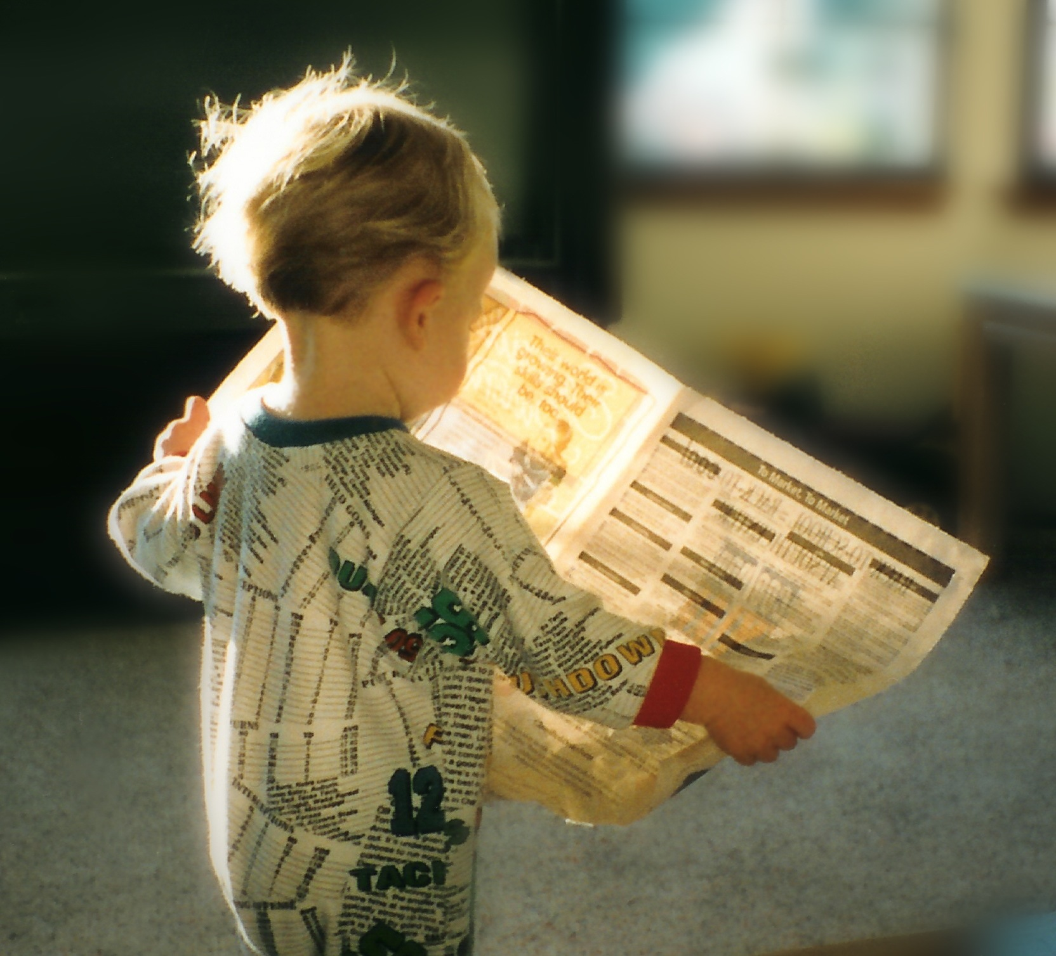
Why is non-fiction so important?

Slide 4
Why is non-fiction so important?
Because non-fiction accounts for about three quarters of adult reading,
And 90% of their writing.
Non-fiction texts require different literacy skills,
And they need to be taught.
What can go wrong?

Slide 5
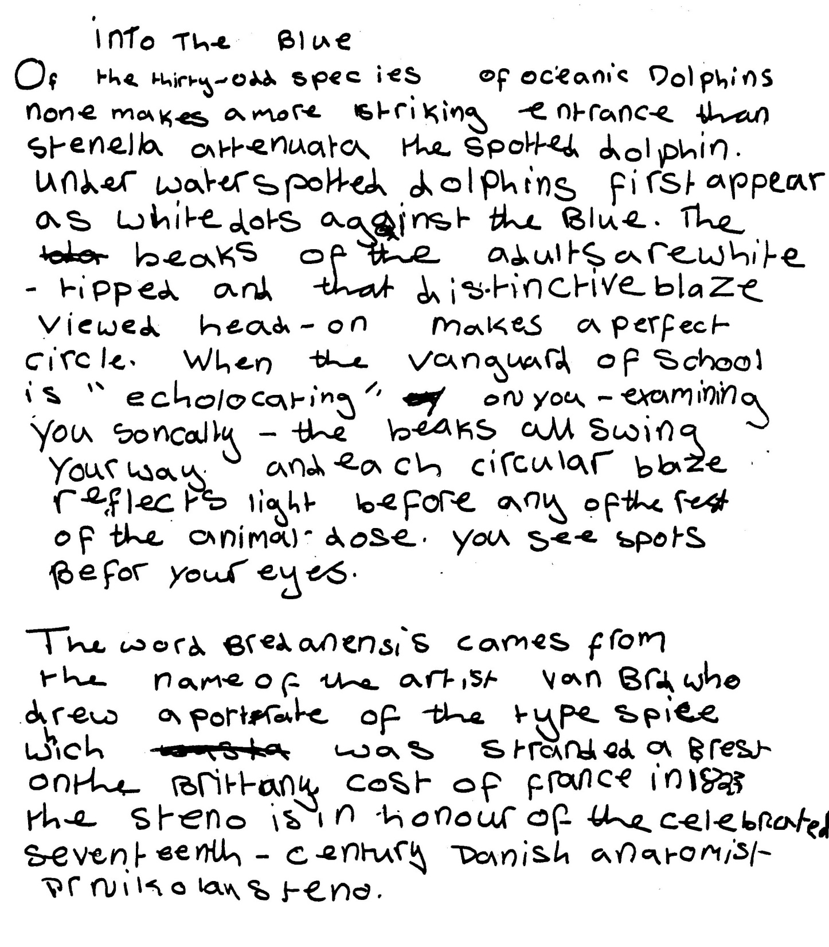

Slide 6
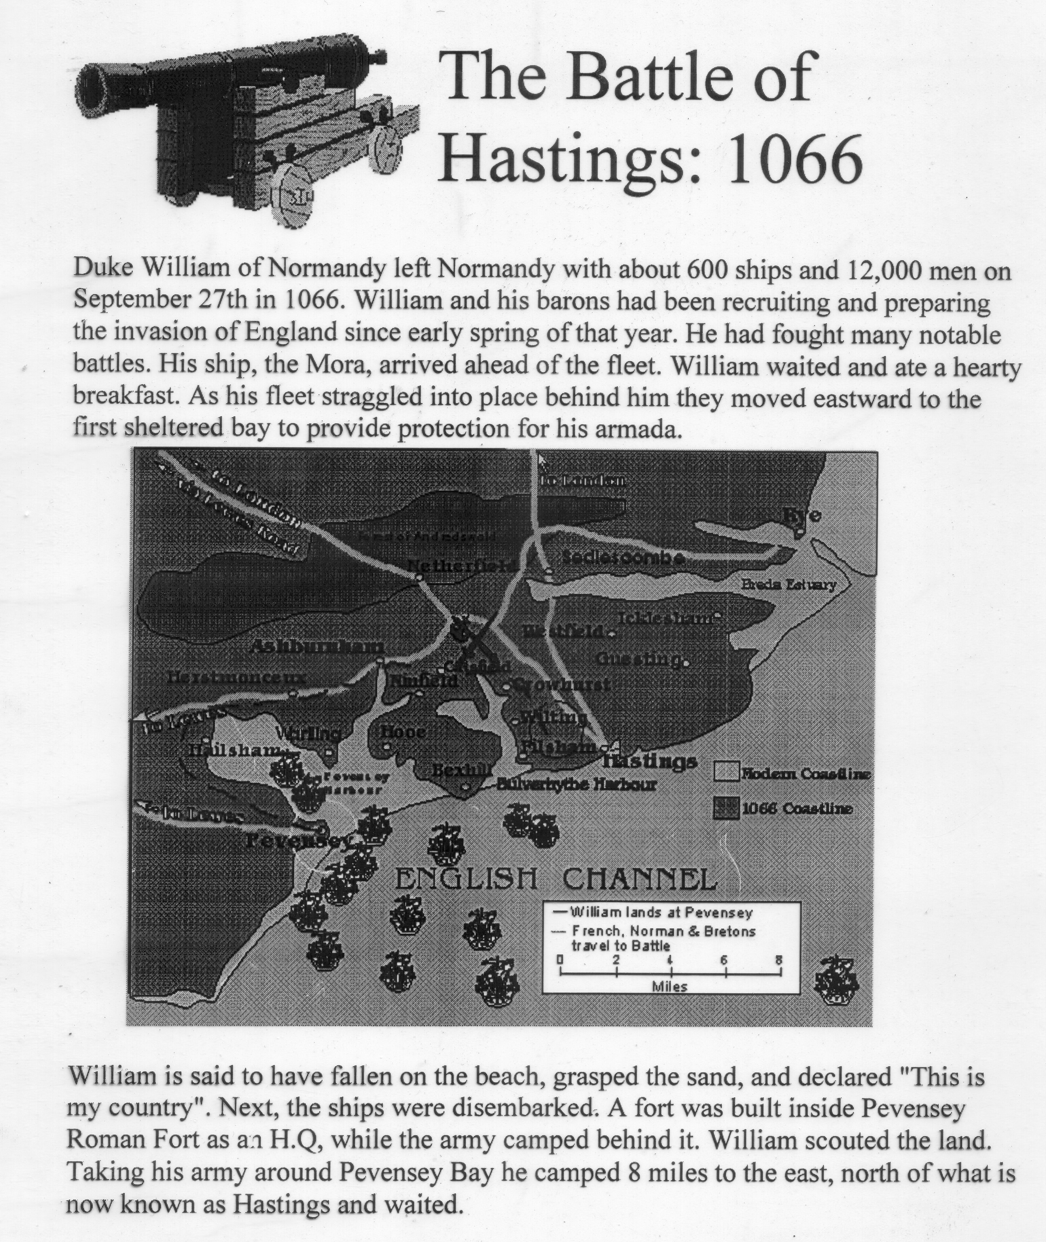

Slide 7
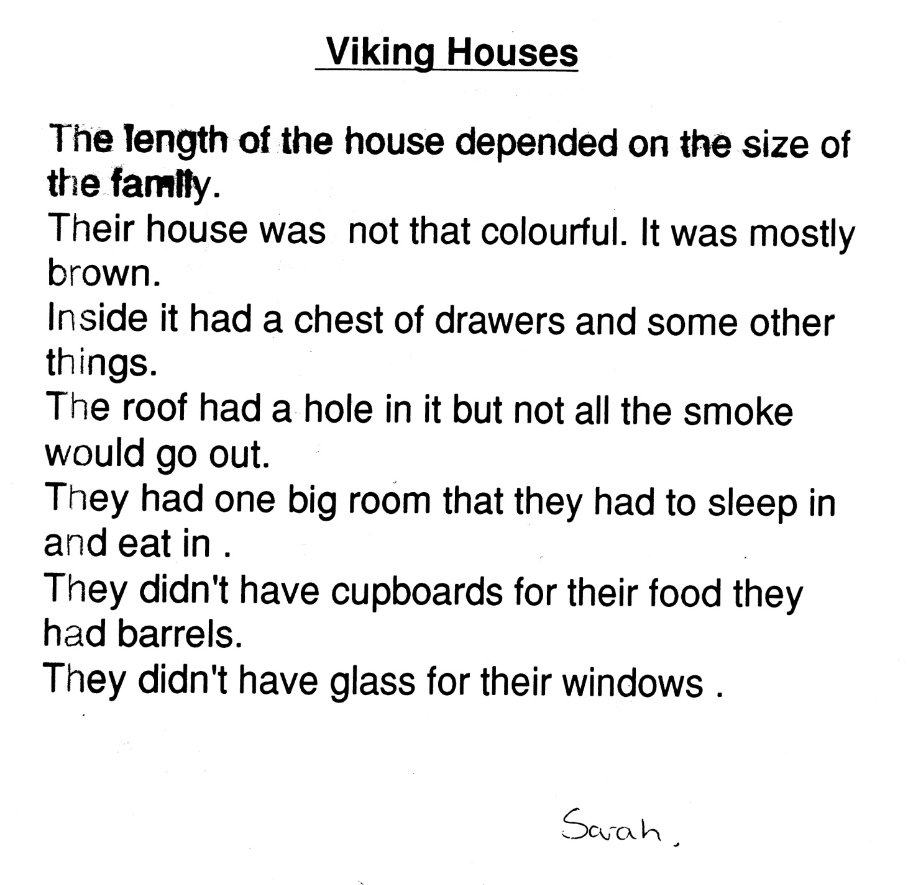
How do we stop learners copying?

Slide 8
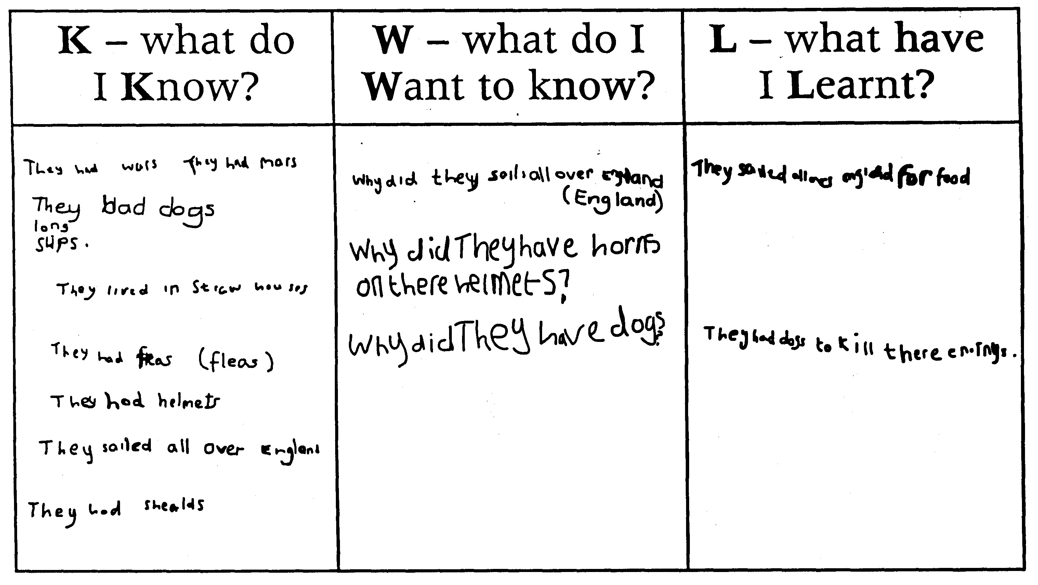

Slide 9
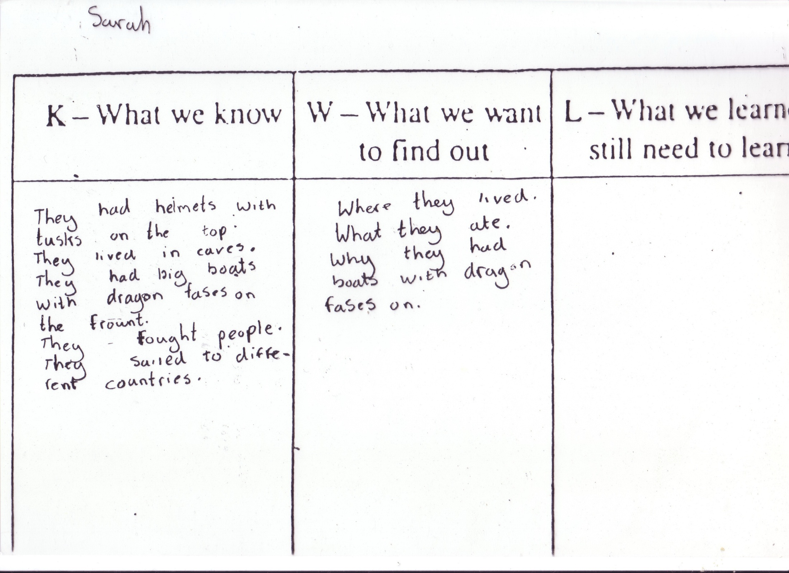

Slide 10
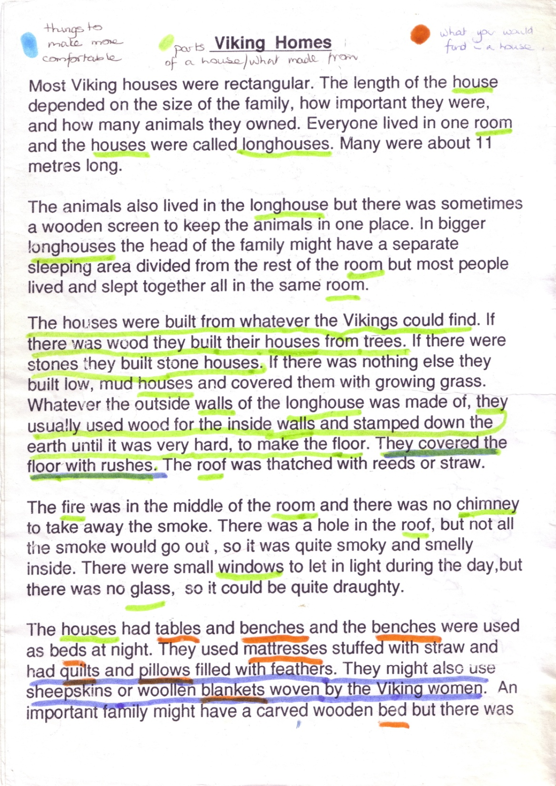

Slide 11
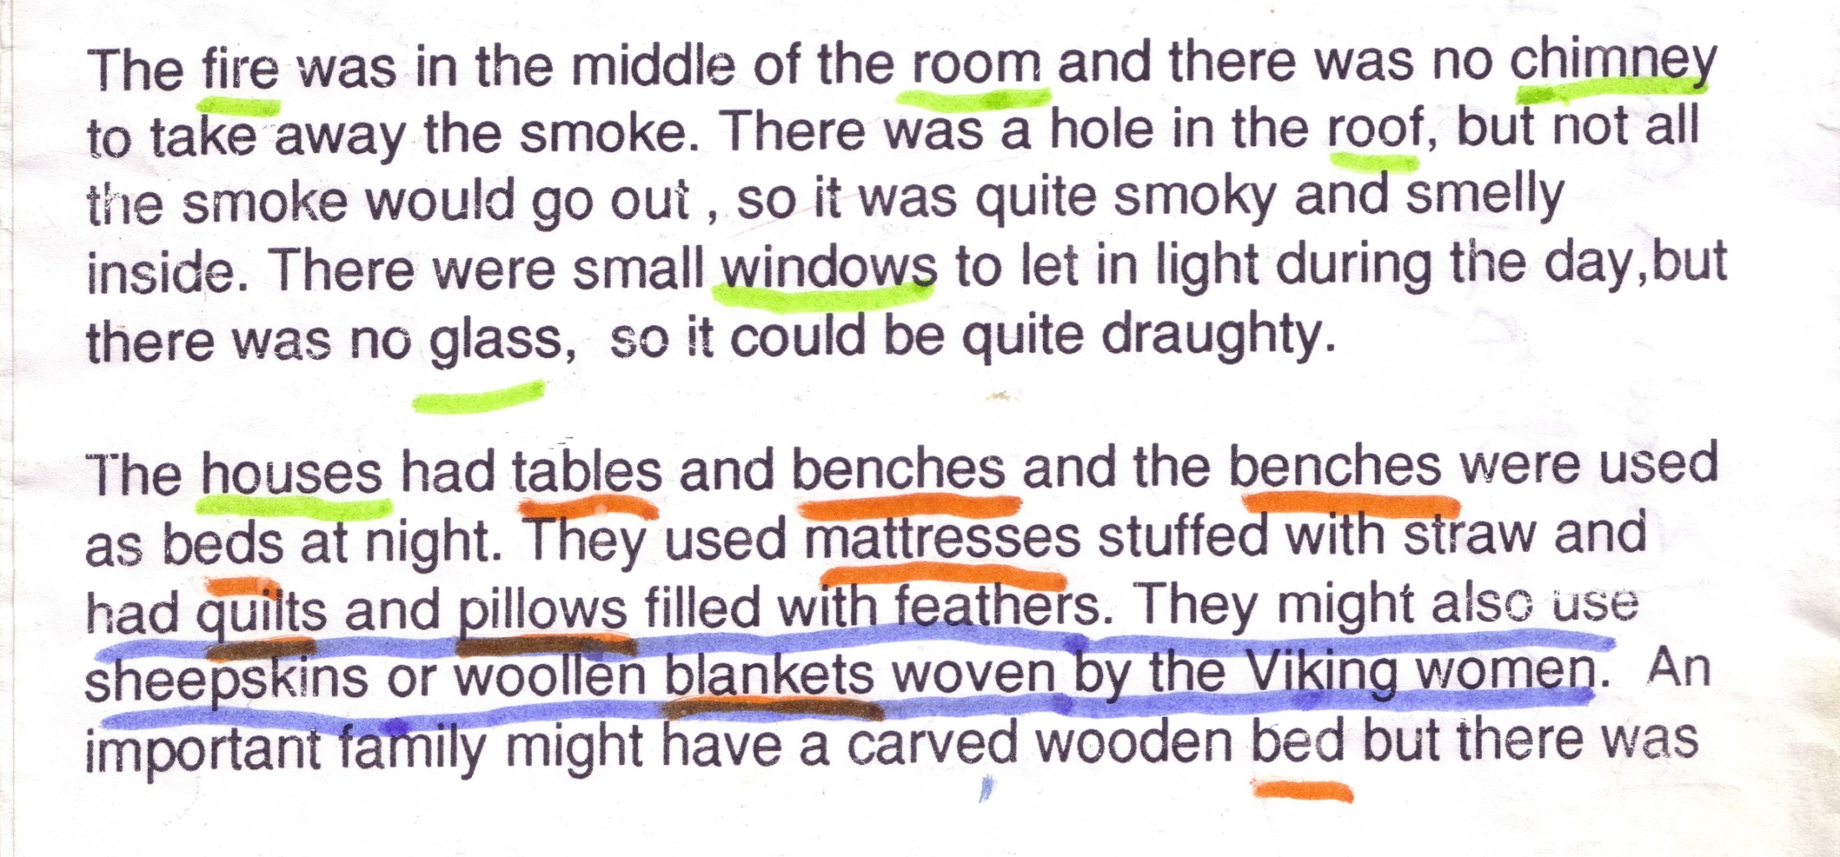

Slide 12
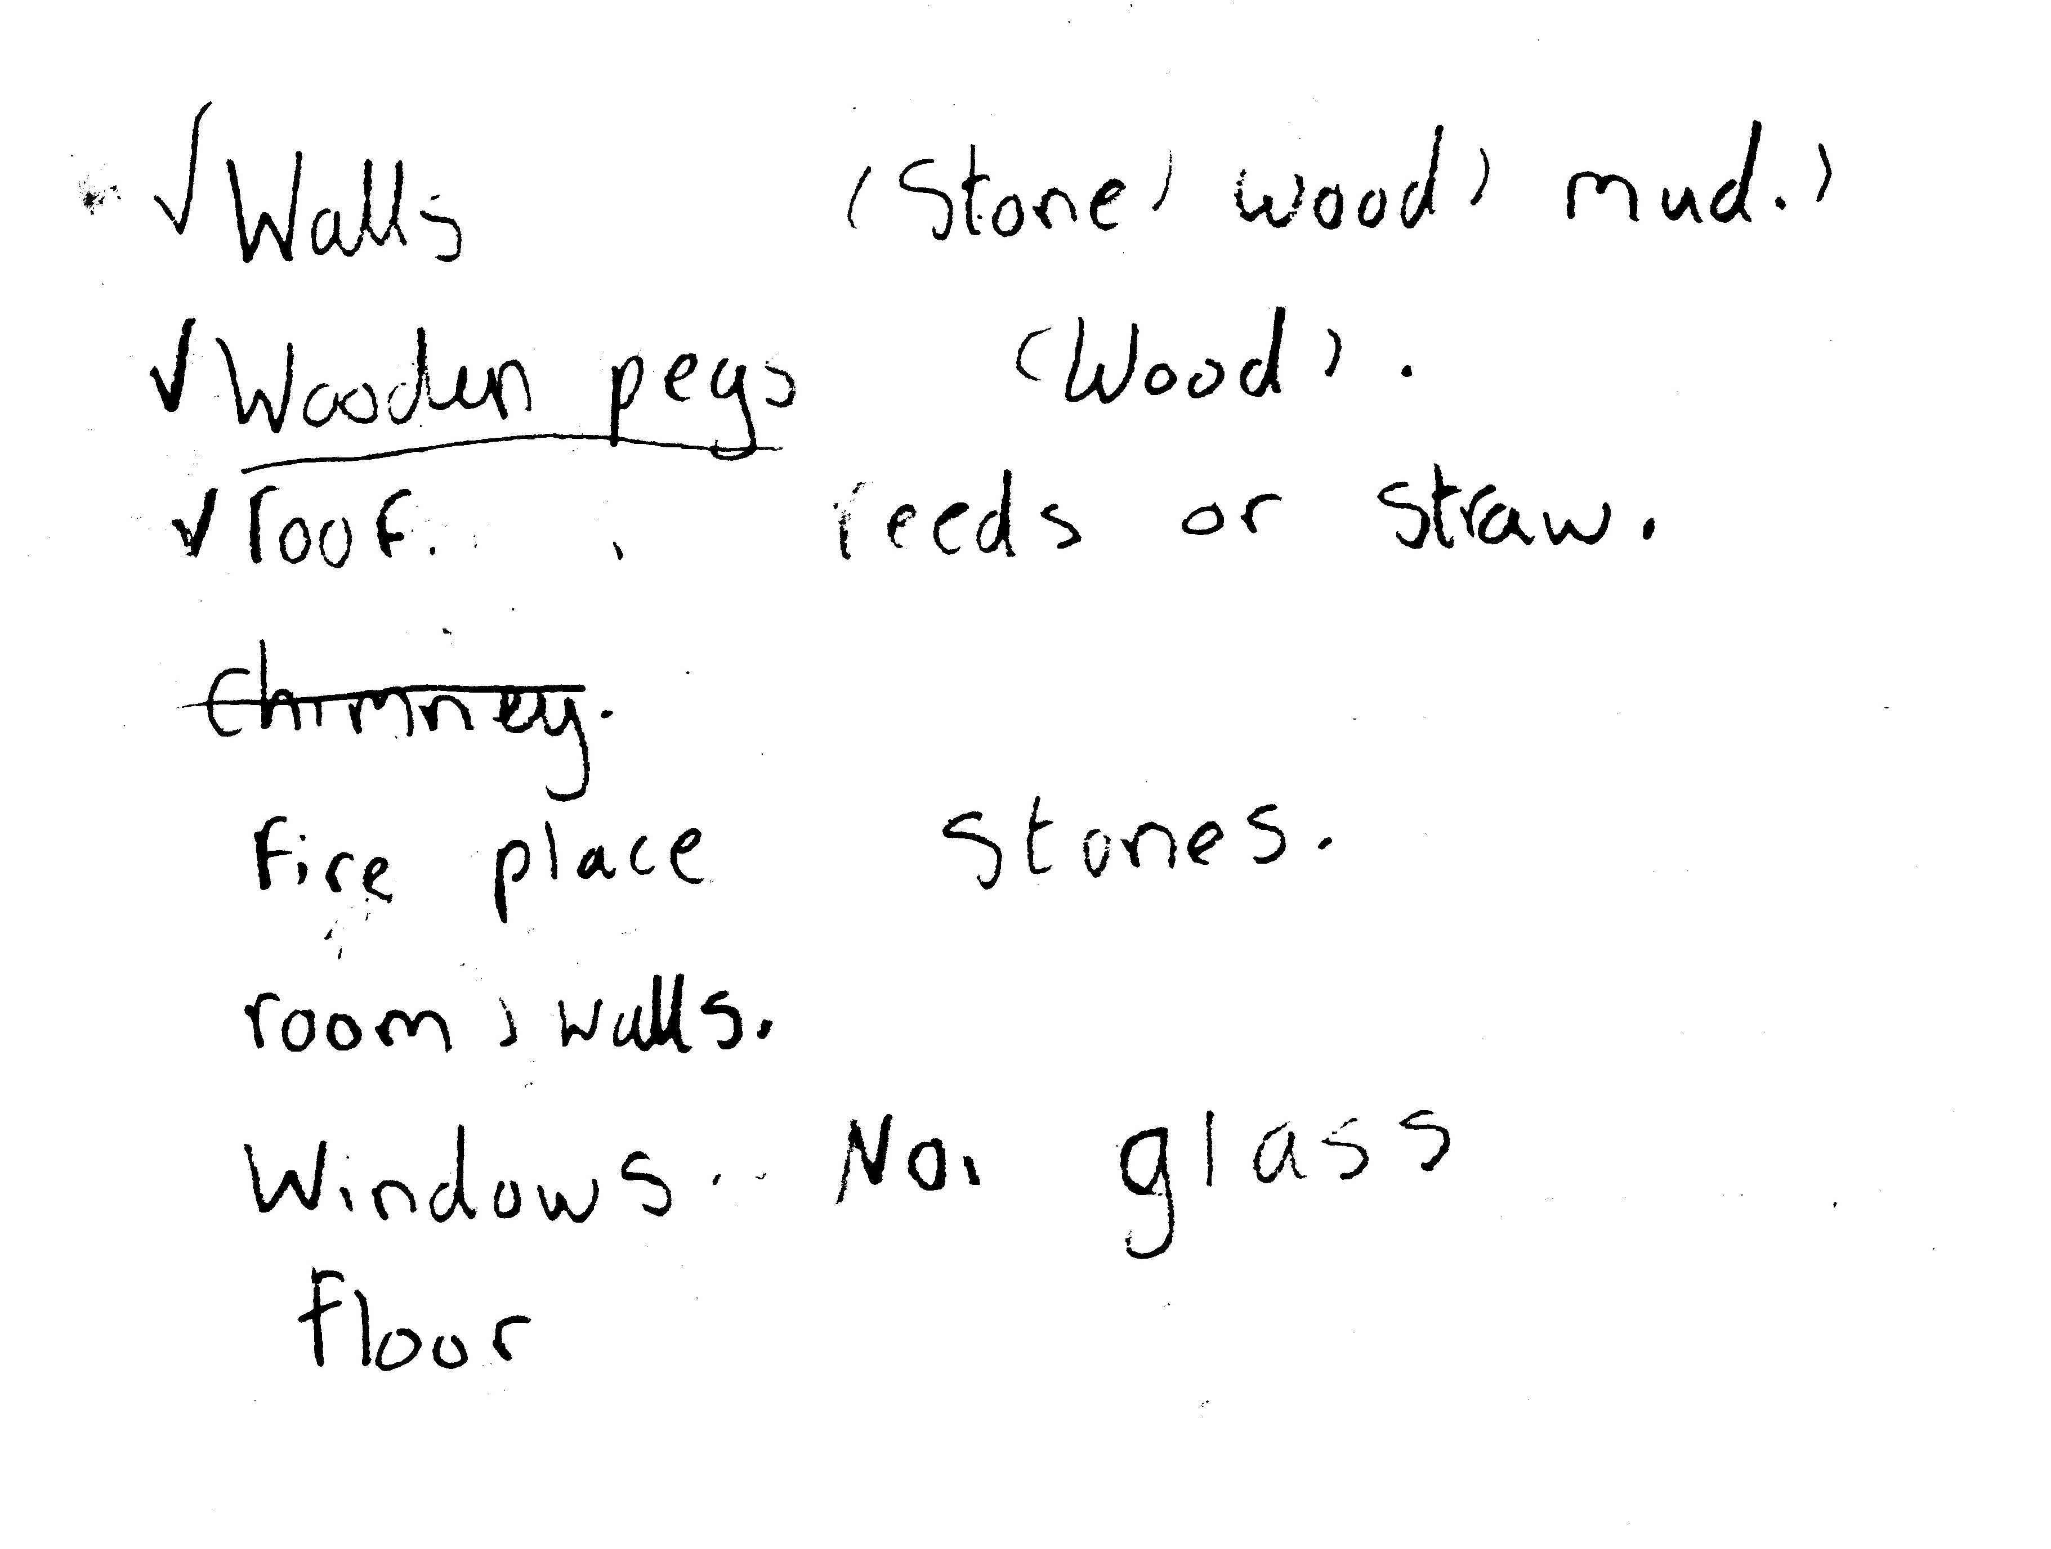

Slide 13
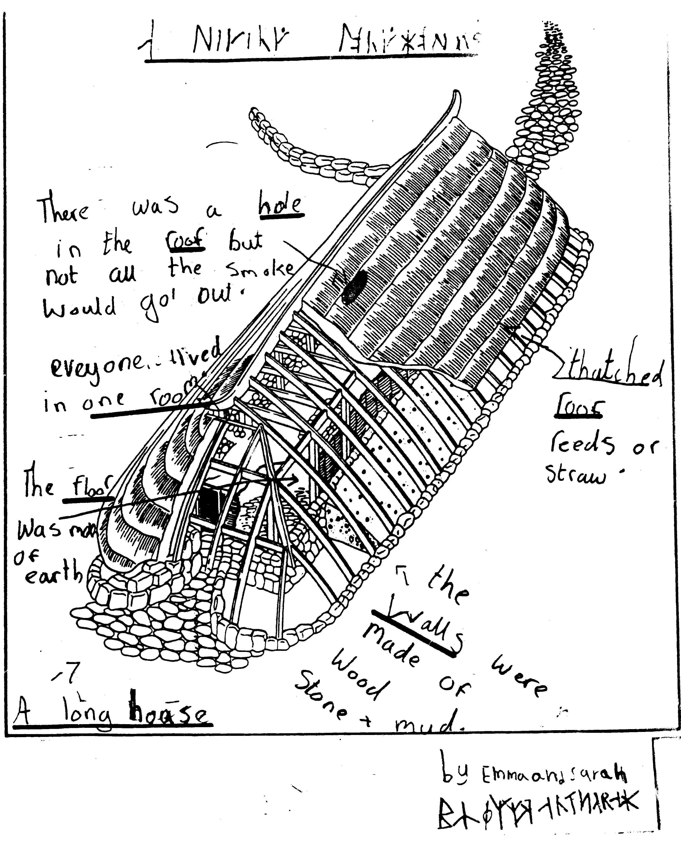

Slide 14
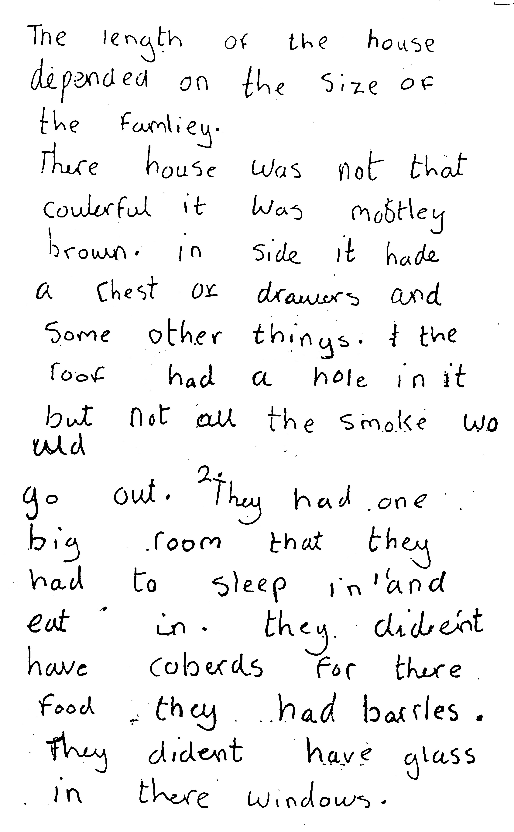

Slide 15
Three main processes in learning from reading
Establish prior knowledge
What do I know already?
Develop questions
What do I want to know?
Restructure information found
What shall I do when I have found the information?

Slide 16
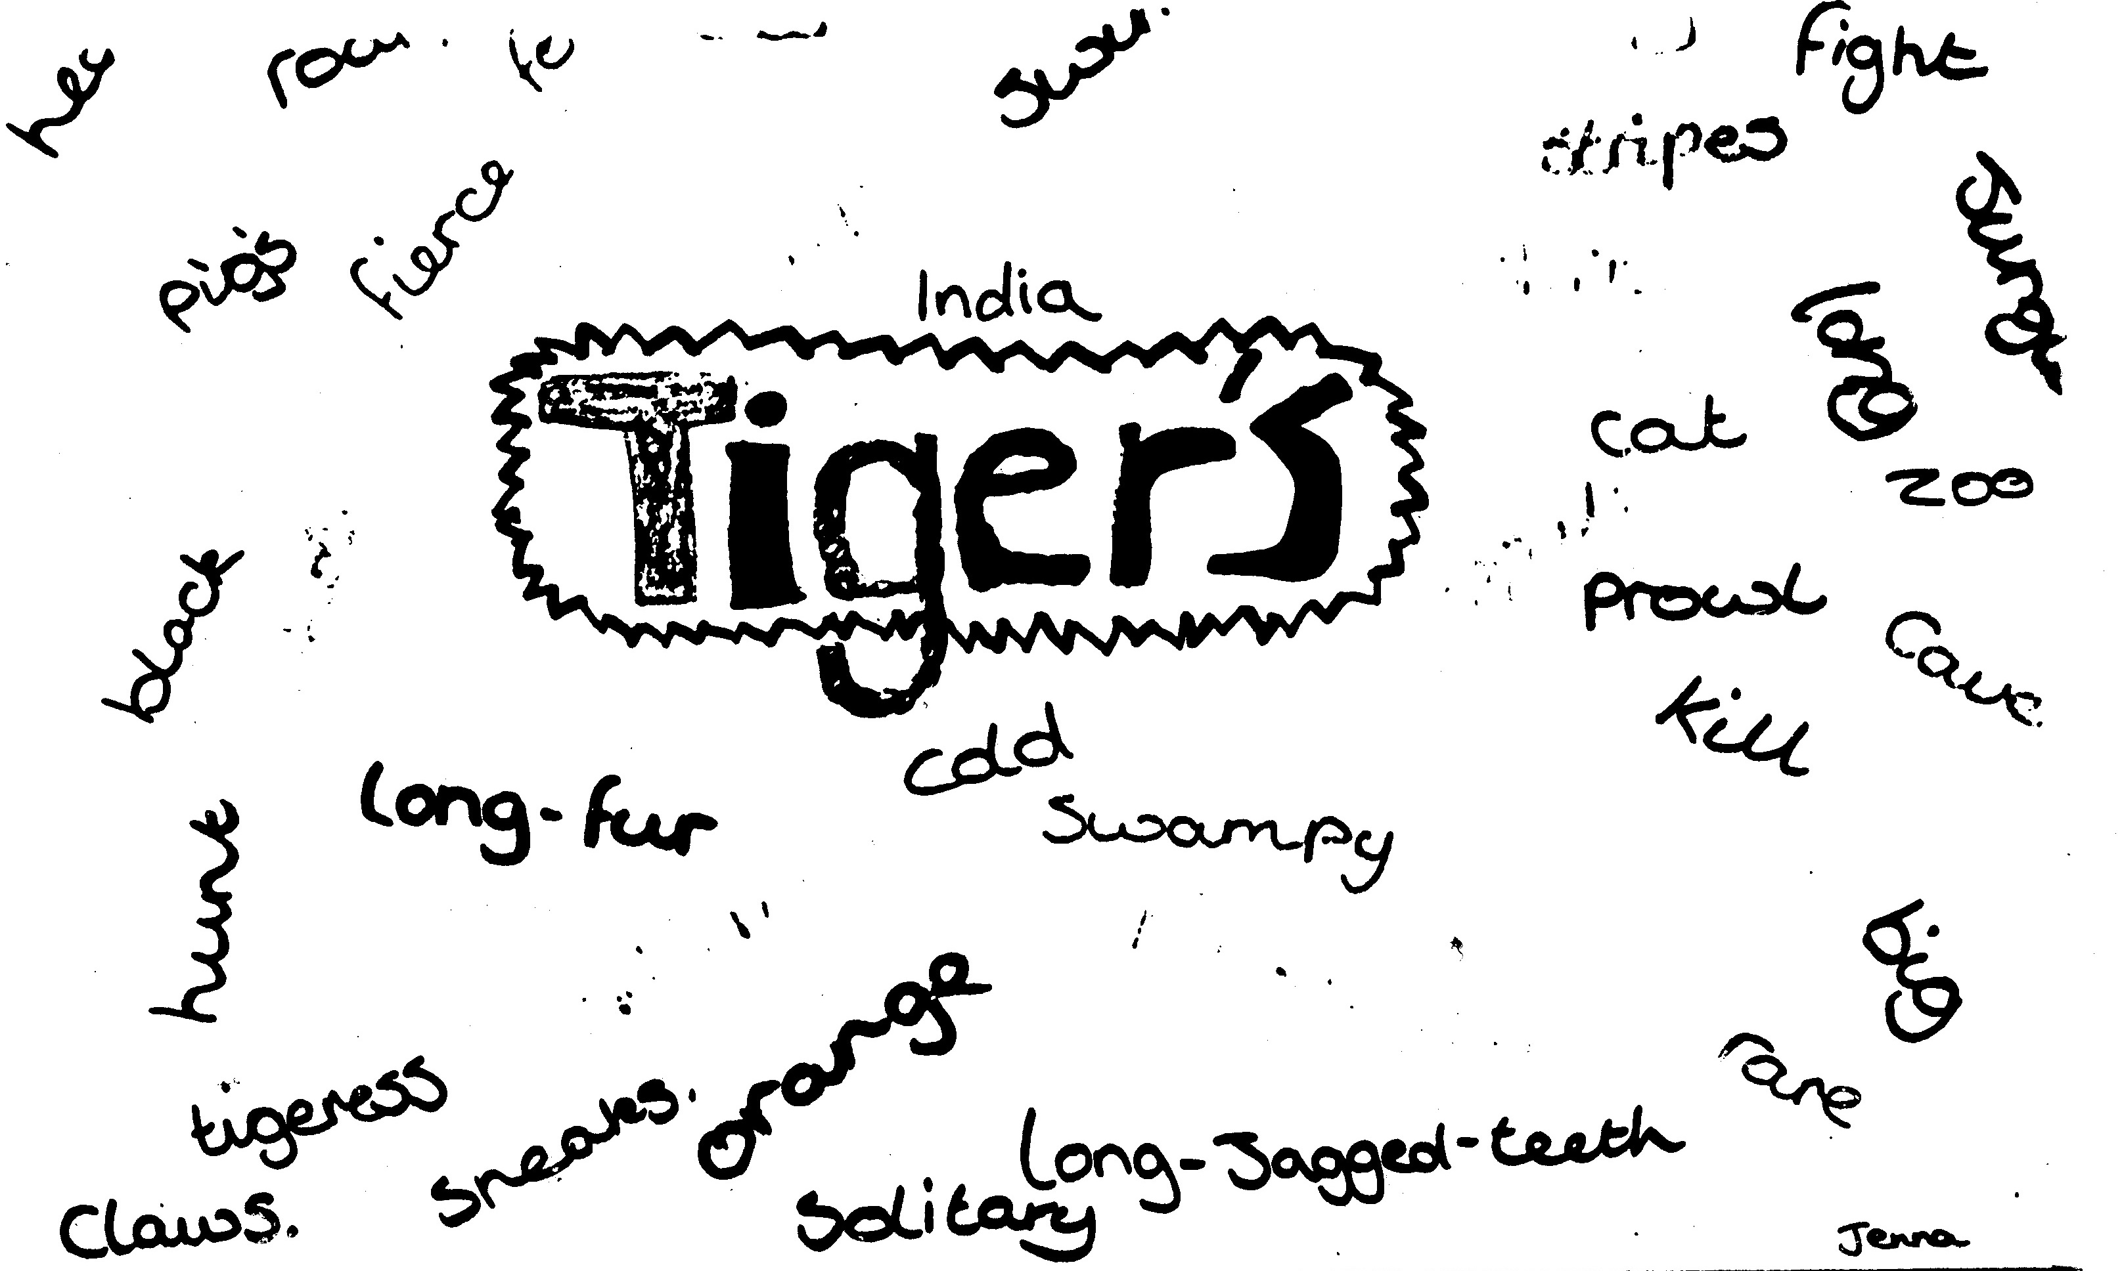
Establishing prior knowledge

Slide 17
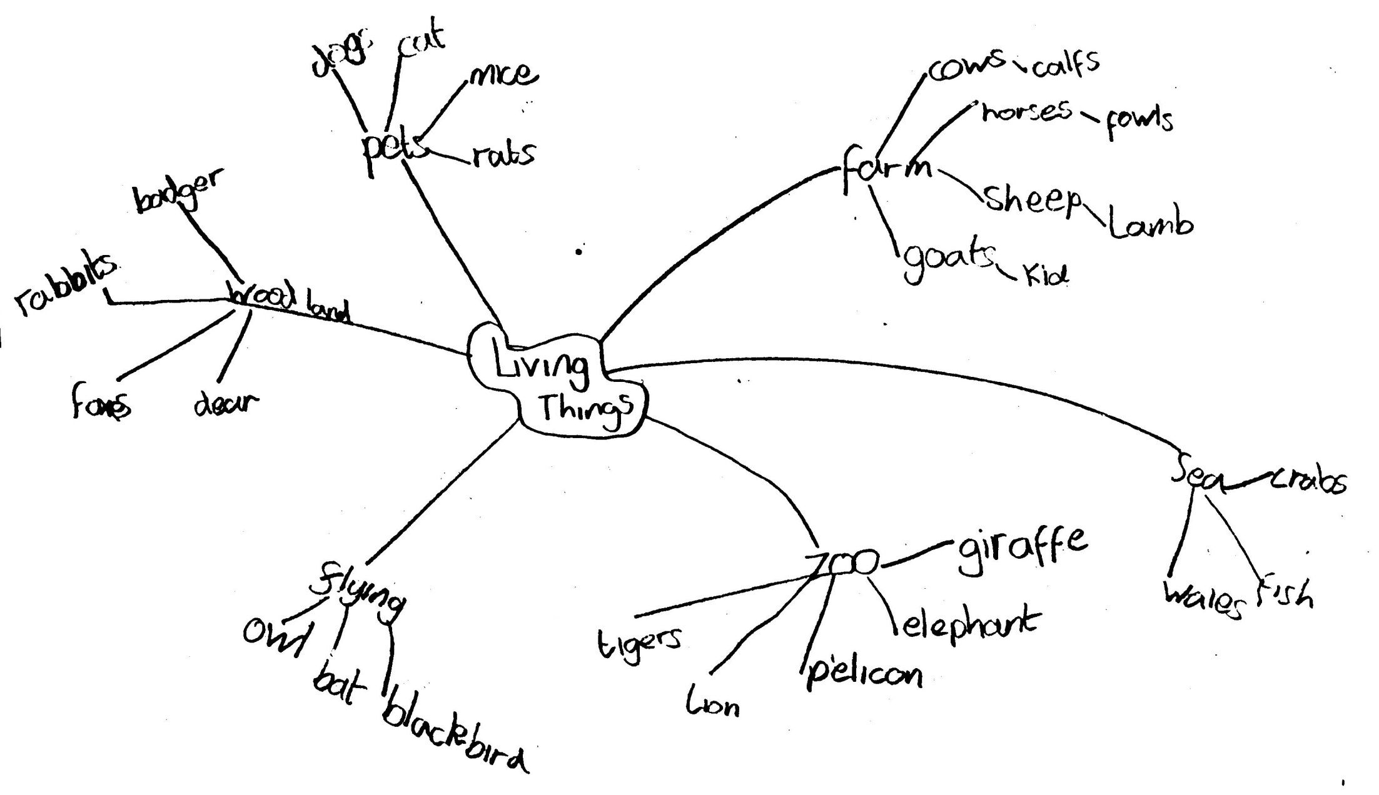

Slide 18
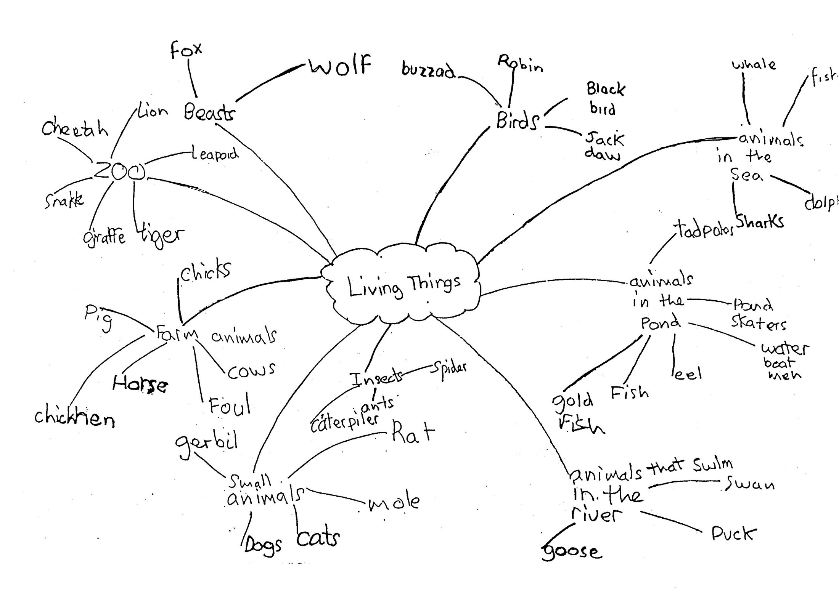

Slide 19
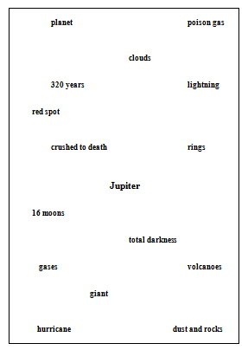

Slide 20
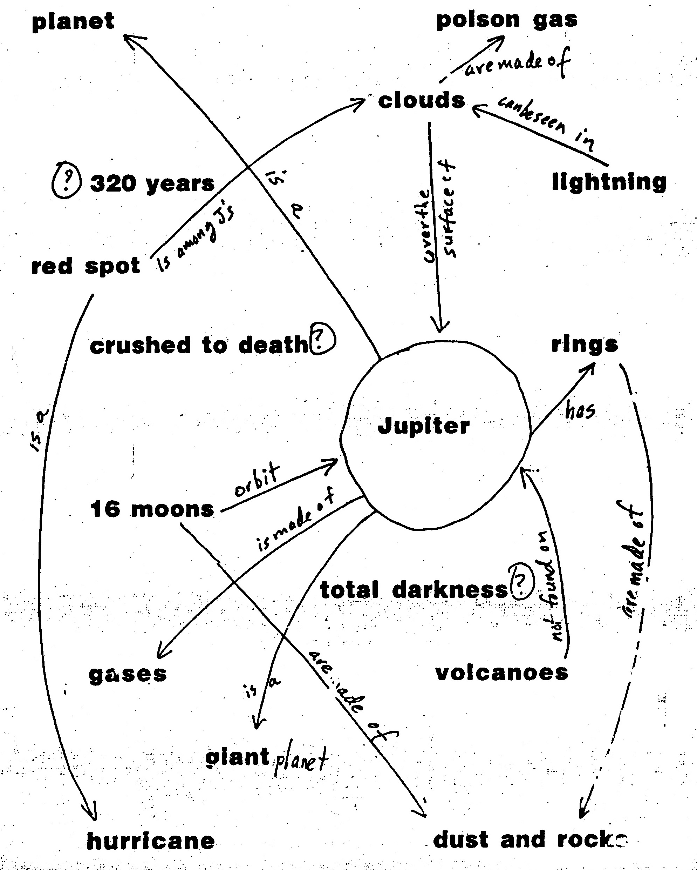

Slide 21
Jupiter
The largest of the giant planets is Jupiter, which is made of the same poison gases as the Sun. Jupiter has at least sixteen moons and two almost invisible rings of dust, unlike Saturn's bright rings made of rocks as well as dust. Jupiter's surface is covered in clouds which are often lit up by lightning, but below these thick clouds there is total darkness. The atmosphere on Jupiter is so dense that we would be crushed to death by its weight. The planet's famous red spot, first observed 320 years ago, is a hurricane storm which has been raging for more than three centuries. Among Jupiter's moons are Ganymede, which appears to have moving continents, and Io, which has at least eight active volcanoes.

Slide 22
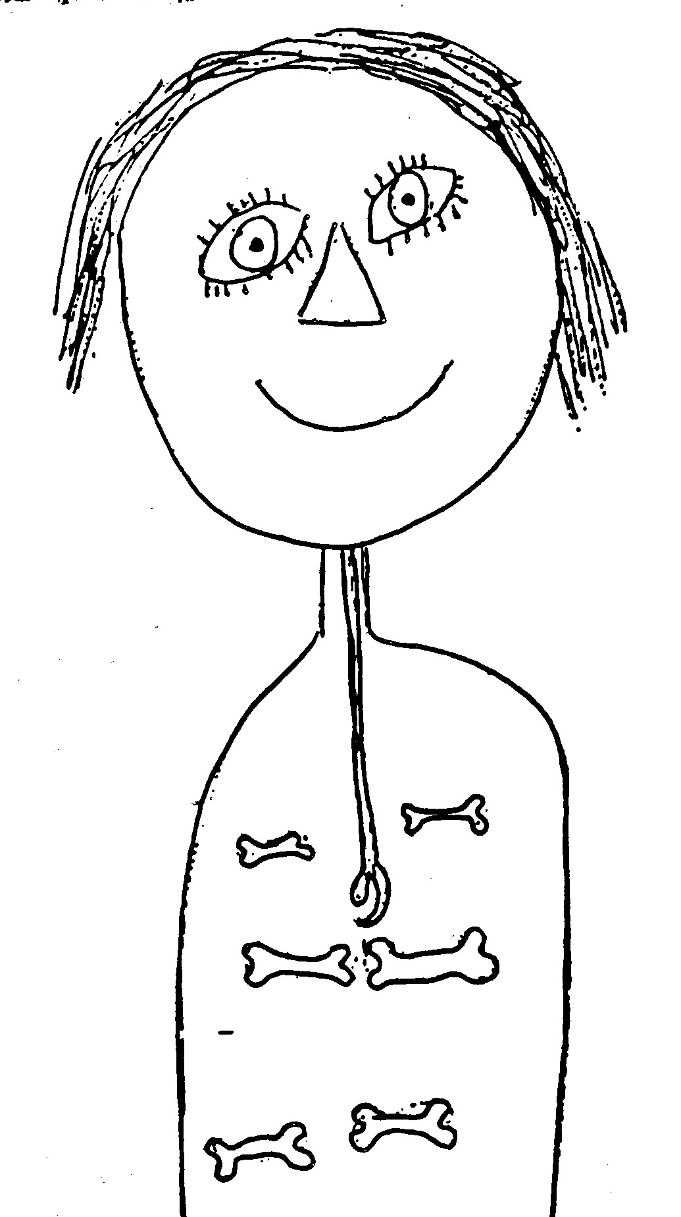

Slide 23
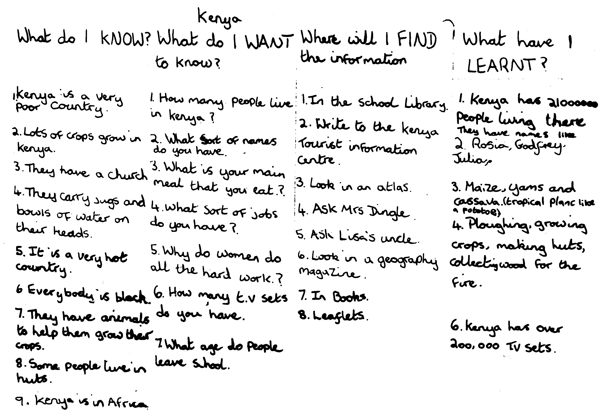
Asking questions

Slide 24
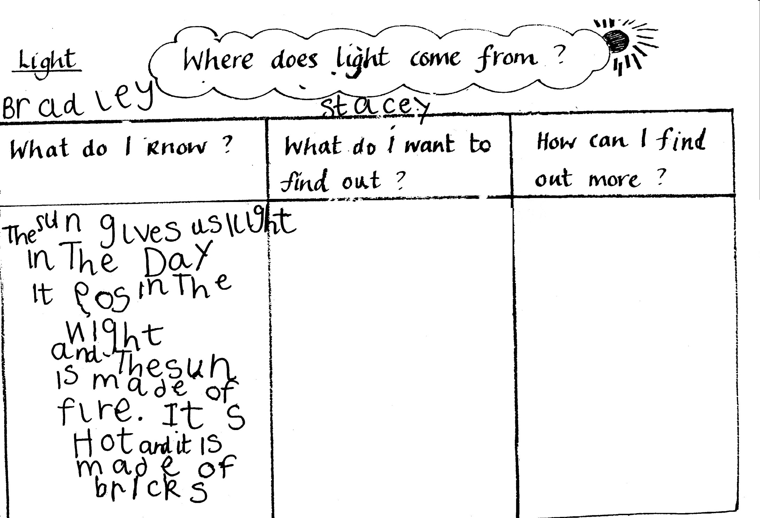

Slide 25
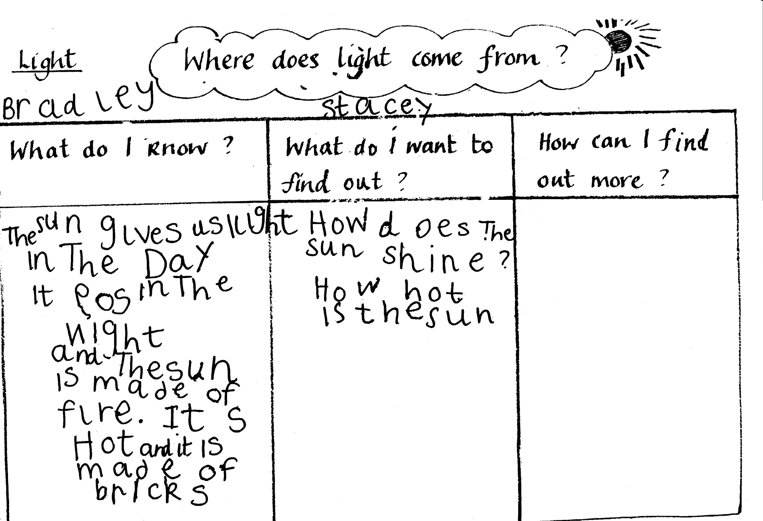

Slide 26
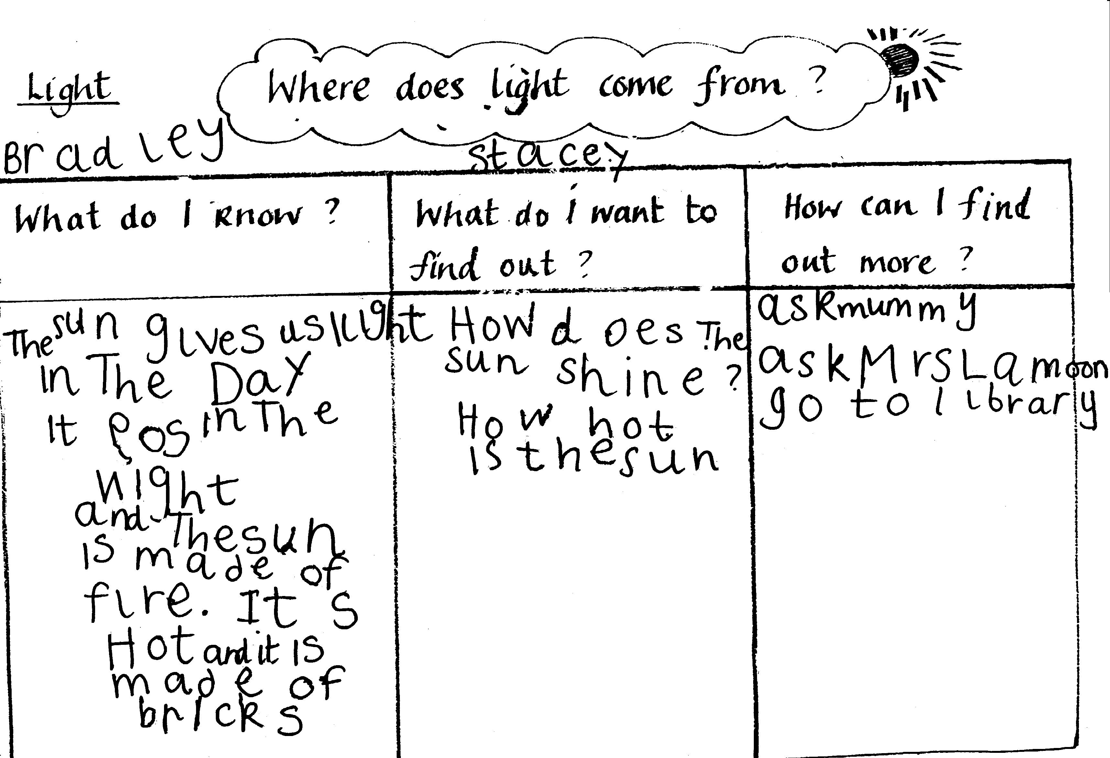

Slide 27
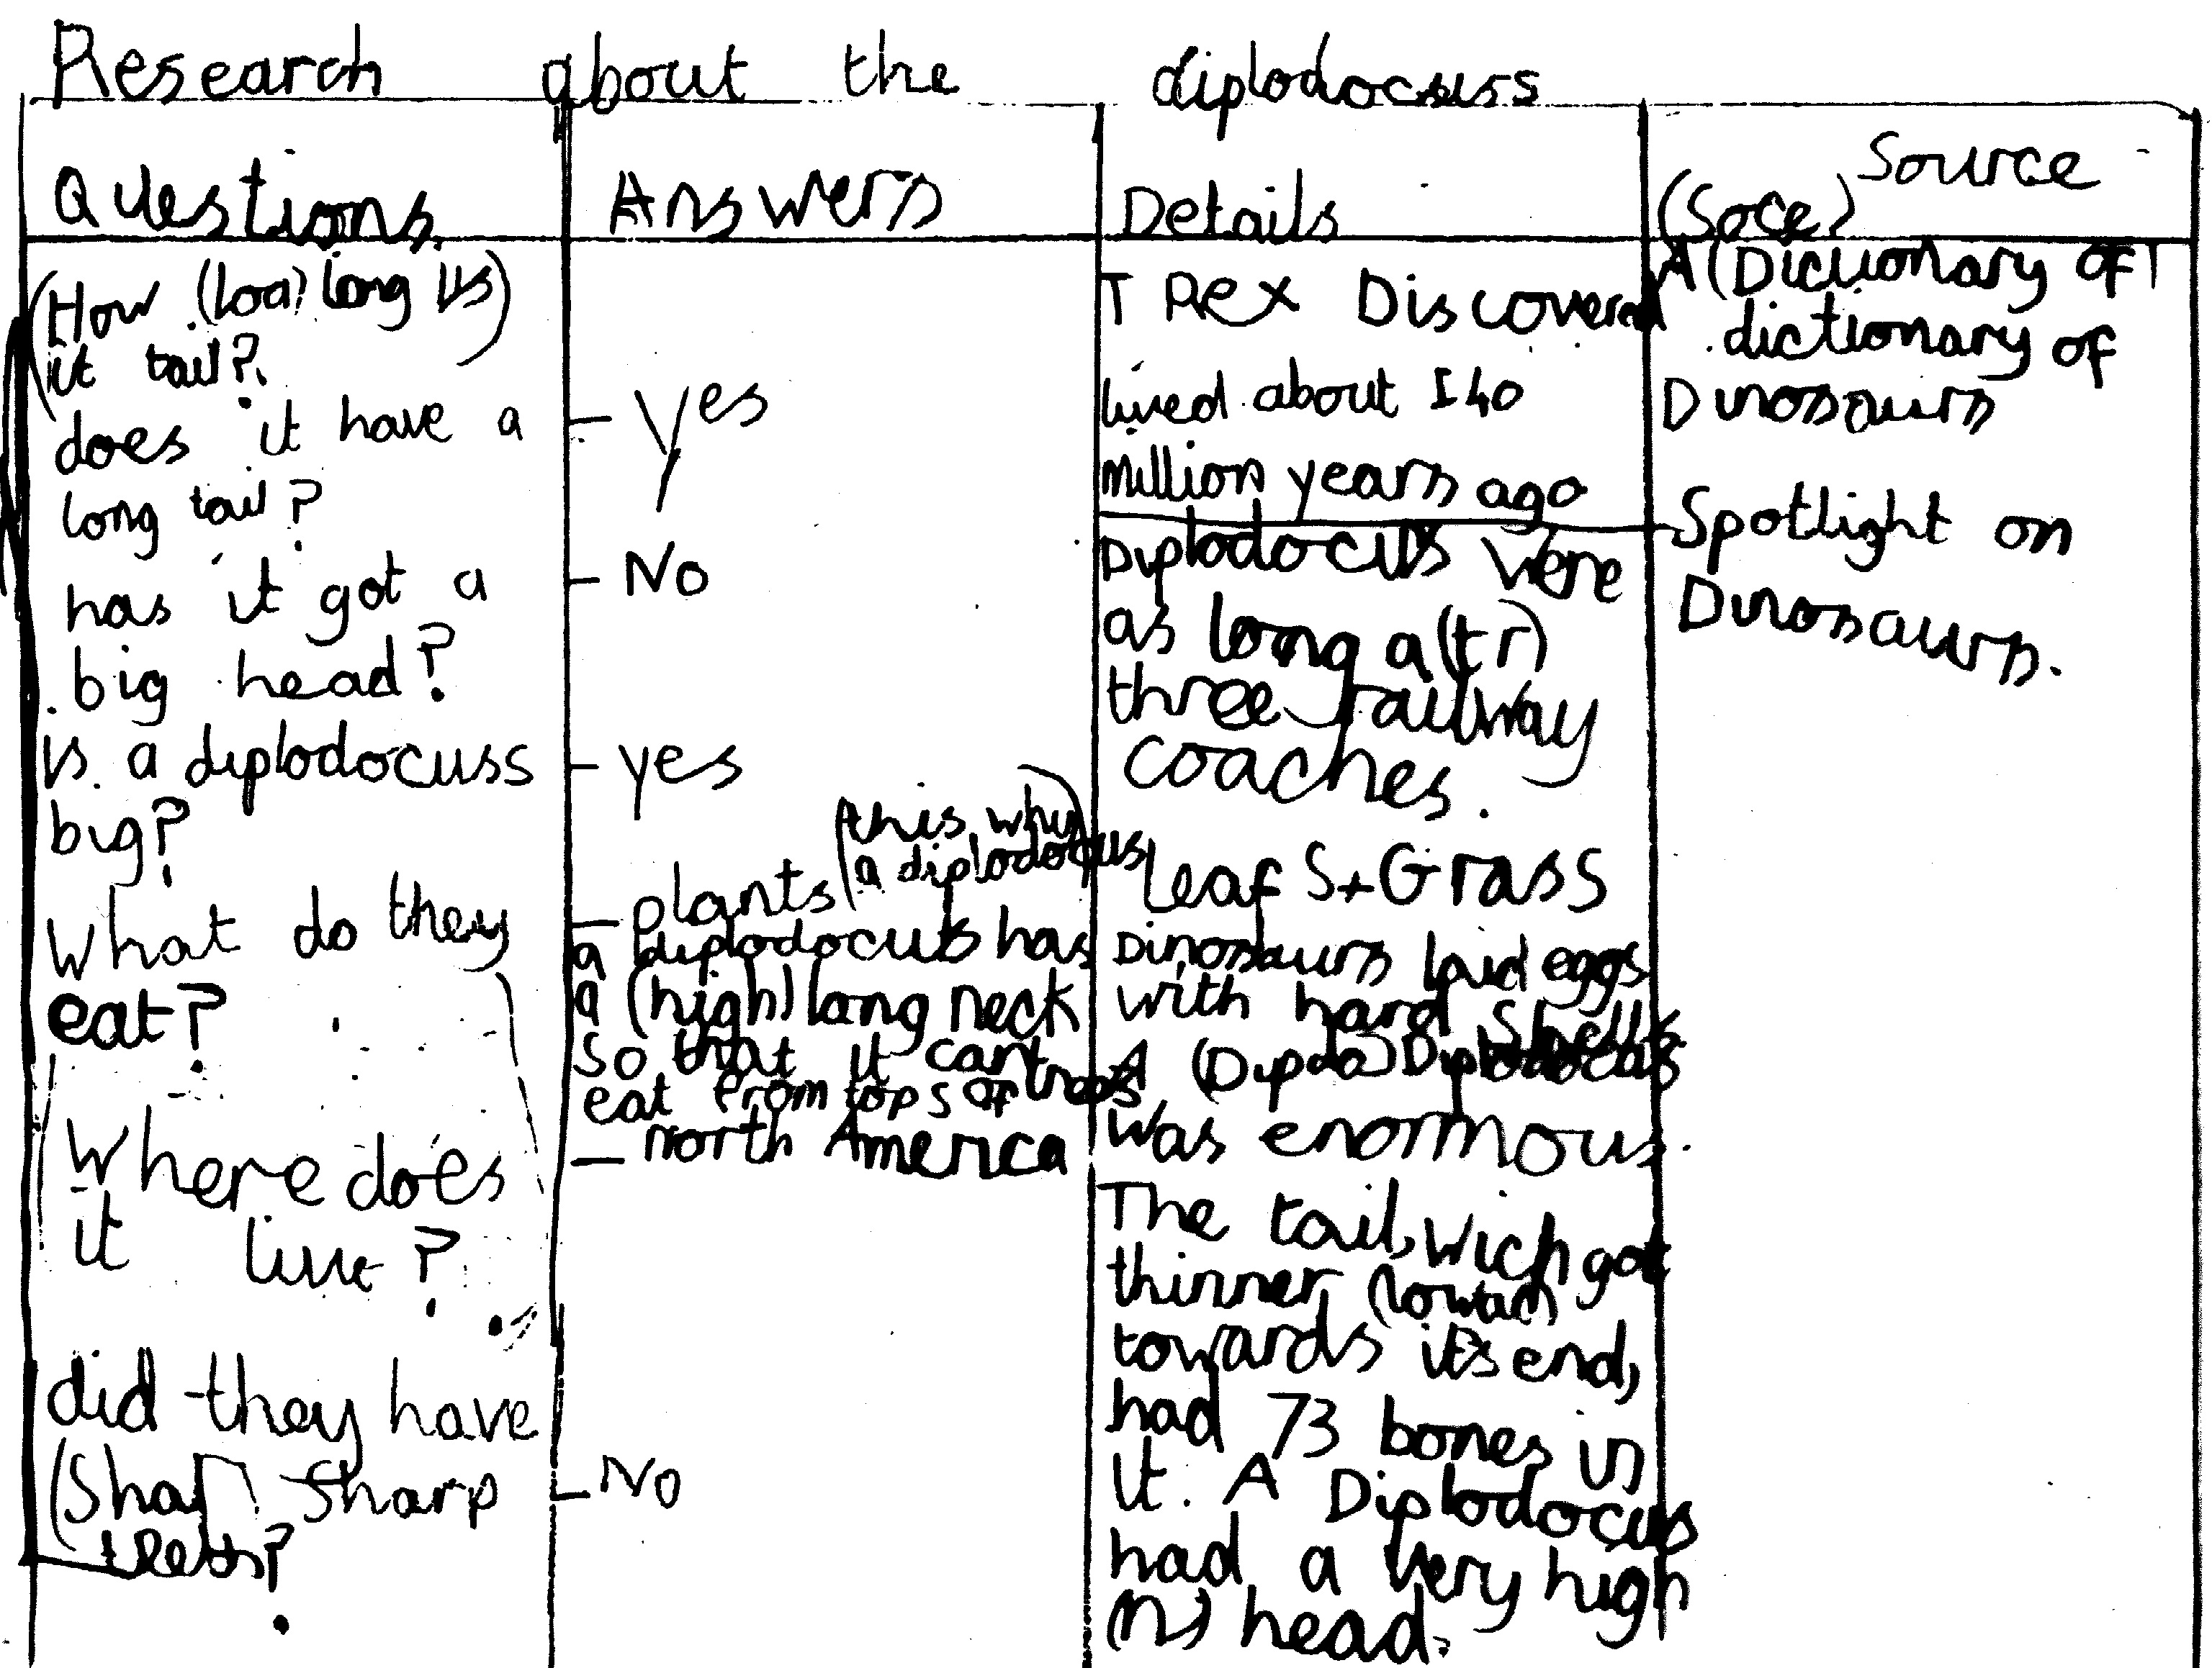

Slide 28
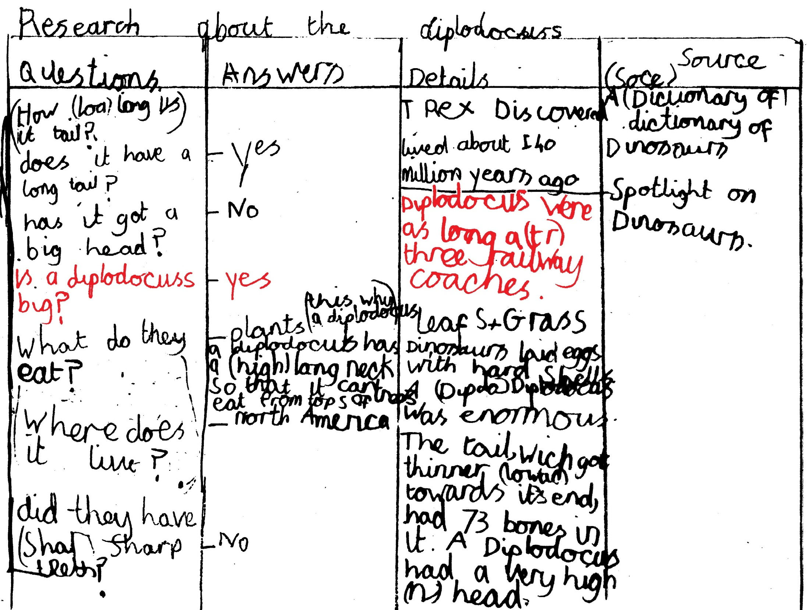

Slide 29
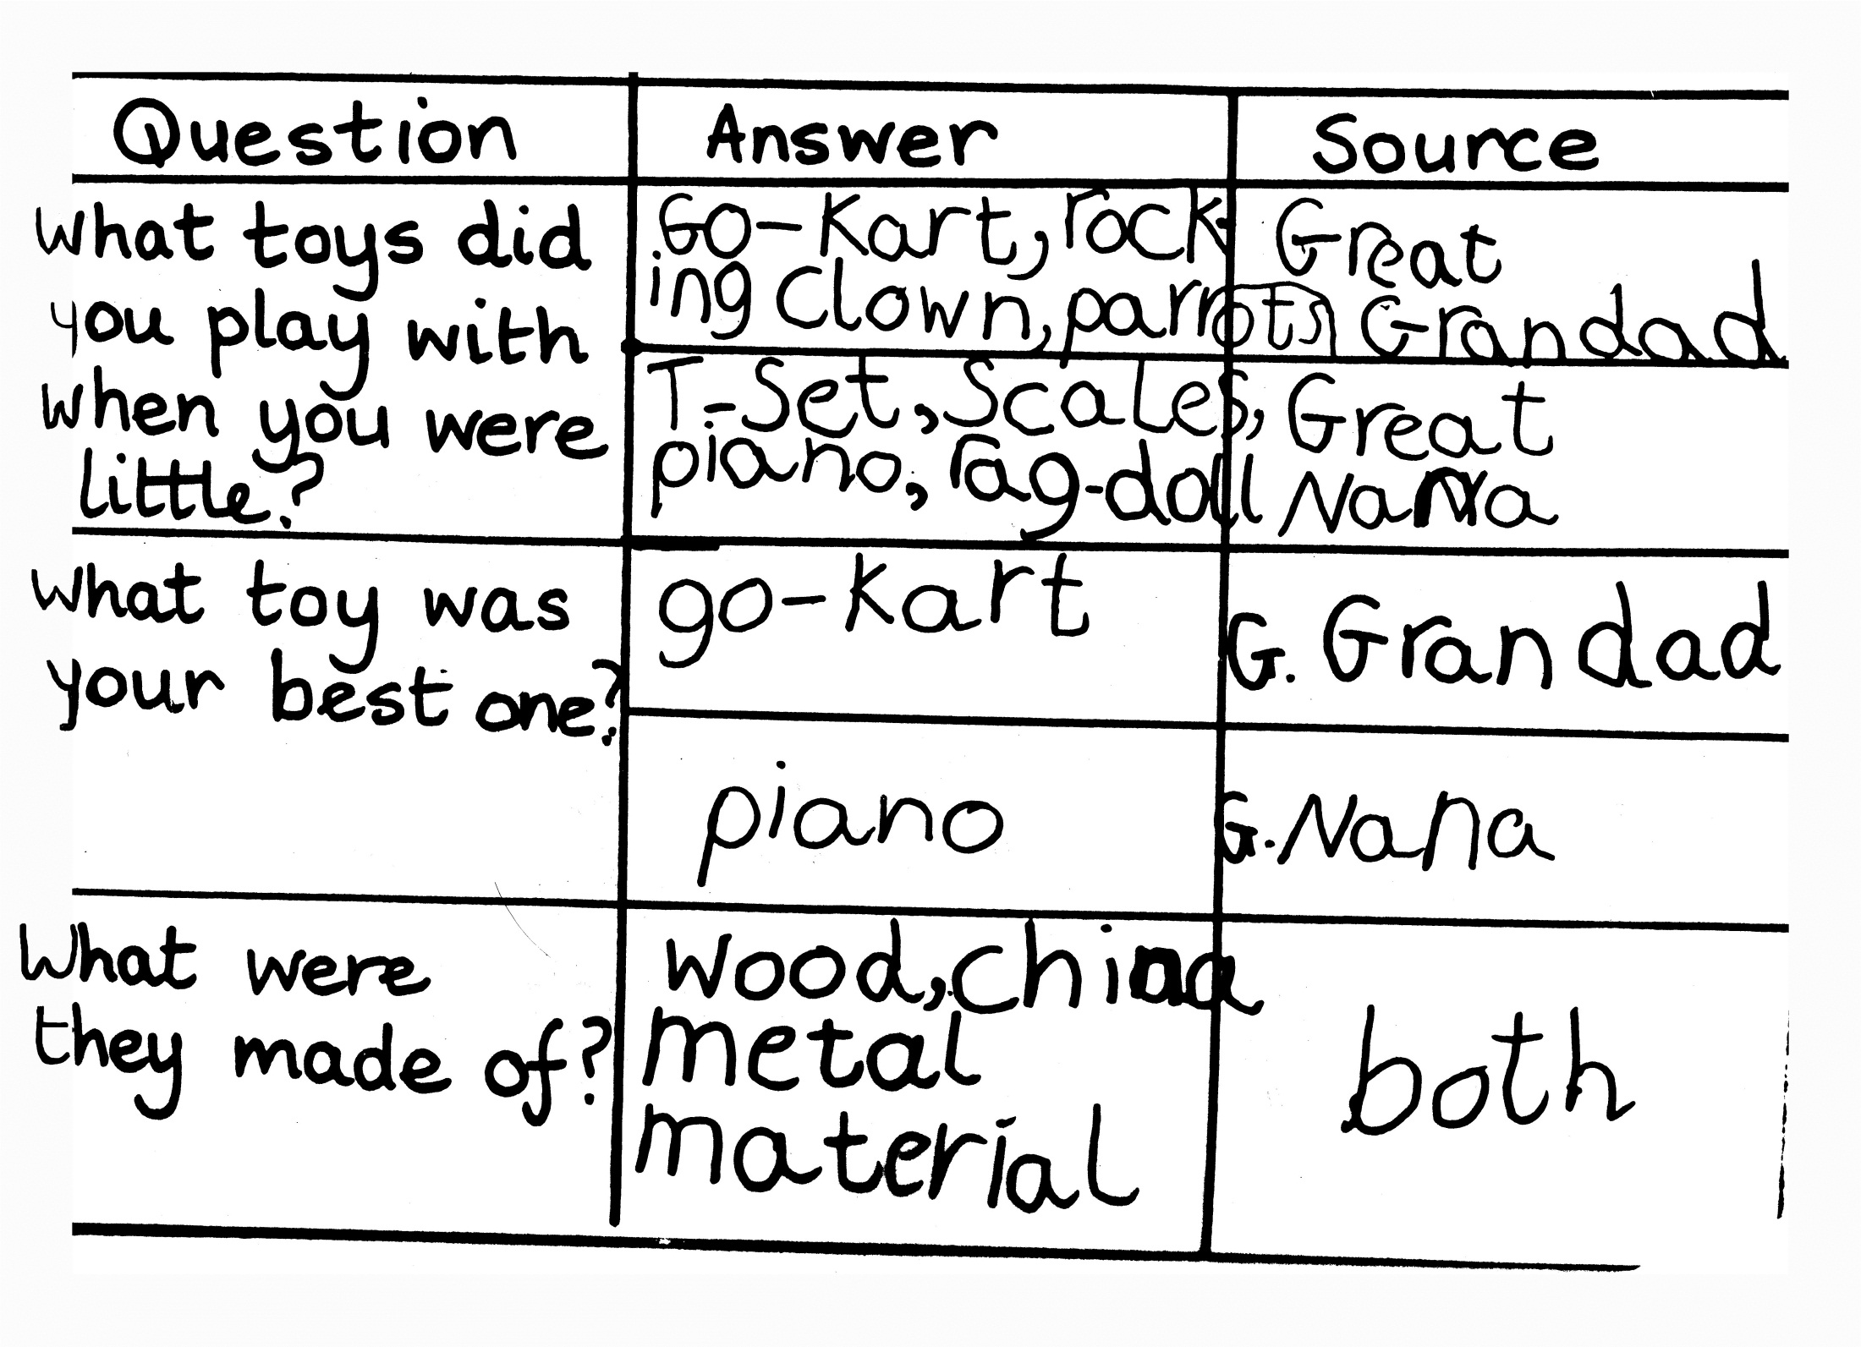

Slide 30
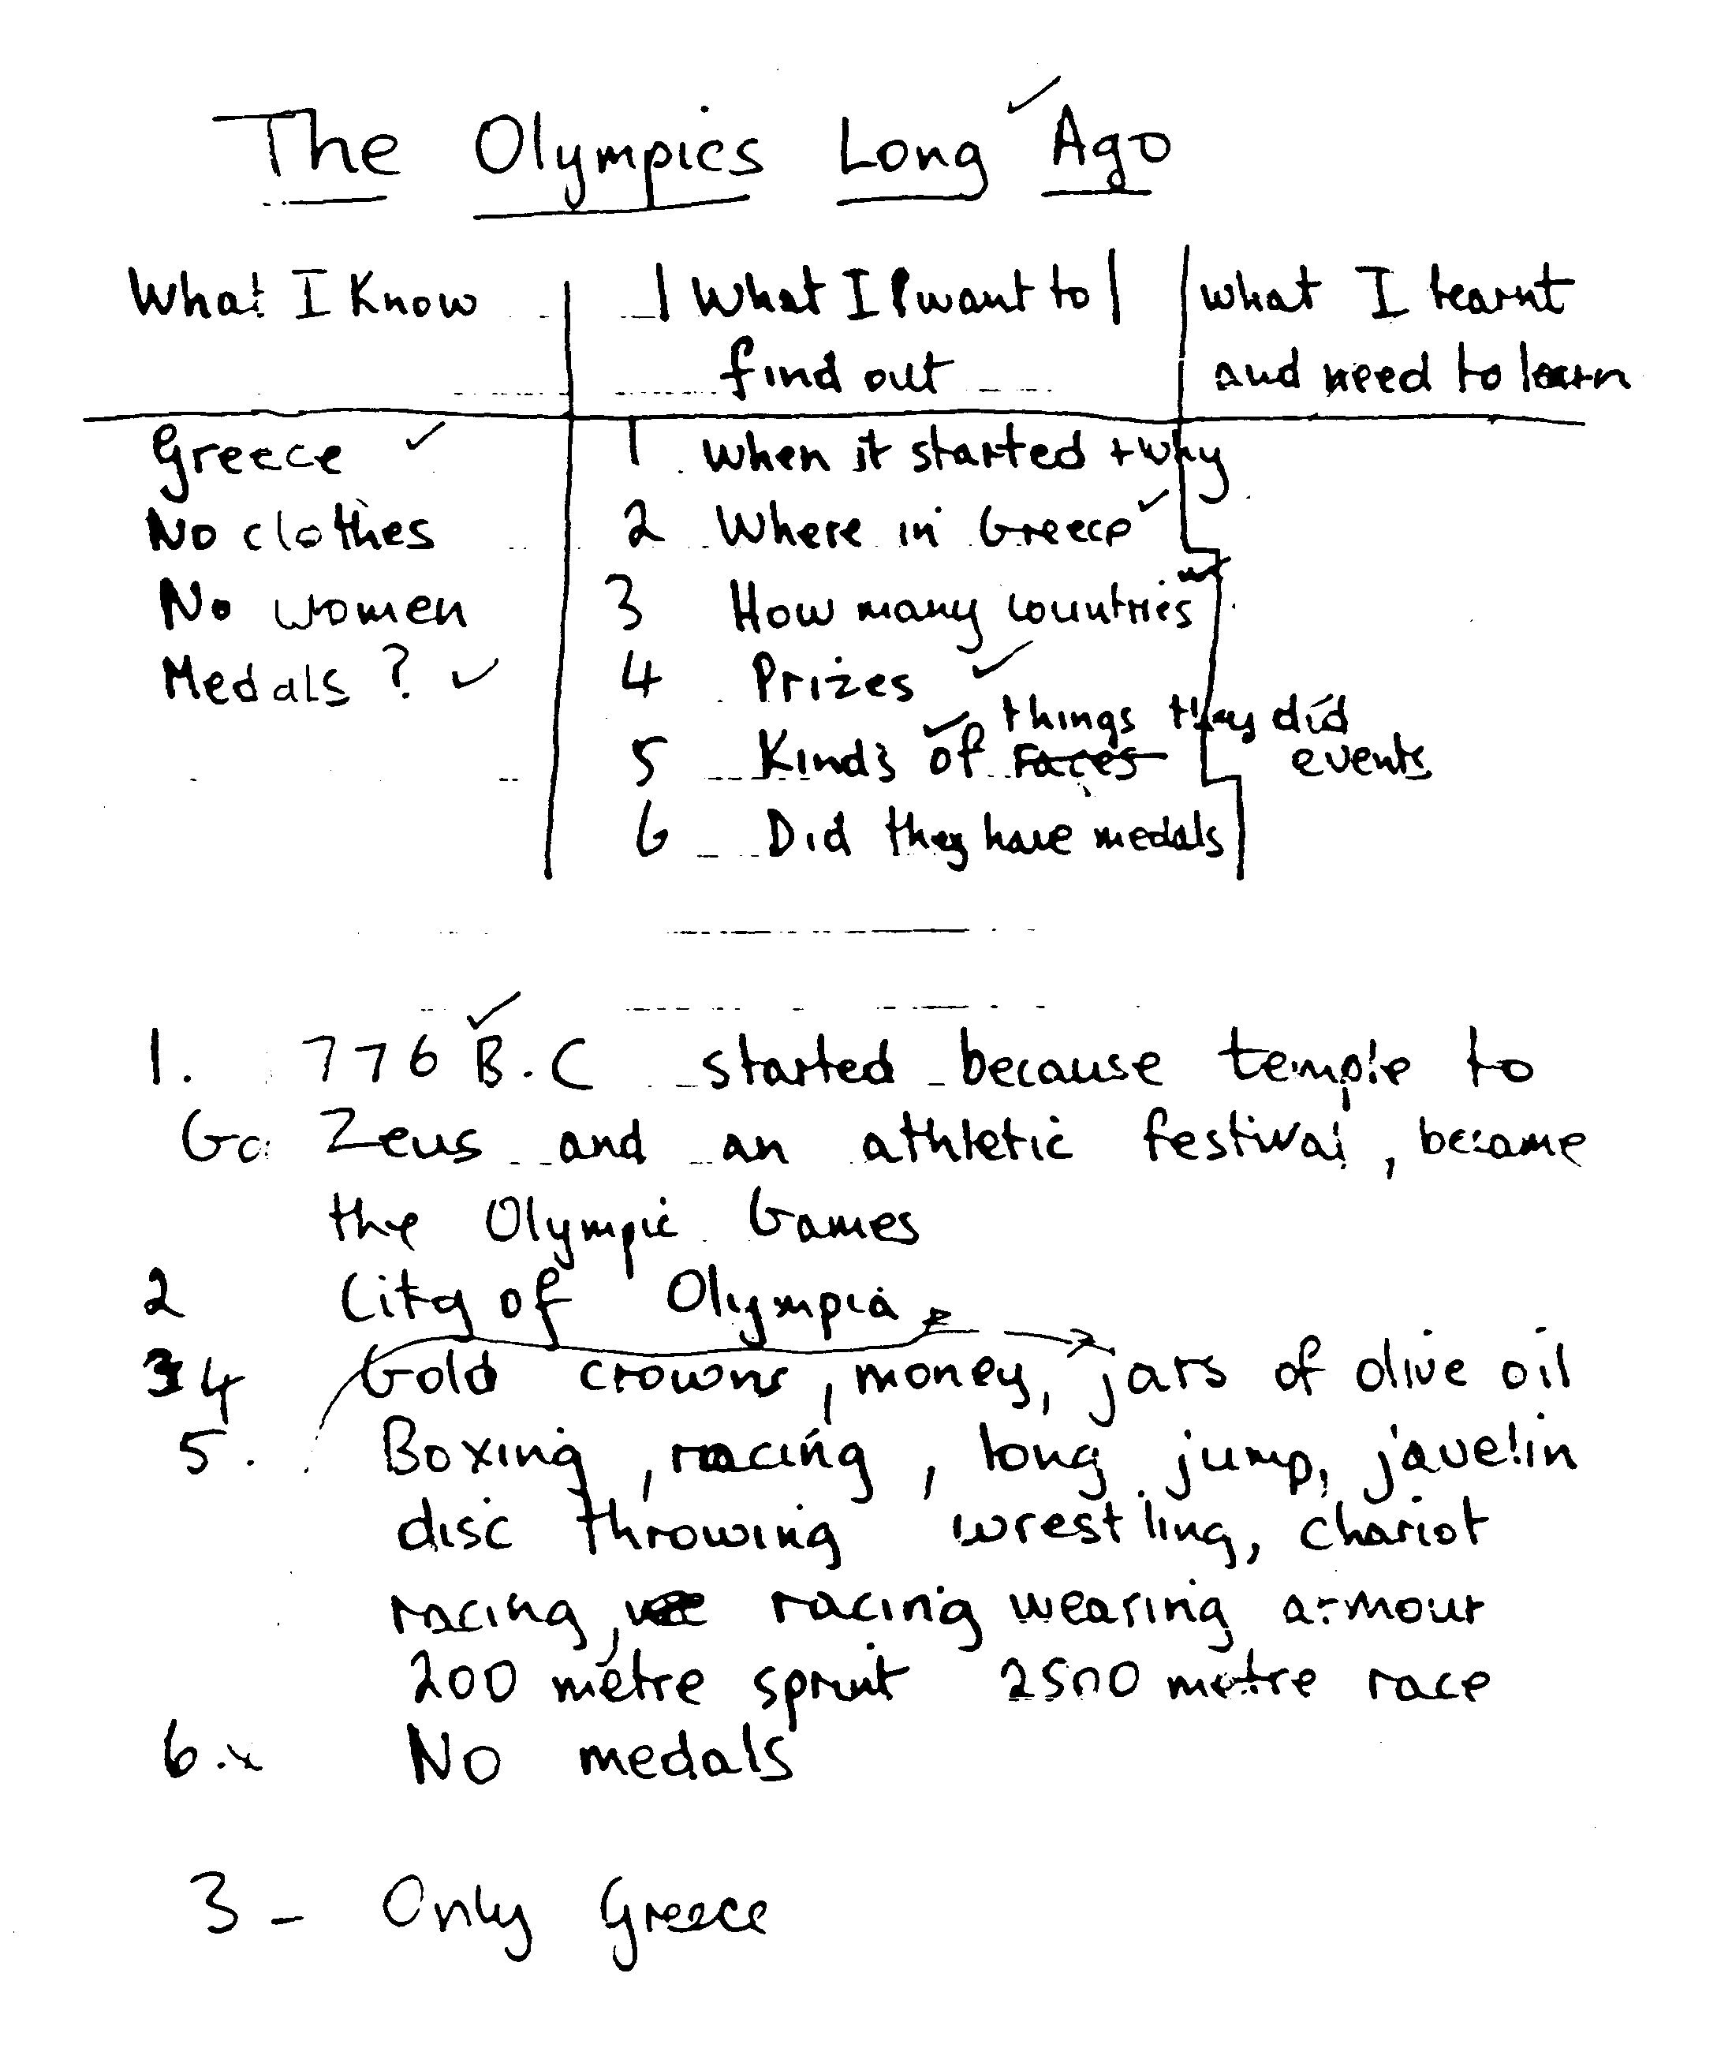

Slide 31
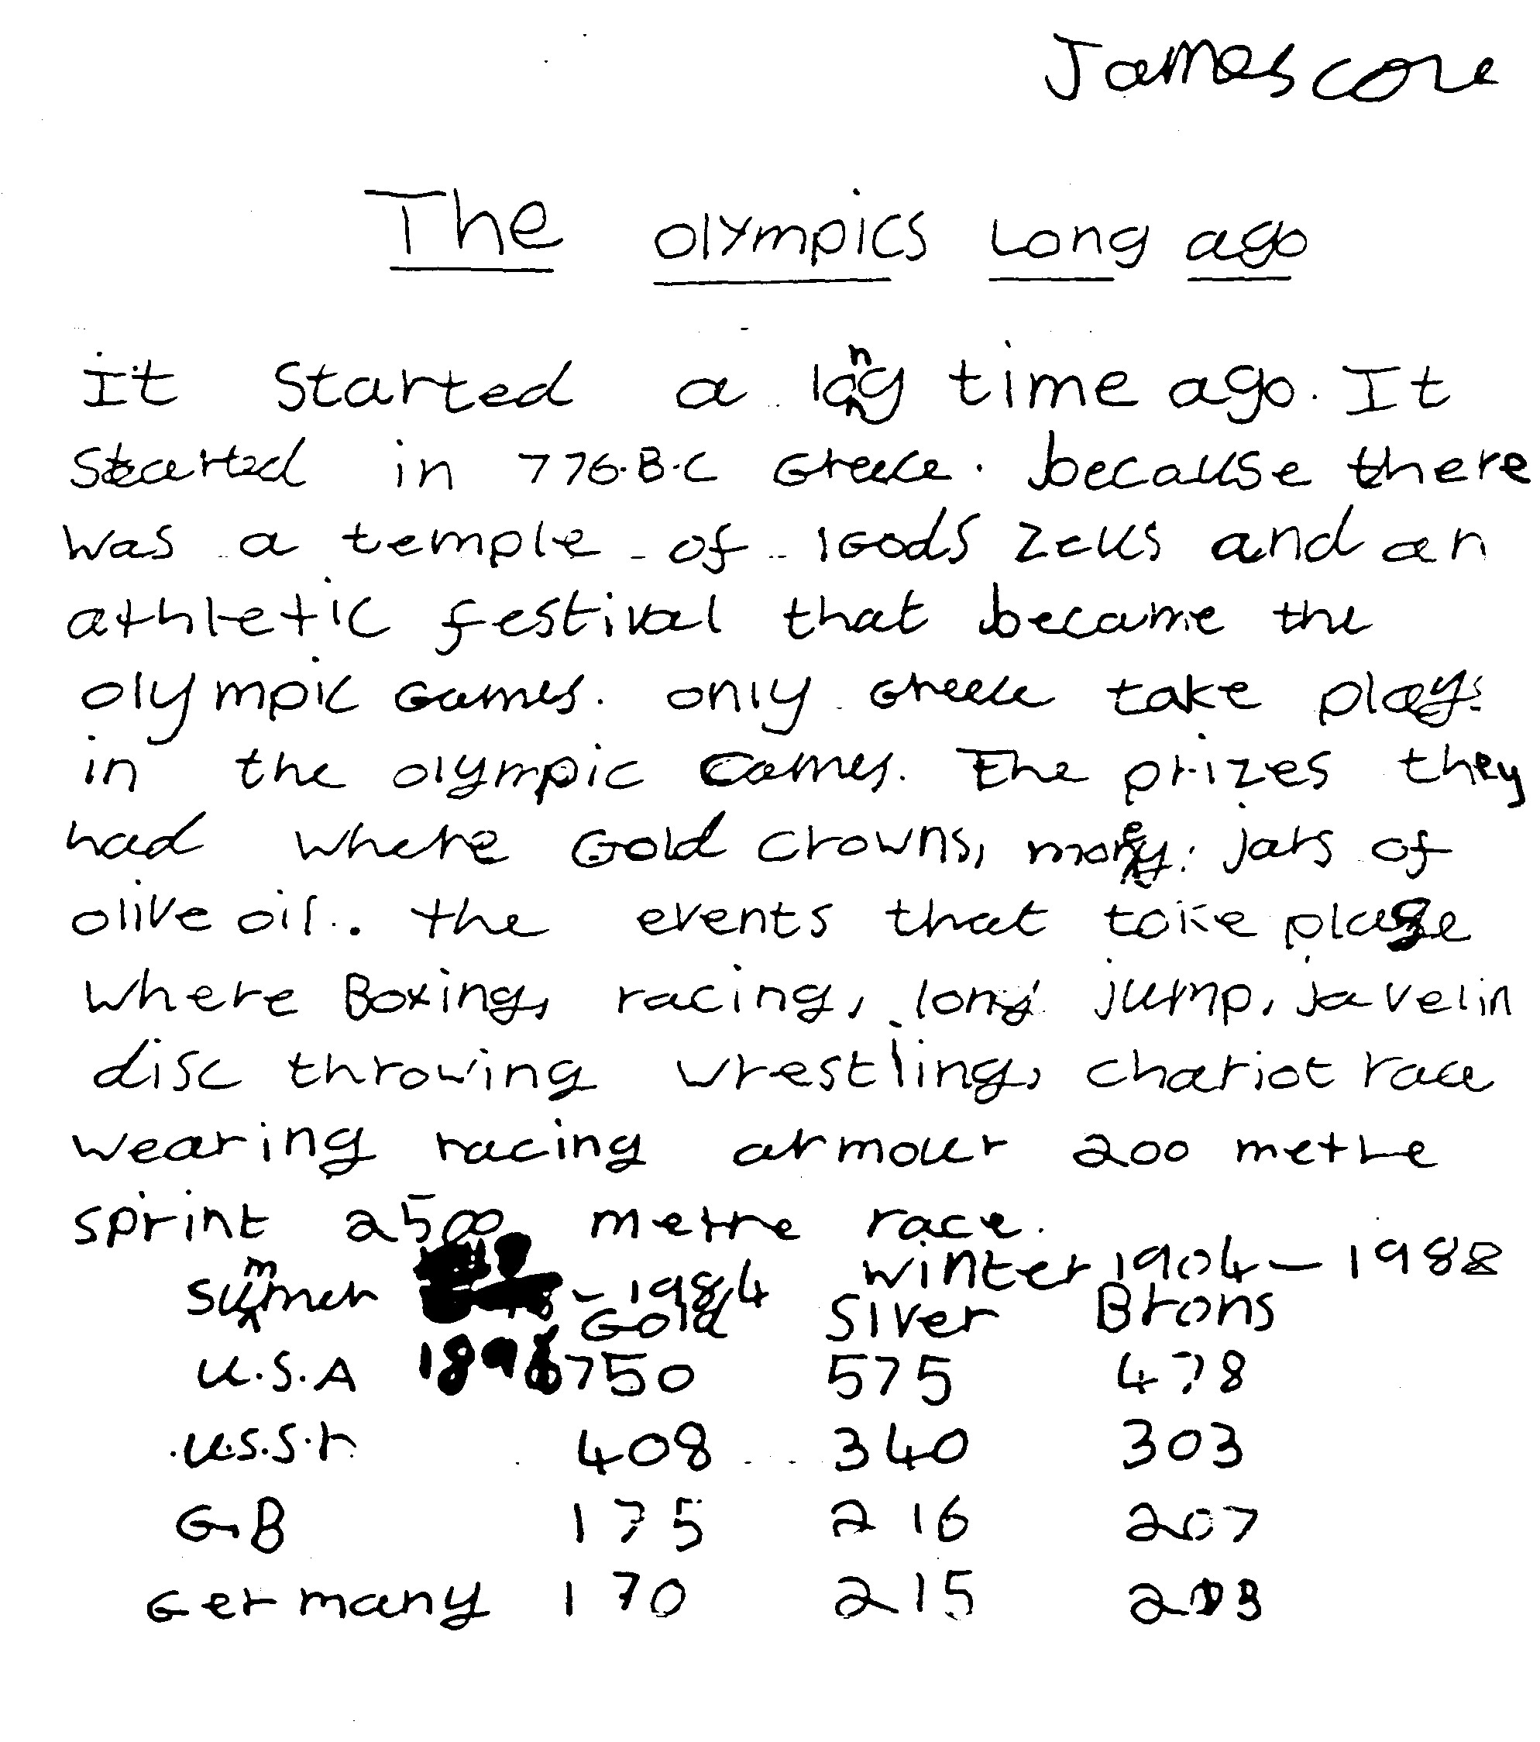

Slide 32
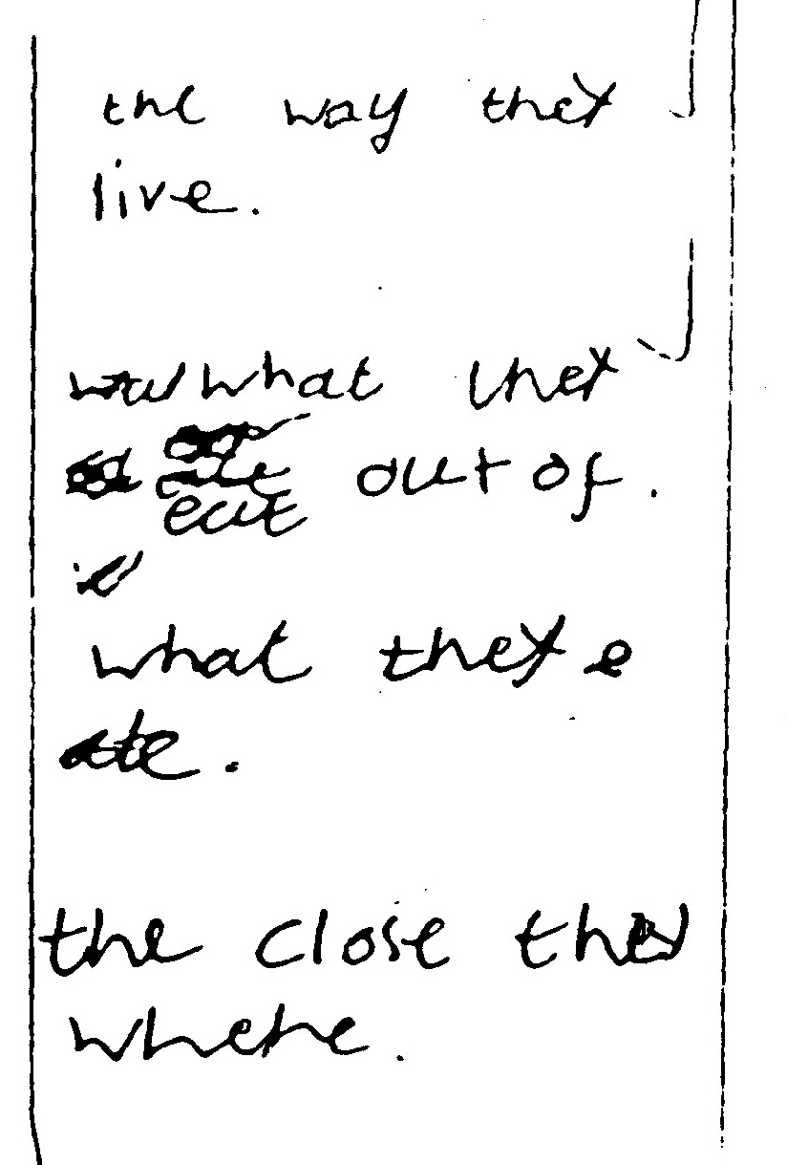

Slide 33
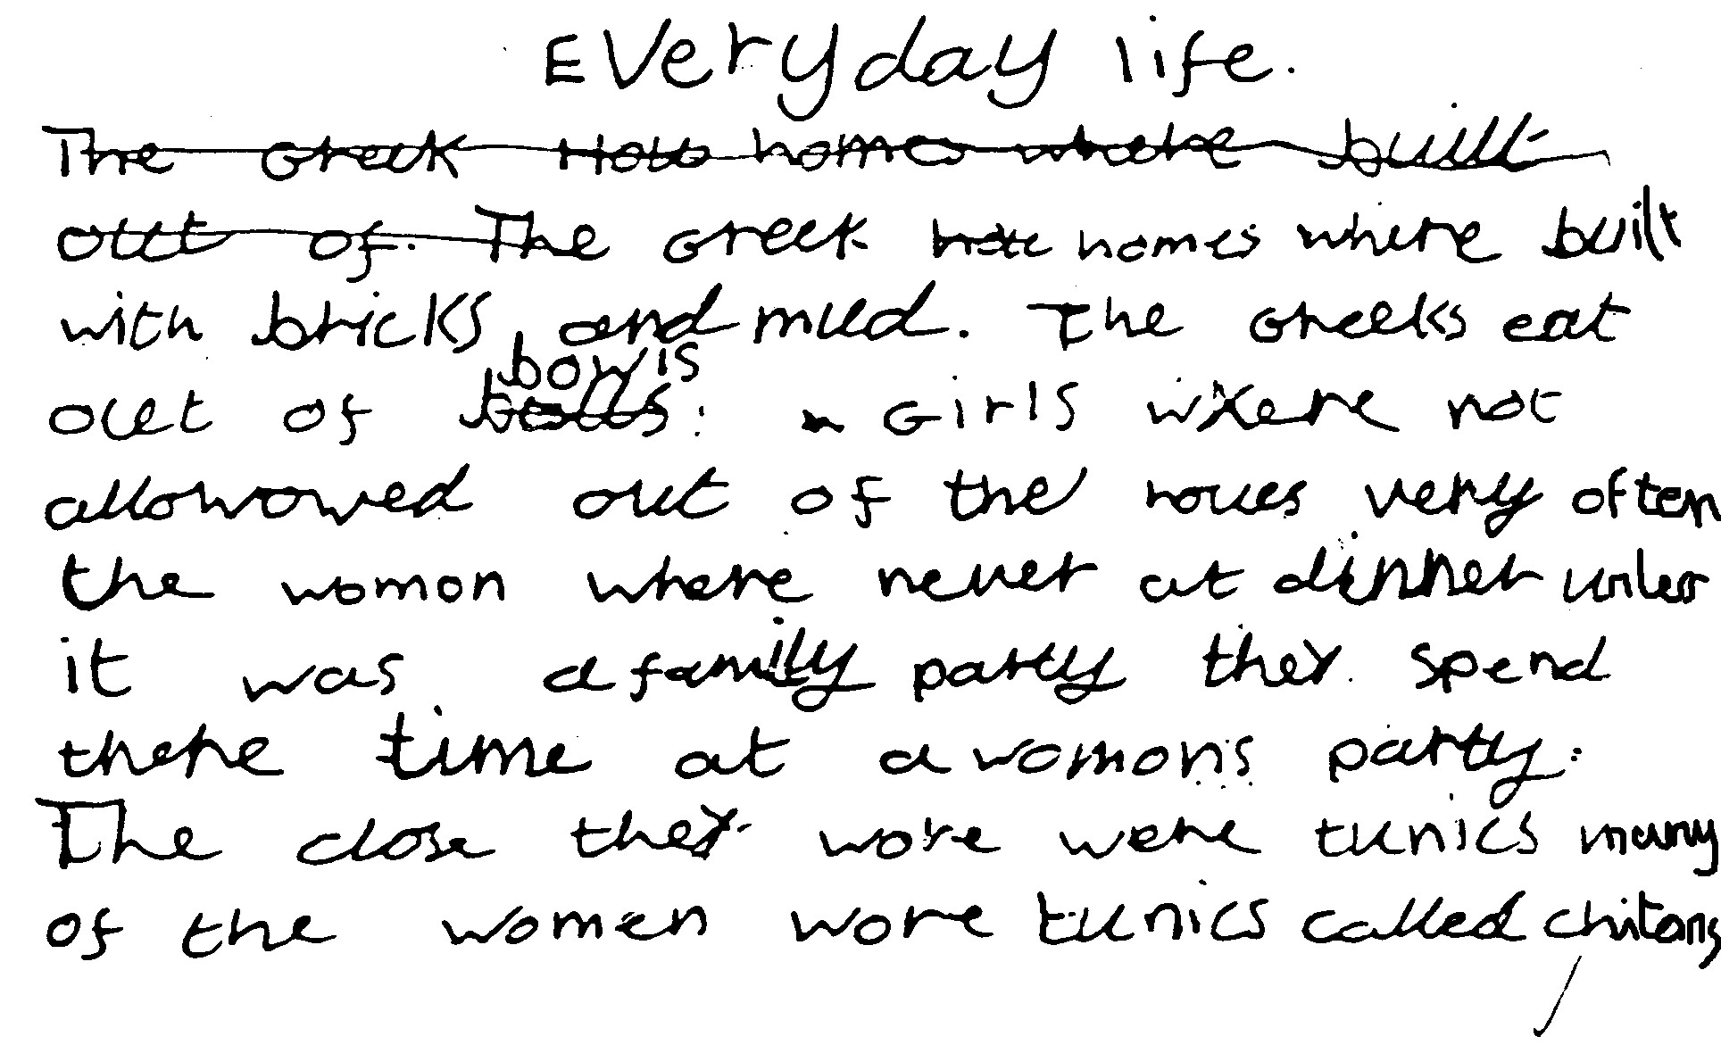

Slide 34
Restructuring information
Venice
Venice is a city of the sea. Her greatness in the Middle Ages was based upon sea trade. For 600 years on Ascension Day the ruler of Venice (called the Doge), dressed in a cloth of gold, was rowed out in his state galleon to the middle of the Lagoon to throw a wedding ring into the sea. He said the words, “We wed thee sea, in token of our perpetual rule”.
However, Venice did not rule for ever. In 1798 it lost its power and independence as a republic. It is still a fascinating city built on stilts and on 117 islands. The city has 150 canals and 400 bridges with hump backs so that boats and barges can go under them. The most famous bridge is the ‘Bridge of Sighs’ which criminals crossed from the Doge’s Palace on the way to prison.

Slide 35
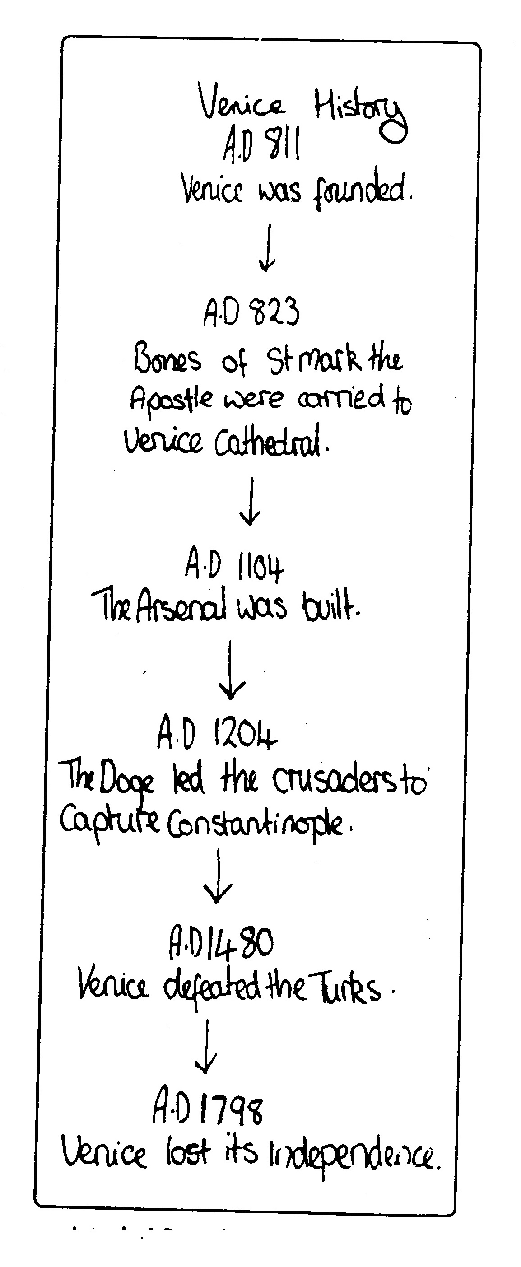

Slide 36
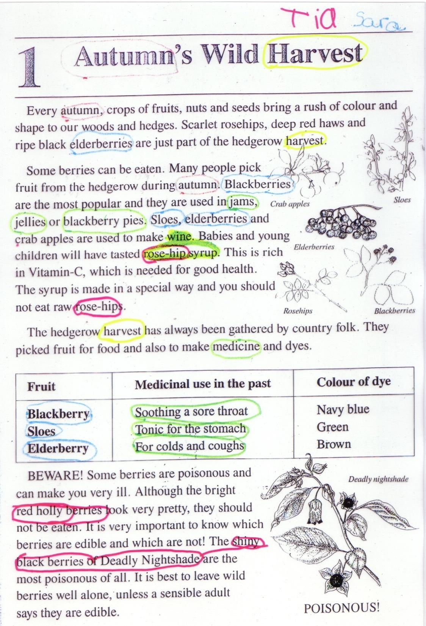

Slide 37
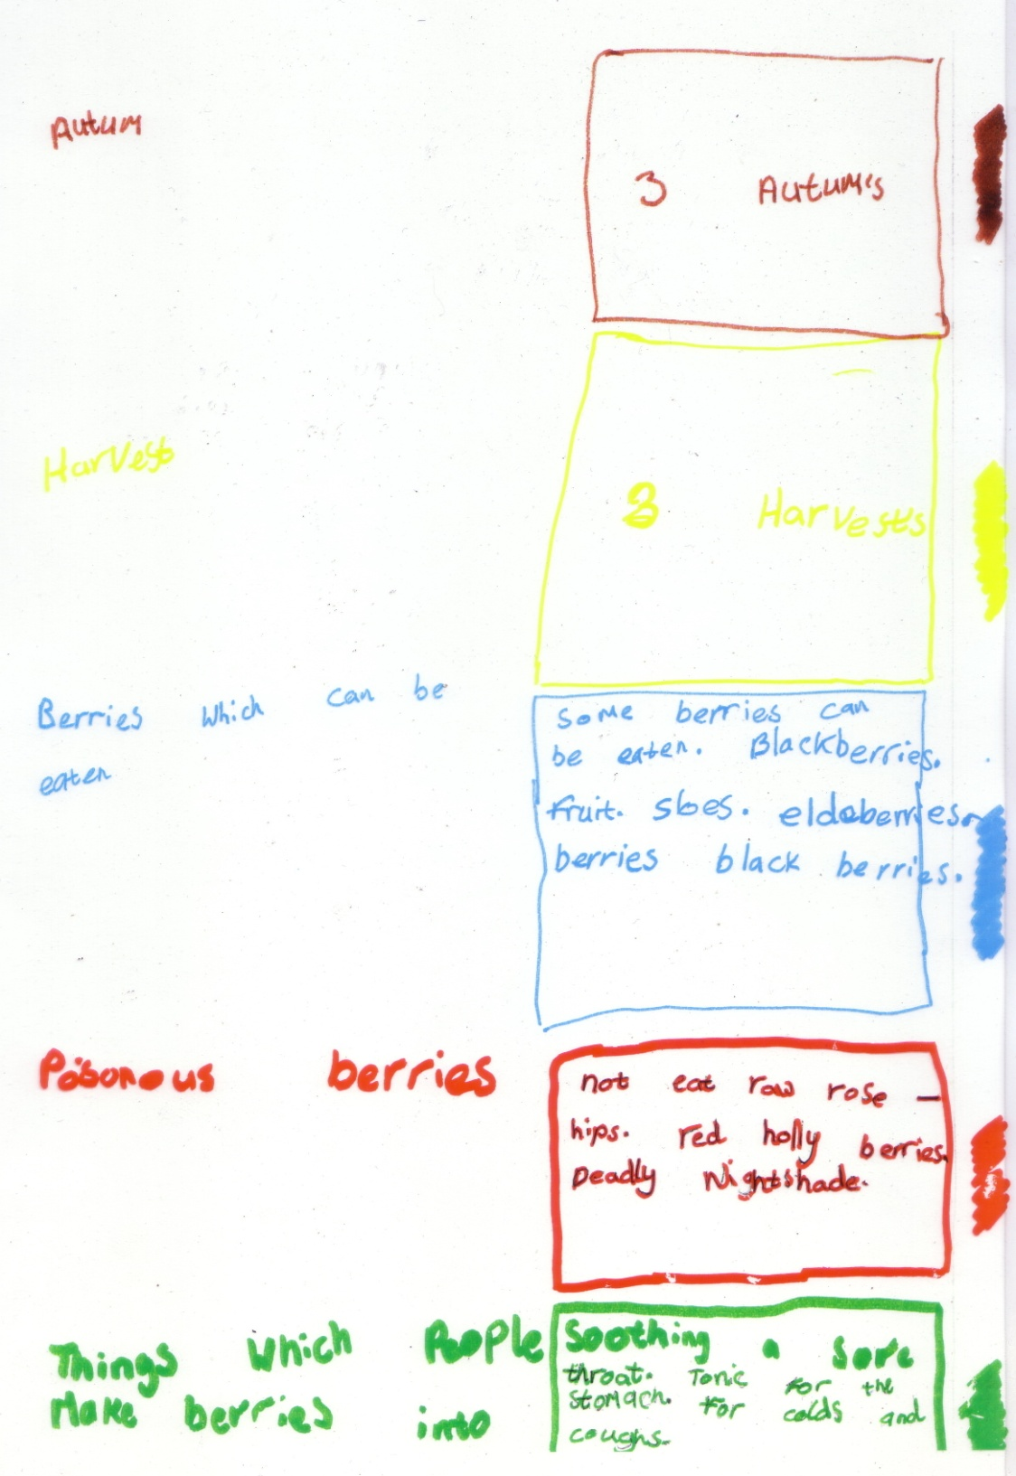

Slide 38
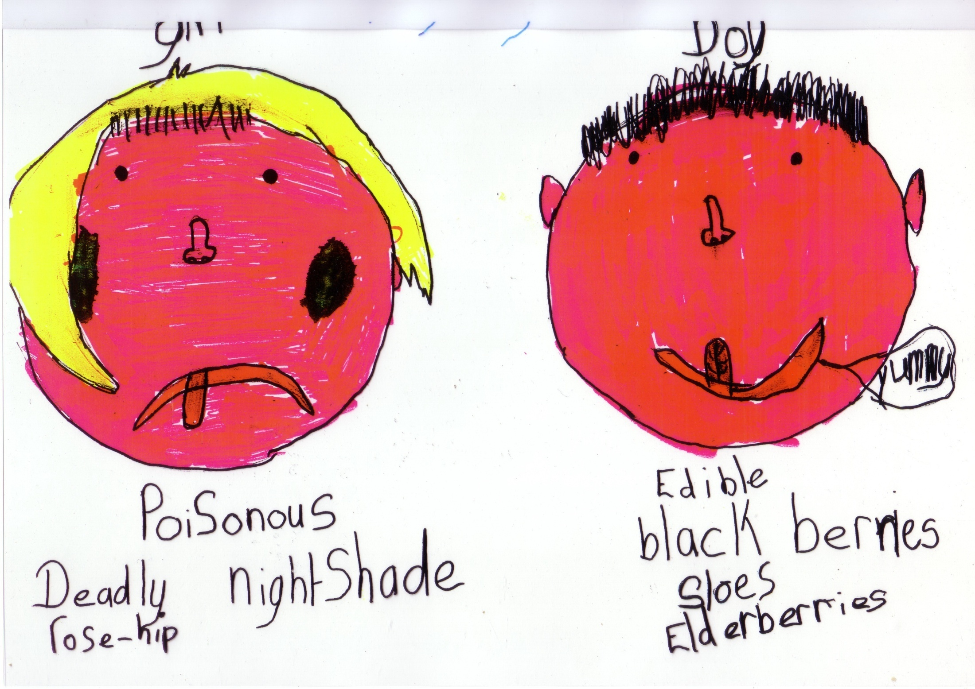

Slide 39
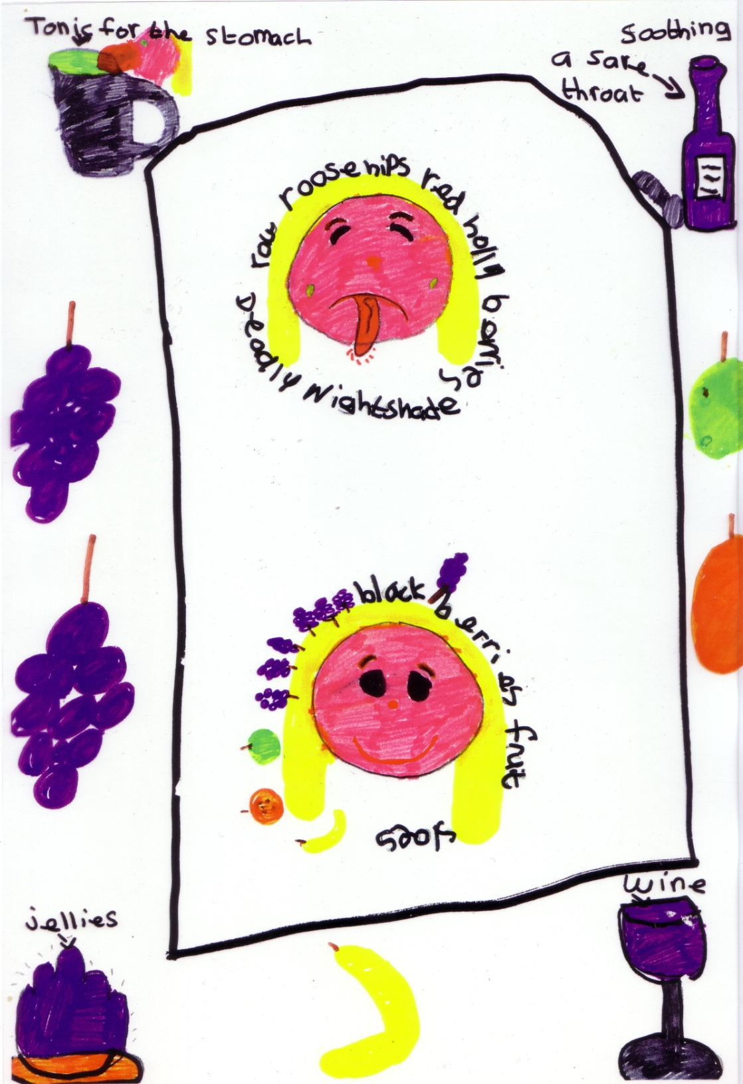

Slide 40
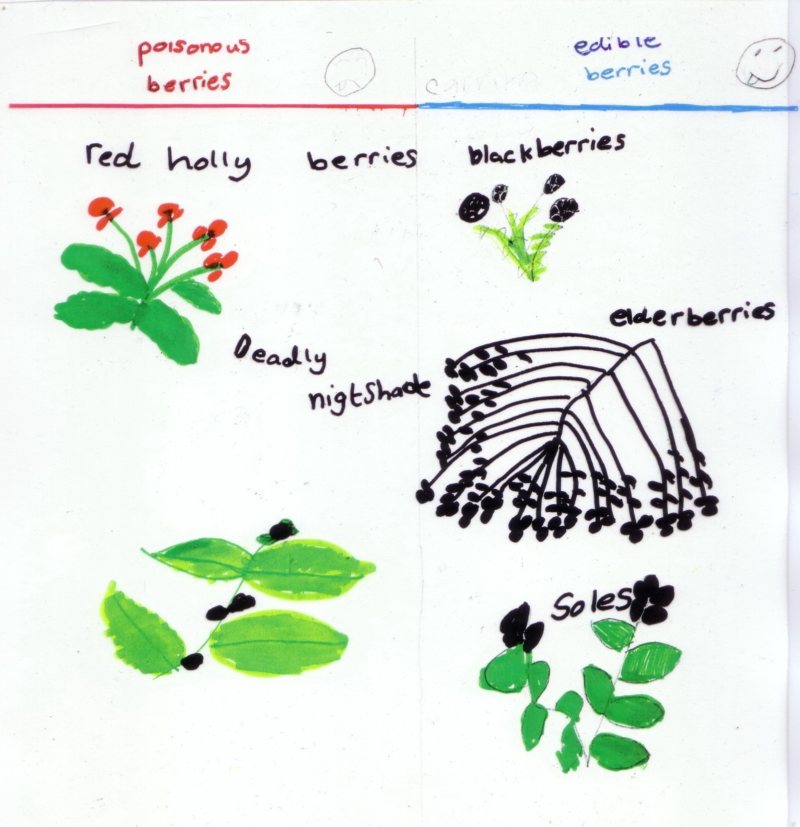

Slide 41
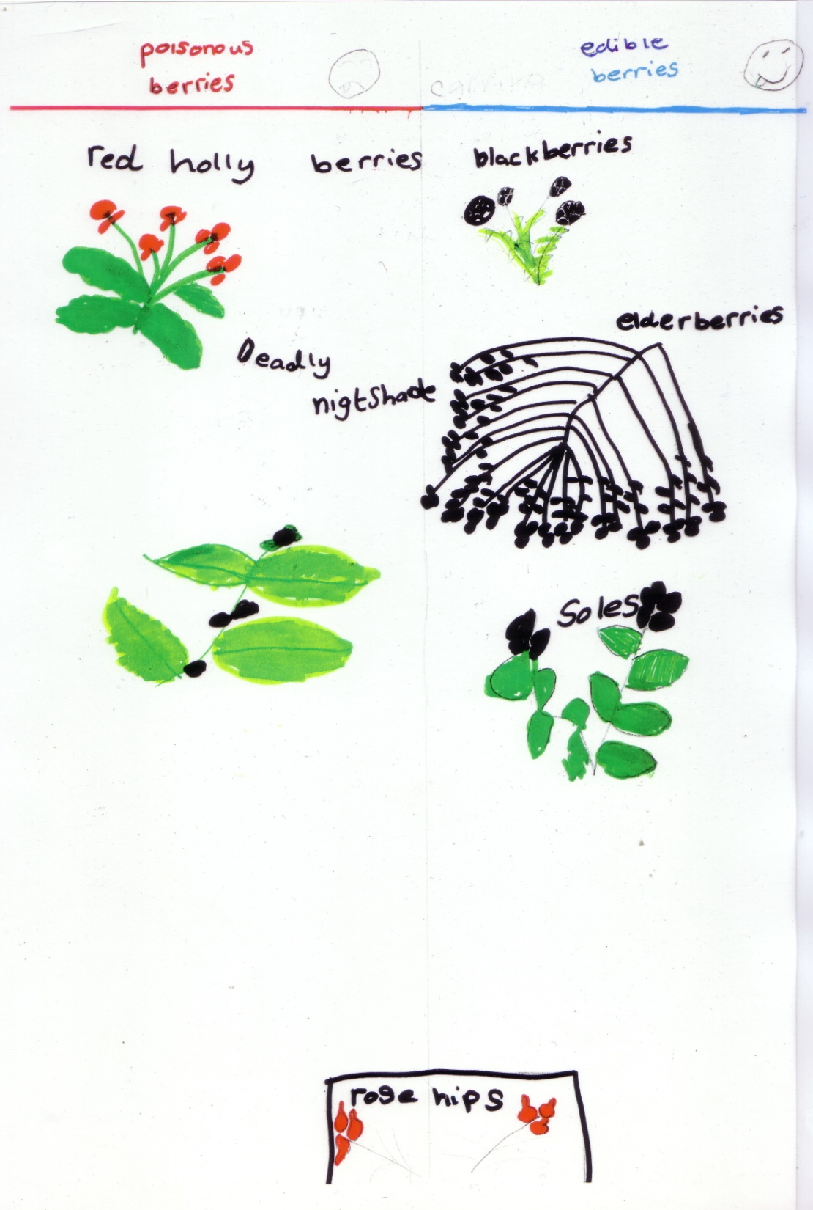

Slide 42
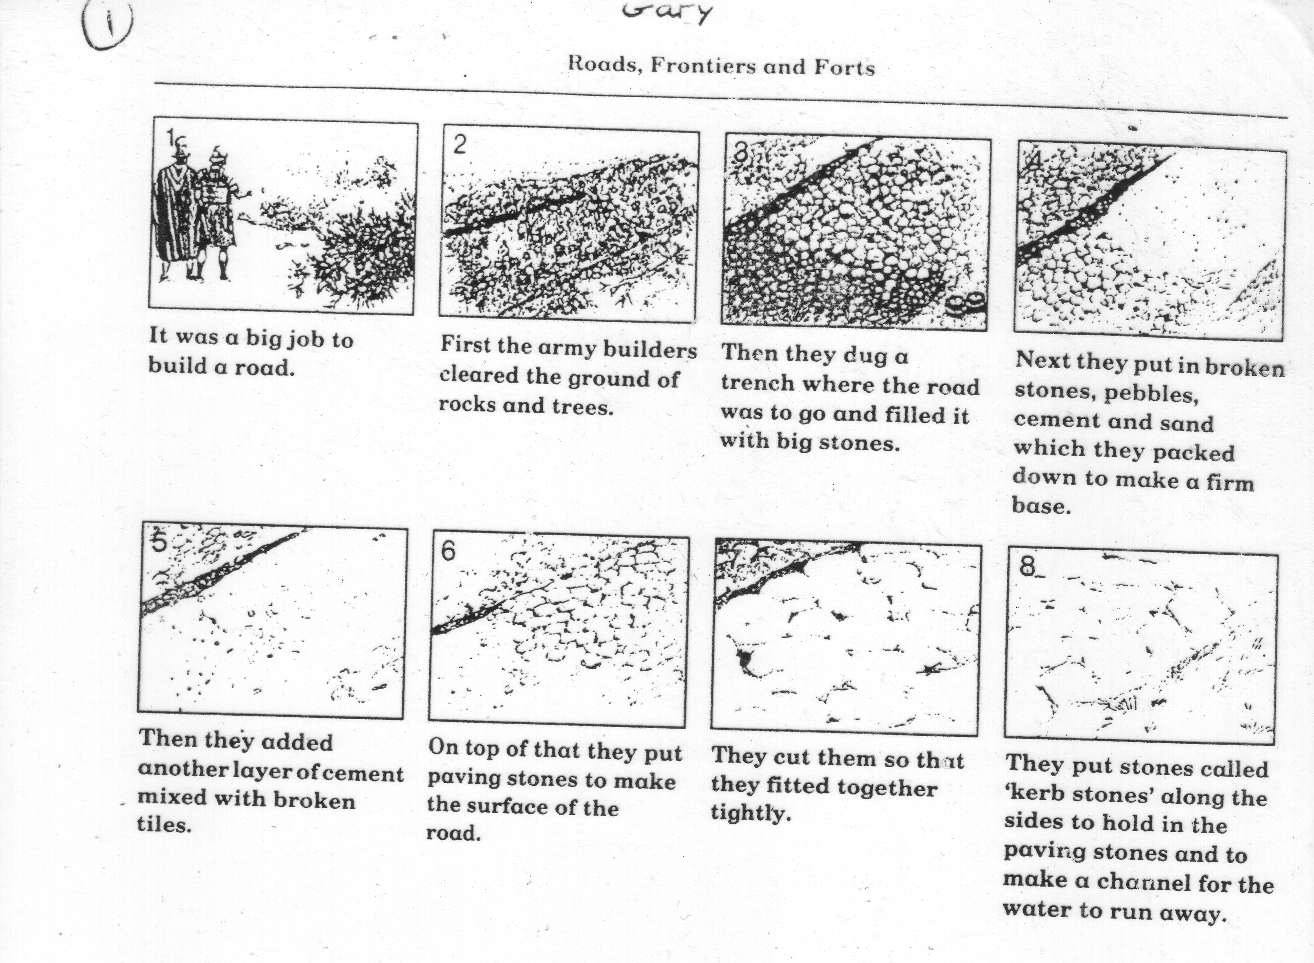

Slide 43
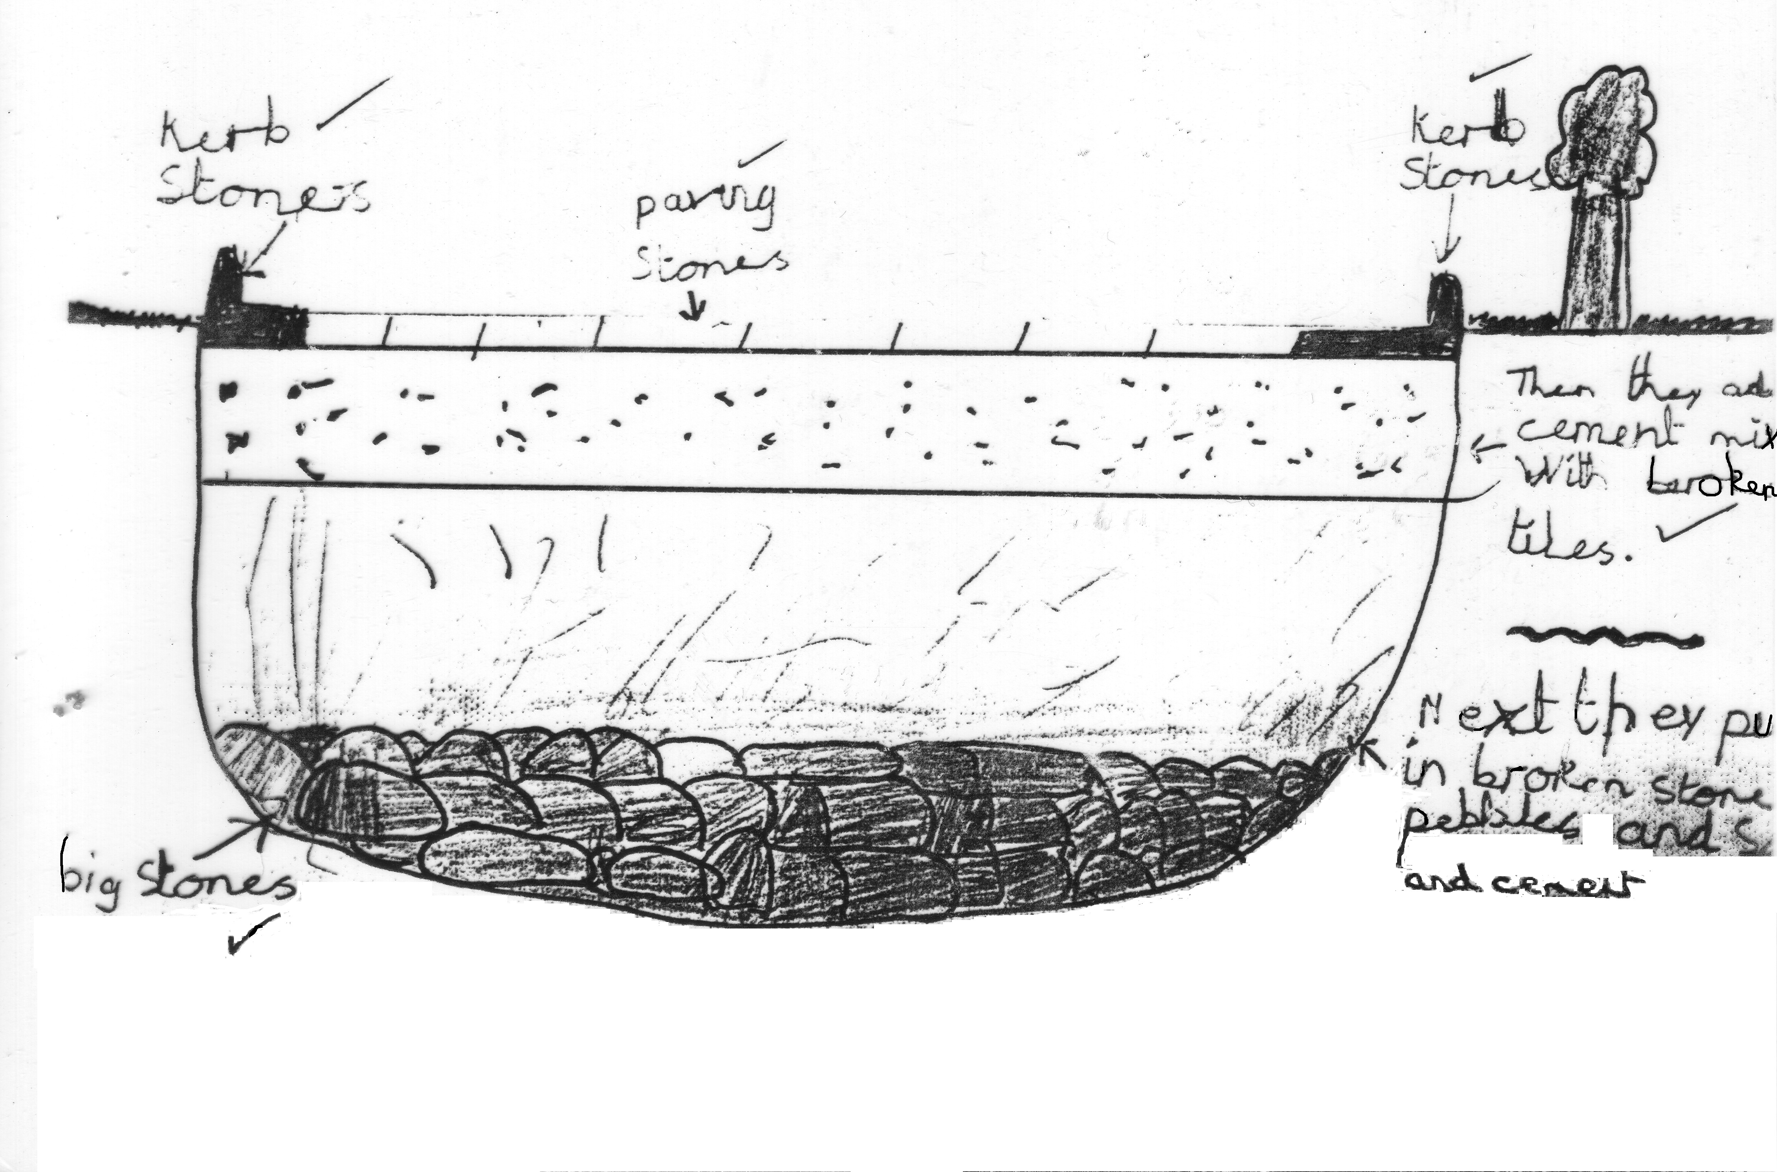

Slide 44
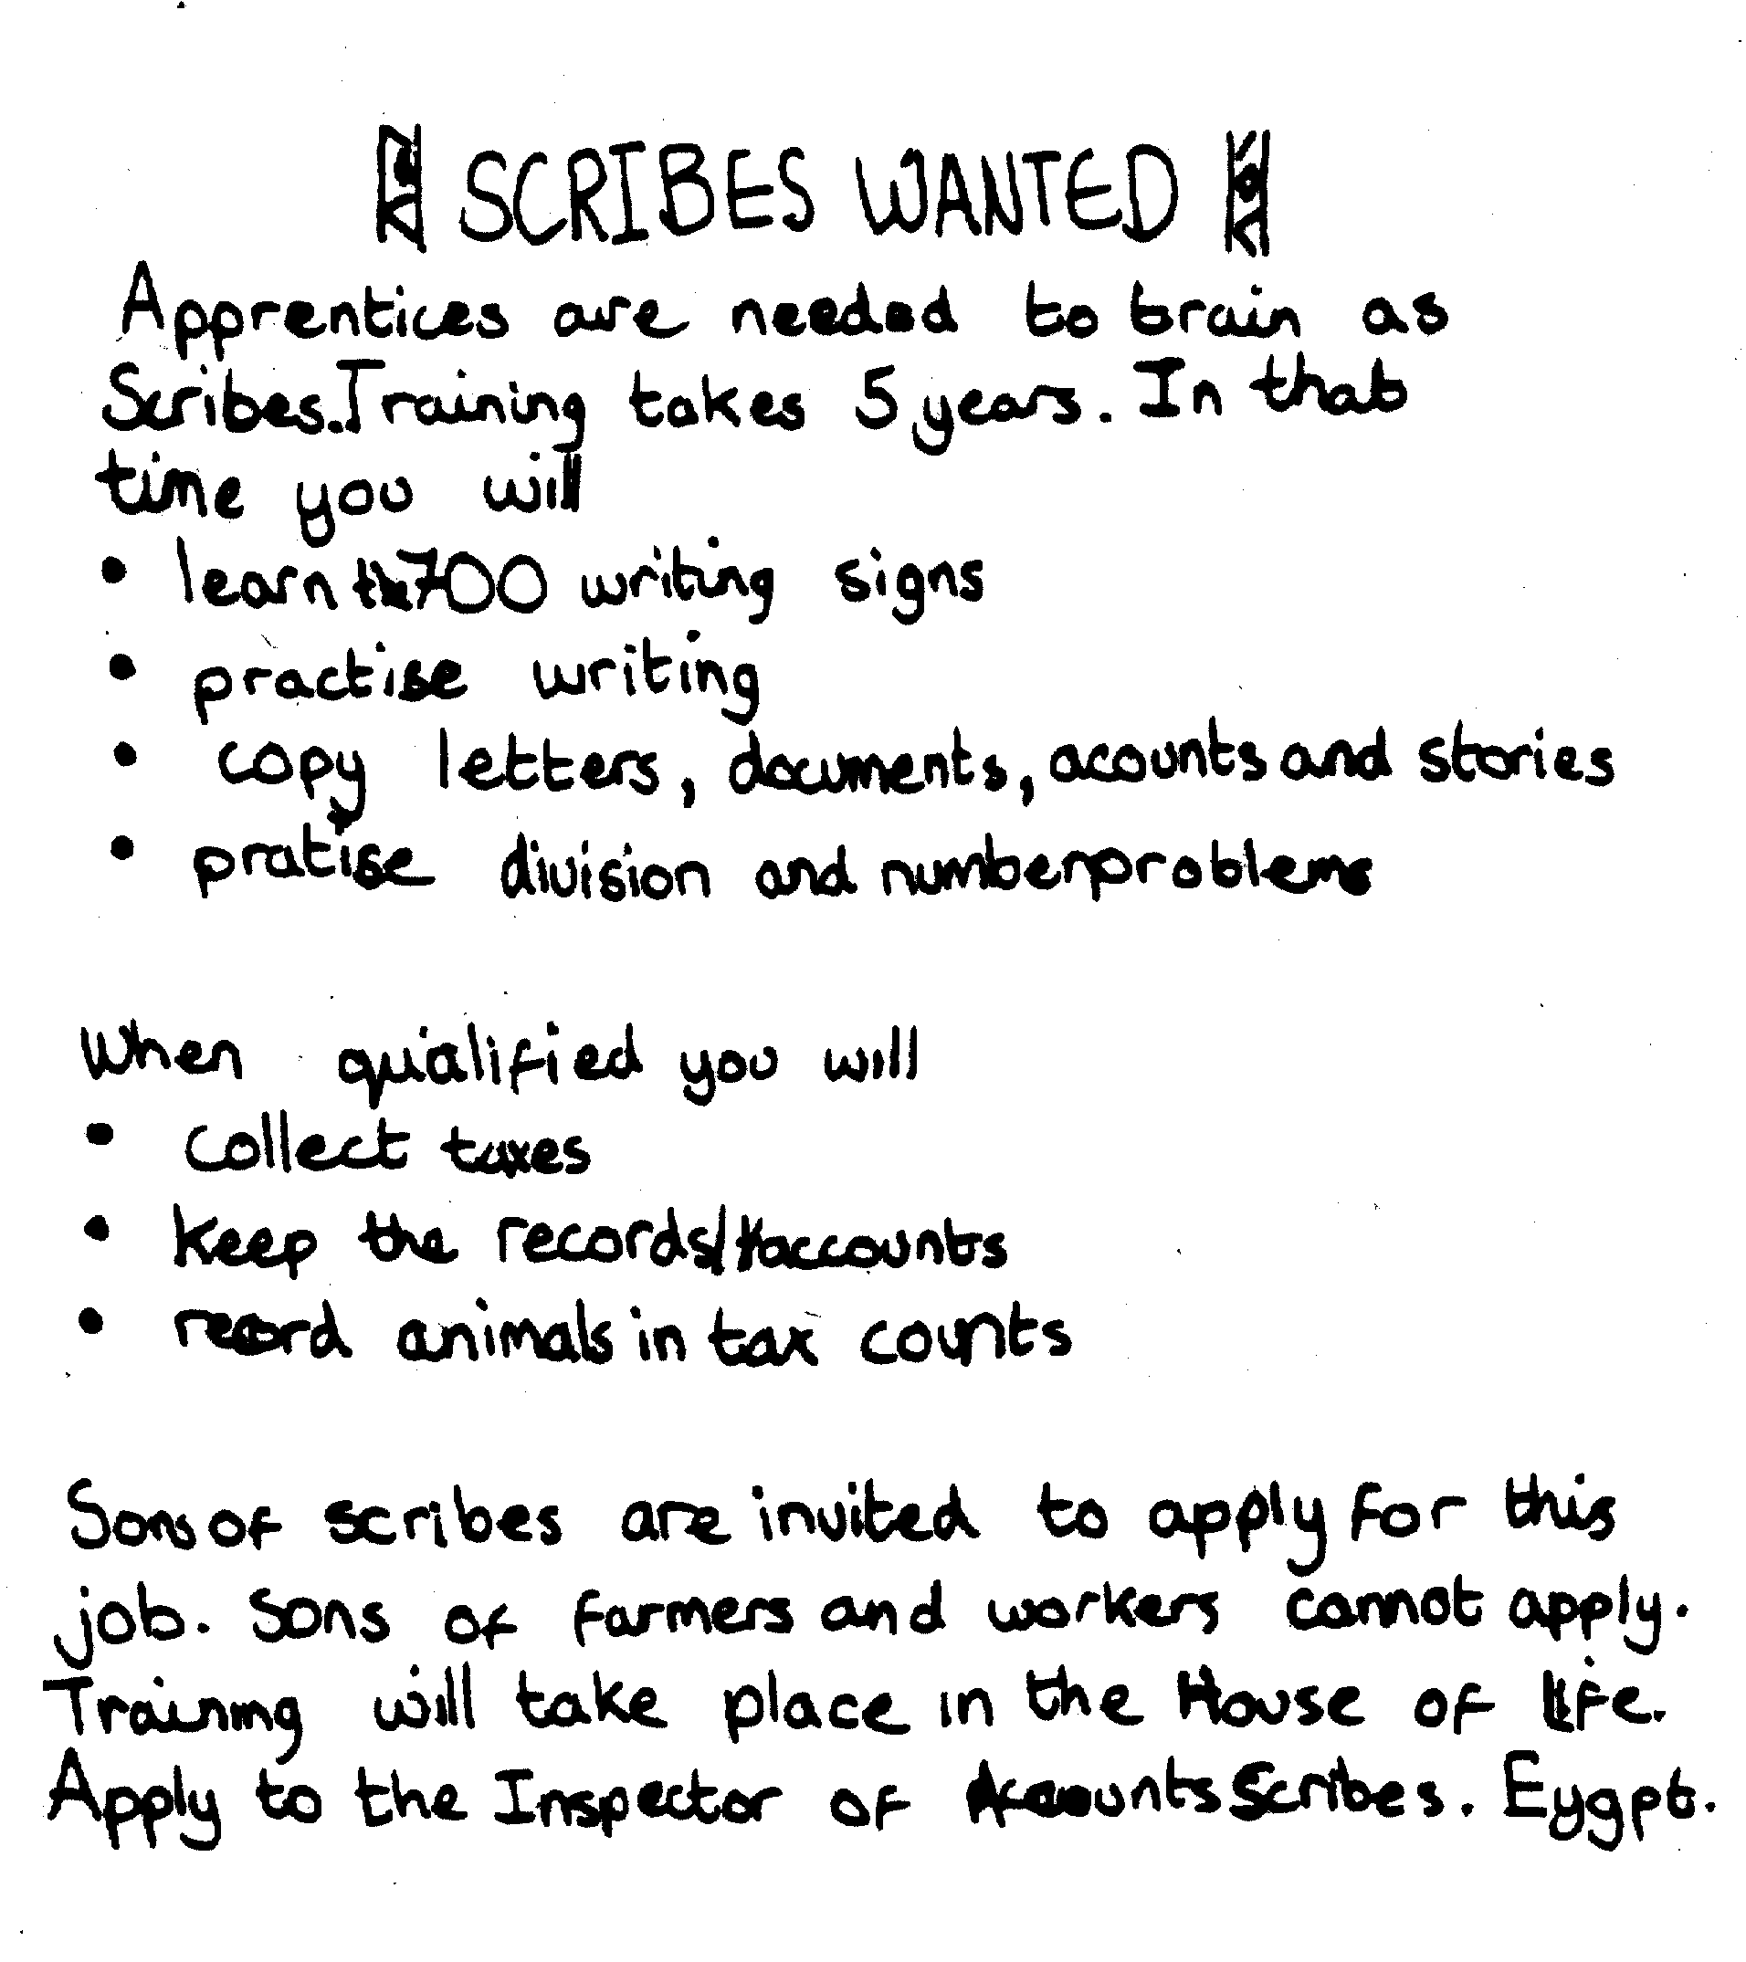

Slide 45
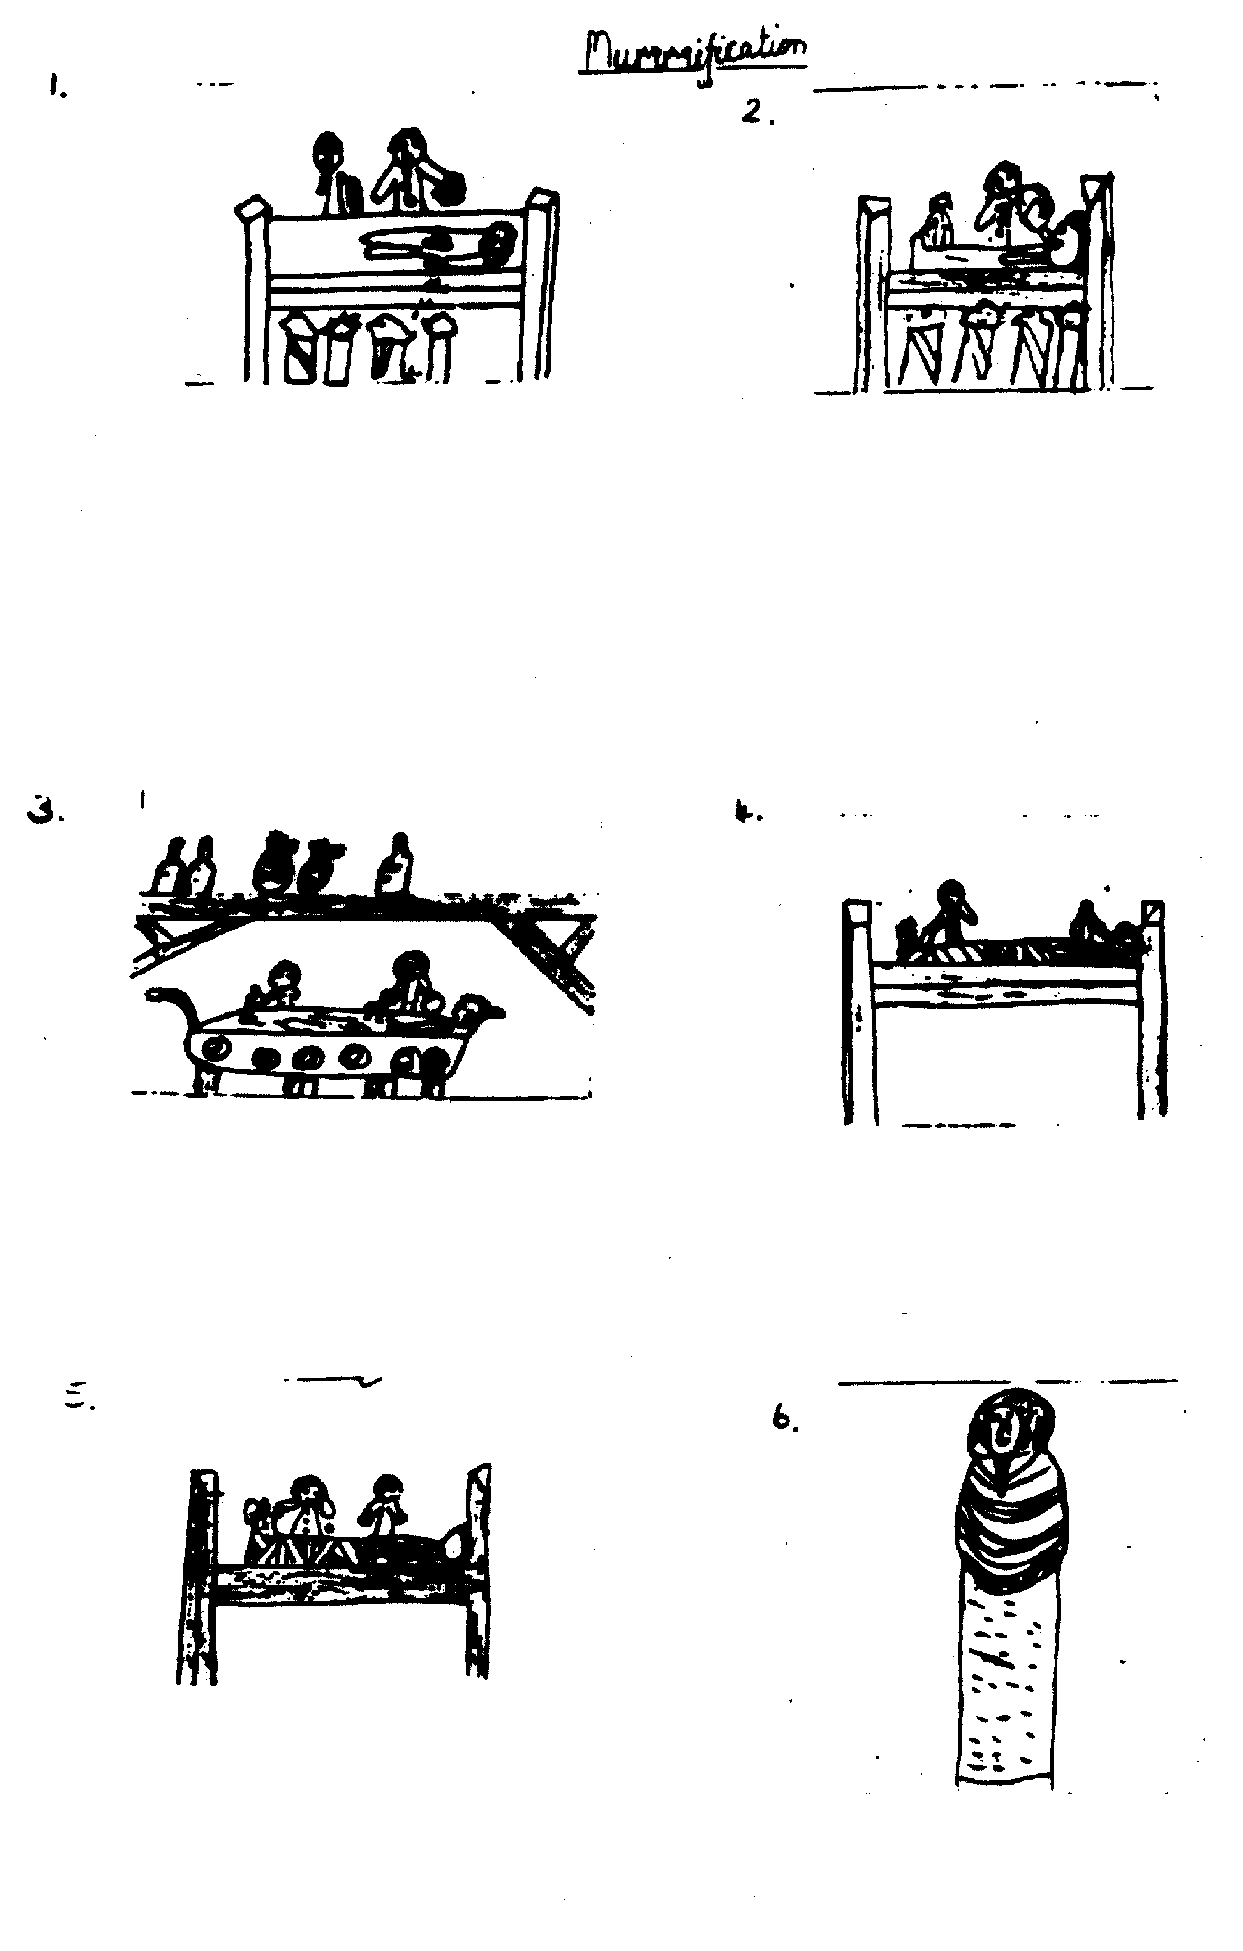

Slide 46
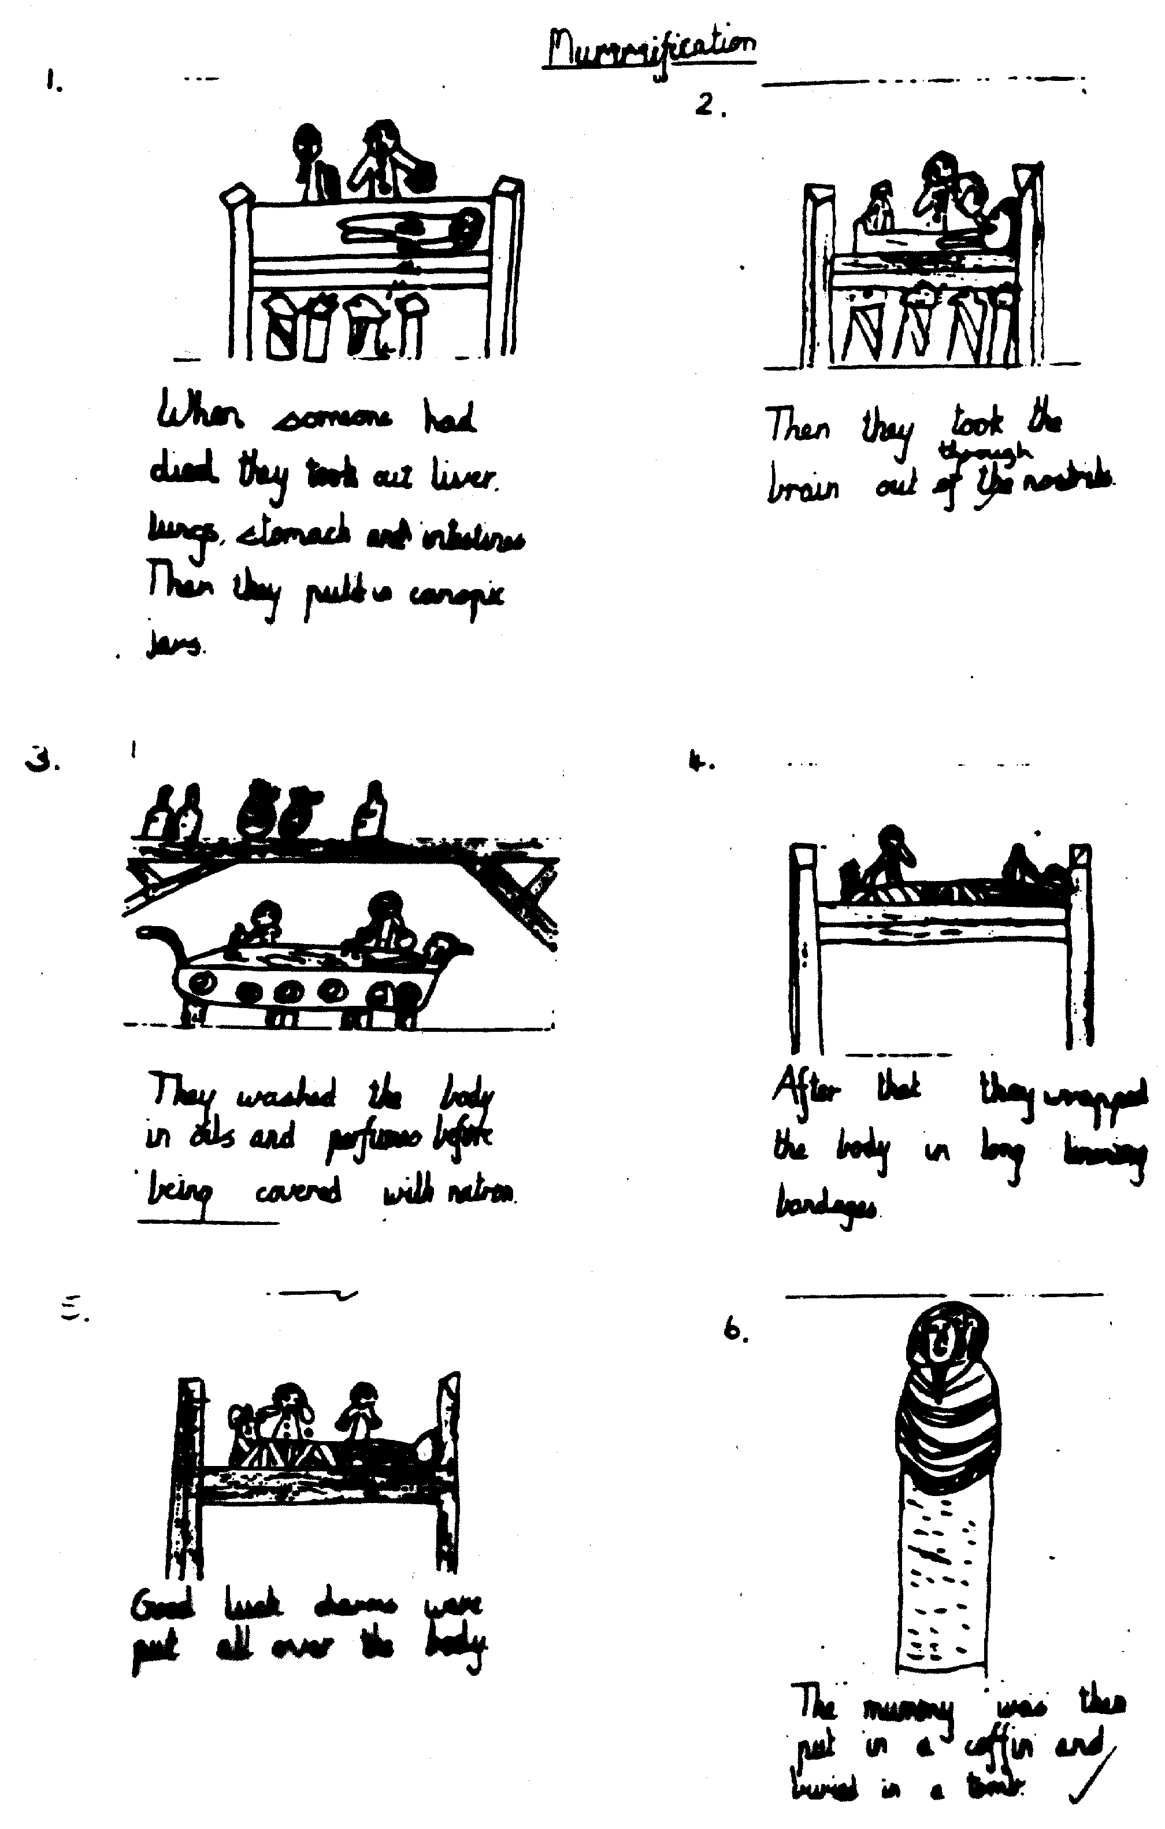

Slide 47
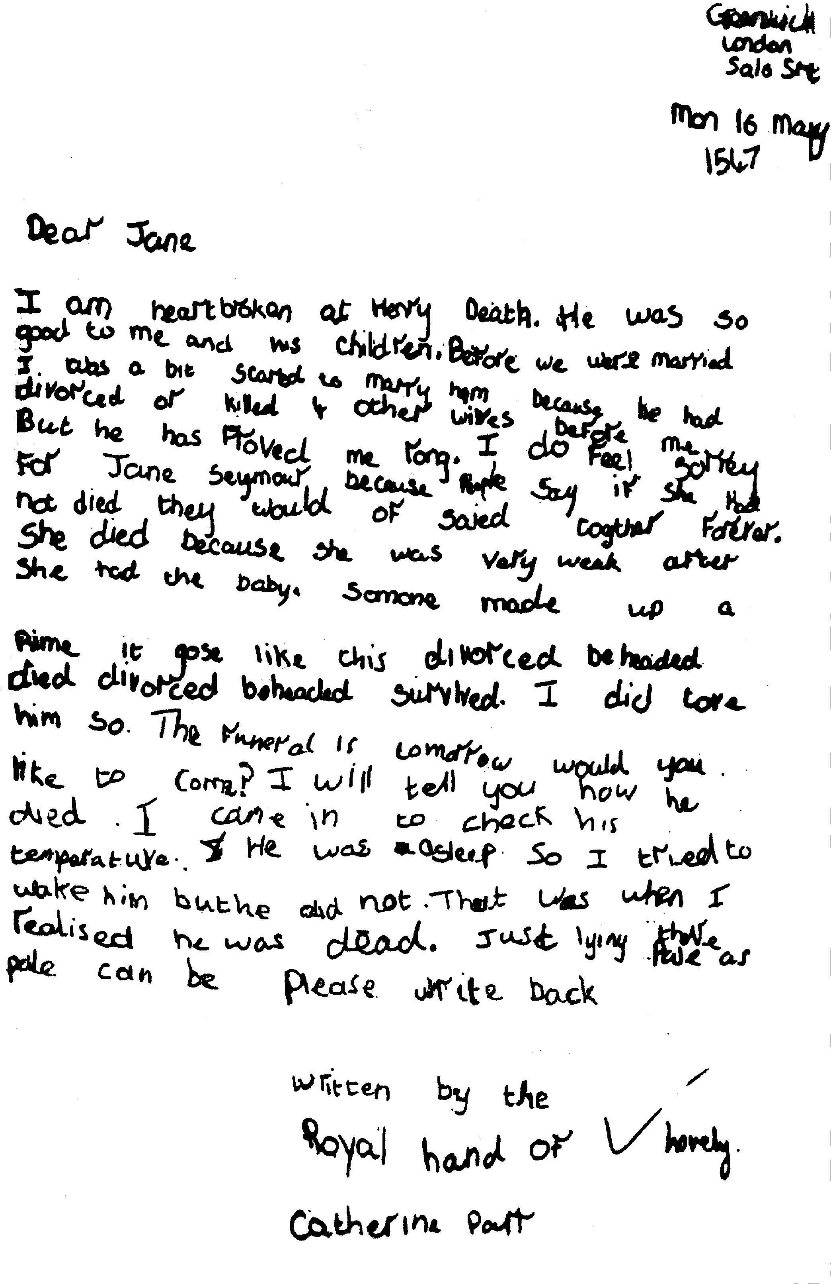

Slide 48
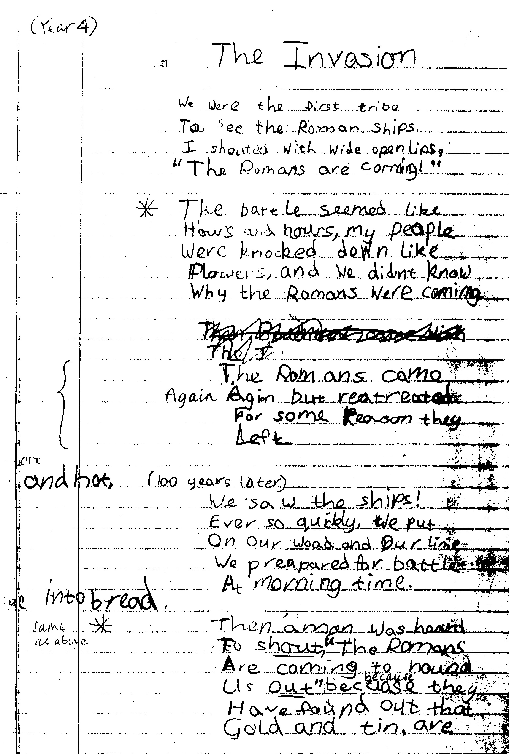

Slide 49
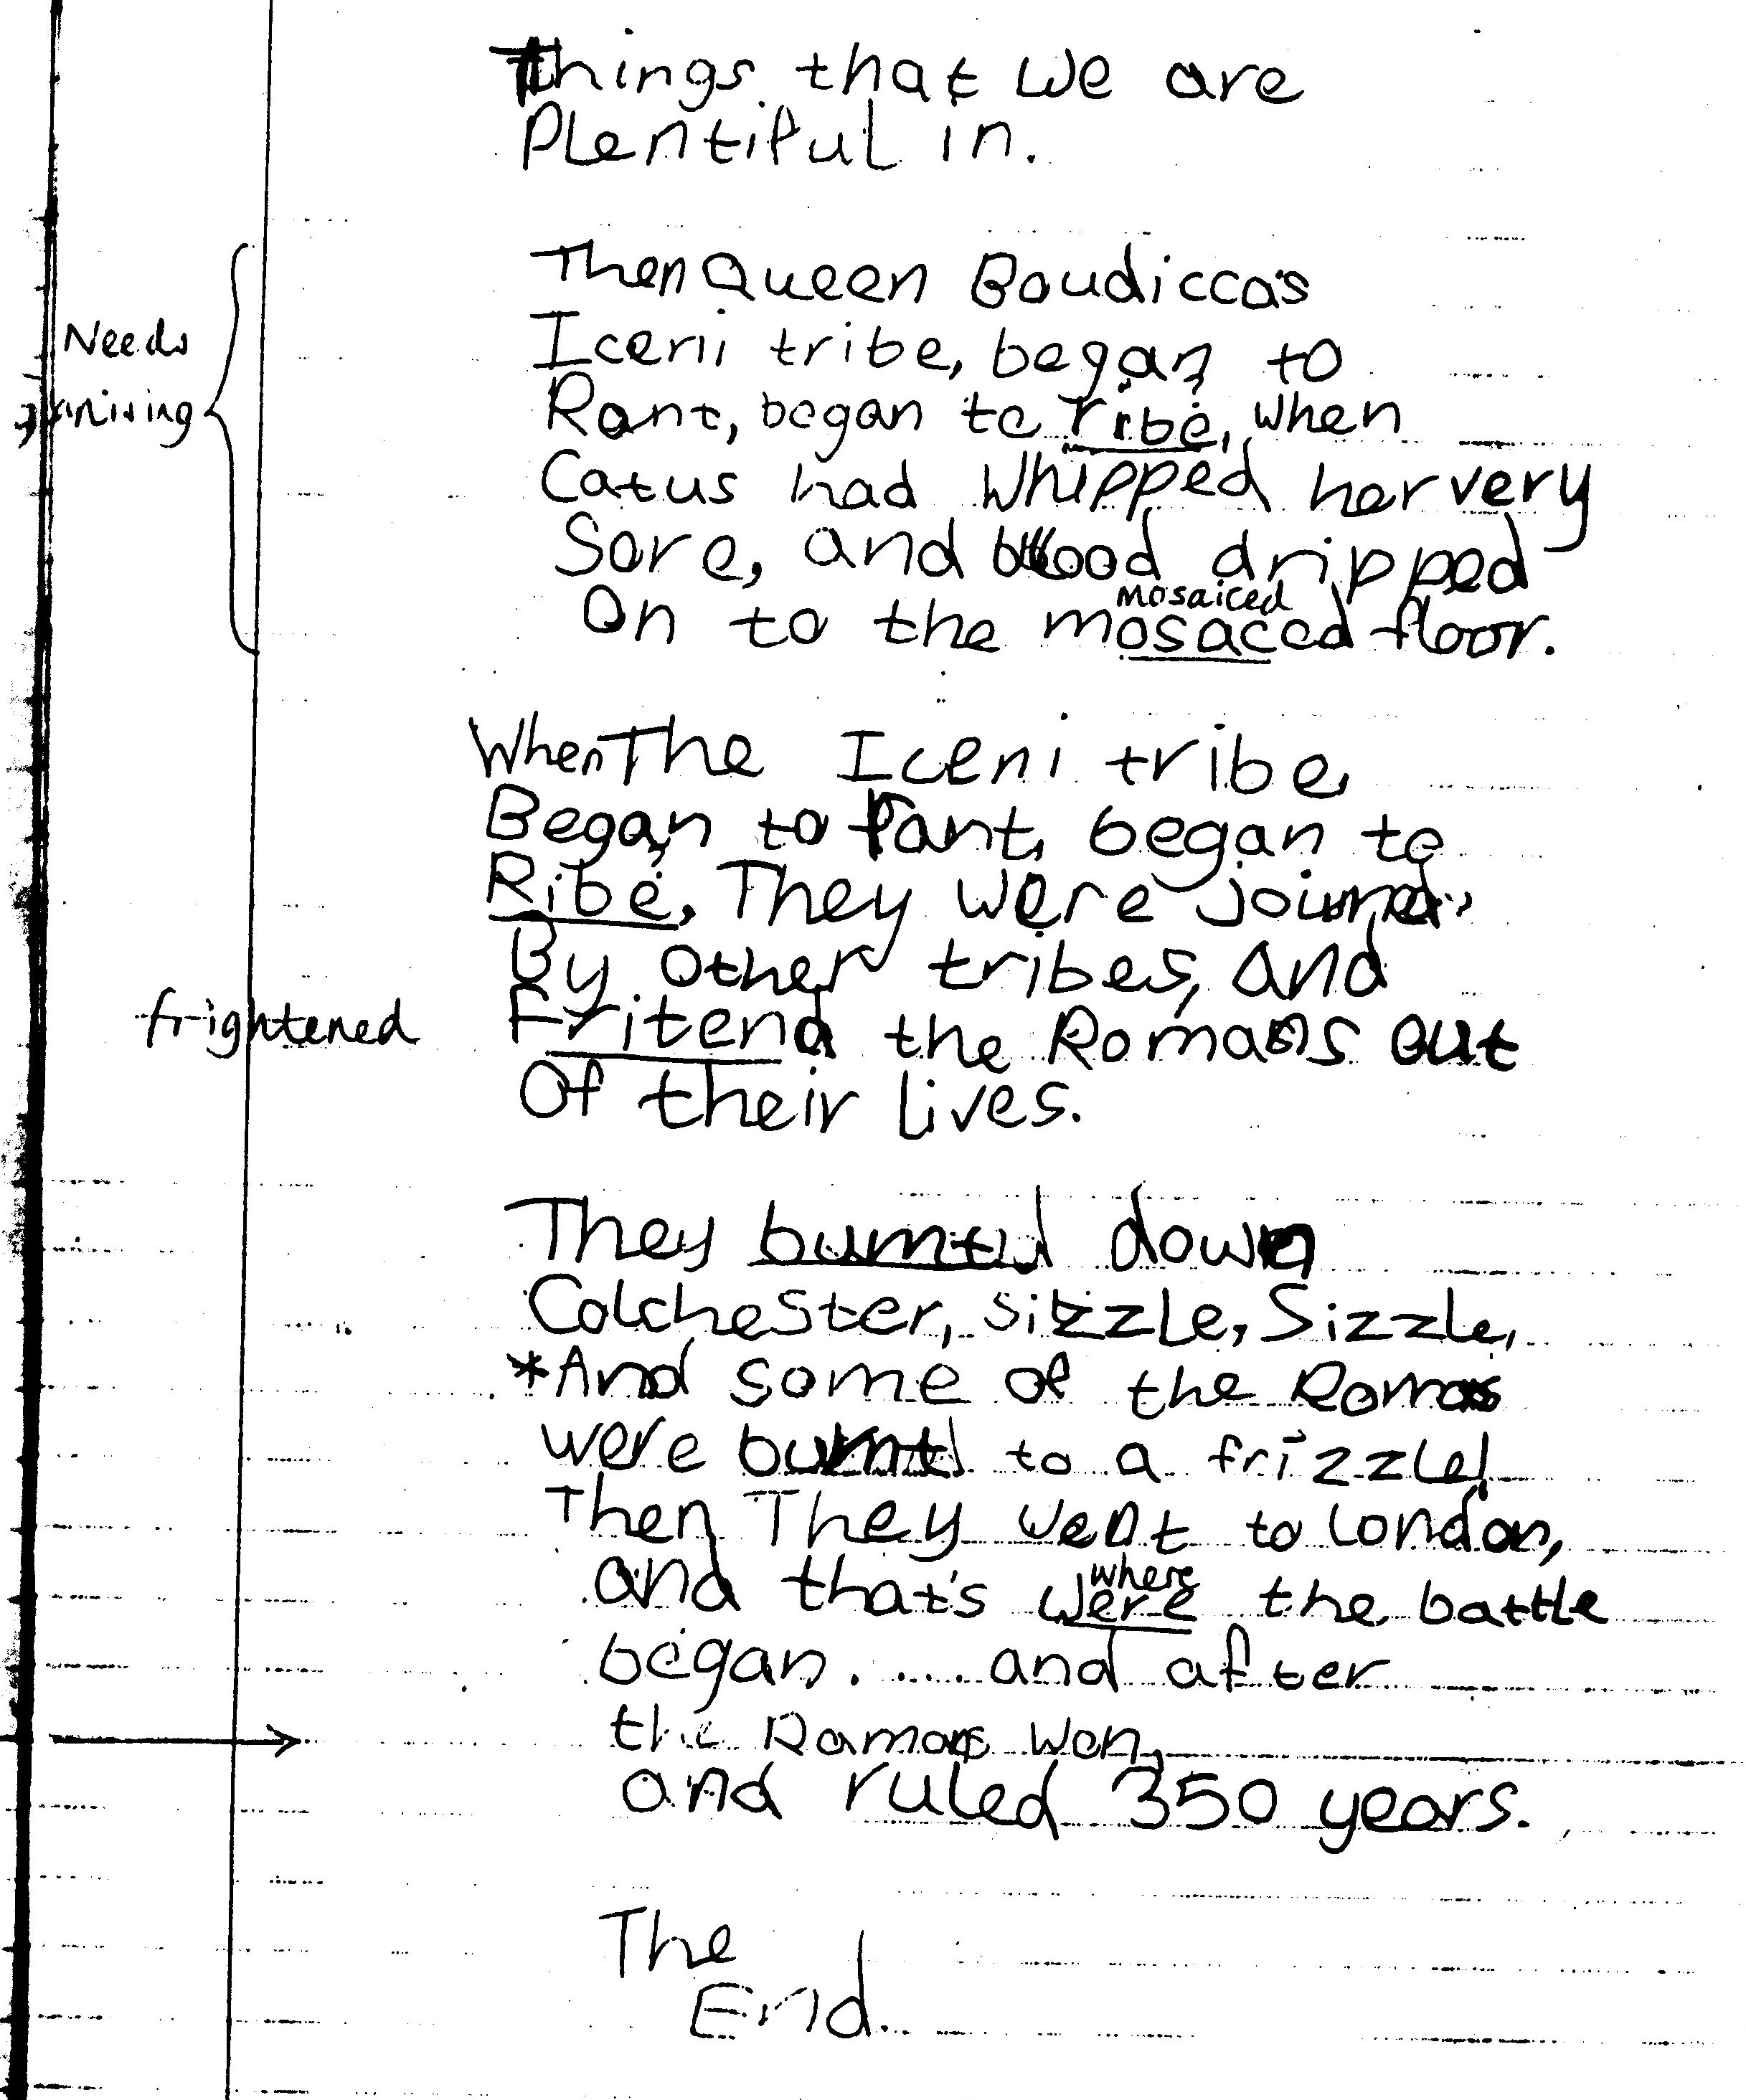

Slide 50
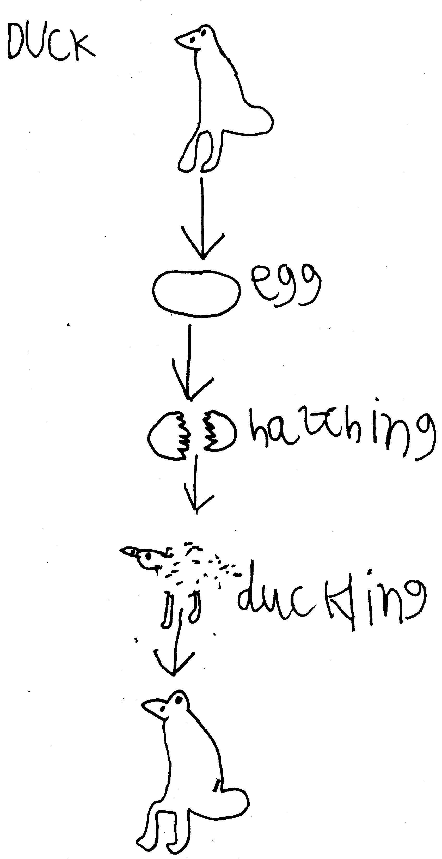

Slide 51
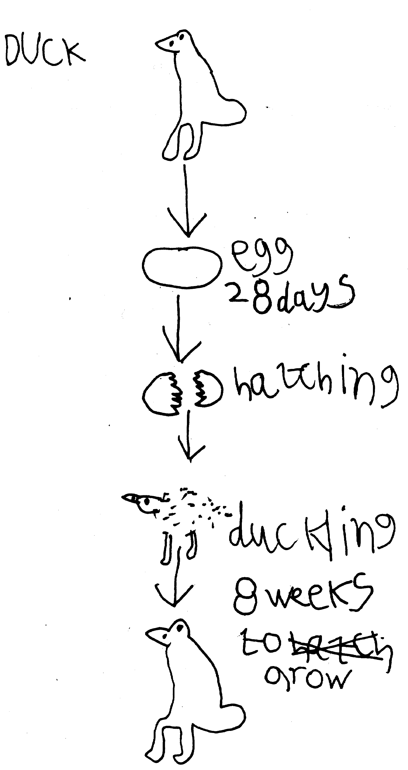

Slide 52

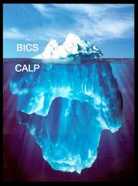
These examples show learners of a range of ages, and in a range of curriculum areas, using reading as a means to develop their learning.
As they read, they develop their language and their thinking.

