Slide 1

From
To Text Complexity

Slide 2
Readability morphs to text complexity
ACT (2006) reported on the testing of American high school students for their readiness to embark on study at college and University level.
Found that what differentiated the success of the students was not what are usually referred to as comprehension skills – looking for the main idea, making inferences, drawing conclusions from evidence, etc.
The difference, rather, lay in the abilities of the students to successfully read and respond to harder, more complex texts. Performance on complex texts was the clearest differentiator.

Slide 3
From readability to text complexity
Text complexity became a huge issue.
It was also realised that high school texts in the US had become easier.
But texts at college/university level, or in the workplace, had NOT become easier.
This inspired a reconfiguration of curricula to stress progressively more complex texts.

Slide 4
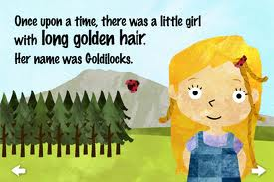
From readability to text complexity
From the Goldilocks principle

Slide 5
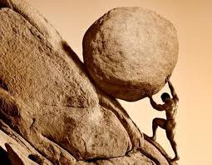
From readability to text complexity
To the Case for Struggle.

Slide 6
Conceptualising text complexity
A complex text can be described by the following six aspects (RSVP):
● Relationships: Interactions among ideas or characters in the text are subtle and involved.
● Richness: The text possesses a large amount of sophisticated information conveyed through data or literary devices.
● Structure: The text is organized in ways that are elaborate and sometimes unconventional.
● Style: The author's tone and use of language are often intricate.
● Vocabulary: The author's choice of words is demanding and highly context dependent.
● Purpose: The author's intent in writing the text is implicit and sometimes ambiguous.

Slide 7
Conceptualising text complexity
Current trends suggest that if students cannot read challenging texts with understanding — because they have not developed the skill, concentration, and stamina — they will read less in general.
In particular, if students cannot read complex text to gain information, they will turn to text-free or text-light sources, e.g. video, podcasts, and tweets. These sources, while not without value, cannot capture the nuance, subtlety, depth, or breadth of ideas developed through complex text.

Slide 8
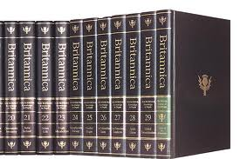

Conceptualising text complexity
As Adams (2009) puts it, “There may one day be modes and methods of information delivery that are as efficient and powerful as text, but for now there is no contest. To grow, our students must read lots, and more specifically they must read lots of 'complex' texts—texts that offer them new language, new knowledge, and new modes of thought”.

Slide 9
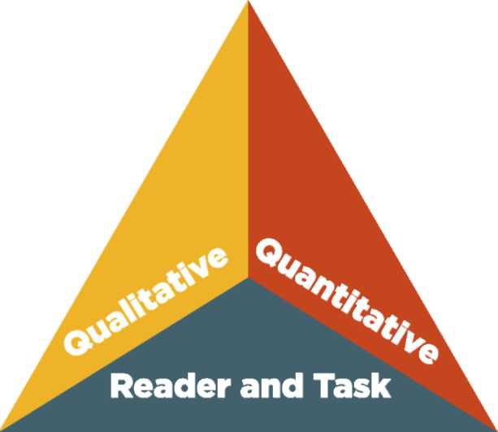
Conceptualising text complexity

Slide 10
Text complexity: Quantitative measures
(computer calculation)
Word frequency
Word length
Sentence length
Sentence complexity
Within-sentence and between-sentence cohesion measures
Newer measures beginning to use corpus-based approaches

Slide 11
Text complexity: Qualitative measures
(human judgement)
Structure
Language Conventionality and Clarity
Knowledge Demands
Levels of Meaning (literary texts) or Purpose (information texts)

Slide 12
Text complexity: Reader and Task Considerations
Variables specific to particular readers:
  motivation,
  prior knowledge,
  experience
Variables specific to particular tasks:
  purpose,
  complexity of the task,
  complexity of questions posed

Slide 13
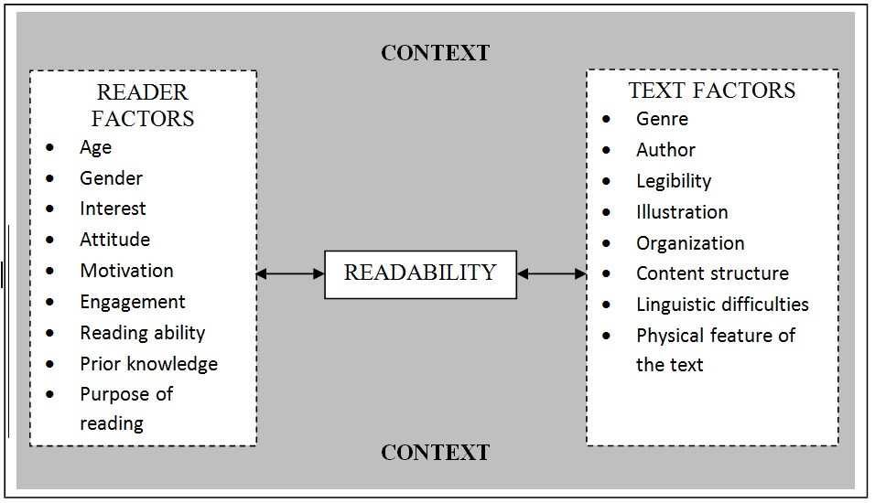
A new model of readability

Slide 14
A research agenda
Testing out the new model of readability in other languages and scripts

Slide 15
A research agenda
Testing out the new model of readability in other languages and scripts
Exploring whether the text complexity principle applies in other countries

Slide 16
A research agenda
Testing out the new model of readability in other languages and scripts
Exploring whether the text complexity principle applies in other countries
Exploring how teachers match texts to readers and how they can be helped to improve this (includes textbook production systems)

