Slide 1

Doing education research

Slide 2
Here we look at
Why do education research?
What types of problems do we have?
What types of research are there?

Slide 3
Why do education research?
Helps guide policy
Helps guide practice
Interesting in own right

Slide 4
What kind of practice questions do we face?
Examples:
Giving feedback
Use of questioning
Positive discipline
Use of group work
Online at home and in the classroom
(flipped classrooms, blended learning, VLEs and information presentation)

Slide 5
What kind of policy questions do we face?
Funding – what are priorities?
Social disadvantage
Leadership
CPD
Reform and how to bring it about
Competitiveness
Happiness and well-being

Slide 6
So where can we get the evidence
Types of research
Practice research
generalised findings
case study descriptions

Slide 7
Practice research
Action research, learning sets, reflective practice
Problem based often collaborative approaches
Bottom up

Slide 8
What is action research?
a systematic attempt to address a practical problem through cycles of planning, implementing and reflecting
Problem
Y7s are disengaged in my class
Reconnaissance
Are they? If so why? What have others done about it? What are my options ?
Design and planning
What will I set out to do? How can I do it?
Implementation
What did I do?
What forms of evidence did I collect?
Evaluation
How did it go? Evidence for impact? What addressed / not addressed?, New problems ?

Slide 9
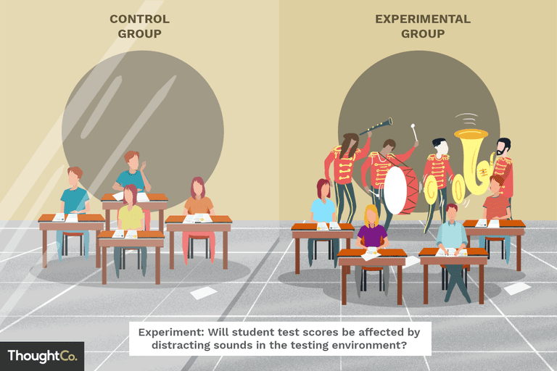
‘scientific research’

Slide 10
Systematic review
Identify your question (eg does homework work)
Identify sources (eg international academic journals)
Access sources (identify key words)
Synthesise findings around key ideas (eg pros cons methodologies)
Report findings

Slide 11
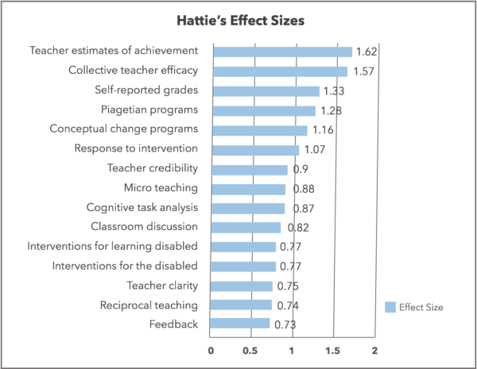
Meta studies- more quantitative

Slide 12
International comparisons
PISA results
International testing of large numbers of students
Identifies what works across systems

Slide 13
Scientific approaches
Intuitively strong
Highlight important issues
Help policy makers
But
Education is not a science – too many factors, values in dispute and too much human agency!
Distorting research to test outcomes

Slide 14
Case study research
Aims at locating what is happening and why happening
Relatable rather than transferable
Multi method, holistic

Slide 15
Examples
Deep and surface learners (Saljo and Marton)
Zone of proximal development (Vygotsky)
Three forms of capital (Bourdieu)

Slide 16
Case study
Pro:
Deep, context rich
Organises our thoughts
Assists practice and policy
Con
Small scale
Application uncertain

Slide 17
Education research
A science or an art?
Driven by values or by evidence?
What kind of research do you want to carry out?
What are the key challenges in education research?

Slide 18
Problems and research approaches
What are the key problems in education
Policy? Funding curriculum well being
Practice? CPD, pedagogy, culture
What are the research priorities?
Large scale intervention programmes
Case studies, action research inquiries

