Slide 1



Education Support:
Prioritising wellbeing as an ECT

Slide 2
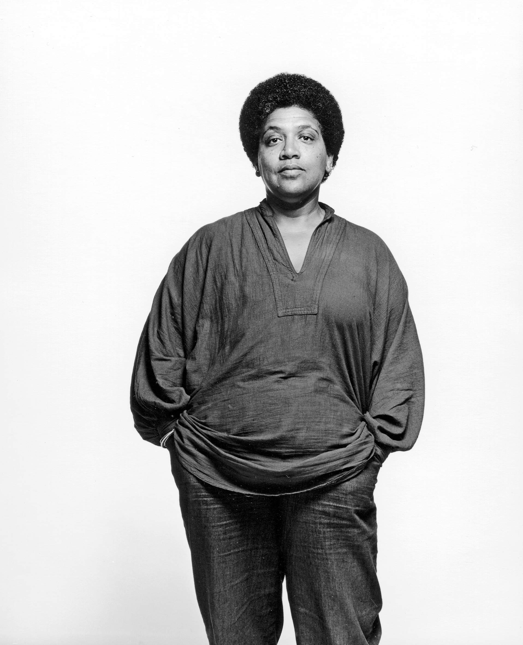
“Caring for myself is not self-indulgence, it is self-preservation……..”
- Audre Lorde

Slide 3




150 years
Education Focused
Charity
Notes:
Who we are:
Our mission is to improve the mental health and wellbeing of teachers and education staff. We believe that better mental health leads to better education.
We support individuals and help schools, colleges and universities to improve the mental health and wellbeing of their staff. We also carry out research and advocate for changes in Government policy for the benefit of the education workforce.

Slide 4



Supporting You

Slide 5



Helpline
Free and confidential
Open 24/7
Staffed by qualified counsellors
08000 562 561
Notes:
Our helpline is available for everyone working in education, including teachers, support staff, lecturers, administrators and teaching assistants. Our helpline offers immediate, emotional support.

Slide 6


Helpline
“The helpline counsellor gave me permission to feel what I was feeling. Get in touch as soon as you feel things aren’t right. The call really helped me.”
- Teacher

Slide 7




Online resources
Notes:
We also have a great bunch of resources available online – a great starting point for education staff and teachers who are not quite ready to use and call our helpline service, but want to receive mental health support.
We also have articles, videos and guides to help your organisation with mental health and wellbeing.
Access our resources on our website: educationsupport.org.uk/resources.

Slide 8

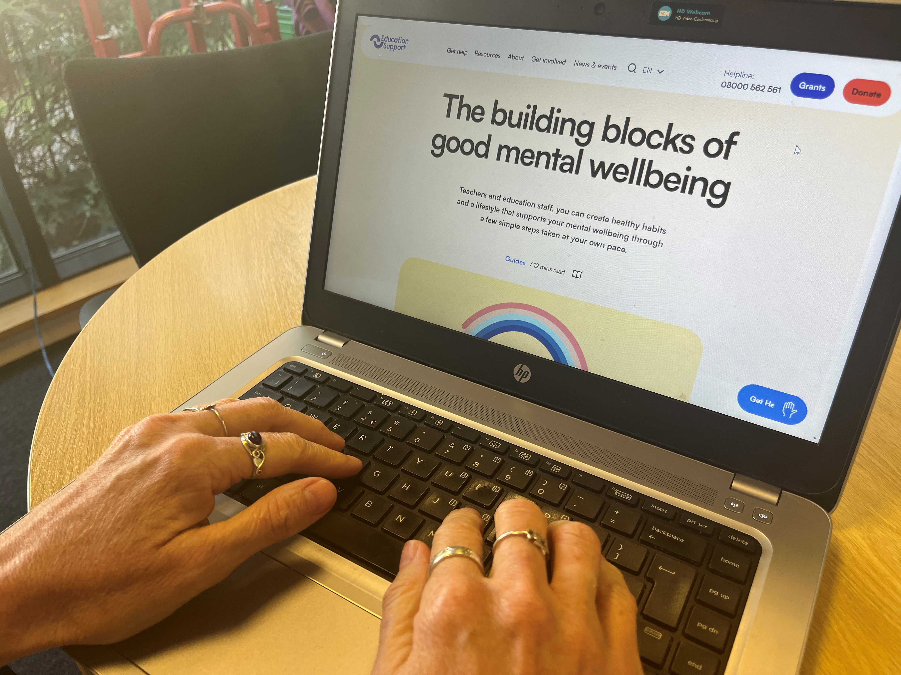

There’s more…
Our website has a wealth of free resources, all the latest news as well as wellbeing events you are welcome to join.
Sign up for our newsletter!
educationsupport.org.uk/subscribe
Notes:
Please visit our website: educationsupport.org.uk

Slide 9

Get Involved
As a charity, our services are funded by the generous support of our donors.
Help us be there for teachers and education staff whenever they need support.
educationsupport.org/donate
Notes:
We are a charity, and we are always grateful to anybody who is able to donate or support us with fundraising.
For information on how to get involved – whether that be to fundraise/donate or get involved in any other way, please visit our website.

Slide 10


Thank you
Enquiries@edsupport.org.uk
educationsupport.org.uk @edsupportuk

