Slide 1



27TH JUNE 2025
DAMIAN MAWDSLEY
Prioritising your wellbeing as an Early Career Teacher
Notes:
Good morning. I’m Damian, and I’ve been invited here today to talk to you about the Charity Education Support, and hopefully give you some valuable information and guidance about maintaining high levels of wellbeing and mental health as you move into the next stage of your career.

Slide 2



Congratulations!
educationsupport.org.uk @edsupportuk
Notes:
But first, congratulations. By taking the next step into teaching you have the opportunity to shape the future the futures of the young people you will teach. Education is a vital driver of social equality, and social justice was mentioned earlier, and you will all be at the forefront of this – a hugely important role!
Teaching is often talked about as a calling, and is considered a vocation, but the idea of a vocation can be a trap.
It is based on the idea of sacrifice and all of the latest research in neuroscience, biology and psychology tells us sacrificing ourselves is counter productive. We perform at our best and therefore give the most when we are well rested and in a good place mentally and physically.
Many teachers put their pupils, their colleagues and the school before themselves. I’m going to talk to you today about the importance of wellbeing and looking after yourselves. Andy mentioned being a subversive teaching and changing habits and ways of working. You can also change the approach to wellbeing in your schools.

Slide 3
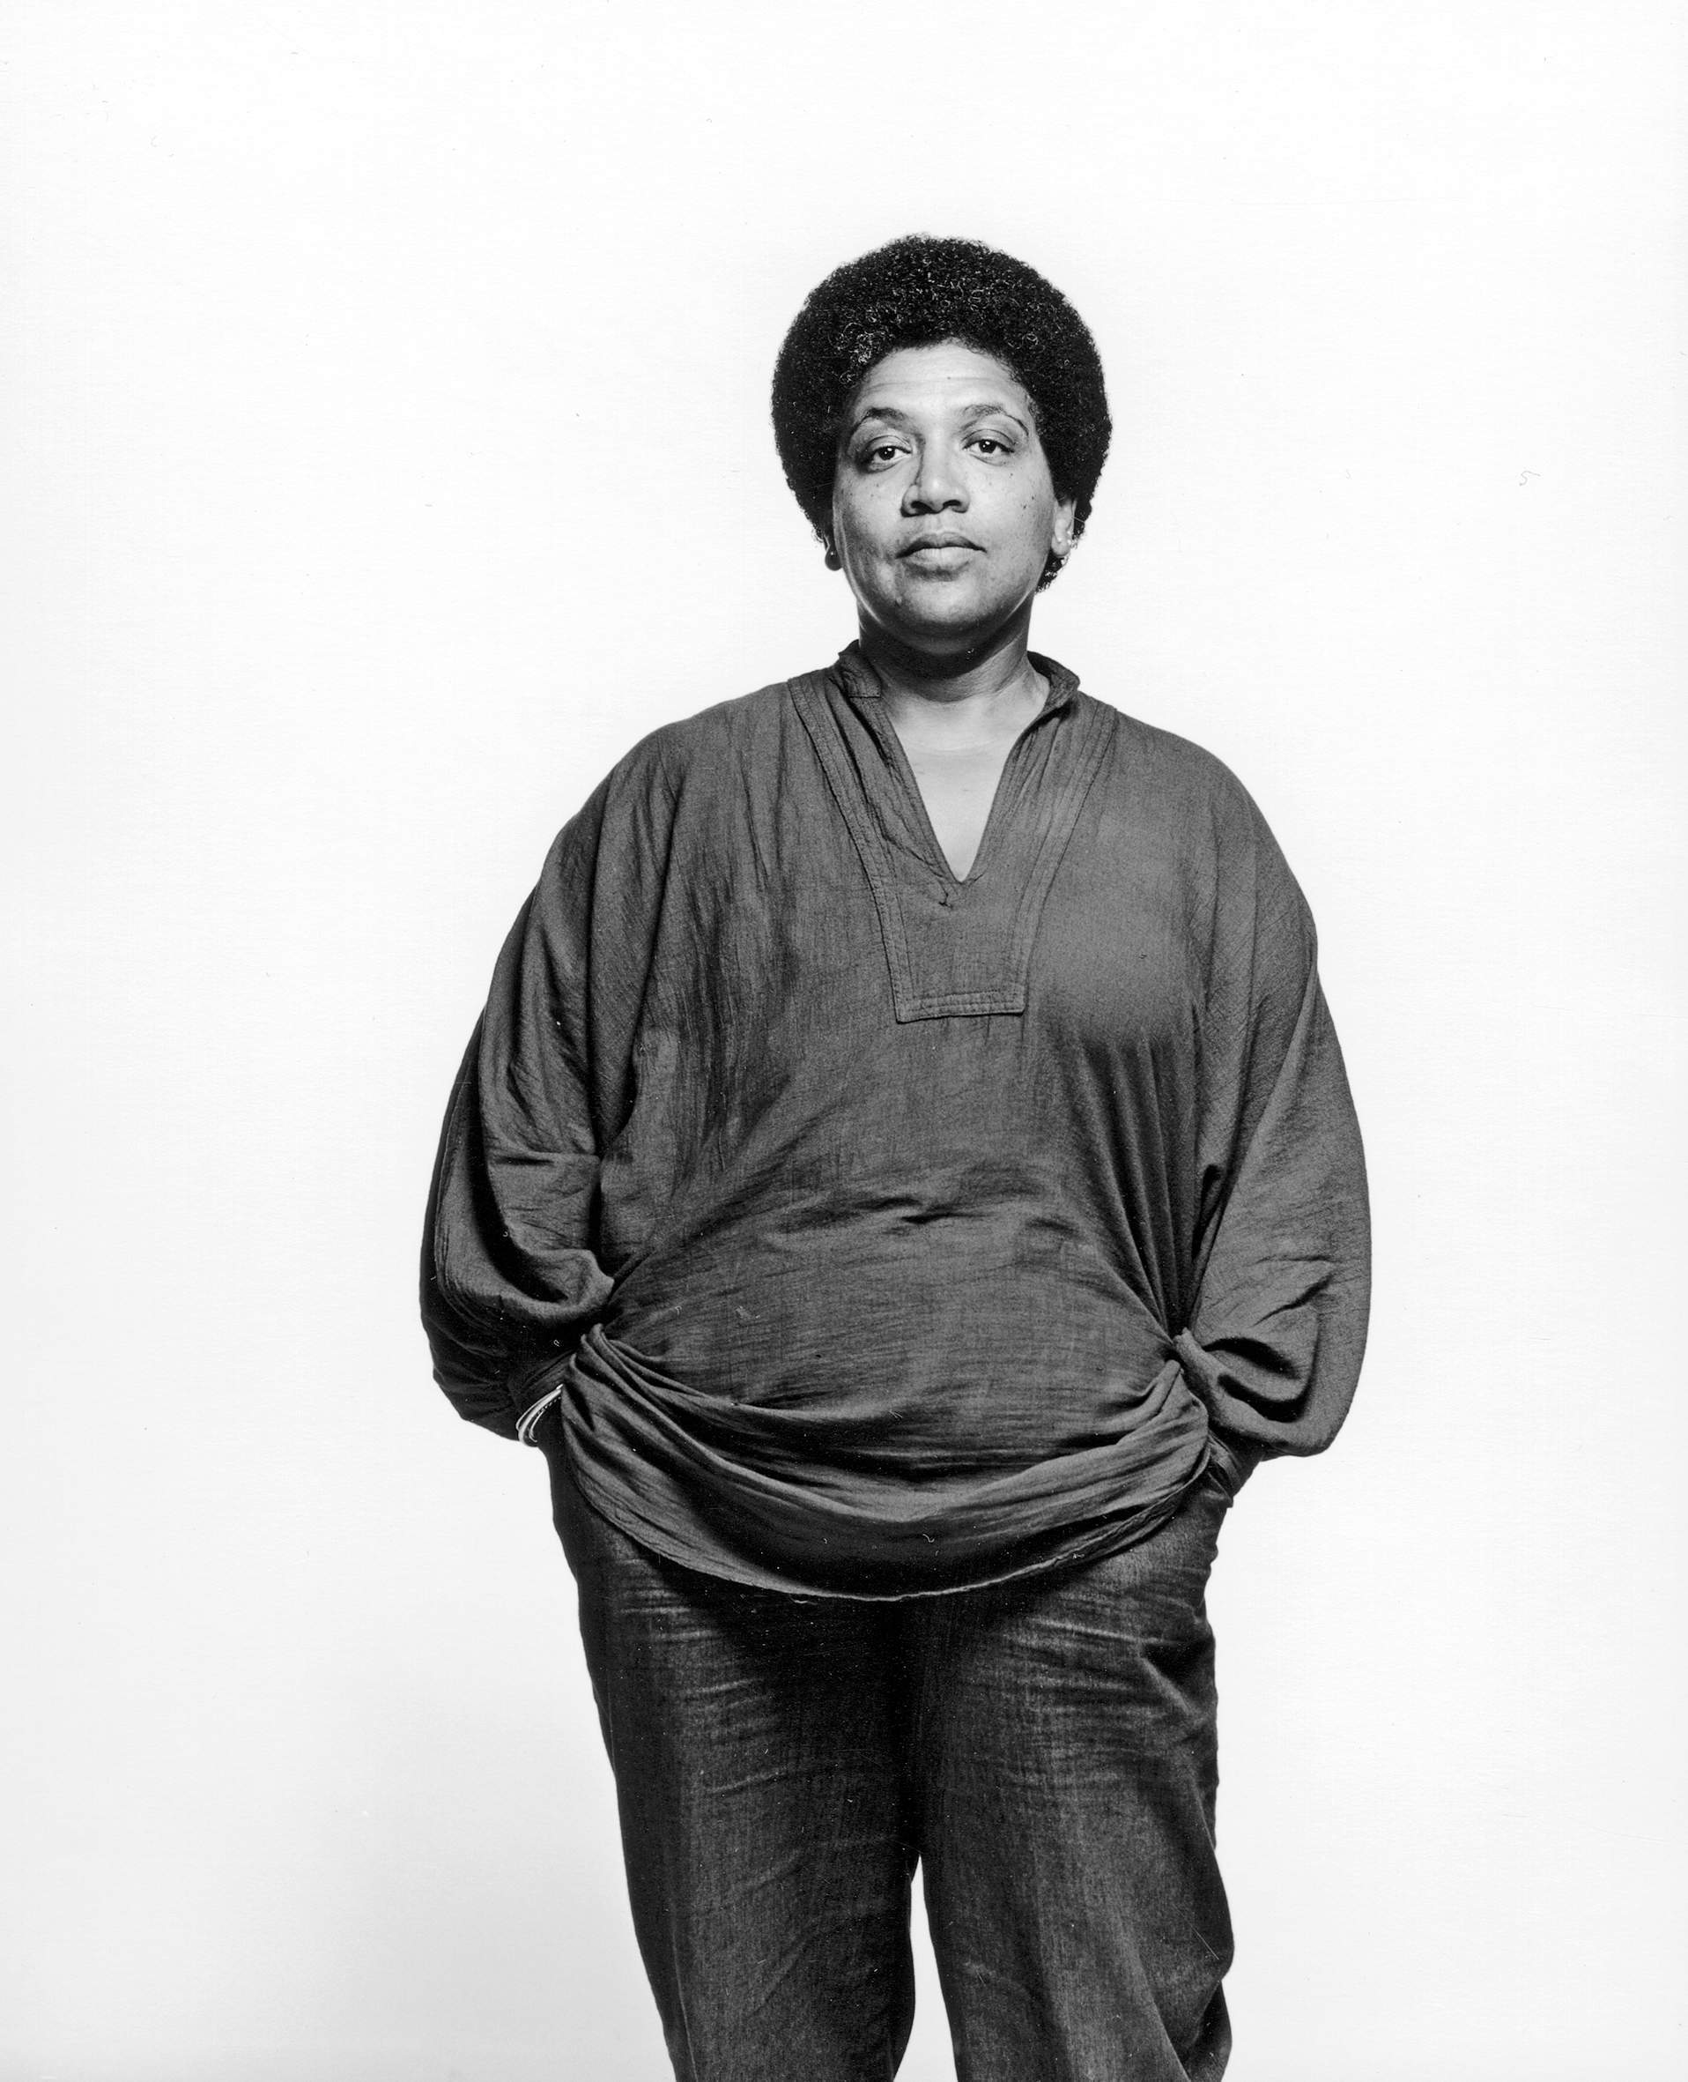
“Caring for myself is not self-indulgence, it is self-preservation……..”
- Audre Lorde
Notes:
Audre Lorde is a bit of a hero at Education Support, and this quote from her absolutely nails how wellbeing should be seen

Slide 4


What do we mean by wellbeing
“Wellbeing: A state of complete physical, mental and social wellbeing and not merely the absence of disease or infirmity.​”
World Health Organisation, 2012
Notes:
What is wellbeing. This is the definition from the World Health Organisation

Slide 5
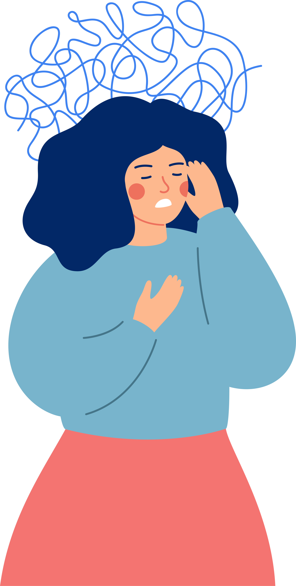
My very complicated theory of teacher wellbeing
Stressors
Protective resilience
Notes:
Technically, this isn’t my theory
It is also not particularly complicated.
To maintain high levels of teacher wellbeing we need to reduce stressors
CLICK
and increase protective resilience
CLICK
So less talk stress

Slide 6
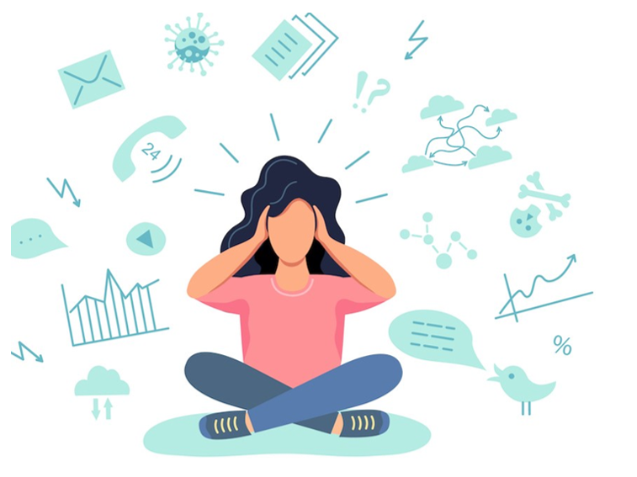
Stressors
Notes:
STRESSOR
These are external things and may include
Expectations
Assessments
Competing priorities
Challenging relationships
Not enough hours in the day

Slide 7
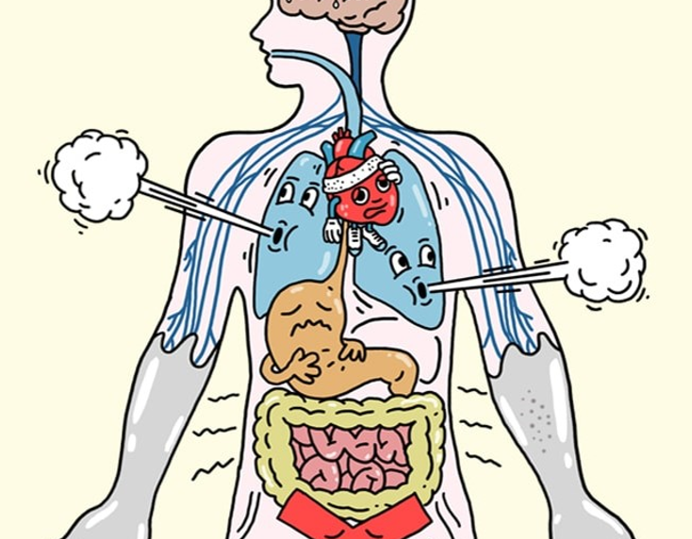
Stress
Notes:
That results in STRESS, an Embodied response to the stressor
You will have an activated stress response ‘i.e. fight or flight’
Chemicals are released in your body: cortisol, adrenaline, epinephrine, glucocortoids, endorphins
It is a multisystem response to help you escape
Crucially it is a cycle to be completed

Slide 8
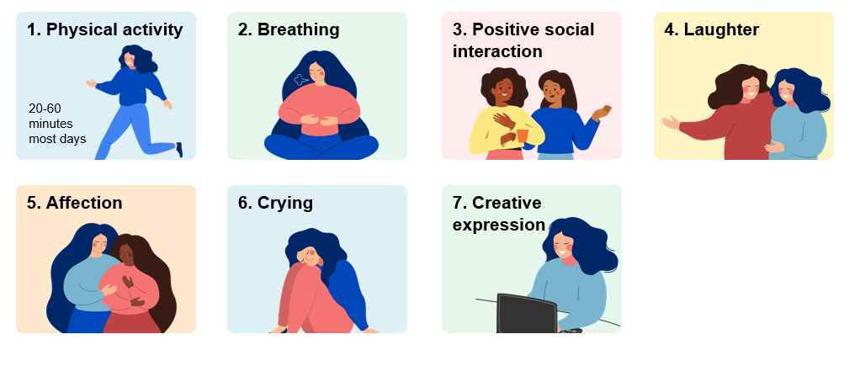
7 evidence-based strategies for completing the stress cycle
Notes:
And these are some ways that you can complete that cycle.
I won’t got through them all, and during the working day some may not be possible. I am also sure some will induce an element of eye rolling, and I understand that, but
Going out for a walk at lunch time is crucial/
Using breathing techniques can be done in many environments
Make sure you take time to speak to colleagues during the day.
All of these things will help you to complete the stress cycle.

Slide 9
Teacher wellbeing: Cliché versus reality
Ten wellbeing clichés (yes, we know!)
Get eight hours’ sleep a night
Get up at the same time each day
Eat five portions of fruit and vegetables a day
Avoid alcohol
Drink 3 litres of water a day
Join a gym!
Indulge in pampering sessions
Schedule ‘date nights'
Limit social media
Use appropriate language at all times
Notes:
Lets look at some wellbeing clichés.
I won’t read these out
And we aren’t saying they aren’t important
But we do know that they aren’t necessarily the right fit for teachers

Slide 10
Teacher wellbeing: Cliché versus reality
Ten tips to survive and thrive at school which work for teachers
Invest in a water bottle that keeps water cool
Keep dried fruit in a drawer
Implement a buddy system
Take the outdoor route and look up!
Communicate face-to-face when you can
Have people to cackle with
Unsync your work email from your phone
Leave on the bell at least once a week
Mark standing up
Find safe spaces in school
Notes:
However, these tips we know do work for teachers.
I wont go through them all but I will flag up a few
CLICK
Fresh air can make such a difference – so get as much as you can!
CLICK
Being able to switch off is essential – and it wont happen if you have work on your personal device
CLICK
Create healthy habits like leaving on the bell at least once a week

Slide 11

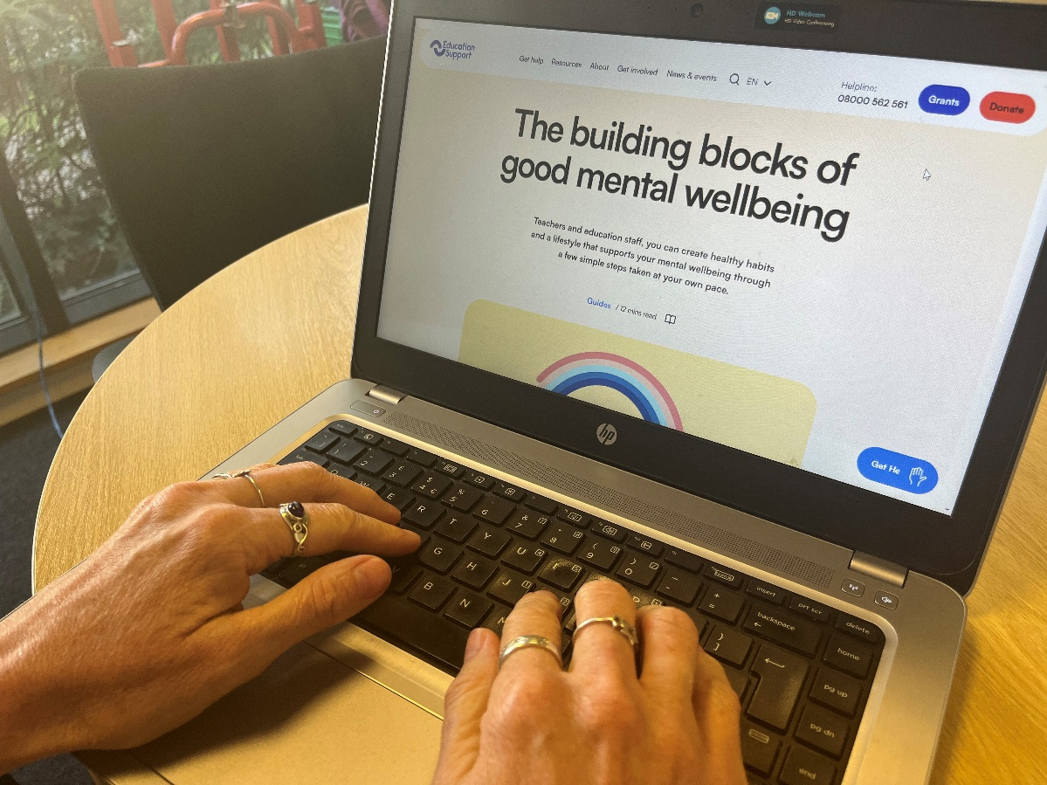
Getting Support
Mentor
Line manager
HR
Union
Friends and family
Education Support
Notes:
Asking for support when you need it is important
So often we see that issues that are ignored or not properly addressed will escalate into more severe scenarios – so always ask for support at the earliest opportunity
CLICK
Lean on support mechanisms at school
CLICK
Speak to other professional support such as your unions
CLICK
Speak to you friends and family
CLICK
And finally, use the services Education Support that I will talk about now

Slide 12




4,178 people supported by our helpline
150 years working in education
564 grants awarded
Notes:
As a charity, our mission is to improve the mental health and wellbeing of teachers and education staff. We believe that better mental health leads to better education.
We support individuals and help schools, colleges and universities to improve the mental health and wellbeing of their staff. We also carry out research and advocate for changes in Government policy for the benefit of
the education workforce.
CLICK
We understand education and have supporting staff in education for almost 150 years.
CLICK
Our free helpline provided support to over 4000 people last year
CLICK
And in the same period we supported over 550 people with our Grants service
As I am sure you can imagine, improving the health and wellbeing of the entire education workforce is not a straightforward task
So how do we approach this?

Slide 13
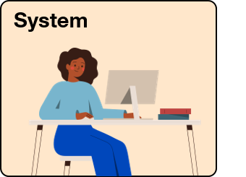
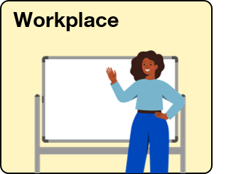

How we work
Notes:
We often talk to teachers and education staff like you about setting boundaries and caring for yourselves.
Sometimes this involves meditation, yoga, or other stuff that might make you roll your eyes.
We get it, no amount of yoga can make you feel well at a school with an unkind culture. And meditation can’t fix systemic challenges in the education system.
That’s why we focus our efforts at three distinct levels - Individual, Workplace and System.

Slide 14
How we work
Notes:
Today I will focus on how we support individual members of the workforce, every day
Teachers and education staff are working hard as part of this system.
We want to arm you with skills to manage your wellbeing and mental health because system and culture change is gradual. In the meantime, you’re trying your best every day.
We provide that support in a number of ways

Slide 15

Helpline
Free and confidential
Open 24/7
Staffed by qualified counsellors
08000 562 561
Notes:
CLICK
Our helpline is available for everyone working in education, including teachers, support staff, lecturers, administrators and teaching assistants.
CLICK
It can be accessed at any time of day and night to offer immediate emotional support.
CLICK
Crucially, not only will you be able to get straight through to a qualified counsellor, but the counsellors are trained in the education sector so understand the specific challenges you face

Slide 16

Helpline
“The helpline counsellor gave me permission to feel what I was feeling. Get in touch as soon as you feel things aren’t right. The call really helped me.”
- Teacher
Notes:
As you can see from this side, the service is highly valued by those using it – please make a note of the number for future reference

Slide 17
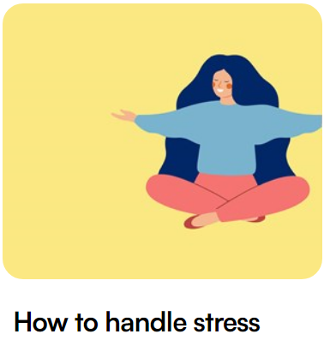


Online resources
educationsupport.org.uk/resources
Notes:
Beyond the helpline we have a bunch of resources available online
These are a great starting point for education staff and teachers who are not quite ready to use the helpline service, but want to receive mental health support.
We have articles, videos and guides to help you and the schools you will be working in with mental health and wellbeing.
CLICK
You can access these resources on our website
CLICK

Slide 18


Grants
Available to everyone in education
Financial help with essential costs:
food
rent/mortgage
utility costs
essential household items
travel to work costs
www.educationsupport.org.uk/grants
Notes:
CLICK
We offer a financial grants service for teachers, teaching assistants, supply and support staff, lecturers and retired staff across the UK.
CLICK
The grants can help with a range of essential costs
CLICK
And you can see some examples on the slide now
CLICK
Eligibility criteria and how to apply can be found on our website
CLICK

Slide 19
There’s more…
Our website has a wealth of free resources, all the latest news as well as wellbeing events you are welcome to join.
Sign up for our newsletter!
educationsupport.org.uk/subscribe
Notes:
Please visit our website: educationsupport.org.uk

Slide 20
Get Involved
As a charity, our services are funded by the generous support of our donors.
Help us be there for teachers and education staff whenever they need support.
educationsupport.org/donate
Notes:
As I mentioned at the start of this presentation, we are a charity, and we are always grateful to anybody who is able to donate or support us with fundraising.
For information on how to get involved – whether that be to fundraise/donate or get involved in any other way, please visit our website

Slide 21
Thank you
educationsupport.org.uk @edsupportuk

