Slide 1
Your Student Membership
Join your professional body for FREE
Presented by:
Carrie Loughran-Smith
Partnerships Manager

Slide 2


Slide 3

Today
The Chartered College, who we are and why we exist How membership can support your training How to make the most of your membership as you study Ideas of resources to get you started

Slide 5
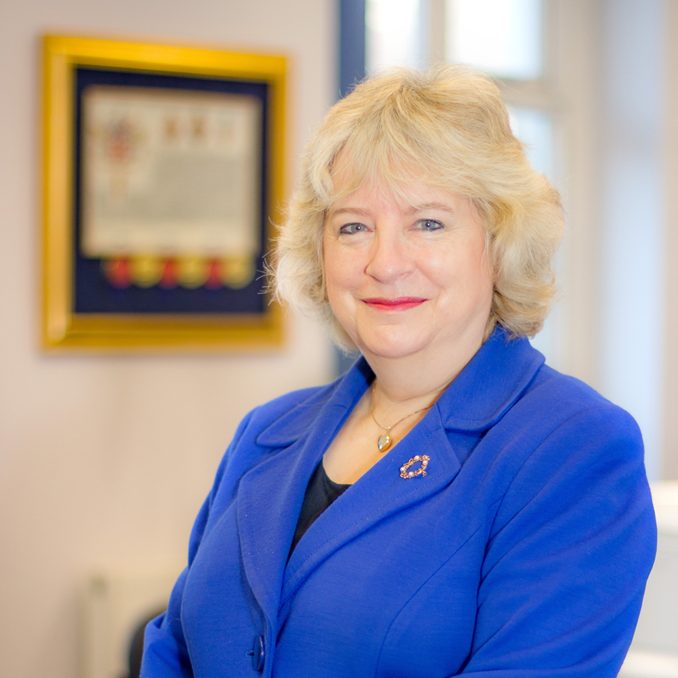
Professor Dame Alison Peacock, CEO
We are working to empower a knowledgeable and respected teaching profession through membership and accreditation.
We are dedicated to bridging the gap between practice and research and equipping teachers with the knowledge and confidence to make the best decisions for their pupils.
Dame Alison Peacock – Author of Learning without Limits
Executive Head at Wroxham Primary Alliance
Visiting professor
Amongst first group of female Honorary Fellows Queens’ College Cambridge
Honorary Fellow of UCL and of Hughes Hall Cambridge
Member of the Education Honours committee

Slide 6

How can we support you as a student and ECT?
Listen to our podcast: Evidence-Informed Teaching
Register for FREE membership which gives access to a huge range of online resources within MyCollege
Online access to our Impact journal
FREE webinars and online events delivered by experts
A network of committed teachers of all levels
A clear professional development pathway that grows as you do in your career: Chartered Teacher Status and Fellowship.

Slide 7
Membership for you
Free as a Student Teacher
£2.00 per month as an ECT
Join now @ chartered.college/join/student-membership/
Add footer/presentation name here

Slide 8

Resources are high quality and reliable.
Resources, articles, videos for teachers, school leaders and those supporting teachers
High quality, RELIABLE information written by teachers and other education experts, all in one place
Extensive database of research and insights to support your practice and make a difference
Make the most of your membership pdf with links and tools inside to help you get started with our resources
Reflective tool (pdf) which you can use with all resources and add to your evidence portfolios when finished
Critical appraisal tool (pdf) to develop your research appraisal skills.

Slide 9

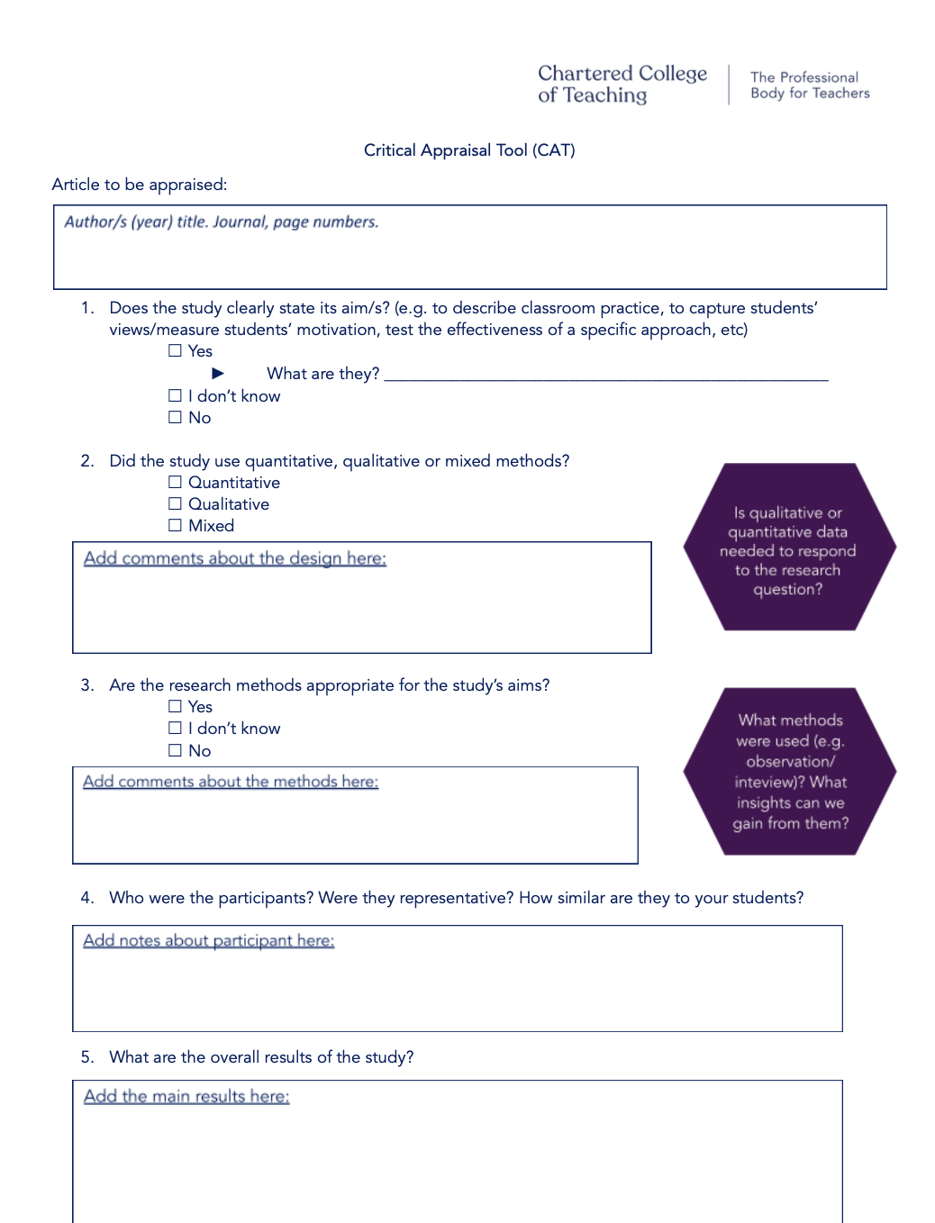

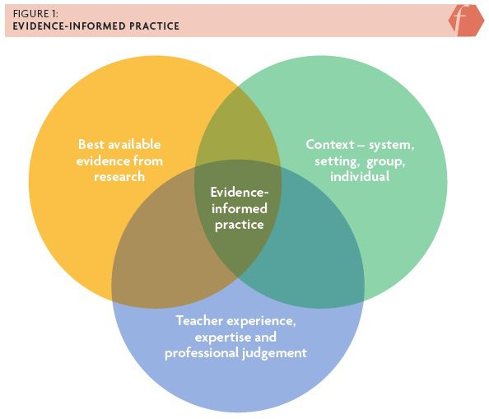
Make the most of your membership

Slide 10

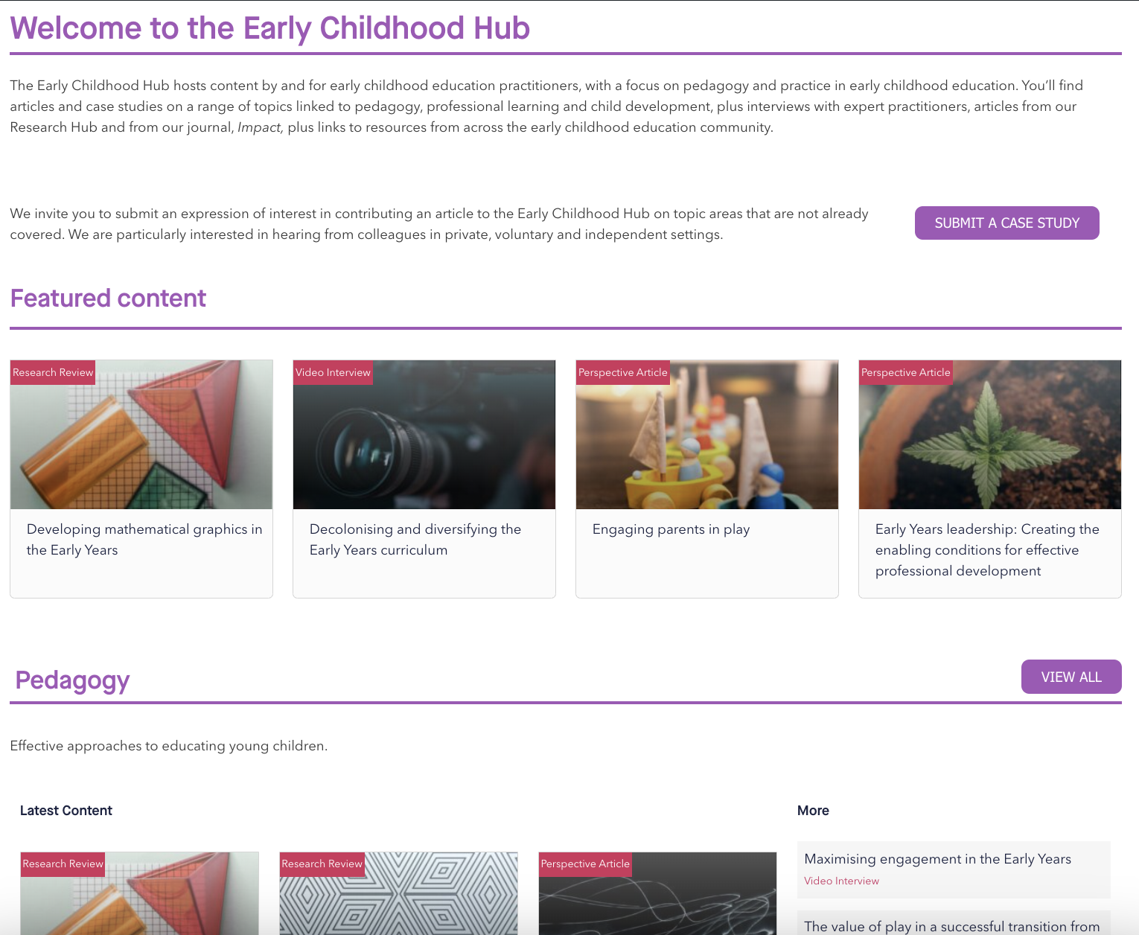
Research and insights from expert practitioners on play, cognitive development and diversifying the Early Years curriculum
Classroom practice videos in early years settings
FREE webinars to attend live and watch back
A wealth of articles, resources and case studies spanning a range of Early Childhood settings
Designed to support literature reviews, assignments and making the most of placements.
“We’re really keen to share knowledge about how our youngest children learn, because this is the start of everything else. If we get it right in early years, everything else follows.”
Dame Alison Peacock, on the launch of Early Childhood Hub

Slide 11

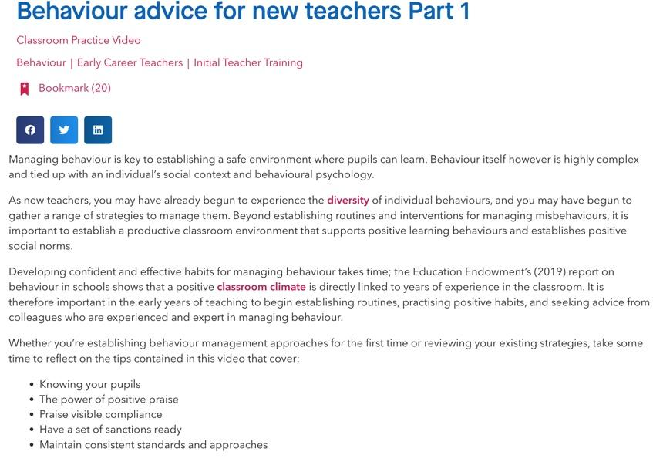
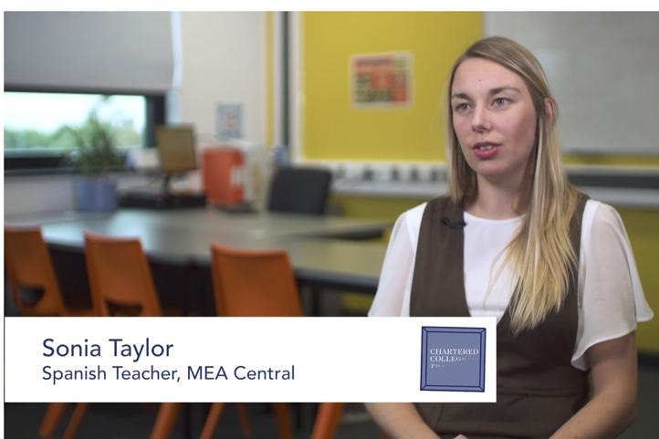
How to use a video from the Video Hub
In this series of 4 short videos, watch experienced practitioners offer practical advice on a range of effective behaviour management strategies.
You could then use our reflective tool from the pdf to note key takeaways and link them to the teacher standards, key areas in your training and then add this to your portfolios.

Slide 12


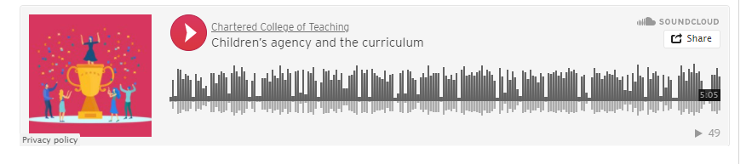
Many of the resources come with slides, transcripts, worksheets and reflective questions that you can annotate and add to your portfolios.

Slide 13


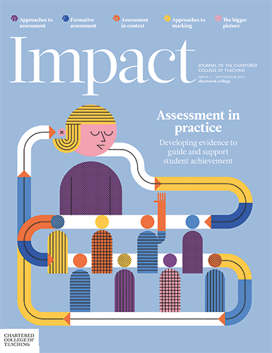

Impact journal: educational research for evidence-informed practice. Useful for essay assignments and literature reviews!

Slide 14
Next Steps
Get your phone out and scan the QR code to register
Follow the Evidence-Informed Teaching podcast
Register for FREE membership
Make copies of the Reflective Tool and the Critical Appraisal tool
Work through some of the resources in the workbook.
4,000+ Student members supported.
50+ Classroom videos to support your practice.

Slide 15
Any questions?
chartered.college/join/student-membership

