Slide 1

ECT Induction
Penny Ottewill: Penny.Ottewill@warwick.ac.uk (Secondary)
Emily Davies: emily.c.davies@warwick.ac.uk (EY and Primary)

Slide 2
The Key Take-Aways of the ECF
The standard length of induction is two school years (6 terms).
In addition to the 10% timetable reduction that ECTs receive in their first year of induction, ECTs will also receive a 5% timetable reduction in the second year of induction.
Schools are expected to deliver an induction period that is underpinned by the ECF. Appropriate bodies will have a role in checking that an ECF-based induction is in place.
The Designated Mentor will have a key role in supporting the ECT during induction and is separate to the role of the Induction Tutor.
There will be two formal assessment points, one midway through induction, and one at the end of the induction period. These will be supported by regular progress reviews to monitor progress, to take place in each term where a formal assessment is not scheduled.

Slide 3


Moving onto the ECF

Slide 4
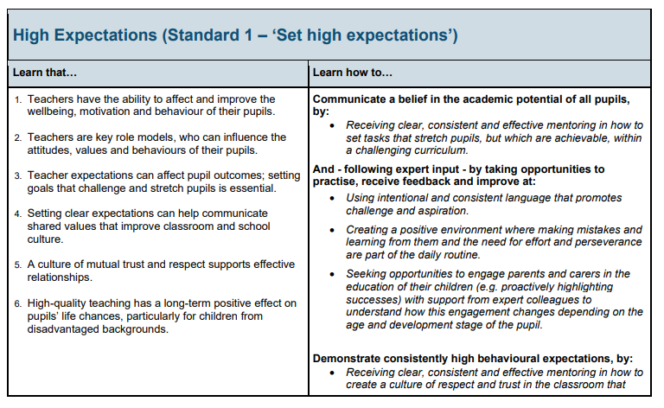
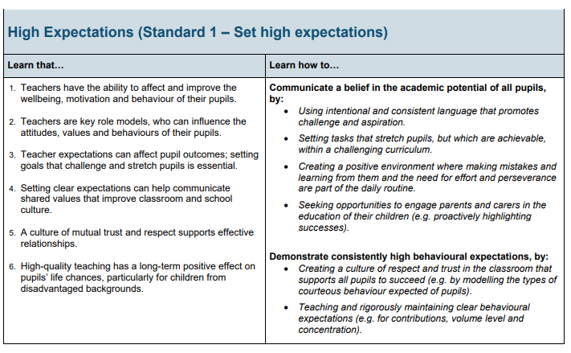
Both frameworks include ‘Learn that…’ and ‘Learn how to…’ statements.
The ‘learn that…’ statements are the same for ITT CCF and ECF.
The ‘learn how to…’ are different and reflect what is expected for pre and post QTS.

Slide 5

The 5 Core Areas of the ECF
Behaviour management
Pedagogy
Curriculum
Assessment
Professional behaviours
Related TS:
TS1 and TS7
Related TS:
TS2, TS4 and TS5
Related TS:
TS3
Related TS:
TS6
Related TS:
TS8

Slide 6
The Roles and Responsibilities – The ECT
The ECT is expected to:
provide evidence that they have QTS and are eligible to start induction;
meet with their induction tutor to discuss and agree priorities for their induction programme and keep these under review;
agree with their induction tutor how best to use their reduced timetable allowance and guarantee engagement with their ECF-based induction programme;
provide evidence of their progress against the Teachers’ Standards;
participate fully in the agreed monitoring and development programme;
raise any concerns with their induction tutor as soon as practicable;
consult their appropriate body named contact at an early stage if there are, or may be, difficulties in resolving issues with their tutor/within the institution;
keep track of and participate effectively in the scheduled classroom observations, progress reviews and formal assessment meetings; and
retain copies of all assessment reports.

Slide 7
What you might do during induction:
Model lessons or parts of lessons with the ECT’s class, ready to discuss the strategies they observed you using.
Joint observations of other teachers (Mentor and ECT together) to guide ECT in what they are looking for.
Utilise strengths in school – this doesn’t always need to be you!
Opportunity to be part of or do learning walks together. Useful if comparing different approaches to behaviour management for example.
Do a book look together. Support your ECT to reflect on progress or marking for example.
Co-planning – work with your ECT to plan lessons to demonstrate what you are looking for.
ECT to record themselves – review together an element of their teaching practice.
Team teach – teach alongside your ECT. Sometimes a particular focus is helpful.

Slide 8
The Induction Tutor
The headteacher/principal should identify a person to act as the ECT’s Induction Tutor, to provide regular monitoring and support, and coordination of assessment.
The Induction Tutor is expected to hold QTS and have the necessary skills and knowledge to work successfully in this role and be able to assess the ECT’s progress against the Teachers’ Standards.
The Induction Tutor will need to be able to make rigorous and fair judgements about the ECT’s progress in relation to the Teachers’ Standards. They will need to be able to recognise when early action is needed in the case of an ECT who is experiencing difficulties.
The Induction Tutor is generally a separate role to that of mentor.
Notes:
The induction tutor (or the headteacher/principal if carrying out this role) is expected to:
provide, or coordinate, guidance for the ECT’s professional development (with the appropriate body where necessary);
carry out regular progress reviews throughout the induction period;
undertake two formal assessment meetings during the total induction period coordinating input from other colleagues as appropriate (normally one at the end of term three and one at the end of term six, or pro rata for part-time staff);
inform the ECT following progress review meetings of the determination of their progress against the Teachers’ Standards and share progress review records with the ECT, headteacher and appropriate body;
inform the ECT during the assessment meeting of the judgements to be recorded in the formal assessment record and invite the ECT to add their comments;
ensure that the ECT’s teaching is observed and feedback provided;
ensure ECTs are aware of how, both within and outside the institution, they can raise any concerns about their induction programme or their personal progress;
take prompt, appropriate action if an ECT appears to be having difficulties; and
ensure that all monitoring and record keeping is done in the most streamlined and least burdensome way, and that requests for evidence from ECTs do not require new documentation but draw on existing working documents.

Slide 9
The Designated Mentor
The headteacher/principal should identify a person to act as the ECT’s Designated Mentor, to provide regular mentoring.
The Designated Mentor and the Induction Tutor are two discrete roles with differing responsibilities and it is expected that these roles should be held by different individuals.
Designated Mentors should not carry out formal assessments unless they are also acting as the Induction Tutor.
Notes:
The mentor (or the induction tutor if carrying out this role) is expected to:
regularly meet with the ECT for structured mentor sessions to provide effective targeted feedback;
work collaboratively with the ECT and other colleagues involved in the ECT’s induction within the same school to help ensure the ECT receives a high-quality ECF-based induction programme;
provide, or broker, effective support, including phase or subject specific mentoring and coaching; and
take prompt, appropriate action if an ECT appears to be having difficulties.

Slide 10
The Appropriate Body
To provide advice, guidance and support on all aspects of induction
To monitor termly and final assessments
Ensure that ECTs records and assessment reports are maintained (for 6 years) ECTs should also keep copies of their records.
To provide the Teaching Regulation Authority (TRA) with details of ECTs who have started: completed (satisfactory or not) those who require an extension or those who have left partway through an induction period
To offer an ‘Independent person’ for ECTs to discuss any difficulties or issues with their induction
To support when ECTs are failing to make satisfactory progress against teacher’s standards including quality assuring all aspects of the induction process in school
To respond to requests for assistance and advice with training for Induction tutors.
Information on Appropriate Bodies can be found HERE.

Slide 11

FAQs
The induction documentation can be found HERE.
Will I still be eligible for a pay progression as an ECT moving into my second year of induction?
A 2-year induction will have no adverse impact upon early career teachers’ pay or career progression opportunities. Early career teachers will still be able to progress on the pay scale as current arrangements allow, both during and after induction
How long do I have to complete my ECT induction?
While ECTs are encouraged to start their induction as soon as possible after gaining qualified teacher status (QTS), there is no set time limit for starting or completing an induction period.
Can I complete my ECT induction on a supply contract?
You can complete your ECT induction if your supply contract is at least 1 term long and agreed upon at the beginning of the contract. You can’t retrospectively do this. Short-term supply placements of less than one term, or equivalent, cannot count towards induction, as such posts will not provide an ECT with the breadth of experience, support, and assessment necessary to enable them to demonstrate that their performance against the Teachers’ Standards is satisfactory.
If I work part-time, will my ECT induction be longer?
Technically, yes. However, your school can agree with the Appropriate Body that this term be reduced if the ECT is effectively demonstrating their performance against the Teachers’ Standards. It is for the appropriate body to consider whether to grant a reduction and bring forward the final assessment point.

Slide 12
Any Further Questions?
If you have any further questions on the ECT Induction, please don’t hesitate to get in touch with:
Penny Ottewill: Penny.Ottewill@warwick.ac.uk (Secondary)
Emily Davies: emily.c.davies@warwick.ac.uk (EY and Primary)
You are also able to stay in touch with Emily and Penny after your complete your PGCE for any additional queries.

