Slide 1
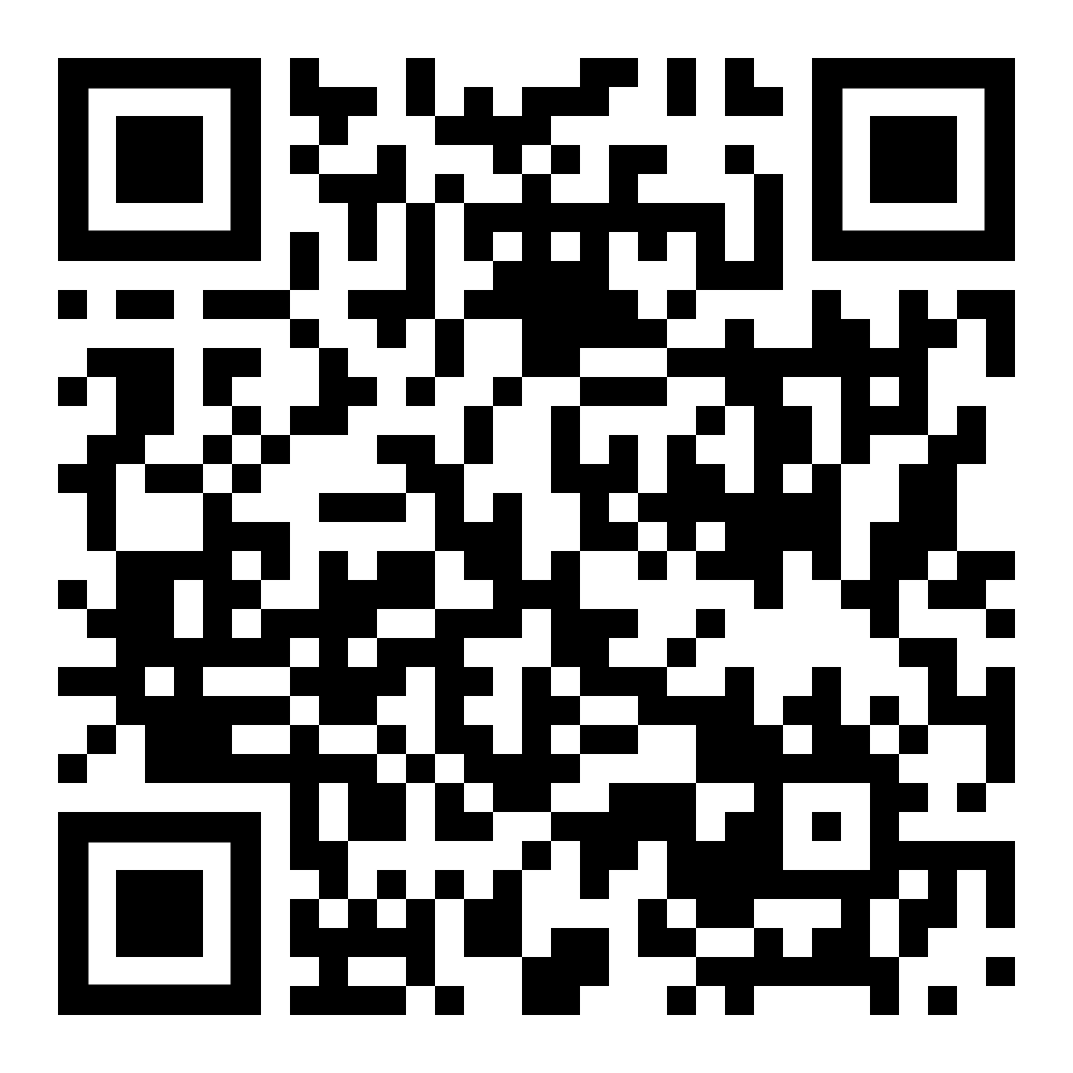
Welcome to your Course Completion Day
Reflections, Celebrations & Next Steps!

Slide 2
Following the exam board on Thursday July 10th an email will be sent confirming your award
Confirmation of QTS can be printed from the DFE portal a few days later.
The PGCE certificate is sent out from central university. Certificates will go to the address you have given the university. If you are moving, you will need to change it on e-vision.

