Slide 1
The role of research in education (including the MA)
Dr Jen Rowan-Lancaster

Slide 2
Jen’s session examines why educational research is an imperative aspect of your teaching career. As a Warwick teacher intellectual curiosity will always be part of your teacher make-up and this session will support you to explore what this means for you beyond the PGCE whether that’s completing your MA at CTE or through engagement with CPD opportunities in school.

Slide 3
Why do we need CPD?
Improve Your Teaching Skills
Focus on a Specialty
Develop Leadership Skills
Develop your knowledge and understanding
Develop your critical reasoning skills
Understand the workings of policies and government strategies
Increases your credibility
Makes you competitive
Increase your skill base
Defines your identity as a teacher and gives you time to focus on your positionality
Have an impact on your sector
Pave the way to an EdD or PhD
Open you up to wider opportunities in the Education Field

Slide 4
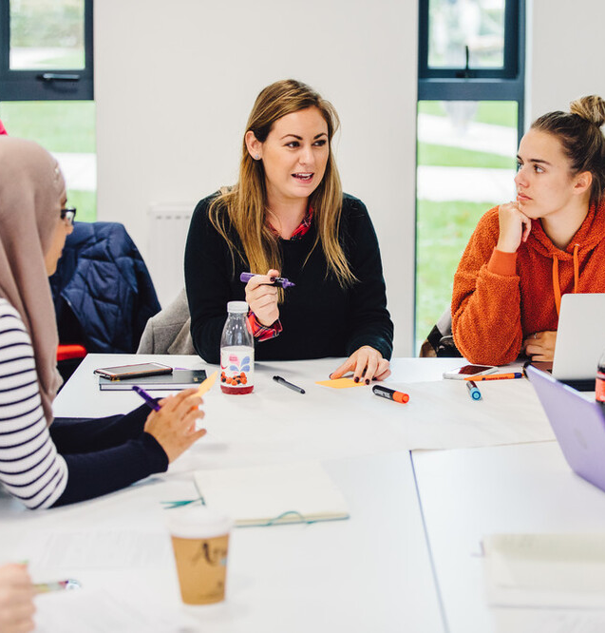
What does the MA involve?
Course begins in January - Year 1 (next cohort begins Jan 2026)
and runs through to the end of
August - Year 2.

Slide 5
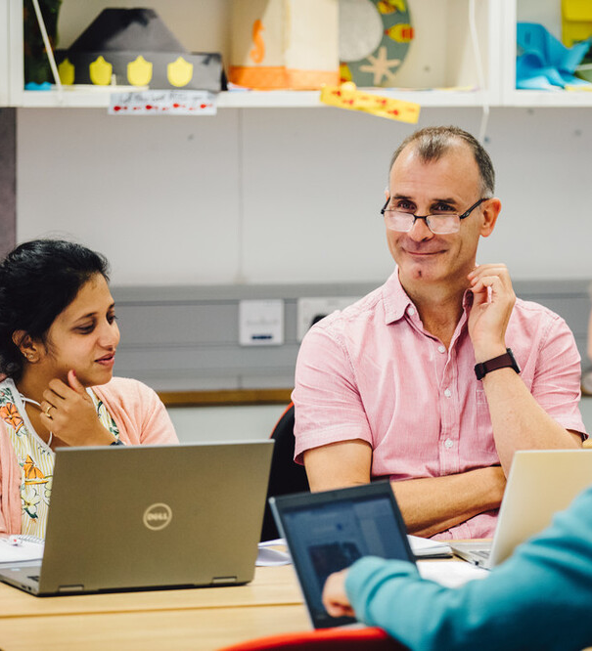
Year 1: Jan - Aug
• Attend introduction to research sessions over two Saturdays in January and March(in person or online).
• Design your own research study, and write a research proposal (submission in May).
• Attend the introduction to ethical practice Saturday in May (in person or online) and submit your ethics application (submission in July).

Slide 6

Year 2: Sep - Aug
• Complete your research at an appropriate time in the academic year according to your focus.
• Attend three supporting research Saturdays in October, January and May (in person or online).
• Write up your findings in a 20,000 word thesis (you can write this in chunks throughout the year) to submit at the end of August).

Slide 7
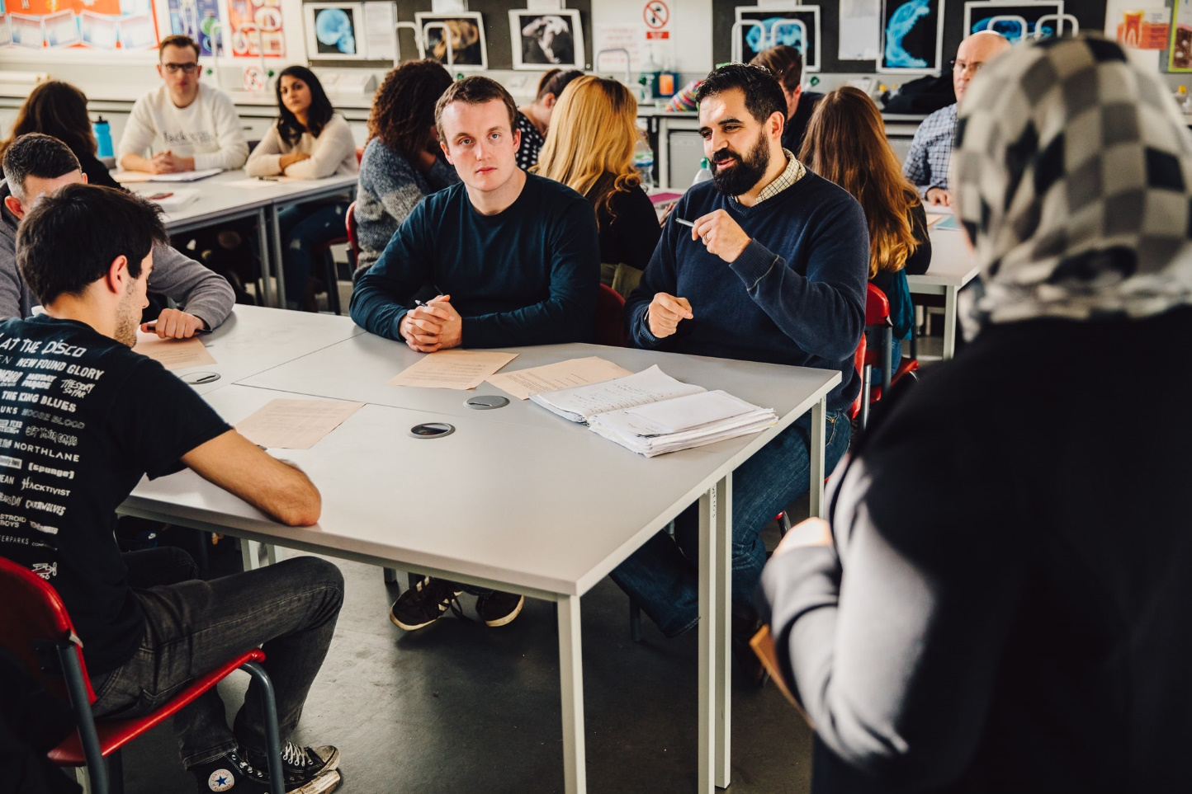
How much
does it cost?
How much?
The fee for the 90 credits over two years is £6200.00 (this is approx, final cost has not been finalised for 2026). The payments are broken down and paid per module, spread over the two years.
How long?
20 months:
from Jan Year 1 – August
Year 2
Additional Costs
Travel Expenses
Books – can use library
Materials - recommend laptop/tablet
Printing – resources, academic

Slide 8
Emma Cooke
Secondary Maths Key Stage 5 Coordinator
Having the opportunity to discuss aspects of education that go beyond day-to-day practice has been so enjoyable and valuable. I have really honed my ability to critique what so-called "experts" tell us and I am better able to see through the fads and gimmicks that are touted as the next big thing in teaching. Having a group of like-minded, highly intelligent, and very supportive colleagues to support me through my Master's journey has made the experience a highlight of my professional life.
Why do an MA?
Curiosity
Self Development
Aspiration
Opportunity

Slide 9
Katherine Wareing
Early Years Foundation Stage Teacher
This Masters course has been a challenging but enjoyable adventure and I am proud to have completed it whilst working full time. The research that I conducted as part of my dissertation made me re-evaluate my approach and teaching strategies towards phonics with EYFS and key stage 1 children, which I have implemented into the classroom. I believe that, as a teacher conducting research in a school, I've been able to share ideas to improve the educational practice of myself and colleagues. I have found this masters course to be invaluable in developing my professional knowledge, confidence and self-belief.
Why do an MA?
Curiosity
Self Development
Aspiration
Opportunity

Slide 10
MA Professional Education
STAGE 1: IDEA GENERATION
STAGE 4: WRITE UP & DISSEMINATION
Research in Professional Practice @ 20 credits. Jan – Apr Year 1
2 x Saturdays in Jan & March
The assignment is an extended research proposal (5000 words)
Sept – Aug: Year 2
3 x Saturdays in Oct, Jan & May
You choose where in the year it is best for your write up to take place.
Submission of 20,000 words research thesis
STAGE 2: PLAN & PREP
Ethics Portfolio @ 10 credits. May – Aug: Year 1
1 x Saturday in May
The assignment is your ethics application & associated documents due at the beginning of July. We encourage you to begin your literature review over summer – there is nothing worse than leaving it until later & realising that all the research you have done in school is undermined by what others have been researching & writing about.
STAGE 3: ACTIVE RESEARCH
Sept – August: Year 2
You choose where in the year your research study is best placed to take place.
Notes:
Brief overview to explain the routes

Slide 11
Examples of MAPE dissertations
A study in resilience and access to education for looked after children.
The Impact of a School-based Mindfulness Programme on KS2 Pupil Wellbeing
Why me? An auto
ethnographic study into how the backgrounds of female students gave them confidence to study physics.
An investigation into whether involvement in a Forest School intervention impacts upon resilience in primary school aged children who are entitled to the Pupil Premium Grant.
What strategies are effective in promoting mathematical reasoning skills for EAL pupils?
A critical evaluation of the ways in which the recent GCSE and A Level reforms in England are impacting on the role and identity of middle leaders.
What insights does a participatory drama project provide regarding the masculinities experienced in an all boys private school?
To what extent does embedding learning help students to be able to recall information in the Geography classroom?

Slide 12
Examples of MAPE dissertations
The Impact of a School-based Mindfulness Programme on KS2 Pupil Wellbeing
What strategies are effective in promoting mathematical reasoning skills for EAL pupils?
A study in resilience and access to education for looked after children.
A critical evaluation of the ways in which the recent GCSE and A Level reforms in England are impacting on the role and identity of middle leaders.
An investigation into whether “most able” GCSE students feel pressure and stress by the expectation of their high target grades in Geography.
An investigation into whether involvement in a Forest School intervention impacts upon resilience in primary school aged children who are entitled to the Pupil Premium Grant.

Slide 13
Examples of MAPE dissertations
If students have more access to their performance data in Mathematics, does it make a difference? Interactions between
What are the attitudes of English teachers to the prioritisation of ‘English literary heritage’ in the new English curriculum? A qualitative analysis of key documents and interviews with English teachers.
In what ways does the individualisation of wellbeing shape children into more compliant neoliberal citizens? An ethnography of wellbeing in a neoliberal school system.
How can teaching opportunities in Early Years be maximised through alternative performance management methods? A case study of progressive interactions in continuous provision.
How do A-Level History students perceive 'Britishness'? A qualitative analysis of student interviews on British history and national identity
What are the experiences of female teachers balancing parental and professional responsibilities? Interviews of teacher attitudes in British secondary schools.
A case study of how Art and Design lessons in a UK, rural primary school can be used to build children's cultural capital.

Slide 14
Examples of MAPE dissertations
How do you improve reading fluency in a whole-class setting within KS3 English?
A case study of the implementation of reading strategies.
What insights does a participatory drama project provide regarding the masculinities experienced in an all boys private school?
Why me? An auto
ethnographic study into how the backgrounds of female students gave them confidence to study physics.
Do supply teachers and cover supervisors in mainstream schools feel equipped to teach SEND students?
A narrative enquiry /case study of past experiences by supply teachers and cover supervisors.
To what extent does embedding learning help students to be able to recall information in the Geography classroom?
How can teaching opportunities in Early Years be maximised through alternative performance management methods? A case study of progressive interactions in continuous provision.

Slide 15
Some of our 2018/19 MA Professional Education teachers at their graduation ceremony - Jan 2020
What are the benefits?
Improve your classroom practice
Develop as a leader of practice in education
Share your research with colleagues and the wider profession
Build your career pathway

Slide 16

How do I apply?
You can apply at any time via the link on CTE webpages.
MA: https://warwick.ac.uk/fac/soc/cte/professionaldevelopment/ma-new/
PGCert:
https://warwick.ac.uk/fac/soc/cte/professionaldevelopment/postgraduate-cert-professional-education/#course-tab-4

Slide 17
Thank you
  for joining us today
Something else you wanted to ask? If it’s personal and you
would like to discuss it with us privately, please email us on
MA.CTE@warwick.ac.uk
Or directly to Dr. Jen Rowan-Lancaster on:
J.Rowan-Lancaster@warwick.ac.uk

