Slide 1

Challenges & Strategies for New Subject Leaders
For Early Career Teachers
Dan Hawksley

Slide 2







Head of KS3 Science
Head of Biology
Head of Physics (acting)
Second in Science
Head of Science
BW Teaching School

Slide 3
Head of KS3 Science
Head of Biology
Head of Physics (acting)
Second in Science
Head of Science
BW Teaching School

Slide 4

What do you think a KS3 lead does?
Curriculum design
Student progress
Teaching & Learning
Transition
QA
Engagement
Notes:
1. Curriculum Leadership
Design, review, and refine the KS3 curriculum to ensure it is sequenced, ambitious, and aligned with national frameworks.
Ensure the curriculum prepares students for success at KS4 and beyond.
Promote curriculum enrichment and cross-curricular links.
2. Teaching & Learning
Lead the development of effective pedagogy across KS3 classes.
Support colleagues with planning, differentiation, and subject knowledge.
Share best practices and deliver KS3-focused CPD where appropriate.
3. Student Progress & Assessment
Monitor student data and track progress across KS3.
Identify underperformance and lead targeted intervention strategies.
Oversee standardisation and moderation of assessments.
4. Transition & Induction
Support the transition from primary school (Year 6) to secondary school (Year 7).
Coordinate with pastoral and curriculum teams to ensure smooth academic induction.
Monitor Year 7 baseline data and adapt planning accordingly.
5. Quality Assurance
Conduct lesson observations, learning walks, and book looks within KS3.
Contribute to department self-evaluation and development planning.
Support the Head of Department with whole-department QA processes.
6. Student Engagement
Foster a love for the subject in younger students.
Promote KS3 subject clubs, competitions, and enrichment opportunities.
Liaise with pastoral teams to support student behaviour and motivation.

Slide 5
You’ve just been given a new leadership responsibility… but your teaching timetable is still full, marking is piling up, and there’s a meeting in 10 minutes — what do you prioritise, and how do you keep on top of it all?

Slide 6

Managing Time & Priorities
Challenge: Feeling overwhelmed by demands.
Strategy:
  Use the Eisenhower Matrix to prioritise.
  Set termly goals with SLT.
  Learn to say 'not yet' instead of 'no'.

Slide 7
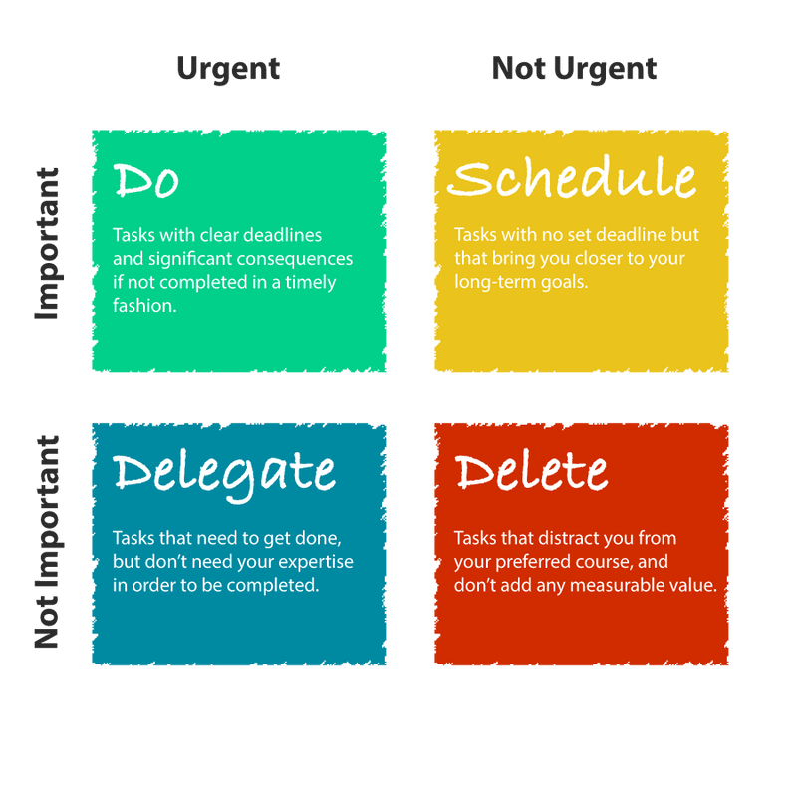
Managing Time & Priorities

Slide 8
You know that really experienced teacher in your department who’s been teaching longer than you’ve been alive??

Slide 9
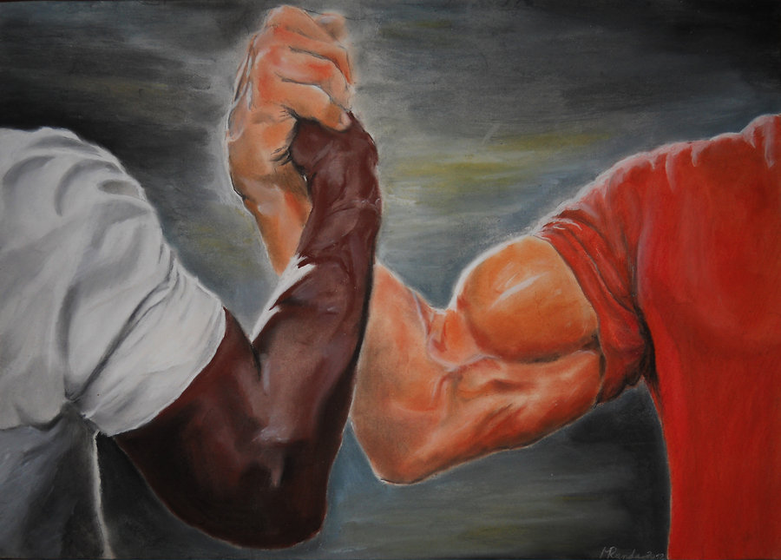
Leading Experienced Colleagues
Challenge: Managing relationships with more experienced staff.
Strategy:
  Lead with humility and respect.
  Focus on collaboration.
  Build trust through consistent communication.
Notes:
Paul Knight, Karen Hearne, Peter Titkin, Sir Peter Simpson

Slide 10

Leading Change & Innovation
Challenge: Managing resistance to new initiatives.
Strategy:
  Involve the team in decisions.
  Pilot changes before scaling.
  Communicate the 'why' clearly.
Notes:
Introduction of structure for practicals – team discussion of point of practicals – prepared proposed structure/sheet – piloted and tweaked – back to team – wide trial – tweak – adapted.

Slide 11
Head of KS3 Science
Head of Biology
Head of Physics (acting)
Second in Science
Head of Science
BW Teaching School

Slide 12
So how is Head of Subject different to KS3 Coordinator?
Curriculum design
Student progress
Transition
Teaching & Learning
QA
Engagement
Notes:
Same as HoS but for multiple Subjects
Except:
Line Management of staff
Accountable to SLT
Strategic and not just operational

Slide 13
Who has found the constant juggle of planning / marking / data entry etc. quite intense this year?

Slide 14

Balancing Teaching & Leadership
Challenge: Juggling classroom responsibilities with leadership tasks.
Strategy:
  Block time weekly for leadership duties.
  Use planning tools (Trello, Outlook).
  Delegate where appropriate.
Notes:
Delegate – lucky to have technicians – but also divided up tasks during gain time

Slide 15

Developing Confidence in Decision-Making
Challenge: Fear of making the wrong decision.
Strategy:
  Seek advice from mentors or SLT.
  Start with small initiatives.
  Reflect regularly to grow confidence.
Notes:
Regular touch base meetings – fortnightly for KS3.

Slide 16
Imagine one of your Year 8 classes just completed an end-of-topic assessment. Some students did brilliantly, others really struggled — how do you decide what to do next, and how do you know if your teaching is having the impact you want?

Slide 17

Using Data & Tracking Progress
Challenge: Making sense of data and showing impact.
Strategy:
  Ask for training on data systems.
  Focus on trends, not just numbers.
  Use data to inform teaching and intervention.
Notes:
SISRA – obvious weaknesses in bio prac questions - led to CPD for staff on each Required practical – did across all three subjects – rolled out
Trend – comparison year on year – which type of question/ impact of staffing on group results/ where can most impact be made

Slide 18
Head of KS3 Science
Head of Biology
Head of Physics (acting)
Second in Science
Head of Science
BW Teaching School

Slide 19
So how is Head of Department different to Head of Subject?
Curriculum design
Student progress
Transition
Teaching & Learning
QA
Engagement
Notes:
Same as KS3 but for KS3-5
Except:
Line Management of staff
Accountable to SLT
Strategic and not just operational

Slide 20
Could you tell me the whole school priorities that your last placement school had?

Slide 21

Understanding Whole-School Priorities
Challenge: Linking subject vision to school goals.
Strategy:
  Read and align with the School Development Plan.
  Attend leadership briefings.
  Consult with other middle leaders.
Notes:
Realised just how much the HoD shielded the department – translating SLT into Teachers is hard!

Slide 22
What would you do if a colleague repeatedly isn’t following the agreed KS3 curriculum — and students are starting to fall behind because of it?

Slide 23

Handling Difficult Conversations
Challenge: Providing feedback or managing conflict.
Strategy:
  Use a coaching approach.
  Stick to facts, not feelings.
  Practise conversations with a mentor.
Notes:
Nigel

Slide 24
Head of KS3 Science
Head of Biology
Head of Physics (acting)
Second in Science
Head of Science
BW Teaching School

Slide 25

What training pathways are there to support your progression?
NPQ in Leading Teaching (NPQLT)

Slide 26

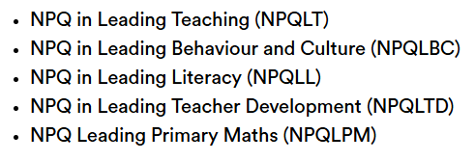

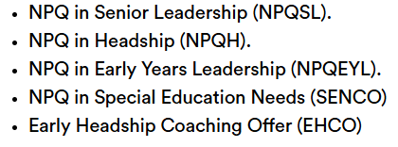

Slide 27

Key Takeaways
  Leadership is a learning curve.
  Ask for support from mentors and SLT.
  Build habits: reflection, planning, communication.
  Be kind to yourself — growth takes time.

Slide 28
If you ever want help / advice from a random guy who you once heard talk for 40 minutes hawksley.d@stowevalley.com

