Slide 1
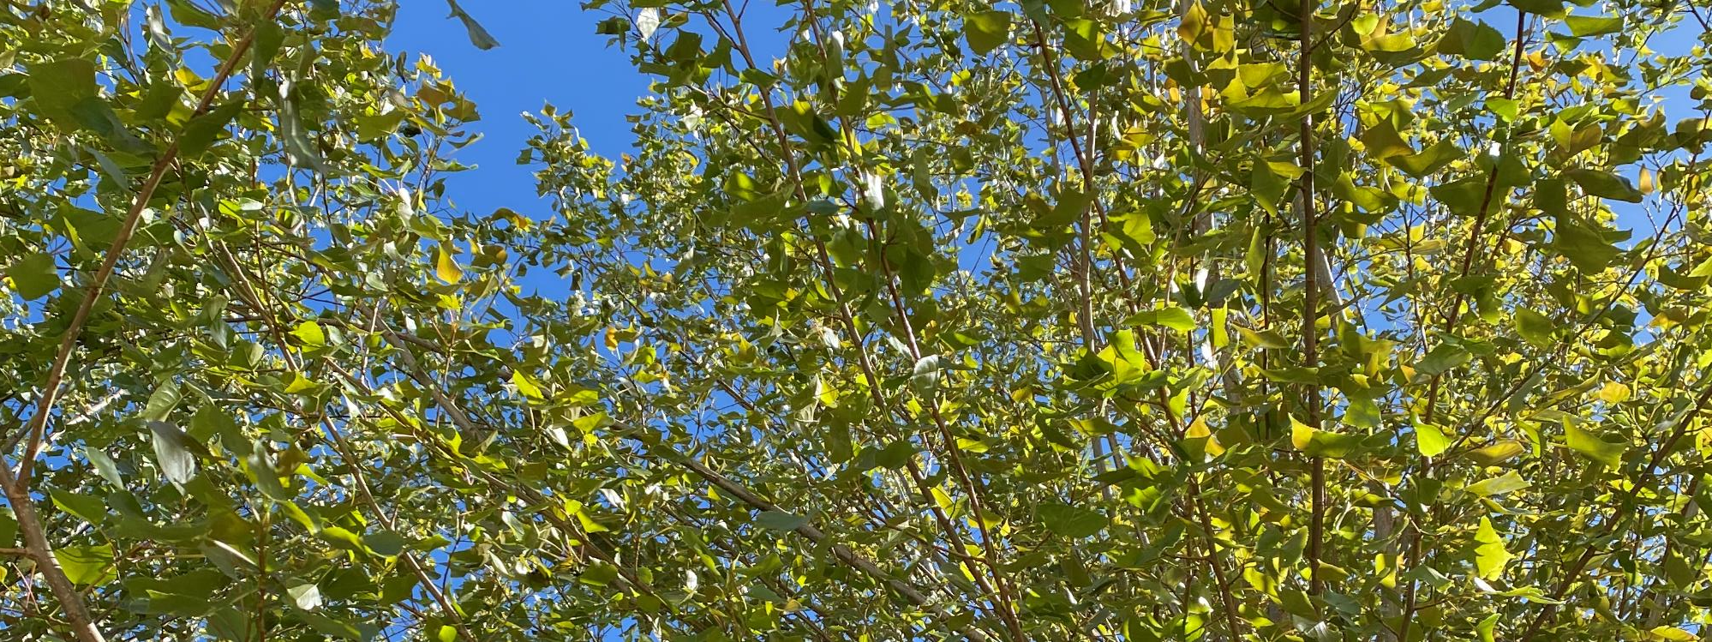
Green Space
A case study
Engaging the Early Years in caring for their environment
One Early Years practitioners experience getting young students (and their parents) more involved in their environment and the natural world.

Slide 2
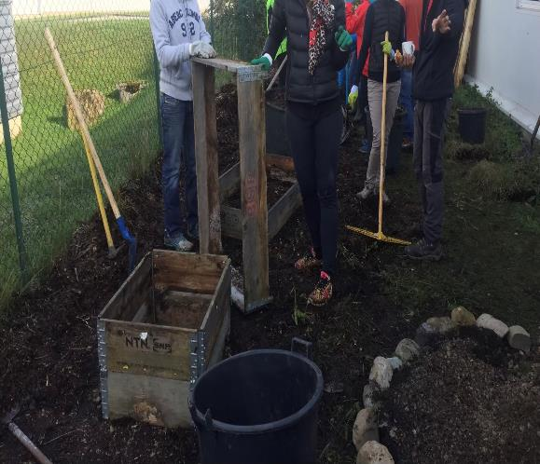
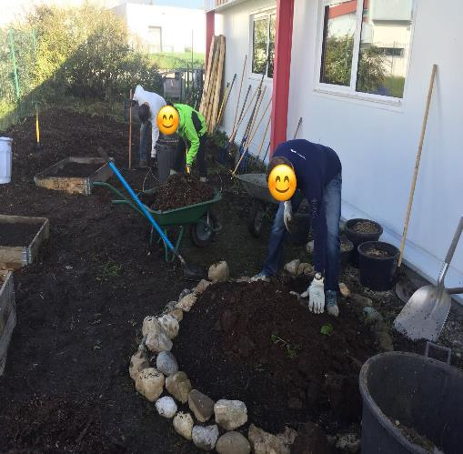
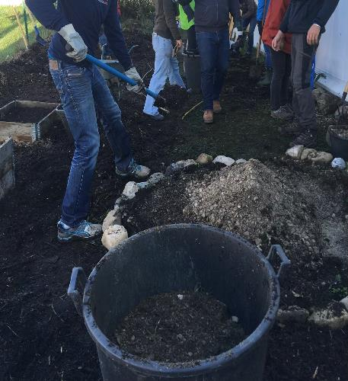
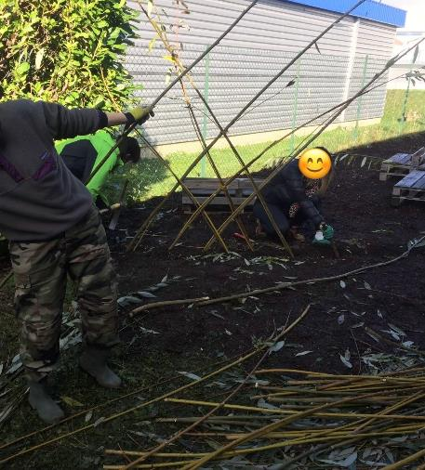
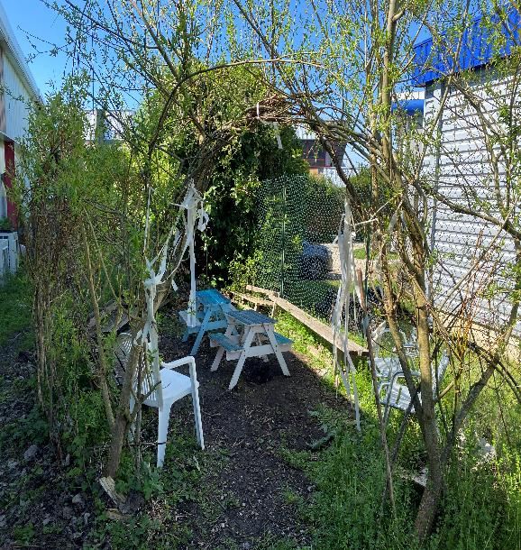
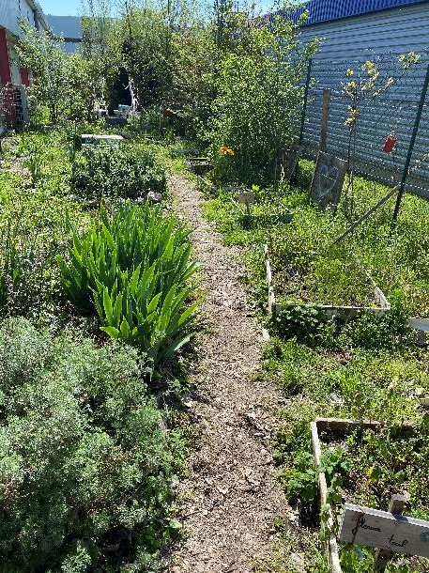
All hands on deck!
Do you have a small area of wasted or unused land? With the help of a local garden designer and a host of parents and children, we transformed this wasted area into a thriving five-senses permaculture green space that is now used by each class of children, school staff, and holiday and after-school clubs. It even includes an outdoor classroom with willow-weaved walls.
Parents signed up to come and help for a few hours, the whole day, or to lend tools or donate plants, trees, or other materials.

Slide 3
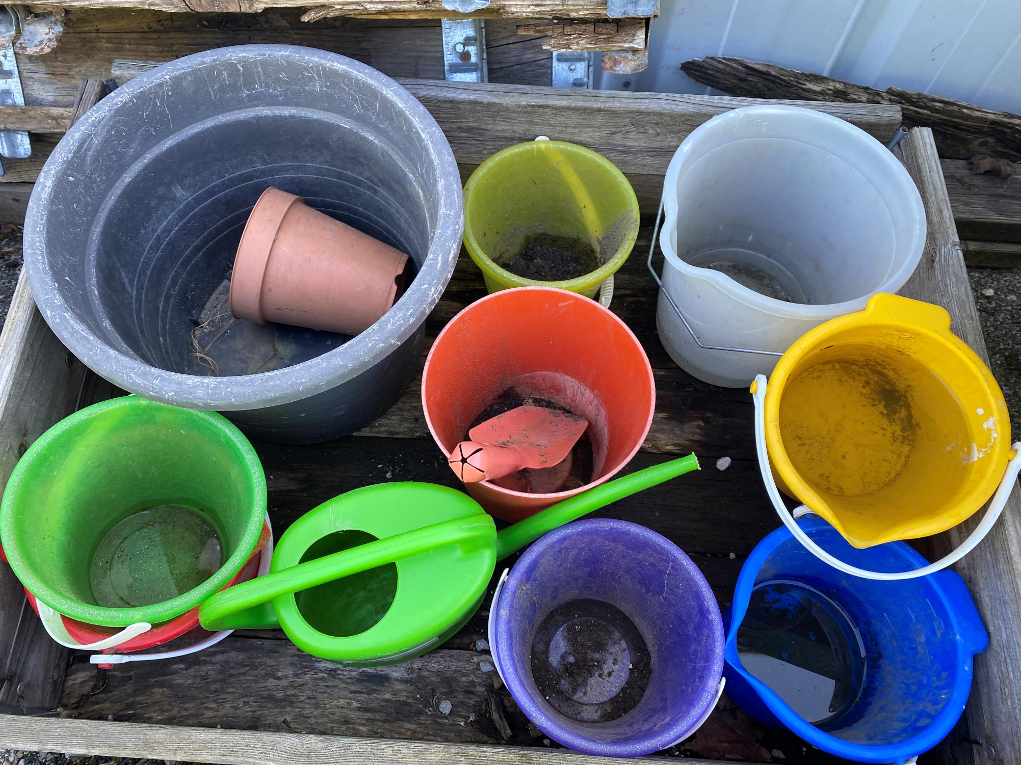
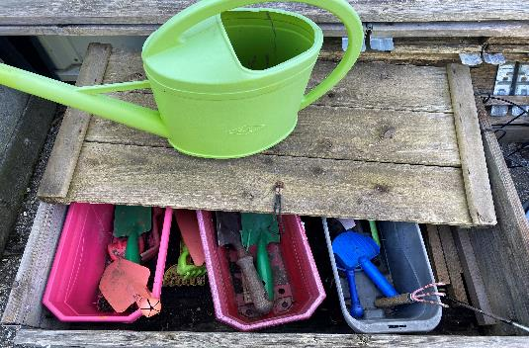
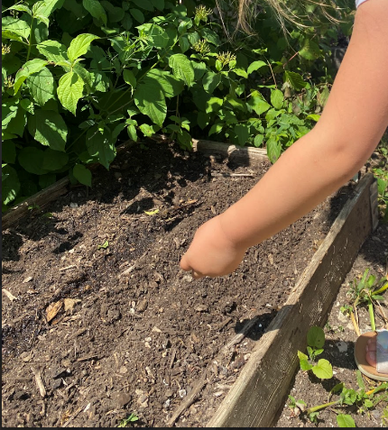
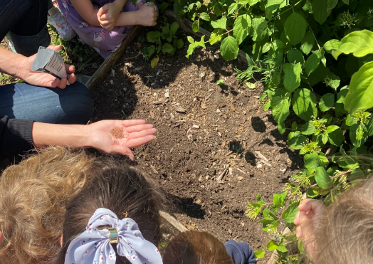
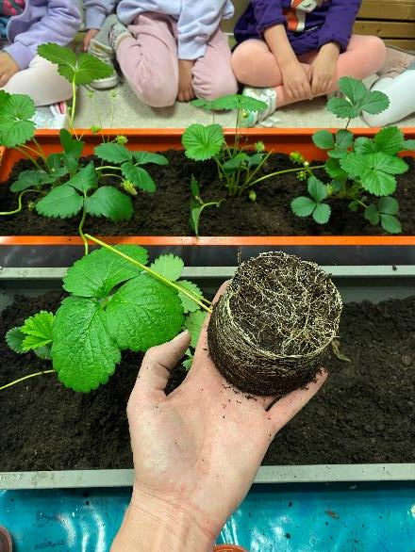
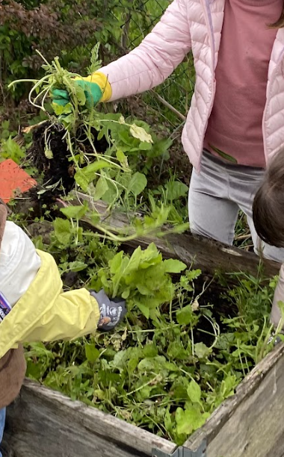
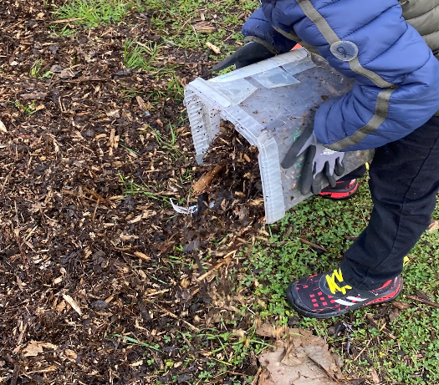
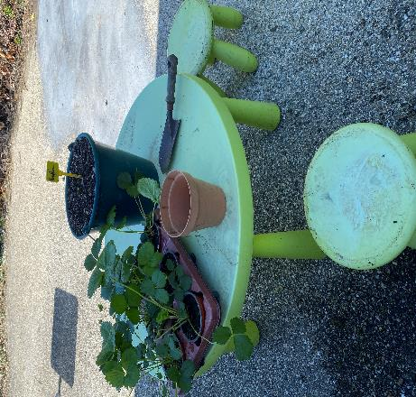
Getting the students Involved with the everyday jobs.
My students love to get their hands in the soil and among the plants. They help with the weeding, the planting, the watering, the mulching, and collecting the autumn leaves for the compost. They learn about the general upkeep of the garden, and of course, when it’s time to harvest what we’ve grown, it’s time to eat! Involving the children in the decisions of which seeds to plant and why helps to build their enthusiasm and engagement.

Slide 4
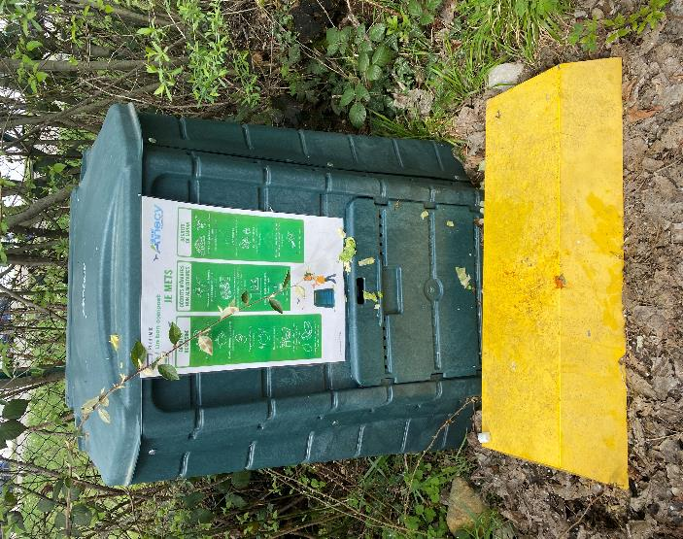
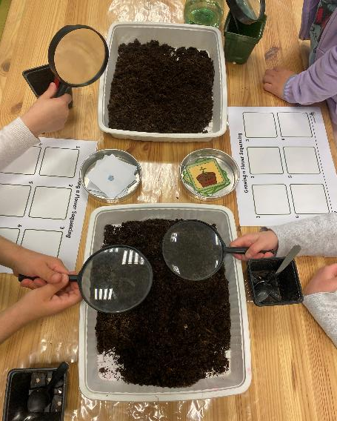
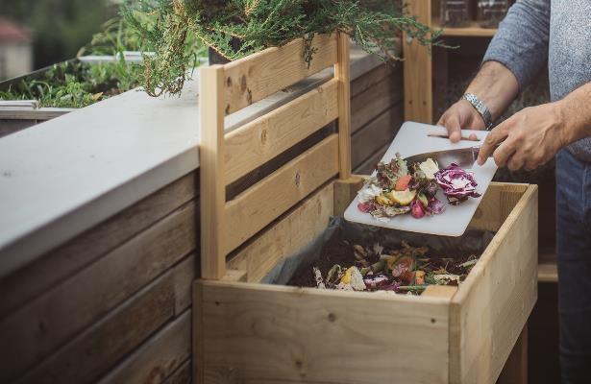
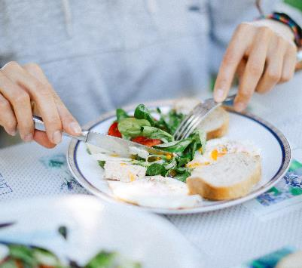
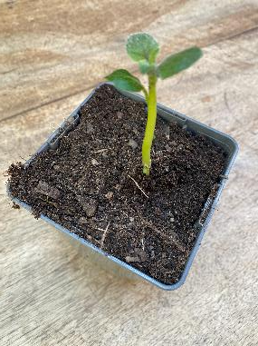

Composting throughout the school
Our students are encouraged to use the small composting bins outside in the playground at the end of the day when they have their snack. The children have been taught about composting in their classes and enjoy participating in the creation of it.
They are able to see each stage of the process and are so excited to get to use the final product!
Older students clear any waste food from the canteen into the smaller compost bins that they will then take to empty into the compost bin outside.

Slide 5
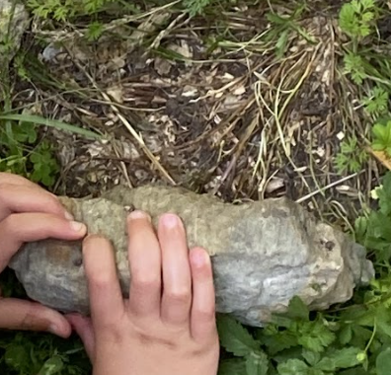
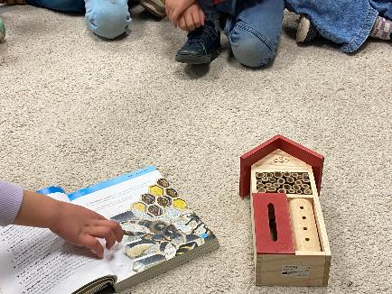
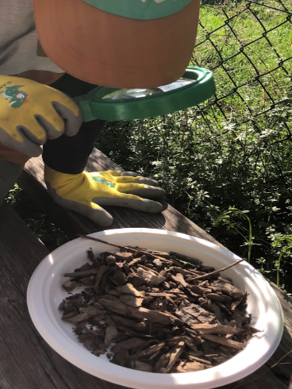
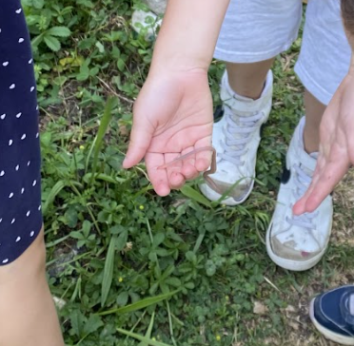
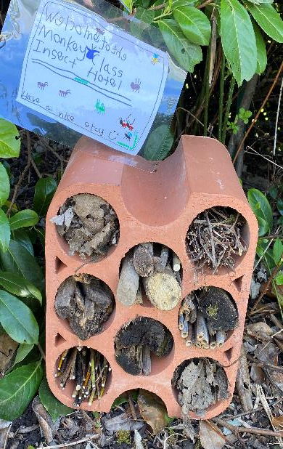
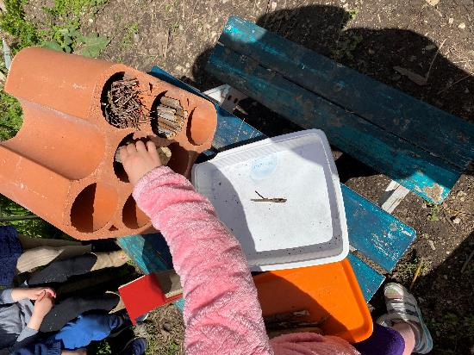
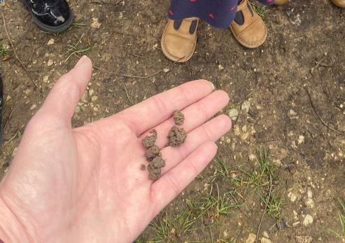
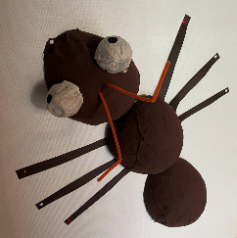
Understanding the important jobs of insects
The school garden is a great place to go on a bug hunt! On each trip, we hunt for these little critters in the garden and then choose one to learn about. The children learn to handle them gently and to be respectful of their homes, food sources, habitats, and the work they do.
One student found a worm in the playground, which sparked a little series of lessons all about the lives and importance of these little creatures.

Slide 6
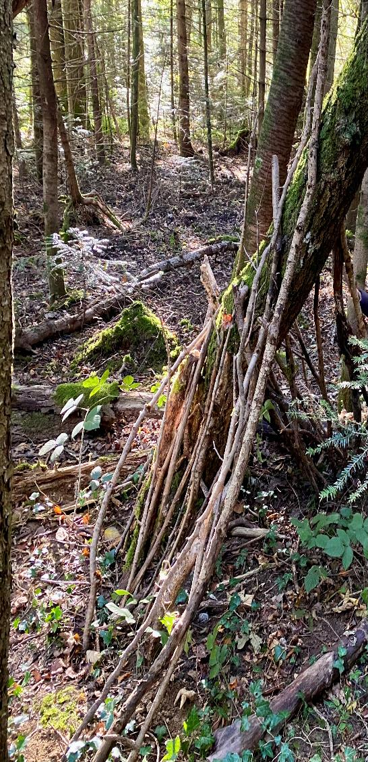
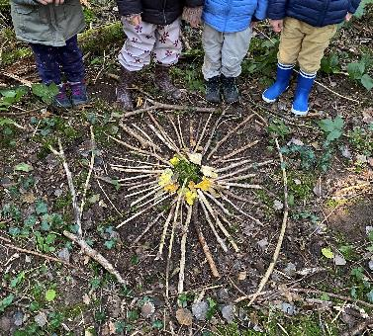
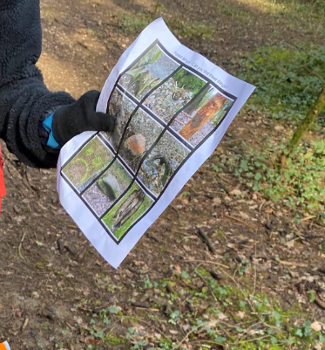
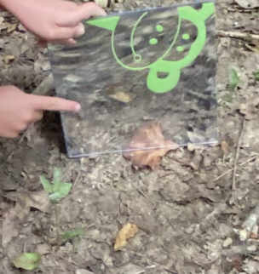
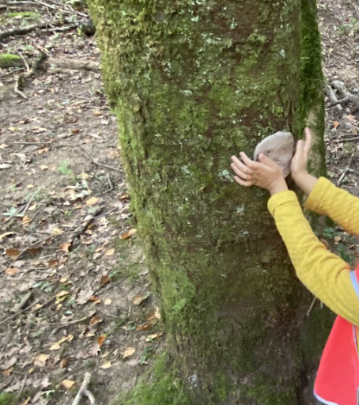
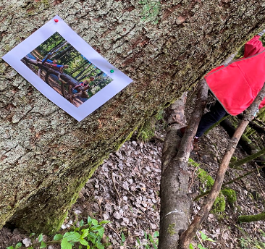
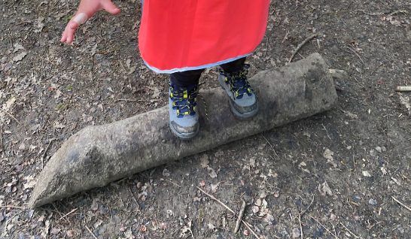
Forest school
There is something fun to discover for every child in the forest!
A local public forest is a short walk away. The children take their lessons outside into nature. all year long. There are opportunities to work on math skills, art, fine motor skills, gross motor skills, science, writing phonics, and so much more. Students are creating, exploring, and experimenting with strategies, problems, and solutions.

Slide 7
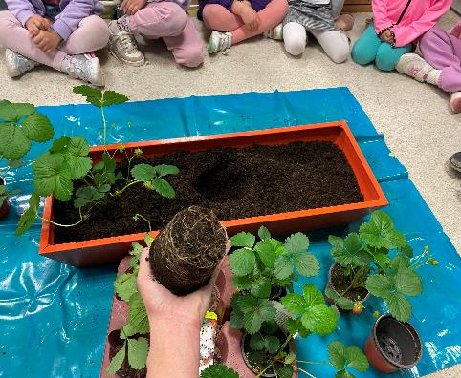
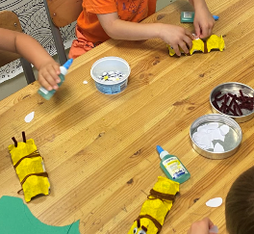
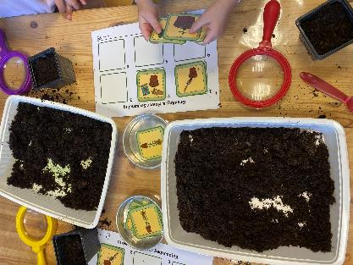
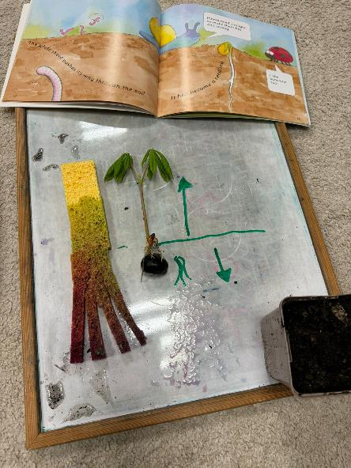
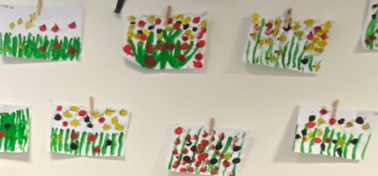
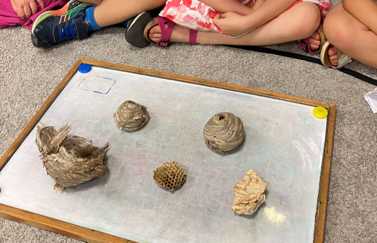
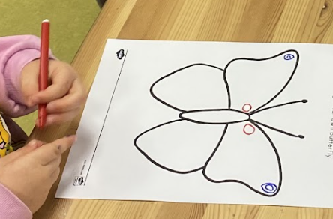
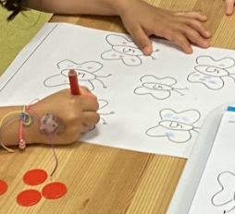
Bringing Nature inside
Bringing nature indoors for a bit to explore and investigate, discuss, hypothesise, get creative with, explore, problem solve, examine, and be inspired by!
- Learning how to plant planters for those who do
not have a garden space.
There are so many ways of bringing nature inside and using it to continue learning in a myriad of lessons. Students generally have a whole host of questions about what they see and experience outside that can be investigated in the classroom.

Slide 8
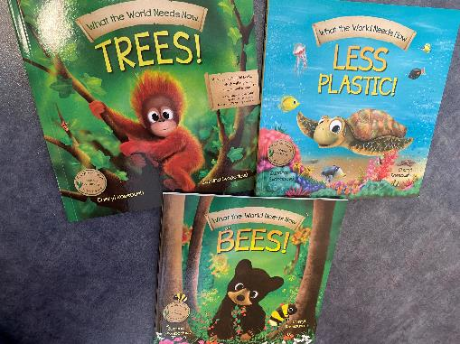

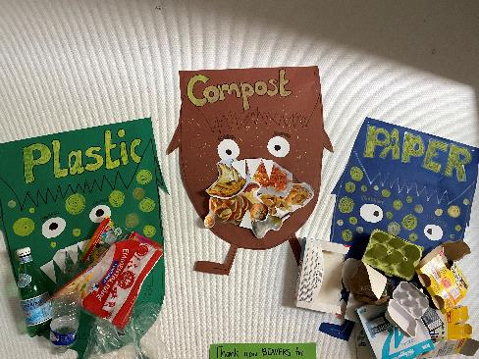
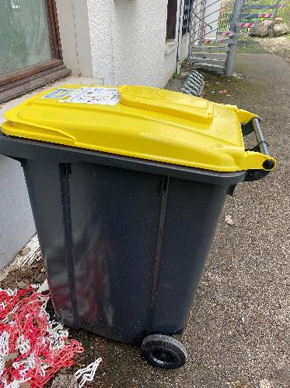
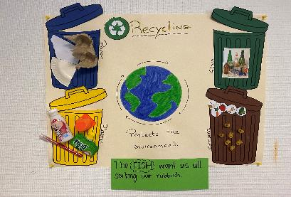
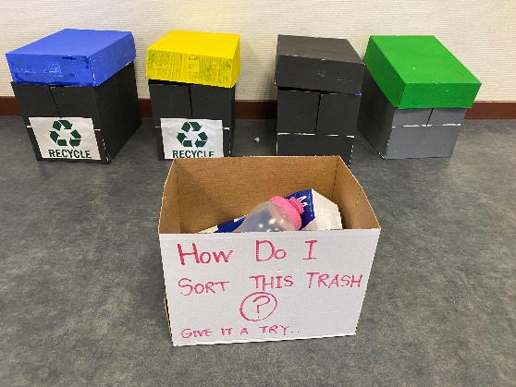
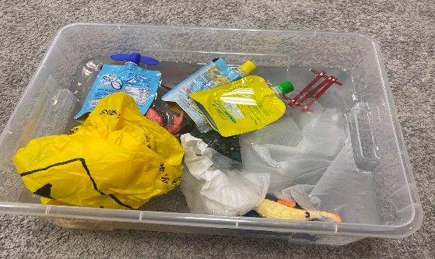
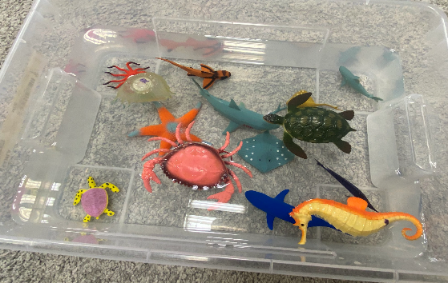
Understanding the impact we have and Making recycling a part of our everyday habits
Inviting innovative green businesses, authors and others into the school to talk to the children not just about the problems but about the possibilities for change.
Students are taught about recycling at every age and always encouraged to make it a habit.

Slide 9








Hands on Recycling
Teaching students about the process of recycling paper in a fun and engaging way. These students then took their new knowledge to other classes and taught other children what they had learned. Giving them the experience of this project inspired questions and discussions about other things that could be recycled, the processes, and the end products.

Slide 10









Community opportunities
Throughout the year and for every level within the school, we arrange trips outside to local green businesses, recycling centres, farms, gardens, nature reserves, local parks, forests, and other green spaces. There is so much we can do to get our students involved in their surroundings in a fun and motivating way through gorilla gardening, practicing and understanding what they themselves can do and learn, the impact they have on their environment, fostering green habits, letting their curiosity and enthusiasm lead the way, and involving parents and families.
’Tell me and I forget, teach me and I may remember, involve me and I learn’.
Benjamin Franklin.

