Slide 1
Anna Donnelly – Assistant Professor
The stories we tell about climate change: environmental children’s literature.

Slide 2
Learning Aim
To deepen understanding of environmental children’s literature
Objectives
Examine the theoretical and educational context in which environmental children’s literature sits
Explore some high quality environmental children’s literature
Consider the design choices that artists make
Understand research linked to how picture book could be explored
Consider how this might be used as a starting point to inspire HOPEFUL climate education learning that encourages POSITIVE ACTION
Social Justice Intellectual curiosity Creativity

Slide 3
Research Foundations
Arizpe, E. (2017) Picturebooks and Situated Readers: The Intersections of Text, Image, Culture and Response. in Beauvais, C. Nikolajeva M. (2017) The Edinburgh Companion to Children's Literature.
Burke, G. and Cutter‐Mackenzie, A. (2010) What’s there, what if, what then, and what can we do? An immersive and embodied experience of environment and place through children’s literature, Environmental Education Research, 16:3-4, 311-330, DOI: 10.1080/13504621003715361
Bamford, A. (2003). The visual literacy white paper. Sydney: Adobe Systems Pty Ltd, Australia.
Chambers, A. (1995) Tell Me: Children, Reading, and Talk. Stenhouse Publishers.
Cutter‐Mackenzie, A. and Payne, P.G. and Reid, A. (2010) Editorial, Environmental Education Research, 16:3-4, 253-264, DOI: 10.1080/13504622.2010.488916
Gaard Greta. 2010. “New Directions for Ecofeminism: Toward a More Feminist Ecocriticism”, Interdisciplinary Studies in Literature and Environment. Vol 17.4, pp.643-660.
Gaard, G. (2009) ‘Children’s Environmental Literature: From Ecocriticism to Ecopedagogy’ Neohelicon 36 (2009): 321–34.
Gare, A. (2001) Narratives And The Ethics And Politics Of Environmentalism: The Transformative Power Of Stories. CAAP.
Gressnich, Eva (2012) “Verbal and Visual Pageturners in Picturebooks,” International Research in Children’s Literature 5.2: 167–183.
Hickman, C., and Marks, E. et al.(2021) Climate anxiety in children and young people and their beliefs about government responses to climate change: a global survey. The Lancet.
Hicks, D. 1998. Stories of hope: A response to the ‘psychology of despair’. Environmental Education Research 4, no. 2: 165–76.
Hunt, P. 1994. An introduction to children’s literature. Oxford: Oxford University Press.
Jewitt, C. (2008) Review of Research in Education. February 2008, Vol. 32, pp. 241–267
Kriesberg, D. 1999. A sense of place: Teaching children about the environment with picture books. Englewood, CO: Teacher Ideas Press.
Kress, G. (2010). Multimodality: A social semiotic approach to contemporary communication. London: Routledge.
Kress, G. (2003) Literacy in the New Media Age. London: Routledge.
McBride, B. B., C. A. Brewer, A. R. Berkowitz, and W. T. Borrie. 2013. Environmental literacy, ecological literacy, ecoliteracy: What do we mean and how did we get here? Ecosphere 4(5):67. http://dx.doi.org/10.1890/ES13-00075.1
Moriarty, S. (2020) Visual Scaling in Environmental Picturebooks: Ecopedagogy and Children’s Literature. DEP.
O'Brien, K and Stoner, D.K. (1987) Increasing Environmental Awareness through Children's Literature. The Reading Teacher , Oct., 1987, Vol. 41, No. 1 (Oct., 1987), pp. 14-19. International Literacy Association and Wiley. Stable URL: https://www.jstor.org/stable/20199688
Reid, A. and Payne, P.G and Cutter‐Mackenzie, A. (2010) Openings for researching environment and place in children’s literature: ecologies, potentials, realities and challenges, Environmental Education Research, 16:3-4, 429-461, DOI: 10.1080/13504622.2010.488939
Roth, C. E. 1992. Environmental literacy: its roots,evolution, and direction in the 1990s. ERIC Clearinghouse for Science, Mathematics, and Environmental Education, Columbus, Ohio, USA.

Slide 4
Theoretical Context

Slide 5
‘Environmental Education’
‘Environmentally literate person’
‘Ecological literacy’
‘Environmental literacy’
‘Ecoliteracy’
Notes:
Environmental Education - North American Association for Environmental Education (NAAEE) IN 2019: “Environmental Education … is a process that helps individuals, communities, and organizations learn more about the environment, develop skills to investigate their environment and to make intelligent, informed decisions about how they can help take care of it. It has the power to transform lives and society. It informs and inspires. It motivates action. EE is a key tool in creating healthier and more civically-engaged communities
Environmentally Literate Person - North American Association for Environmental Education (NAAEE) IN 2019: “An Environmentally Literate Person…is someone who, both individually and together with others, makes informed decisions concerning the environment; is willing to act on these decisions to improve the well-being of other individuals, societies, and the global environment; and participates in civic life. Those who are environmentally literate possess, to varying degrees, the knowledge and understanding of a wide range of environmental concepts, problems, and issues; a set of cognitive and affective dispositions; a set of cognitive skills and abilities; and the appropriate behavioral strategies to apply such knowledge and understanding in order to make sound and effective decisions in a range of environmental contexts.”
Environmental Literacy - “Roth (1992) the term environmental illiteracy predated the term environmental literacy, in the same way that the term illiteracy predated the term literacy.”
Ecological literacy- “An ecologically literate individual understands environmental realities by specifically identifying their cause and effect relationships. Recent ecological literacy frameworks also emphasize systems thinking, which involves identifying the various biophysical and social components in a given environmental context and distinguishing their interrelations, allowing for the construction of a ‘‘big picture’’ view. As such, the ecologically literate individual has a clear perception and understanding of a system’s dynamics and ruptures, as well as its past and alternate future trajectories. He or she understands the complexity of studied objects and phenomena, allowing for more enlightened decision-making.”
Ecoliteracy - “Capra (1997) coined the term ecoliteracy, defined as an understanding of the principles of the organization of ecosystems and the application of those principles for creating sustainable human communities and societies.The idea of using resources in such a way as to ensure future availability was an essential element of ecoliteracy.”

Slide 6
‘Derangement of Scale’
(Cohen, T. 2021)

Slide 7
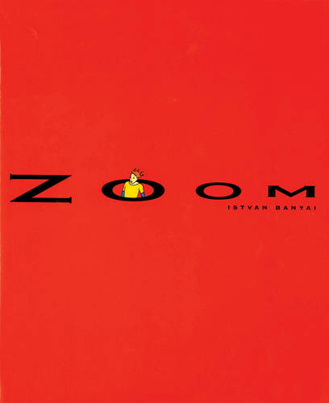
Notes:
Zoom Video: https://www.youtube.com/watch?v=Kgi-RCEjOLw&t=3s
4:46 mins long - watch together if technology works - if not, watch independently and be ready to discuss reactions to it.

Slide 8
‘Derangement of Scale’
(critically naïve) Personal Scale
Takes into account only the narrator’s immediate circle of family and acquaintances over a time scale of several years.
Historical Period Scale
A national culture and its inhabitants, with a time frame of perhaps a few decades.
Hypothetical Scale
Whole earth and its inhabitants, and placing [environmental challenge] in the middle of a, say, six hundred year time frame.
Notes:
Key Question - what problems might this pose to us a TEACHERS and our CHILDREN in school?

Slide 9
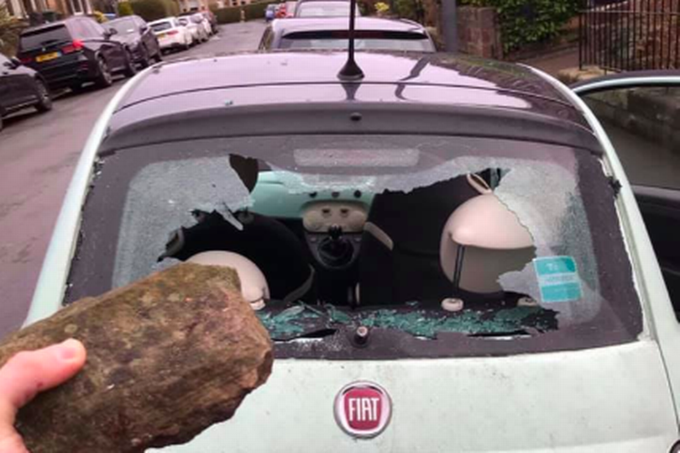
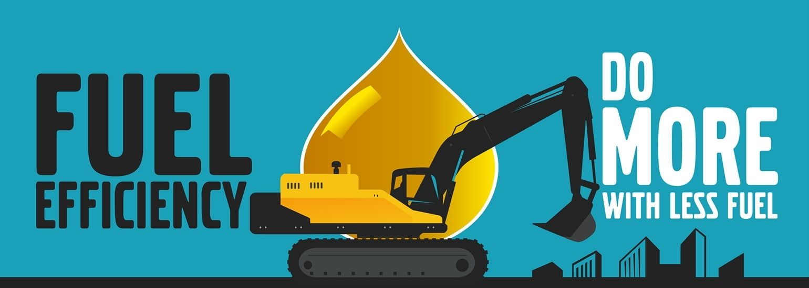
‘Derangement of Scale’
“Climate change is now acknowledged as a legitimate and serious concern and the government will continue to support measures to improve the fuel efficiency of motor vehicles.”
“The only defensible relationship to have with a car is with a well aimed brick.”
Notes:
Do we tinker on the edges OR do we cease and desist? Is there space in between? How do WE find that space? How do CHILDREN and YOUNG PEOPLE find that space?

Slide 10
Educational Context in Primary Curricula
- Nationally and Internationally

Slide 11


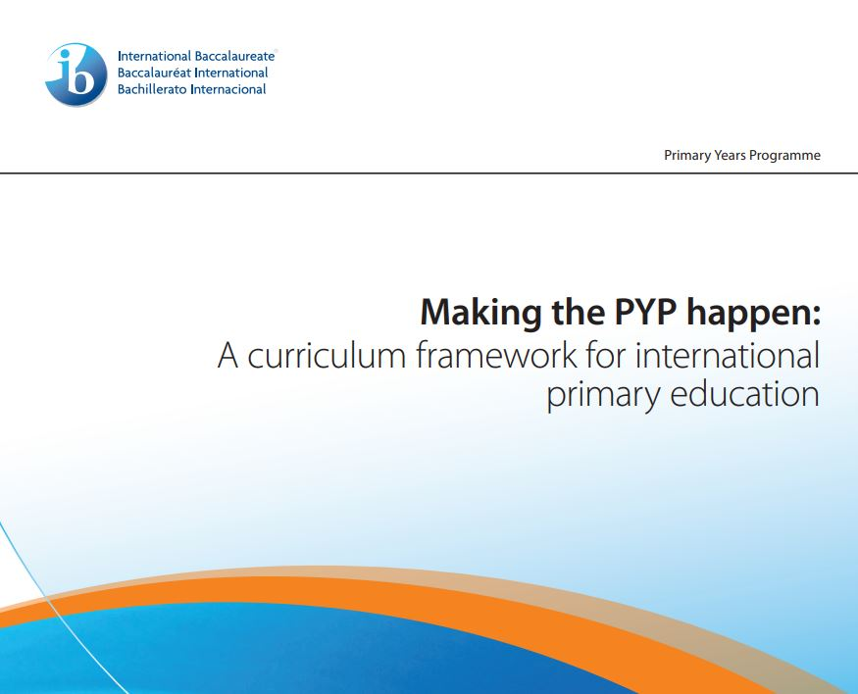

Notes:
The details and summary of what each of these curricula say about climate change in on the Padlet: https://warwick.padlet.org/annamdonnelly/green-space-conference-2023-6ug5xuplsdh23lte
https://assets.publishing.service.gov.uk/government/uploads/system/uploads/attachment_data/file/335186/PRIMARY_national_curriculum_-_English_220714.pdf
https://hwb.gov.wales/curriculum-for-wales
https://education.gov.scot/documents/All-experiencesoutcomes18.pdf
https://mtpyph.weebly.com/uploads/9/0/6/9/9069240/mtpyph_doc.pdf

Slide 12
Explore some high quality children’s literature and analysing design choices

Slide 13
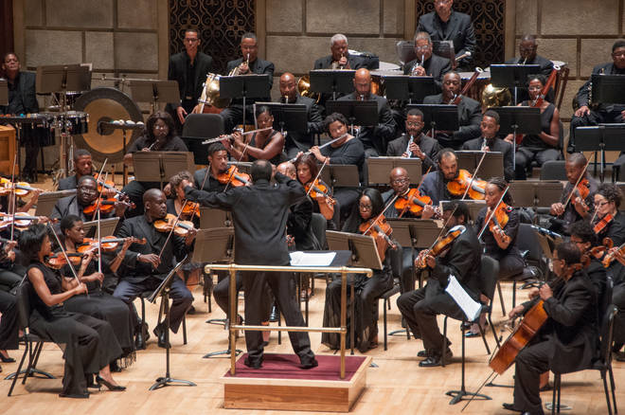
“It is no longer possible to think about literacy solely as a linguistic accomplishment.” (Jewitt, 2008)
“Modes are arranged in a combination of multimodality and are rich orchestrations of meaning.”
Source: Jewitt, C. (2008) Review of Research in Education. February 2008, Vol. 32, pp. 241–267
Notes:
Literacy is not a ‘one instrument’ show!

Slide 14
“The layout of words and pictures is intentional and purposeful. A text sequence is related to a picture or a set of pictures and the arrangement of both on the page or the double spread is never coincidental. The page is thus not only a means to carrying the text and the pictures, but an element that influences the way we read the story.” (Gressnich, 2012)
Gressnich, Eva (2012) “Verbal and Visual Pageturners in Picturebooks,” International Research in Children’s Literature 5.2: 167–183.
Notes:
To Begin

Slide 15
Modes: a ‘channel’ of representation or communication for which previously no overarching name had been proposed.
Writing
Still Image
Speech
Gesture
Moving Image
Sound
Gaze
Body language
Colour?
Typography?
Others?
Source: Kress, G. and Van Leeuwen, G. (2001). Multimodal Discourse: The Modes and Media of Contemporary Communication. Oxford UK: Oxford University Press
Notes:
Physiological: eyes for emotion, muscles for facial expression, vocal apparatus for sound

Slide 16
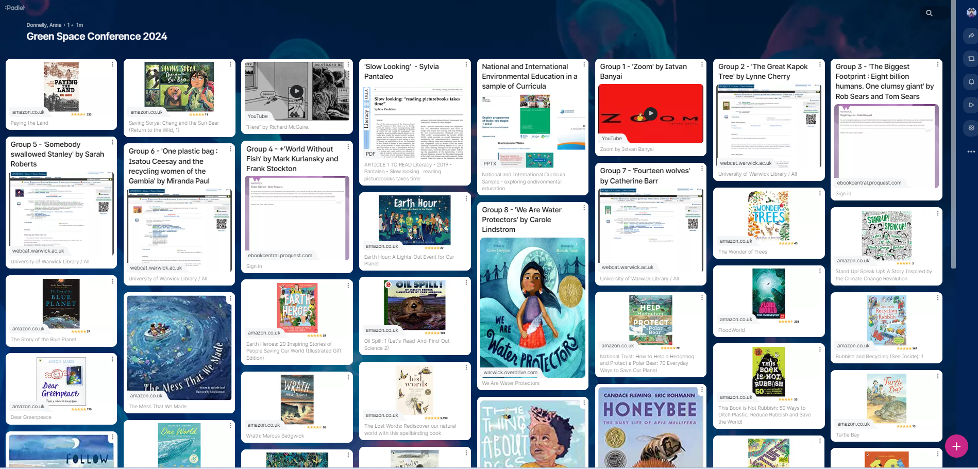
Explore all of these and select one you want to explore with your sample group. Consider the themes it brings up linked to the environment.
https://warwick.padlet.org/annamdonnelly/6ug5xuplsdh23lte
Notes:
TASK (10 mins) - Split attendees into 8 random groups (there are 8 e-texts). One person in the group logs on to the library and screenshares so that all in that room can see the text. You will return back to room - nominate one person to:
Summarise the text in terms of narrative / nf content
Share the environmental themes it explores
Share the design choices that the author/illustrator has made (media, mode, affordance)

Slide 17
Reading Picturebook Research

Slide 18
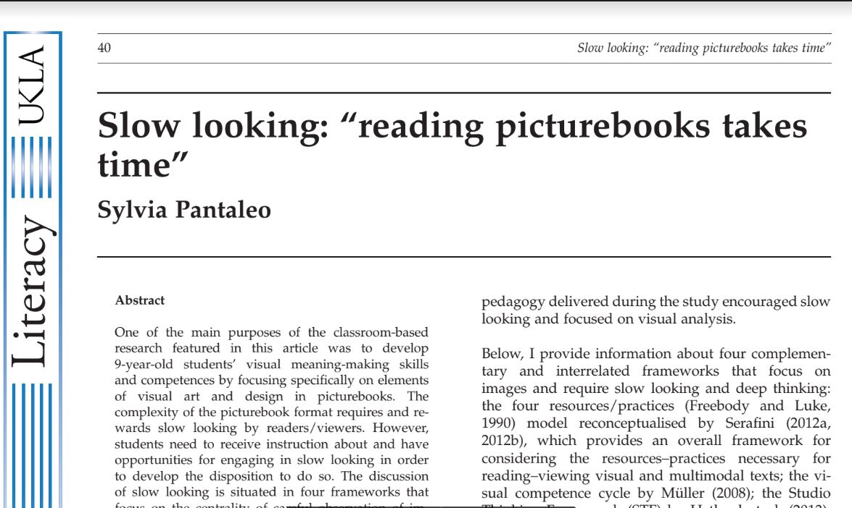

‘Slow Looking’
Notes:
Task for this afternoon: take time to read this when you are exploring the activities you are planning with your ‘children’

Slide 19
Hopeful Learning
+
Positive Action
Notes:
Task:

Slide 20
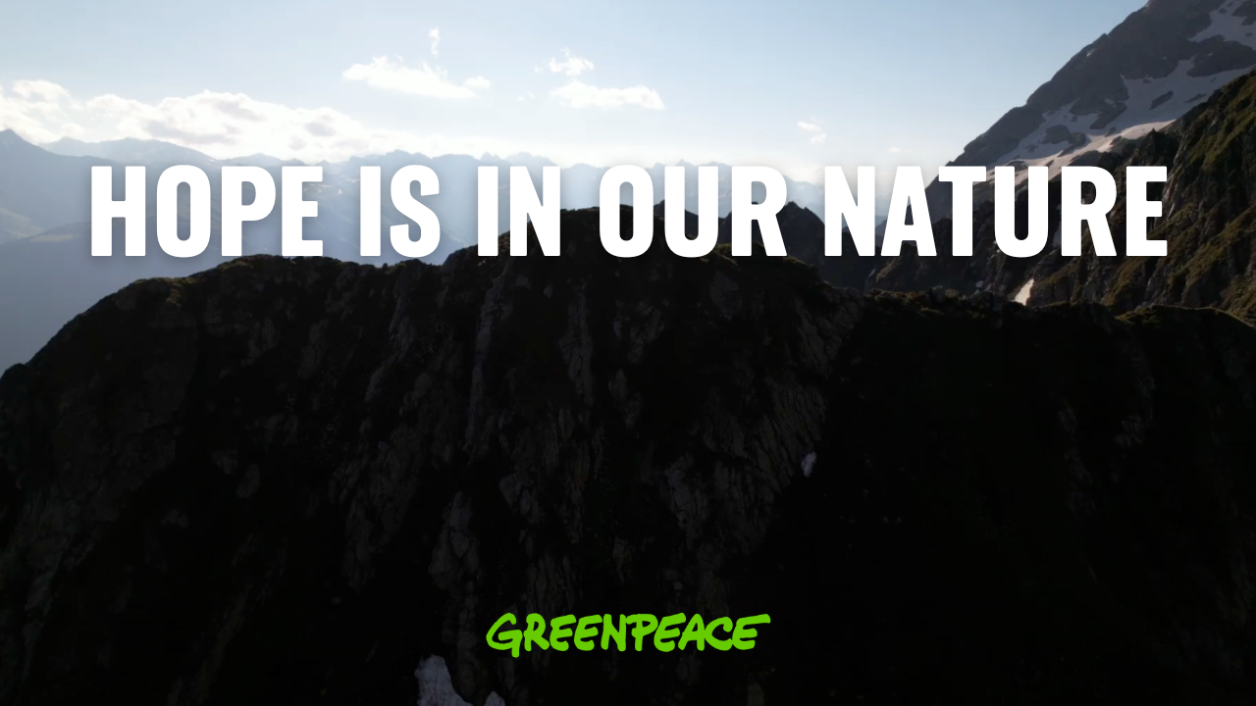

Slide 21
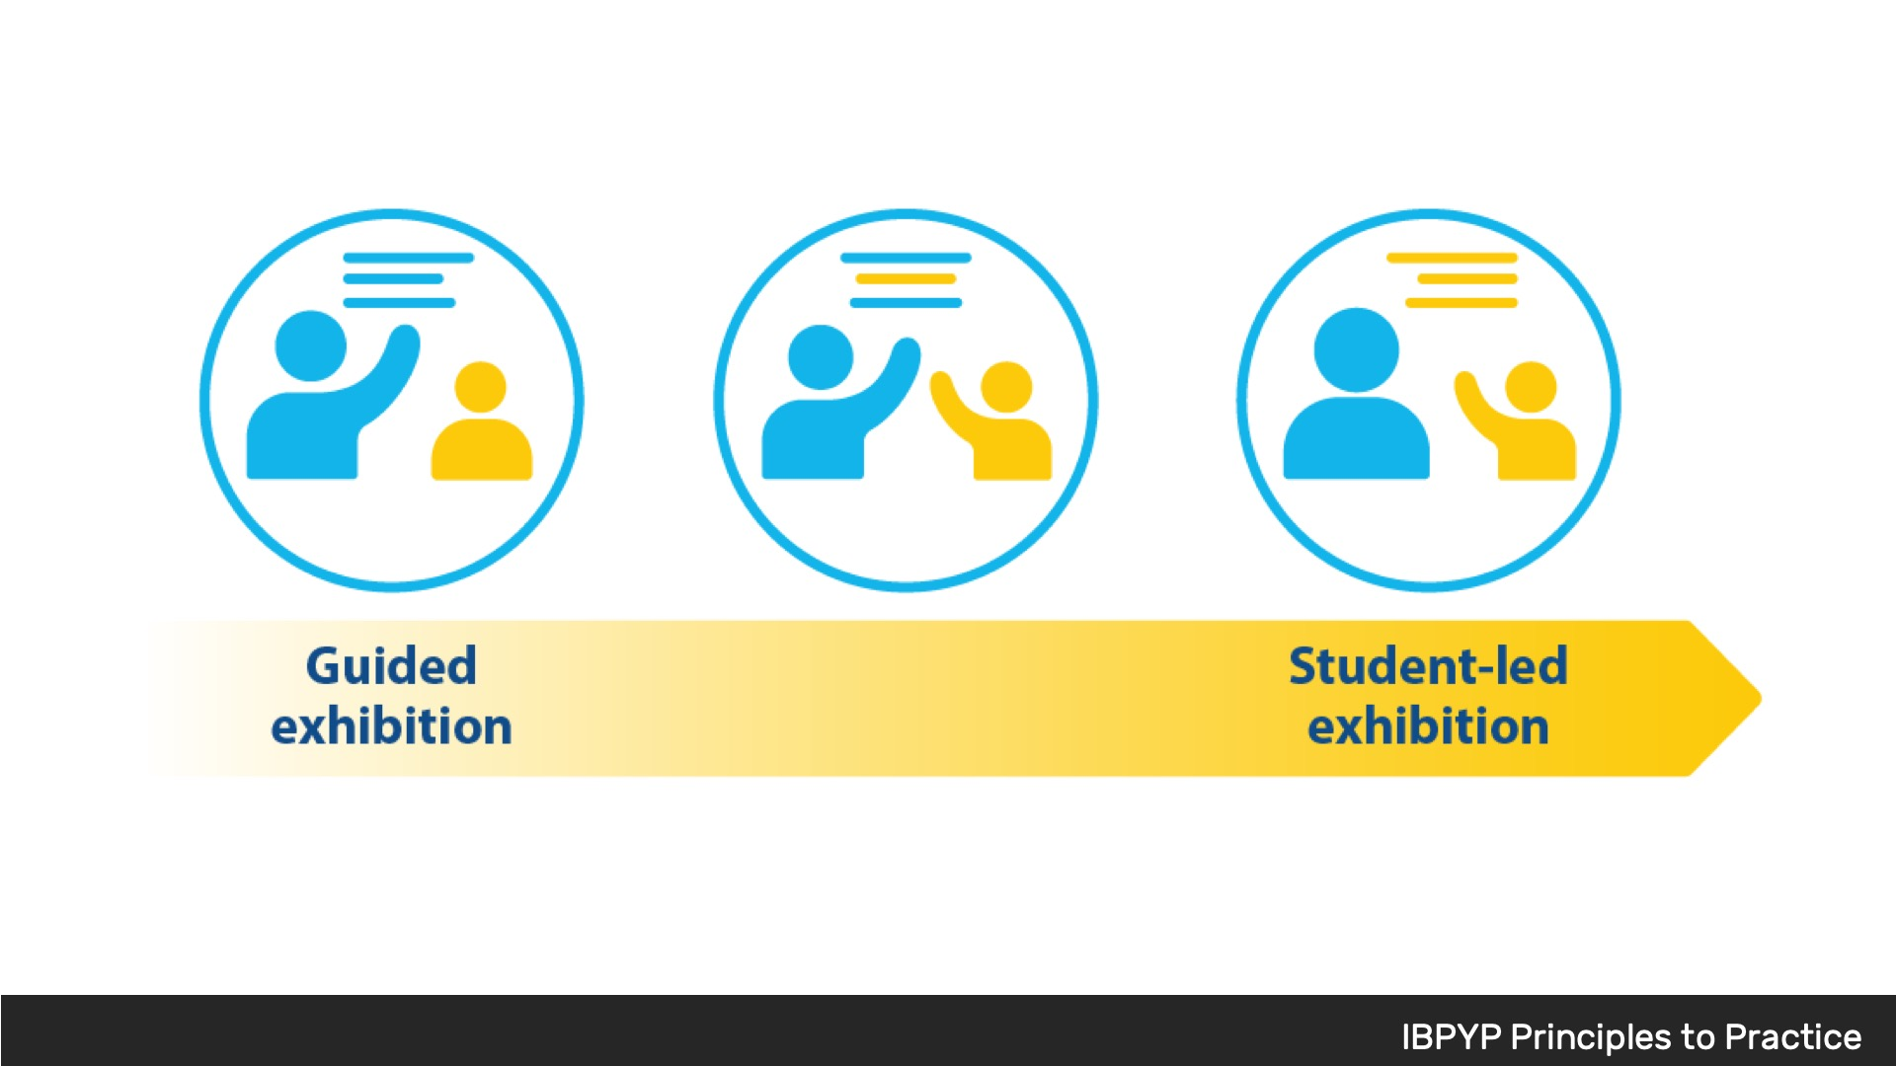
Notes:
Inquiry

Slide 22
Stage 1 Research and Planning
The first stage of the exhibition involves students researching and selecting a topic of interest. They work with their peers to form a group and identify an issue that they want to address. This stage requires extensive research, including the use of primary and secondary sources. Students also work to create a plan outlining the steps they need to take to complete their project.
Notes:
Inquiry

Slide 23
Stage 2 Taking Action
The second stage of the exhibition involves students taking action to address the issue they identified during the planning stage. This could involve anything from creating a public service announcement, organising a fundraiser, or designing and building a prototype of a product. The important thing is that students take action and work towards making a positive change.
Notes:
Inquiry

Slide 24
Stage 3 Reflecting and Presenting
The final stage of the exhibition is all about reflection and presentation. Students reflect on what they have learned throughout the process, the challenges they faced, and the successes they achieved. They then prepare and present their project to their peers, parents, and teachers. This presentation is an opportunity for students to showcase their hard work, knowledge, and understanding of their chosen topic.
Overall, the process of the IB-PYP Exhibition is designed to be a collaborative and reflective experience for students. It challenges them to think critically, work creatively, and develop a sense of responsibility towards their community. Through the exhibition, students gain important skills such as research, communication, collaboration, and self-management, which they can apply in their future studies and personal lives.
Notes:
Inquiry

Slide 25


Explore all of these and select one you want to explore with your sample group. Consider the themes it brings up linked to the environment.
https://warwick.padlet.org/annamdonnelly/hopeful-learning-and-positive-action-resource-posts-6tixg4ec2rsiabd1
Notes:
TASK (10 mins) - You are mentoring a group of mixed attainment learners in Year 6 (10-11 years old). They are doing a 6 week project, culminating in an ‘Exhibition’ of their learning and action.
They have chosen the theme of environmental hope for their exhibition.
Consider and collect a range of resources that might support them in their inquiry.
Consider some possible actions that they might undertake and how you might support them in achieving that.

