Slide 1


What does being an Eco School mean?
Mr Jack Lakin – Rushcliffe Spencer Academy

Slide 2
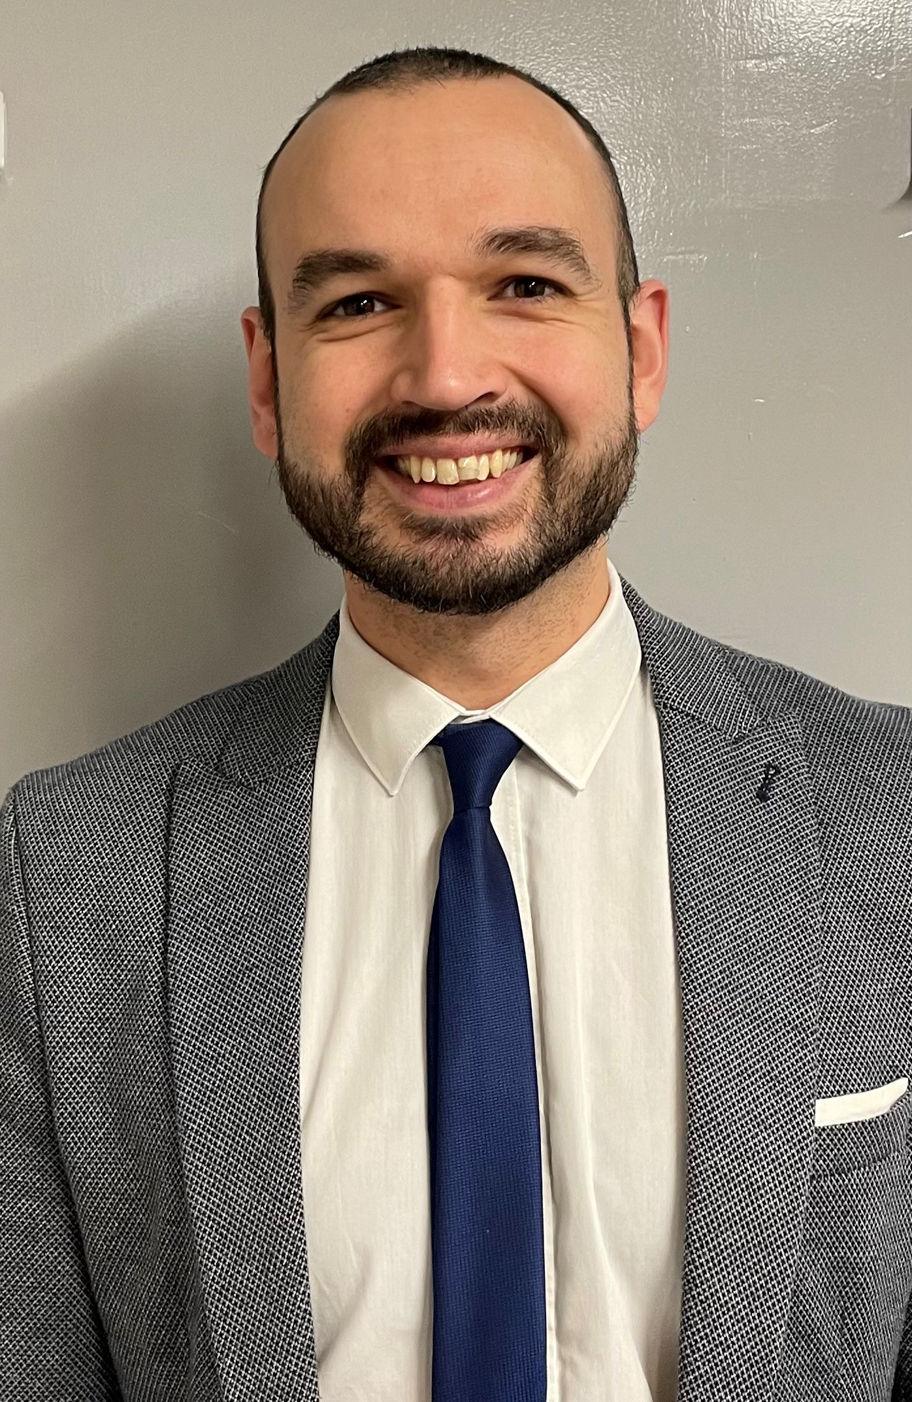
A little about me
Trained as a History teacher (2013)
Brought in to help teach Geography the past few years
Taken on the Eco Lead at Rushcliffe Spencer Academy this academic year (2023/2024)

Slide 3




Rushcliffe Spencer Academy’s Eco Journey
2017
2019
2020 and 2021
2018

Slide 4
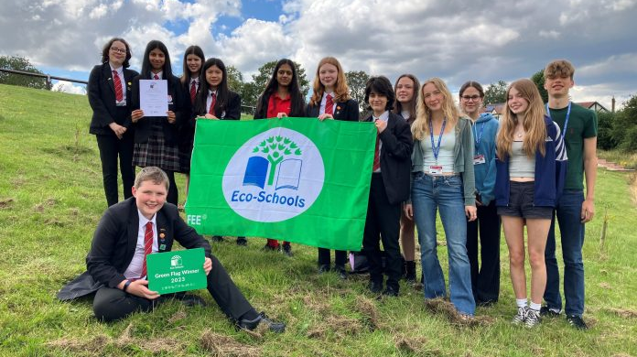
2022/2023 – We finally got Distinction!
And Eco School of the Year!

Slide 5
What is Eco-Schools?
For me (and our students) Eco-Schools really helped to give us the knowledge and know-how to help make changes to support the environment and be more sustainable.
They have a simple 7 step programme to help the students develop their understanding and help by giving the students 3 areas to focus on out of total of 10.

Slide 6





The 10 Topics
1. Biodiversity: Maintaining a high level of plant, insect and animal life locally and globally
4. Healthy Living: Addressing your, and our planet’s health. These two issues are intrinsically linked!
2. Energy: Reducing energy use and investigating greener energy sources.
5. Litter: Reducing litter, which harms wildlife and costs millions to clear every year.
3. Global Citizenship: Taking an active role in your community and making our planet more peaceful, sustainable and fair.

Slide 7





The 10 Topics
6. Marine: Protecting and conserving water-based ecosystems.
9. Waste: Refusing, reducing, reusing, repairing, recycling.
7. School Grounds: Improving School Grounds for students, staff, plants, insects and animals.
10. Water: Valuing and preserving our most important natural resource.
8. Transport: Promoting and Encouraging Sustainable Transport.

Slide 8

So, how do you get students enthused?!
My Top 5 Tips

Slide 9


1. Be Loud!
To get to as many students as possible, you have to sell it to as many as you can!
Try to get students from across all year groups and ensure they know what you are doing, and why you’re doing it!

Slide 10


2. Get teachers enthused
Teachers have a profound impact on students. What they say matters. Getting more teachers on board with eco work and sustainability helps spread the message, and in turn get more students involved.
We also work plenty with different departments to have a shared ‘eco curriculum’ across the year!

Slide 11





3. Use the excellent stuff out there

Slide 12
Just a bit more about this…

Slide 13
4. Competition
As with most things in life, a bit of friendly competition really helps to get people involved!
This can be either through inter-school competitions (Earth Day etc) or through the other institutions you’re involved with (Eco-Schools, Energy Sparks)

Slide 14


5. Celebrate Success
Students do like to be recognized for their achievements – even when it doesn’t look like they do!
So make sure you reward those that help out and let people know the great things you’re doing!

Slide 15



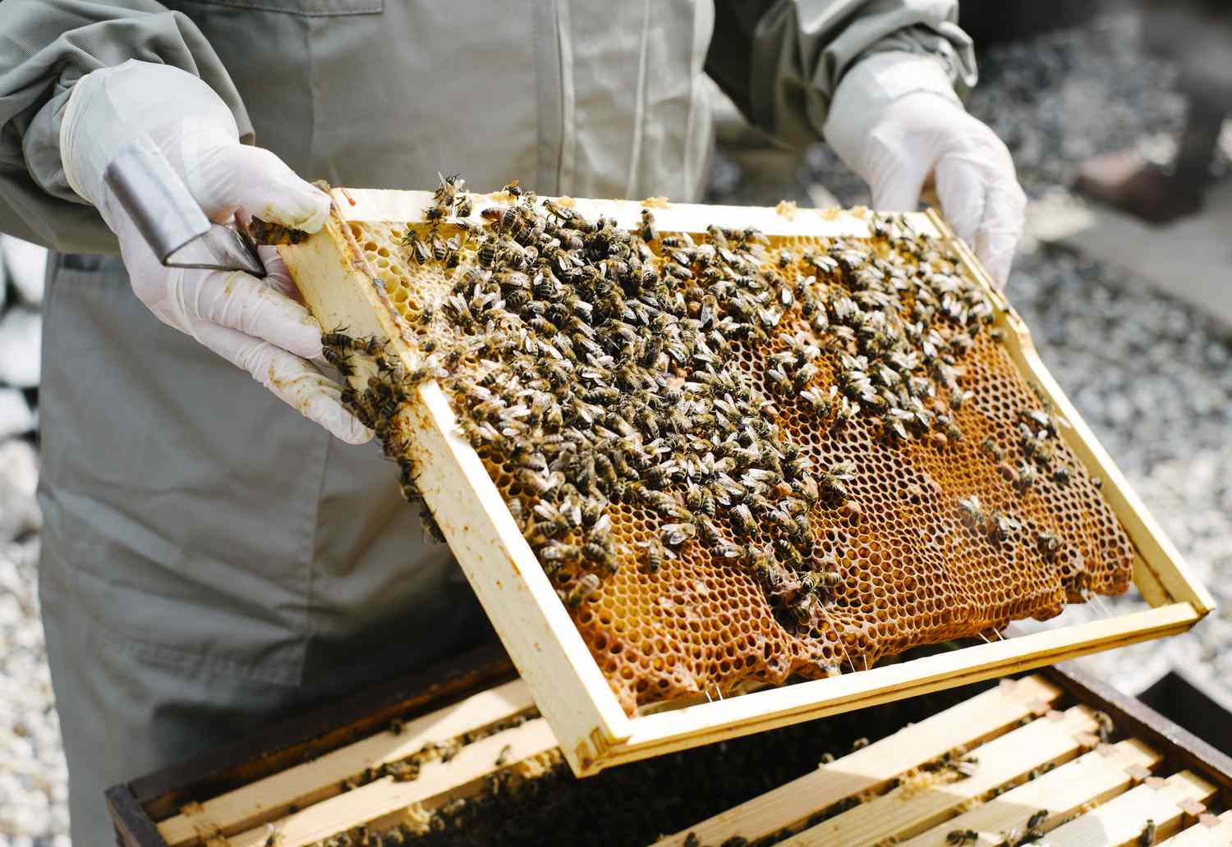
Future Projects for Rushcliffe

Slide 16


