Slide 1
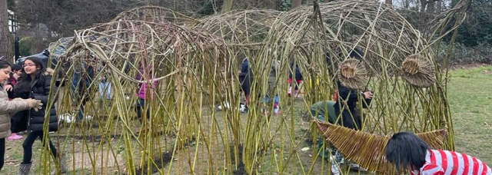
Working with Teachers and Pupils to develop Climate Change Education
Dr. Nasreen Majid nasreen.majid@ucl.ac.uk
UCL IOE. Faculty of Education and Society

Slide 2
Today, we will cover...
UCL Centre for Climate Change and Sustainability Education's professional development modules- Teaching for Sustainable Futures. I will share the content from the primary mathematics module.
A Curriculum design project, funded by BERA exploring 'Nature Connectedness through the arts to support pupil wellbeing.

Slide 3
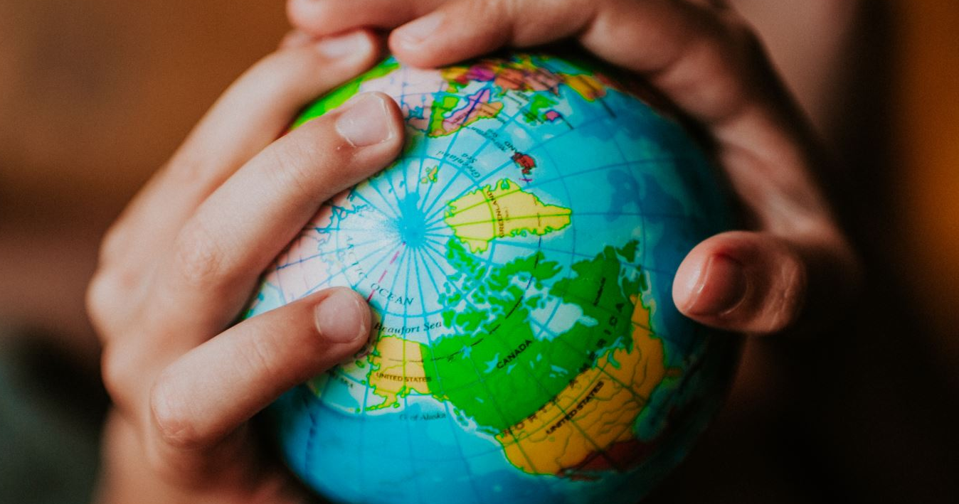
UCL Centre for Climate Change and Sustainability Education
Teaching for Sustainable Futures
A Professional Development Programme for Teachers
Image credit: Hero Images / Adobe Stock

Slide 4
Teaching for Sustainable Futures is a free online professional development programme to help teachers embed issues of climate change and sustainability into their teaching practice. Currently available for history and geography (primary and secondary) and soon for English and mathematics (primary and secondary) and secondary science.
Key features include:
Free for all teachers; accessible online at any time.
Tailored to individual subjects and to primary and secondary age phases.
Research-informed; developed with teachers.
Quality assured by UCL.
Aligned with the National Curriculum in England but adaptable to any classroom setting.
Each online module takes about 90 minutes to complete. You can do it all at once or revisit whenever you have some time. They can be done individually or with colleagues.

Slide 5
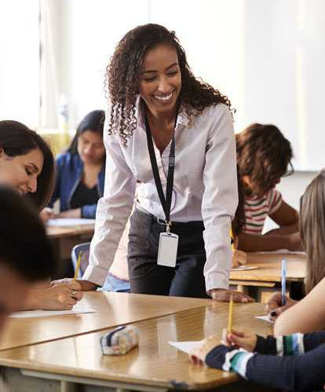
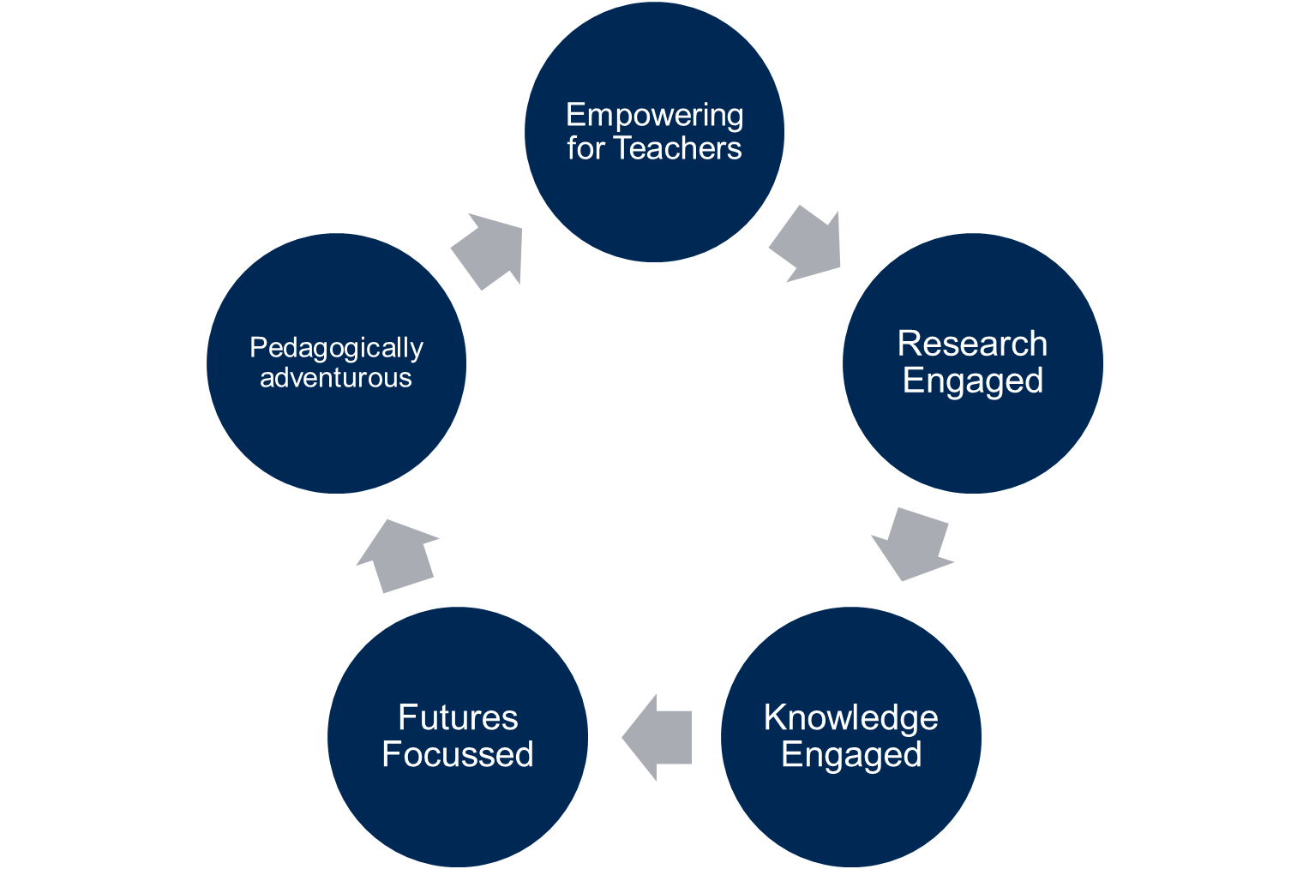
Principles
Notes:
Professional development which supports schools to implement teacher professional development that enables all young people to access effective and transformative climate change education.
Teaching for Sustainable Futures will empower teachers to draw on their age-phase and subject expertise whilst also supporting teachers to engage with climate change as a challenge which has political, economic, social, ethical complexities as well as scientific realities.
Will situate climate change in the wider context of environmental sustainability, which can be explored across the whole curriculum through an appreciation of nature, an understanding of biodiversity loss, the uneven social implications of climate change around the world, the ways that we can live more sustainably and so on.
History lessons, for example, can help young people understand how we reached this point of crisis and when the turning points in our journey towards the Anthropocene began.
In mathematics, students can explore the way climate change predictions are calculated or work out how much energy solar panels on the roof of the school are generating and how much money and carbon emissions that is saving.
Art lessons can allow students to depict a world that isn’t seen through an anthropogenic perspective and explore sustainable art practices.
And in primary schools, students can engage with local environments, explore ways to make their school sites greener, learn about sustainable practices and understand how all aspects of nature are connected.
Geography and History will be launched in July.

Slide 6

Outcomes for young people
Every child and young person has the agency and capabilities to act for the environment
Every child and young person is equipped to contribute to a socially just, equitable and compassionate world
Every child and young person experiences a life-long connection with nature which enhances their physical and mental well-being
Every child and young person understands the planet as an interconnected system and their place in human and more than human communities
Notes:
Professional development which supports schools to implement teacher professional development that enables all young people to access effective and transformative climate change education.
Teaching for Sustainable Futures will empower teachers to draw on their age-phase and subject expertise whilst also supporting teachers to engage with climate change as a challenge which has political, economic, social, ethical complexities as well as scientific realities.
Will situate climate change in the wider context of environmental sustainability, which can be explored across the whole curriculum through an appreciation of nature, an understanding of biodiversity loss, the uneven social implications of climate change around the world, the ways that we can live more sustainably and so on.
History lessons, for example, can help young people understand how we reached this point of crisis and when the turning points in our journey towards the Anthropocene began.
In mathematics, students can explore the way climate change predictions are calculated or work out how much energy solar panels on the roof of the school are generating and how much money and carbon emissions that is saving.
Art lessons can allow students to depict a world that isn’t seen through an anthropogenic perspective and explore sustainable art practices.
And in primary schools, students can engage with local environments, explore ways to make their school sites greener, learn about sustainable practices and understand how all aspects of nature are connected.
Geography and History will be launched in July.

Slide 7
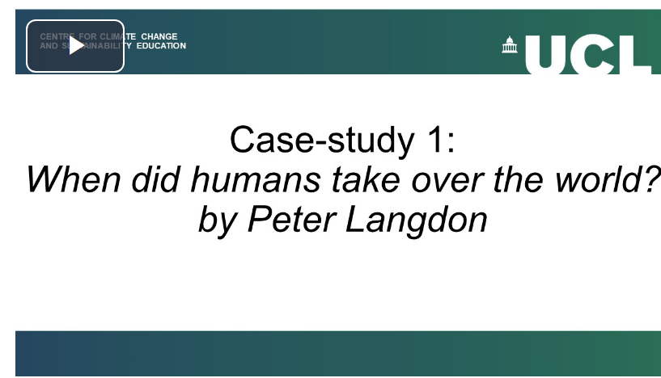
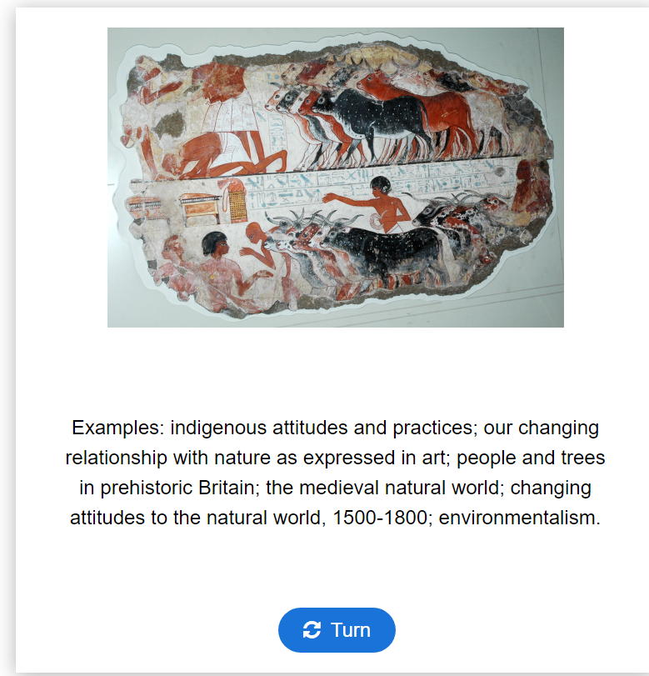
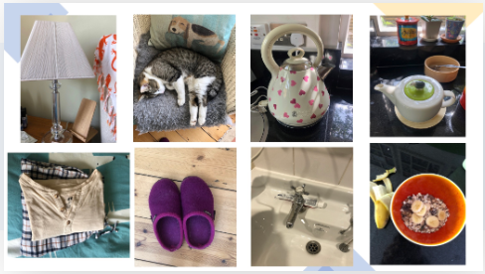
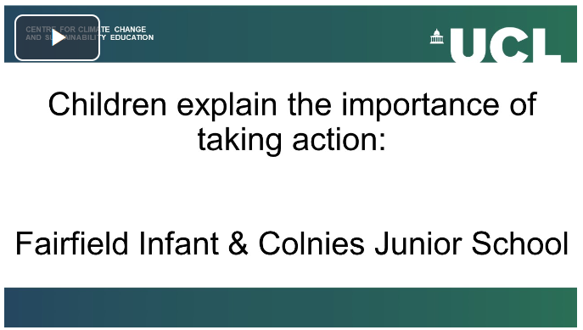
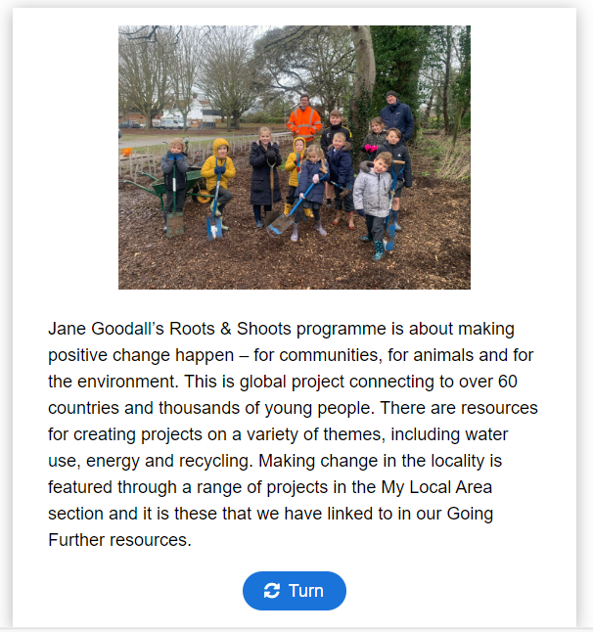
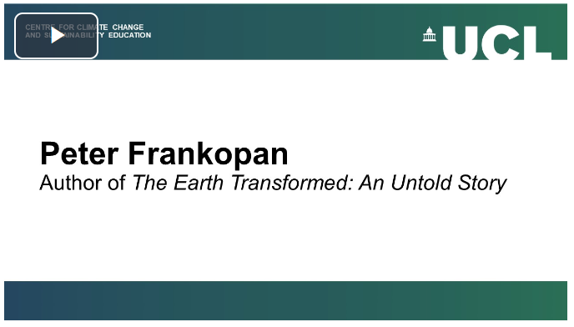



What do the modules look like?

Slide 8
Primary Mathematics module structure
1.Consumption and sustainability.
3.Social Justice and Mathematics.
2.Nature and Mathematics.

Slide 9
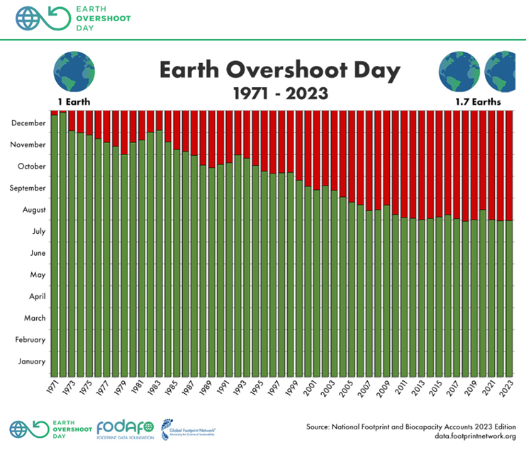
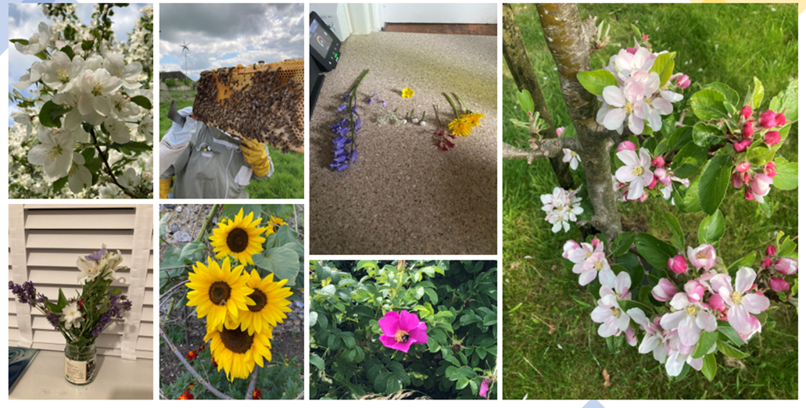
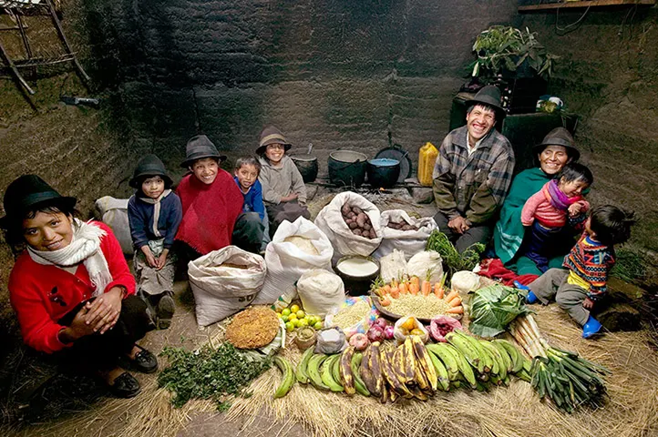
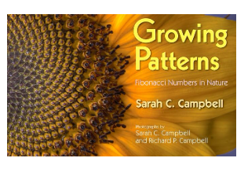

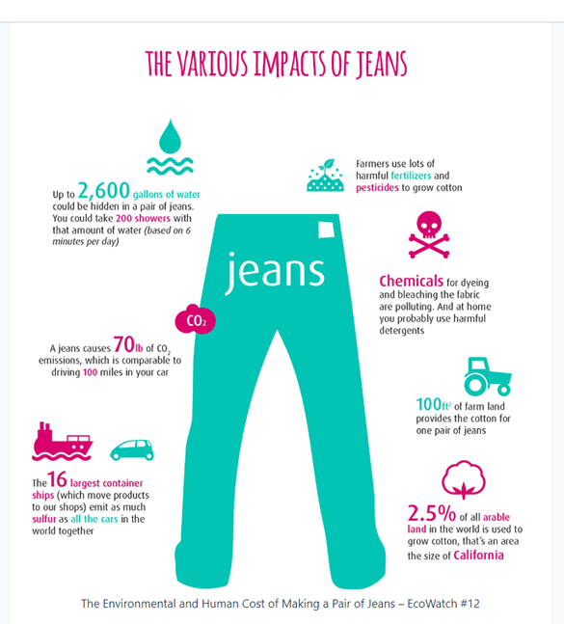
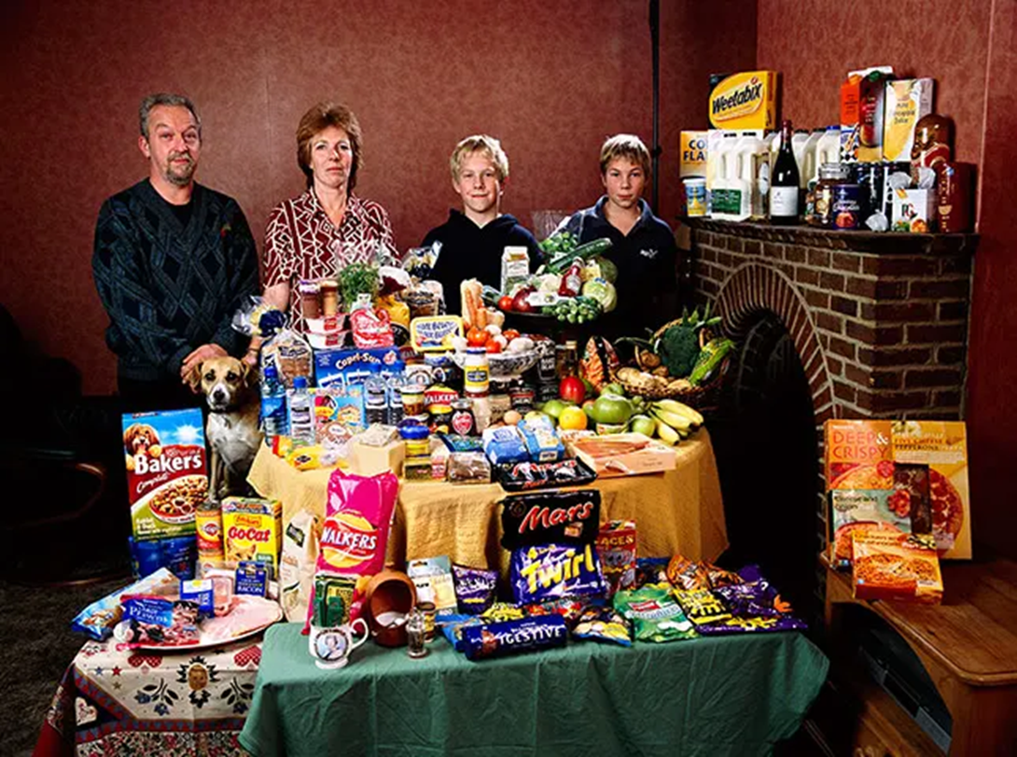
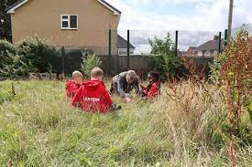
Content
2
1
3
Consumption and sustainability
Nature and Mathematics
Social justice and mathematics

Slide 10
1.Consumption and sustainability.
How would you interpret this graph?
What is it telling you?
How could we use this graph as a starting point for conversations about CCSE?

Slide 11
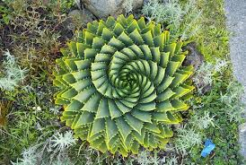
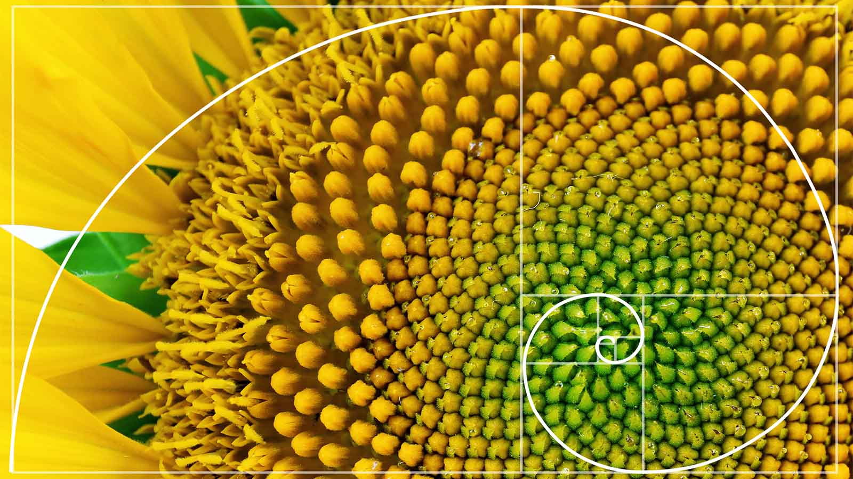
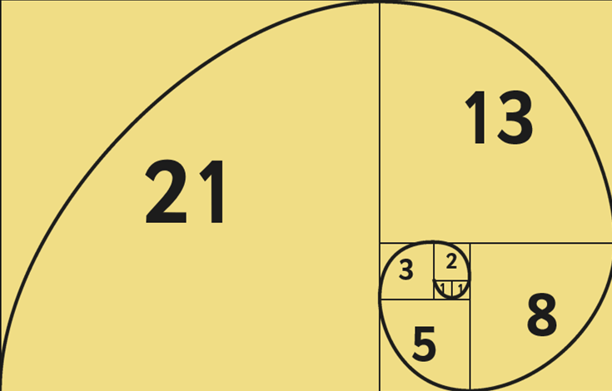
2.Nature and Mathematics.

Slide 12
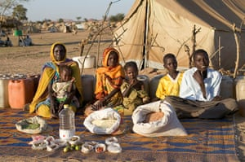
3.Social Justice and Mathematics.
The Aboubakar family from Darfur, Sudan, in the Breidjing refugee camp in Chad.
Their weekly food, which feeds six people, costs 79p
Photograph: Peter Menzel /Barcroft media

Slide 13
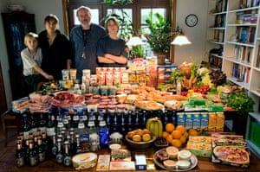
3.Social Justice and Mathematics.
The Melander family from Bargteheide, Germany.
Their weekly food, which feeds 4 people, costs £320.
Photograph: Peter Menzel /Barcroft media

Slide 14
Mapping to the aims of the mathematics National Curriculum
become fluent in the fundamentals of mathematics, including through varied and frequent practice with increasingly complex problems over time, so that pupils develop conceptual understanding and the ability to recall and apply knowledge rapidly and accurately
reason mathematically by following a line of enquiry, conjecturing relationships and generalisations, and developing an argument, justification or proof using mathematical language
can solve problems by applying their mathematics to a variety of routine and non-routine problems with increasing sophistication, including breaking down problems into a series of simpler steps and persevering in seeking solutions

Slide 15
Share your thoughts on this menti

Slide 16
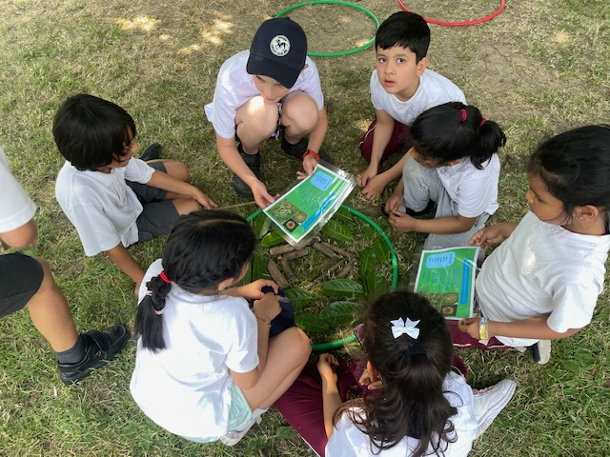
NATURE CONNECTEDNESS
THROUGH THE ARTS.
CO-CREATING A CURRICULUM TO SUPPORT PUPIL WELLBEING IN PRIMARY SCHOOLS
Dr. Nasreen Majid ​
Lucy Taylor​
Jim Dees​
Year 5 pupils West Lodge School, Harrow

Slide 17
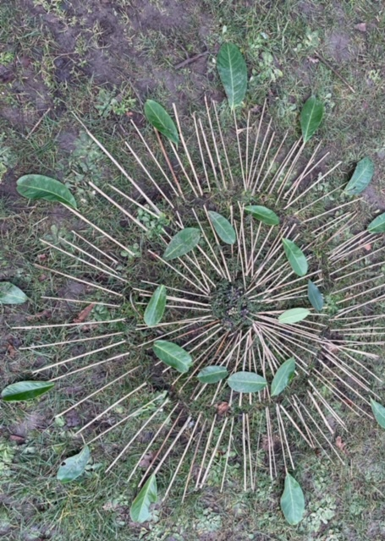
Curriculum Development

Slide 18
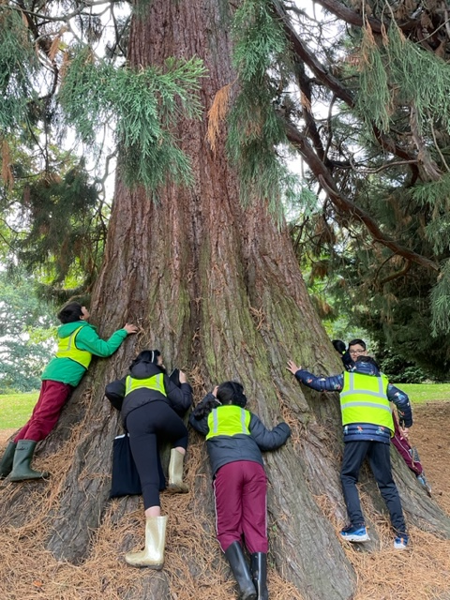
Nature connectedness through the arts Co-creating a curriculum to support pupil wellbeing in primary schools
How can pupils in primary school be supported to develop a sense of connecting with nature through the arts to enhance their wellbeing?
What scaffolding can schools provide to pupils to support them in the development of an art-based curriculum to connect with nature?
How many of the eight eco-capabilities did the pupils develop by the end of the project?
What role do teachers and school leaders play in enabling pupils in the development of a nature connected curriculum?

Slide 19
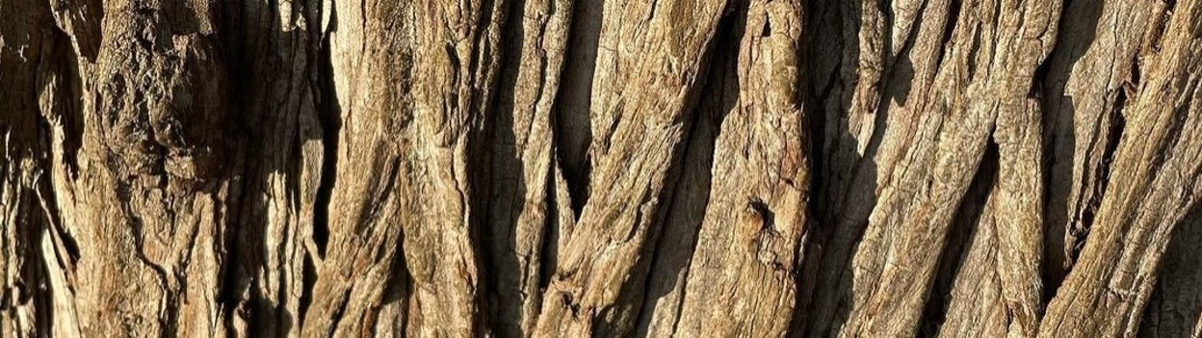
Year 5 pupils will design a curriculum, encompassing the schools’ estate and local park to enable nature connections to enhance and support pupil wellbeing and the wellbeing of the wider school community.

Slide 20
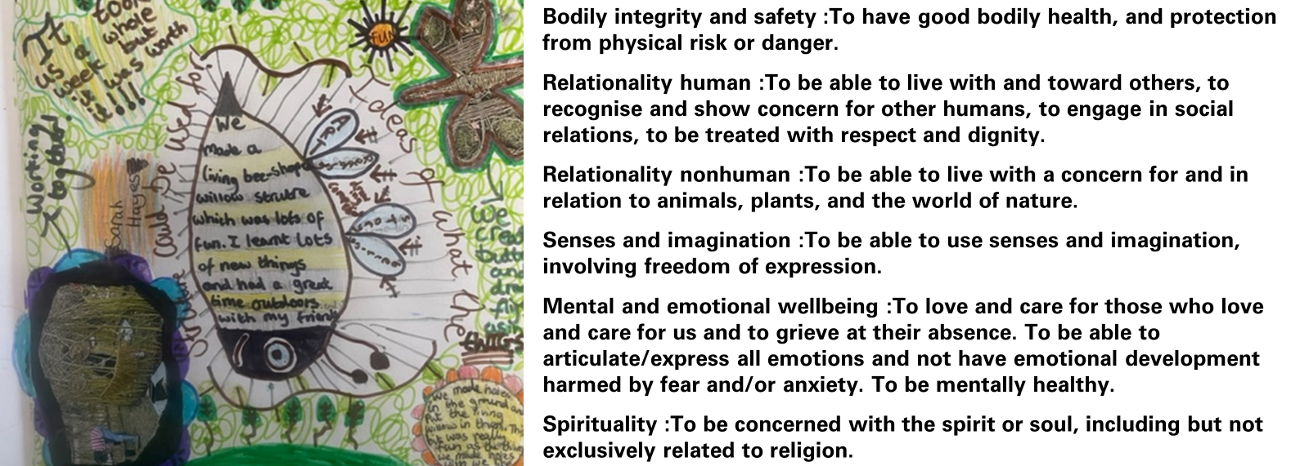
Research Inspired by- Eco- Capabilities as a Pathway to Wellbeing and Sustainability- (Walshe, Moula, & Lee, 2022)

Slide 21
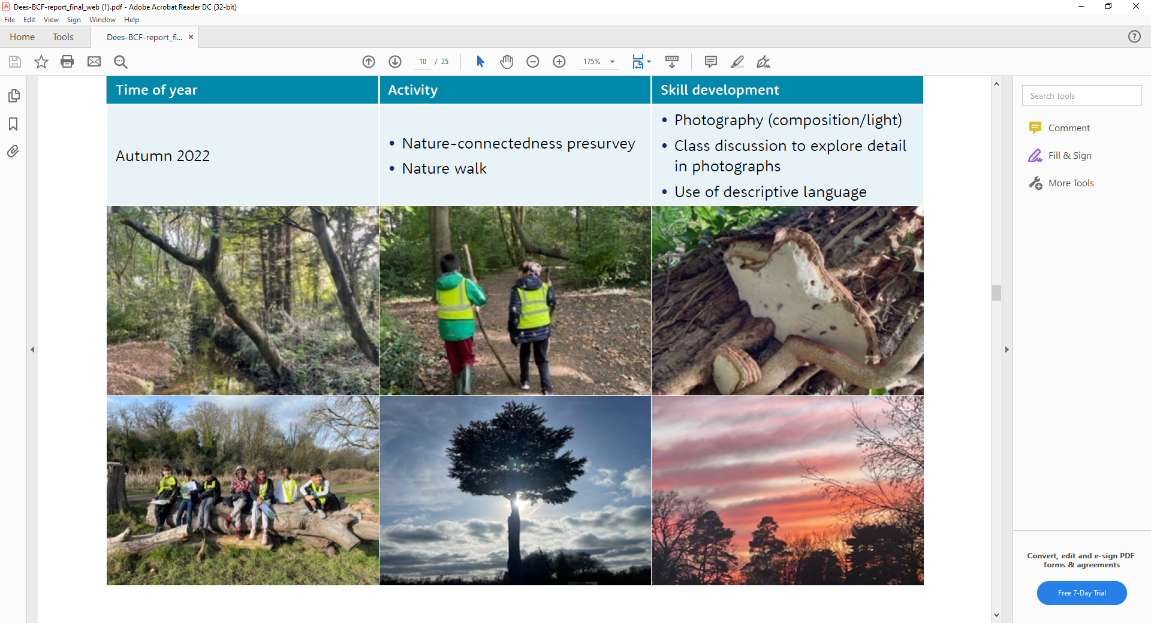

Slide 22
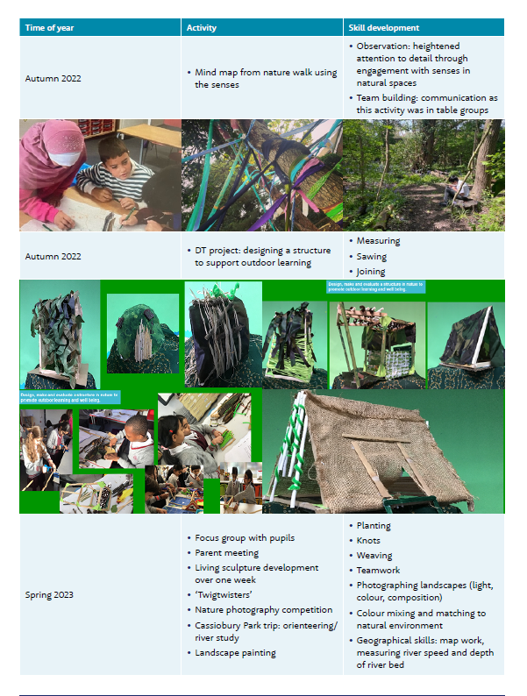
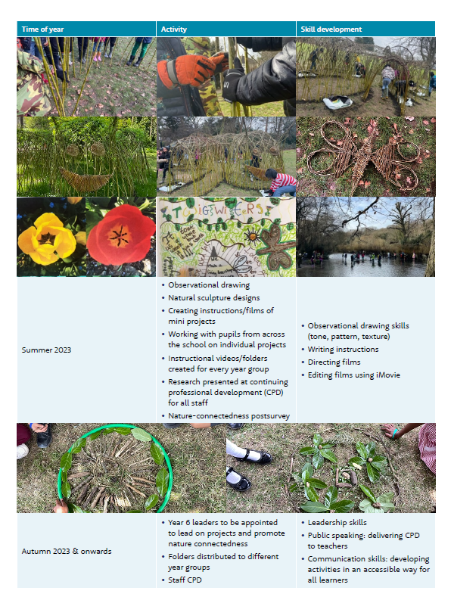

Slide 23
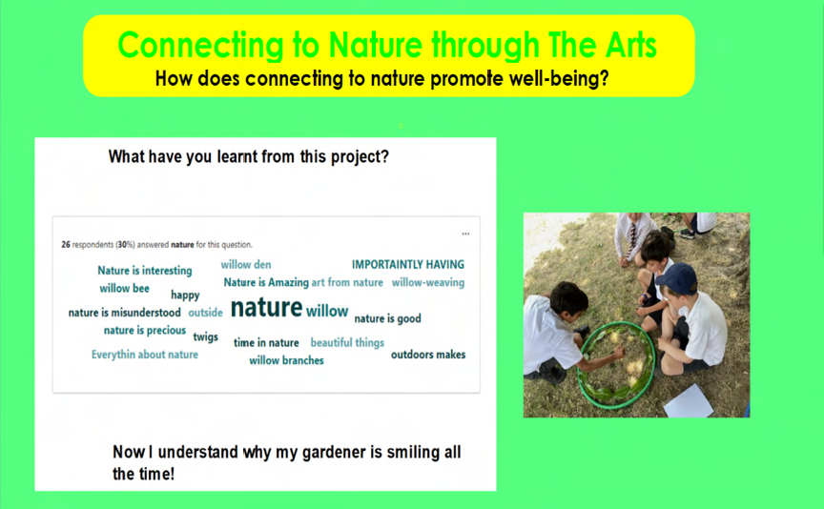
This image highlights some of the key words and comments that came from the post-project pupil survey.

Slide 24
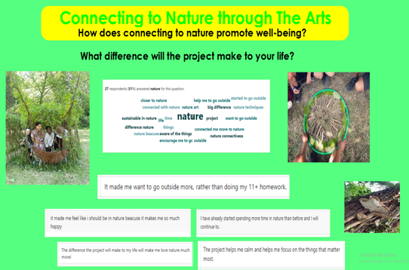
Quotes from the post-project survey highlighting the impact that the project has had on changing pupils’ perceptions and behaviors.

Slide 25
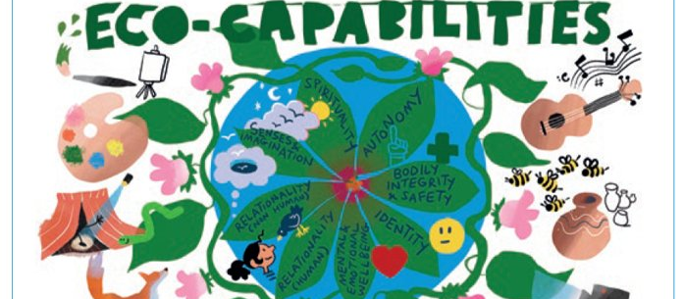
How many of the eight eco-capabilities did the pupils develop by the end of the project?

Slide 26
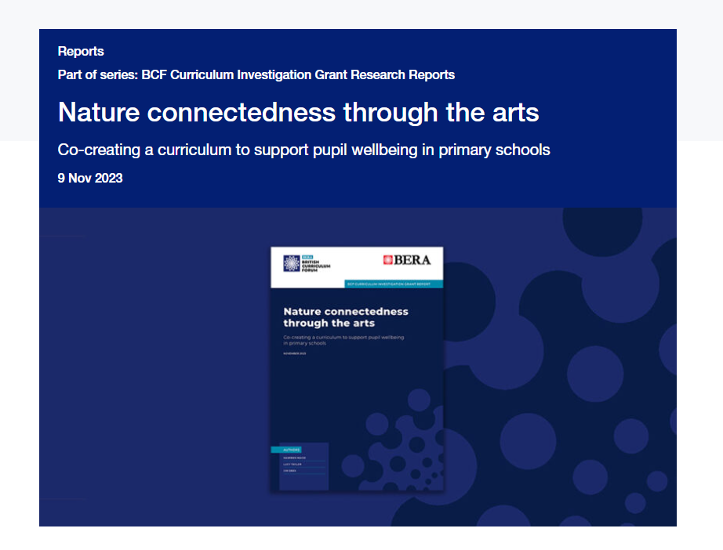
The full report for the project is available on the BERA site- you can click here to access it.

