Slide 1

Demystifying Climate Education
Understanding how to bring climate change into your classroom.
Notes:
Hi everyone!
I’m Jack - a Project Manager at the environmental education charity Students Organising for Sustainability UK - and I’m excited to be here today to talk to you about Demystifying Climate Education. Over the next hour I want to explore what a quality climate education can/should look like, hopefully demonstrating the holistic nature of climate education and the many opportunities you have to bring climate change into your classroom no matter what subject you teach.

Slide 2
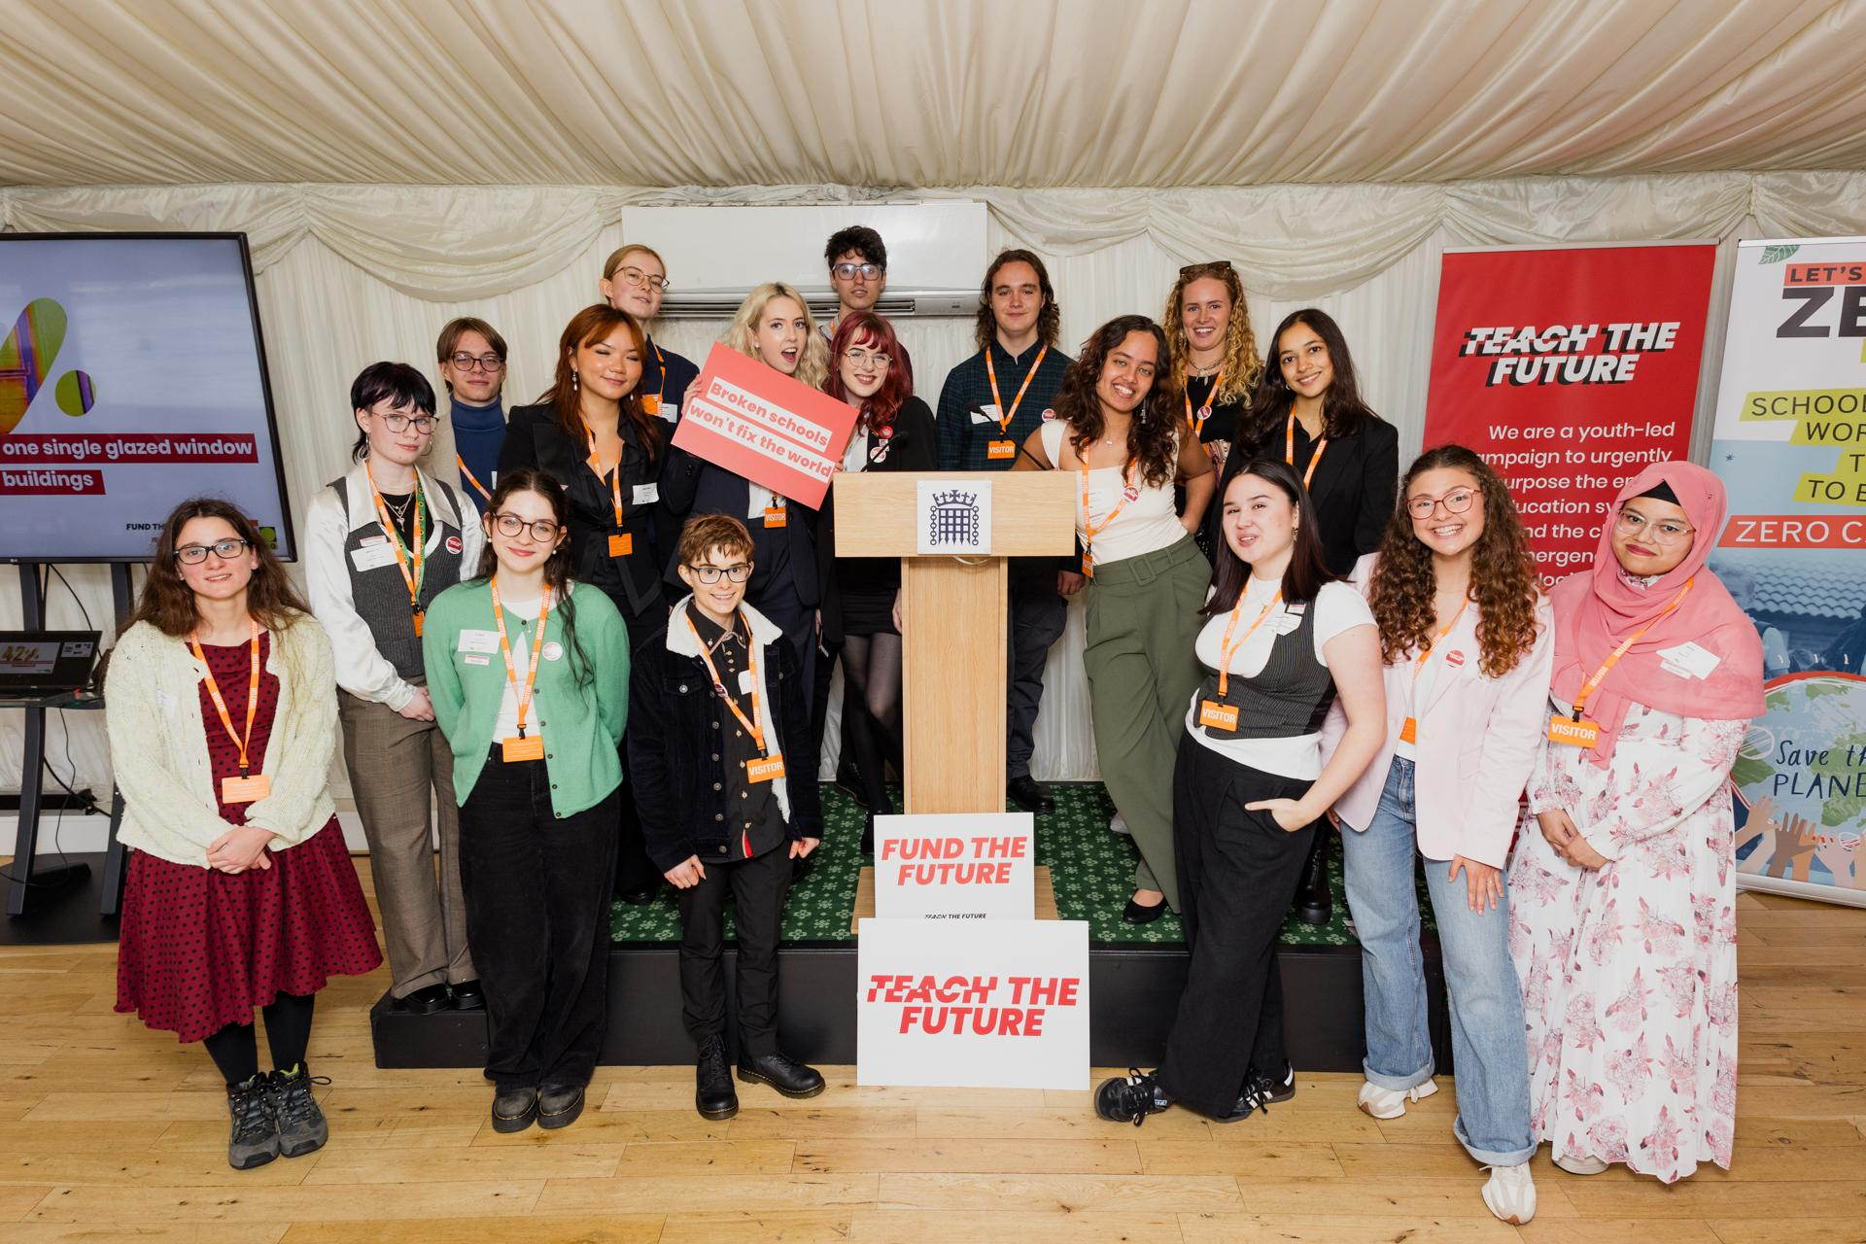
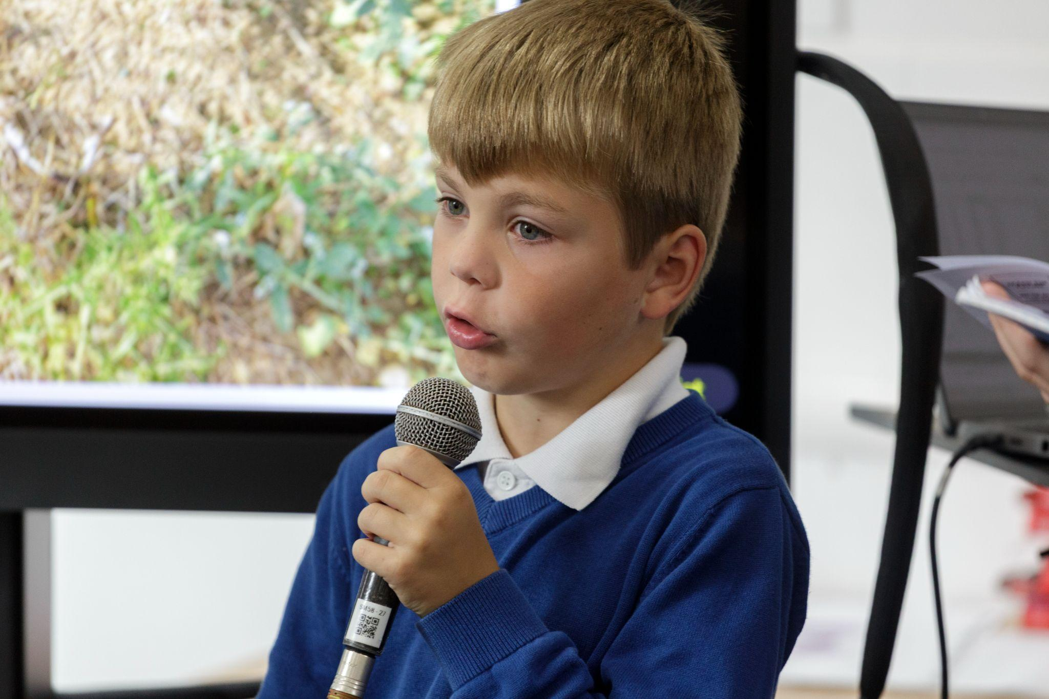
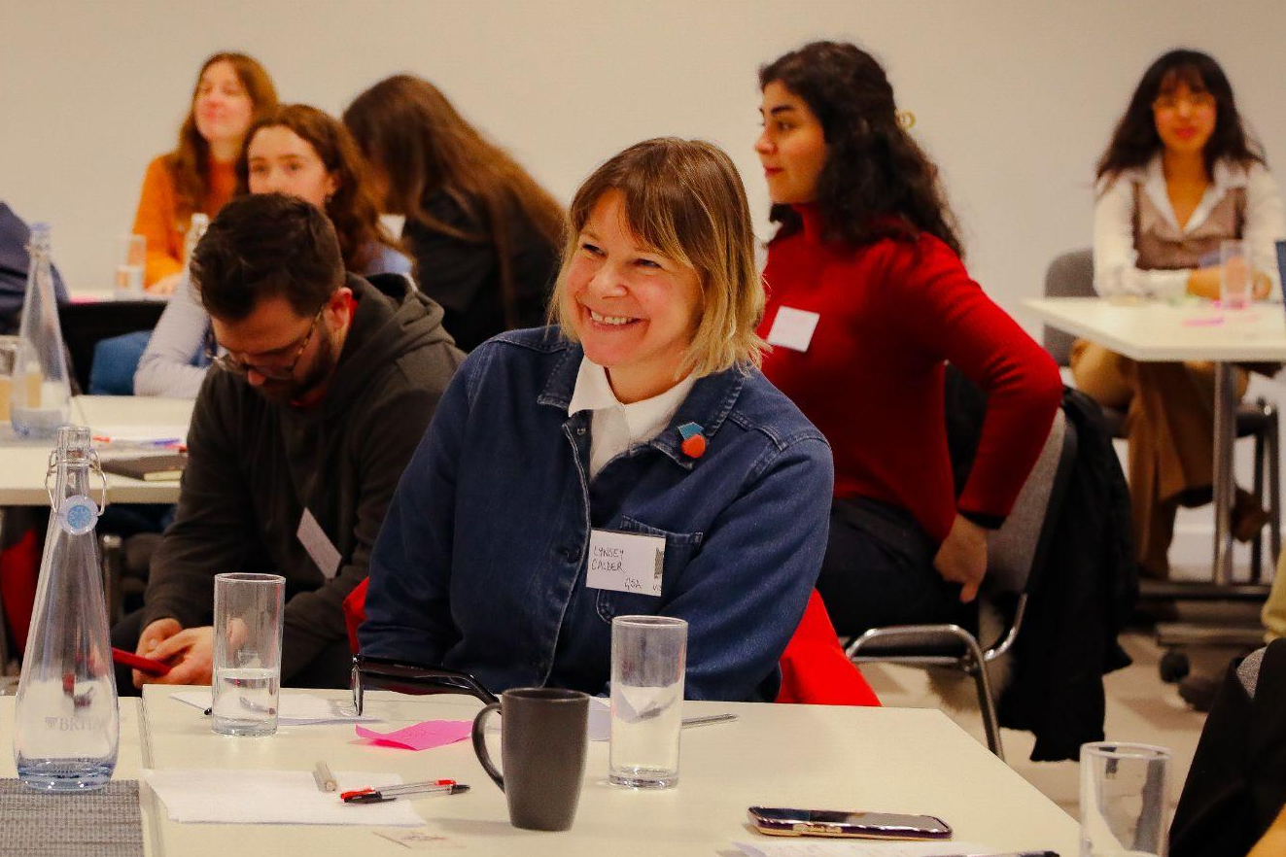
Students Organising for Sustainability UK
Our three aims:
Change the way we teach, what we learn, and how that’s assessed so climate and nature is a priority
Make sure the places where we learn show us what’s possible, helping us to help nature and the climate
Ensure students from every background can play their role in protecting and building a better world
Notes:
Firstly, I just wanted to take a moment to let you know about Students Organising for Sustainability UK - or SOS UK.
We’re an environmental education charity that’s been running as an independent charity for around 6 years now, working with young people, schools, colleges, and universities across the UK on a number of different projects relating to climate, nature, and curriculum.
We have three main aims which I’ll kind of summarise for you:
The first, is making sure that climate and nature is included in the curriculum. Currently climate change is only mandatory in science and geography at GCSE level in England and we want to make sure all learners, even those not interested in science are able to learn about climate change and how they can make a difference. That’s where campaigns like Teach the Future - pictured here - come in, working with young people across the UK to lobby the government for curriculum change.
Secondly, we want to make sure that outside of the curriculum our places of education are taking climate action themselves, modelling good practice for their learners. If the places we learn prioritise important issues like climate change then their learners will also.
And thirdly, we want to make sure those from underrepresented backgrounds are getting the opportunity to get involved in climate action. The environment sector is the second least racially diverse sector in the UK and it’s important we’re making sure everyone sees themselves in this space and knows they can make an impact and a difference.
Pictured here is also some of our other work - on the left a primary school student from Bath delivering a workshop alongside his classmates to trainee teachers about why climate education is important and what they want to see from the teachers of tomorrow. And on the right an academic from Glasgow School of Art attending our conference looking at how we can tackle the climate crisis through more creative means and non STEM subjects.

Slide 3

Why is climate education important?
Notes:
Ok, and that brings us onto the main content of today's workshop.
And the first question I want to address is why is climate education important.
Does anyone have any personal reflections on why climate education is important?
Great! We also have 4 statistics for you that hopefully also work to demonstrate this point.

Slide 4

Why is climate education important?
99%
of scientists agree that climate change is real
95%
of young people are concerned about climate change
72%
of young people want climate education in school
70%
of teachers don’t feel trained to teach about climate change
Lynas et al. 2021
UNICEF 2021
British Science Association 2023
Teach the Future 2021
Notes:
The first fact is that: 99% OF SCIENTISTS AGREE THAT CLIMATE CHANGE IS REAL and is being caused or worsened by human action.
Climate change is a real issue which is going to impact everyone, so it’s important that young people are being prepared for their futures by learning about it and how they can take action.
The second fact is that: 95% OF YOUNG PEOPLE AGED ___ - ___ ARE REPORTED TO FEEL CONCERNED ABOUT CLIMATE CHANGE.
As young people, the idea of climate change can feel scary, especially with how it’s spoken about in the media. Climate education can show that climate change isn’t an impossible issue to overcome, and this can help reduce feelings of climate anxiety that young people might be experiencing.
The third fact is that: 72% OF YOUNG PEOPLE AGED ___ - ___ ACTIVELY WANT CLIMATE EDUCATION IN THEIR SCHOOL.
We know there’s a demand for climate education, so as new teachers we want you to feel confident to deliver this.
And our fourth fact is that: 70% OF TEACHERS DON’T FEEL TRAINED TO TEACH ABOUT CLIMATE CHANGE.
And that’s why we’re here today - to help you see how easy it can be to deliver a quality climate education in your classroom. You don’t need to be an expert to talk about climate change, but it’s important that your students are given the tools they need to take action and understand how they can be an agent of positive change.

Slide 5

Climate quiz
Up to environmental refugees predicted by 2050
of coral reefs could be lost by 2100
Up to of sea level rise by 2100 due to melting ice caps
of the year school classrooms will overheat
Up to people predicted to lack sufficient water by 2050
Notes:
If we don’t learn about climate change and start taking action then climate change has the potential to have big impacts on the planet.
Here we have 5 examples of how climate change could impact the planet, if we reach two degrees of global warming (which we’re currently on track to!). We want to see if you can guess what these impacts are.
Q1. How many environmental refugees are there predicted to be by 2050?
An environmental refugee is someone who has to leave their home and move somewhere else due to climate change and natural disasters.

Slide 6
Climate quiz
1.2 billion
Up to environmental refugees predicted by 2050
of coral reefs could be lost by 2100
Up to of sea level rise by 2100 due to melting ice caps
of the year school classrooms will overheat
Up to people predicted to lack sufficient water by 2050
Notes:
A1. The correct answer is up to 1.2 billion environmental refugees are predicted by the year 2050. This is a problem for not only the people who have to leave their homes but also the places they move to, as they might not have the infrastructure to support so many people.
Q2. What percent of coral reefs could be lost by the year 2100?
As of 2026, 14% of coral reefs have already been lost due to climate change and ocean acidification.

Slide 7
Climate quiz
1.2 billion
Up to environmental refugees predicted by 2050
of coral reefs could be lost by 2100
Up to of sea level rise by 2100 due to melting ice caps
of the year school classrooms will overheat
Up to people predicted to lack sufficient water by 2050
99%
Notes:
A2. 99% of coral reefs could be lost by 2100. Around 25% of all sea life relies on coral reefs at some stage in their life cycle, so this could have huge knock on impacts across the food chain.
Q3. Up to how many meters of sea level rise are predicted to take place by 2100?

Slide 8
Climate quiz
1.2 billion
Up to environmental refugees predicted by 2050
of coral reefs could be lost by 2100
Up to of sea level rise by 2100 due to melting ice caps
of the year school classrooms will overheat
Up to people predicted to lack sufficient water by 2050
99%
1.1 meters
Notes:
A3. The correct answer is up to 1.1 meters of sea level rise could happen by 2100. This would have huge impacts for coastal communities, however scientists believe we could reduce sea level rise to only 29cm by 2100!
Q4. What percentage of the school year are classrooms predicted to overheat as a result of climate change?
Schools already lose an average of 7 days of learning per year due to classroom overheating.

Slide 9
Climate quiz
1.2 billion
Up to environmental refugees predicted by 2050
of coral reefs could be lost by 2100
Up to of sea level rise by 2100 due to melting ice caps
of the year school classrooms will overheat
Up to people predicted to lack sufficient water by 2050
99%
1.1 meters
33%
Notes:
A4. School classrooms could overheat for (click) 33% of the year. That’s the equivalent to losing one entire term of learning.
And finally, Q5. Up to how many people are predicted to lack access to sufficient water by 2050?
By ‘access to sufficient water’ we’re referring to having enough clean water to drink, cook, and clean every day without concern.

Slide 10
Climate quiz
1.2 billion
Up to environmental refugees predicted by 2050
of coral reefs could be lost by 2100
Up to of sea level rise by 2100 due to melting ice caps
of the year school classrooms will overheat
Up to people predicted to lack sufficient water by 2050
99%
1.1 meters
33%
5 billion
Notes:
A5. The correct answer is that up to (click) 5 billion people are predicted to lack access to sufficient water by 2050. That’s almost half of what the Earth’s population will be in 2050!
These are just predictions of what might happen if we don’t take action on climate change, but these statistics are avoidable! And that’s why it’s important that young people are learning about climate change and how to take climate action now, so they’re able to make good choices today and to understand how they can make a larger impact when their older either in their personal lives or in their careers.

Slide 11

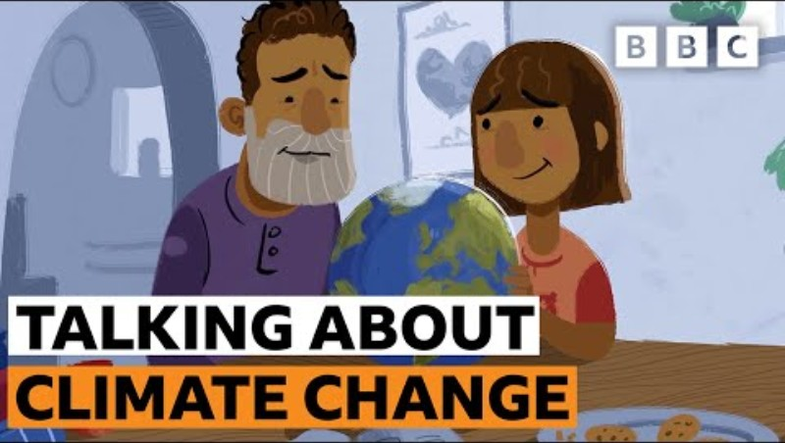
How to talk about climate change
Notes:
To help explain further why climate education is important, and to introduce you to thinking about how you can talk to young people about climate change, we’re now going to watch this short 3-minute video made by the BBC and Open University.

Slide 12

Demystifying climate education
Notes:
Hopefully you’ve now got a good idea of why you should be bringing climate change into your classroom as a teacher and are starting to think about how you can do that. But before you think too much about this, we want to make sure we have a collective understanding about what climate education actually is.
I have a few questions I’d love to hear your thoughts and experiences on:
(1) What did your climate education look like in school? If you didn’t learn about climate change in school, where did you learn about it?
(2) What does a quality climate education look like to you? This can be as bluesky / radical as you’d like!
Thanks so much for these answers! Over the next few slides we’ll expand upon some of what you’ve said, and use the experience we have at SOS UK to understand what a quality climate education can/should look like, shaped by the experiences of the young people we work with.

Slide 13



What does good quality climate education look like?
Science
Notes:
So, what does a good quality climate education look like?
As you covered already, climate education involves learning about the SCIENCE of climate change and its impacts, but that’s just one part of the whole story!

Slide 14
What does good quality climate education look like?
Science
Arts & Humanities
Notes:
Young people can and should receive a climate education in ARTS & HUMANITIES too! Climate change isn’t only going to impact people interested in science, and it’s going to take more than just scientists to make an impact and tackle climate change. If we think about the COVID crisis, while it took scientists to create the vaccines, non-STEM jobs were important in tackling the crisis too from securing funding for vaccines, running information campaigns to build public trust in the vaccination schemes, to creating laws and public health guidance to keep people safe. No issue is just a STEM issue, so it’s important that no matter what subject a young person is interested in at school that they can see how that discipline relates to climate change. It’s important that young people are receiving an integrated climate education across all subjects in school!

Slide 15
What does good quality climate education look like?
Knowledge, skills & values
Science
Arts & Humanities
Notes:
A quality climate education not only provides young people with KNOWLEDGE, but also the SKILLS & VALUES needed to apply that knowledge in the real world. Having knowledge about the issue of climate change or how to take climate action is just one step. Without the skills to apply that knowledge you can’t take action. A quality climate education ensures that young people are aware of the skills they’re gaining - something they often struggle to recognise! - and that they understand how those skills are useful in tackling the issue of climate change. Does anyone have any examples of skills that are important in tackling climate change? And then it’s important that young people are developing a solid system of values. Again, without values such as empathy or respect, you might not want to take action on a topic like climate change which currently isn’t impacting the average person in the UK too severely. As with skills, young people often struggle to identify the values they hold, and it’s important that as teachers you’re able to help them see what those values are and why they’re important.

Slide 16
What does good quality climate education look like?
Knowledge, skills & values
Science
Arts & Humanities
Methods of teaching
Notes:
Delivering a quality climate education can be achieved through a variety of different METHODS OF TEACHING, it doesn’t just need to be something read about in the classroom. We know that traditional classroom teaching can be a struggle for some students, but learning about climate and nature gives us the chance to be more creative with how we’re teaching. Does anyone have any ideas of the different methods of teaching that we can use when teaching about climate change? Some examples of the different methods of teaching that can be used when talking about climate change include: (1) Outdoor learning: Young people having the opportunity to spend time outside in nature can help build their relationship with the natural world. This is so important in making sure they feel a connection to nature and have a want to protect the environment from climate change. Actions as simple as having a lesson outside, looking for wildlife on the school grounds, or building a bug hotel can have a huge impact for a young person - and often times these opportunities offer them the chance to gain some hands on practical skills too. (2) Games / roleplaying / storytelling: Climate change is an unknown, and it can be scary for young people to talk about. However, games/roleplaying/storytelling offer us the chance to talk about something that’s not concrete. Playing games can let young people explore how to approach a topic like climate change. Role playing offers the chance for young people to think creatively, to imagine a different world or new ideas. And storytelling can not only build relationships with nature - e.g. by watching movies like A Bugs Life - but also let us explore the topic of climate change and have a happy ending. It’s important we’re able to offer young people that happy ending so we’re not making them anxious about the future and climate change. This anxiety could lead to climate inaction, so games, roleplaying, and storytelling actually offer a great opportunity for young people which is often overlooked!

Slide 17
What does good quality climate education look like?
Student leadership
Knowledge, skills & values
Science
Arts & Humanities
Methods of teaching
Notes:
It’s also important for climate education to offer the chance for STUDENT LEADERSHIP. Young people can often feel helpless in the face of big issues like climate change. They can’t vote, they don’t have jobs, they can’t easily make big decisions like what food to buy or whether or not to go on a family holiday that year. It’s important that schools offer young people a chance to be leaders and take action themselves, no matter how small. At SOS UK we’ve worked with schools across the country and in some cases we’ve had push back from teachers telling us they don’t want to organise a litter pick at school because in the grand scheme of things it doesn’t make a difference. Which I can understand - a lot of the responsibility for tackling climate change does land with governments and big businesses. However you can’t say that to a young person who wants to make a difference, we don’t want to make them apathetic or feel it’s hopeless. Taking part in a litter pick, running an assembly, or planting some wildflowers might not feel like much to us as adults, but for a young person that could be the biggest action they could take. It could feel like a lot, and could be the start of their environmental journey (which will end up with them challenging those big businesses!). It’s important to remember that a young person’s world is often a lot smaller than ours, and what may seem like a small action to us is actually a big action to them. We also recently worked with a primary school where the students were saying that climate change is scary, and gave examples of their experiences of climate change such as plants dying in their granddad’s garden because it was a very hot summer, or a beach umbrella flying away in a storm. With these examples a few teachers noted to us afterwards that “this isn’t climate change”, but again - if a young person believes this is a result of climate change, it’s important to meet them where they’re at. If a litter pick at school can help them feel that they’re making a difference to stop those storms happening again, it’s an easy win for us to do. And taking small actions like this can also help reduce feelings of climate anxiety in young people, which is another win!

Slide 18
What does good quality climate education look like?
Student leadership
Knowledge, skills & values
Science
Climate justice
Arts & Humanities
Methods of teaching
Notes:
And finally, it’s important that a quality climate education includes engaging in the topic of CLIMATE JUSTICE. Not everyone is equally responsible for climate change and not everyone will be equally impacted – it’s important we’re thinking about everyone in how we tackle climate change and are working to reduce existing inequalities as we adapt or rebuild. Climate change is also an intersectional topic. Often it’s people of colour, older people, disabled people, or people from low socioeconomic backgrounds who will be most affected. Your students may be passionate about another important topic - like LGBT rights - and may not want to focus their efforts on tackling climate change. However you can help them see the links between climate change and the issues they’re most passionate about. For example, people of colour in the UK are statistically more likely to live in areas of high air pollution, so tackling air pollution will disproportionately positively impact communities of colour. The increased temperatures brought about because of climate change will likely cause more people to get sick, putting increased pressure on the NHS which many disabled people rely on; so tackling climate change will also positively impact outcomes for disabled people too. It may take a bit of research, but you’ll learn in your school what your students are most passionate about and you can learn how to frame climate change in a way that will make them want to take action (or similarly, if they’re passionate about climate change, how to frame others issues like lgbt or womens rights!).
No matter what subject you teach you can help young people receive a quality climate education!

Slide 19

Let’s Tackle Climate Issues!
Notes:
For our next activity we want you to think about how the education you’re providing to young people can help them tackle climate change in their futures.
We’re going to look at 3 different examples of the impacts of climate change or environmental issues facing us right now and the work that’s happening today to help tackle these issues. After we’ve looked at each issue we’ll give you a few minutes in pairs/groups to discuss:
What jobs are involved in tackling this issue
What knowledge, skills and values are needed to do these jobs

Slide 20



Insect Decline
UK’s flying insect population decreased by 63% between 2021 - 2024
JOBS
Buglife 2025
¾ of the crops grown by humans require insects to pollinate them
KNOWLEDGE, SKILLS & VALUES
Lautenbach et al. 2012
Devon Wildlife Trust are creating new wetlands to increase insect habitats
Notes:
Our first climate impact is: Insect decline.
Buglife have been using citizen science to monitor the flying insect population in the UK and between 2021 – 2024 they found a 63% decrease in flying insects reported.
A decreasing insect population will have big impacts not only on other animals like bats who eat insects, but also on people, as three quarters of the crops grown by humans rely on insects to pollinate them. It’s important that we’re working hard to protect our insect population!
Work is already happening to tackle this decline by organisations like Devon Wildlife Trust who have been working with farmers to reduce agricultural pollution and to restore and create new wetlands, providing increased habitat for insects to live. And there’s lots more involved in protecting insects than just land management!
ACTIVITY: Thinking about the topic of insect decline:
What jobs will be needed to help tackle the problem of insect decline? Ask teachers to raise their hand to suggest jobs that can help tackle insect decline. Once you’ve received a few answers, click to reveal the suggested jobs on the slide and mention any that your teachers didn’t think of.
What knowledge, skills, and values will be needed to tackle insect decline and be used in these jobs? Ask teachers to raise their hand to suggest what knowledge, skills, and values are needed to do the jobs they’ve just suggested or those listed on the slide. Once you’ve received a few answers, click to reveal the suggested knowledge, skills, and values on the slide and mention any that your teachers didn’t think of.
Hopefully you can see that a topic like insect decline – which feels like such a science heavy subject – will need people with skills that can come from all subjects to help tackle it!

Slide 21
Insect Decline
UK’s flying insect population decreased by 63% between 2021 - 2024
Conservationist, Education Officer, Engagement Officer, Land Manager Policy Writer, Farmer
JOBS
Buglife 2025
¾ of the crops grown by humans require insects to pollinate them
KNOWLEDGE, SKILLS & VALUES
Lautenbach et al. 2012
Devon Wildlife Trust are creating new wetlands to increase insect habitats
Notes:
Our first climate impact is: Insect decline.
Buglife have been using citizen science to monitor the flying insect population in the UK and between 2021 – 2024 they found a 63% decrease in flying insects reported.
A decreasing insect population will have big impacts not only on other animals like bats who eat insects, but also on people, as three quarters of the crops grown by humans rely on insects to pollinate them. It’s important that we’re working hard to protect our insect population!
Work is already happening to tackle this decline by organisations like Devon Wildlife Trust who have been working with farmers to reduce agricultural pollution and to restore and create new wetlands, providing increased habitat for insects to live. And there’s lots more involved in protecting insects than just land management!
ACTIVITY: Thinking about the topic of insect decline:
What jobs will be needed to help tackle the problem of insect decline? Ask teachers to raise their hand to suggest jobs that can help tackle insect decline. Once you’ve received a few answers, click to reveal the suggested jobs on the slide and mention any that your teachers didn’t think of.
What knowledge, skills, and values will be needed to tackle insect decline and be used in these jobs? Ask teachers to raise their hand to suggest what knowledge, skills, and values are needed to do the jobs they’ve just suggested or those listed on the slide. Once you’ve received a few answers, click to reveal the suggested knowledge, skills, and values on the slide and mention any that your teachers didn’t think of.
Hopefully you can see that a topic like insect decline – which feels like such a science heavy subject – will need people with skills that can come from all subjects to help tackle it!

Slide 22
Insect Decline
UK’s flying insect population decreased by 63% between 2021 - 2024
Conservationist, Education Officer, Engagement Officer, Land Manager Policy Writer, Farmer
JOBS
Buglife 2025
¾ of the crops grown by humans require insects to pollinate them
KNOWLEDGE, SKILLS & VALUES
Problem solving, Critical thinking, Communication, Challenging the status quo, Curiosity, Leadership, Respect
Lautenbach et al. 2012
Devon Wildlife Trust are creating new wetlands to increase insect habitats
Notes:
Our first climate impact is: Insect decline.
Buglife have been using citizen science to monitor the flying insect population in the UK and between 2021 – 2024 they found a 63% decrease in flying insects reported.
A decreasing insect population will have big impacts not only on other animals like bats who eat insects, but also on people, as three quarters of the crops grown by humans rely on insects to pollinate them. It’s important that we’re working hard to protect our insect population!
Work is already happening to tackle this decline by organisations like Devon Wildlife Trust who have been working with farmers to reduce agricultural pollution and to restore and create new wetlands, providing increased habitat for insects to live. And there’s lots more involved in protecting insects than just land management!
ACTIVITY: Thinking about the topic of insect decline:
What jobs will be needed to help tackle the problem of insect decline? Ask teachers to raise their hand to suggest jobs that can help tackle insect decline. Once you’ve received a few answers, click to reveal the suggested jobs on the slide and mention any that your teachers didn’t think of.
What knowledge, skills, and values will be needed to tackle insect decline and be used in these jobs? Ask teachers to raise their hand to suggest what knowledge, skills, and values are needed to do the jobs they’ve just suggested or those listed on the slide. Once you’ve received a few answers, click to reveal the suggested knowledge, skills, and values on the slide and mention any that your teachers didn’t think of.
Hopefully you can see that a topic like insect decline – which feels like such a science heavy subject – will need people with skills that can come from all subjects to help tackle it!

Slide 23

Notes:
Thinking about insect decline, we have a short message from students from Welton Primary School we’d like to share with you - talking about the importance of climate storytelling in teaching.
[play video]

Slide 24
Air Pollution (+ campaigning)
UK human-made air pollution is responsible for 28,000 – 36,000 deaths annually
JOBS
GOVT 2022
Hotter weather can cause air to stagnate over an area, preventing pollution from dispersing
KNOWLEDGE, SKILLS & VALUES
Environmental Defense Fund. 2025
Choked Up are raising awareness of air pollution through creative campaigning
Notes:
Our second environmental issue is: Air Pollution.
In the UK, man-made air pollution is responsible for up to 36,000 deaths every year.
With climate change we know that we’ll experience hotter summers, and this hot weather can cause air to stagnate over an area, which stops pollution from dispersing. This means it will be more difficult to improve the air quality in areas of poor air pollution as the natural process is slowed down.
There are lots of activists and campaigners – like Choked Up – who are raising awareness of air pollution through creative campaigning, creating art installations to communicate the issue in an engaging way for the public.
ACTIVITY: Thinking about the topic of air pollution and the importance of campaigning:
What jobs will be needed to help tackle the problem of air pollution? Ask teachers to raise their hand to suggest jobs that can help tackle air pollution. Once you’ve received a few answers, click to reveal the suggested jobs on the slide and mention any that your teachers didn’t think of.
What knowledge, skills, and values will be needed to tackle air pollution and be used in these jobs? Ask teachers to raise their hand to suggest what knowledge, skills, and values are needed to do the jobs they’ve just suggested or those listed on the slide. Once you’ve received a few answers, click to reveal the suggested knowledge, skills, and values on the slide and mention any that your teachers didn’t think of.

Slide 25
Air Pollution (+ campaigning)
UK human-made air pollution is responsible for 28,000 – 36,000 deaths annually
Campaigner, Artist, Data Analyst, Transport Manager, City Planner, Air Quality Scientist, Communications Officer
JOBS
GOVT 2022
Hotter weather can cause air to stagnate over an area, preventing pollution from dispersing
KNOWLEDGE, SKILLS & VALUES
Environmental Defense Fund. 2025
Choked Up are raising awareness of air pollution through creative campaigning
Notes:
Our second environmental issue is: Air Pollution.
In the UK, man-made air pollution is responsible for up to 36,000 deaths every year.
With climate change we know that we’ll experience hotter summers, and this hot weather can cause air to stagnate over an area, which stops pollution from dispersing. This means it will be more difficult to improve the air quality in areas of poor air pollution as the natural process is slowed down.
There are lots of activists and campaigners – like Choked Up – who are raising awareness of air pollution through creative campaigning, creating art installations to communicate the issue in an engaging way for the public.
ACTIVITY: Thinking about the topic of air pollution and the importance of campaigning:
What jobs will be needed to help tackle the problem of air pollution? Ask teachers to raise their hand to suggest jobs that can help tackle air pollution. Once you’ve received a few answers, click to reveal the suggested jobs on the slide and mention any that your teachers didn’t think of.
What knowledge, skills, and values will be needed to tackle air pollution and be used in these jobs? Ask teachers to raise their hand to suggest what knowledge, skills, and values are needed to do the jobs they’ve just suggested or those listed on the slide. Once you’ve received a few answers, click to reveal the suggested knowledge, skills, and values on the slide and mention any that your teachers didn’t think of.

Slide 26
Air Pollution (+ campaigning)
UK human-made air pollution is responsible for 28,000 – 36,000 deaths annually
Campaigner, Artist, Data Analyst, Transport Manager, City Planner, Air Quality Scientist, Communications Officer
JOBS
GOVT 2022
Hotter weather can cause air to stagnate over an area, preventing pollution from dispersing
KNOWLEDGE, SKILLS & VALUES
Public speaking, Creativity, Communicating complex issues, Numeracy, Seeing the bigger picture
Environmental Defense Fund. 2025
Choked Up are raising awareness of air pollution through creative campaigning
Notes:
Our second environmental issue is: Air Pollution.
In the UK, man-made air pollution is responsible for up to 36,000 deaths every year.
With climate change we know that we’ll experience hotter summers, and this hot weather can cause air to stagnate over an area, which stops pollution from dispersing. This means it will be more difficult to improve the air quality in areas of poor air pollution as the natural process is slowed down.
There are lots of activists and campaigners – like Choked Up – who are raising awareness of air pollution through creative campaigning, creating art installations to communicate the issue in an engaging way for the public.
ACTIVITY: Thinking about the topic of air pollution and the importance of campaigning:
What jobs will be needed to help tackle the problem of air pollution? Ask teachers to raise their hand to suggest jobs that can help tackle air pollution. Once you’ve received a few answers, click to reveal the suggested jobs on the slide and mention any that your teachers didn’t think of.
What knowledge, skills, and values will be needed to tackle air pollution and be used in these jobs? Ask teachers to raise their hand to suggest what knowledge, skills, and values are needed to do the jobs they’ve just suggested or those listed on the slide. Once you’ve received a few answers, click to reveal the suggested knowledge, skills, and values on the slide and mention any that your teachers didn’t think of.

Slide 27

Notes:
It’s important we’re taking collective action on topics like air pollution. We have a message from students from Calderglen High School to play you now, talking about the Impartiality Guidance for Schools and how you can talk about climate change in schools.
[play video - only for schools in England]

Slide 28
Sea Level Rise (+ climate migration)
Up to 1.1 meters of sea level rise is predicted by 2100 due to ice caps melting
JOBS
USGCPR 2017
17 – 72 million people will need to migrate from coastal areas by 2100
KNOWLEDGE, SKILLS & VALUES
Linke & Hinkel, 2021
Shelter Box provides shelter and essential items to those affected by natural disasters
Notes:
Our final climate issue is: Sea level rise.
Due to ice caps melting it’s predicted that the sea levels will rise by up to 1.1 meters by the year 2100.
Sea level rise will cause increased flooding and coastal erosion. It’s also predicted that by the year 2100 around 17 – 72 million people will need to migrate from coastal areas as the environment changes and they’re unable to continue living in their homes.
The organization Shelter Box works to support those people affected by natural disasters by providing them with temporary shelter and essential items, ensuring no one goes unhoused as a result of natural disasters.
ACTIVITY: Thinking about the topic of sea level rise and the possibility of climate migration:
What jobs will be needed to help tackle the problem of sea level rise? Ask teachers to raise their hand to suggest jobs that can help tackle sea level rise. Once you’ve received a few answers, click to reveal the suggested jobs on the slide and mention any that your teachers didn’t think of.
What knowledge, skills, and values will be needed to tackle sea level rise and be used in these jobs? Ask teachers to raise their hand to suggest what knowledge, skills, and values are needed to do the jobs they’ve just suggested or those listed on the slide. Once you’ve received a few answers, click to reveal the suggested knowledge, skills, and values on the slide and mention any that your teachers didn’t think of.

Slide 29
Sea Level Rise (+ climate migration)
Up to 1.1 meters of sea level rise is predicted by 2100 due to ice caps melting
Geographer, Construction worker, City planner, Housing developer, Community worker, Child minder, Lawyer
JOBS
USGCPR 2017
17 – 72 million people will need to migrate from coastal areas by 2100
KNOWLEDGE, SKILLS & VALUES
Linke & Hinkel, 2021
Shelter Box provides shelter and essential items to those affected by natural disasters
Notes:
Our final climate issue is: Sea level rise.
Due to ice caps melting it’s predicted that the sea levels will rise by up to 1.1 meters by the year 2100.
Sea level rise will cause increased flooding and coastal erosion. It’s also predicted that by the year 2100 around 17 – 72 million people will need to migrate from coastal areas as the environment changes and they’re unable to continue living in their homes.
The organization Shelter Box works to support those people affected by natural disasters by providing them with temporary shelter and essential items, ensuring no one goes unhoused as a result of natural disasters.
ACTIVITY: Thinking about the topic of sea level rise and the possibility of climate migration:
What jobs will be needed to help tackle the problem of sea level rise? Ask teachers to raise their hand to suggest jobs that can help tackle sea level rise. Once you’ve received a few answers, click to reveal the suggested jobs on the slide and mention any that your teachers didn’t think of.
What knowledge, skills, and values will be needed to tackle sea level rise and be used in these jobs? Ask teachers to raise their hand to suggest what knowledge, skills, and values are needed to do the jobs they’ve just suggested or those listed on the slide. Once you’ve received a few answers, click to reveal the suggested knowledge, skills, and values on the slide and mention any that your teachers didn’t think of.

Slide 30
Sea Level Rise (+ climate migration)
Up to 1.1 meters of sea level rise is predicted by 2100 due to ice caps melting
Geographer, Construction worker, City planner, Housing developer, Community worker, Child minder, Lawyer
JOBS
USGCPR 2017
17 – 72 million people will need to migrate from coastal areas by 2100
KNOWLEDGE, SKILLS & VALUES
Compassion, Collaboration, Accountability, Decision making, Conflict resolution, Foreign language
Linke & Hinkel, 2021
Shelter Box provides shelter and essential items to those affected by natural disasters
Notes:
Our final climate issue is: Sea level rise.
Due to ice caps melting it’s predicted that the sea levels will rise by up to 1.1 meters by the year 2100.
Sea level rise will cause increased flooding and coastal erosion. It’s also predicted that by the year 2100 around 17 – 72 million people will need to migrate from coastal areas as the environment changes and they’re unable to continue living in their homes.
The organization Shelter Box works to support those people affected by natural disasters by providing them with temporary shelter and essential items, ensuring no one goes unhoused as a result of natural disasters.
ACTIVITY: Thinking about the topic of sea level rise and the possibility of climate migration:
What jobs will be needed to help tackle the problem of sea level rise? Ask teachers to raise their hand to suggest jobs that can help tackle sea level rise. Once you’ve received a few answers, click to reveal the suggested jobs on the slide and mention any that your teachers didn’t think of.
What knowledge, skills, and values will be needed to tackle sea level rise and be used in these jobs? Ask teachers to raise their hand to suggest what knowledge, skills, and values are needed to do the jobs they’ve just suggested or those listed on the slide. Once you’ve received a few answers, click to reveal the suggested knowledge, skills, and values on the slide and mention any that your teachers didn’t think of.

Slide 31

Notes:
And we have one final video to share with you from Calderglen High School students on the topic of climate justice.
[play video]

Slide 32

The 3 Curricula
Notes:
We hope these three examples show that tackling climate change isn’t just a job for scientists – lots of different people will be involved in tackling climate change, and there are lots of transferable skills and values that are useful for taking up these jobs.
Now we want you to think about how you can bring the knowledge, skills, and values we’ve just spoken about into school. How can you integrate climate into your classroom and take climate action across the school community?
To help us with this conversation we’re going to structure our thoughts around the 3 curricula.
Does anyone know what the three curricula are? / Has anyone heard of the three curricula before?

Slide 33

The 3 Curricula
Formal
Informal
Hidden
Notes:
The different ways and places that students learn in school can be broken down into three areas (or curriculas):
The formal curriculum
The informal curriculum
And the hidden curriculum
Does anyone know, or want to take a guess, at what each of these curriculums refers to?
Ask your teachers to raise their hand to guess what the formal curriculum means
The formal curriculum: Everything that you learn in the classroom, set out by the national curriculum
Ask your teachers to raise their hand to guess what the informal curriculum means
The informal curriculum: Everything that you learn in school, through activities outside of the classroom (e.g. field trips, clubs, assemblies)
Ask your teachers to raise their hand to guess what the hidden curriculum means
The hidden curriculum: Everything you learn in school naturally through the culture and norms of the school
We’ll take a look at some examples of each of these over the next few slides!

Slide 34
The 3 Curricula
English: Learning how to write a letter to our local council to take climate action
Formal
Maths: Using climate data in example questions to show real world uses
Art & Design: Designing artwork to communicate climate and climate action
Notes:
Examples of linking climate change into the formal curriculum:
English: In English lessons we could learn about how to write a letter to our local council or MP, encouraging them to take action on climate change. This is not only a good activity in creative writing, but also helps teach how to make change in your local community!
Maths: Climate change is maths! Being able to read graphs and understand data is at the heart of climate science. In maths, replacing data in example questions with heat, rainfall, or other real life data can help students see how what they’re learning applies to real world scenarios.
Art & Design: Art is a great communication tool, and you can teach about how to use artwork as a way to get across a message about climate change and taking climate action.
Feel free to edit this slide and change these examples to some of your own or include more than 3!

Slide 35
The 3 Curricula
Green Week: Giving young people the chance to run a week of environmental themed activities to raise awareness
Informal
Litter Pick: Having the opportunity to make a positive impact in school or the local community
Assembly: Inviting a local charity to speak about climate action going on in the local area
Notes:
Examples of linking climate into the informal curricula:
Green Week: You could organize a Green Week at your school, giving students the chance to help organize a week of environmental themed activities. This is a great way to get student leadership on climate action!
Litter Pick: You could run a litter pick around the school or local area. For many young people, being able to do something like this in their local area can help them feel like they’re making a real difference, which can reduce feelings of climate anxiety.
Assembly: You could also organize an assembly on a climate related topic or maybe invite a local charity to talk about the climate action happening in the local area. Assemblies are a great chance to connect with speakers and organisations outside of the school, showing that climate action is happening all over!
Feel free to edit this slide and change these examples to some of your own or include more than 3!

Slide 36
The 3 Curricula
Water fountains: Showing that you don’t need to buy plastic water bottles
Hidden
Recycling: Clearly labelled recycling bins so young people know what they can and can’t recycle
Art Supplies: Using sustainable art supplies encourages young people to choose sustainable supplies in their personal life too
Notes:
Examples of linking climate into the hidden curriculum:
Water fountains: If your school has water fountains around the school, allowing students to fill up their own bottles, this encourages young people to use reusable bottles and shows that you don’t need to buy plastic water bottles to stay hydrated
Recycling: Having clearly labelled recycling bins can help young people to understand what you can and can’t recycle, and having lots of bins around the school encourages students to use them. Picking up this habit at school is also something that students can take home with them, helping to influence their family and friends to recycle correctly too!
Art supplies: If you use art supplies from sustainable brands, students will build a relationship with using those brands and will be more likely to choose sustainable art supplies in their personal lives too.
Feel free to edit this slide and change these examples to some of your own or include more than 3!

Slide 37
The 3 Curricula
Letter Writing
Formal
Litter Pick
Recycling
Informal
Hidden
Notes:
And each of these three curriculums is linked to each other.
For example:
Informal: You could run a litter pick around the school. Through this, students might notice a lot of recyclable materials aren’t being recycled, and that rubbish is piling up outside the school gates.
Formal: To help remove the rubbish from outside the school gates, students could learn how to write a letter to your local council in English or PSHE.
Hidden: To help address the recyclable materials not being binned correctly you could improve signage around the school of what you can and can’t recycle.
Thinking about education in terms of these three curriculums can help you integrate climate education across all areas of the school!

Slide 38
The 3 Curricula
Formal
Informal
Hidden
Notes:
How could you integrate climate into each of the three curricula, including the subjects that you teach!
Give the teachers a few minutes to discuss amongst themselves how they think they could bring climate into each of the three curriculums. For the formal curriculum, ask them how they could bring climate into the subject that they teach.
If the teachers need some support, you might want to assign climate topics to groups of teachers, asking each group how they could link the issue into each of the three curriculums (e.g. plastic pollution, renewable energy, biodiversity loss, ethical consumption).
After hearing ideas from the teachers, give them your own ideas too so they can learn how you’d like to see climate integrated across your school!

Slide 39
Reflection &
Next Steps
Notes:
Thank you for your great suggestions on how to bring climate into the classroom!
We hope you’ve been able to see how broad climate education can be. It’s a lot more than just learning about climate change in a science classroom – there’s lots of ways you can help prepare students to tackle climate change both now and in their future careers.
To finish today’s workshop we want to reflect on what you’ve learned today and how you can bring these ideas to reality.

Slide 40
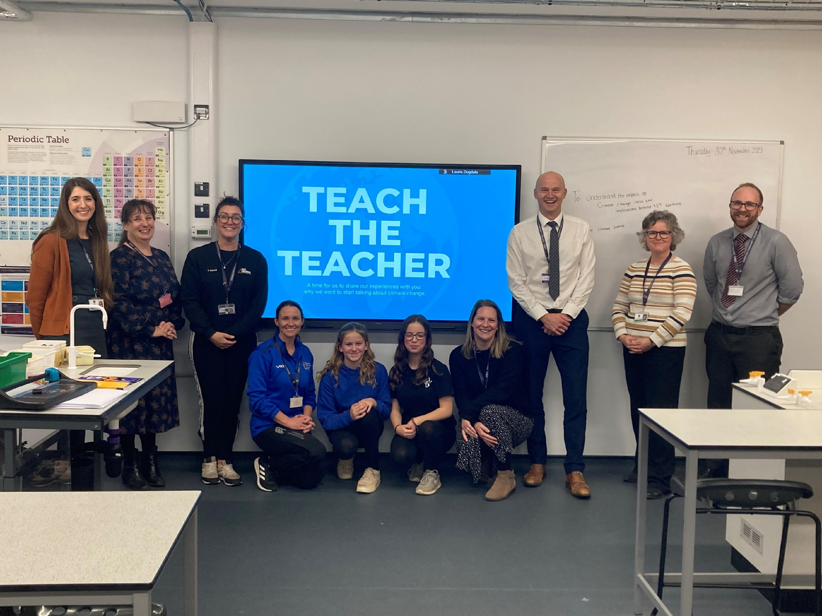
Reflection
What are the BARRIERS and OPPORTUNITIES for bringing climate into the classroom?
And how can STUDENTS help their teachers to provide a quality climate education for all?
Notes:
Let’s reflect!
What do you think are the barriers to bringing climate change into your classroom? And how could these be overcome? Ask the teachers to suggest what they think might stop them from bringing climate into their classrooms. This could be issues such as: Not enough time to plan lessons, not sure where to find resources, not feeling confident enough to talk about it, etc.
What opportunities exist to bring climate into your classroom? Ask the teachers to suggest what opportunities they might have to bring climate into their classrooms. This could include opportunities such as: Running special lessons for Earth day (and other events), relating a lesson to a recent piece of climate news, etc.
How can we work collectively, students and teachers, to bring climate into our school? What role can students play in supporting a quality, integrated climate education for all? Ask the teachers to suggest how they could work collaboratively with students to bring climate education into their school. This might include suggestions such as: running student-led climate assemblies, students designing informative posters, eco committee helping create the school’s climate action plan, etc.

Slide 41

Join our trainee teacher network!
Thank you
Jack Di Francesco
Project Manager
Stduents Organising for Sustainability UK
Notes:
Thank you so much for listening today!
We hope you’ve learned a bit about the importance of bringing climate into your lessons no matter what subject you teach, and the simple yet impactful ways you can do this!

