Slide 1
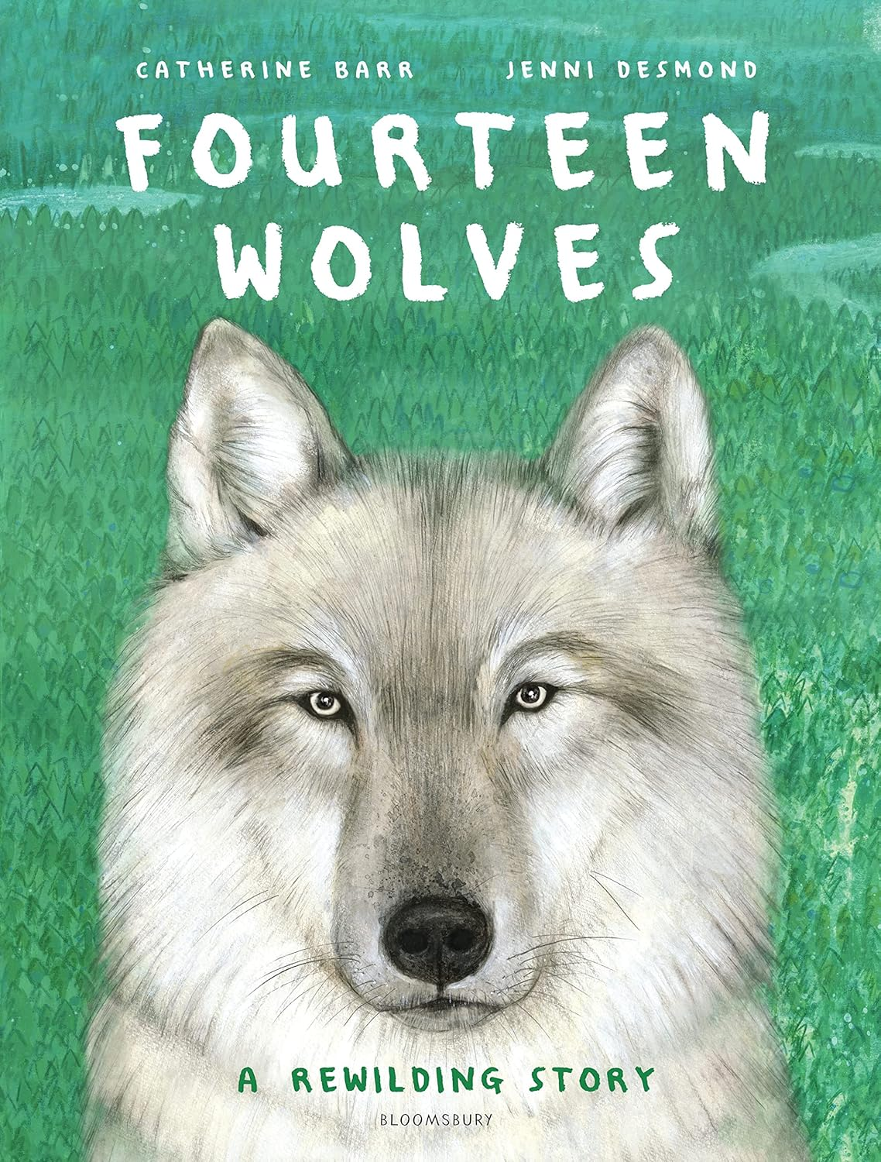
The stories we tell about climate change: environmental children’s literature.
Anna Donnelly – Assistant Professor

Slide 2
Learning Aim: To deepen understanding of environmental children’s literature
Objectives:
Examine the theoretical and educational context in which environmental children’s literature sits
Explore some high-quality environmental children’s literature
Consider the design choices that artists make
Understand research linked to how picture book could be explored
Consider how this might be used as a starting point to inspire HOPEFUL climate education learning that encourages POSITIVE ACTION

Slide 3
Research Foundations
Arizpe, E. (2017) Picturebooks and Situated Readers: The Intersections of Text, Image, Culture and Response. in Beauvais, C. Nikolajeva M. (2017) The Edinburgh Companion to Children's Literature.
Burke, G. and Cutter‐Mackenzie, A. (2010) What’s there, what if, what then, and what can we do? An immersive and embodied experience of environment and place through children’s literature, Environmental Education Research, 16:3-4, 311-330, DOI: 10.1080/13504621003715361
Bamford, A. (2003). The visual literacy white paper. Sydney: Adobe Systems Pty Ltd, Australia.
Chambers, A. (1995) Tell Me: Children, Reading, and Talk. Stenhouse Publishers.
Cutter‐Mackenzie, A. and Payne, P.G. and Reid, A. (2010) Editorial, Environmental Education Research, 16:3-4, 253-264, DOI: 10.1080/13504622.2010.488916
Gaard Greta. 2010. “New Directions for Ecofeminism: Toward a More Feminist Ecocriticism”, Interdisciplinary Studies in Literature and Environment. Vol 17.4, pp.643-660.
Gaard, G. (2009) ‘Children’s Environmental Literature: From Ecocriticism to Ecopedagogy’ Neohelicon 36 (2009): 321–34.
Gare, A. (2001) Narratives And The Ethics And Politics Of Environmentalism: The Transformative Power Of Stories. CAAP.
Gressnich, Eva (2012) “Verbal and Visual Pageturners in Picturebooks,” International Research in Children’s Literature 5.2: 167–183.
Hickman, C., and Marks, E. et al.(2021) Climate anxiety in children and young people and their beliefs about government responses to climate change: a global survey. The Lancet.
Hicks, D. 1998. Stories of hope: A response to the ‘psychology of despair’. Environmental Education Research 4, no. 2: 165–76.
Hunt, P. 1994. An introduction to children’s literature. Oxford: Oxford University Press.
Jewitt, C. (2008) Review of Research in Education. February 2008, Vol. 32, pp. 241–267
Kriesberg, D. 1999. A sense of place: Teaching children about the environment with picture books. Englewood, CO: Teacher Ideas Press.
Kress, G. (2010). Multimodality: A social semiotic approach to contemporary communication. London: Routledge.
Kress, G. (2003) Literacy in the New Media Age. London: Routledge.
McBride, B. B., C. A. Brewer, A. R. Berkowitz, and W. T. Borrie. 2013. Environmental literacy, ecological literacy, ecoliteracy: What do we mean and how did we get here? Ecosphere 4(5):67. http://dx.doi.org/10.1890/ES13-00075.1
Moriarty, S. (2020) Visual Scaling in Environmental Picturebooks: Ecopedagogy and Children’s Literature. DEP.
O'Brien, K and Stoner, D.K. (1987) Increasing Environmental Awareness through Children's Literature. The Reading Teacher , Oct., 1987, Vol. 41, No. 1 (Oct., 1987), pp. 14-19. International Literacy Association and Wiley. Stable URL: https://www.jstor.org/stable/20199688
Reid, A. and Payne, P.G and Cutter‐Mackenzie, A. (2010) Openings for researching environment and place in children’s literature: ecologies, potentials, realities and challenges, Environmental Education Research, 16:3-4, 429-461, DOI: 10.1080/13504622.2010.488939
Roth, C. E. 1992. Environmental literacy: its roots,evolution, and direction in the 1990s. ERIC Clearinghouse for Science, Mathematics, and Environmental Education, Columbus, Ohio, USA.

Slide 4

Theoretical Context

Slide 5
‘Environmental Education’
‘Environmentally literate person’
‘Ecological literacy’
‘Ecoliteracy’
‘Environmental literacy’
Notes:
Environmental Education - North American Association for Environmental Education (NAAEE) IN 2019: “Environmental Education … is a process that helps individuals, communities, and organizations learn more about the environment, develop skills to investigate their environment and to make intelligent, informed decisions about how they can help take care of it. It has the power to transform lives and society. It informs and inspires. It motivates action. EE is a key tool in creating healthier and more civically-engaged communities
Environmentally Literate Person - North American Association for Environmental Education (NAAEE) IN 2019: “An Environmentally Literate Person…is someone who, both individually and together with others, makes informed decisions concerning the environment; is willing to act on these decisions to improve the well-being of other individuals, societies, and the global environment; and participates in civic life. Those who are environmentally literate possess, to varying degrees, the knowledge and understanding of a wide range of environmental concepts, problems, and issues; a set of cognitive and affective dispositions; a set of cognitive skills and abilities; and the appropriate behavioral strategies to apply such knowledge and understanding in order to make sound and effective decisions in a range of environmental contexts.”
Environmental Literacy - “Roth (1992) the term environmental illiteracy predated the term environmental literacy, in the same way that the term illiteracy predated the term literacy.”
Ecological literacy- “An ecologically literate individual understands environmental realities by specifically identifying their cause and effect relationships. Recent ecological literacy frameworks also emphasize systems thinking, which involves identifying the various biophysical and social components in a given environmental context and distinguishing their interrelations, allowing for the construction of a ‘‘big picture’’ view. As such, the ecologically literate individual has a clear perception and understanding of a system’s dynamics and ruptures, as well as its past and alternate future trajectories. He or she understands the complexity of studied objects and phenomena, allowing for more enlightened decision-making.”
Ecoliteracy - “Capra (1997) coined the term ecoliteracy, defined as an understanding of the principles of the organization of ecosystems and the application of those principles for creating sustainable human communities and societies.The idea of using resources in such a way as to ensure future availability was an essential element of ecoliteracy.”

Slide 6
‘Derangement of Scale’
(Cohen, T. 2021)

Slide 7
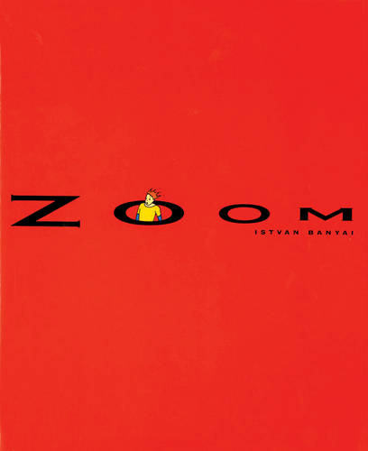

https://www.youtube.com/watch?v=Kgi-RCEjOLw&t=3s 4:46 mins long

Slide 8
‘Derangement of Scale’
(critically naïve) Personal Scale
Takes into account only the narrator’s immediate circle of family and acquaintances over a time scale of several years.
Historical Period Scale
A national culture and its inhabitants, with a time frame of perhaps a few decades.
Hypothetical Scale
Whole earth and its inhabitants, and placing [environmental challenge] in the middle of a, say, six hundred year time frame.
Notes:
Key Question - what problems might this pose to us a TEACHERS and our CHILDREN in school?

Slide 9
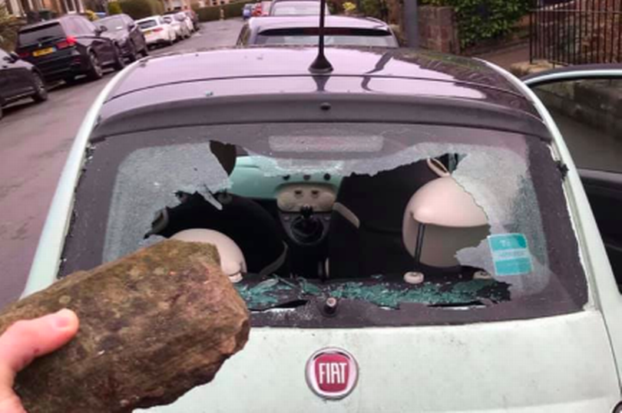
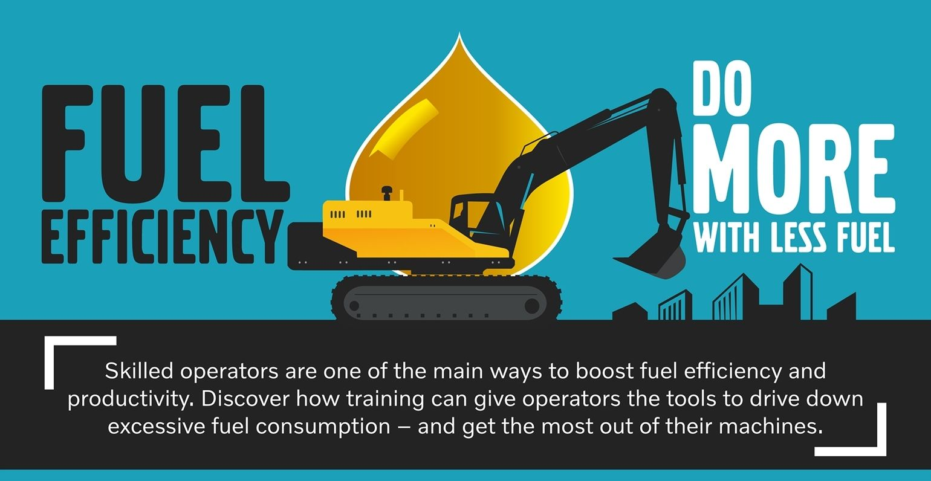
‘Derangement of Scale’
“Climate change is now acknowledged as a legitimate and serious concern and the government will continue to support measures to improve the fuel efficiency of motor vehicles.”
“The only defensible relationship to have with a car is with a well aimed brick.”
Notes:
Key Question - what problems might this pose to us a TEACHERS and our CHILDREN in school?

Slide 10
Current Educational Context:
what comes before Year 7?

Slide 11
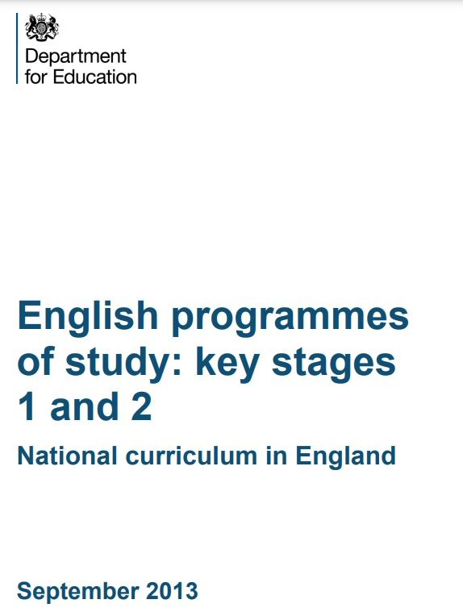

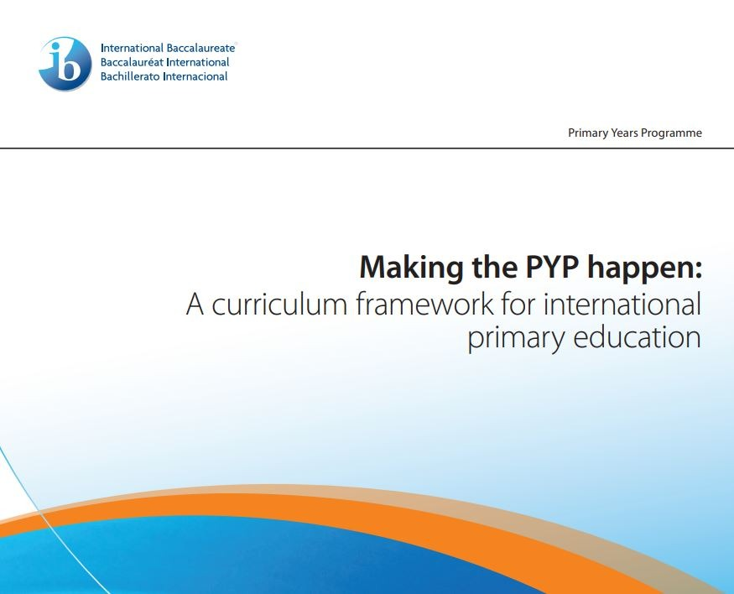

1 reference to climate
Notes:
he details and summary of what each of these curricula say about climate change in on the Padlet: https://warwick.padlet.org/annamdonnelly/green-space-conference-2023-6ug5xuplsdh23lte
https://assets.publishing.service.gov.uk/government/uploads/system/uploads/attachment_data/file/335186/PRIMARY_national_curriculum_-_English_220714.pdf
https://hwb.gov.wales/curriculum-for-wales
https://education.gov.scot/documents/All-experiencesoutcomes18.pdf
https://mtpyph.weebly.com/uploads/9/0/6/9/9069240/mtpyph_doc.pdf

Slide 12
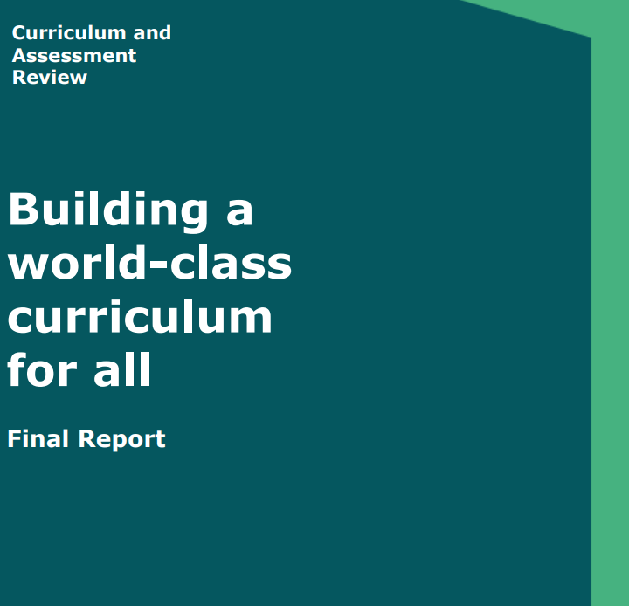

62 references to climate

Slide 13
Explore some high quality children’s literature and analysing design choices

Slide 14
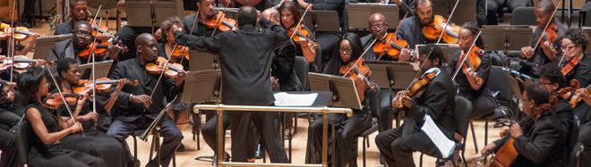
“It is no longer possible to think about literacy solely as a linguistic accomplishment.” (Jewitt, 2008)
“Modes are arranged in a combination of multimodality and are rich orchestrations of meaning.”

Slide 15
“The layout of words and pictures is intentional and purposeful. A text sequence is related to a picture or a set of pictures and the arrangement of both on the page or the double spread is never coincidental. The page is thus not only a means to carrying the text and the pictures, but an element that influences the way we read the story.” (Gressnich, 2012)

Slide 16
Picturebook Research

Slide 17
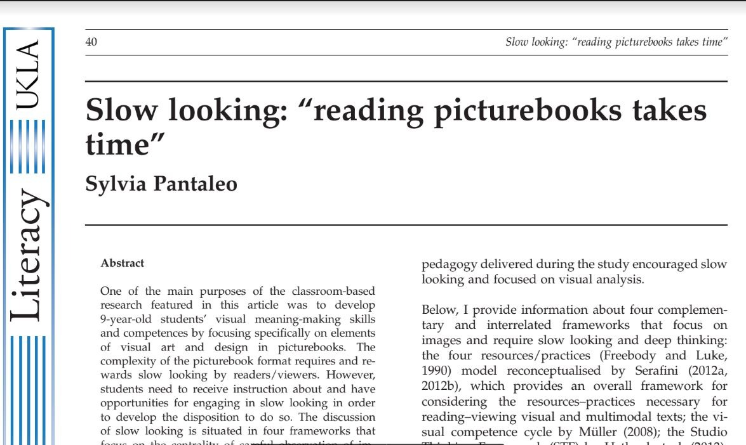


Slide 18
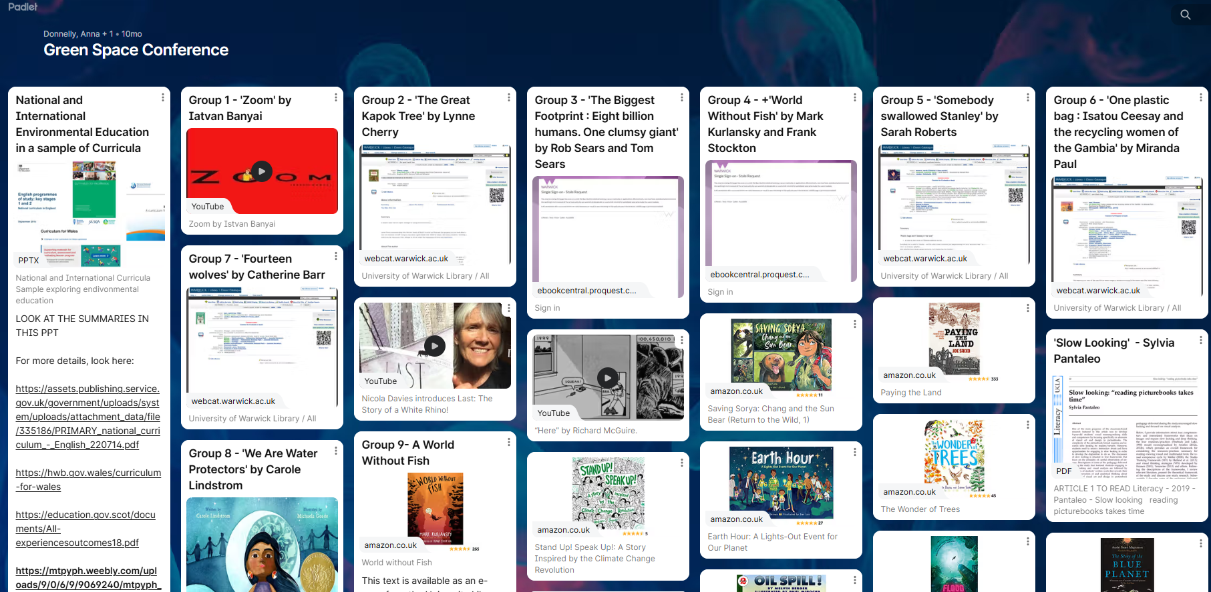

https://warwick.padlet.org/annamdonnelly/6ug5xuplsdh23lte
Notes:
Time to explore

Slide 19
Hopeful learning
and
Positive action

Slide 20
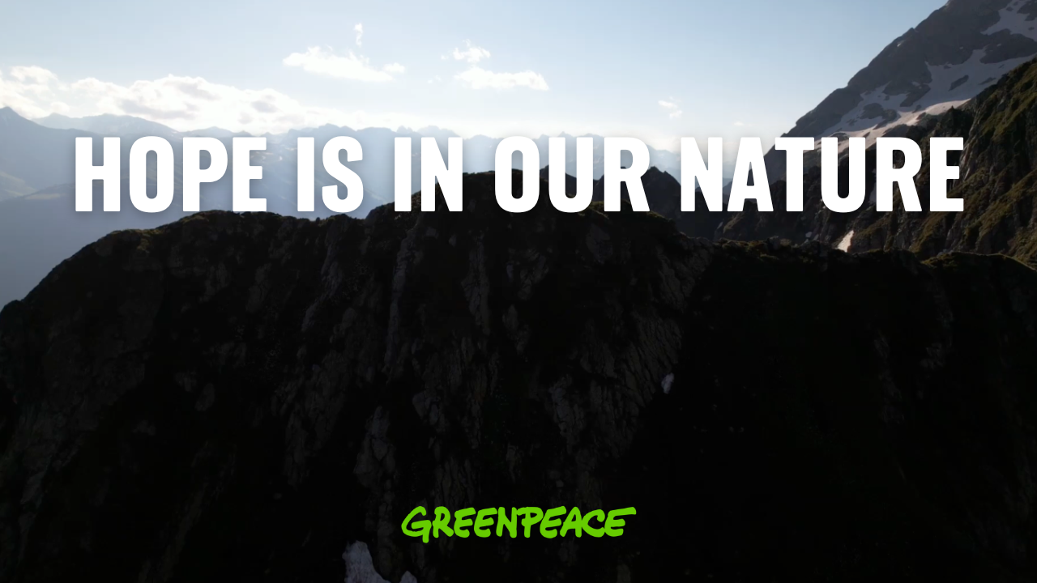
Notes:
I hope that this has inspired you to think about Year 7s and beyond and inspired you to use narrative in your assemblies, pastoral time and beyond, in your lessons, where relevant.

