Slide 1
National Education Nature Park​
Putting nature and climate at the heart of education​

Slide 2
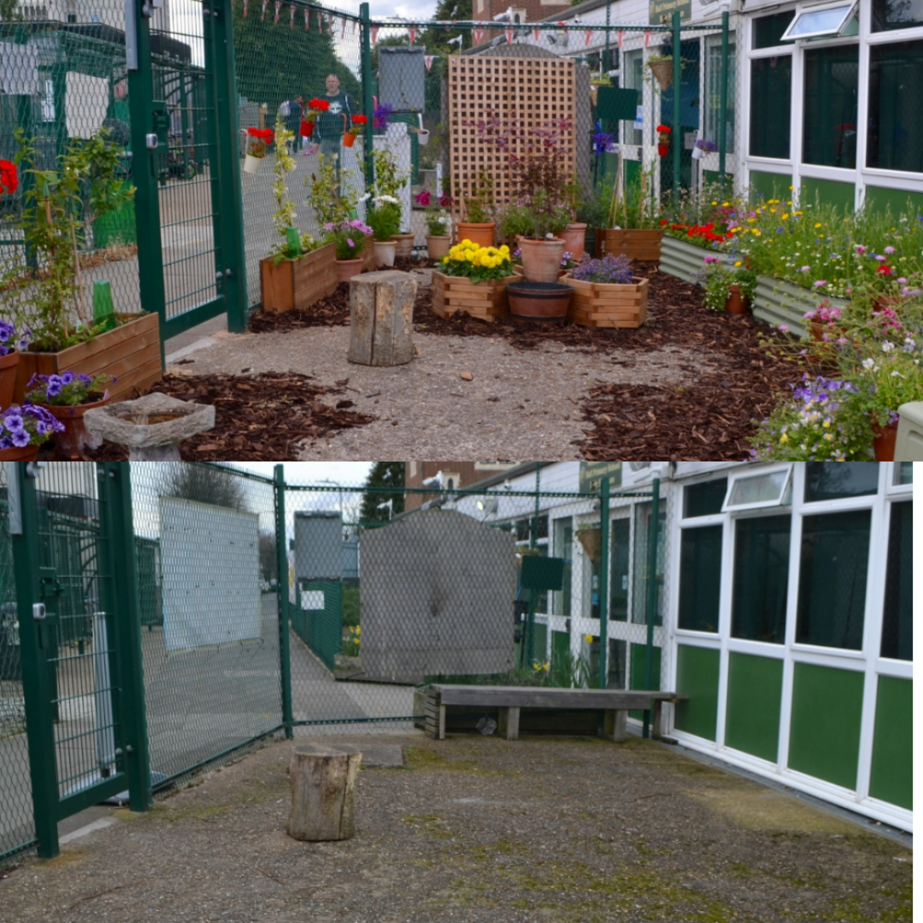
Young people are leading the way in creating a network of green spaces in schools, colleges and nurseries across the country
Free programme for schools, nurseries and colleges in England
Empowering young people to understand, care for and take action to improve the natural world
Exploring and transforming their learning sites for people and wildlife by turning the ‘grey’ spaces into green, nature-rich areas
Taking part in real scientific research: using digital tools to map out and survey their outdoor spaces
Quality-assured, curriculum-linked resources put nature and climate at the heart of education across subjects and key stages

Slide 3




Programme goals
To empower every young person in England to take action to make a positive difference to both their own and nature’s future
Put nature and climate at the heart of education
Foster meaningful connection with nature
Develop green and digital skills
Boost biodiversity in schools across the country
"The space is used to support pupils with emotional regulation and it is really important for our pupils as many of them do not live in houses that have green spaces." — Teacher at Warren Wood Primary School

Slide 4
Part of the Department for Education’s Sustainability and Climate Change strategy

Slide 5
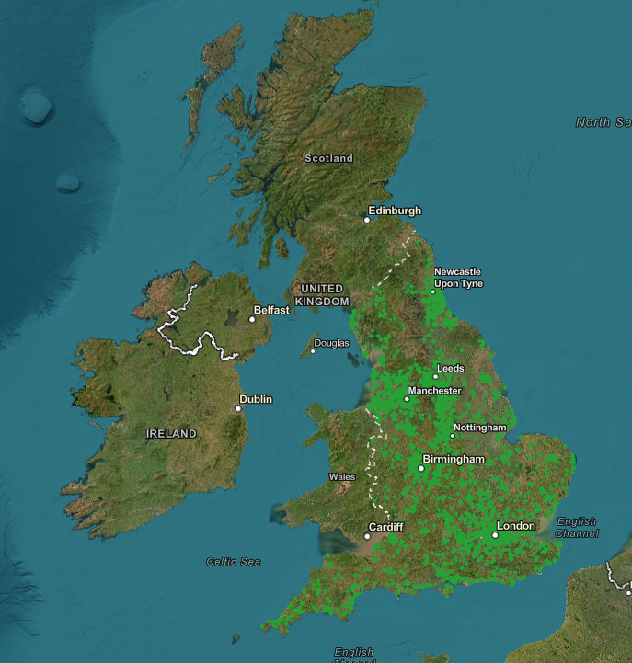
How’s it going so far?
9,250+ registered across all regions of England
Habitats being created up and down the country, from green walls and ponds to mini allotments and planters filled with flowers
More than 21 million square metres mapped – that’s more than 16,800 Olympic-size swimming pools!
Over £12 million awarded to settings through the grants programme
“It made me feel important and like I was making a difference." — Year 5 pupil from St Meriadoc CofE Junior Academy ​
​

Slide 6
Why is this important?
The UK is one of the most nature-depleted countries on Earth
Nature connectedness benefits both people and nature: increases care for the environment and greater wellbeing
The Dasgupta Review – calls for an urgent transformation of our systems, particularly education
The UK has a green skills shortage, and demand is growing

Slide 7



Why take part?
Educational
Develops vital skills and knowledge for the future
Supports everyday teaching and learning
Part of Climate Action Plans
Emotional
Enhanced wellbeing for learners and staff
Improved behaviour
Builds agency – making a real difference
Environmental
Creating new habitats support local wildlife
Adds up to boost biodiversity across the country
Part of groundbreaking scientific research

Slide 8
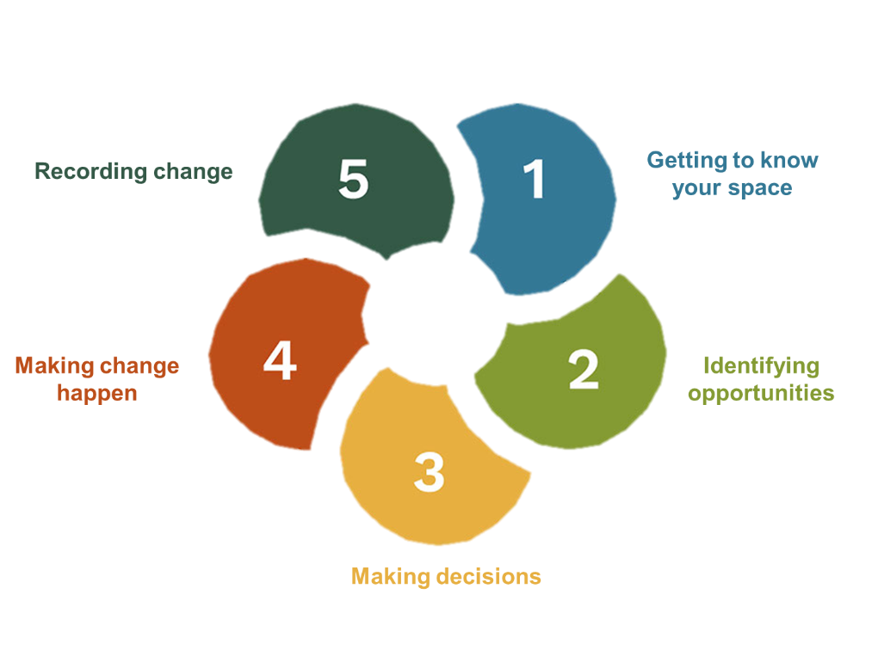
How it works: five-step cycle

Slide 9
Curriculum-linked resources
Growing library of free, quality-assured teaching resources​
Provides a range of activities to support each step​ and a wide range of skill-building and engagement for all ages
Opportunities to integrate climate and nature education into national curriculum learning across subjects​ and key stages
Curriculum and Assessment Review recognised importance of climate and nature education – we’re continuing to build on this and ensure that the programme aligns with the new curriculum as programmes of study are introduced

Slide 10





Supporting Climate Action Plans
The Department for Education expects all education settings to develop and implement a Climate Action Plan, and the National Education Nature Park can support this.
​A Climate Action Plan sets you up for a sustainable future, whether it’s through your buildings, outdoor spaces or curriculum
Centered around four pillars to bring about wellbeing, learning and environmental benefits: adaptation, biodiversity, climate education and decarbonisation
The Nature Park supports all four pillars and works alongside other DfE-supported programmes to help you create and implement a Climate Action Plan

Slide 11
Contributing to scientific research
What’s currently living and growing on school grounds is a bit of a mystery
All primary and secondary schools add up to roughly twice the size of Birmingham – huge potential for nature!
By getting involved, educators and learners become part of a huge team conducting groundbreaking scientific research
With the data collected through the Nature Park we’ll be able to estimate:
  Current biodiversity across all schools, colleges and nurseries
  Potential biodiversity gains that could be achieved through the amazing work of young people creating new habitats
We’re hoping to design a tool so settings can see how much biodiversity is on their own site and watch it improve

Slide 12
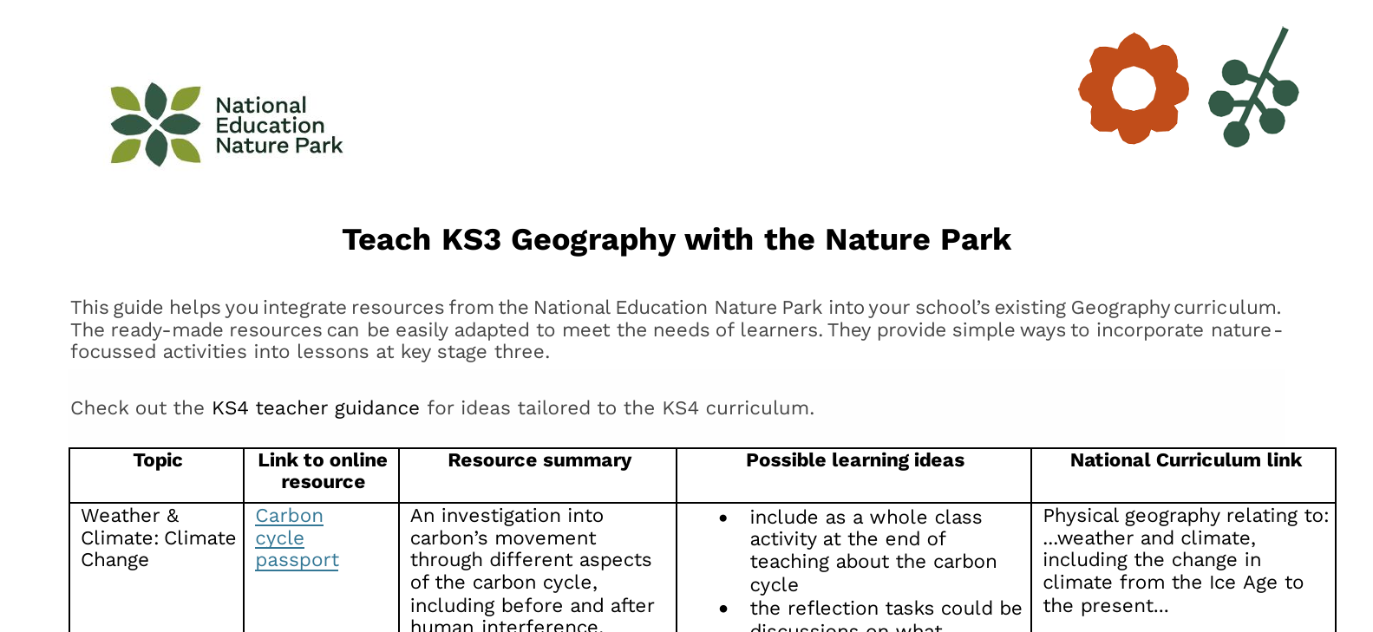
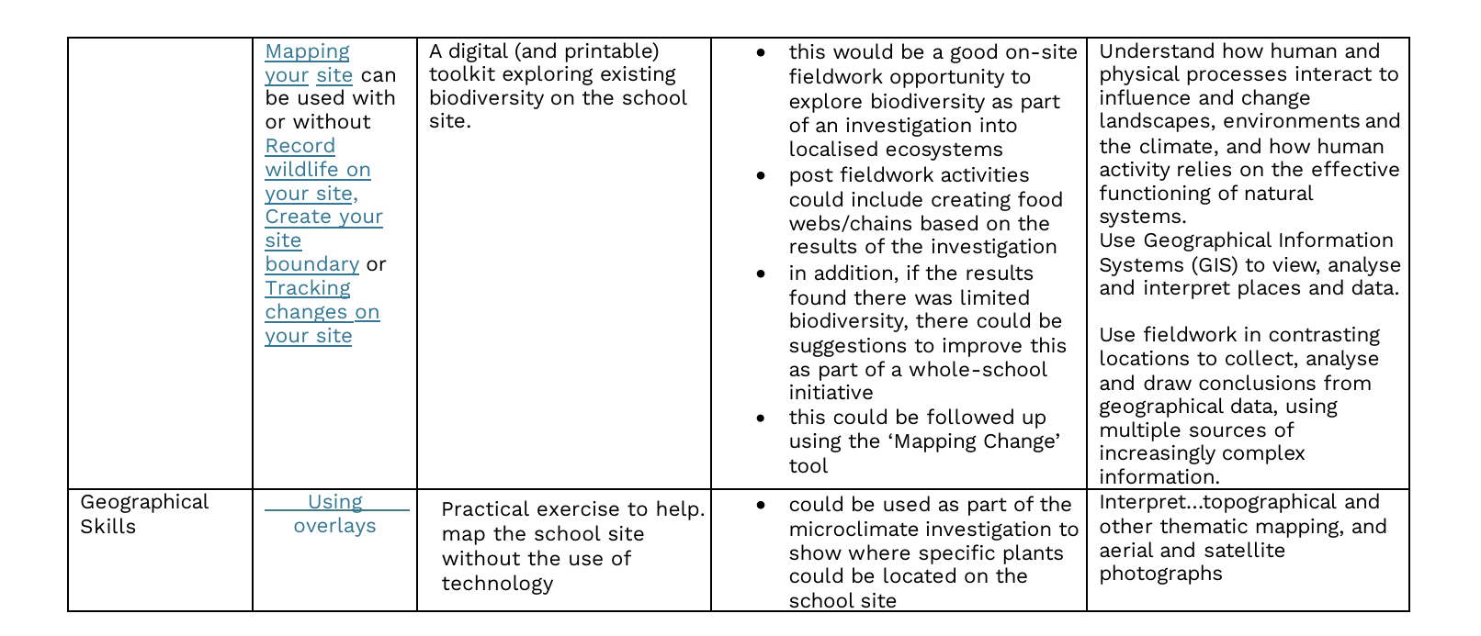
Geography & Nature Park Guide
Key stage 3 & 4
Topic
Nature Park resource
Learning ideas
Curriculum

Slide 13
Nature Park Map
Collective difference being made is displayed on an online interactive map
accessible by anyone via the Nature Park website

Slide 14
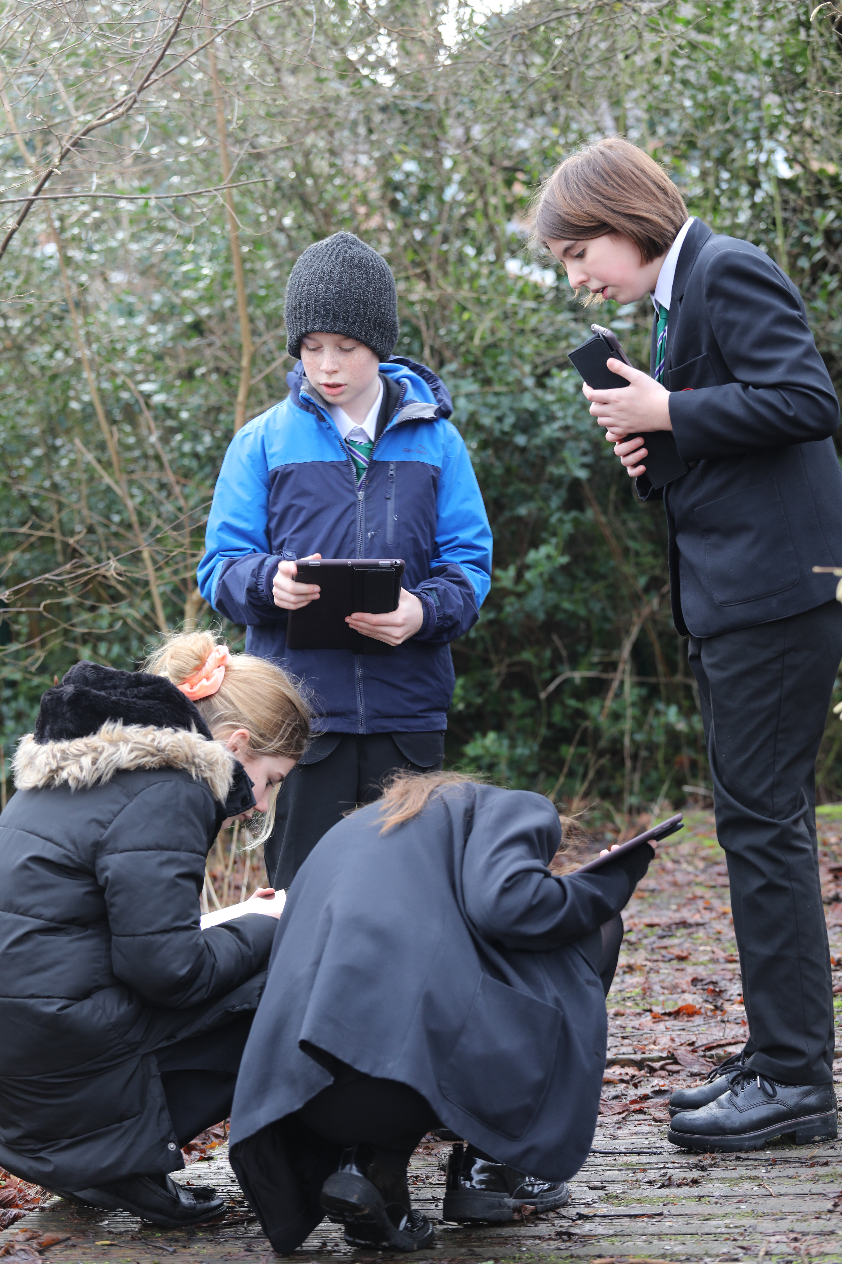
Habitat mapping
Mapping your baseline habitats helps make informed decisions about nature and sustainability on your school grounds
Young people will be more connected to nature after exploring and ‘taking notice’ (Nature Connectedness research group, University of Derby)
Your data will help scientists at the Natural History Museum and Department for Education to have a better understanding of nature across school grounds.

Slide 15
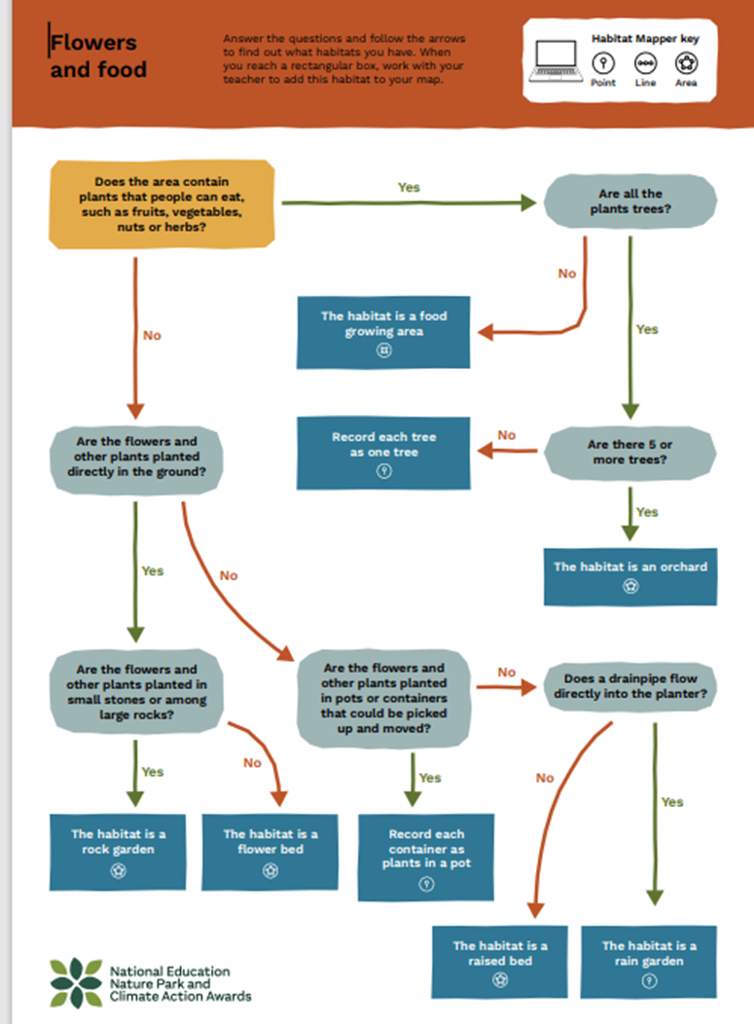
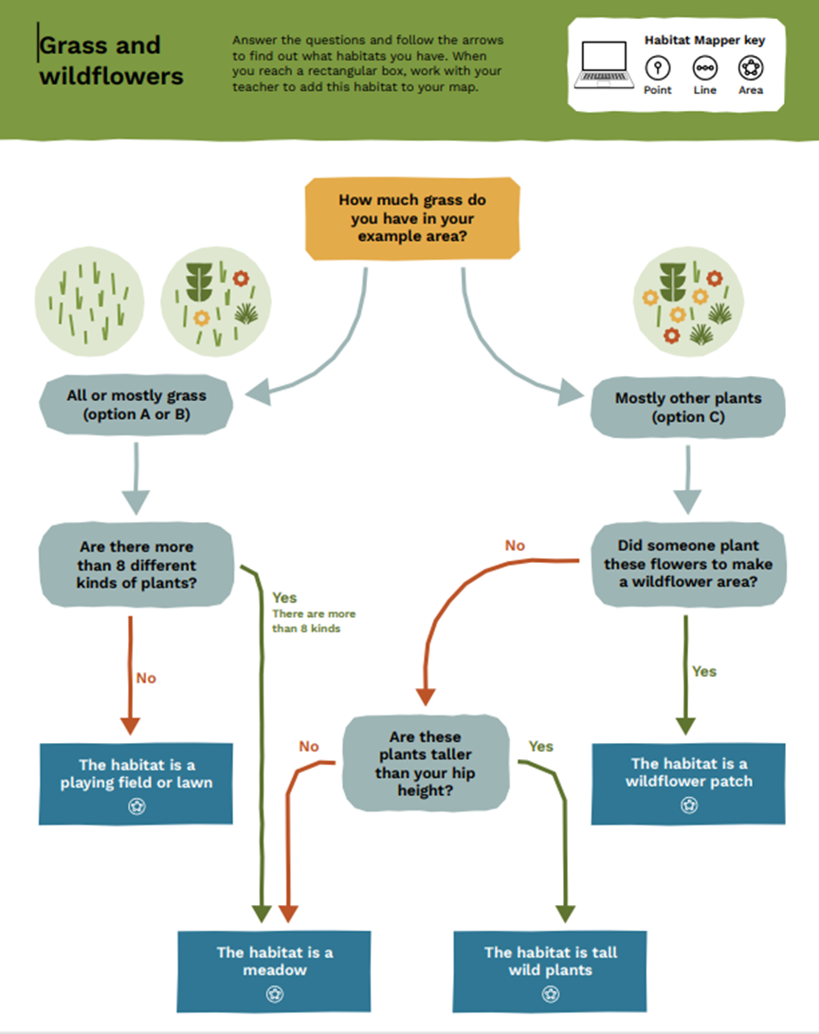

Slide 16
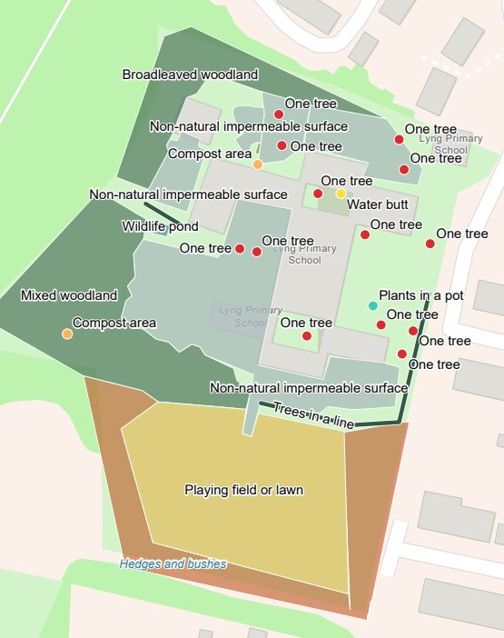
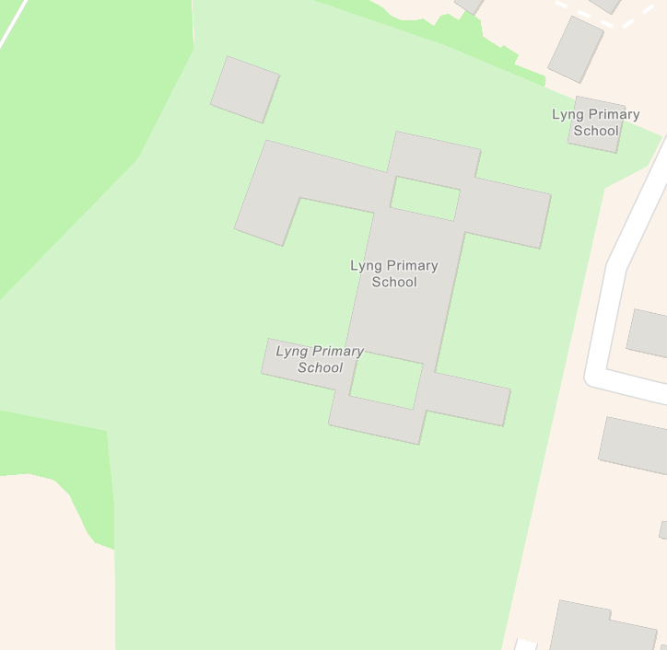

Slide 17
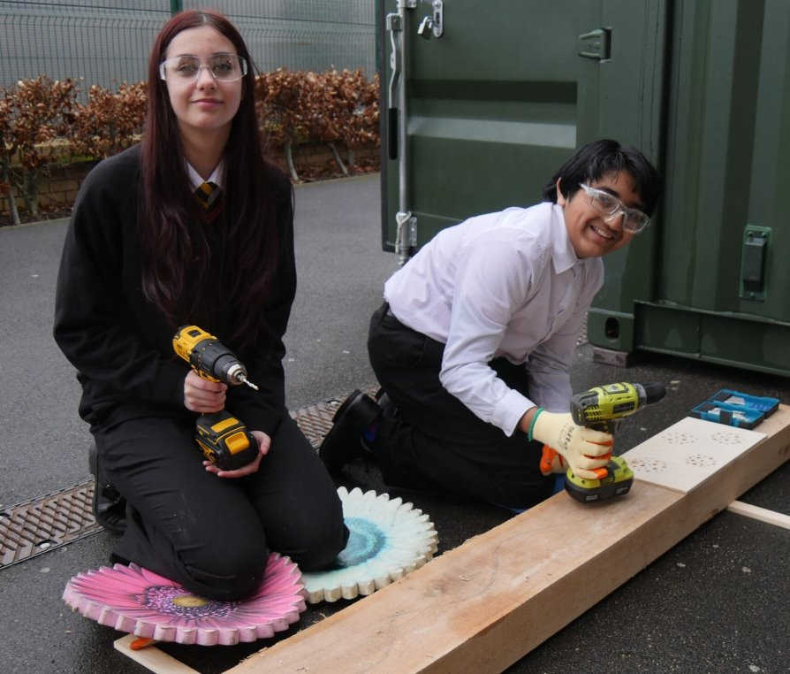
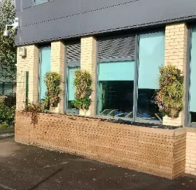
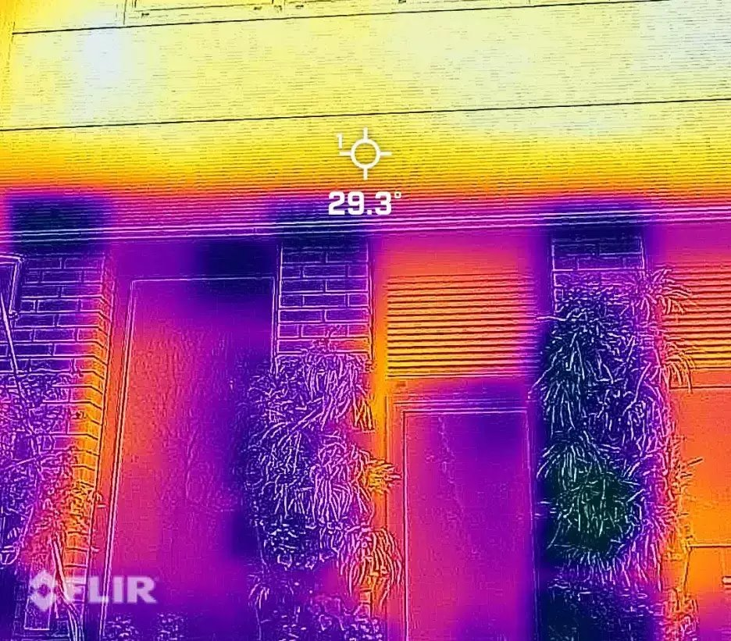
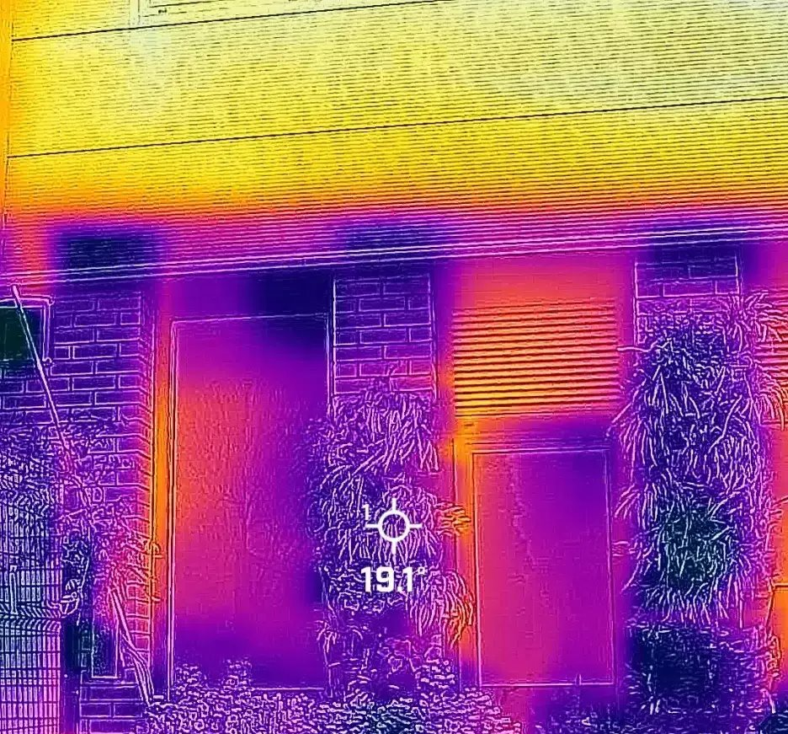
Creating a green wall at Co-op Academy, Manchester​
A grey, south-facing wall in a concrete area of their school, outside a classroom that gets very warm in summer​
Students built a large wooden planter, and attached vertical plant pots to the wall, concealing a water butt for irrigation​
Mediterranean sun-loving plants​
A greener space for staff and students​
Thermal imaging cameras showing effectiveness of planting and greenery​
Supporting Business and Physics lessons​

Slide 18
How’s it going so far?
Independent review shows early success
Ecorys, 2025
Pupils enjoy learning outdoors!
Educators finding resources and digital tools easy to use
More than one third registered have had no prior involvement in nature-related programmes
38% of registered settings are those with higher-than-average eligibility for Pupil Premium and free school meals, driven by the grants programme
Early years: supporting language development and emotional and behaviour regulation
Primary: positive engagement from pupils who struggled with concentration and behaviour in classrooms
Secondary: pupils reported to have pride and ownerships of the spaces they’d improved through the programme, and motivation to take further positive climate related actions

Slide 19
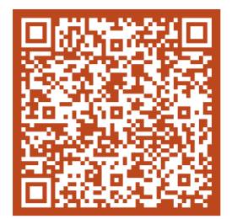
Register to join​
​
www.educationnaturepark.org.uk​
​
Get in touch​
​
hello@educationnaturepark.org.uk ​

