Slide 1

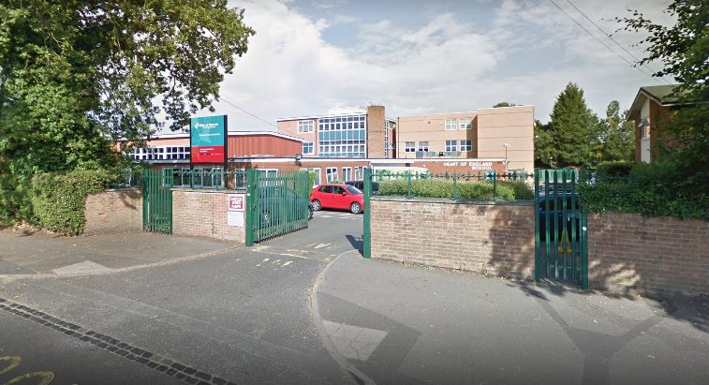
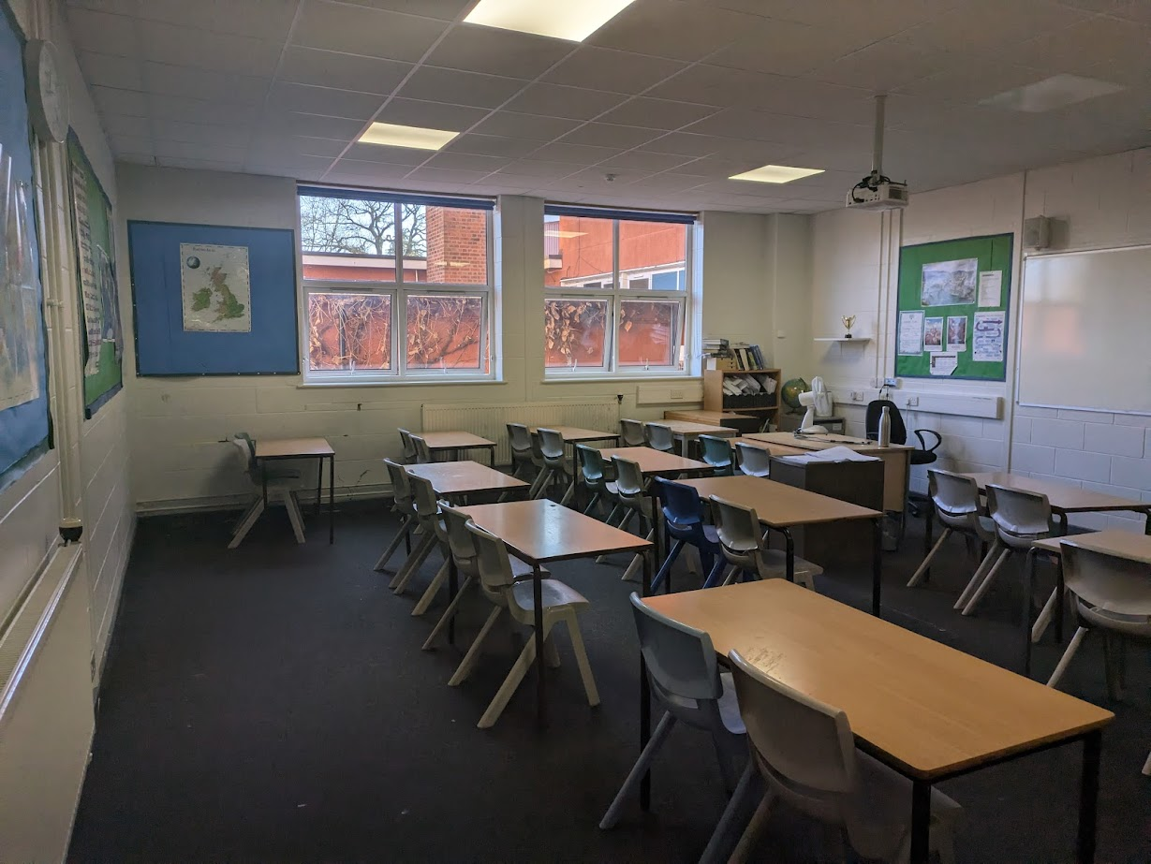

Slide 2
Teach the Teacher:
Let’s Talk About
Climate Education!
Students Organising for Sustainability UK
Notes:
[LUCY]
Hi everyone!
Thanks so much for having us here today to talk to you all about climate education.
My name is Lucy (age, pronouns, where you live, little bit about your climate journey - mention CAPs but we’ll talk about TTT on the next slide, so don’t mention that)
[Jack to give short intro too]

Slide 3
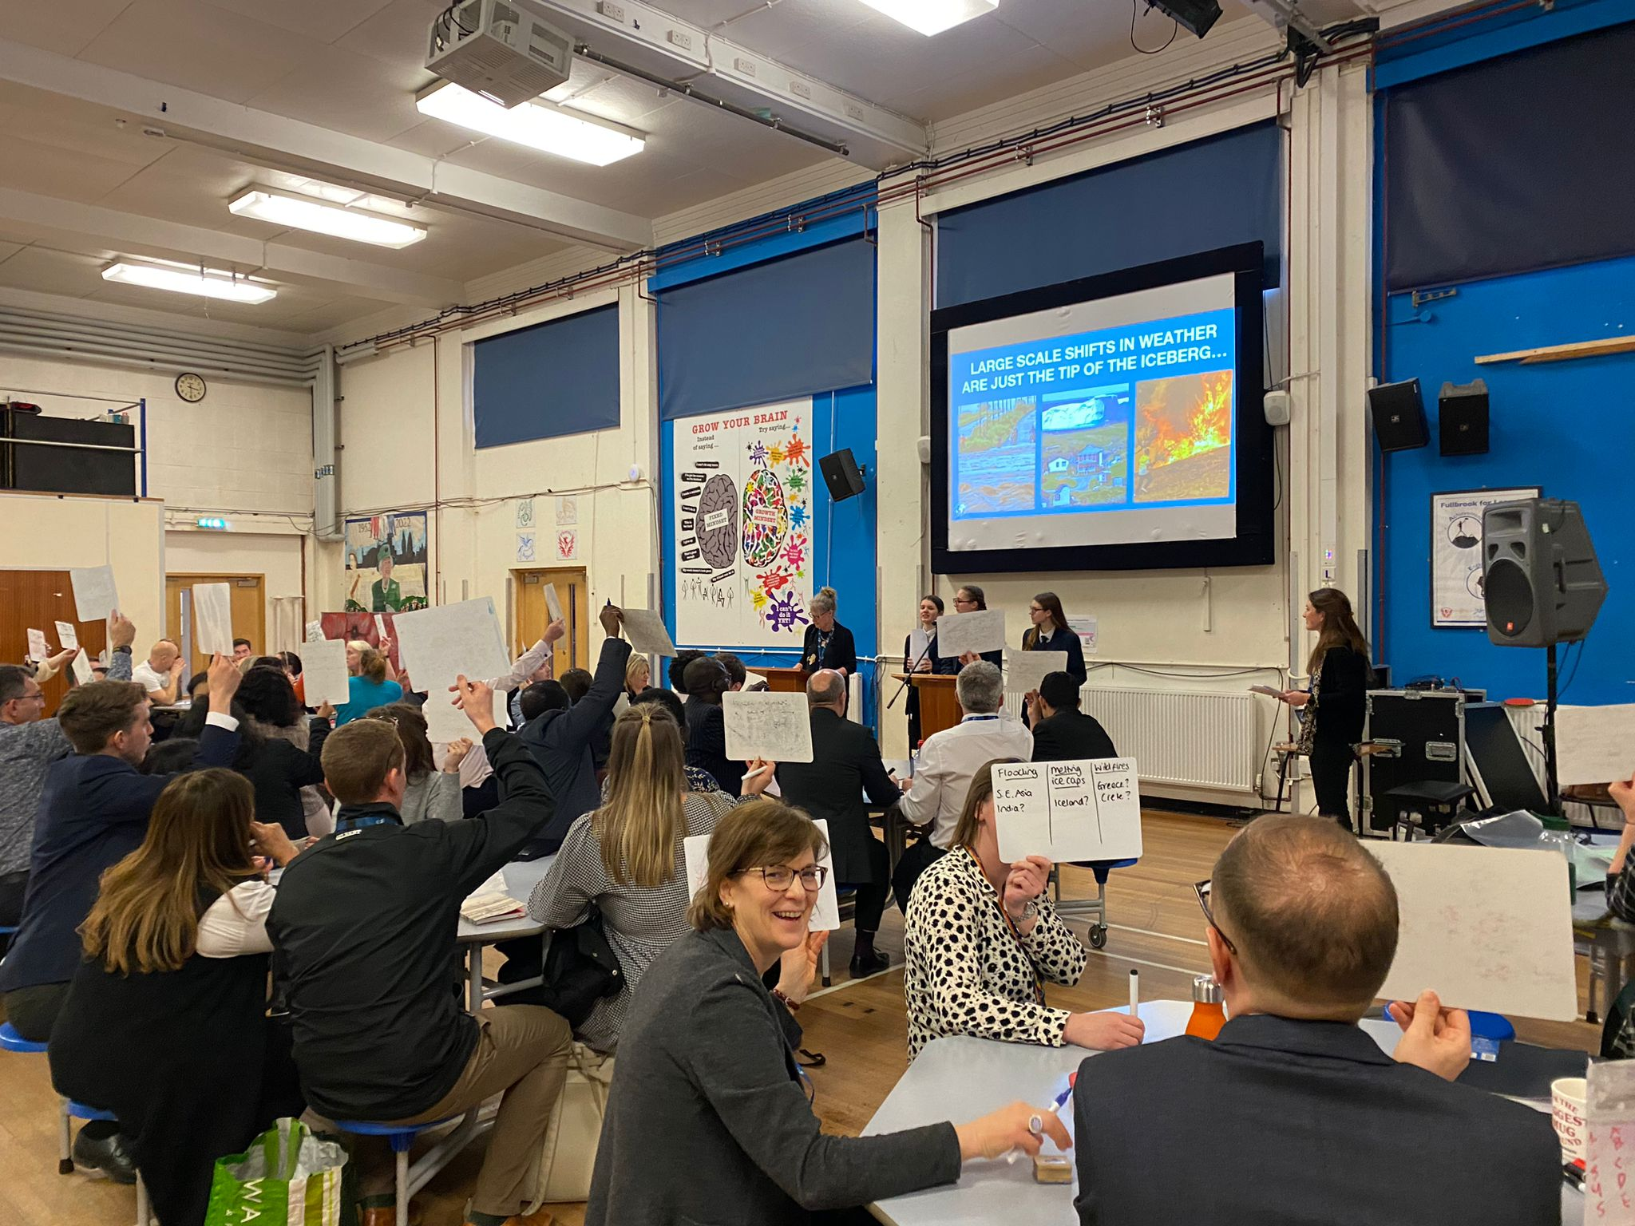


Students Organising for Sustainability UK
More students leading on, and learning for, sustainability
An education system repurposed around the climate emergency and ecological crisis
Sustainability that is more inclusive, so is for everyone
Notes:
[JACK]
We’re here today thanks to our work at Students Organising for Sustainability UK, or SOS-UK for short.
Environmental education charity
Formed from NUS sustainability team, becoming own charity in 2019
Work across FE, HE, and schools running projects, programmes and campaigns to address climate and sustainability through a variety of avenues such as:
Green Impact - behaviour change
Teach the Future - advocacy
SDG Mapping - curriculum change
Wilding Schools/Campuses - biodiversity
Three main aims:
More students leading on and learning for sustainability - making sure young people are ready to be leaders on climate action
Education system repurposed around climate emergency - making sure climate is embedded like a golden thread in education from early years through to adult learning, so all learners are able to engage in climate change
Sustainability that is more inclusive - sustainability sector second least racially diverse in the UK and very middle class, wanting to break down barriers to entry
Me and Lucy work on Teach the Teacher - empowering young people to talk to their teachers about climate education and the simple, yet impactful ways that climate can be brought into the classroom. Important to offer young people an opportunity to gain green skills and take leadership, and for teachers to receive a unique opportunity for student-led CPD
Here today to talk to you about climate education based on our experience working with young people, teachers and trainee teachers across the UK - we want to share some advice on how to bring climate into your classrooms

Slide 4
Climate Education: How Do You…
How do you communicate the issue of climate change to young people?
How do you help young people to not feel anxious about climate change, instead feeling ready to take climate action?
How do you effectively bring the topic of climate change into your classroom?
How do you learn to feel confident talking to your students about climate change?
Notes:
[JACK]
As one of the most pressing issues of our time, we believe it’s important that all young are receiving a quality climate education to prepare them for their futures. But we know that as teachers, it can feel daunting trying to convey such a large and ever changing topic to your students, especially if you don’t feel like an expert yourself. We’re here today to tell you that you don’t need to be an expert to provide a good quality climate education to your students! But we understand you might have some questions, which we’re hoping to address throughout this lecture:
How do you communicate the issue of climate change to young people?
How do you help young people to not feel anxious about climate change and instead feel ready to take climate action?
How do you effectively bring climate change into your classroom?
And finally, how do you as teachers learn to feel confident in talking to your students about climate change (or any other current global issue!)?

Slide 5
“THE THING ABOUT THE CLIMATE CRISIS IS THAT YOU CAN BE OVERWHELMED BY THE COMPLEXITY OF THE PROBLEM OR FALL IN LOVE WITH THE CREATIVITY OF THE SOLUTIONS.”
- Mary Helgar
SOLUTIONS THINKING
CLIMATE ANXIETY

Slide 6
What Teach the Teacher looks like
1-hour Teams call with one of our climate activists, giving your students the training and resources to demand better climate education
Independent student preparation time
1-hour workshop run by students for teachers, giving recommendations about what they want from their climate education
£100 microgrant from SOS-UK to your school to say thank you!
Notes:
[JACK]
As one of the most pressing issues of our time, we believe it’s important that all young are receiving a quality climate education to prepare them for their futures. But we know that as teachers, it can feel daunting trying to convey such a large and ever changing topic to your students, especially if you don’t feel like an expert yourself. We’re here today to tell you that you don’t need to be an expert to provide a good quality climate education to your students! But we understand you might have some questions, which we’re hoping to address throughout this lecture:
How do you communicate the issue of climate change to young people?
How do you help young people to not feel anxious about climate change and instead feel ready to take climate action?
How do you effectively bring climate change into your classroom?
And finally, how do you as teachers learn to feel confident in talking to your students about climate change (or any other current global issue!)?

Slide 7











ACTIVITY
CLIMATE EDUCATION

Slide 8
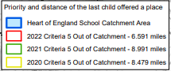

Solihull Borough – Chelmsley wood, Solihull Town, Balsall Common and Hampton in Arden.
Coventry – Tile Hill, Canley and Burton Green
Warwickshire and Birmingham

Slide 9
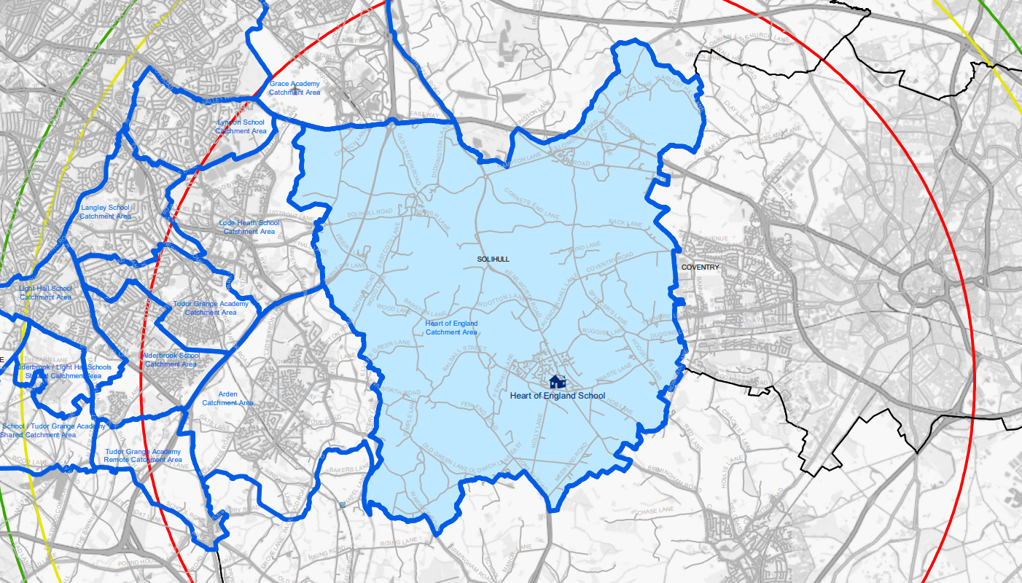

Slide 10
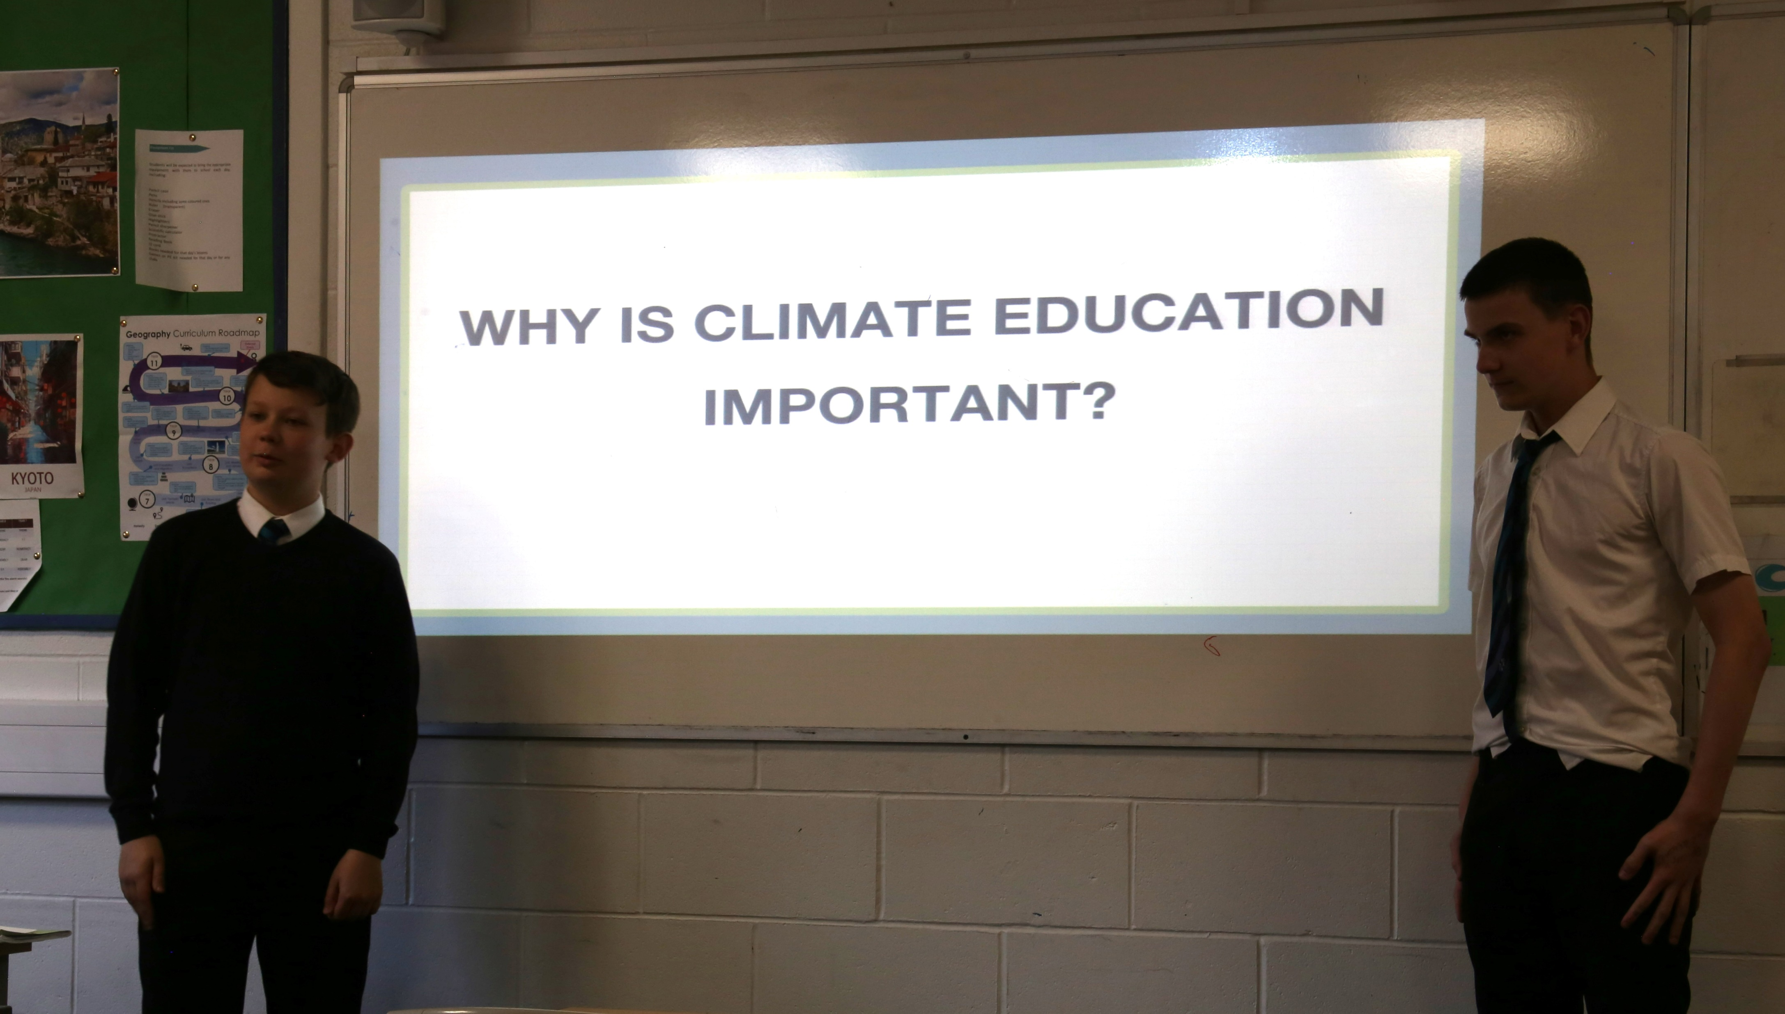

Slide 11
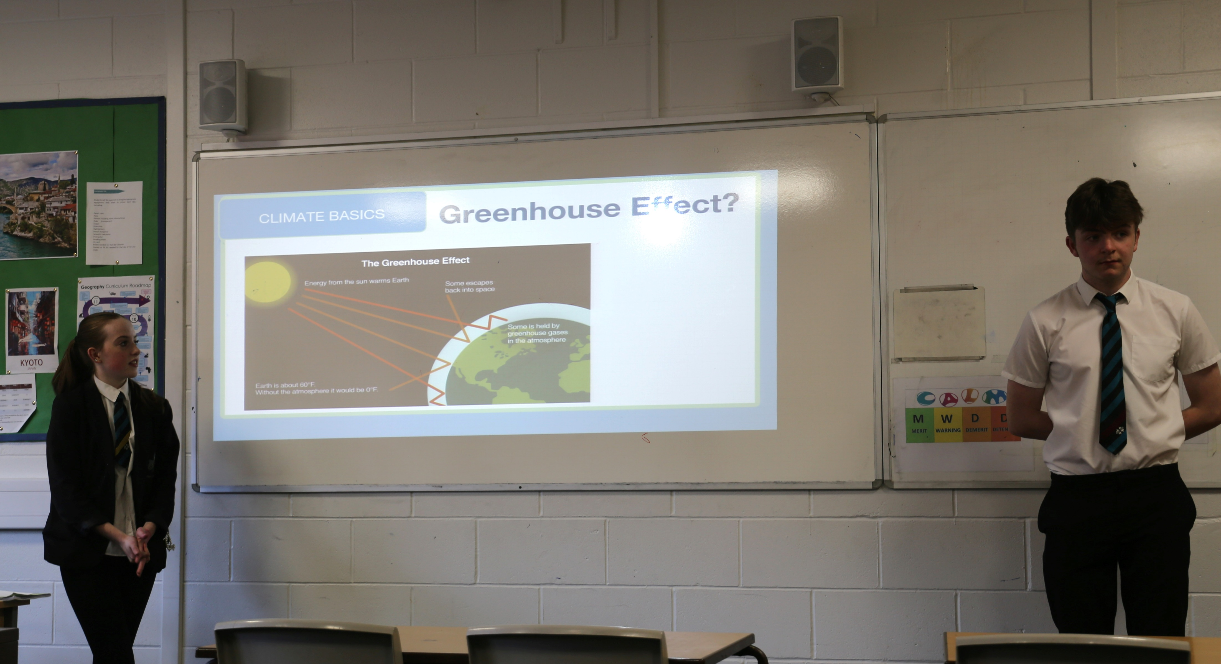

Slide 12
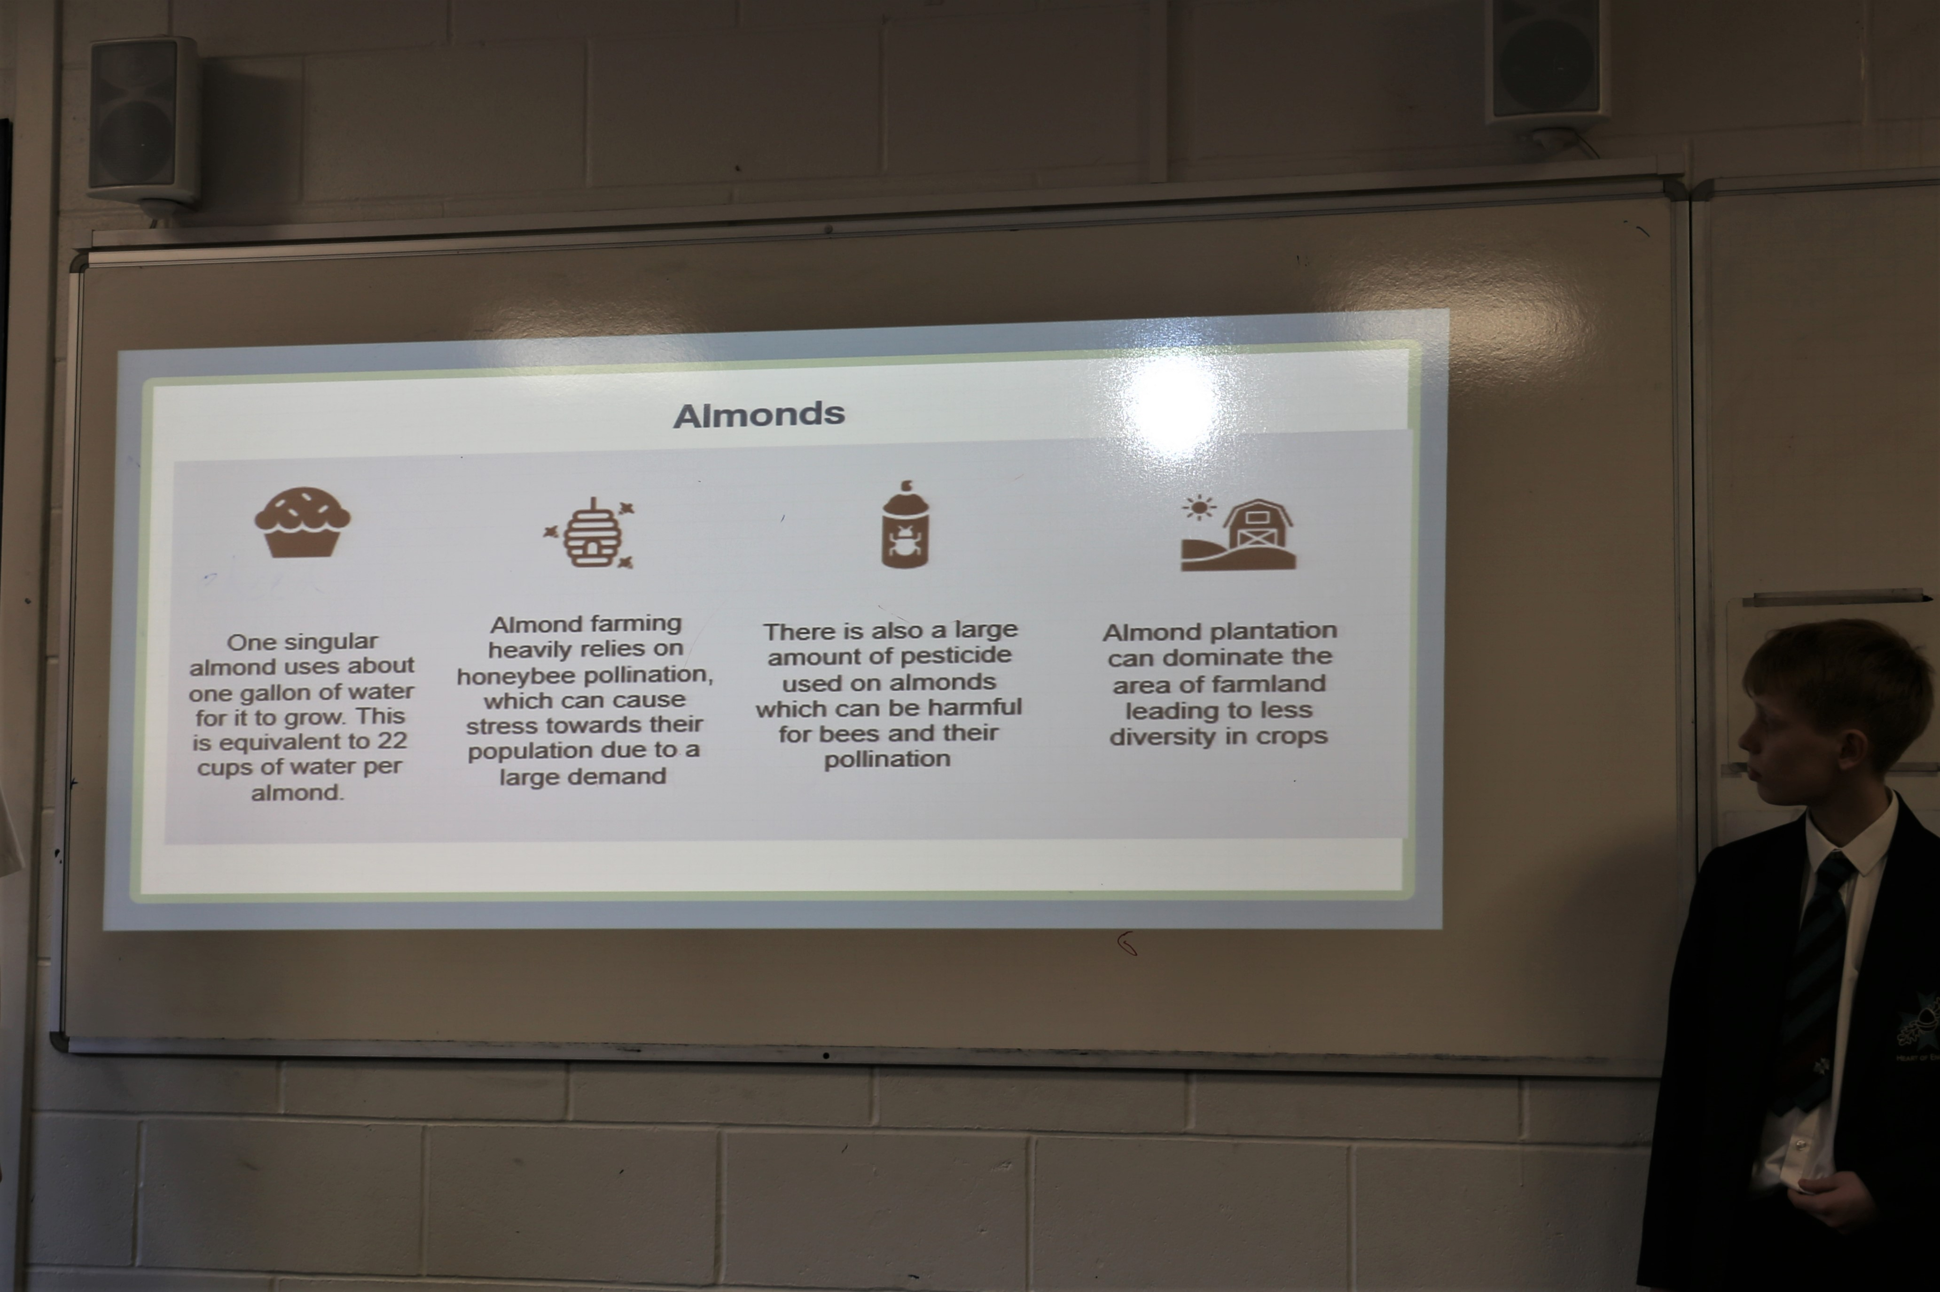

Slide 13
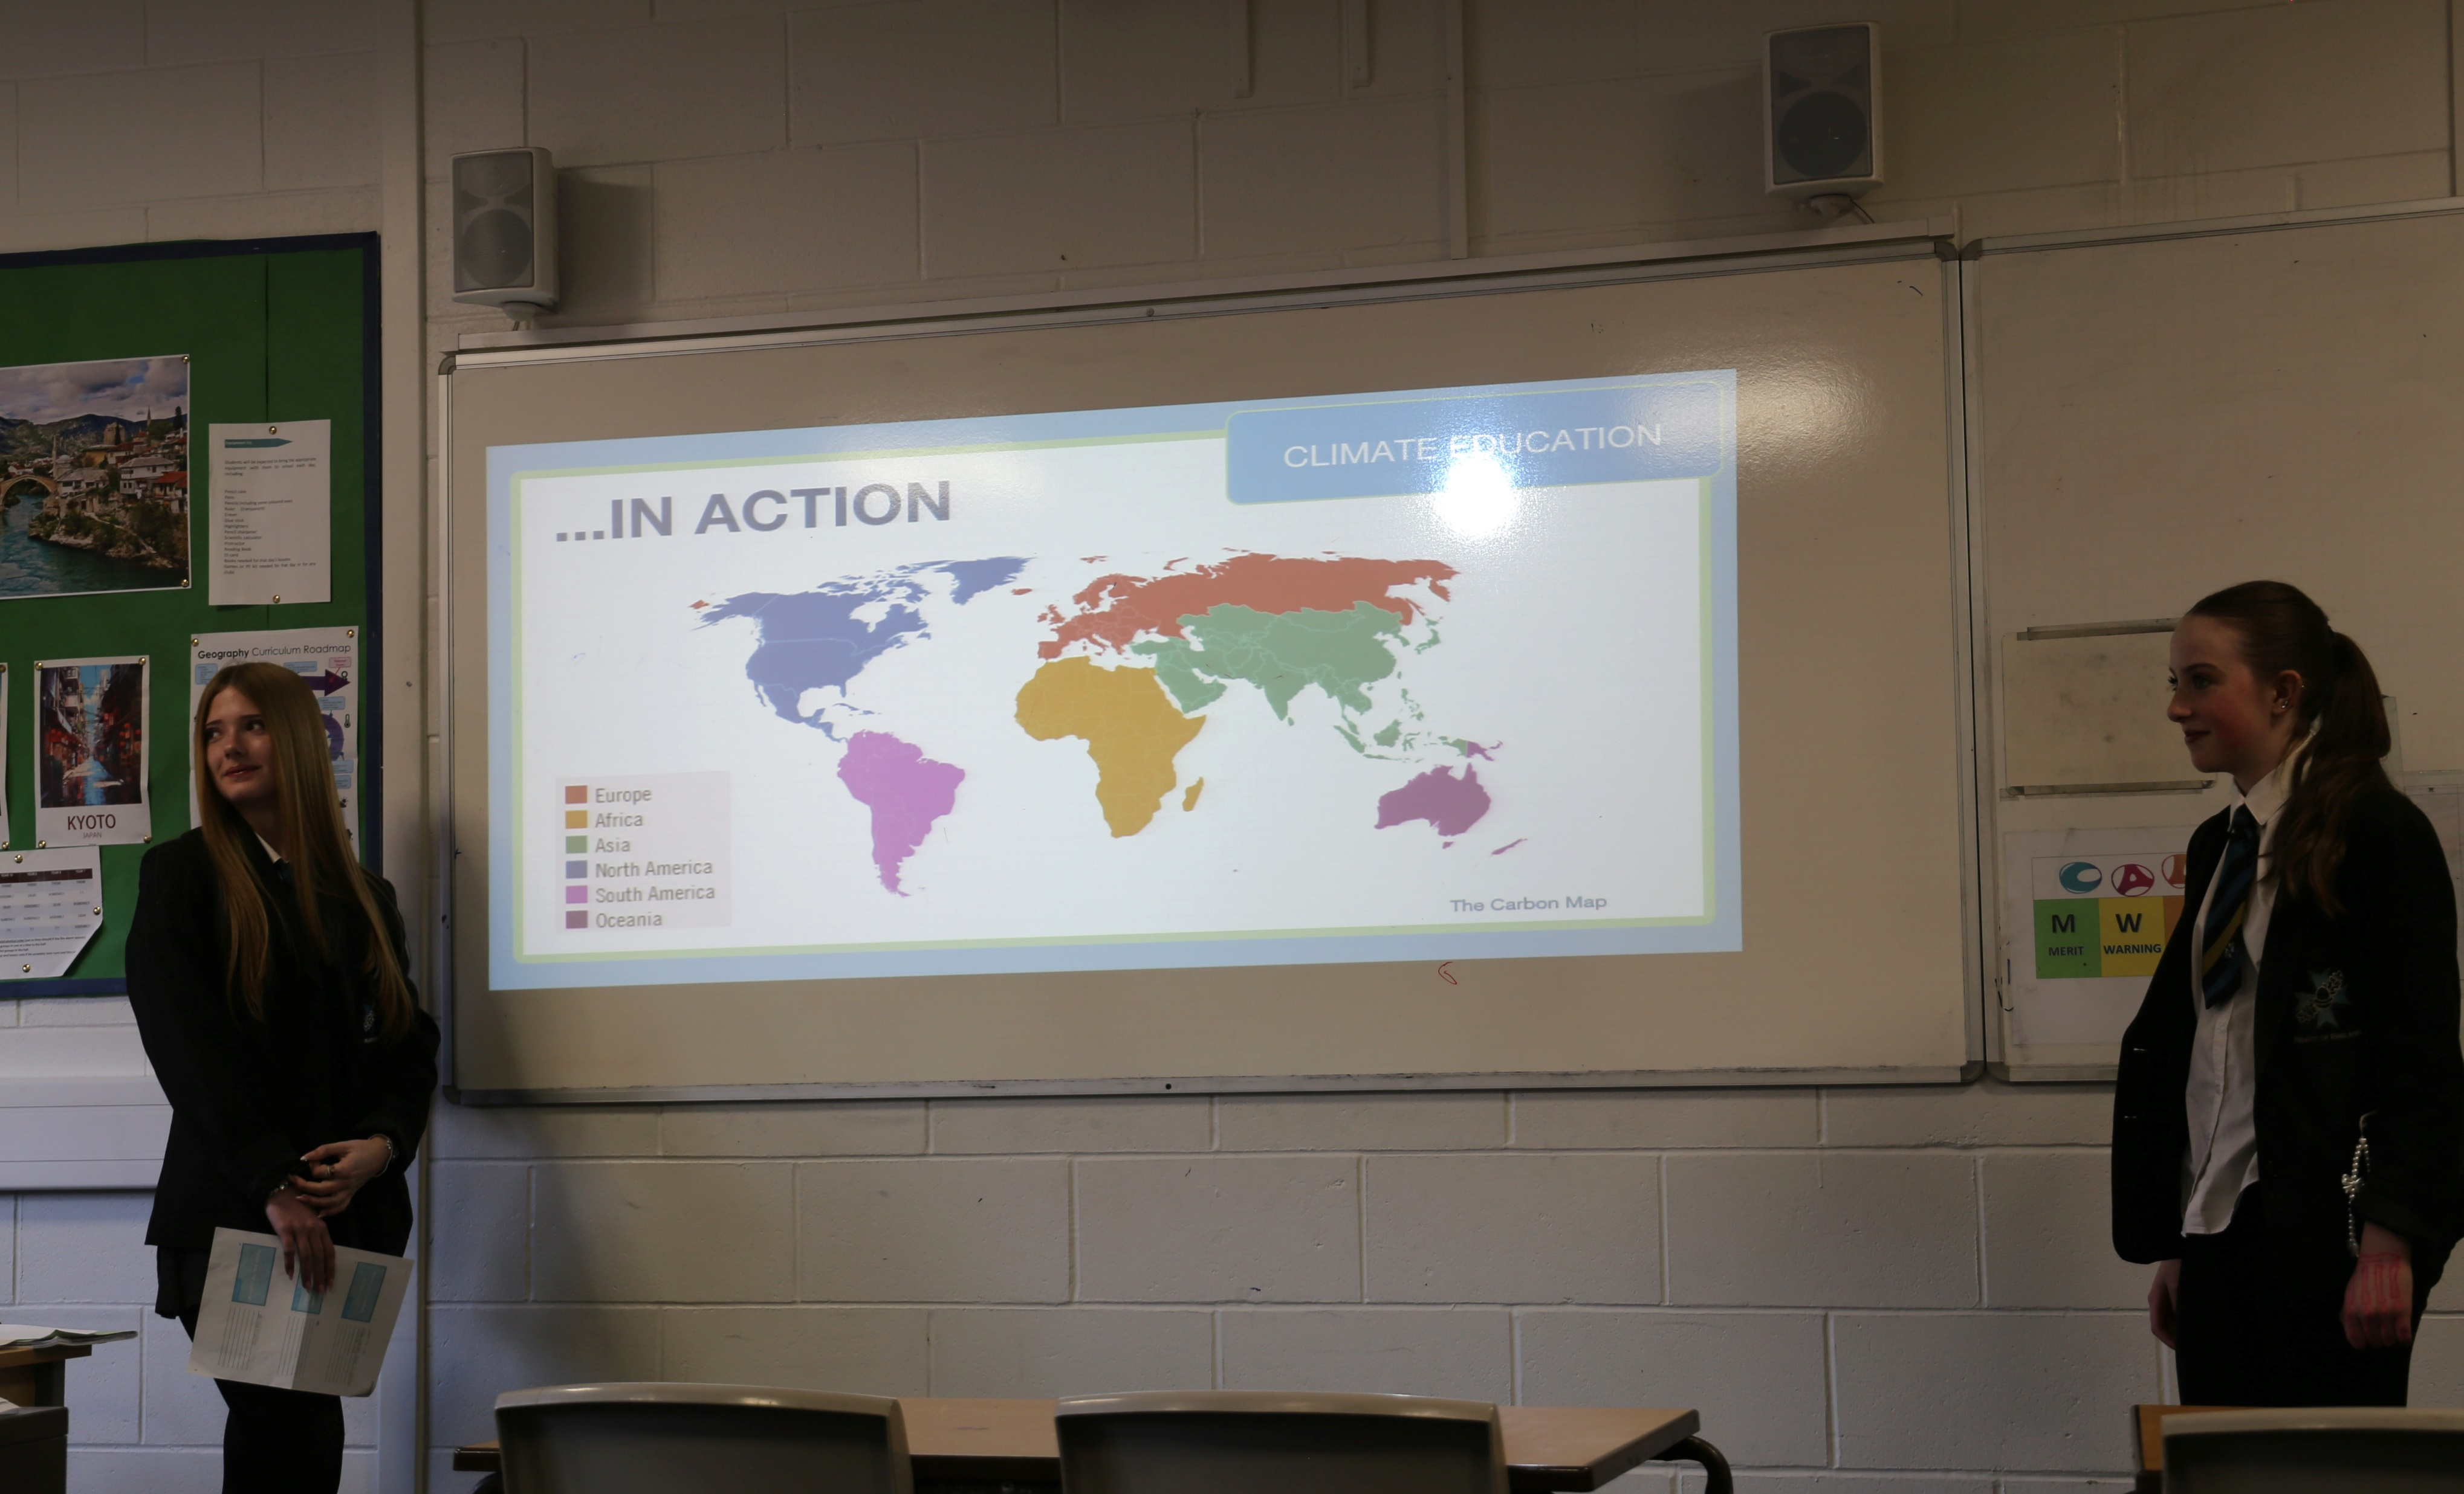

Slide 14
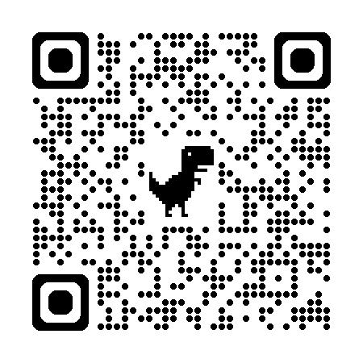
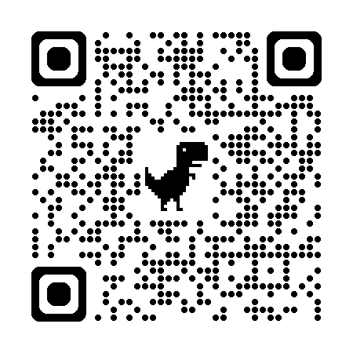
Thank you so much for listening!
Resources to check out:
TEACH THE TEACHER:
RUN A YOUTH-LED CLIMATE WORKSHOP AT YOUR SCHOOL
TEACH THE FUTURE’S
TRACKED CHANGES DOCUMENTS
Notes:
[JACK]
Thanks so much for listening to us today and getting involved by answering all of our questions.
We hope to have shared some useful knowledge with you today and we really hope to have shown:
The benefits of climate storytelling as a teaching tool
The importance of developing skills and values, not just knowledge, when trying to develop climate conscious and action ready students
That climate education doesn’t just come from the formal curriculum, but there are opportunities for you to utilise the informal and subliminal curricula too
That we’re all just trying to do our best - as teachers you never stop learning and it’s important that you’re engaging your students in such important topics like climate change in the classroom
On the screen we have some QR codes that you might find useful - the QR code on the left to check out Teach the Future’s Tracked Changes documents that Jack just mentioned, and the QR code on the right for the Teach the Teacher website, where you can sign up to bring Teach the Teacher to your placement schools as an activity for your students to take part in, or where we can give you access to more resources to support you to integrate climate into your classrooms going forward
Does anyone have any questions?
Thanks so much!

