Slide 1
Adventures with the Morecambe Bay Curriculum
Chris Barlow
Senior Lecturer in Primary Education
University of Cumbria

Slide 2
Adventures with the Morecambe Bay Curriculum
Experience of working with local schools as they develop a bespoke Morecambe Bay Curriculum
Experiences of working with student teachers to develop ideas and resources for the Morecambe Bay Curriculum
Experiences of working with the Morecambe Bay Curriculum Primary Geography Subject Leaders Group in developing a place-based best practice template for learning

Slide 3
Context
Primary Education Lecturer
Responsibility for and interest in primary geography
2020 asked to be UOC lead tutor working with Morecambe Bay Schools as they develop a bespoke Morecambe Bay Curriculum

Slide 4
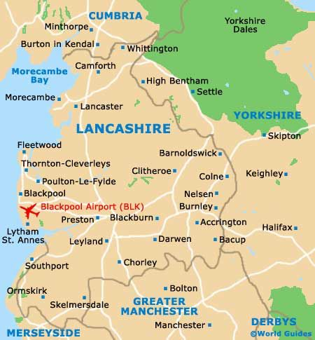
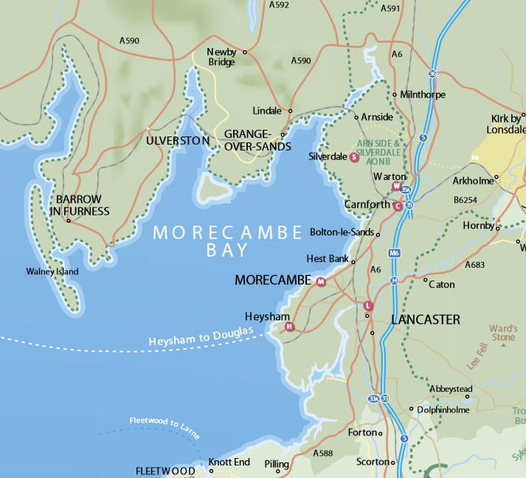
Welcome to Morecambe Bay

Slide 5
A community-curated, place-based approach to learning about sustainability - encouraging and empowering children and young people to become the change-makers and innovators our planet needs.

Slide 6
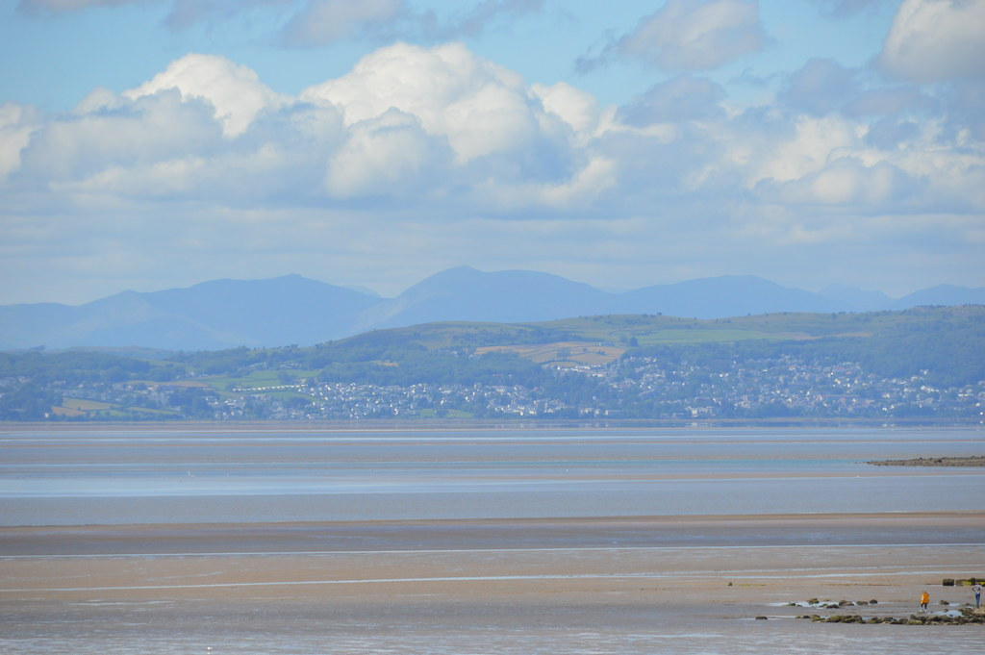
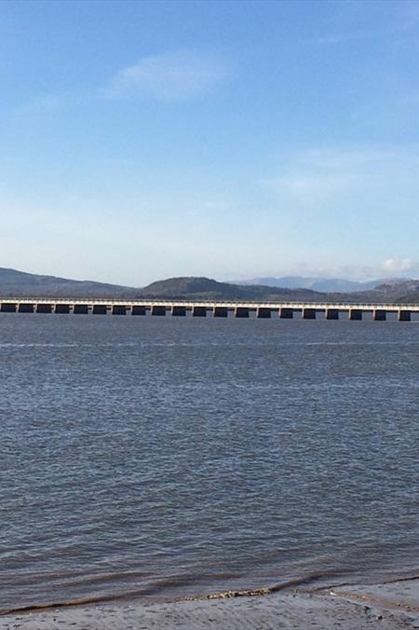
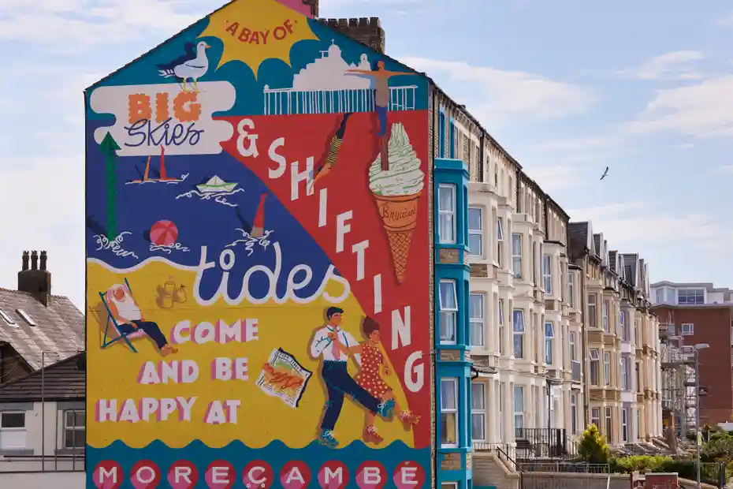
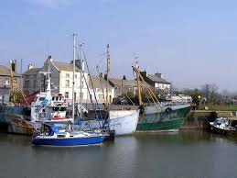
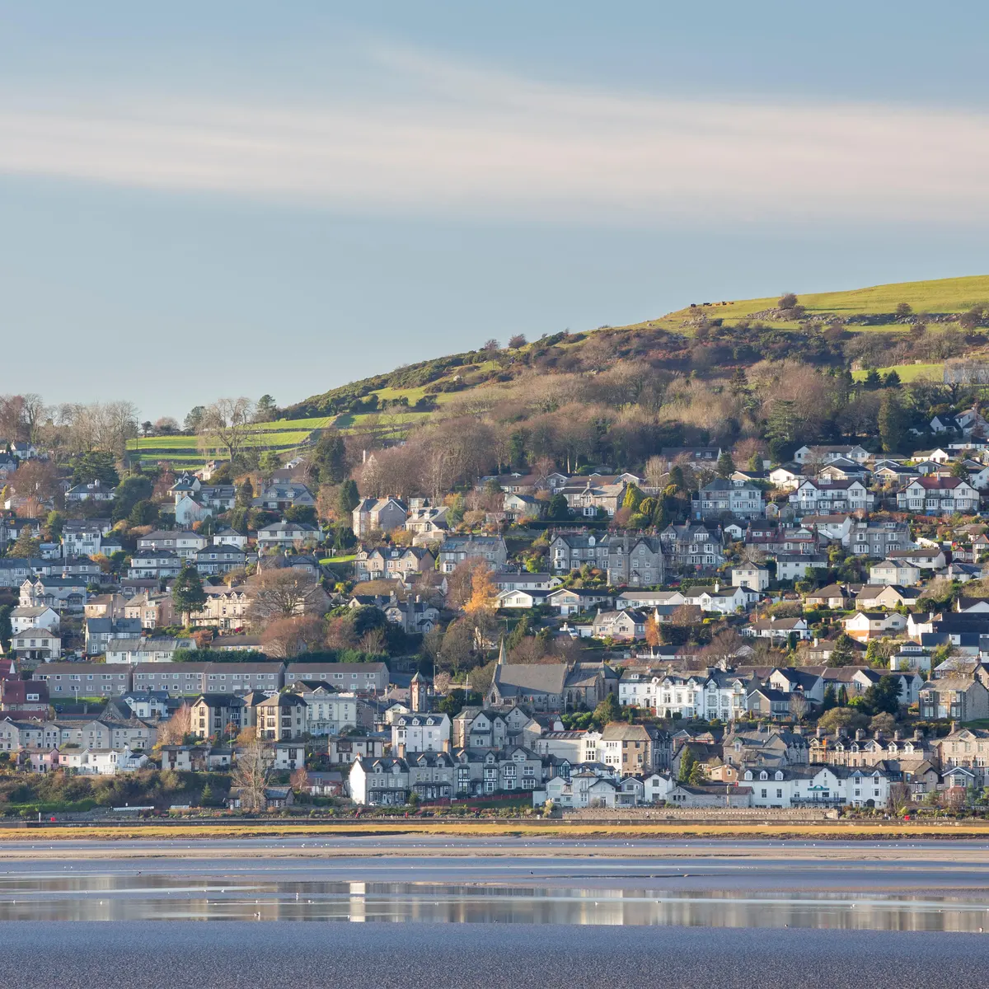
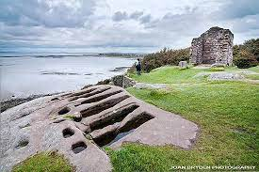
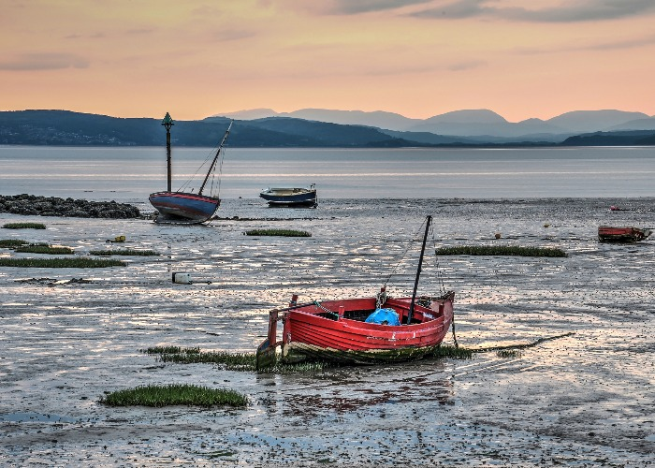
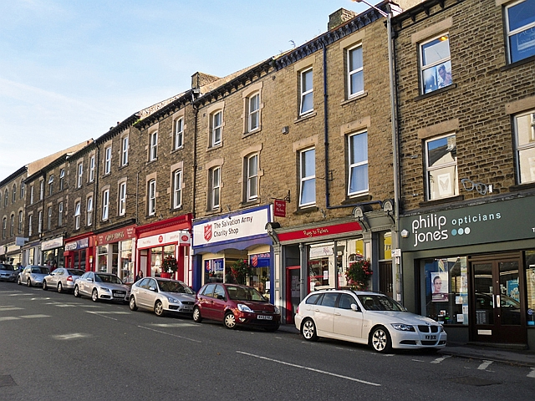
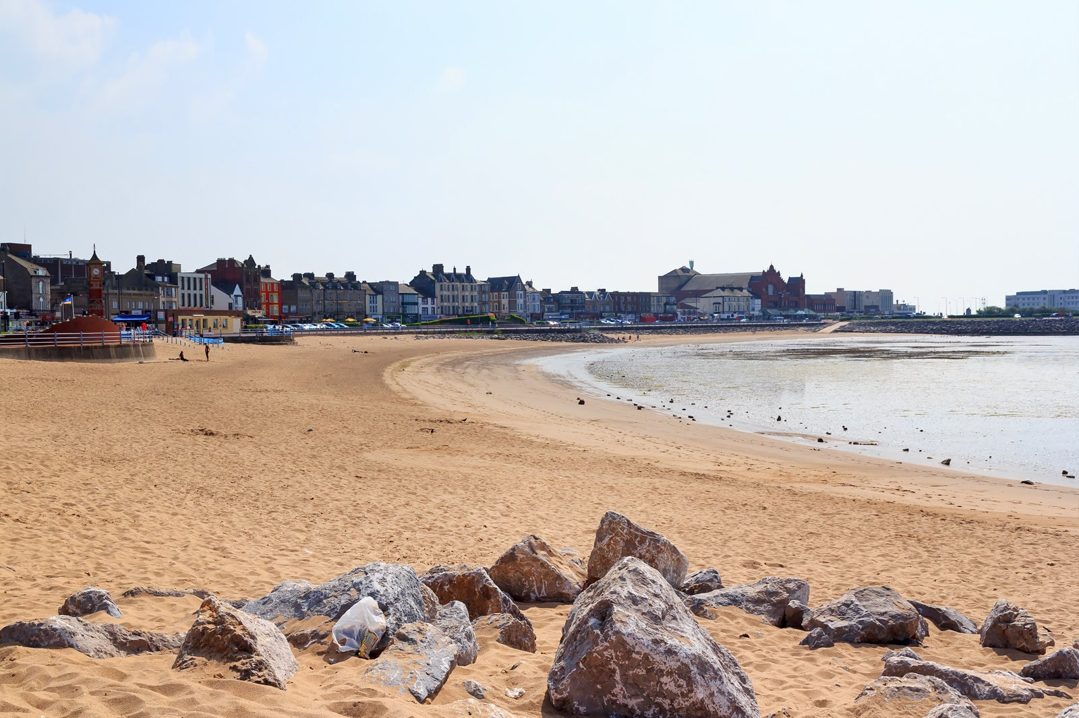
Morecambe Bay: vast and varied

Slide 7
https://www.youtube.com/watch?v=e01vofdAcsE

Slide 8
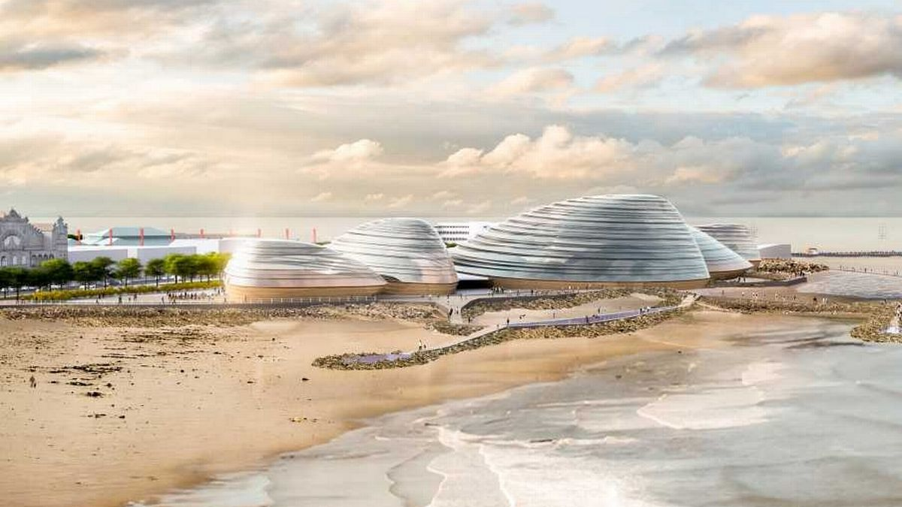
Eden Project North re-imagines Morecambe as a seaside resort for the 21st Century, inspiring wonder and a connection with the natural world drawing on the Eden Project’s focus on education, ecology and community.

Slide 9
The Morecambe Bay Curriculum (MBC)
Inspired by the prospect of Eden Project North and built upon the ideals of Eden learning
A bespoke place-based curriculum for Morecambe Bay
National Curriculum+
Learning that is immediately relevant to children
Learning that promotes curiosity, awareness and caring

Slide 10
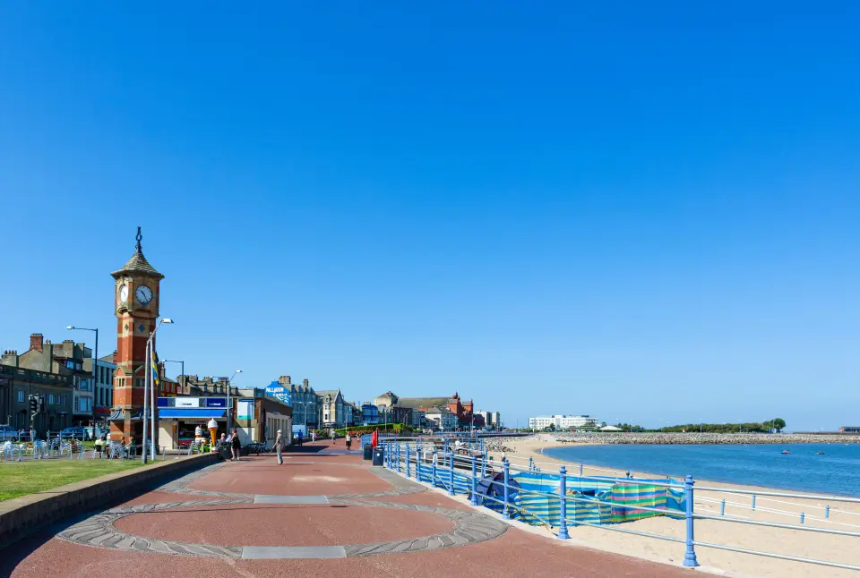

More of a way of thinking

Slide 11
The Morecambe Bay Curriculum: an aspirational curriculum for lifestyle learning
We are living in a time of unprecedented environmental, social and economic challenges that we
witness at a global scale and experience within our communities. The educational approach for
Morecambe Bay responds to these challenges by putting community and environment at the
forefront so that we apply learning to and from our local situation. Our ambition is to prepare our
children and young adults to be changemakers and innovators, active in ecological regeneration and
positive social change. This approach will provide opportunities for children and young people to
make a difference within their places of learning, the community of Morecambe Bay and the wider
world.

Slide 12
A curriculum rooted in the unique place where we live; its people, its natural environment, its history, its future and its stories.
nurtures a deeper, richer understanding of and care for Morecambe Bay,
knowledge and skills to pursue dreams and ambitions and make an active contribution to the community.
wellbeing, resilience, social and environmental sustainability and nature learning principles
comparisons and connections between our local situation and wider global issues.
answering real questions and responding to real challenges.
what it means to be a Morecambe Bay Citizen.
care for ourselves, each other and our planet
enquiry-based, experiential learning that is outdoor, sensory and immersive, project-based, challenge-focused and supports curiosity.

Slide 13
Morecambe Bay: a cavass for learning

Slide 14

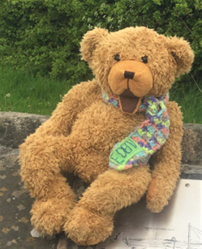
Working with Schools an interesting ‘organic’ process
Songwriting at Sandylands
Eden Bear Booklets
Trails based on noticing, celebrating and caring for the immediate environment
Supporting with creative fieldwork INSET
Myth and Legends of the Bay – expanding the idea
Distant place study review

Slide 15
Working alongside MBC
Developing enquiry suggestions relating to the place-based best practice documents
Creating place-based best practice documents for submission to the MBC (Geography Group)
Involvement in ‘testing’ and developing the actual place-based best practice template
Banking of ideas and resources relating to place-based best practice in other subject areas
Involvement in offshoot activities – EYFS Eden Bear Booklets, invite to CPD
Attendance and recognition of involvement at a primary geography conference

Slide 16
The Think Tank Initiative
Invite to student teachers on all routes towards primary QTS to suggest, discuss, develop and contribute ideas to the MBC
On-line meetings once a month
Monthly theme explored and discussed in groups
Exploring ‘themes’, developing subject knowledge and subject potential as well as pedagogical approaches

Slide 17
A variety of themes including:
Wildlife Settlement Leisure Tourism Industry Jobs
How the bay was formed Facts and Figures Transport
Other Bays in the UK and around The World Woodlands
Crossing the Bay Environmental Quality Villages of the Bay
The Mystery Road Ancient Times Conflict Resolution

Slide 18

Place-based Best Practice Template
Key Question
Overview
Outcomes and learning impact
Curriculum Links (lead subject)
Locality-based experience
On the trail (detail)
Back in class (action suggestions)
Resource links
Links to UN Sustainable Development Goals

Slide 19

On the Spot What Have We Got?
Weather Old and New Likes and Dislikes
Transport People Jobs
Pattern and Shape Shops Problems
Seasons Services Sounds
Colours Hidden Treasures Textures
Numbers Big and Small Up-close
Wildlife Materials Up and Down
Likes and dislikes Textures Words

Slide 20
Morecambe Bay Curriclum Timeline

Slide 21
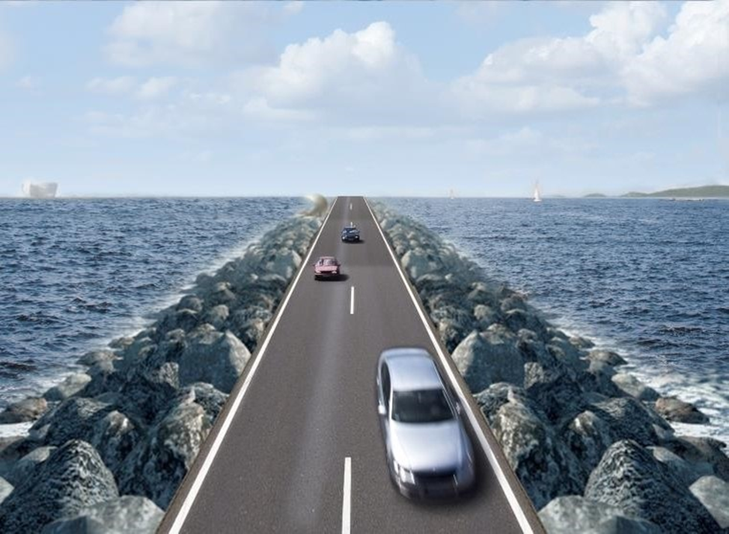

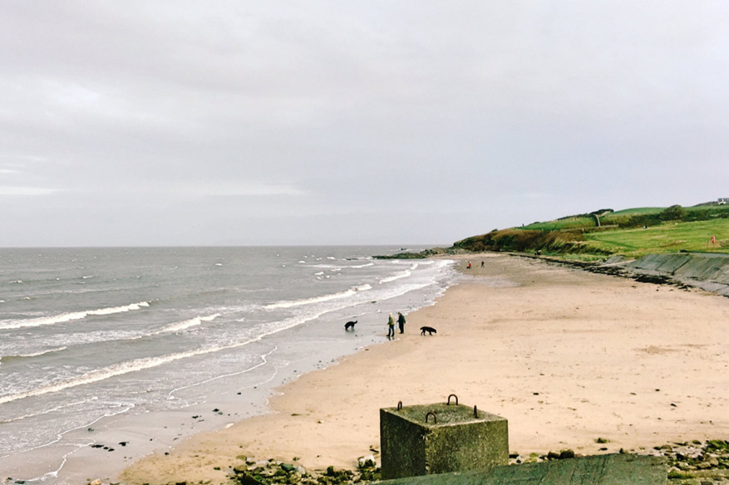

Recent
Place Based Best Practice Update
Eden Bear’s Adventures Update
History Group Meeting report
Village Walk Questions (additions?)
What if…
History in the MBC
Next Meeting suggestion

Slide 22
Think Tank Reflections: 10 Positives
This has been an enjoyable and academically stimulating cognitive exercise for me and students
It has been a welcome forum for students to share ideas and build on the ideas of others, whilst also allowing an opportunity for student teachers to meet local head teachers, subject leaders, teachers and representatives of agencies.
There has been a degree of the breaking down of student / tutor relationships – working together more like colleagues
Student development of and recognition of the importance of teacher subject knowledge, whilst exercising their creative thinking regarding research techniques, learning possibilities and learning approaches
There has been highly rewarding cross-course, cross-year group and pre-course engagement

Slide 23
Cont..
Students have reported a positive influence on their classroom practice and professional thinking
Students have made a strong impression on local school representatives – status for UOC student empowerment and a seriously ‘tasty’ job application / interview point.
8. Promotion of new teachers as curriculum designers and innovators
Recognition that many student teachers will go ‘above and beyond’ and act in highly professional ways…when they can
Overall this initiative has moved the development of the Morecambe Bay Curriculum significantly forward

Slide 24
Think Tank Reflections – 10 Concerns
Engaging students in something from a distance is really challenging, especially if they don’t already have an existing relationship with the tutor
Can lead to cynical thinking, ie ‘Do colleagues pass on messages and help nurture interest when asked?’, ‘Why bother?’
Maintaining interest is difficult for many possible reasons
Student interest in something seems to depend on their perceived value of the activity…which seems obvious to me, but…
Students find it intimidating to join ‘something’ without a friend, or to join ‘something’ with members from other year groups and courses

Slide 25
Cont…
6. On-line engagement is challenging and needs nurturing…is it just another university session?
7. Despite best attempts a student / tutor dynamic is hard to dismantle
8. Students are very busy or don’t read emails or are not interested in this form of idea sharing? Whilst it can be soul destroying to put time and energy into something when few people attend despite declaring interest – am I being naive?
9. Such a thing involves time and effort on top of existing work load – the ‘leader’ of such a thing needs to follow up on ideas to see them through
10. Managing the discord between school expectations of student availability and what they actually can do.

Slide 26
MBC Geography Steering Group
Working with group of 7 Geography Leaders from MBC primary schools
Lead leaders from Overton St Mary’s and Greatwood Primary Schools
Formed end of 2020 to steer the development of a first chosen focus subject and to work alongside the Morecambe Bay Curriculum Group to develop and pilot the place-based best practice format for MBC learning

Slide 27

Place- based Best Practice Pilot Project
Discussion of aims, possibilities and high-quality practice
What to include in a template for learning
Creation of draft ideas
QA process
Launch and celebration
Continuation
Nurturing of further groups

Slide 28
Positives
Leading in such a venture is professionally rewarding and interesting
Pedagogically stimulating
Ideas generated inform my own teaching
Keeps me ‘fresh’, more up to date with current school thinking
Professional networking, development of relationships – placement opportunities, guest speakers, school visits, colleagues to draw advice from, outside agencies, invites etc
Very good PR for UOC – my status / reputation
Sits well with UOC goals to be a ‘player’ in the wider community

Slide 29
Tanya's Experience
"Being part of the Morecambe Bay Curriculum Think Tank has given me the opportunity to develop my own understanding of experiential learning and place-based best practice, in order to create lessons that excite and engage children. It is a great chance for a group of like-minded people, all at different stages in their education careers, to come together, develop ideas and see the Morecambe Bay Curriculum take shape. As I joined the Think Tank before I started my PGCE, it helped me to feel more confident when I began planning lessons during placements, and encouraged me to take a more experiential approach to my teaching practice. Now that I have graduated, I feel that being part of the Think Tank really has influenced my practice for the best, and that I can take my own experiences from the classroom to help develop the Morecambe Bay Curriculum further. I feel so proud to be part of something that is already being so well received within schools and has the potential to massively impact the way we approach education for the better."
- Tanya Fairclough

Slide 30
Concerns, limitations and challenges
Head above the parapet - living up to and managing school expectations alongside over reaching my capabilities…all knowing expert?
Very time consuming – timetable and personal constraints
Constraints on subject leader time and energy
Meetings create meetings which create more meetings
When to step in, when to step back?
Danger of over enthusiasm
How to spread the word and involve other colleagues?
On-going lack of an actual Eden Project North or a server to share resources

Slide 31
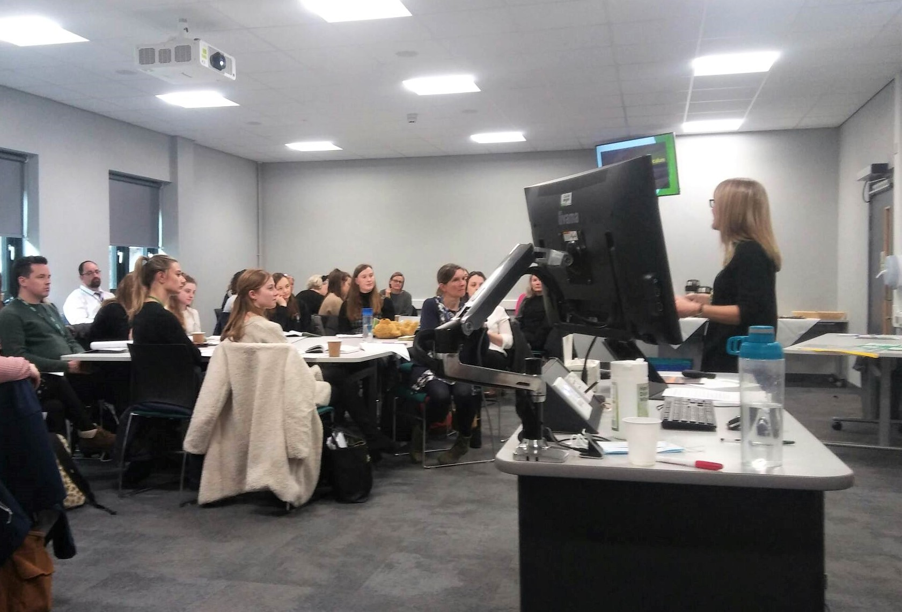
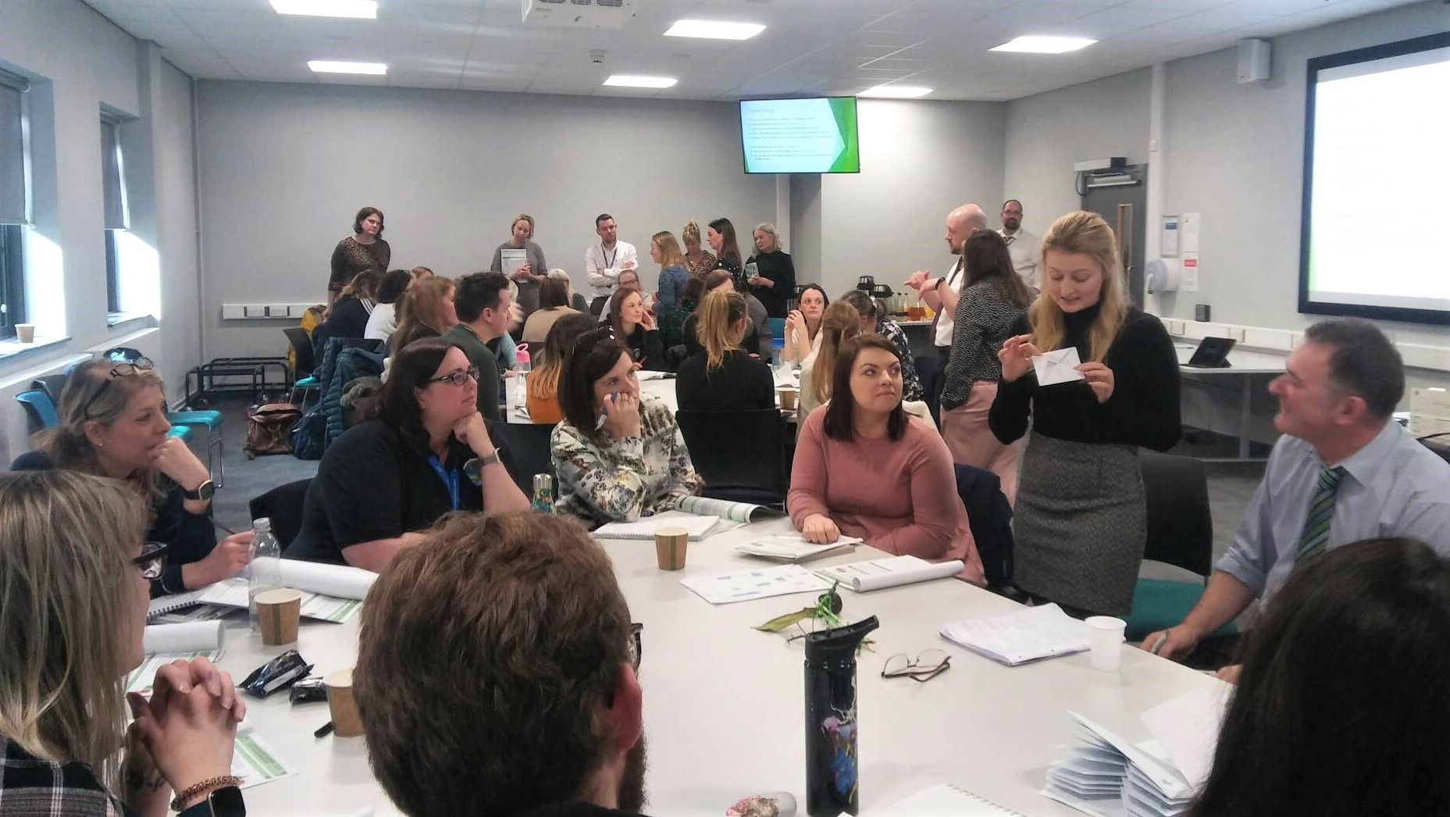
Geography Subject Leader’s Conference

Slide 32
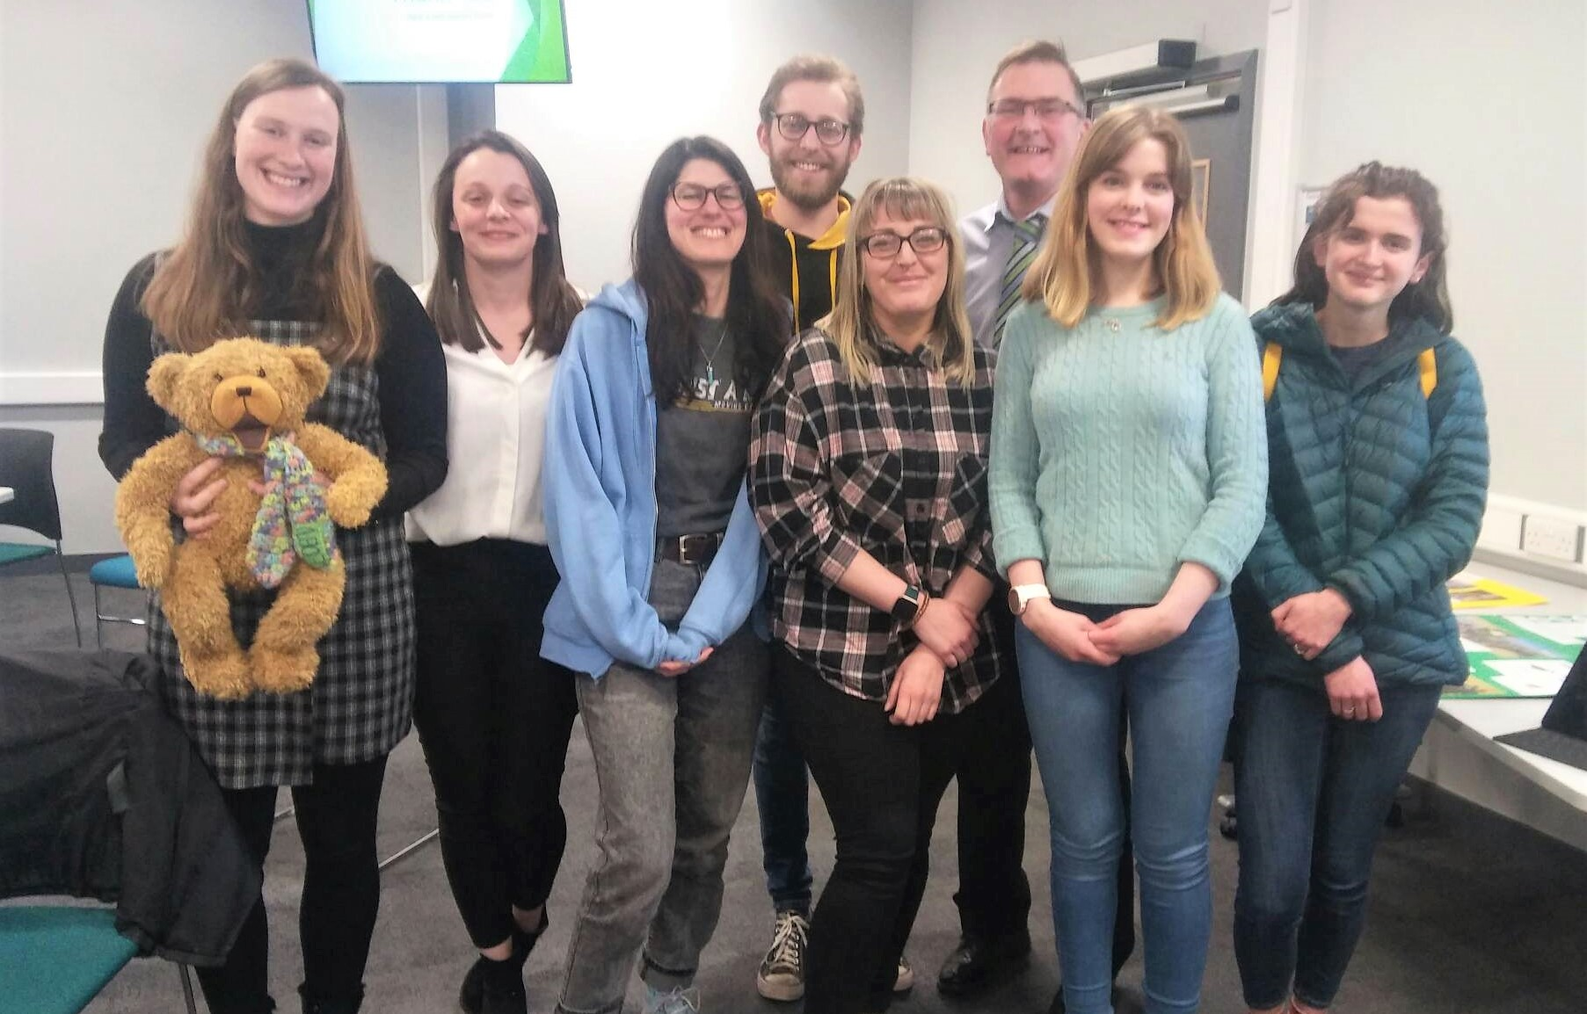
Student Teacher Involvement
Empowering
Rewarding
Nurturing desirable
professional attitudes and
practices
Engagement in a rich learning
community
Networking
Good UOC P.R

Slide 33
Next Steps…
A Geographical Association article
Seeking wider ways to disseminate amongst UOC colleagues
Nurturing involvement of relevant colleagues
To work towards a small-scale research project on student involvement
To nurture new members of the think tank
To reflect upon and refine the Eden inspired Environmental and Experiential Education primary PG specialism
To keep on doing what I’ve been doing, to achieve several works in progress and to enjoy (and carefully managing) the ride

Slide 34

Any questions, comments or suggestions?

