Slide 1



Nurture in Nature for
Nurture of Nature
Dr. Smriti Safaya
Research Associate | Stockholm Environment Institute (York)

Slide 2
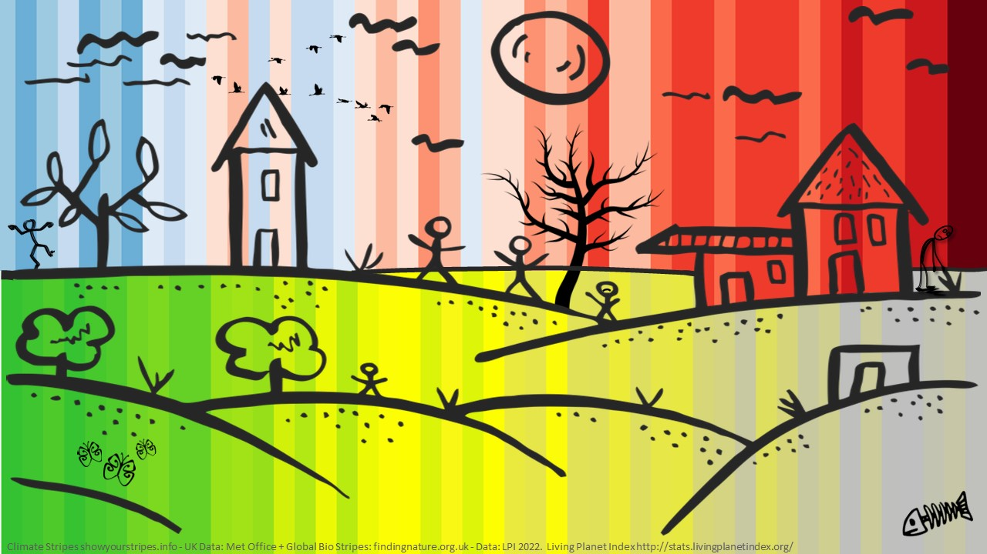
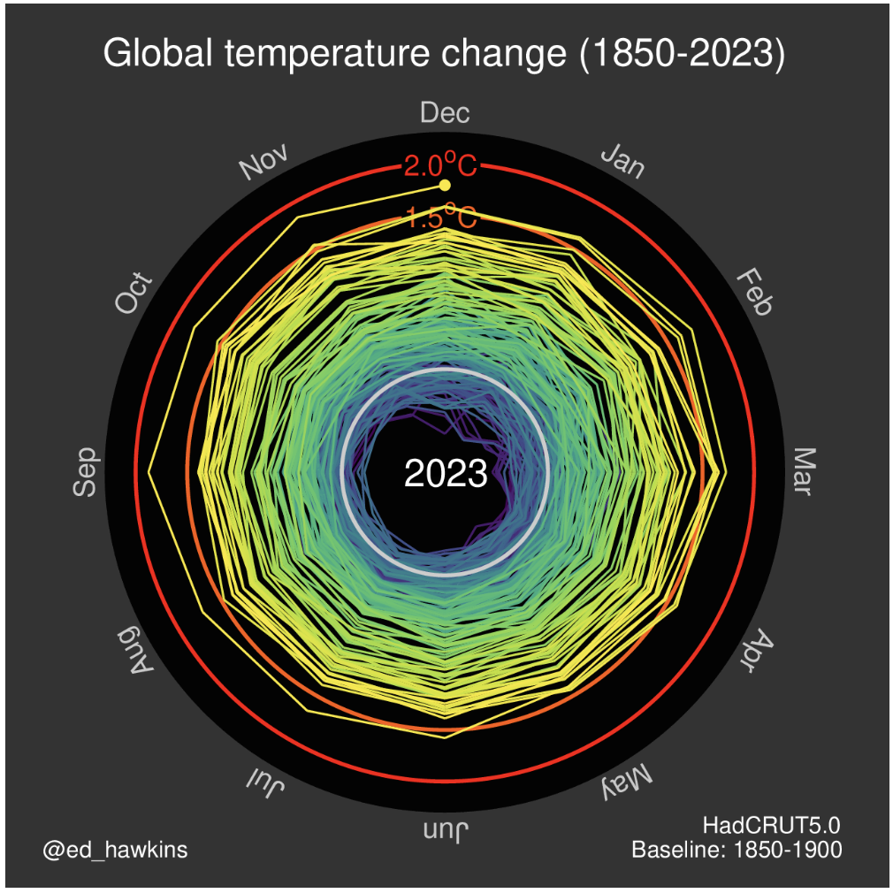
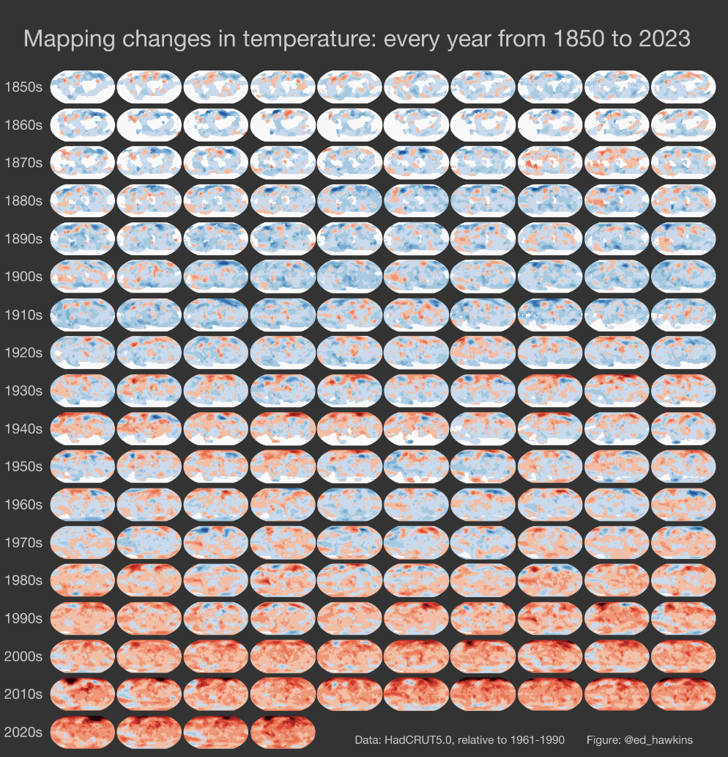
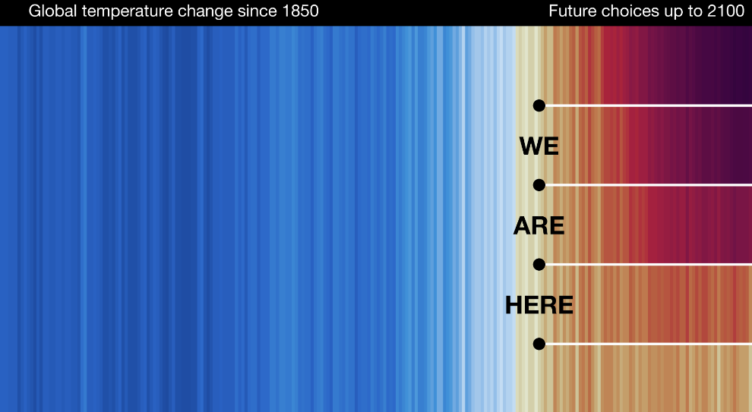

Slide 3
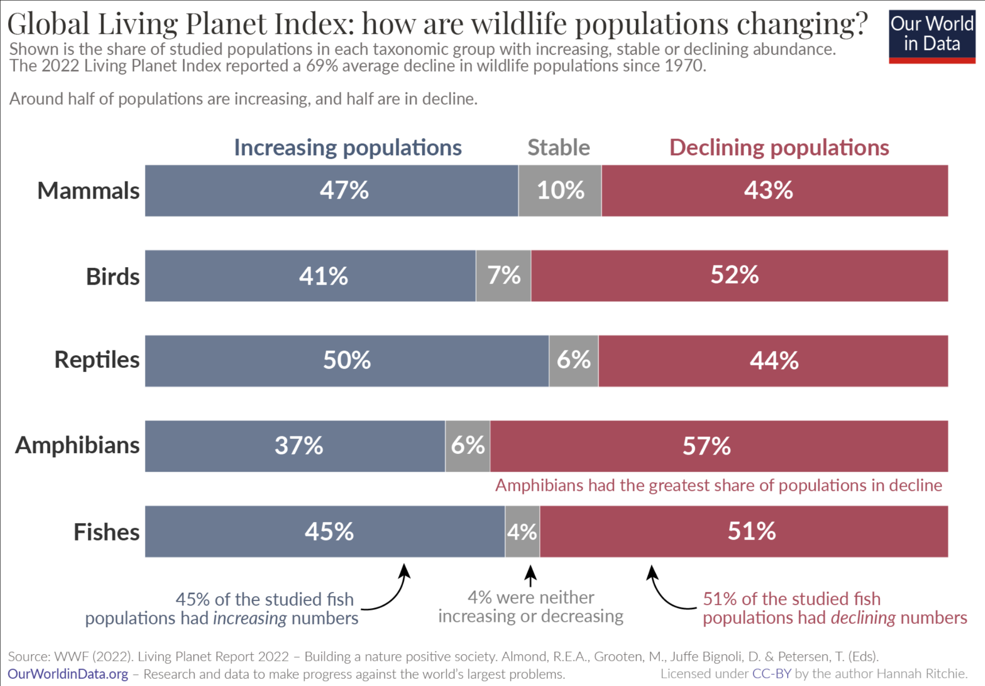
"Not the End of the World"
Book by Hannah Ritchie (2024)
(Editor at 'Our World in Data')

Slide 4
UK Youth Climate Action Research
Report 2022 - 2023
InterClimate Network surveyed ~ 10,000 students (11-18 years old) about climate actions, barriers and motivations
80%
concerned about climate change
70%
already taking action at home
Limited time to take action
Little & irregular time in nature
Frustrated with inaction by leaders
Lack of infrastructure to make taking action easy
Felt left out of decision-making in their community
Inconsistent expectations at home, school & society
Don't want to do climate strikes or protests, want alternatives
Did not know how to take action, especially collective action
BARRIERS
OPPORTUNITIES!
40%
at school
30%
when out

Slide 5
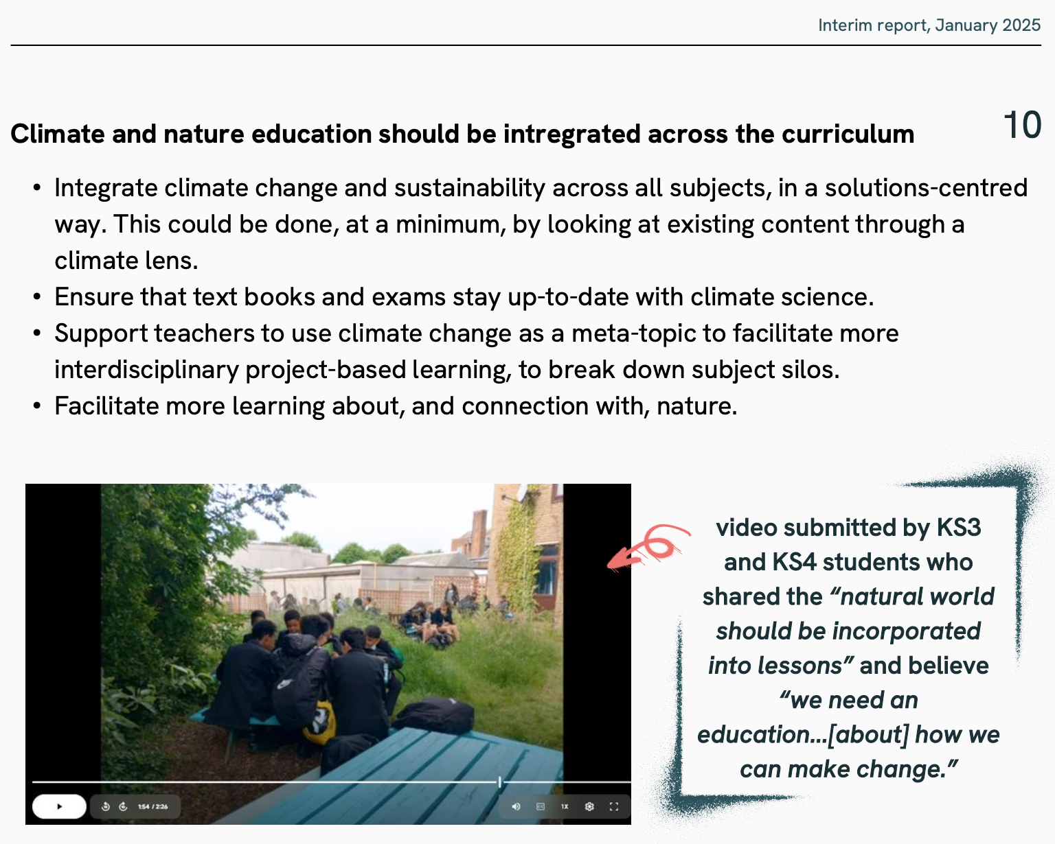
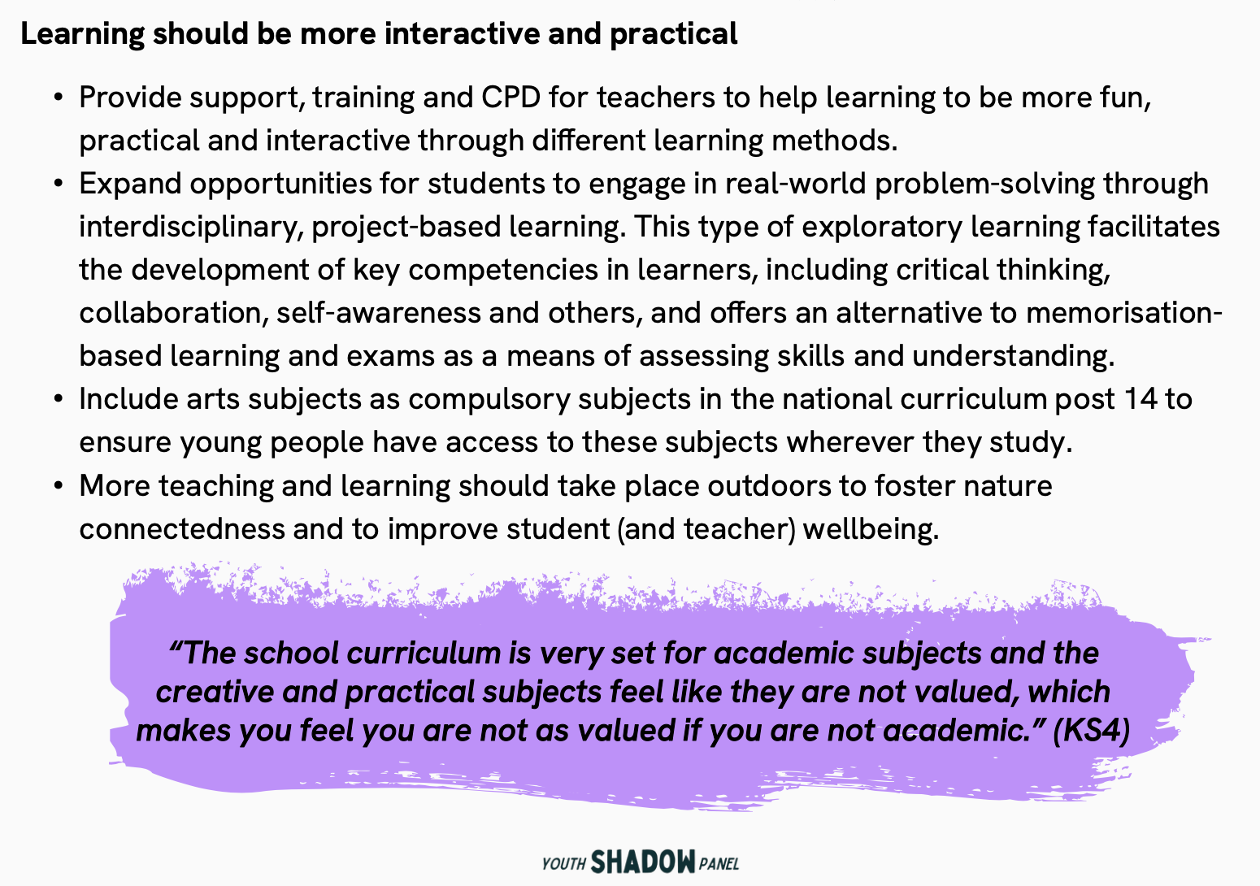
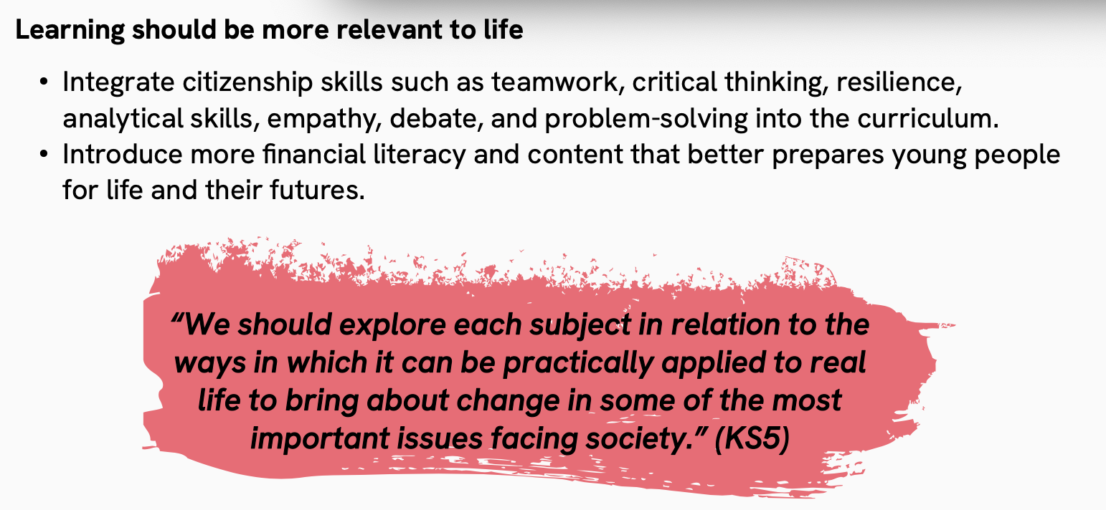
Youth Shadow Panel for DoE review (interim report 2025)

Slide 6
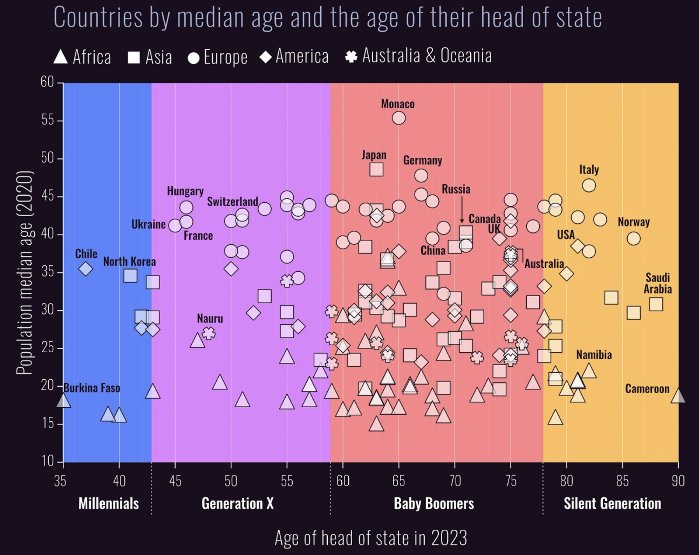
equal ages
Seeing
eye-to-eye?
leaders 2x public age

Slide 7
"If we want to support critical and engaged students, we cannot dodge the difficult questions… sometimes we need to engage in politics."
"Engaged pedagogy requires [educators] to make their practices a site of resistance".
Jo Sharp, Geographer Royal for Scotland
bell hooks, educator, activist, author

Slide 8
Geologist
School Teacher
Instigator / Catalyst…
Academic

Slide 9
50⁺ field trips
2200⁺ students
experiential education ⇒ stealth learning

Slide 10
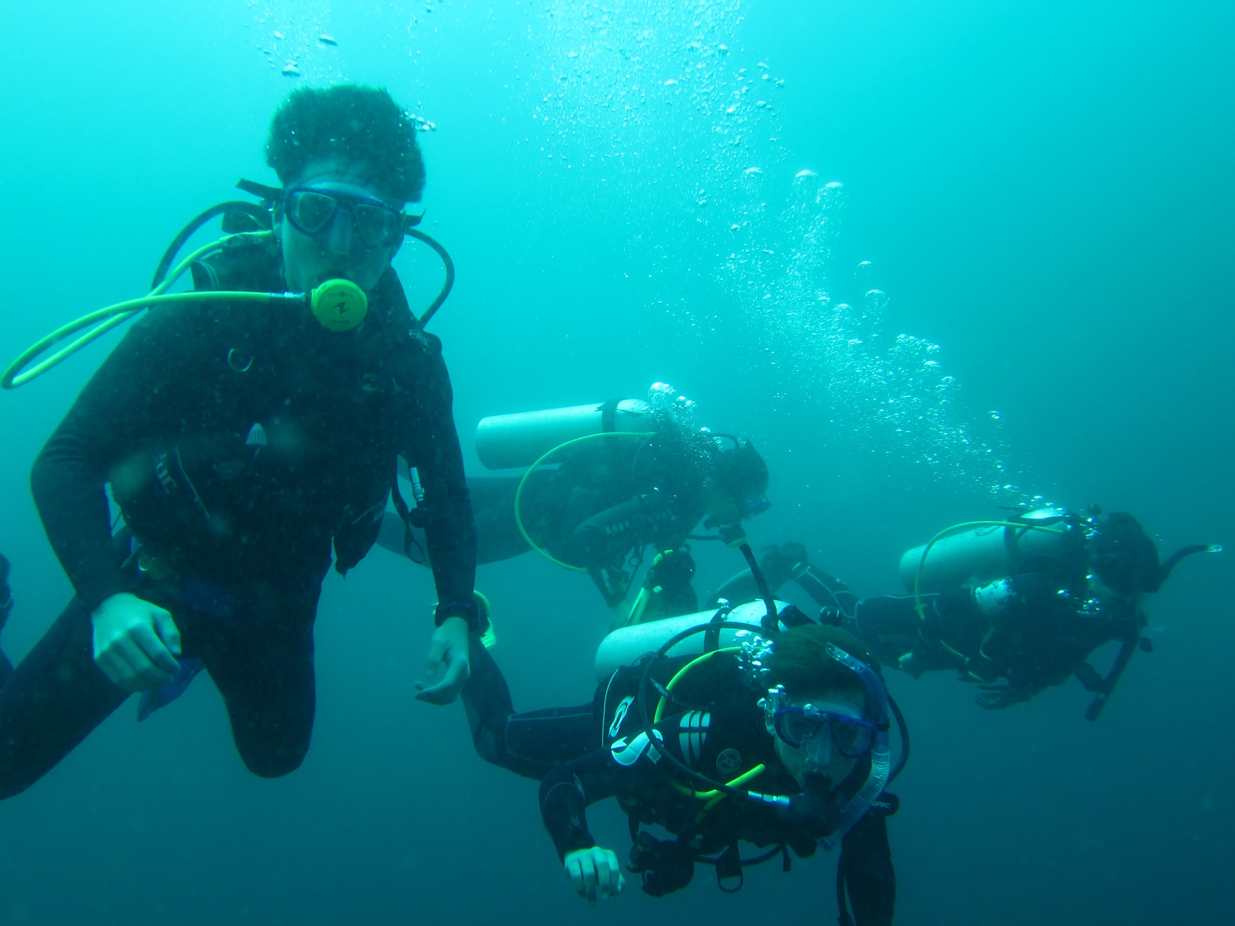
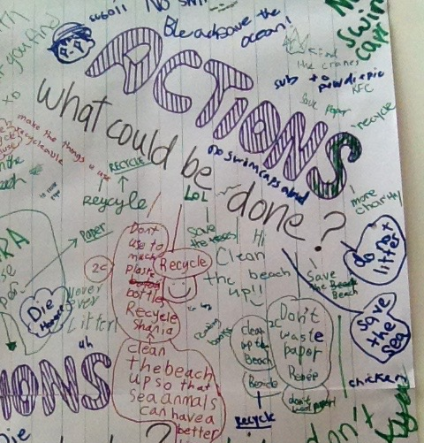
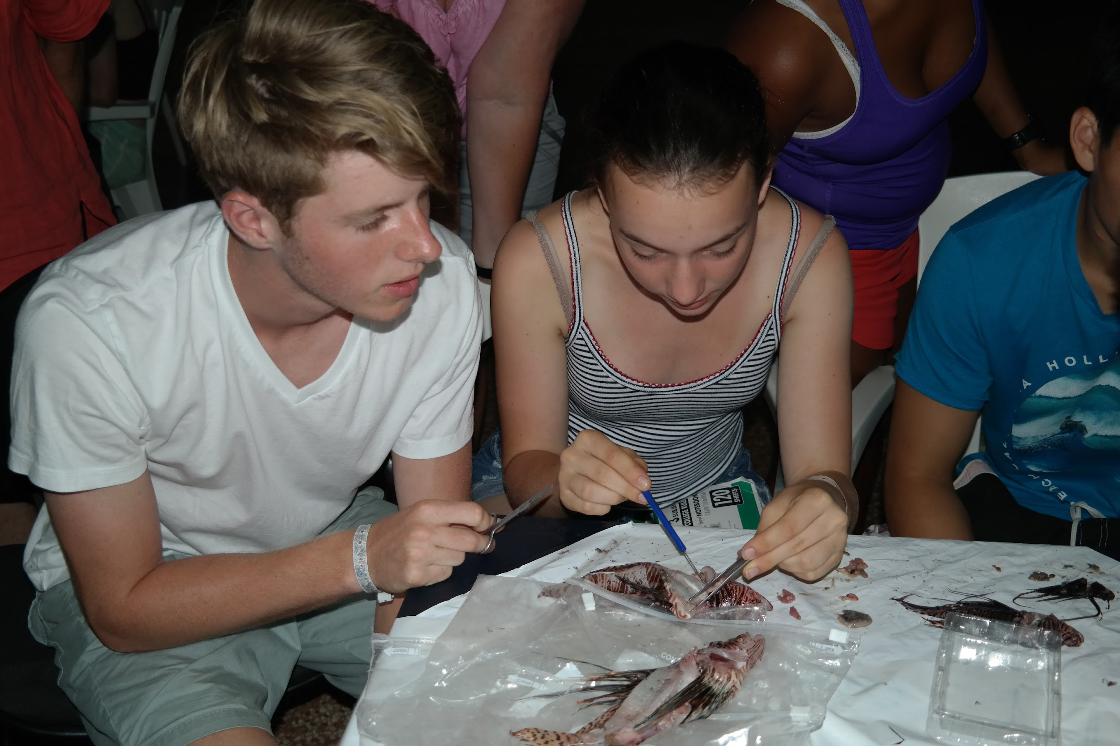
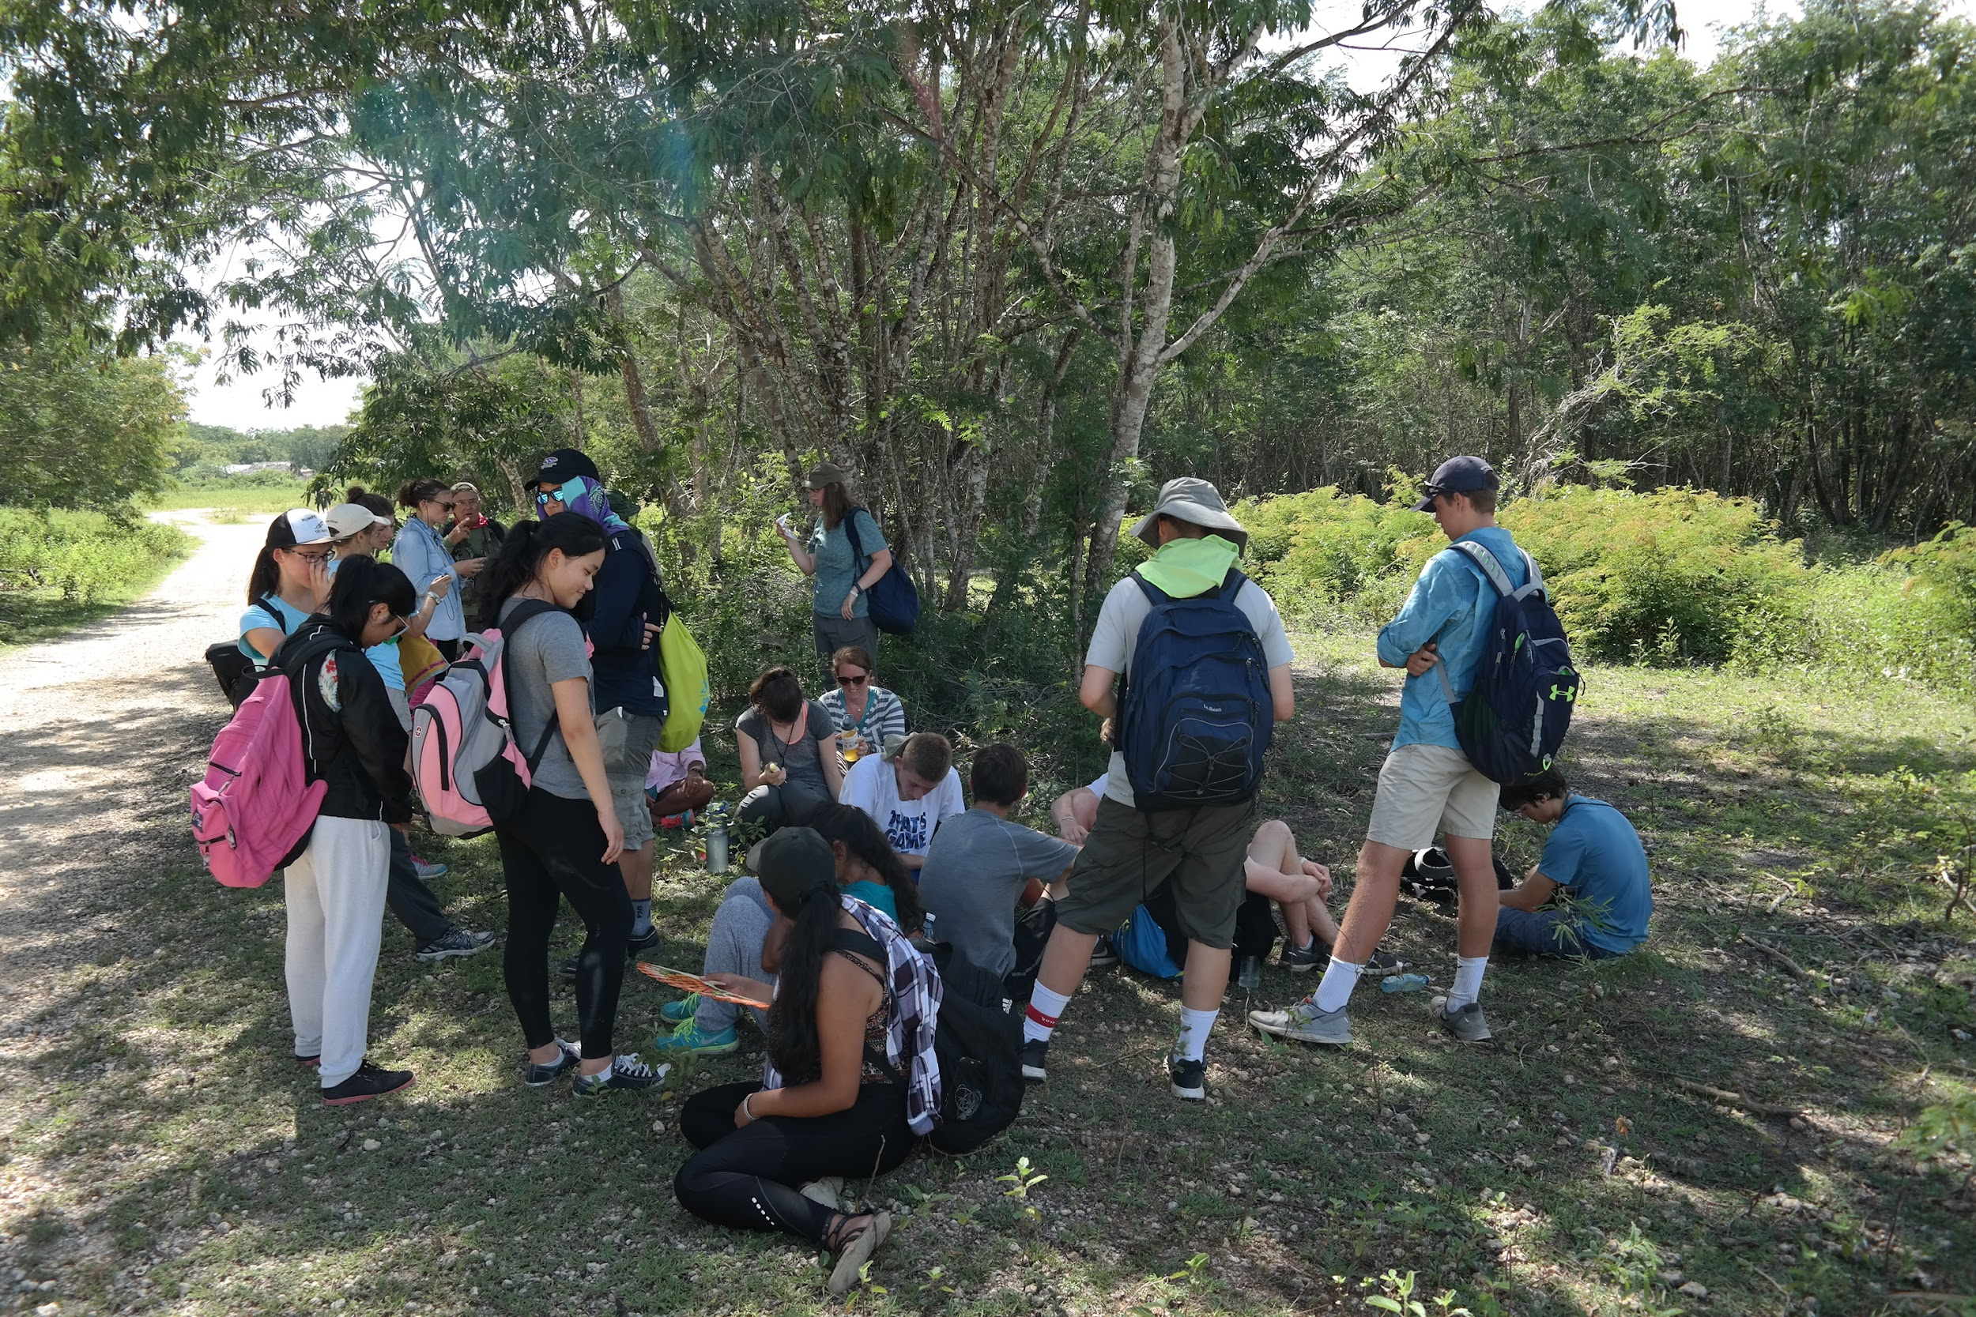
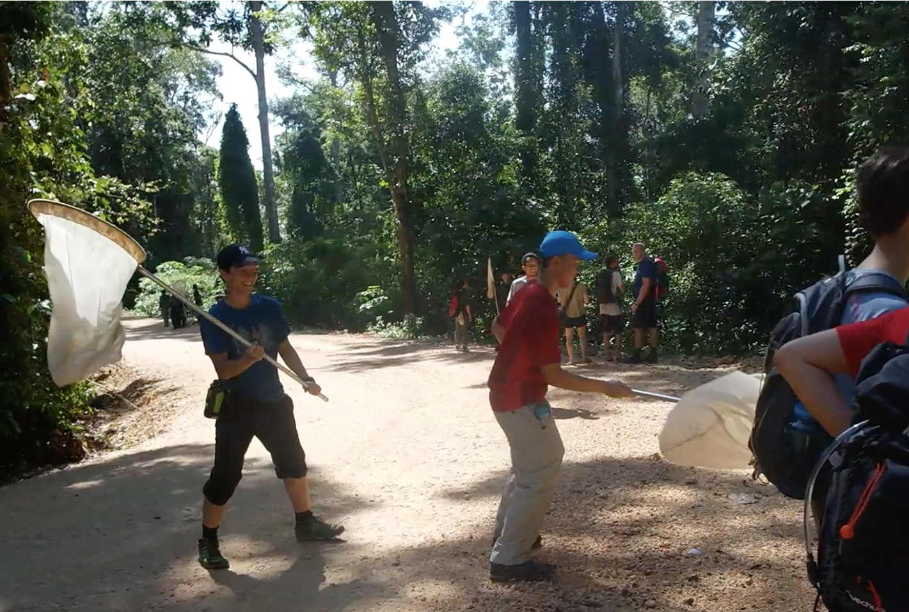
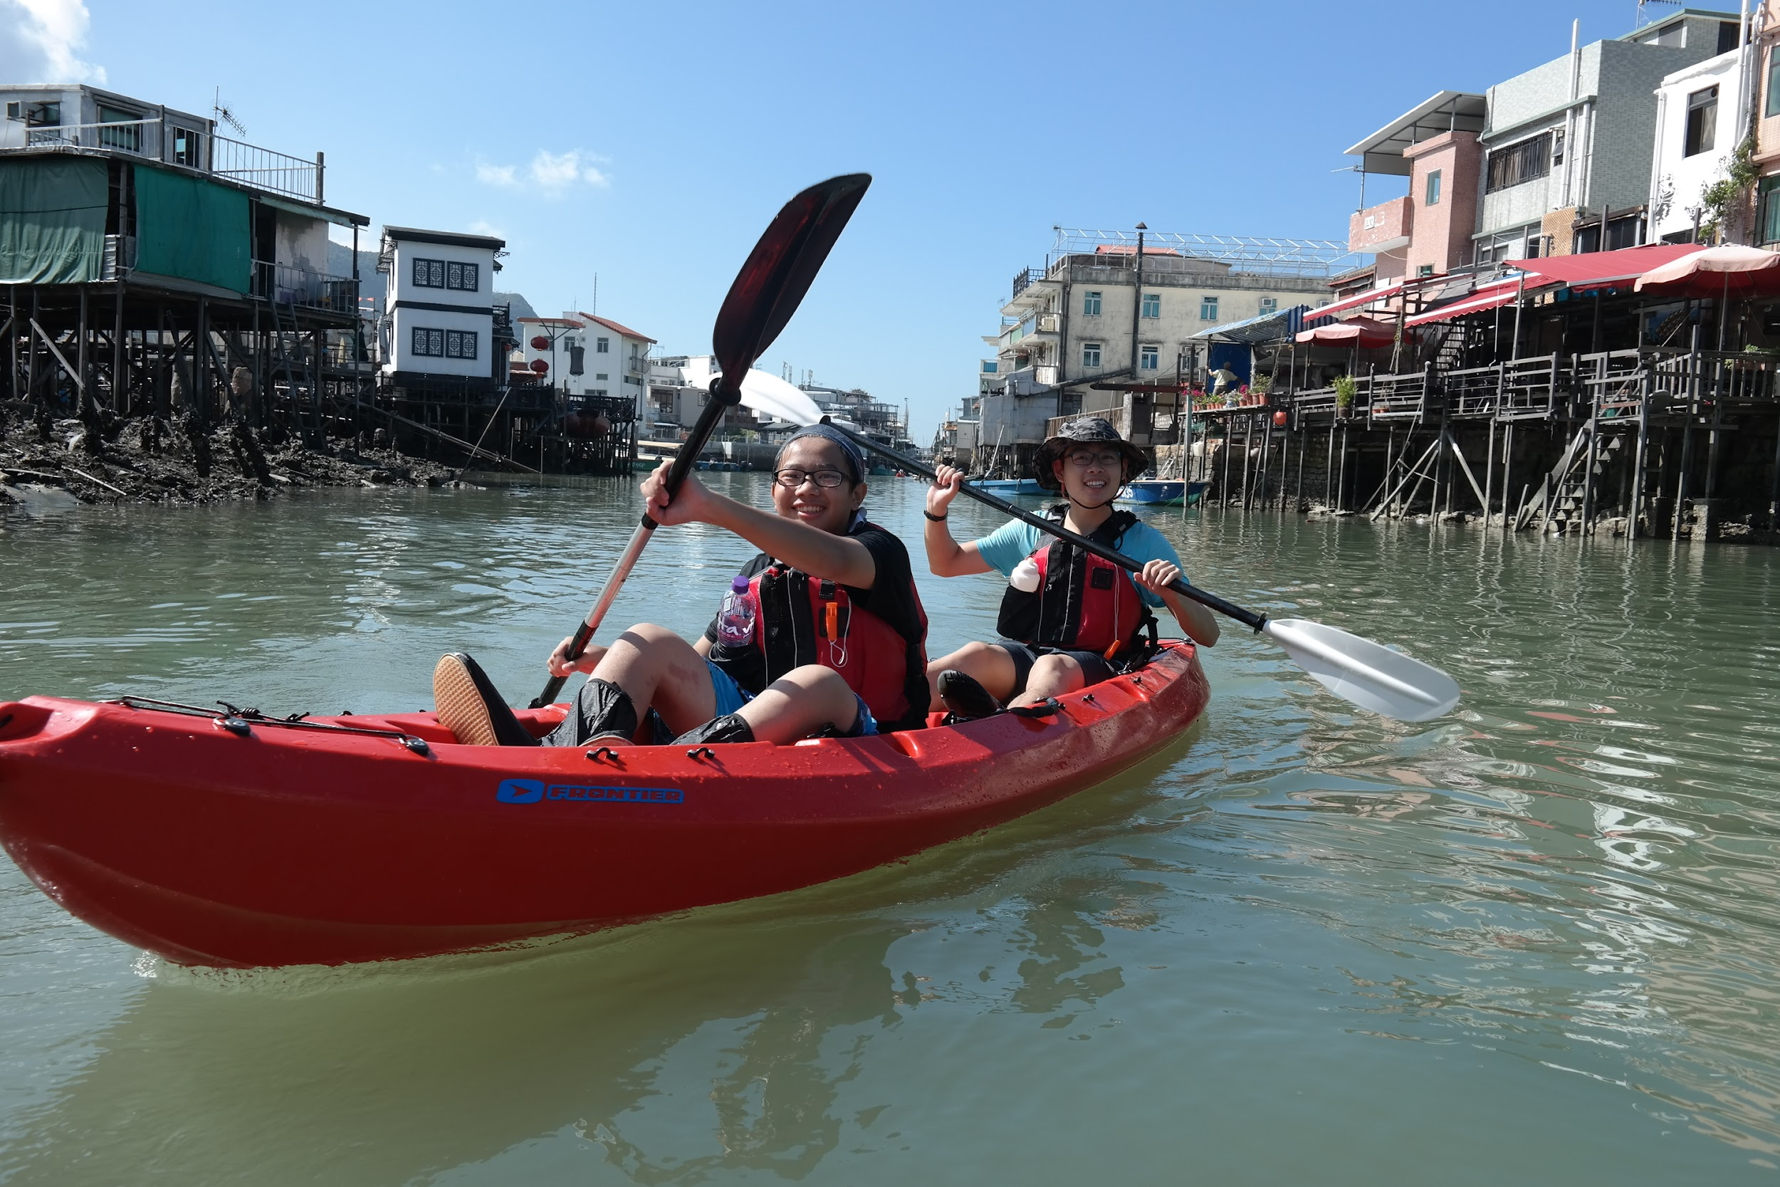
Learning where the action is…
monitoring coral health in Sulawesi, Indonesia
measuring distribution of and dissecting invasive lionfish species in Cuba
lepidoptera research in Sulawesi, Indonesia
marine debris and water quality monitoring in
Tai O, western Hong Kong
terrestrial biodiversity research in central Cuba

Slide 11
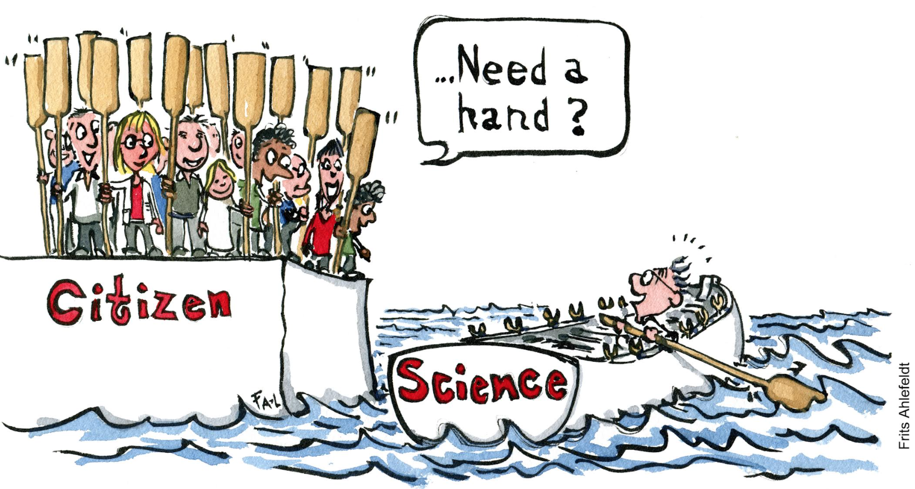
CITIZEN SCIENCE
experts and public engage in research
to address local and/or global issues

Slide 12
Do environmental citizen science experiences have an impact on youth values, attitudes & behaviours?

Slide 13
Environmental Citizen Science in Schools
5* school field observations
46 student interviews
18 teacher interviews
187 student pre-surveys
187 student post-surveys
citizen science experience
1 - 2 weeks before
1 - 2 weeks after
3 - 6 weeks after

Slide 14
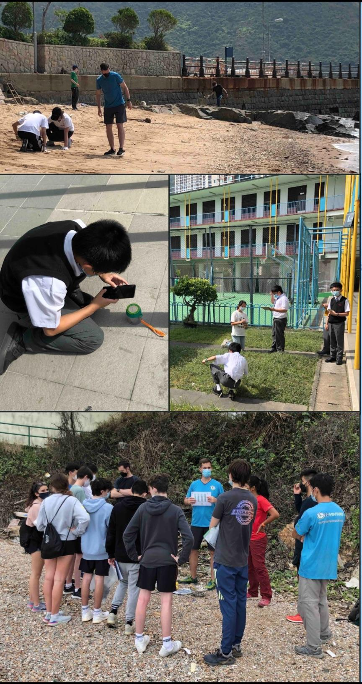
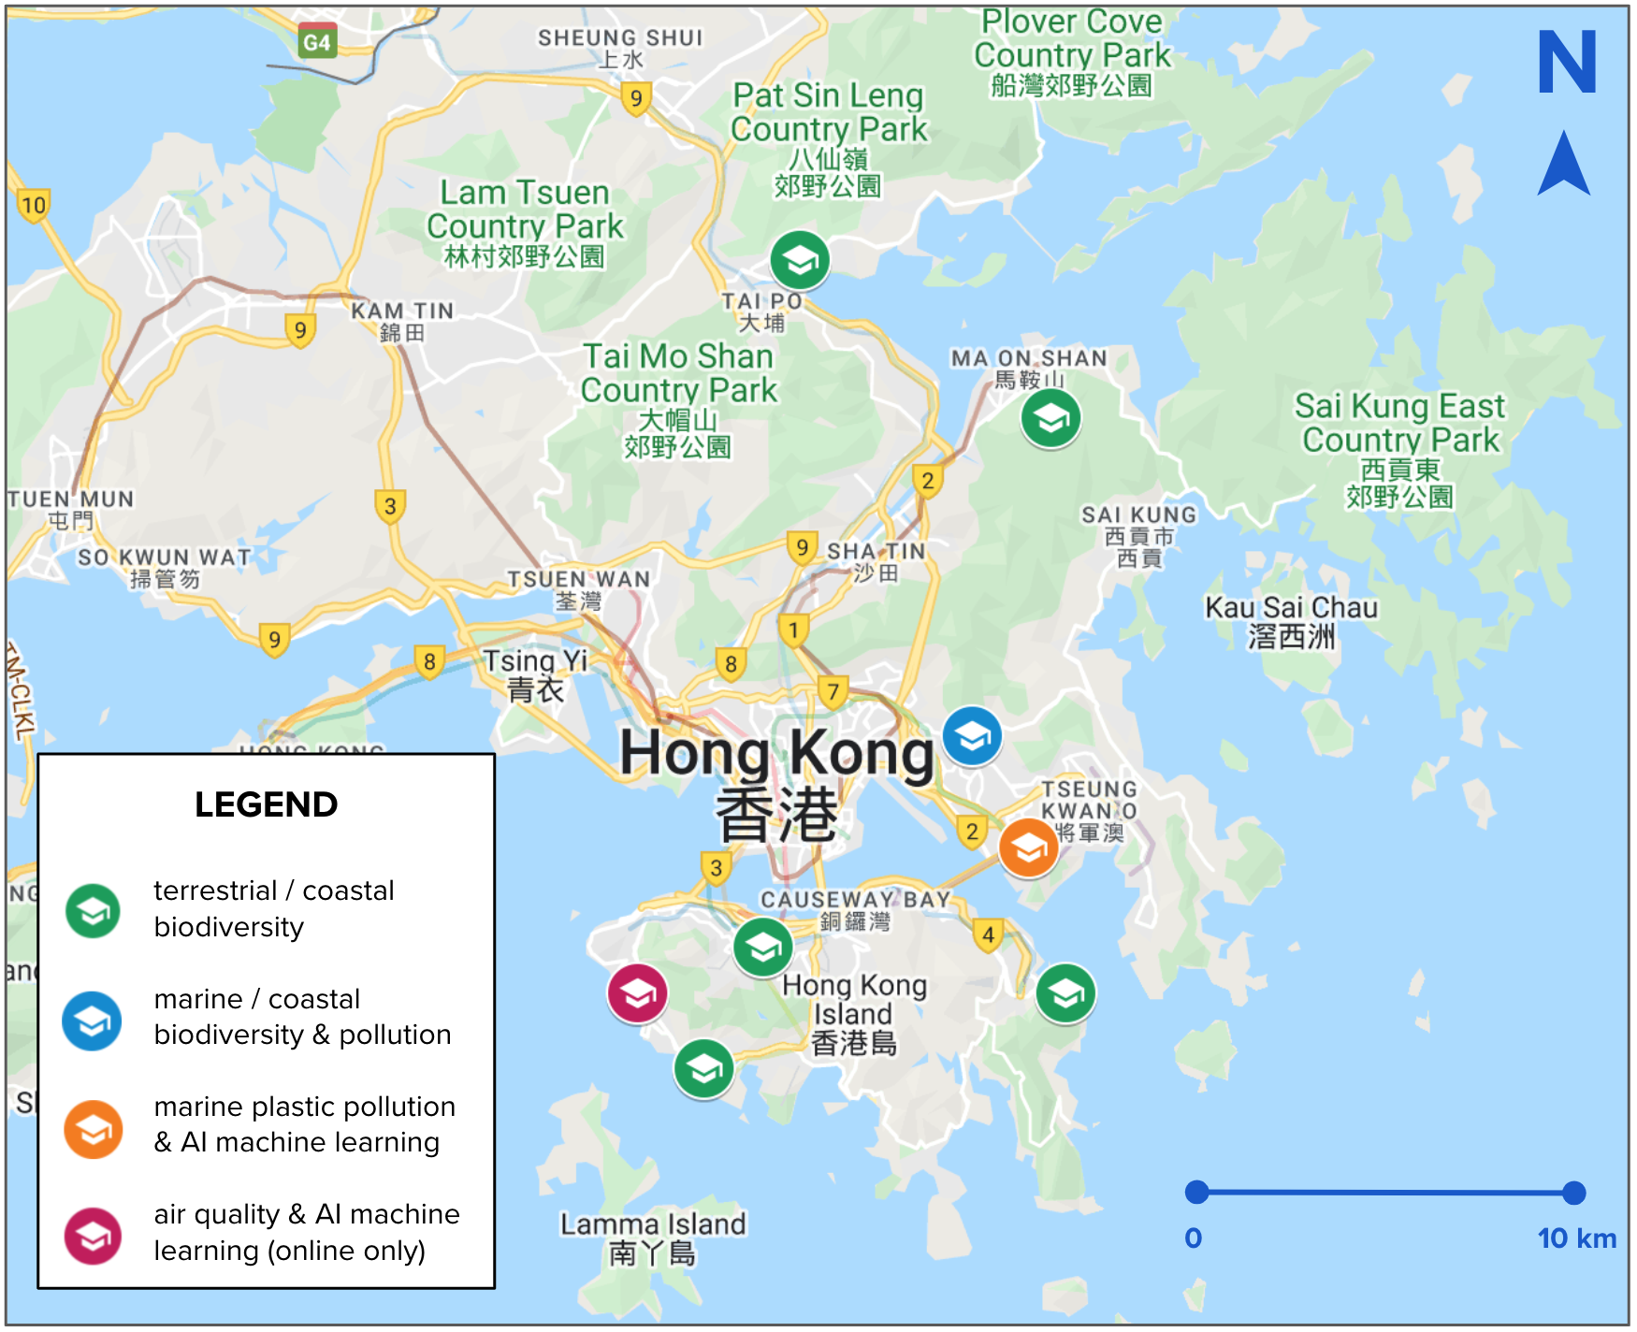

Slide 15
Short, one-time citizen science experiences =>> positively impact environmental knowledge and behaviours of 11-19 year old students in Hong Kong local and international schools.
Co-created citizen science =>> larger positive impacts (greater % change) on behaviour, compared to those doing contributory citizen science.
Younger students (11-14 yrs) want more knowledge and experience taking action to boost confidence of their impact; older students (15-19 yrs) moved by their motivations & values

Slide 16

DO YOU THINK LIKE A
STUDENT OR TEACHER?
Jump onto: MENTI.COM Enter code: 3671 9080

Slide 17
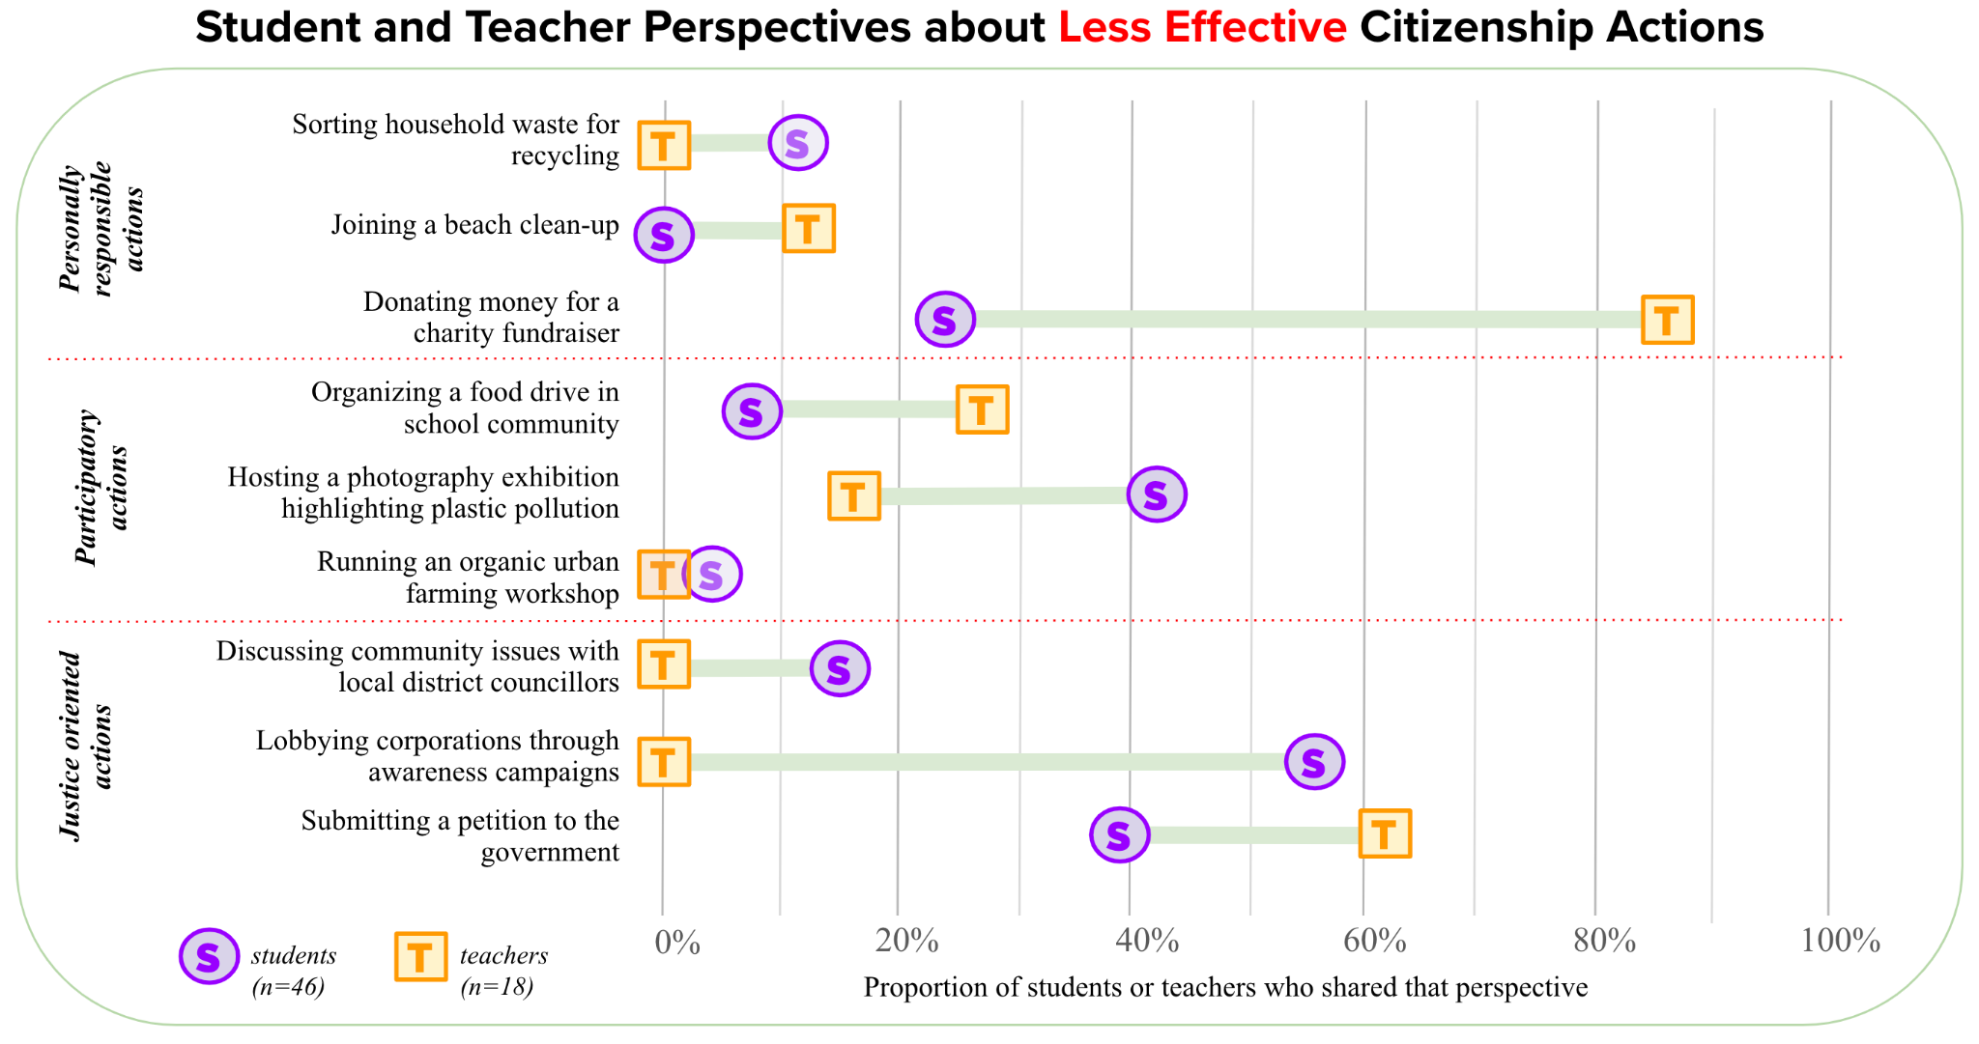

Slide 18
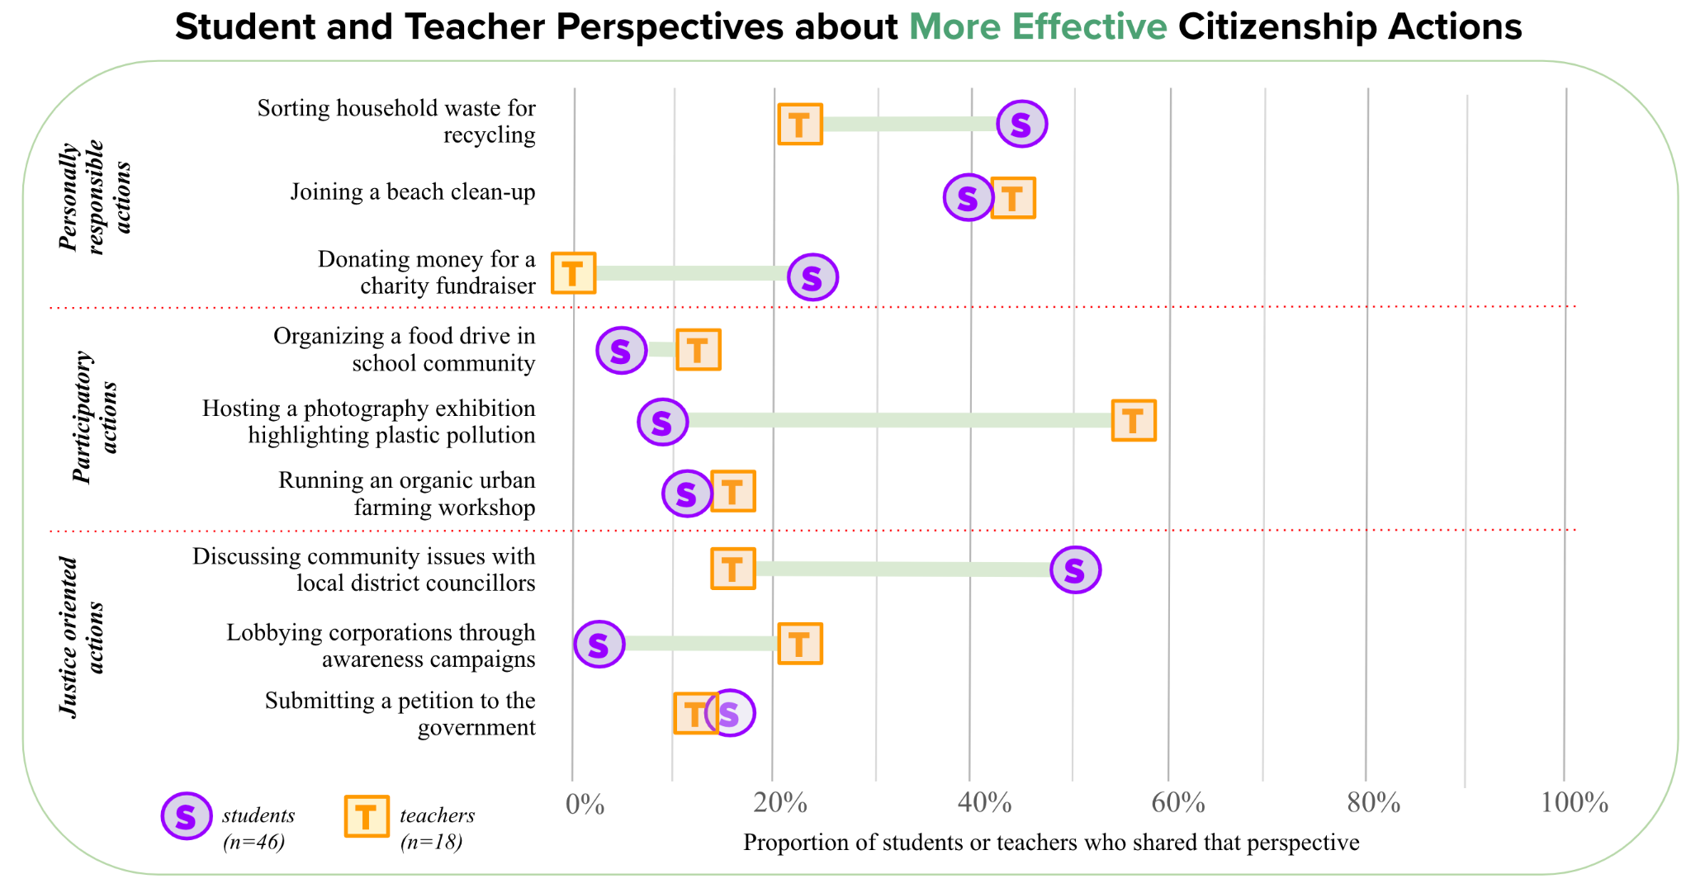

Slide 19
PERSPECTIVES ON CITIZENSHIP ACTION
students care more about making a tangible impact
teachers prioritize learning about environmental issues over tangible impacts
students find personal actions and engaging with community-level authority most impactful: they can see change and be heard by adults with power
teachers think awareness-raising campaigns, like a photography exhibition, impact students' emotions which prompt action, a view not shared by most students
  students: 'out-of-sight, out-of-mind' can occur
teachers see donating money as a disengaged activity: removes the responsibility to act
  students: efficient resource allocation to those who already
  have real-world expertise; why reinvent the wheel?

Slide 20
1
Personal Experiences:
personal time in nature
school field trips in nature
FACTORS INFLUENCING PRO-ENVIRONMENTAL BEHAVIOUR
2
Preservation Values:
one's connection to nature
How can we combine these ideas to build impactful learning experiences?
3
Household Experiences:
talking to family about environmental issues
4
Social Influence:
seeing known people take positive environmental action
hearing positive stories about environmental action

Slide 21
Place-Based Education
"education grounded in the local place" (David Sobel)
social
geographic
artistic
environmental
economic
historical
scientific
cultural
political
(insert your lens here!)
Pedagogical connections
inquiry-based, solutions-based, project-based, nature-based learning; interdisciplinary, design-thinking…

Slide 22
5Ws
Prompts to create place-based
learning & teaching

Slide 23

What?
Topic / Issue / Challenge

Slide 24
Where?
Location / Setting / Context

Slide 25
Why There?
Uniqueness / Crossroads

Slide 26
Why Then?
Scales of Time:
Past / Present / Future

Slide 27
Why Care?
Consequence / Impact / Meaning

Slide 28
Y.
P.A.R.
Youth
Participatory Action Research
A collaborative research approach between researchers and participants to investigate a question and implement actions to bring about change

Slide 29
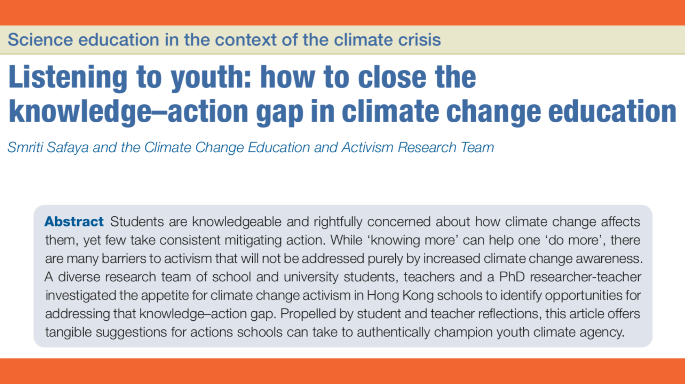
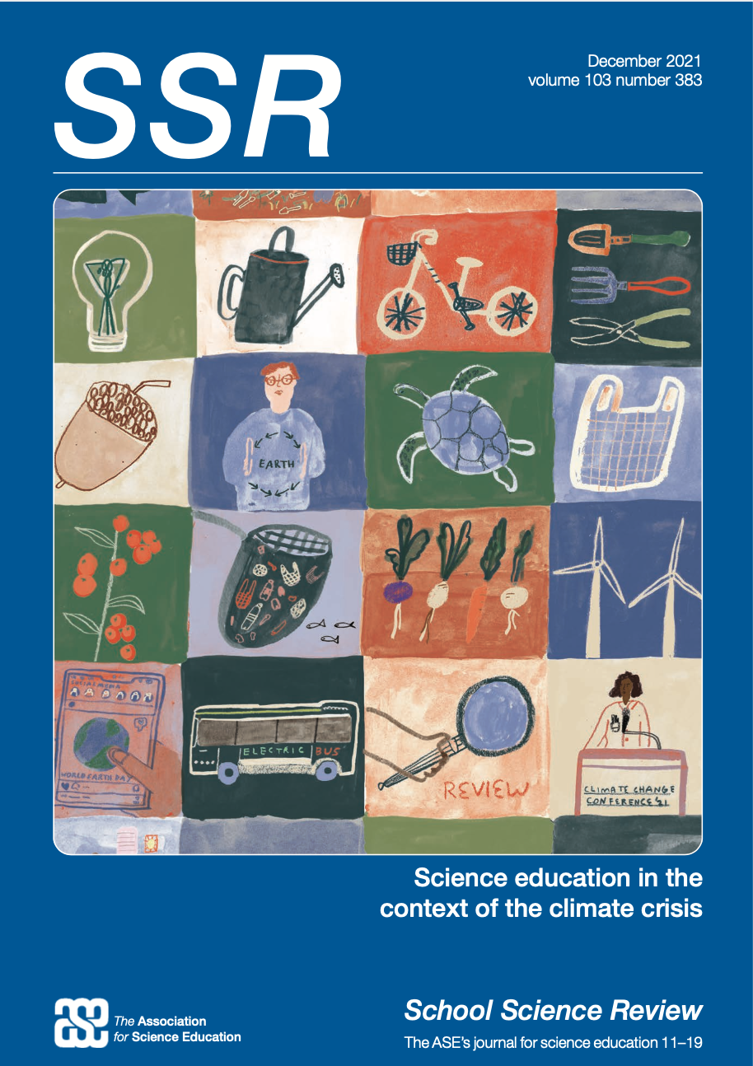
Climate Change Education & Action
Team of 18 students and teachers across 4 schools in Hong Kong
Flat Structure
Opt-in / opt-out
Organized
Use any platform students liked: Google Drive, Whatsapp, Email, Slack, etc.
Equal voice & decision-making between students and teachers in research team
Flexible options to do the work across all research and writing stages

Slide 30
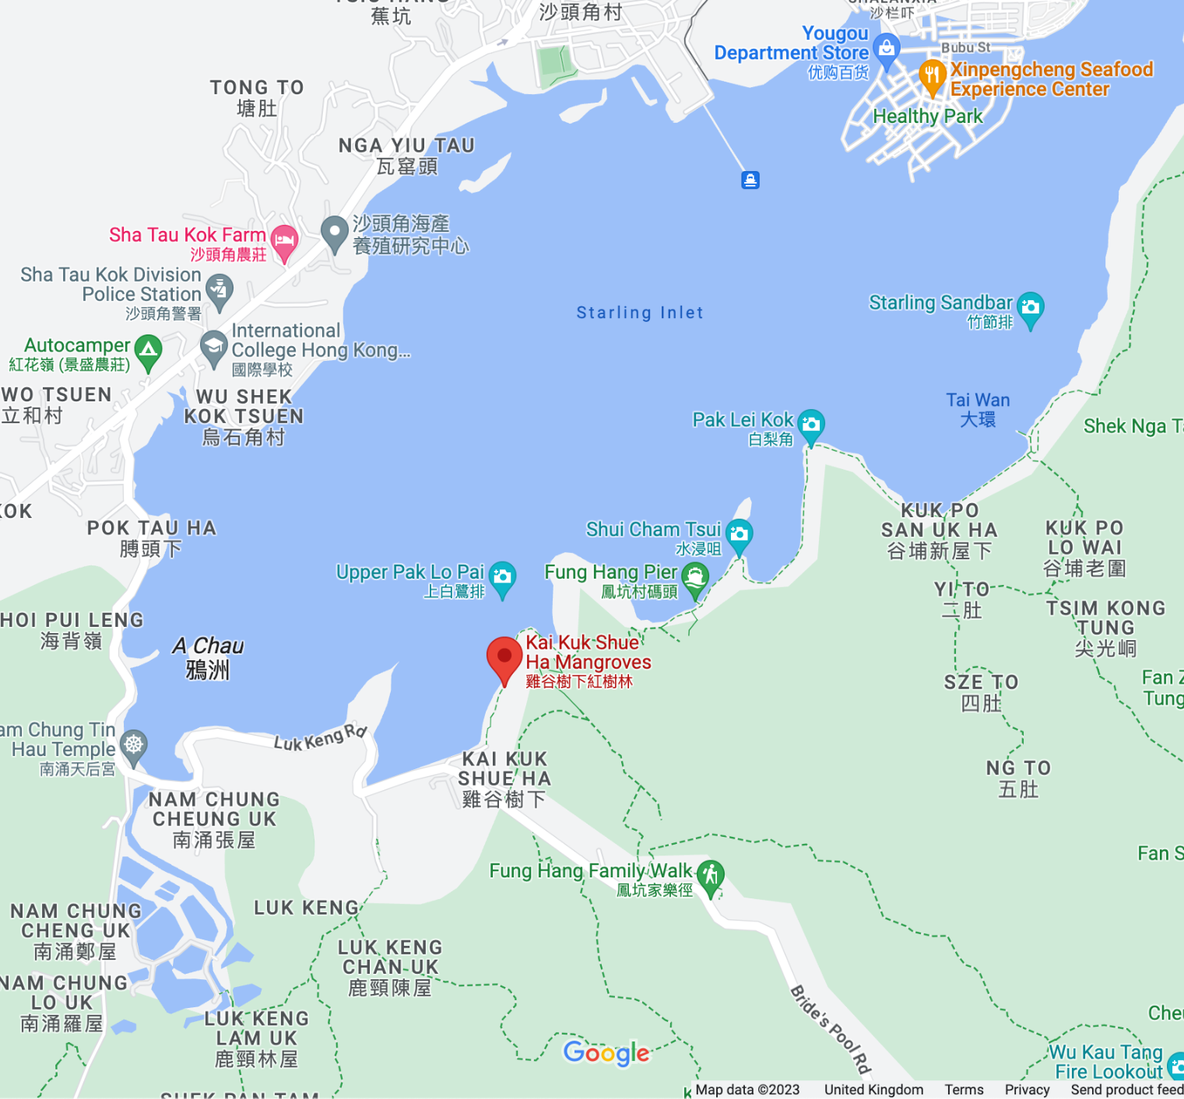
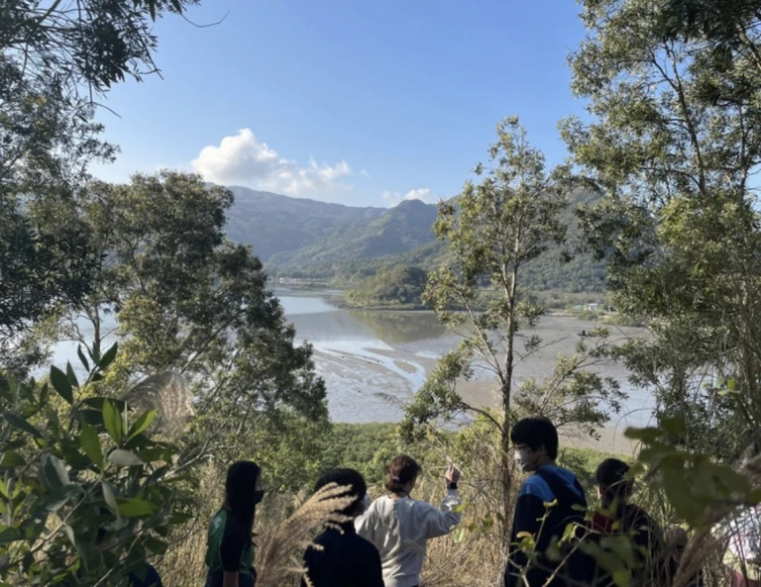
Starling Inlet Ecology Study
a YPAR project with Y7-Y13 students and teachers, to monitor biodiversity and advocate for habitat conservation action in their 'backyard'

Slide 31

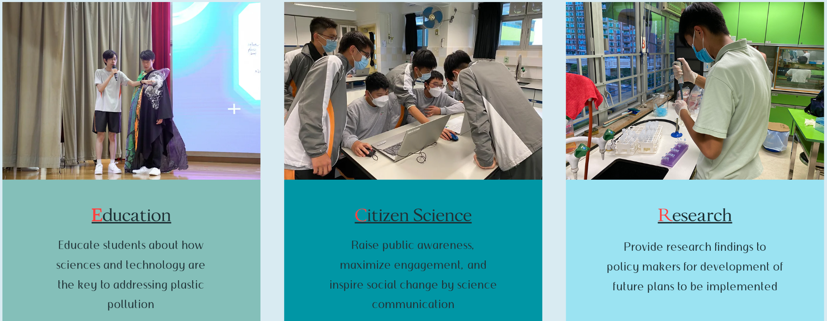
a student-led interschool advocacy and research group from secondary schools across Hong Kong

Slide 32
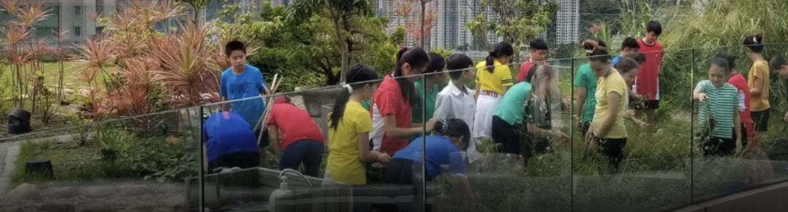
What does our community need?
Community Mapping
Grade 5 & 6 students plotted various issues they chose to investigate on small scale Google My Maps. They analysed and presented the spatial extent and possible solutions to school leadership and local district councillors to initiate change in their communities; e.g. greening the neighborhood and improving accessibility infrastructure.

Slide 33
1
2.2
15,000
school
km
people
Community Mapping
Grade 11 Geography students mapped the commuter traffic problem and presented findings to the school board, staff & parents. The school now has a mandatory bus policy to reduce the collective carbon footprint.

Slide 34

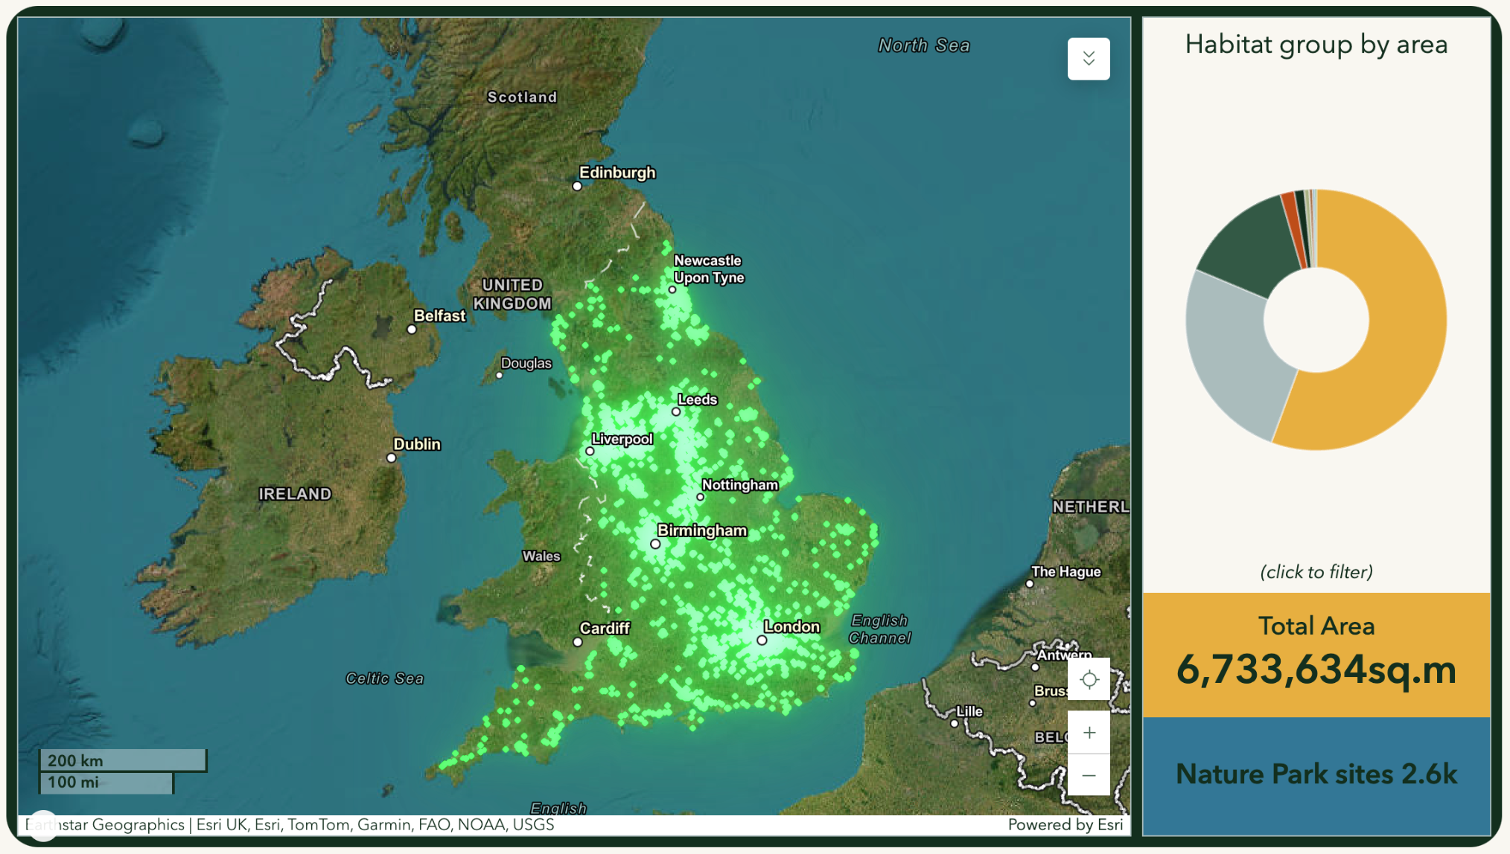
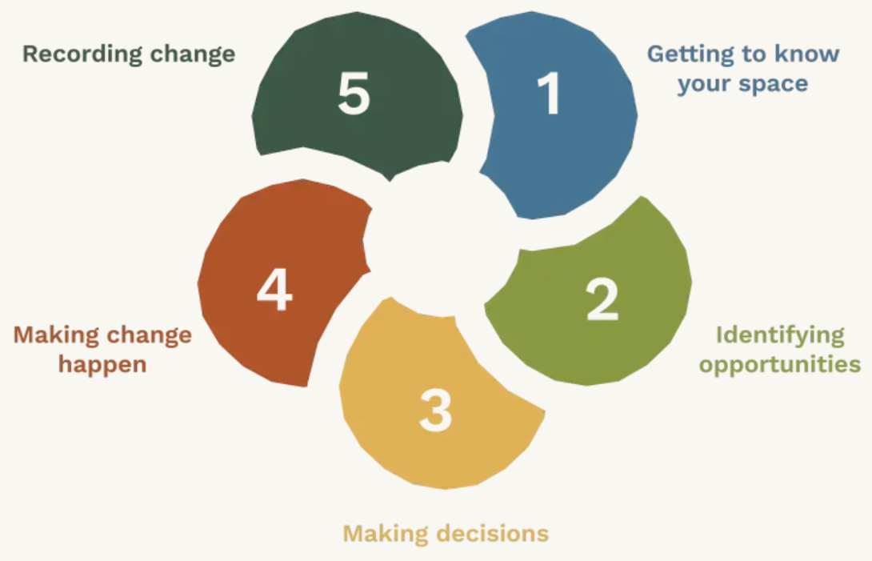
CITIZEN SCIENCE FOR TAKING ACTION NOW!

Slide 35
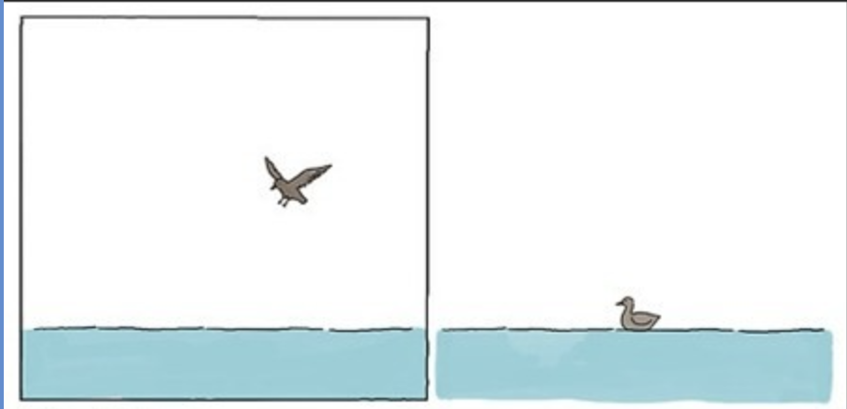
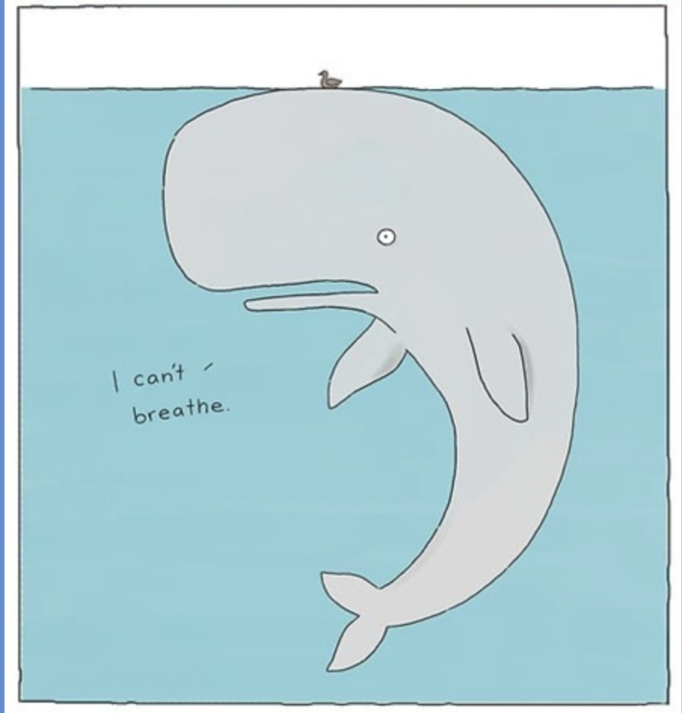
no matter how small…
never doubt the power
of one
student.
teacher.

Slide 36

Let's chat!
Dr. Smriti Safaya
Postdoctoral Fellow (U. York) | Educator (Hong Kong & UK)
Please keep this slide for attribution

