Slide 1

Social Inclusion at Warwick
Kulbir Shergill, Director of Social Inclusion

Slide 2
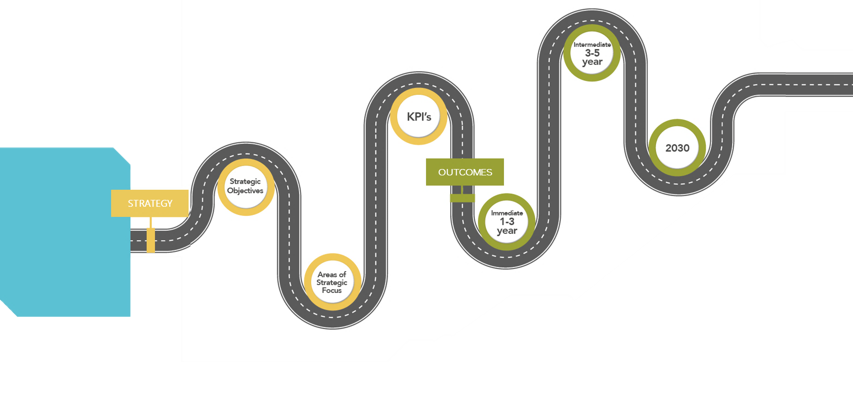
Strategy Map
Please Note:
This slide has animation, if you’d prefer to turn it off you can do so in the ‘Animations’ tab.
Our Social Inclusion Strategy will help us to re-imagine the original purpose of setting up Warwick in 1965, to ‘increase access to higher education’.
This strategy aspires to remove economic, socia, and cultural barriers that have prevented people from working, studying and succeeding at Warwick. Through greater diversity of thought and an inclusive culture we achieve excellence with purpose in education and research.
Reviewed and revised systems and processes for recruitment, retention and promotion of staff.
Reduce the black (and other identified areas) attainment gap.
Increase in number of ethnic minority, disabled and LGBQTUIA+ employees at senior levels for professional services and academic staff.
Diverse talent pipelines creating next generation leaders.
Reduce gender, ethnicity, and disability pay gap.
An established reputation as an inclusive employer and provider of an inclusive student experience.
Eliminate the black attainment gap.
A culture that is inclusive and supports its diverse community to be high performing, creative and innovative
A leading voice on the causes of exclusion and interventions that support sustainable economic and social inclusion.
A role model for inclusive leadership.
A place where everyone is valued for their individuality and where everyone is respectful of others.
Eliminate gender, ethnicity, and disability pay gap.
By 2025
Student targets:
4:1 POLAR4 Q5/Q1 ratio.
Eliminate Black awarding gap.
By 2030
Staff at FA9:
50% FA9 women staff.
25% FA9 BAME staff.
18% FA9 disabled staff.
7% FA9 LGBTQUIA+ by sexual orientation staff.
Pay Gaps:
Eliminate gender pay gap.
Eliminate ethnicity pay gap.
Intermediate:
3-5 years
Progress:
We are launching new training and seminars to engage and inform people on current social inclusion issues.
The National Centre for Research Culture held the first International Research Culture Conference to foster meaningful conversations and build an inclusive community of practice.
Leaders and line managers participated in training on building inclusive behaviours, diverse talent development, and developing inclusive cultures. From this we developed inclusive behaviour frameworks.
We have held 10 Forum for Leaders of Inclusive Cultures events covering all areas of inclusive leadership. Hosting 24 panellists with expertise and experience. Attended by over 430 people.
The National Scientific Thinking Challenge tests young people’s ability to think like a scientist, decoupled from the curriculum. In 2023, 13,652 students participated.
Our University of Sanctuary scholarships are increasing access to higher education for students seeking asylum.
We are working in partnership with the EY Foundation to deliver two employability programmes to give young people real, valuable work experience and a chance to find out what it is like to work and study at Warwick and beyond.
Since 2019, we have a higher proportion of disabled, Black, Asian, and minority ethnic, and religious students. In addition, a higher proportion of students have declared their sexual orientation.
A Warwick Transformation programme has been established to review and update the end-to-end staff recruitment process.
INspire is supporting leaders who face well documented barriers getting into top leadership positions . 50% of the first cohort have since achieved promotions.
Senior Leadership colleagues sponsored INspire participants to create opportunities to expand their network, get exposure to senior colleagues, and insight into the pathway to leadership.
The IDG Women’s Leadership and Development Programme is helping to address the under-representation of women in FA9 positions in the department.
Degree Apprenticeships allow students to combine academic knowledge and practical skills, all whilst earning a salary.
In 2023, we graduated the first cohort of University College Birmingham undergraduates and postgraduates to have their degrees accredited and awarded by Warwick.
An increasing number of staff and students are using our secure and confidential online platform, Report + Support to reporting incidents of sexual misconduct, bullying, harassment, discrimination, or hate crime and seek support. We have worked hard to promote the service; increased use reflects a growing awareness of and trust in the platform.
We have identified a number of key performance indicators to support and monitor progress against our strategic objectives.
The Social Inclusion Committee is responsible for the promotion and monitoring of equality, diversity, and inclusion issues throughout the University. It includes representation from our inclusion Taskforces, each of the University’s faculties, and the Students’ Union.
KPIs
2030
Vision
By 2030 Warwick University will be recognised as best in class for our approach to equality, diversity, and inclusion for students, staff and the partners and communities that we work with.
Research.
Education.
Widening. Participation.
People.
Regional Leadership.
Internationalisation.
Communications.
Innovation.
Outcomes
Strategic objectives
Strategy
Increased awareness, understanding, and engagement with social inclusion at a community and personal level.
Leadership teams that model inclusive behaviours.
Regional presence and voice on inclusive practice and leadership.
A co-ordinated and strategic approach to widening participation, diversity, inclusion and equality.
Increased diversity in our students of UK origin.
Develop and implement positive action interventions to increase diversity at senior levels and develop diverse talent pipelines.
Increased access to undergraduate courses through alternative routes.
A robust reporting and response system for incidents of hate/ violence supported by preventative interventions.
Accountability for delivery of Social Inclusion Strategy.
Immediate:
1-3 years
Increase the diversity of staff and students.
Develop a culture that supports our students and staff to achieve their potential
Become an internationally recognised leader in inclusion
Areas of strategic focus

Slide 3





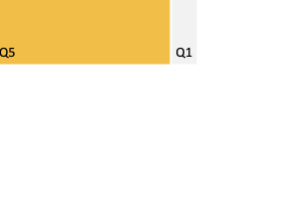
Key Performance Indicators
Please Note:
This slide has animation, if you’d prefer to turn it off you can do so in the ‘Animations’ tab.
The KPIs detailed below have been identified to support our strategic objectives.
Q5/Q1 Ratio
Black Awarding Gap
Pay Gap - Gender
Pay Gap - Ethnicity
Target: 4:1 by 2025
Target: 0 by 2025
Target: 0% by 2030
Target: 0% by 2030
6.6:1
6.6:1
18/19
18/19
Mean
18/19
21/22
Mean
18/19
21/22
21/22
21/22
Sector: 14.2% | Russell Group: 17.8%
Sector: 0.9%
better than sector average
Median
18/19
21/22
Median
18/19
21/22
Sector: 2.4:1
Sector: 20.1 pp
Sector: 14.2% | Russell Group: 17.8%
Sector: 0.1%
FA9 – Gender
FA9 – Ethnicity
FA9 – Disability
FA9 – Sexual orientation
Target: 50% by 2025
Target: 25% by 2025
Target: 18% by 2025
Target: 7% by 2025
Profs
Profs
PSS
PSS
PSS
Profs
Profs
PSS
18/19
21/22
18/19
21/22
18/19
21/22
18/19
21/22
18/19
21/22
18/19
21/22
18/19
21/22
18/19
21/22
Profs – Sector: 28.5%
Profs – Sector: 12.1%
Profs – Sector: 4.1%
Notes:
All data are the most up to date available:
Q5/Q1 ratio – 2023/24
Black awarding gap – 2022/23
Pay gaps – 2021/22
FA9 diversity – 2023/24
Sector – 2021/22
Warwick is performing better than the higher education sector on the Black Awarding gap. In 2021/22, the sector average was 20.1 percentage points. Whereas, that year Warwick’s awarding gap was 5.4 percentage points.

Slide 4
Inclusive Education
The Inclusive Education approach is a holistic change programme to ensure all students benefit from a diverse and student-centred education and experience. The approach is co-designed and focuses on all aspects that impact and influence student success and the wider student experience. Key activity includes:
Project work to support student groups e.g. Positive Digital Practices work for mature, part-time, commuter students
Working with departments to develop and fund Inclusive Education initiatives
Supporting staff with a programme of events to share practice and experiences
Monitoring insight and data to better understand community and belonging
Mapping student touchpoints with services and engagement by demographic
Personal Tutor training developments e.g. conversation starters, inclusive tutoring, building rapport
Training for students on community values and being an active bystander
Supporting change in teaching and learning e.g. inclusive curriculum design
Working with students to conduct research and develop inclusive resources

Slide 5
Key Performance Indicators
Please Note:
This slide has animation, if you’d prefer to turn it off you can do so in the ‘Animations’ tab.
The KPIs detailed below have been identified to support our strategic objectives.
Q5/Q1 Ratio
Black Awarding Gap
Pay Gap - Gender
Pay Gap - Ethnicity
Target: 4:1 by 2025
Target: 0 by 2025
Target: 0% by 2030
Target: 0% by 2030
6.6:1
6.6:1
18/19
18/19
Mean
18/19
21/22
Mean
18/19
21/22
21/22
21/22
Sector: 14.2% | Russell Group: 17.8%
Sector: 0.9%
better than sector average
Median
18/19
21/22
Median
18/19
21/22
Sector: 2.4:1
Sector: 20.1 pp
Sector: 14.2% | Russell Group: 17.8%
Sector: 0.1%
FA9 – Gender
FA9 – Ethnicity
FA9 – Disability
FA9 – Sexual orientation
Target: 50% by 2025
Target: 25% by 2025
Target: 18% by 2025
Target: 7% by 2025
Profs
Profs
PSS
PSS
PSS
Profs
Profs
PSS
18/19
21/22
18/19
21/22
18/19
21/22
18/19
21/22
18/19
21/22
18/19
21/22
18/19
21/22
18/19
21/22
Profs – Sector: 28.5%
Profs – Sector: 12.1%
Profs – Sector: 4.1%
Notes:
All data are the most up to date available:
Q5/Q1 ratio – 2023/24
Black awarding gap – 2022/23
Pay gaps – 2021/22
FA9 diversity – 2023/24
Sector – 2021/22
Warwick is performing better than the higher education sector on the Black Awarding gap. In 2021/22, the sector average was 20.1 percentage points. Whereas, that year Warwick’s awarding gap was 5.4 percentage points.

Slide 6
Why feeling included matters
The Pearson Report
20,000
young people in Britain are growing up with same sex parents.
33%
of all children are living in poverty.
15.5%
of all pupils from Special Educational Needs (SEN)
33%
of the total school population are from minority ethnic backgrounds

Slide 7
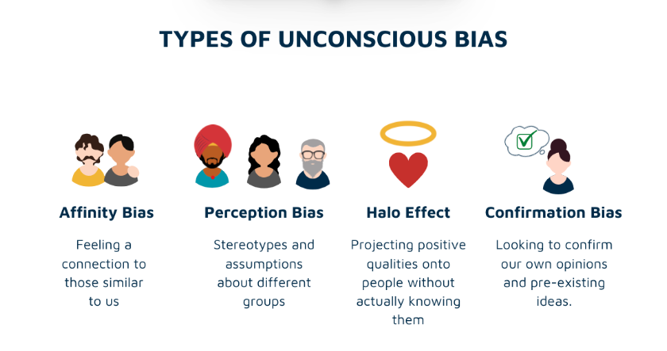

Slide 8


The Ancient Greeks on unconscious bias
‘People love those who are like themselves’
Nichomachean Ethics - Aristotle
‘Similarity begets friendship’
Phadedrus - Plato
‘People love those who are like themselves’
Nichomachean Ethics - Aristotle
‘Similarity begets friendship’
Phadedrus - Plato

Slide 9





Everyday micro-incivilities
Ignored and interrupted
Constantly criticised
Stereotypical judgements
Not giving eye contact
Not pronouncing name correctly

Slide 10
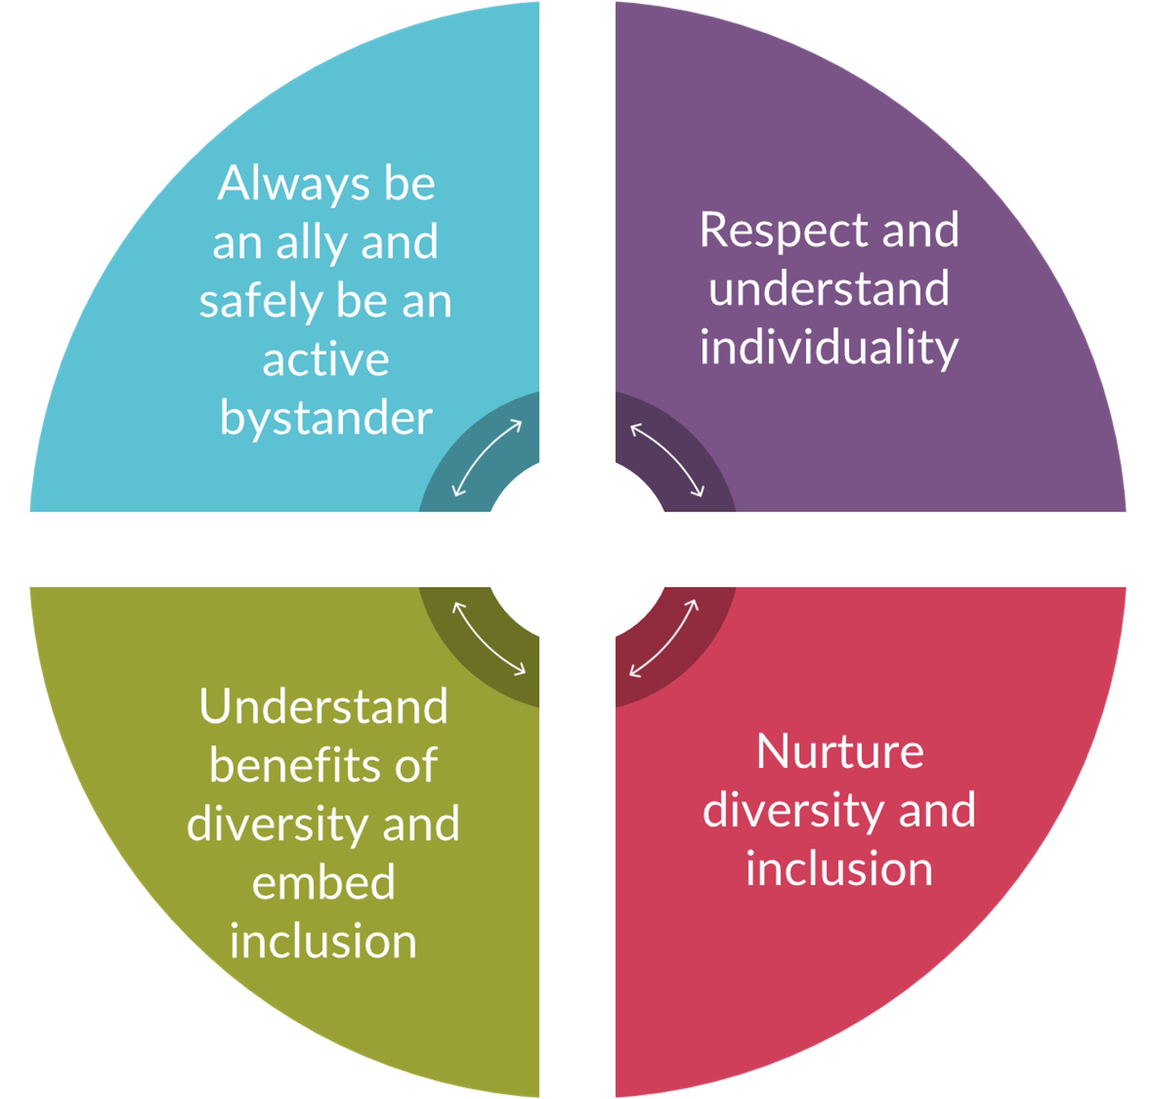
Inclusive Behaviours framework
Actions of inclusive leaders include…
Building psychological safety by being aware of and challenging micro-incivilities.
Being visibly committed through articulation and action.
Advocating for inclusion and wellbeing by supporting networks and task groups.
Using positive micro-affirmations.
Using inclusive communication.
Being self-aware and understanding my own biases.
Listening to others with empathy.
Being cognisant of body language and facial expressions.
Being humble and seeking feedback on my communication style.
Being a reciprocal mentee.
Nurturing a culture of respectful challenge and safety to make mistakes.
Including diversity and inclusion actions and targets into my objectives.
Articulating diversity and inclusion as part of my vision and values.
Supporting a culture of intelligent working for the team.
Providing transparency of systems and processes.
Making communications, systems, processes, and tools accessible.
Understanding the diversity of my team and implications for ways of working.
Being approachable and supportive to colleagues.
Demonstrating empathy when colleagues need support.
Supporting colleagues to reach goals.
Offering advice, guidance, and inspiration when it is needed.
Having diverse networks.

Slide 11
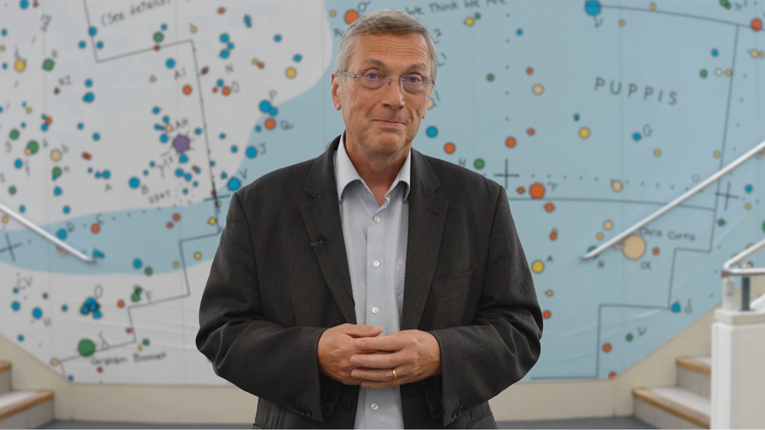
Annual Report
Please Note:
This slide is a video, it will play on click. You can change it to play automatically if preferred.
This report looks back over the progress we’ve made so far and forward to the challenges we embrace in the future.
Read the report: You can read the Social Inclusion Annual Report in full on our website.

Slide 12
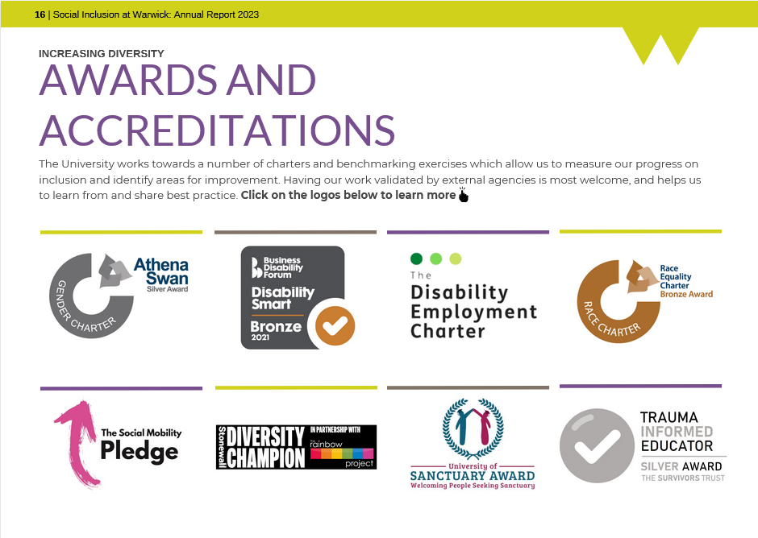
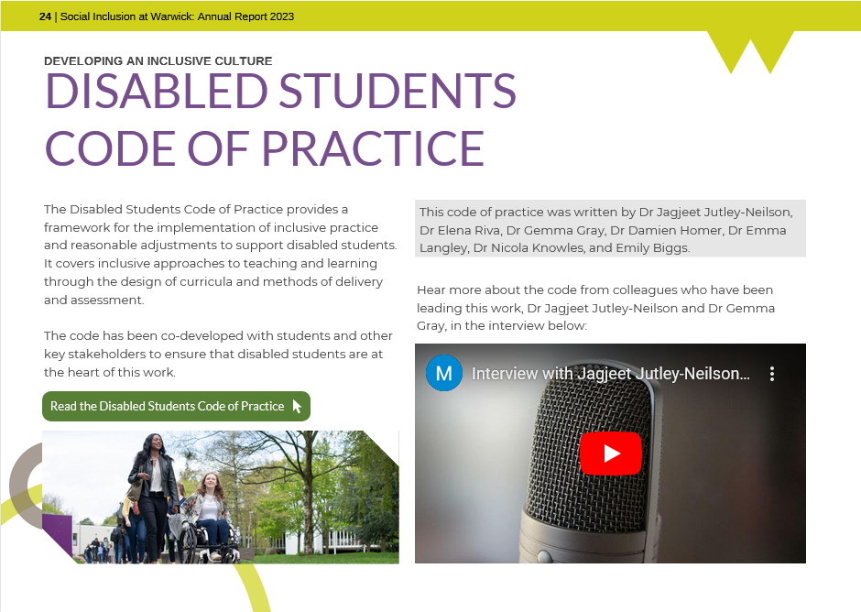
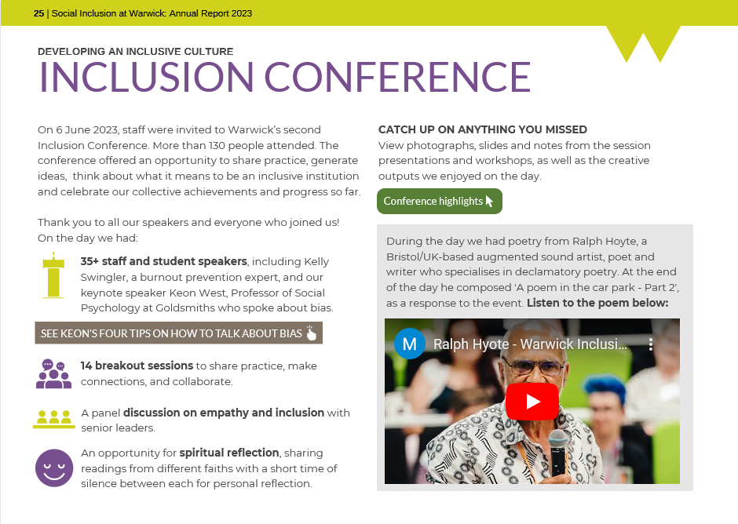
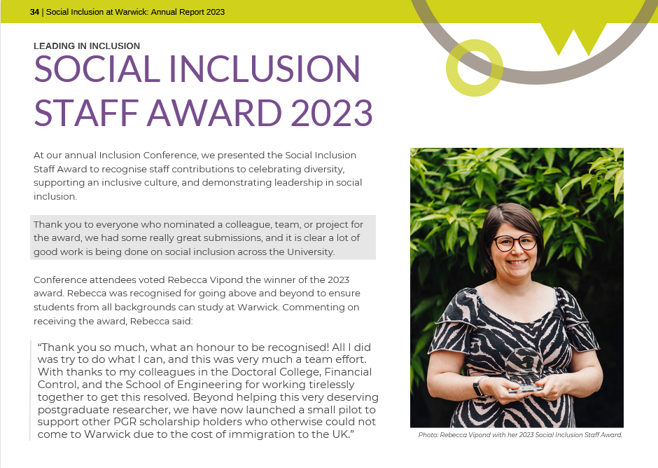
Annual Report
Please Note:
I have included a different option for an annual report slide, if you don’t want the video.
This report looks back over the progress we’ve made so far and forward to the challenges we embrace in the future.
Our Social Inclusion Annual Report highlights the work that has been taking place across the University over the last year, and how it is helping us to meet our strategy objectives to increase staff and student diversity, develop an inclusive culture, and become leaders in inclusion.
We hope it gives you a flavour of some of the work that our community has engaged in and created together and inspires you to be part of this agenda as we move ahead.

