Slide 1

From Reactive to Proactive: Evolving Trauma-Informed Behavior Management
Jen Murch BA MA
Director of Alternative Provision

Slide 2

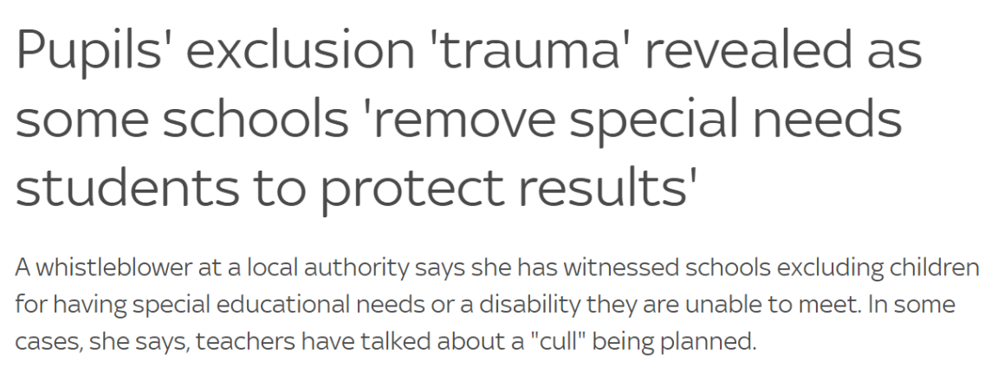


Behaviour Management
1. Lack of Adequate Training
2. High Workload and Stress
3. Limited Support Services
4. Large Class Sizes
5. Inconsistent Policies & Changes
6. Underinvestment in Special Educational Needs (SEN)
7. Limited Professional Development Opportunities
8. Teacher Retention Issues
9. Pressure on Academic Achievement
10. Insufficient Mental Health Support
11. Lack of Parental Engagement
12. Inequality in Education
13. Teacher Autonomy Challenges
14. Focus on Punitive Measures
Notes:
1. Lack of Adequate Training:
- Insufficient training and resources for teachers in effective behavior management strategies.
2. High Workload and Stress:
- Excessive workload, administrative demands, and stress contribute to teacher burnout, impacting their ability to effectively manage classroom behavior.
3. Limited Support Services:
- Inadequate access to support services, such as counseling or behavioral specialists, to assist teachers in dealing with complex behavioral issues.
4. Large Class Sizes:
- Large class sizes make it challenging for teachers to provide individualized attention and address behavioral issues promptly.
5. Inconsistent Policies:
- Lack of consistent behavior management policies across schools and regions may result in confusion and varying approaches to discipline.
6. Underinvestment in Special Educational Needs (SEN):
- Insufficient resources and support for students with special educational needs, leading to challenges in managing their behavior effectively.
7. Limited Professional Development Opportunities:
- Inadequate opportunities for continuous professional development in the area of behavior management, hindering teachers' ability to adopt new and effective strategies.
8. Teacher Retention Issues:
- High levels of stress and dissatisfaction contribute to teacher turnover, impacting the stability and continuity of learning environments.
9. Pressure on Academic Achievement:
- Overemphasis on academic outcomes may lead to neglect of social and emotional aspects, contributing to behavior-related challenges.
10. Insufficient Mental Health Support:
- Inadequate mental health support for both students and teachers can exacerbate stress and impact the overall classroom atmosphere.
11. Lack of Parental Engagement:
- Limited parental involvement and support in addressing behavioral issues at home can hinder efforts made by teachers in the classroom.
12. Inequality in Education:
- Socioeconomic disparities and inequality in educational resources can contribute to behavioral challenges, with students facing additional stressors outside the school environment.
13. Policy Changes and Uncertainty:
- Frequent changes in education policies and uncertainty in educational practices may create challenges in maintaining consistent behavior management approaches.
14. Teacher Autonomy Challenges:
- Limited autonomy for teachers in decision-making regarding behavior management strategies may contribute to frustration and dissatisfaction.
15. Focus on Punitive Measures:
- Over Reliance on punitive measures instead of preventive and restorative approaches can create a negative atmosphere and hinder positive behavior development.
Addressing these issues requires a comprehensive, systemic approach that includes adequate training, support services, and a focus on the well-being of both students and teachers in the UK education system.

Slide 3

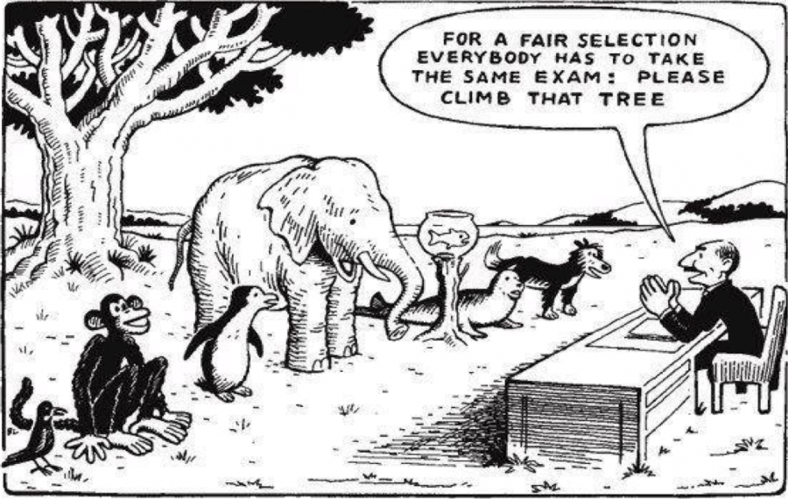
Alternative Provision

Slide 4

Working definition of “trauma-informed practice”
“Trauma-informed practice is an approach to health and care interventions which is grounded in the understanding that trauma exposure can impact an individual’s neurological, biological, psychological and social development.”
https://www.gov.uk/government/publications/working-definition-of-trauma-informed-practice/working-definition-of-trauma-informed-practice

Slide 5

Benefits of being trauma-informed
1. Holistic Understanding
2. Reduced Stigma
3. Improved Relationships
4. Enhanced Communication
5. Prevention of Re-traumatisation
6. Tailored Interventions
7. Improved Outcomes
8. Empowerment and Resilience
9. Cultural Sensitivity
10. Organisational Transformation
Notes:
The use of trauma-informed practice offers several benefits, rooted in its understanding of the profound impact of trauma on individuals' neurological, biological, psychological, and social development. Here are some key advantages:
1. **Holistic Understanding:**
- **Benefit:** Trauma-informed practice recognizes that trauma affects various aspects of an individual's life. By adopting this approach, practitioners gain a more comprehensive and holistic understanding of the person's experiences and challenges.
2. **Reduced Stigma:**
- **Benefit:** Shifting the focus from "What is wrong with this person?" to "What does this person need?" helps reduce stigma. It promotes empathy and understanding, acknowledging that behaviors may be coping mechanisms rather than intrinsic character flaws.
3. **Improved Relationships:**
- **Benefit:** Trauma-informed care emphasizes building trust and fostering a safe environment. This approach can enhance the therapeutic relationship between service providers and individuals, leading to more effective interventions and outcomes.
4. **Enhanced Communication:**
- **Benefit:** Understanding the impact of trauma encourages practitioners to communicate in a sensitive and supportive manner. Clear and compassionate communication is crucial for building trust and facilitating effective collaboration in the healing process.
5. **Prevention of Re-traumatization:**
- **Benefit:** Trauma-informed practice strives to avoid re-traumatization by being aware of potential triggers and providing a safe space for individuals. This can prevent the exacerbation of trauma-related symptoms during interventions.
6. **Tailored Interventions:**
- **Benefit:** Instead of applying a one-size-fits-all approach, trauma-informed practice allows for more individualized and tailored interventions. This increases the likelihood of addressing the specific needs and coping strategies of each person.
7. **Improved Outcomes:**
- **Benefit:** By focusing on what individuals need and addressing the root causes of their challenges, trauma-informed care has the potential to improve outcomes. This approach may contribute to the development of more effective treatment plans and interventions.
8. **Empowerment and Resilience:**
- **Benefit:** Trauma-informed practice aims to empower individuals by recognizing their strengths and resilience. By fostering a strengths-based perspective, practitioners can support individuals in building on their existing resources for coping and recovery.
9. **Cultural Sensitivity:**
- **Benefit:** Trauma-informed practice encourages cultural sensitivity and humility. Recognizing and respecting cultural differences is integral to providing effective and respectful care.
10. **Organizational Transformation:**
- **Benefit:** Embracing trauma-informed principles can lead to organizational transformation. Institutions that adopt trauma-informed practices may see improvements in staff well-being, reduced burnout, and a more compassionate and supportive work culture.
In summary, using the term "trauma-informed practice" signals a commitment to understanding and responding to the complex impact of trauma on individuals, fostering a more compassionate and effective approach to health and care interventions.

Slide 6

Inform Behaviour Management Practice
1. Understanding Triggers
2. Prevention of Re-traumatisation
3. Shift from "What's Wrong" to "What Happened"
4. Building Trust and Connection
5. Individualised Support
6. Emphasis on Strengths
7. Restorative Approaches
8. Enhanced Communication
9. Self-Regulation Skills
10. Professional Development
Notes:
Being trauma-informed in behavior management is rooted in understanding and responding to the impact of trauma on individuals. This approach recognizes that challenging behaviors can be manifestations of past trauma and emphasizes creating a safe and supportive environment. Here's how being trauma-informed helps with behavior management:
1. **Understanding Triggers:**
- **Benefit:** Trauma-informed practice helps educators and caregivers understand that certain behaviors may be triggered by past traumatic experiences. This understanding allows for a more compassionate and empathetic response.
2. **Prevention of Re-traumatization:**
- **Benefit:** Trauma-informed approaches aim to prevent re-traumatization by avoiding punitive measures and creating an environment that feels safe and predictable for individuals who have experienced trauma.
3. **Shift from "What's Wrong" to "What Happened":**
- **Benefit:** Instead of focusing solely on problematic behaviors, a trauma-informed approach encourages asking, "What happened to this person?" This shift in perspective helps address the root causes of behaviors rather than simply reacting to symptoms.
4. **Building Trust and Connection:**
- **Benefit:** Trauma-informed practices prioritize building trust and positive relationships. This emphasis on connection creates a supportive foundation for individuals to feel secure and understood, reducing the likelihood of disruptive behaviors.
5. **Individualized Support:**
- **Benefit:** Trauma-informed approaches recognize that individuals respond differently to trauma. By tailoring interventions based on individual needs and coping strategies, behavior management becomes more effective and respectful.
6. **Emphasis on Strengths:**
- **Benefit:** Trauma-informed care acknowledges the strengths and resilience of individuals who have experienced trauma. Focusing on strengths rather than deficits can empower individuals and contribute to positive behavior development.
7. **Cultural Sensitivity:**
- **Benefit:** Trauma-informed practice includes cultural humility, recognizing and respecting diverse cultural backgrounds. This sensitivity is crucial in understanding how trauma may be experienced and expressed differently across cultures.
8. **Restorative Approaches:**
- **Benefit:** Trauma-informed practices often incorporate restorative approaches that focus on repairing harm, promoting accountability, and fostering empathy. This can lead to a more positive and inclusive school or organizational culture.
9. **Enhanced Communication:**
- **Benefit:** Trauma-informed communication is clear, respectful, and supportive. Effective communication contributes to building positive relationships and helps prevent misunderstandings that could escalate into challenging behaviors.
10. **Self-Regulation Skills:**
- **Benefit:** Trauma-informed strategies often include teaching and promoting self-regulation skills. Helping individuals develop effective coping mechanisms contributes to better emotional and behavioral regulation.
11. **Professional Development:**
- **Benefit:** Trauma-informed training provides educators and staff with the tools and knowledge needed to understand trauma and implement supportive practices. This ongoing professional development contributes to a more skilled and confident team.
In summary, being trauma-informed in behavior management creates a foundation of empathy, understanding, and support. By addressing the underlying trauma that may be contributing to challenging behaviors, educators and caregivers can implement strategies that promote healing, resilience, and positive behavior development.

Slide 7

Challenges of the trauma-informed approach
1. Limited Training and Resource
2. Resistance to Change
3. Time Constraints
4. Overemphasis on Individual Behaviours
5. Inadequate Screening and Identification
6. Inconsistent Implementation
7. Risk of Re-traumatisation
Notes:
While trauma-informed practice offers numerous benefits, it is not without its challenges. Implementing and sustaining a trauma-informed approach can face various obstacles:
1. **Limited Training and Resources:**
- **Challenge:** Many professionals may not have adequate training in trauma-informed care. Limited resources and funding may hinder organizations from providing comprehensive training programs.
2. **Resistance to Change:**
- **Challenge:** Resistance to adopting new practices and changing organizational culture can be a significant challenge. Some staff members may be resistant to embracing trauma-informed principles, viewing them as additional burdens or disruptions.
3. **Time Constraints:**
- **Challenge:** Implementing trauma-informed care requires time for training, policy development, and cultural shifts within an organization. In busy healthcare or social service settings, time constraints may impede the thorough integration of trauma-informed practices.
4. **Lack of Standardization:**
- **Challenge:** There may be a lack of standardized guidelines and metrics for trauma-informed care, making it challenging to measure the effectiveness of interventions and ensuring consistent implementation across different settings.
5. **Overemphasis on Individual Behaviors:**
- **Challenge:** While trauma-informed practice seeks to move beyond focusing solely on behaviors, there can be a risk of overemphasizing individual responses to trauma. Broader systemic issues, such as social determinants of health, may be overlooked.
6. **Staff Burnout:**
- **Challenge:** Working with individuals who have experienced trauma can be emotionally demanding. Staff may experience burnout and compassion fatigue if they lack adequate support and self-care resources.
7. **Inadequate Screening and Identification:**
- **Challenge:** Identifying individuals who have experienced trauma may be challenging, as some may not disclose their experiences willingly. Inadequate screening procedures may result in individuals not receiving the necessary trauma-informed care.
8. **Inconsistent Implementation:**
- **Challenge:** Achieving consistent implementation of trauma-informed practices across different departments or sectors within an organization can be difficult. Inconsistencies may compromise the overall effectiveness of the approach.
9. **Limited Cross-Sector Collaboration:**
- **Challenge:** Collaborative efforts between different sectors (e.g., healthcare, education, criminal justice) may be limited. Lack of communication and collaboration can hinder the comprehensive support needed for individuals who have experienced trauma.
10. **Cultural Competency Issues:**
- **Challenge:** Ensuring cultural competence in trauma-informed care is crucial, but it can be challenging to address the diverse cultural backgrounds and experiences of individuals. Inadequate cultural competency may result in insensitive or ineffective interventions.
11. **Risk of Re-traumatization:**
- **Challenge:** Despite efforts to prevent re-traumatization, there is a risk that certain interventions or interactions may inadvertently trigger traumatic responses. This underscores the importance of ongoing training and awareness.
12. **Limited Research and Evidence Base:**
- **Challenge:** While the principles of trauma-informed care are widely accepted, there may be a limited empirical evidence base for specific interventions. This can make it challenging to assess the long-term impact and effectiveness of trauma-informed practices.
Addressing these challenges requires a sustained commitment from organizations, ongoing training, and a willingness to adapt practices based on feedback and emerging research in the field of trauma-informed care.

Slide 8

Thinking Differently
Top 5 Takeaways:
1. Build Positive Relationships
2. Create a Safe Physical Environment
3. Establish Clear and Predictable Routines
4. Responses to Behaviours
5. Mindfulness and Self-Regulation Activities
Notes:
Certainly! Here are the top five key strategies for teachers to incorporate trauma-informed practices into the mainstream classroom:
1. **Build Positive Relationships:**
- **Implementation:** Prioritize building trusting relationships with students through active listening, empathy, and genuine interest in their well-being.
2. **Create a Safe Physical Environment:**
- **Implementation:** Design a physically safe and supportive classroom with clear visual cues, predictable routines, and designated quiet spaces.
3. **Establish Clear and Predictable Routines:**
- **Implementation:** Develop consistent routines using visual schedules, clear instructions, and advance notice of any changes to reduce anxiety and promote a sense of control.
4. **Trauma-Informed Responses to Behaviors:**
- **Implementation:** Respond to challenging behaviors with empathy and curiosity, focusing on understanding students' feelings and needs rather than punitive measures.
5. **Mindfulness and Self-Regulation Activities:**
- **Implementation:** Integrate mindfulness and self-regulation exercises into the daily routine to help students manage their emotions, fostering a calm and focused learning environment.

Slide 9
From Reactive to Proactive: Evolving Trauma-Informed Behavior Management
Jen Murch BA MA
Director of Alternative Provision

