Slide 1


Coventry Emotional Health and Wellbeing Support.
Understanding Emotional Wellbeing in Children and young people - PGCE seminar

Slide 2


What is emotional wellbeing?

Slide 3
Emotional well-being is a positive state of mind that includes a sense of balance, purpose, and satisfaction with life.
It also involves the ability to manage emotions, thoughts, relationships, and goals.

Slide 4
Feeling a sense of balance in your emotions, thoughts, and relationships
Being able to recover from setbacks
Experiencing a range of positive emotions, such as joy, hope, and gratitude
Being able to identify and express emotions in healthy ways

Slide 5

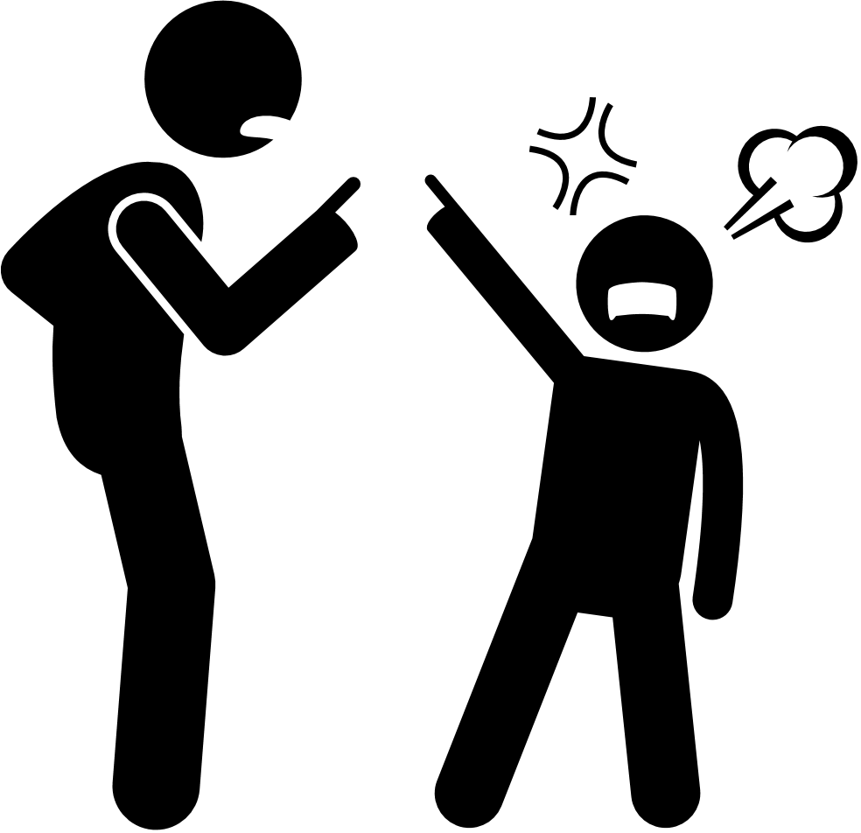
What is behaviour?
a reaction (+/-), to a feeling, situation or event whether internal or external

Slide 6
THIS reaction is an ‘EMOTIONAL’ reaction

Slide 7
‘children who need love the most will always ask for it in the most unloving ways’
quote from Jane Evans

Slide 8
Consider this statement:
‘all behavior is a form of communication, meaning that it conveys a message or intention’
Notes:
chat open

Slide 9



What does a healthy EMOTIONAL REACTION look like?
Possible things include:
ENJOYING TIME TOGETHER
PLAYING TOGETHER
HEALTHY FRIENDSHIPS
FEELING GOOD ABOUT YOURSELF
YOU SMILE/ LAUGH
SHARING
FEELING SAFE/ SECURE/ LOVED

Slide 10
Possible causes of UNHEALTHY REACTIONS
feeling unsafe/unloved (school / home / local area)
difficulties with peer - feeling insecure
being bullied (online / in private or in front of others)
experienced a trauma
feeling unsure about a situation and/or event
not feeling happy or content

Slide 11

What do unhealthy EMOTIONAL REACTIONS look like?
Possible things include:
being withdrawn or isolated
struggling with friendships/ playing nicely
shouting/screaming
crying/sobbing
hitting/lashing out - at self or others
having physical feelings within body - aches, pains, feeling or being sick

Slide 12




why do we react like this?
Science behind the behaviour;
chemical/hormones being released
fight, flight, response
flip your lid
window of tolerance
normal reaction
Struggling to regulate (BASE LINE)
It’s ok to have big emotions - it’s how we manage them

Slide 13
intention?

Slide 14
Behavior can be a sign of past experiences
Behavior can be a sign of difficulty coping
Behavior can be misinterpreted

Slide 15
These behaviors are usually signs of a highly dysregulated C/YP

Slide 16
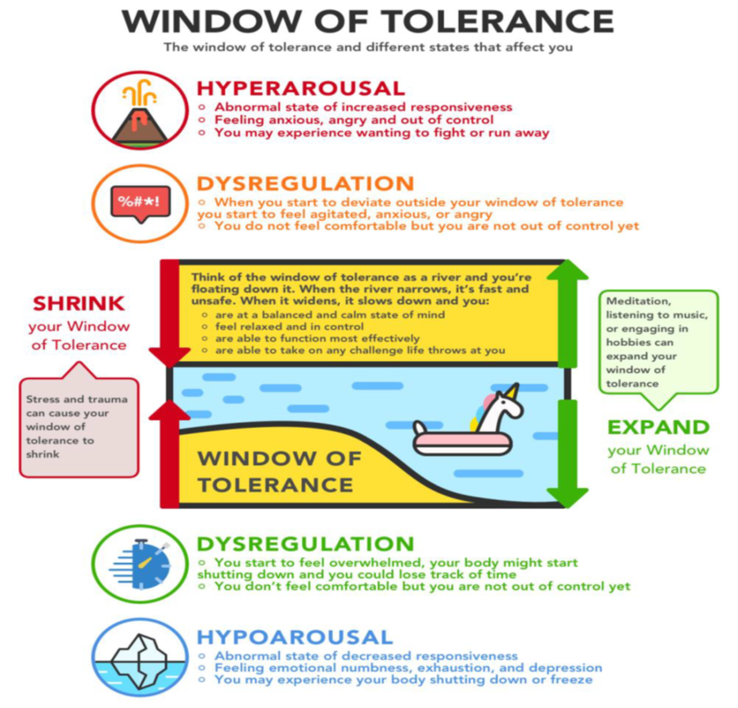
Window of tolerence
A term used to describe the zone of arousal
function most effectively
able to readily receive, process, and integrate information
respond to the demands of everyday life
first named by Dan Siegel

Slide 17
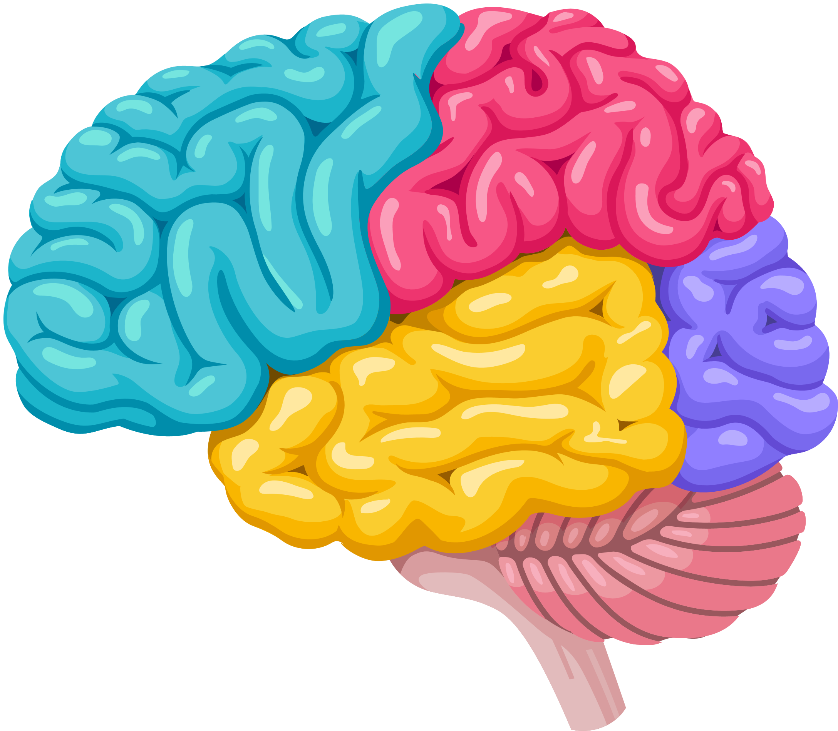



why do we react like this?
why the teenage brain development causes heightened emotions

Slide 18
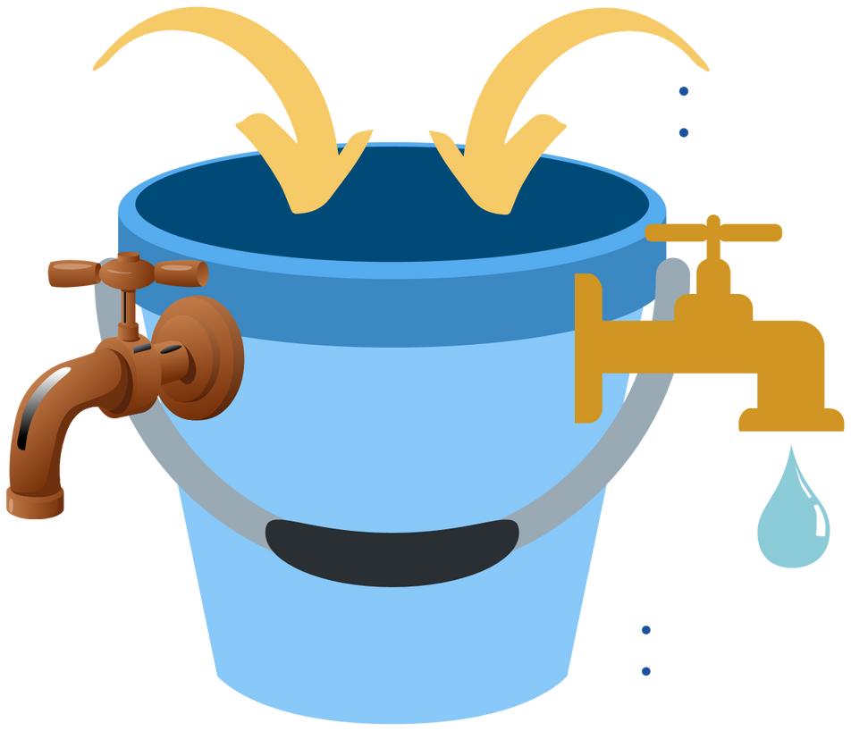
STRESS BUCKET
worry about something
friendship difficulties
stress at home
not sleeping well
GOLD TAPS
engaging in hobbies
speaking to friends and
family
listening to music
RUSTY TAPS
alcohol/ drugs
self-harm
sleeping too much
isolating self

Slide 19
What will help?

Slide 20

Ideally know the C/YP well
Not always possible - recognise behaviours

Slide 21

What are the foundations to encourage positive behaviour?
Connecting with ourselves and others in healthy and meaningful ways can help us support our own mental health and well-being and that of others.
LOVE
honesty
trust
Connecting with ourselves
kindness
CARE
respect

Slide 22
What you can do
recognising the signs and the difference between being hungry and tired and something else
communication is key
being together and not even saying anything can be enough
seek/ offer support if relationships are affected by behaviour
model/ praise good behaviour

Slide 23
Understanding triggers
DOESN’T SEEM THAT BIG OF A DEAL?

Slide 24
Reactive Strategies
Remain Calm (or appear Calm)
Soften/ slow voice
Reduce demands on C/YP
Reduce stimuli
Stop activity
Reduce/ stop instructions

Slide 25

What does this look like?

Slide 26
Proactive strategies are used to ‘prevent’ or lessen challenging behaviour
Some strategies to consider;
Timetables (give notice of change, where possible)
Positive reinforcement
Offer choices (limited)
Plan ‘free passes’ (pick your battles)
Know your children
Social stories x2 (model expected/ unpicking scenarios)

Slide 27
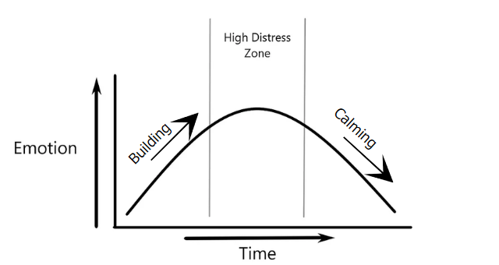
Support during the urge
Create a list of other things they can do straight away, this can help your child to ‘ride the wave’ of their intense feelings without self-harming.
What works will depend on the feelings - some seek soothing, others need to do something physical.

Slide 28
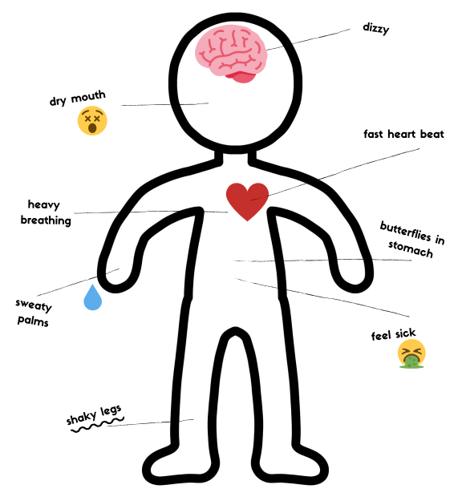
HELP THEM TO IDENTIFY EARLY WARNING SIGNS
THOUGHTS - PHYSICAL FEELINGS
ZONED OUT/ FULL OF PANIC
FEELING / COPING STRATEGY
KEEP A RECORD (MOOD DIARY)

Slide 29







Identify early warning signs
Possible EMOTIONAL effects
Possible PHYSICAL effects
Anger
Upset/crying
Fear
Panic
Worry
Frustration
Shame
Remember! Everyone is different but they are
NORMAL body reactions

Slide 30
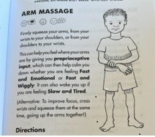
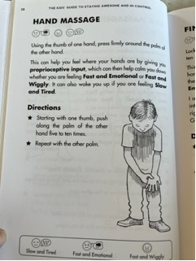
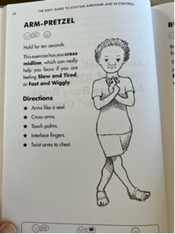
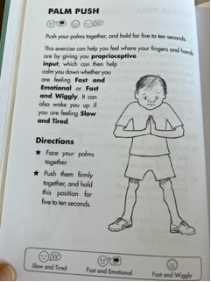
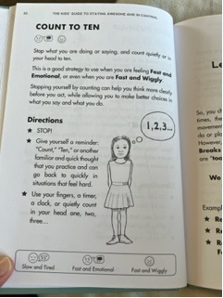
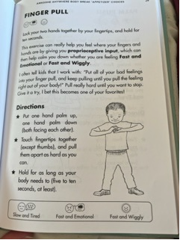
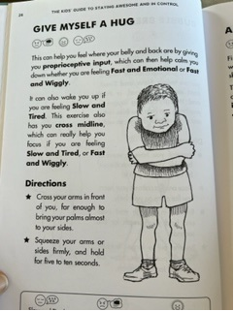
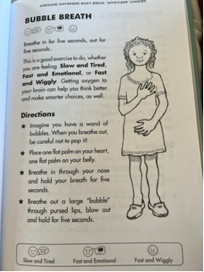
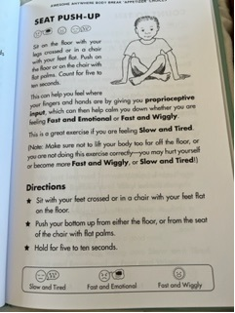
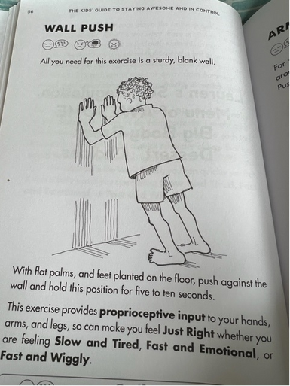


Emotional Regulation Techniques-HEAVY WORK!!
Arm Massage
Firmly squeeze your arms, from your wrist to your shoulder, or from your shoulder to your wrist, five to ten times. Repeat with other arm.
Hand Massage
Using the thumb of one hand, press firmly around the palm of the other hand, five to ten times. Repeat with other palm.
Arm Pretzel
Cross your arms and touch your palms together. Interlace your fingers and twist your arms into your chest.
Hold for as long as you can but five to ten seconds at least
Palm Push
Face your palms together in front of you. Push them firmly together and hold for as long as you can but five to ten seconds at least
Finger Pull
Put one hand palm up, one hand palm down (both facing each other). Touch fingertips (except thumbs) and pull them apart as hard as you can. Hold for as long as you can (five to ten seconds at least)
1 minute count
Breathing normally, time yourself breathing for one minute. One breath is counted as in and out. Next stop you need to regulate, count the same number of breaths
Count to Ten
Stop what you are doing or saying and count quietly or in our head to ten.
Give myself a hug
Cross your arms in front of you, far enough to bring your palms almost to your sides. Squeeze your arms or sides firmly and hold for five to ten seconds.
Seat Push-up
Sit on the floor with your legs crossed or in a chair with your feet flat on the floor. Using your hands, push yourself up from the floor or chair. Hold for five to ten seconds
Wall Push
With palms flat on a sturdy wall, and feet planted flat on the floor, push against the wall and hold the position for five to ten seconds.
Re-route that sensory pathway!!
Using physical techniques can also help relax your body AND IMPROVE symptoms as well as helping you think more clearly.

Slide 31

Encourage SELF CARE - what’s that?
Sometimes it can be difficult to take time for selfcare.
Feed their sensory diet!!
People may feel guilty for putting themselves first.
Encourage children to create a list of activities they
could do to look after themselves that they would find enjoyable.
Choose one to try each day and reflect on how it made them feel.
REMEMBER ROME WASN’T BUILT IN A DAY!

Slide 32

Listen to music
Take a shower
Talk to a friend
Watch a movie
Read a book
Go for a walk
Ride your bike
Exercise
Play with your pet
Stretch your muscles
Do yoga
Meditate or pray
Talk to a friend on the phone
Go the park with a friend*
Go shopping
Get a hair cut
Take a nap
Plan an outing with friends
Go for a jog

Slide 33
Responses to questionnaire
Dealing with violent outbursts in the classroom - remove risk - either self or others - allow time to regulate.
Adaptive teaching for those with a diagnosis, but those without a diagnosis who lack motivation or gets overwhelmed etc. while not having a formal diagnosis are largely ignored - Education, Health and Care Plan via SENCO - Social and emotional care
Discussions on how to approach mental health and emotional well-being, for instance, a student with low self-esteem how to make them engaged without overwhelming them - building confidence - positive praise - realistic targets.
I haven’t had much information regarding EWB and MH training during the university sessions, I think as this is such a big part of everyday education, it needs to be focused on in a session - agree - evidence from increased numbers into our service - school a key factor
How to help children to control their behavior when they are anxious or in low mood - reducing expectations/ stimuli/ space/ time to decompress/ regulate.
More information on how to put it to affect - adopting strategies - home/ school communication
It’s such a broad and complex spectrum that it’s hard to cover every eventuality or scenario. I do think a training similar to what social care students might receive on the topic would help us see another perspective though - I would be keen to see what is covered.

Slide 34


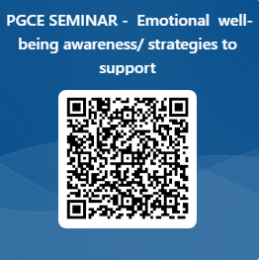

Thank you - please post any questions in chat and I will respond following the seminar.

