Slide 1

ADHD in the Classroom
Dr Gemma Gray
Department of Psychology

Slide 2
Session overview
What is ADHD?
ADHD Misconceptions
Characteristics in the classroom
What helps?

Slide 3
What is your experience of ADHD in the classroom?
What behaviours do you see?
How do you currently manage those behaviours?

Slide 4
What is ADHD?
Attention Deficit Hyperactivity Disorder (ADHD):
“A persistent pattern of inattention and/or hyperactivity-impulsivity that interferes with functioning or development” DSM 5
Three main types:
Primarily hyperactivity/impulsivity: around 15%
Primarily Inattentive: around 20 – 30%
Combination of both: around 50 – 75%

Slide 5
What is ADHD?
Frequently noticeable before the age of 12
Late diagnosis becoming more common
No clear markers or causes, BUT
High heritability – runs in families
Differences in neurotransmitter pathways/levels: dopamine and norepinephrine implicated
Differences in brain size and networks in specific regions

Slide 6
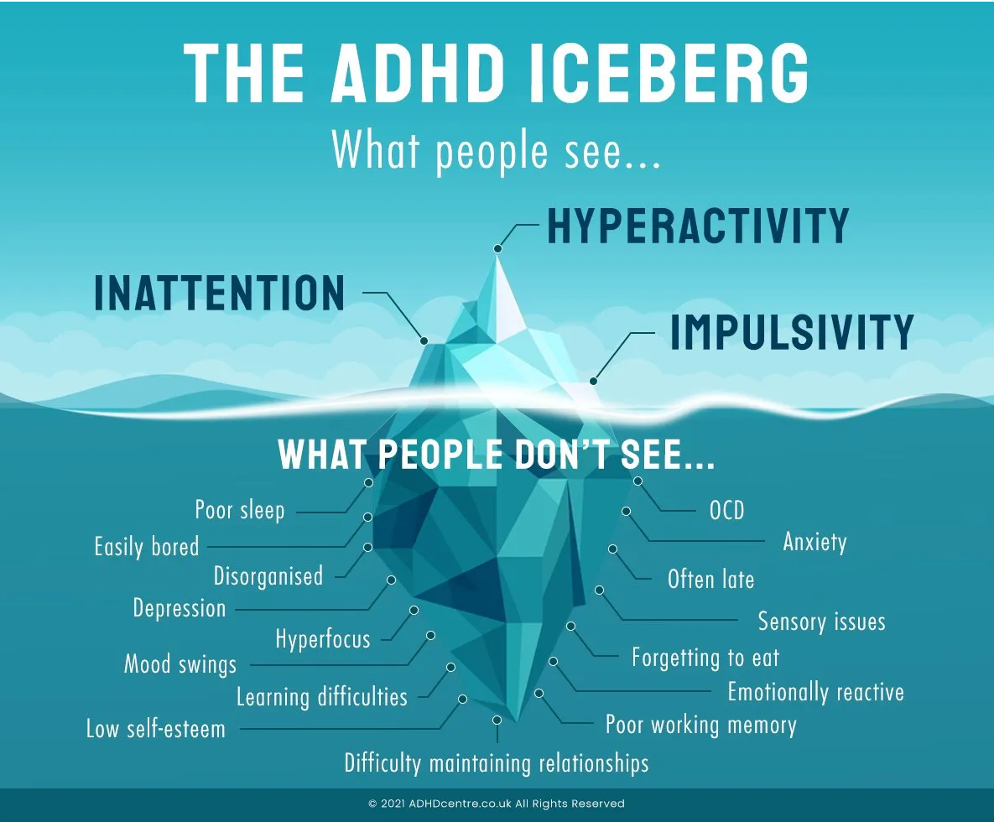
What is ADHD?
Source: ADHDCentre.co.uk

Slide 7
What is ADHD?
Source: ADHDCentre.co.uk

Slide 8
Other traits
Behavioural: Fidgeting, impulsive talking or action
Cognitive: Working memory difficulties, auditory processing difficulty, co-occurring learning differences
Emotional: rejection sensitivity, emotional regulation, co-occurring mental health conditions
Social: loneliness, self-stigma, family issues

Slide 9
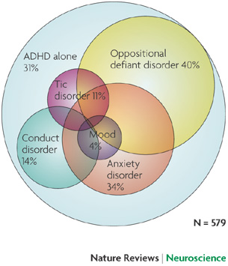
Variations in ADHD
Gender differences: Original diagnostic criteria focused on boys and external characteristics; ADHD in girls poorly understood
Co-occurrences can mask impact
Reale et al. (2017) only 34% of children and adolescents with ADHD had a single diagnosis.
56% also had a learning difference diagnosis
Often misdiagnosed as something else
Sources: Singh (2008)

Slide 10
Prevalence and Diagnosis
Prevalence rates currently estimate 2% - to 7% (Polanczyk et al., 2014) of the population have ADHD, but currently underdiagnosed
Why?
Shifts in diagnosis criteria
Issues understanding variability of ADHD
More in the public eye – Tik Tok, high profile people with ADHD
Currently very long waiting lists for assessment and diagnosis

Slide 11
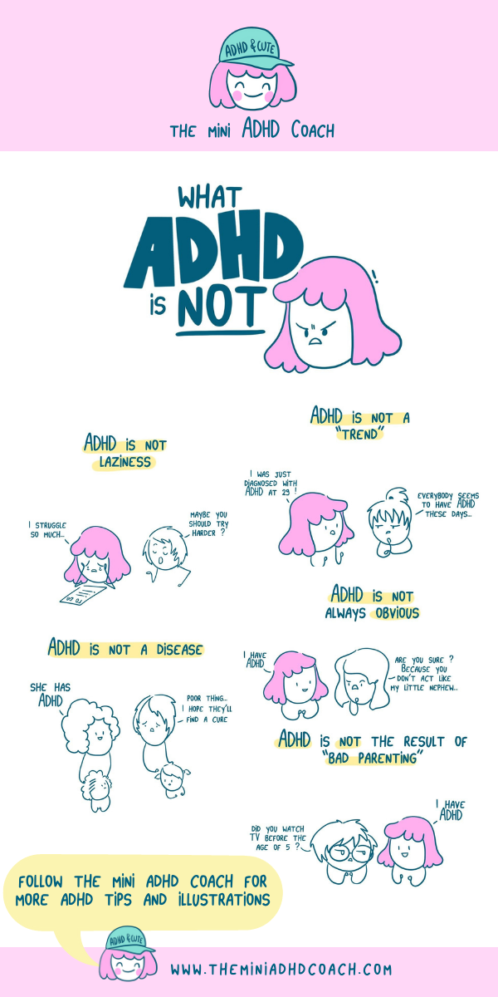
ADHD misconceptions
It’s not always obvious
It's not laziness
It’s not a trend
It’s not all about issues and difficulties

Slide 12
Take home message…
ADHD isn’t the same for everyone – different presentation due to the complex links between cognitive, behavioural, emotional and social factors
Historically more focus on externalising behaviours, but cognitive factors of more impact to child’s learning
Emotional impact of ADHD on children can be underestimated

Slide 13
ADHD in the classroom -
Behavioural
Fidgeting
Inability to sit still
Being unable to wait their turn
Shouting out in class
Interrupting others

Slide 14
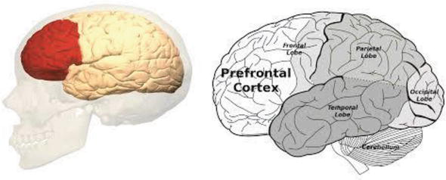
Cognitive issues in the classroom
Attention Difficulties
Sustaining attention, (especially when bored or not engaged), but also tuning out distractions
Poor working memory
Need more time to understand complex conceptual ideas
Disorganisation
Forgetting books, pens etc, lateness
Difficulties with planning and time
Misjudging how long tasks take to perform
Procrastination
Difficulty starting or finishing tasks
Mind wandering
Zoning out, daydreaming
Difficulties with instruction
Either due to auditory processing or working memory problems
Hyper-focus
Intense focus on topics of self-interest to the detriment of other tasks (and distress when interrupted)
Source: Akyurek (2018)

Slide 15
Outcomes
Pre-School: children with ADHD behind in school-readiness skills
Primary: Zendarski (2022) compared reading and numeracy and non- academic scores for year 5 - ADHD and sub-threshold ADHD pupils lower than control
Secondary level: decrease in traits, but still impacts on achievement and engagement - Loe and Feldman (2007) e.g. key predictor of GCSE outcomes (Birchwood and Daley, 2012)
Long-term: traits decrease but 50 -80% adults still have some traits Ingram et al (1999) small percentage have severe traits, that contribute to mental health, anti-social and criminal behavior

Slide 16
ADHD in the classroom – your reflections
What are the challenges when teaching children with ADHD?

Slide 17
Difficulty in the classroom
Balancing need of child with needs of the class
May have lack of additional support in the classroom
Variability in presentation: different kids with ADHD have different needs, issues with getting assessed –> untreated ADHD traits
Co-occurring difficulties: mental health, learning differences etc.

Slide 18
Studies on teacher reflections
Ward et al. (2021) Primary teachers views on supporting children with ADHD
– need to support individual needs as well as the whole class
- having a joined-up team approach
- support needs in training and teamwork
Szép et al (2021) Class size, lack of time, and having multiple students with disabilities in the class affects uptake of classroom strategies

Slide 19

What can help?
Think about the environment: Seating, visual cues and reminders, potential distraction/overstimulation, consider energy levels at transition points in the day
Balance between Structure and flexibility
Building in a consistent routine: clear rules, expectations and repetition
Task/strategy switching
Breaking tasks down

Slide 20
What can help?
Building awareness
Others: fellow teaching/tutors (Ward et al., 2022), peers, family
Self-awareness: metacognition, impact of masking
Encouraging reflection on the good things, through feedback
“ADHD is an explanation, not an excuse for behaviour”
Building relationships
What’s difficult? What do they enjoy? What are their triggers for a bad day? What is rewarding for them?
Reframe their traits
Building self-esteem

Slide 21
What are the challenges with these approaches in the classroom?

Slide 22
Any Questions?

Slide 23
Resources
O’Regan (2022) Teaching and Managing Students with ADHD:Systems, strategies solutions https://www.adhdfoundation.org.uk/wp-content/uploads/2022/03/Teaching-and-Managing-Students-with-ADHD.pdf
Neurodiversity toolkit: https://warwick.ac.uk/fac/cross_fac/academy/activities/learningcircles/neurodiversity/toolkit

