Slide 1
Cognitive Learning Theory
and
Trauma Sensitive Schooling
Paul Green, Headteacher, Lyng Hall School

Slide 2
A Simple diagram to explain Memory
Finite capacity
Infinite capacity
Touch
Smell
Sight
Taste
Sound
Sensory memory
4 secs
Short
Term
memory
Long
Term
Memory
Environmental stimuli
Information is forgotten at this point if it is not considered relevant
Information is forgotten due to interference, decay or retrieval failure

Slide 3
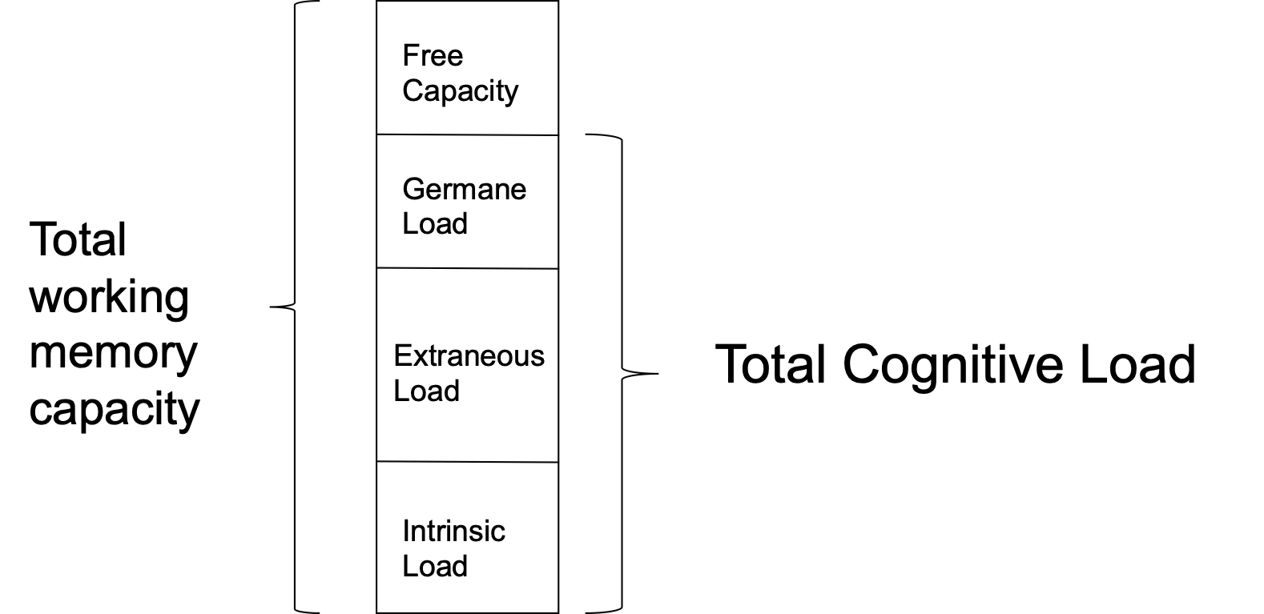
Capacity of Working Memory

Slide 4
Normal Stress
Toxic Stress / trauma
Germane Load
Extraneous Load
Intrinsic Load
Germane Load
Extraneous Load
Intrinsic Load

Slide 5
When do we learn best?
Research suggests we naturally learn best……
Things that are..
Inspiring
Funny
Personal
Emotional
Linked to our senses
Connected with sex
The first and the last thing e.g. in a lesson, revision session etc

Slide 6
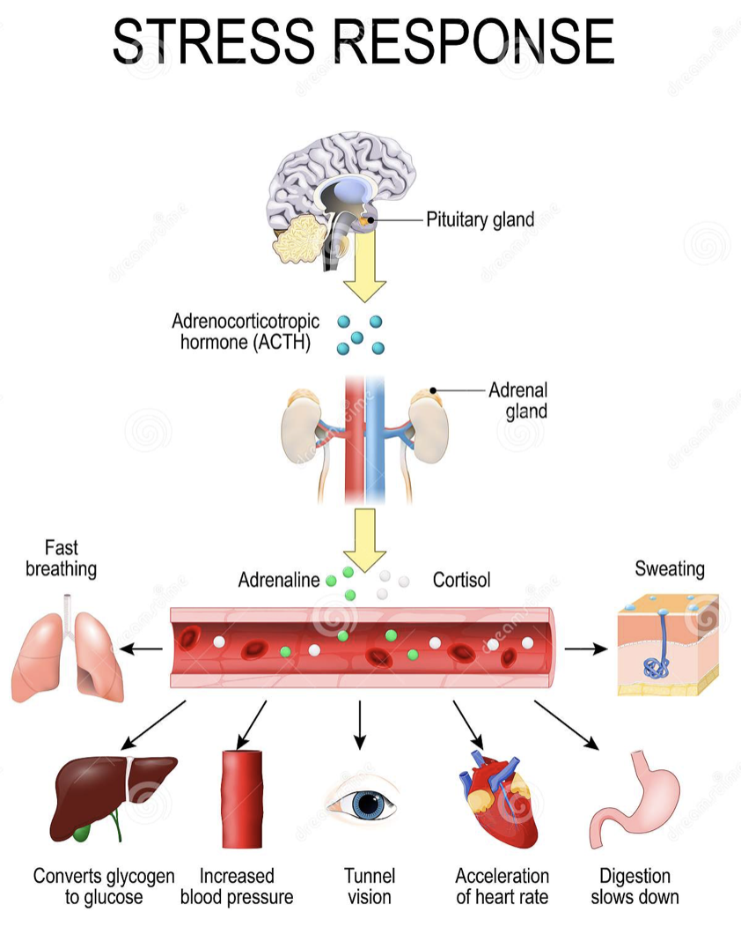

Slide 7
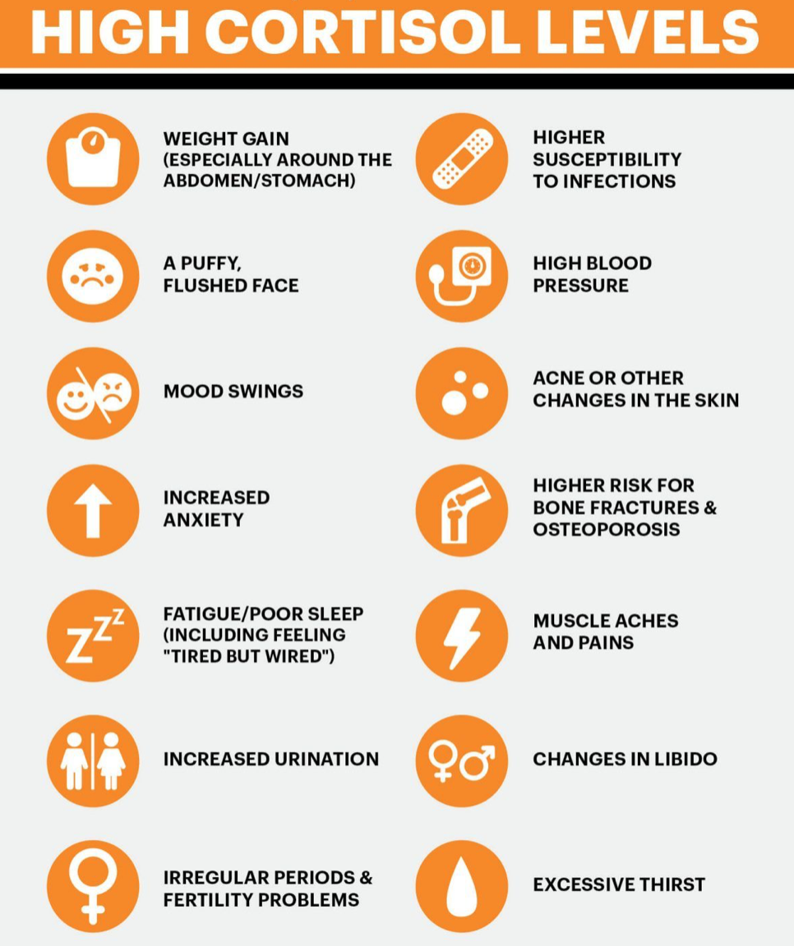

Slide 8
The long-term activation of the stress-response system and the overexposure to cortisol and other stress hormones that follows can disrupt almost all your body's processes. This puts you at increased risk of many health problems, including:
Anxiety
Depression
Digestive problems
Headaches
Heart disease
Sleep problems
Weight gain
Memory and concentration impairment

Slide 9
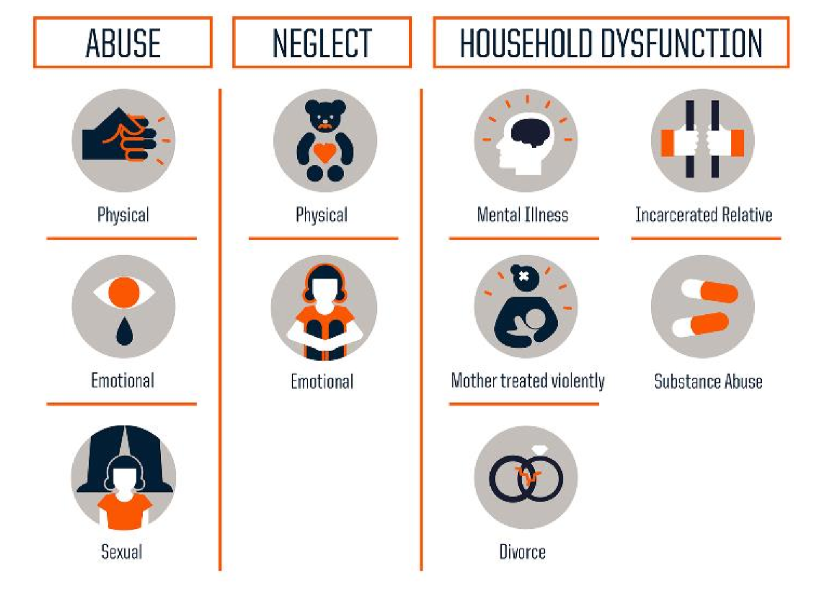
Sources of Trauma

Slide 10
Additionally…….
Bullied
Homelessness
Refugee
Community violence
Looked after
Surviving a disaster
Undergoing multiple invasive surgeries
Live with a parent suffering from PTSD
Children do not respond to trauma in exactly the same way
Knowing this helps us to avoid viewing trauma related behaviours as intentional or stemming from a lack of motivation, laziness or overtly attention seeking.
This helps us to stop punishing poor behaviour and instead helps us to recognise the need to diagnose the reasons for it.

Slide 11
Poverty has the same impact on cognitive capacity as being a chronic alcoholic

Slide 12
Poverty, stress, anxiety, fear and other adverse childhood experiences all create a lot of extraneous cognitive load which squeezes out capacity for germane load i.e learning

Slide 13
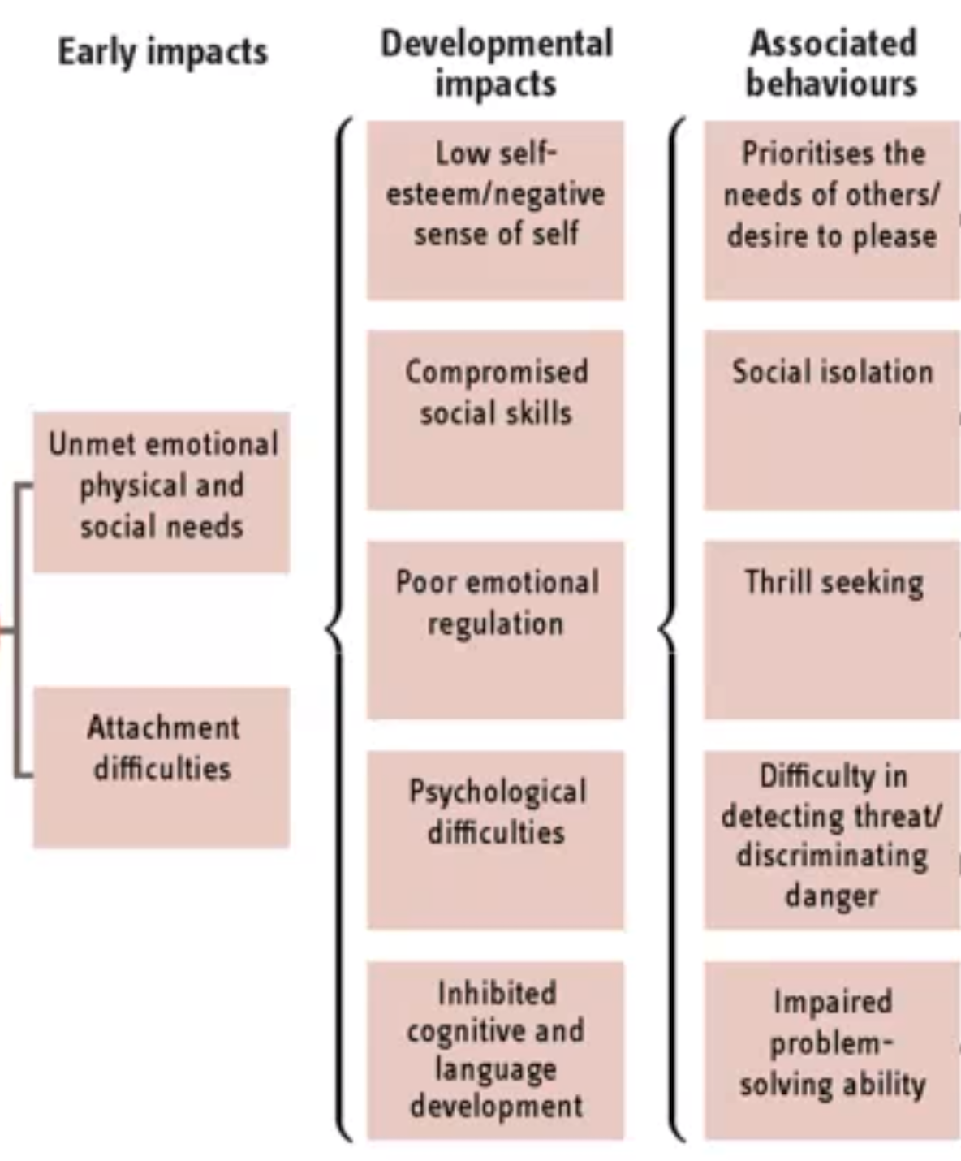
Possible impact
Drug use
Running away
Poor system response to need
Trauma
Family breakdown
CSE
Homeless
Gang involvement
Susceptible to grooming

Slide 14
Traumatic experiences will seriously inhibit the development of the prefrontal cortex. Vital functions such as good decision making, management of risk and emotional regulation may never be achieved.
However, although traumatic experiences inhibit learning and development on a neurobiological level, teachers and other adults of importance can have a tremendous healing effect.

Slide 15
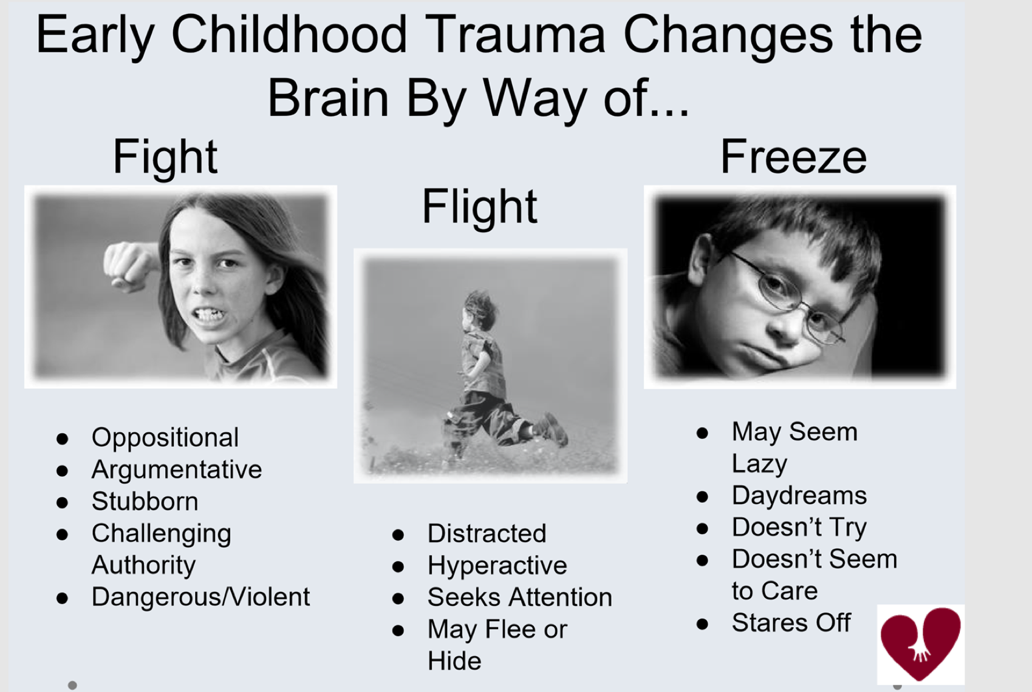

Slide 16
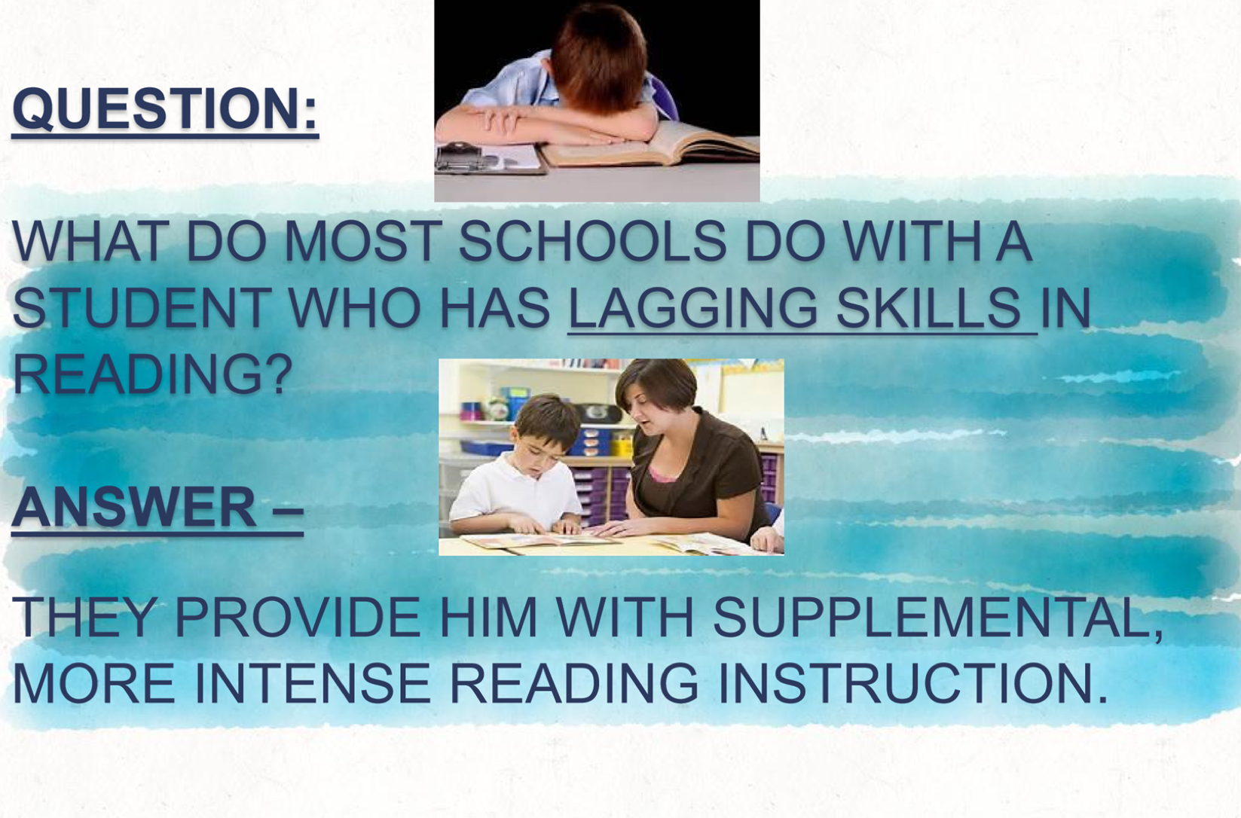

Slide 17
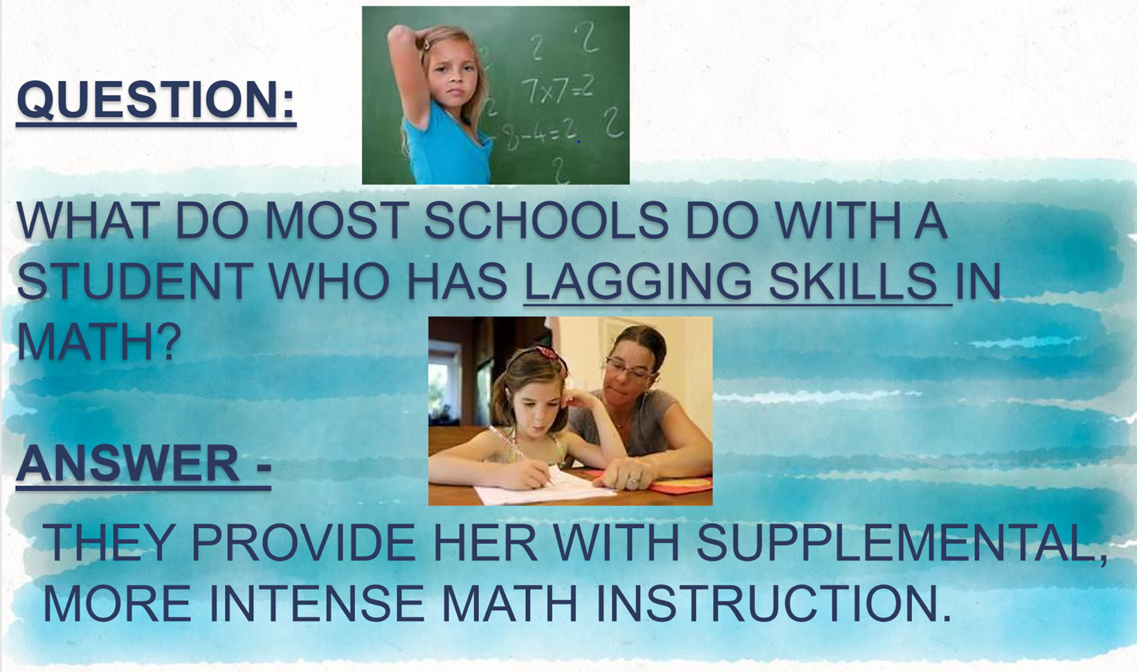

Slide 18
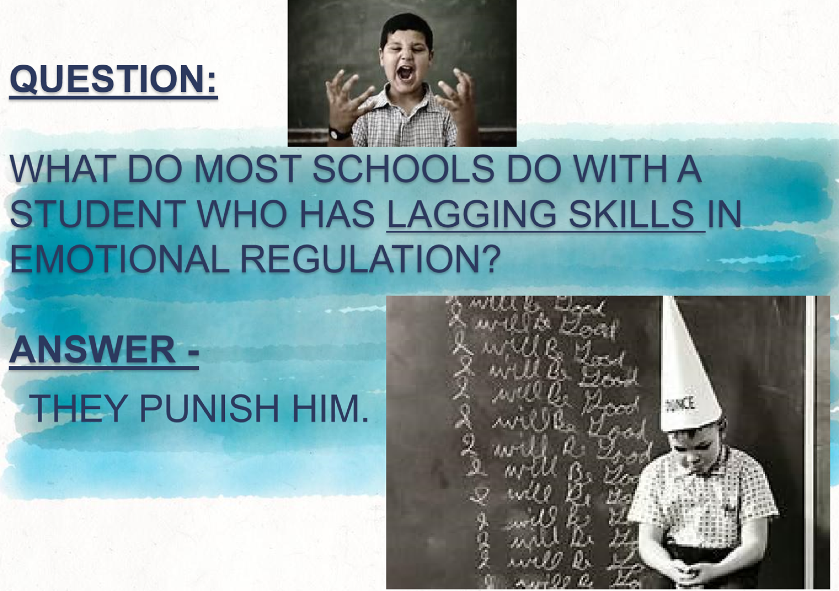

Slide 19
Trauma sensitive learning environments…..
Trauma-sensitive learning environments should have several key elements that promote safety and the potential for healing:
Calming colour schemes for walls and decor help set the mind at ease.
Uncluttered and organized classrooms create a sense of calm, well-being, and predictability.
Posted visual cues for routines that are well-established and known to students provide reminders for what comes next.
Advance warning for transitions helps students mentally and emotionally prepare for the next thing.
Designated safe spaces provide students a place for self-regulation. In our preschool, we use the term “peace island,” but others use “Zen den” or “calm corner,” for example.
Having students repeat back verbal instructions helps build the capacity for active listening.

Slide 20
Considerations for relationship-based practice
Understand the child’s chronological age and development age may be at odds
Understand the ‘good intention of the child even if behaviour may not be ideal’
Notice things the child does well and build on these
Set and maintain appropriate boundaries.
View discipline as a ‘learning moment as opposed to a punitive moment’
Use praise and acknowledge good choices and behaviours
Always be ‘Bigger, Stronger, Wiser and Kind’

Slide 21
Considerations for relationship-based practices
Partner with parents and earn their trust
Be mindful of the risk of shaming experiences
Keep parents informed
Welcome parental involvement and create opportunities for this to occur
Be respectful of parents, carers and family.
Become culturally informed and sensitive
Provide opportunities to repair relationships

Slide 22
How do we reduce the impact of toxic stress and re balance emotional regulation ?
Help students to learn emotional self regulation
Unrelenting positivity and kindness
Language that reduces stress rather than increases it.

Slide 23
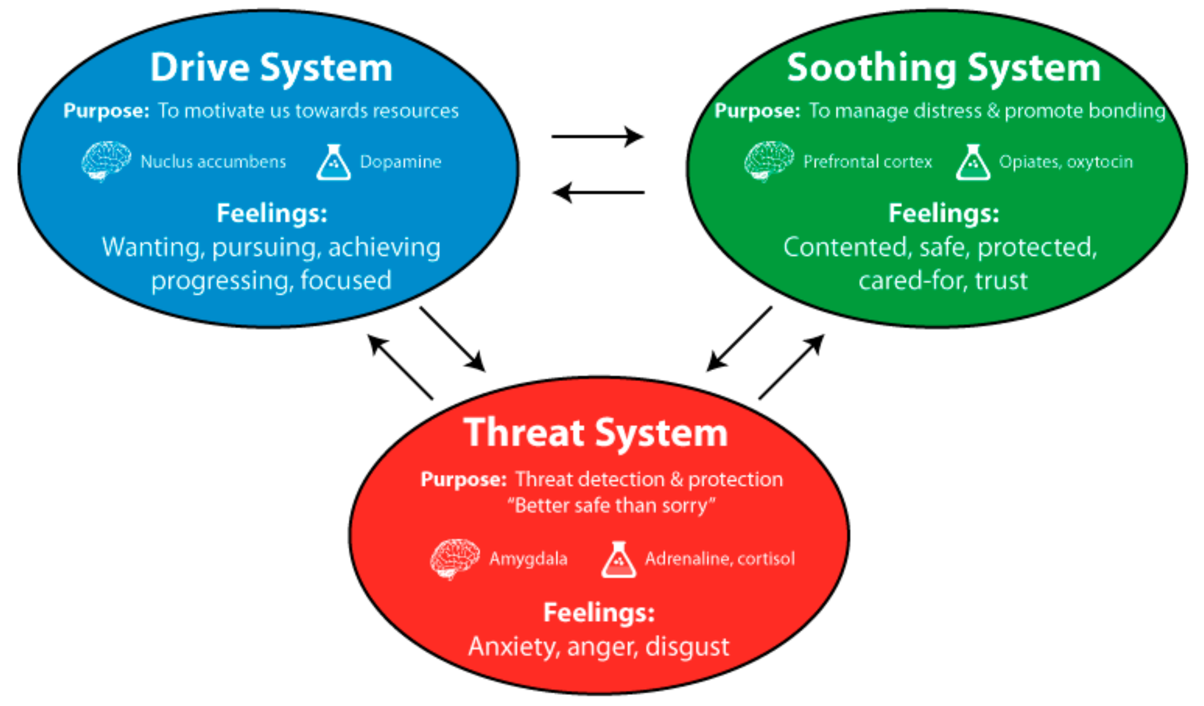
Emotional Regulatory Systems
Distress occurs when these systems are not in balance. For an emotionally dysregulated child this often means that the soothing system is under developed.

Slide 24
So……..
Remove all negative language
Do not refer to punishments (instead think of therapies)
Do not introduce systems that cause confrontation (e.g. equipment, lateness)
Build strong, positive, self-affirming relationships
Don’t lose patience with children
Don’t trivialise their issues
Don’t over analyse… you are not a therapist.

Slide 25
In trauma Sensitive Schools……
The adults……
Share an understanding of how trauma impacts on learning.
Support all students to feel safe.
Address students needs taking account of relationships, ability to self regulate, academic competence, physical and emotional well being.
Explicitly connect students to the school community.
Embrace teamwork, demonstrating a shared responsibility for every student.
Anticipate and adapt to the ever changing needs of individual students and their community.

Slide 26
Beware!!!
Avoid “dumbing down”……….
Children will often interpret this lowering of standards as a validation of their own worthlessness.

Slide 27
The feeling of physical safety is crucial
In the ….
Classroom
Corridor
Playground
Toilets
Bus
Gym
Walk to school
Social, Emotional and Academic safety are also important
Children need to feel safe enough to make mistakes.
Answering questions poses a huge risk.
Highly attention seeking students may not be controlled by ignoring them as they may be seeking reassurance about their own safety.

Slide 28
Correct adult behaviour is crucial:
Unrelentingly positive
Never giving up
Calm at all times
Reliable
Confident
Interested
Never outwardly anxious

Slide 29
Disconnection
Traumatised children can feel disconnected from others.
Too often we respond negatively to a child who is seeking attention or whose behaviour is confusing or oppositional.
We discipline children for an inappropriate response which we label disrespectful when it may in fact be a clumsy and awkward effort to relate to us.
In an effective trauma sensitive school, parents are fully engaged. As their parents start to become engaged students can begin to feel that they belong to a community that cares.
Remember, you may be dealing with traumatised adults!!!

Slide 30
School structures that support connectedness
Define the role of support staff
Trauma sensitive alternatives to sanctions
Registration time “Frame the day”
Teams or groups to belong to
Charity work
Student leadership responsibilities
Outrageous opportunities
Celebrate and publish
Recognise positive social behaviour

Slide 31
Summary….
Three things that all children need…..
Affection
Attention
Affirmation

