Slide 1


Building an Inclusive Culture: Fostering Belonging and Equity for Children and Young People
Alison Betts
National Coordinator
Whole School SEND
Notes:
Inclusion is not just about the big organisational strategies; it's also about the small, everyday actions that make each child and young person feel safe, welcomed, and valued. This presentation will explore the balance between broad, systemic approaches and the detailed, personalised efforts that together create a truly inclusive environment. We'll discuss whether we should 'sweat the small stuff' and how these details contribute to a sense of belonging and equity for every student.

Slide 2
Universal SEND Services programme:
aims
To improve the quality of teaching to children and young people with SEND, particularly in mainstream settings (both schools and further education).
To ensure needs are identified and met earlier and more effectively, and that preparation for adulthood is delivered from the earliest stages, to support effective transitions, including into employment.
Whole School SEND Home Page | Whole School SEND

Slide 3
Aims of the session:
To understand and explore the importance of inclusion
To look at how to balance organisational and individual approaches
To explore and recognise the impact of small actions
To think about how these link with a sense of belonging

Slide 4
What do we mean by the terms Inclusion, Belonging and Equity?
How would you define inclusion?
Are you clear as to your own views on inclusion?
Is there a shared vision for inclusion across the school?
How do you know?
Notes:
Start with: What do we mean by the terms Inclusion, Belonging and Equity?
Have been in discussions with school leaders, partnership organisations and DfE and it is hard to gain a consensus of what we mean by inclusion in education.
Some people consider inclusion in terms of including children and/or young people with special educational needs and/or a disability (SEND) in a mainstream setting. Others see Special Schools as inclusive. Some people view it as encompassing all additional needs.
Others see it in the widest sense as providing a sense of belonging for all members of the school community.
If able to contribute : discuss what does inclusion mean to you, is this shared across your setting, how do you know/what do you see that demonstrates it?

Slide 5

Inclusion
Inclusion is the active, intentional, and ongoing effort to ensure that every child - regardless of background, ability, or identity - feels safe, valued, and able to participate fully in all aspects of school life.
Notes:
I have had a go at putting my definition together, not as an expert, I am not that! Just my own thoughts based on my 30 years as a teacher and school leader in mainstream nursery and primary schools, and with my own lived experience of school and as a parent of children with a disability attending mainstream schools.
Read slide;
ACTIVE- because it is always changing. In my experience each child and family has the potential to need something different to feel included and so inclusion isn’t a destination to get to but a way of thinking and adapting.
INTENTIONAL- the idea of inclusion by design but also it being on-going as you consider every child.
It’s not just about access; it’s about meaningful engagement and visibility.

Slide 6
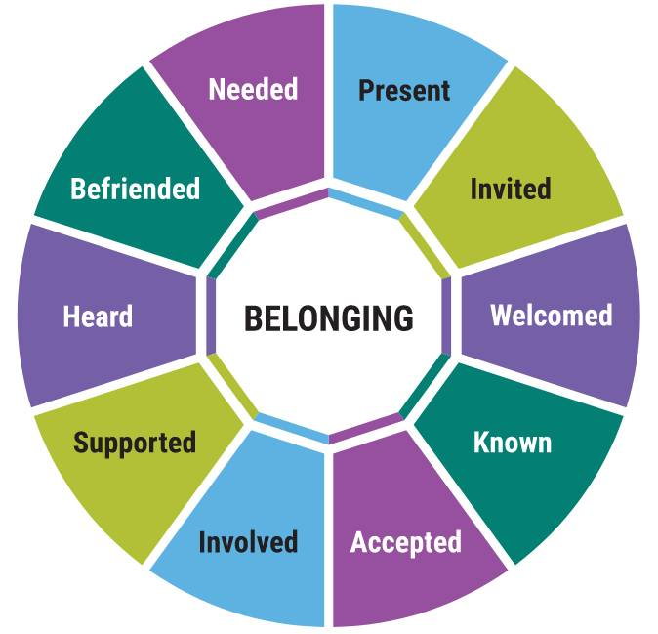
Belonging
Belonging is the emotional experience of being accepted, respected, and connected. It’s when a child feels: “I matter here.”
Belonging is the outcome of inclusive culture - it’s felt in relationships, routines, and the smallest interactions.
Notes:
Belonging for me was harder to define. I found this image which gives lots of words which help develop a sense of belonging. I am sure many of us have had the experience of the feeling of not belonging and just how difficult that can be- feeling the opposite of some of those words-unwelcome, unsupported, not needed, not accepted but it is perhaps more difficult to say how we feel when we do belong and how that links with inclusion.
I think belonging is the outcome of inclusive culture — Belonging is the emotional experience of being accepted, respected, and connected it’s felt in relationships, routines, and the smallest interactions, it can be an emotional experience ‘I matter here’

Slide 7
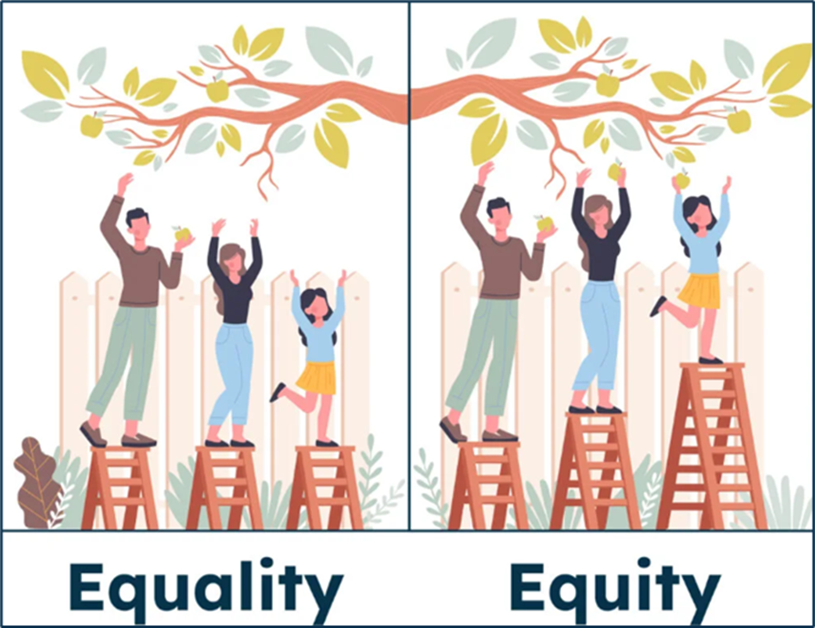
Equity
Equity means recognising that children have different starting points and needs - and responding with fairness, not sameness. It’s about removing barriers and providing tailored support so that every learner can thrive.
Notes:
Let’s start with a simple distinction:
Equality means giving everyone the same thing.
Equity means giving each person what they need to succeed.
In schools, we have been aware of equality for a long time, it was in my initial Teacher Training all those years ago. It might look like offering the same resources, the same timetable, or the same expectations to every pupil. It sounds fair—but it assumes every child starts from the same place, with the same needs. And we know that’s not true.
Equity, on the other hand, recognises that every learner is different. It asks: What does this child need to thrive? That might mean extra time, sensory adjustments, language support, or simply a trusted adult within school who understands their story.
You will have seen visual metaphors like this before: Often children watching a football or cricket match. Here we have people picking apples on stepladders.
Equality gives each of them the same ladder to stand on.
Equity gives each pupil a different-sized ladder—so they can all reach the branches.
In practice, equity is about removing barriers. It’s about tailoring support so that every child—not just the majority—can access learning, feel a sense of belonging, and reach their potential.
Why does this matter? As teachers we are all leaders, leading our class and maybe leading a team within school such as TA’s or subject colleagues-
Because when we lead with equity:
We close gaps in achievement and engagement.
We honour pupil voice, especially those who are often unheard.
We build inclusive cultures where difference is not just accepted, but valued.
Equity isn’t a soft add-on—it’s a strategic, ethical commitment. It’s how we move from “fair” to just. And it’s how we ensure that every child, whatever their starting point, has a real chance to flourish.

Slide 8
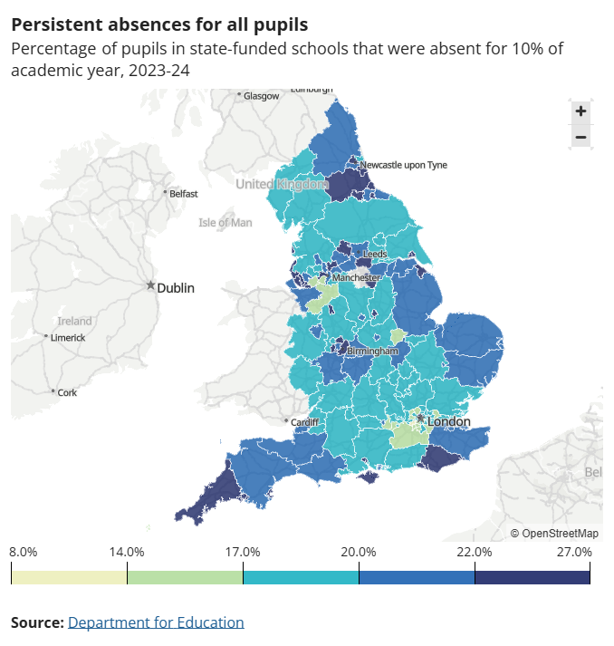
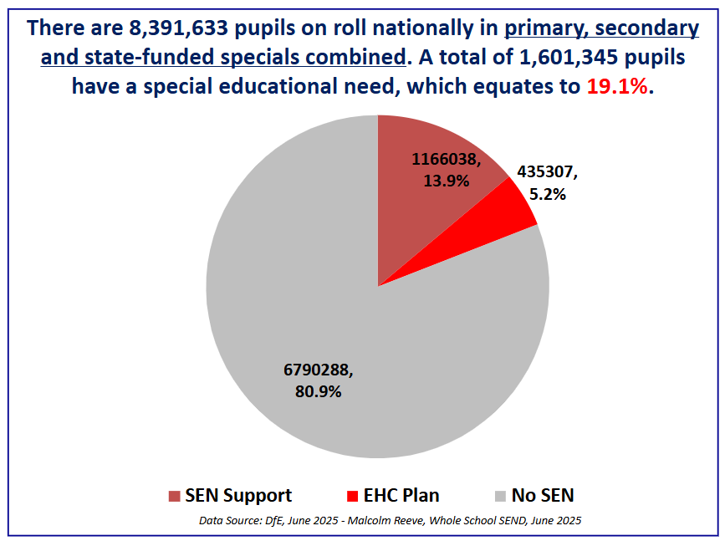
SEN Number June 2025
Notes:
I have been trying to put these things together to know what it would look like if we were actively trying to develop a sense of belonging through an inclusive culture.
Opportunity to reflect after 30 years teaching and school leadership and moving into nasen role:
Have things changed in schools or wider society and has this had an impact on inclusion and our learner's sense of belonging?
We know emotionally based school avoidance (EBSA)—has seen a marked rise in recent years, particularly in the UK.
The map shows here the persistent absence rates for pupils (which has improved slightly since these statistics) those off for 10% of the school year. It is quite shocking –that’s about 19 days school or more. In my part of the country the South West that’s somewhere between 22-27% of pupils .
We also know the number of children with SEN has been increasing and is now at 19.1%
Interestingly in January 2014 (just before the Code was introduced):
SEN overall: Approximately 1.49 million pupils (18.7% of all pupils)
School Action: ~1.1 million pupils
School Action Plus: ~300,000 pupils
Statements of SEN: ~226,000 pupils (2.8% of all pupils)
So overall figures not too different but number of EHCPs a marked increase.
I find myself asking is this why is our education system and particularly SEND is struggling to cope or have things in schools and society as a whole changed that have made it more difficult for learners?

Slide 9
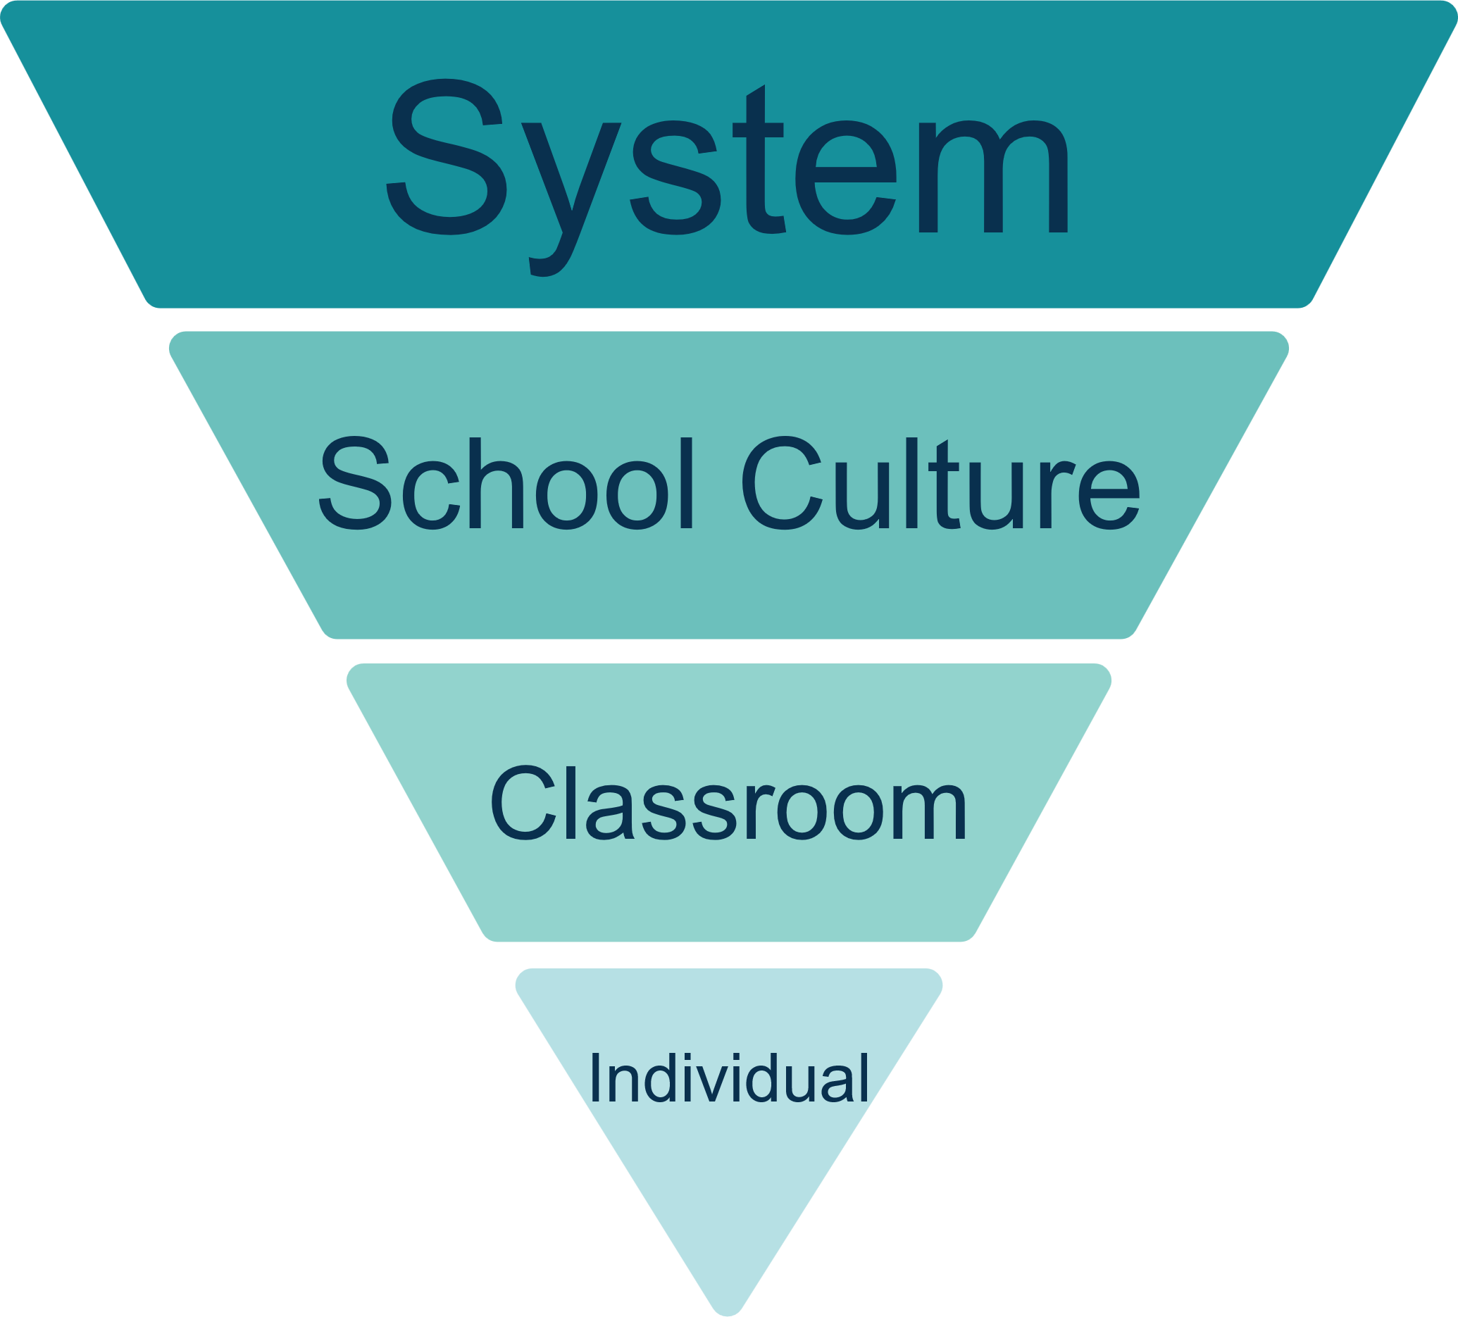
Developing a sense of Belonging and Inclusion
Notes:
I put together this inverted pyramid to bring together my thoughts and to express everything that I think needs to be in place within the system to develop belonging through an inclusive culture.
On my reflection on what had changed in the thirty years- I remember after completing my teaching degree getting my first classroom, after 8 years in the world of banking, thinking these are my four walls, I am in charge and I am responsible for making sure these children (a year 2 class in an infant school) have the best possible learning experience, and leave here to go to junior school loving education, having high self esteem and being able to read- these were my aims. This was both exciting and scary!
30 years later when I came out of the school environment it felt like there were things in the ‘system’ that made a difference to that enthusiastic individual teacher-OFSTED-although always there had changed their Handbook and approach to inspections, league table and data were a big focus and , Senior Leadership and MAT executive teams priorities for school improvement.
I know an individual teacher doesn’t operate in a vacuum so concluded that maybe inclusion and belonging started with the wider system and the school environment which influenced the classroom and the individual?

Slide 10

Do we need to sweat the small stuff?
Notes:
So the question I have been asking myself is do we need to sweat the small stuff in education? Or do we get ourselves one of these prints from Etsy to hand on the wall and wait for the the big systemic change to improve everything?
Let's examine each of those levels on my inverted pyramid of thought and think about some of the things which help to develop and inclusive school or college which supports a learner to feel like they belong.

Slide 11
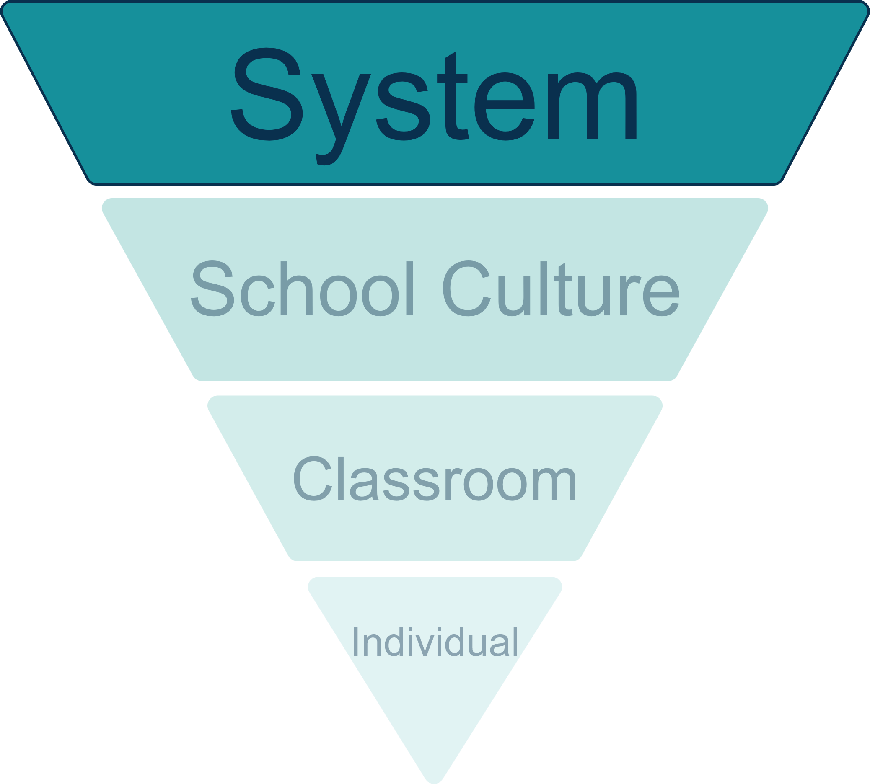









The Current Education System
Notes:
Starting with the system-
Explain: This visual representation tells us there is a lot to be thinking about as teachers and school leaders.. Lots of busy people balancing priorities, undertaking a range of tasks, holding different responsibilities .
One of the facts of working in education is that there are many frameworks and expectations which govern us.
Part of each of our jobs, regardless of what job we hold in our school or college, is understanding those expectations that are placed on us and enacting them.
We could spend an hour looking at each of these in turn in the impact on inclusion and belonging but today I’ll just mention 3 in more detail.

Slide 12

What do OFSTED say about Inclusion?
9th September: Ofsted confirms changes to education inspection and unveils new-look report cards
Disadvantaged and vulnerable children at the heart of reforms, with a focus on ‘inclusion’ in every inspection.
Notes:
9th September -Changes came into place after wide consultation:
New 5-point grading scale, including the new ‘exceptional’
Five main changes were bullet pointed and communicated:
Parents and carers to receive the detailed information about nurseries, schools and colleges they’ve asked for, with strengths and areas for improvement highlighted.
Schools and colleges with identified areas for improvement to receive additional monitoring inspections, to ensure swift improvements are made.
Nurseries and childminders to be inspected more frequently,
Increased focus on professionals’ well-being and workload through a more collaborative approach to inspection.
Disadvantaged and vulnerable children at the heart of reforms, with a focus on ‘inclusion’ in every inspection.

Slide 13
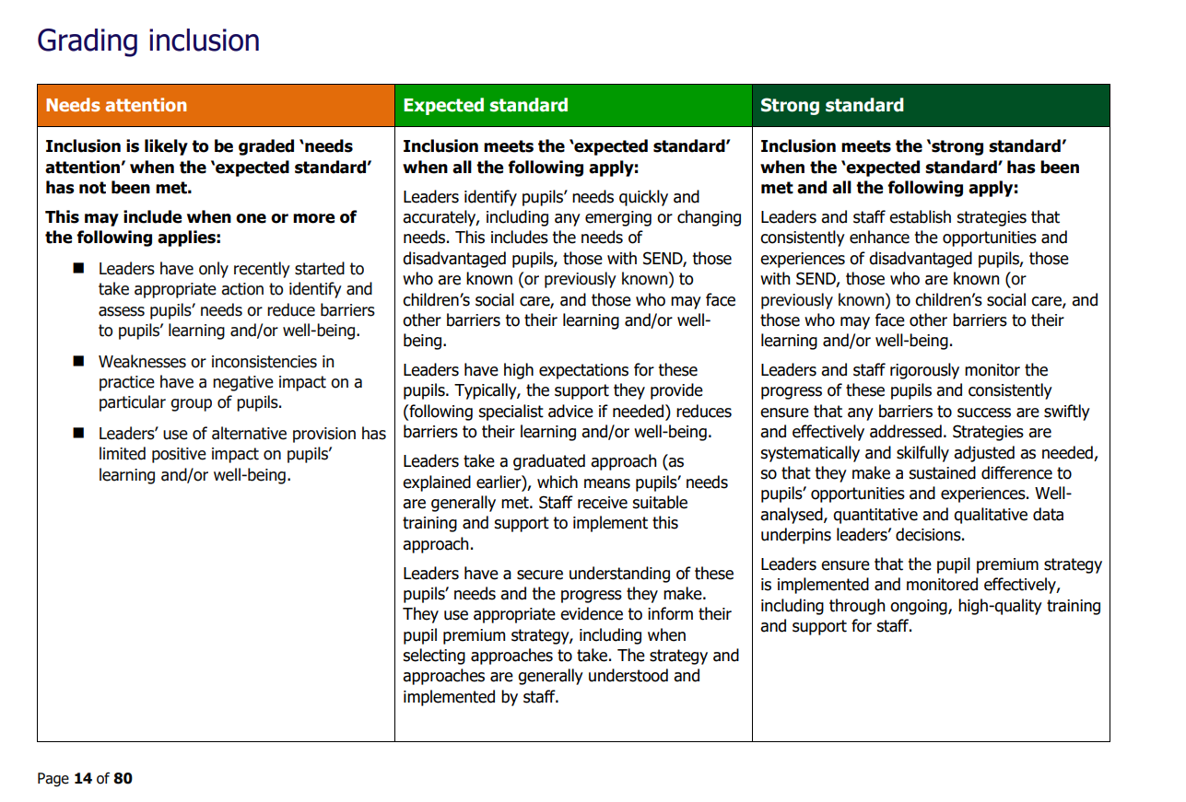
Gathering evidence about inclusion
Identifying, assessing and meeting needs, and reducing barriers
Supporting disadvantaged pupils
Supporting pupils with SEND
Supporting pupils who are known (or previously known) to children’s social care
Notes:
Inclusion
This evaluation area considers how leaders and staff identify and support:
-socioeconomically disadvantaged pupils (those eligible for the pupil premium)
-pupils with SEND; this means pupils receiving special educational needs (SEN) support, and those with an education, health and care (EHC) plan
-pupils who are known (or previously known) to children’s social care, such as children in need and looked-after children
-pupils who may face other barriers to their learning and/or well-being, which may include pupils who share a protected characteristic-links in with the Equality Act- pleased to see that there
Inclusion meets the ‘expected standard’ when all the following apply:
Leaders identify pupils’ needs quickly and accurately, -wide definition of this
Leaders have high expectations for these pupils.-following specialist advice if needed) reduces barriers to their learning and/or well-being.
Leaders take a graduated approach. Staff receive suitable training and support to implement this approach.
Leaders have a secure understanding of these pupils’ needs and the progress they make. –evidence informed PP strategy, fully understood by staff
The qualified SENCo has sufficient authority within the leadership structure to make a positive difference for pupils with SEND.
Leaders are committed to, and understand, their role in the local area partnership’s strategy to improve the experiences of, and outcomes for, pupils with SEND.
Leaders support pupils who are known (or previously known) to children’s social care, including looked-aft
Alternative provision is commissioned appropriately and is used in pupils’ best interests.

Slide 14
What does the Equality Act say?
Protected characteristics
1.9 It is unlawful for a school to discriminate against a pupil or prospective pupil by treating them less favourably because of their:
• sex
• race
• disability
• religion or belief
• sexual orientation
• gender reassignment
• pregnancy or maternity
• marriage and civil partnership
Equality Act 2010: advice for schools - GOV.UK
Notes:
So OFSTED saying. inclusion is about assessing, identifying and meeting needs and removing barriers to learning. What about equity and how does the Equality Act help?
- Unlawful to discriminate because of any of the nine protected characteristics

Slide 15
Under the Equality Act 2010:
The duty to make reasonable adjustments is a legal requirement
The Act outlines three types of reasonable adjustments that may be required:
Changing provisions, criteria, or practices that disadvantage disabled people.
Altering physical features of premises (e.g. installing ramps or lifts).
Providing auxiliary aids or services, such as accessible formats or support workers.
Notes:
The duty to make reasonable adjustments is a legal requirement designed to ensure that disabled people are not substantially disadvantaged when accessing services, education, employment, or public functions.
the Act says:
The Act outlines three types of reasonable adjustments that may be required:
Changing provisions, criteria, or practices that disadvantage disabled people.
Altering physical features of premises (e.g. installing ramps or lifts).
Providing auxiliary aids or services, such as accessible formats or support workers.
This duty is anticipatory, meaning organisations must consider and plan for the needs of disabled people in advance—not just react when a problem arises.
“Every learner matters and matters equally” is deeply rooted in UNESCO’s inclusive education agenda. It was prominently introduced in the UNESCO (the United Nations Educational, Scientific and Cultural Organization,) Guide for Ensuring Inclusion and Equity in Education (2017), and has since become a guiding principle in global efforts to promote inclusive schooling.

Slide 16
Reasonable Adjustments
Emotional regulation stations
Alternative seating
Alternative formats
Sensory toolkits
Staff/pupil co-reflection journal
Uniform flexibility
Multi-model input strategies
Visual timetables
Choice based tasks
Healthy snack policy
Micro transitions
Traffic light cards
Modified seating
Notes:
What do reasonable adjustments look like in practice? The are different for different settings and different pupils . As part of the Universal SEND services programme the University of Derby ran lesson studies and action research projects with schools and colleges all over the country. At nasen we have been cataloguing these to make them digitally available to the sector who might be interested to know what other settings are doing. I have taken just some of the adjustments that were made during theses studies that schools reported to have made a significant impact on either pupil engagement or outcomes.
Alternative formats: Providing worksheets on coloured paper for pupils with dyslexia.
Visual timetables: Supporting predictability and executive function for neurodiverse learners.
Modified seating: for a pupil with a visual impairment to sit at the back to accommodate their field of vision
Sensory tools: Access to ear defenders, fidget items, or weighted cushions for regulation.
Traffic light cards: For pupils who need non-verbal ways to express overwhelm or request help.
Uniform flexibility: Adapting materials for pupils with eczema or sensory sensitivities.
Healthy snack policy: Adjusted for pupils with diabetes or other medical needs.
Micro-transitions supported by visual countdowns or personalised cues.
I think you will agree that they are all quite ‘doable’ and yet schools saw behaviour incidents decrease, attendance improve, academic outcomes improve and better engagement in lessons.

Slide 17
SEND Code of Practice
A child or young person has SEN if they have a learning difficulty or disability which calls for special educational provision to be made for him or her.
A child of compulsory school age or a young person has a learning difficulty or disability if he or she:
has a significantly greater difficulty in learning than the majority of others of the same age, or
has a disability which prevents or hinders him or her from making use of facilities of a kind generally provided for others of the same age in mainstream schools or mainstream post-16 institutions
SEND code of practice: 0 to 25 years - GOV.UK
Notes:
when a child or young person requires special educational provision which is over and above the adjustments, aids and services required by the Equality Act (2010), they will be covered by the SEN definition.
The Equality Act (2010) defines disability in the following way:
‘A person has a disability if they have a physical or mental impairment that has a substantial and long-term adverse effect on their ability to carry out normal day-to-day activities age.
A physical or mental impairment includes learning difficulties, mental health conditions and hidden impairments such as specific learning difficulties, autism and speech language and communication impairments.
Substantial is defined as ‘more than minor or trivial’.
Long term is defined as a ‘year or more’
The definition of disability is wider than many might presume and so covers a greater number of children than many practitioners may realise. The definition includes sensory impairments, such as hearing or vision, and long-term health conditions such as asthma, diabetes, epilepsy and cancer. Children and young people with some of these conditions may not have special educational needs, but it is not unusual for there to be an overlap between disabled children and young people and those with SEN. Research indicates that about a quarter of disabled children do not have a SEN. (DCSF 2008, Disability Data Collection for Children’s Services Research Report RR062).
However, when a child or young person requires special educational provision which is over and above the adjustments, aids and services required by the Equality Act (2010), they will be covered by the SEN definition.
SEND code of practice: 0 to 25 years - GOV.UK

Slide 18
Developing a sense of Belonging and Inclusion
That’s why thriving and belonging will feature so prominently in our work in the opportunity mission, hand in hand with attainment.
Giving every child the best start in life
Notes:
So back to the inverted pyramid: There is a lot within the education system to ensure schools and collages are inclusive so every child feels safe, valued, and able to participate fully in all aspects of school life and so will get a sense of belonging as an outcome of that inclusive culture.
We know the current government, have had a focus on mainstream inclusion and belonging: Bridget Phillipson's speech at the Confederation of School Trusts (CST) Conference

Slide 19
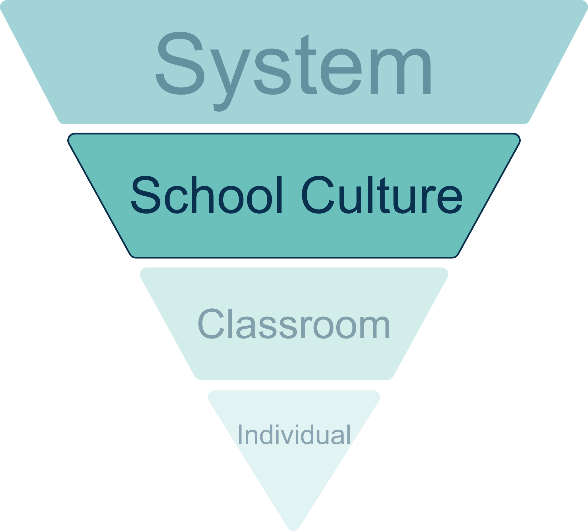
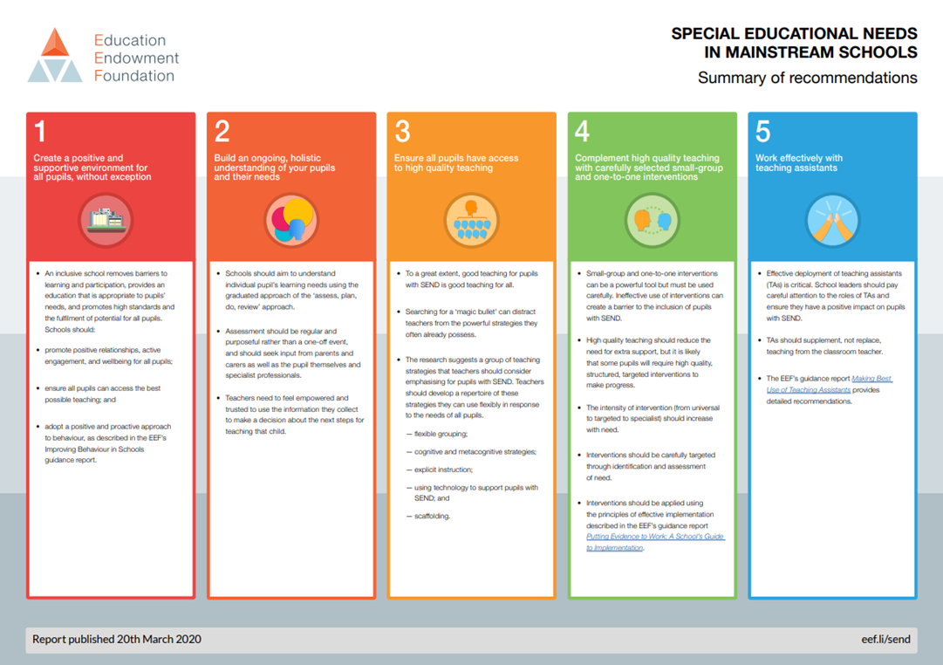
The School Culture
Create a positive and supportive environment for all pupils without exception
Build an ongoing, holistic understanding of your pupils and their needs
Ensure all pupils have access to high quality teaching
Complement high quality teaching with carefully selected small-group and one-to-one interventions
Work effectively with teaching assistants
Improving Behaviour in Schools | EEF
A School’s Guide to Implementation
A School’s Guide to Implementation
Deployment of Teaching Assistants
Notes:
In school we are always looking to root our practice in evidence- evidence informed teaching
The EEF produced this evidence document to support SEN in mainstream schools.
1) An inclusive school removes barriers to learning and participation, provides an education that is appropriate to pupils’ needs, and promotes high standards and the fulfilment of potential for all pupils. Schools should:
promote positive relationships, active engagement, and wellbeing for all pupils;
ensure all pupils can access the best possible teaching; and
adopt a positive and proactive approach to behaviour, as described in the EEF’s Improving Behaviour in Schools guidance report.
2) Schools should aim to understand individual pupil’s learning needs using the graduated approach of the ‘assess, plan, do, review’ approach.
Assessment should be regular and purposeful rather than a one-off event and should seek input from parents and carers as well as the pupil themselves and specialist professionals.
Teachers need to feel empowered and trusted to use the information they collect to make a decision about the next steps for teaching that child.
3) To a great extent, good teaching for pupils with SEND is good teaching for all.
Searching for a ‘magic bullet’ can distract teachers from the powerful strategies they often already possess.
The research suggests a group of teaching strategies that teachers should consider emphasising for pupils with SEND. Teachers should develop a repertoire of these strategies they can use flexibly in response to the needs of all pupils.
flexible grouping;
cognitive and metacognitive strategies;
explicit instruction;
using technology to support pupils with SEND; and
scaffolding.
4) Small-group and one-to-one interventions can be a powerful tool but must be used carefully. Ineffective use of interventions can create a barrier to the inclusion of pupils with SEN.
High quality teaching should reduce the need for extra support, but it is likely that some pupils will require high quality, structured, targeted interventions to make progress.
The intensity of intervention (from universal to targeted to specialist) should increase with need.
Interventions should be carefully targeted through identification and assessment of need.
Interventions should be applied using the principles of effective implementation described in the EEF’s guidance report A School’s Guide to Implementation.
5) Effective deployment of teaching assistants (TAs) is critical. School leaders should pay careful attention to the roles of TAs and ensure they have a positive impact on pupils with SEND.
TAs should supplement, not replace, teaching from the classroom teacher.
The EEF's guidance report Deployment of Teaching Assistants provides detailed recommendations. We were lucky enough to have Lorwyn Randle from EEF present a webinar on that guidance around TAs so I have added the link to that too.

Slide 20


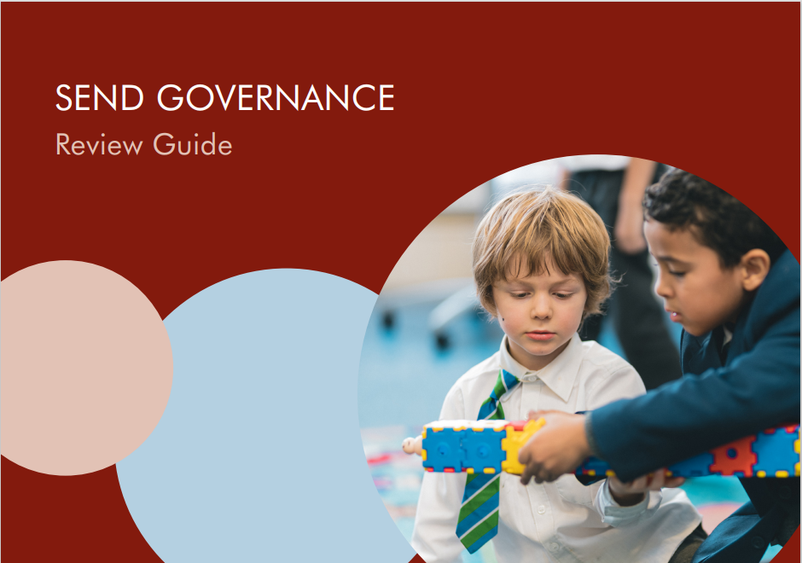


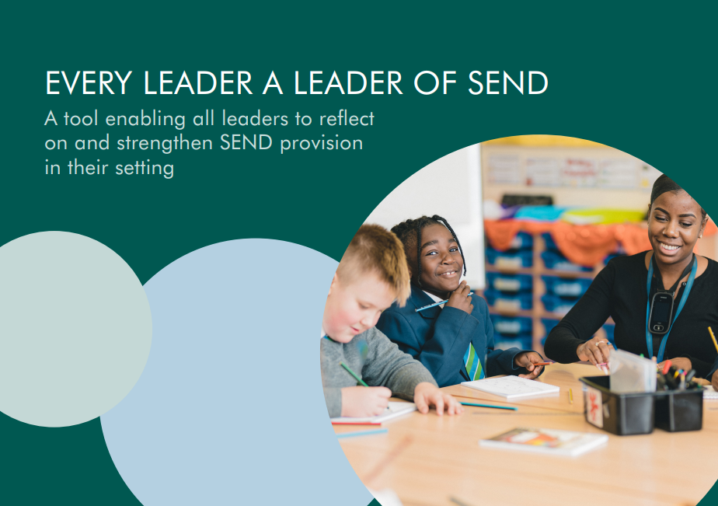





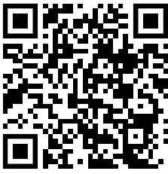
Review Guides
Executive Headteachers, MAT SEND Leaders, Trust Boards
Early Years, FE Settings
Governors in all schools
Headteachers
SENCOs, other Senior Leaders
Individuals or whole staff in all schools
Find out more here: https://www.wholeschoolsend.org.uk/page/wss-review-guides
Notes:
If you are not sure you have fully embedded these 5 recommendations from the evidence drawn together by EEF then it can be a good starting point to review the practice in your school
At WSS we have a suite of fully funded by the DfE, free to use, review guides .
Other review resources are available
Can:
Use to evaluate
Peer review
Or commission a system leader to review

Slide 21

School Culture
• Leadership of SEND
• High Quality Adaptive Teaching
• Implementation of the Graduated Approach
• Identification, Assessment and Outcomes
Notes:
Whole School SEND has for many years promoted the principle that every leader in a school should be a leader of SEND. This initiative developed from the language ‘every teacher a teacher of SEND’ that arrived on the education landscape in 2015 following the 2014. The toolkit: Every Leader a Leader of SEND
these principles have been reduced to twenty-four key statements across four areas fundamental to effective SEND provision in school.
These four areas are:
• Leadership of SEND
• High Quality Adaptive Teaching
• Implementation of the Graduated Approach
• Identification, Assessment and Outcomes
Take a look at one area in more detail next.

Slide 22
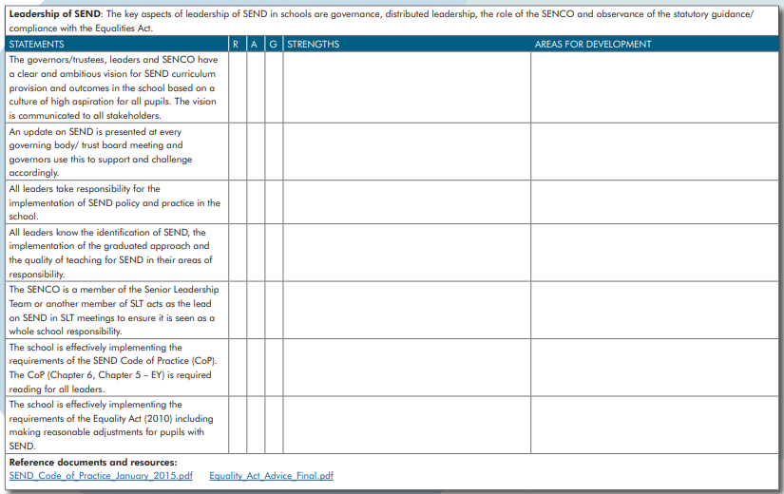
School Culture
Notes:
Looking at the Leadership section of this guide., which is available as an editable copy so you can personalize it to your school requirements.
This is getting you to think about and reflect the :
Curriculum
Governing body
Policy
Graduated response
Leadership team and staff well being
Implementation of those statutory documents such as Co P and Equality Act

Slide 23
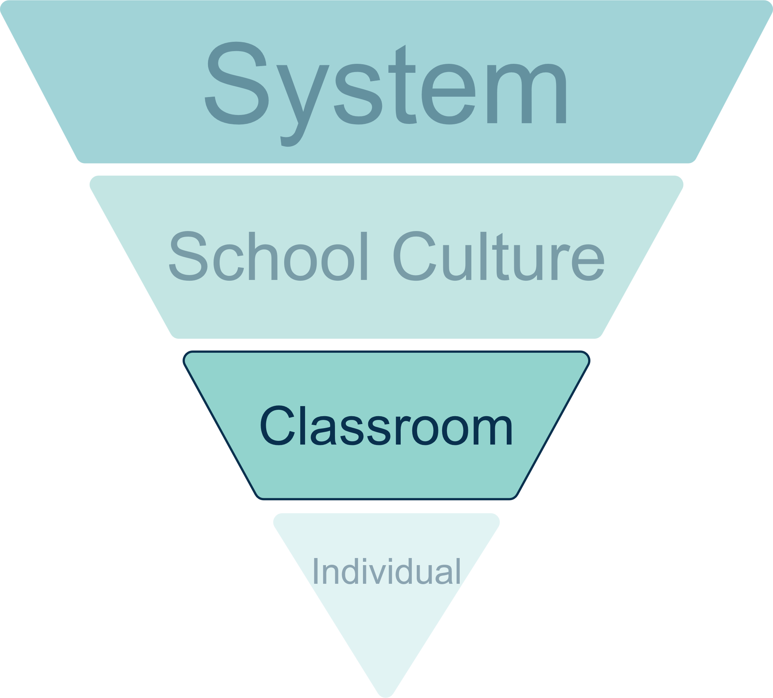

Classroom Practice
It is divided into 30 statements across three aspects:
• Knowledge of the learner
High quality adaptive teaching
• Creating an inclusive environment
Notes:
Thinking about classroom practice now, there is also a SEND guide from WSS which is free to access to help guide classroom teachers in evaluation their practice- The SEND reflection framework
The purpose of the SEND Reflection framework is to support teachers in reflecting on and self-evaluating the extent to which they meet the requirements of learners with SEND and wider inclusion needs. It can be used as a valuable tool for both individual and whole school self-assessment and improvement. Understanding how you evaluate yourself and develop your professional attitudes and practices can lead to much broader improvements in performance.

Slide 24
My Top Ten Tips for the Classroom
🌱 1. Start with Belonging
🧠 2. Know Every Learner’s Story
🚪 3. Actively Remove Barriers to Learning
🧑‍🏫4. Use Strategic Teacher Movement
📅 5. Use Visual Anchors and Predictable Structures
🤝 6. Build Meaningful Co-Production
🧘 7. Prioritise Emotional Safety
🤝 8. Collaborate Across Roles
🫶 9. Develop a Classroom Culture of Respect
🔁 10.Be Reflective
Notes:
There is so much we could include when talking about an inclusive classroom, I have tried to break it down to my Top ten tips:
🌱 1. Start with Belonging
Create rituals of welcome—morning greetings, pupil-led check-ins, or visual cues that affirm identity. Inclusion begins when pupils feel seen before they are taught.- needs to be genuine interest in the pupils, we can all spot someone who is going through the motions of this!! EG if you say good morning and they say it isn’t you can’t ignore that you need to engage further find out what’s going on for the child often it will be something you can help with –dropped lunch on the way into school but even if it isn’t –beloved pet died you can attune to their feelings
2. Know Every Learner’s Story
Use pupil voice tools, one-page profiles, or micro-narratives to understand strengths, sensory needs, and emotional landscapes. This isn’t just differentiation—it’s dignified design. This supports early identification and early support/intervention. Use the Plan do review-slide. Be curious!
🚪 3. Actively Remove Barriers to Learning
Audit your environment, curriculum, and routines for hidden hurdles—whether sensory, linguistic, emotional, or cognitive. Then adapt visibly and unapologetically. Inclusion isn’t just adding supports; it’s subtracting obstacles. Normalise the reasonable adjustments you are making!
Show slide on Teacher Handbook and online units- unashamed plug for 2 major WSS resources;
4. Use Strategic Teacher Movement
Position yourself intentionally to scan for engagement, offer proximity support, and reduce power imbalances. Movement isn’t just supervision—it’s relational pedagogy in motion.
5. Use Visual Anchors and Predictable Structures
Timelines, visual timetables, and dual-coded instructions reduce cognitive load and support executive function. They also foster autonomy for neurodiverse learners. And give security to those who need structure
6. Build Meaningful Co-Production
Involve pupils, families, and support staff in designing, reviewing, and evolving inclusive practice. Co-production isn’t consultation—it’s shared authorship of belonging. If you would like more information on co-production there is an online unit from WSS which supports this.
🧘 7. Prioritise Emotional Safety
Build in regulation breaks, calm corners, and relational routines. A dysregulated child can’t access learning—so wellbeing is foundational, not optional.
🤝 8 Collaborate Across Roles
Co-plan with TAs, therapists, and families. Inclusion is a team sport—and shared insight leads to sustainable, joined-up support. But also think about internally who do you need to talk to to meet a child’s needs- meal time assistant, receptionist, sports coach, careers lead ther are many people within our schools who need to knowledge of a child to help them succeed. Tnink about all the transitions that are made and how you can make it easier.
9. Develop a Classroom Culture of Respect-teach your class the impact of their words and the importance of respectful communication. Use a restorative approach so the children are continuing to learn about the impact of their behaviour .
📚 10.Be Reflective
Use lesson study, pupil feedback, and micro-evaluations to iterate. Inclusion isn’t a fixed state—it’s a living practice

Slide 25
The Graduated Approach
Assess, Plan, Do, Review
6.54 The impact and quality of the support and interventions should be evaluated, along with the views of the pupil and their parents
6.45 In identifying a child as needing SEN support the class or subject teacher, working with the SENCO, should carry out a clear analysis of the pupil’s needs.
Review
Assess
6.52 The class or subject teacher should remain responsible for working with the child on a daily basis. Where the interventions involve group or one-to-one teaching away from the main class or subject teacher, they should still retain responsibility for the pupil.
6.49 All the teaches and support staff who work with the pupil should be made aware of their needs. The outcomes sought, the support provided and any teaching strategies or approaches that are required. This should also be recorded on the school’s information system.
Do
Plan
Notes:
Good process for all classrooms:
Assess where the child is at in a holistic way or just in one part of their learning
Plan the learning needed, along with teaching strategies and outcomes needed
Teach in appropriate way- whole class, intervention or 1:1
Review impact and quality and feedback in to planning process

Slide 26
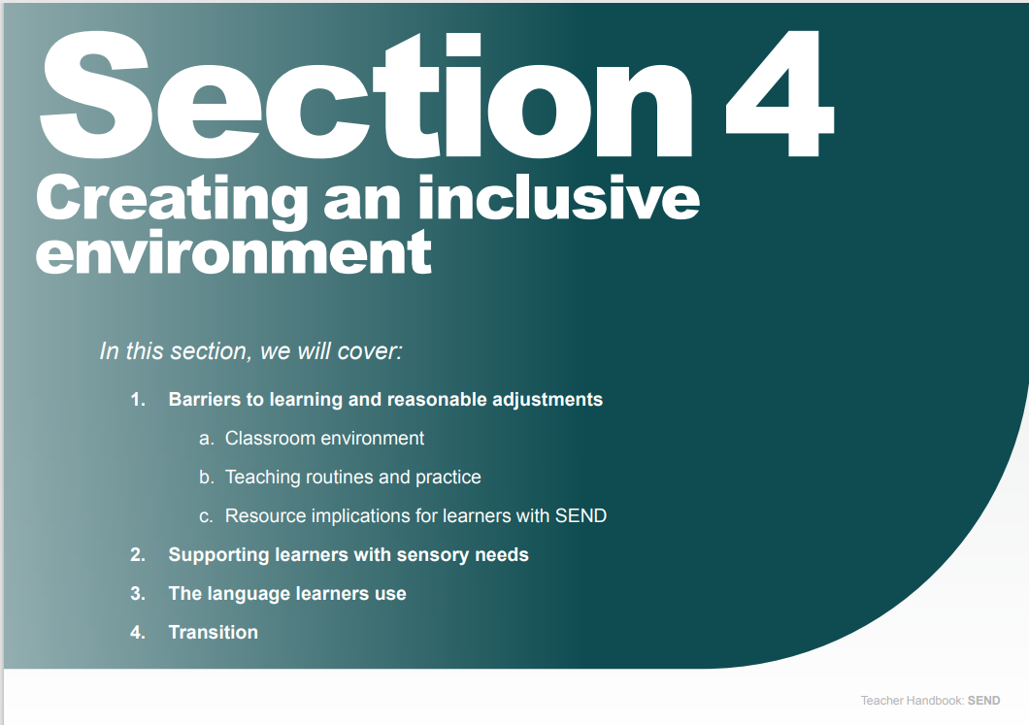

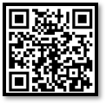
1. Barriers to learning and reasonable adjustments:
Classroom environment
Teaching routines and practice
Resource implications for learners with SEND
2. Supporting learners with sensory needs
3. The language learners use
4. Transition
Teacher Handbook: SEND | Whole School SEND
Notes:
Teachers Handbook for all teachers
Section 4 goes into detail on
Barriers to learning and reasonable adjustment-classroom, teaching routines and practice, resource implications
Sensory needs
The language of learners
Transition
Too much detail for now but well worth a look at and great if you are planning any CPD

Slide 27


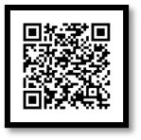
Online SEND CPD Units
Developed in partnership with young people, specialists and mainstream practitioners.
Explore some of the most commonly observed barriers to learning, regardless of age, label or area of need.
Each unit can be completed in under an hour. No need to complete units in a single session – progress is saved.
Provides knowledge and skills required to build a holistic understanding of individual learners’ characteristics.
Provides clear guidance and strategies to enable practitioners to adapt their teaching, across the age range, to meet the needs of a wider range of learners.
Badges and certificates awarded for completion of multiple units.
Online CPD Units | Whole School SEND
Notes:
Online units-
Unit 1: Creating an emotionally safe environment
Unit 2: Creating a socially safe environment
Unit 3: Creating a physically safe environment
Unit 4: An introduction to speech, language and communication needs (SLCN)
Unit 5: Identifying and supporting speech, language and communication needs (SLCN)
Unit 6: Supporting the development of speech, language and communication skills
Unit 7: Creating a learning environment that supports speech, language and communication
Unit 8: Understanding behaviour as communication
Unit 9: Promoting mental wellbeing in your setting
Unit 10: Understanding and promoting resilience
Unit 11: Understanding anxiety and creating a supportive learning environment
Unit 12: Supporting sensory differences in the learning environment
Unit 13: An introduction to teaching learners with physical needs
Unit 14: Understanding executive functioning
Unit 15: Memory for learning
Unit 16: Supporting reading and comprehension across the curriculum
Unit 17: Developing maths skills
Unit 18: Person centred working
Unit 19: Promoting independence
Unit 20: Transitions

Slide 28
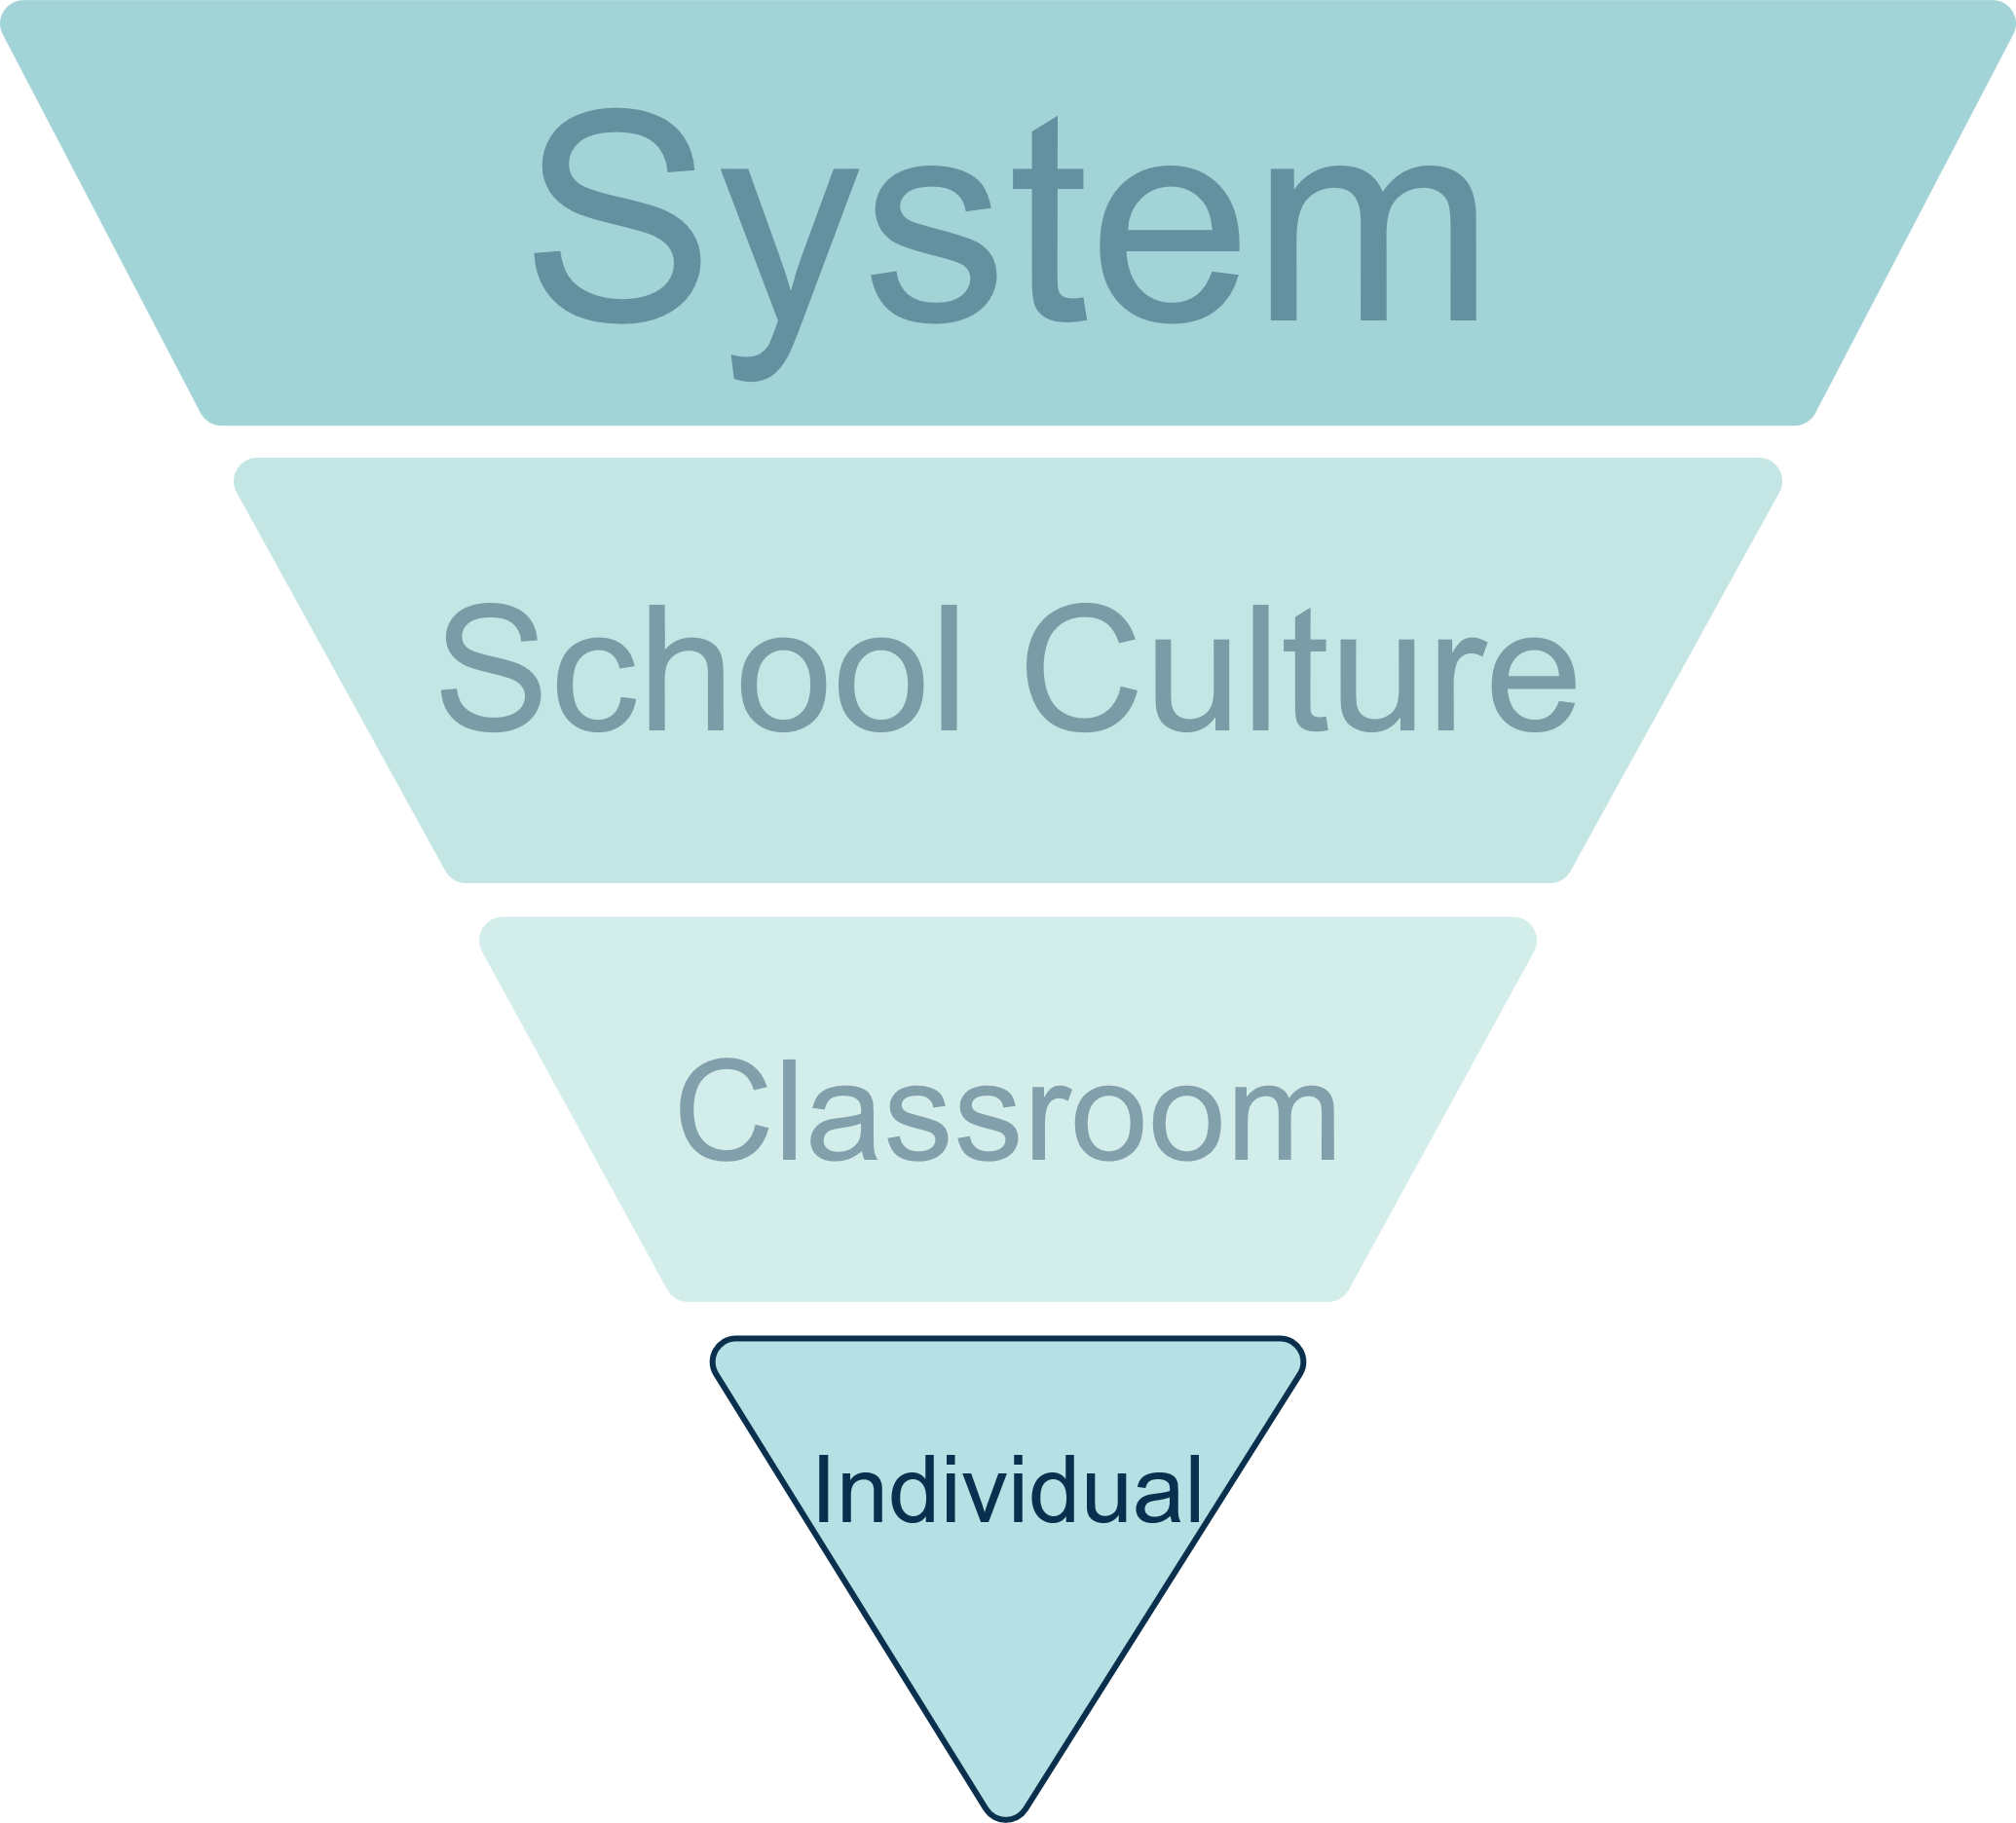
Developing belonging through your personal values
Unconditional positive regard
Curiosity not judgement
Equity guiding decisions
Model respect and emotional regulation
Believe that small acts matter
Notes:
Moving on to the individual part of the pyramid:
These are the values that I have found helpful to guide me as a classroom teacher and perhaps more so as a school leader where decisions can be difficult and I tried to keep the child at the centre of my thought processes.
Unconditional Positive Regard
Believe that every pupil is worthy of respect, regardless of behaviour, ability, or background. This isn’t naïve, I know some might dismiss this as soft or unrealistic especially in the high-pressure environments we work in but I don’t believe it is incompatible with rigour or professionalism, they can all work together—it’s radical dignity- radical because it goes against the deficit-based norms. we are sometimes faced with. It’s dignity because it affirms the worth of every child, not just the compliant or the ones who hit their academic targets. You are saying: I will see you, hear you, and honour you—even when it’s hard. Especially when it’s hard.
Curiosity not judgement
There are many occasions where curiosity is useful. For me working in a school with a high level of need it was invaluable when a pupil dysregulated, disengaged, or disrupted, to ask: What’s this behaviour communicating? Curiosity opens doors that judgment slams shut.
Equity guiding decisions
Fair not meaning equal but being responsive. Take time to think about a situation and maybe adjust your expectations, supports, and interactions based on need, not sameness.
Model respect and emotional regulation
Speak about pupils with dignity, especially when they’re not present- around other members of the team. We know our own nervous system sets the tone. Calm, attuned adults create safe spaces for children and young people. Sometimes that means recognising when you need support, supervision or just some time out so you can be that calm regulated version of yourself.
Believe that small acts matter
A quiet check-in. A name remembered. A choice offered. These aren’t extras—I believe they are the architecture of belonging.

Slide 29

We need an education system that is inclusive by design, where all schools, and all classrooms, are equipped and supported to meet the needs of all children.
Every child attends a brilliant school
Every child feels engaged and enriched by their school experience
Every child is championed to attain and achieve academically and developmentally
Every child is supported to excel and succeed into adulthood
The Children’s Plan: The Children’s Commissioner’s School Census
Notes:
Children’s Commissioner Dame Rachel de Souza has commissioned The Children’s Plan, 4 themes come out of that:
Every child attends a brilliant school, close to home and their friends, that knows them, cares for them and can support their needs, when they need it, for as long as they need it, without delay;
• Every child feels engaged and enriched by their school experience, at a school which offers fun, meaningful and rich experiences, and which enables children and young people to thrive;
• Every child is championed to attain and achieve academically and developmentally, whatever that means for them, at a school which is inclusive by design, ambitious for all children and young people, and dedicated to pastoral care and formation of the whole child;
• Every child is supported to excel and succeed into adulthood, at a school which provides great careers education, with a focus on independence.

Slide 30
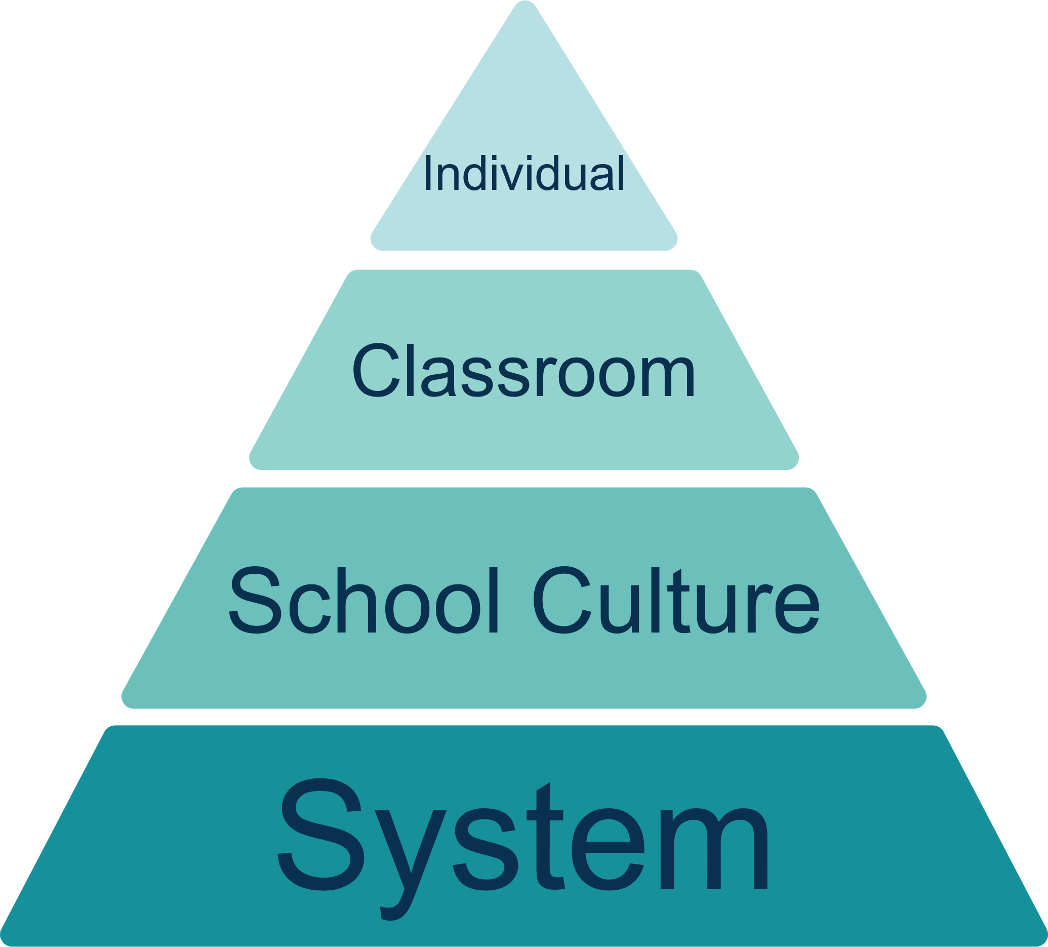
Developing a sense of Belonging and Inclusion
Notes:
Back to my pyramid- not inverted this time!
Because the system is the base, not the summit. Yes It can provide structure, duty, and accountability. It anchors our work in policy, equity, and shared responsibility. But it is not the point of our work.
The point/ the apex stands the individual—the teacher, the TA, the adult who chooses to see, hear, and honour every child. Because belonging is not delivered by system alone. It is enacted, moment by moment, by people.
This upright pyramid reminds us:
That governance supports, but relationships transform
That policy protects, but presence empowers people
That structures enable, but humans connect
And most of all, it reminds us that one person can make all the difference. Not by bypassing the system, but by activating it—through intentional, relational, emotionally intelligent practice.
The pyramid stands upright now because I believe that belonging begins with us.

Slide 31

You have no idea of your power to influence. It’s often the smallest acts that make the biggest difference.
The power of everyday heroes | Jaz Ampaw-Farr | TEDxNorwichED
Notes:
Sorry not time to watch this now but if you need further convincing of the difference you can make, as an individual, take a look at this video by Jaz Ampaw-Farr, ex-teacher and BBC Apprentice contestant, , it’s about 10 minutes long and you might need a hankie but it’s a great reminder of why we do the job!
I saw her speak at a Headteacher conference in Devon some years back. She tells her story as child in school facing all sorts of challenges and says ‘You have no idea of your power and influence. It is often the smallest acts that make the biggest difference- and I agree, in times where it is cool to be an Influencer, as a teacher we can be cool and make such a positive influence on our young people's lives!

Slide 32
Any Questions?
Thank you
Alison Betts
alisonb@nasen.org.uk
Notes:
Thank you for listing to my thoughts on this subject of belonging which I feel passionately about and have seen first hand the difference it can make to children and young people.
Any questions or thoughts that you would like to share.

