Slide 1



Overcoming barriers: autism- specific strategies for meeting the demands of a challenging curriculum
Inclusion Conference: January 22nd 2026
Ms Sarah Rose- Deputy Headteacher and SENDCo
Ms Kate Foxon – Assistant Headteacher: Teaching and Learning

Slide 2

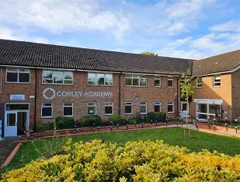

Corley Academy
Corley Academy is a secondary school for children with complex social and communication difficulties. Many of our students have a diagnosis of autism and their academic abilities span the full National Curriculum and GCSE range.
We gained Autism Accreditation through the National Autistic Society in November 2017 and re-accreditation was awarded in 2021.
In 2025, we achieved advanced status.

Slide 3

This session will aim to:
Improve our understanding of autistic learning behaviours
Understand how executive functioning impacts on learning
-------------------------------------------------------------------
Identify autism-specific challenges posed by a GCSE curriculum
Explore strategies to overcome barriers to a GCSE -focusing on literacy

Slide 4

Inclusive Assessment Development
In 2025, we partnered with and presented to Ofqual directors to explore how GCSEs and other Key Stage Four qualifications could be made more accessible for SEND students.
Many of the strategies and autistic learning behaviours explored with Ofqual are contained within this session today

Slide 5

Let’s break it down…
Let’s improve our understanding of autistic learning behaviours
Let’s develop our understanding of how executive functioning impacts on learning

Slide 6






Shared experiences
First – Think about your understanding and previous experiences of autism.
Next - Make notes or discuss if you are with others.
Then – Add your comments to the ‘chat’ function.

Slide 7


If this activity was in the classroom, we might use a timer to…
Support time management
Replicate exam timings and ‘chunking’
Offer predictability
Be aware- timers can increase anxiety or pressure for some. Preparation and practice is key.

Slide 8

Autism
Autistic people communicate, interact and process the world around them differently.
Autism is:
A neurodevelopmental difference
Diagnosed in more than 1 in 100 people
Often co-occurs with other condition (around a third of autistic people may also have a learning disability, autism in itself is not a learning disability)
Not a mental health condition though mental health issues may arise
“The National Autistic Society emphasizes that autism is a lifelong neurodivergence- a difference, not a deficit- and that acceptance and understanding, not harmful myths or cure narratives, are vital’
(National Autistic Society, 2025)

Slide 9

How we talk about autism
Evolving attitudes and understanding about autism
Language preferences (Identify-first person language “autistic person”)
Shift from focus on negative perceptions “deficits, impairments, symptoms, high/low functioning, mild, severe”
We are not “all a little bit autistic”.

Slide 10



Autism is broadly defined by the triad of impairments:
Social communication
Differences in understanding and using verbal and non-verbal communication
Social interaction
Differences in forming and maintaining social relationships
Social imagination
Differences in flexibility of thinking, predicting outcomes or understanding others’ perspectives.

Slide 11
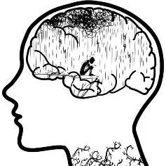


Autism is a spectrum condition and affects people in different ways.
Below is a list of difficulties autistic people may share, including the two key difficulties (in red) required for a diagnosis.
Social communication and social interaction challenges
Repetitive and restrictive behaviour
Over/under sensitivity to light, sound, taste or touch
Highly focused interests or hobbies
Extreme anxiety
Meltdowns/shutdowns

Slide 12
Autism and related conditions
AD(H)D – Attention Deficit (Hyperactivity) Disorder
Anxiety
Asperger Syndrome (no longer used as a diagnosis)
Attachment Disorder
Additional Learning Difficulties
Bipolar Disorder
Bowel/Immune
Depression
Dyslexia
Dyspraxia
Dyscalculia
Fetal Alcohol Syndrome
Epilepsy
Mental Health
OCD – Obsessive Compulsive Disorder
PDA – Pathological Demand Avoidance Disorder
Pica
Sensory Issues
Self injurious behaviour
Self stimulation or ‘Stimming’
Sleep problems
Tourette Syndrome
Visual Impairment
Epilepsy
Not an exhaustive list!

Slide 13



Theory of Mind ‘Theory of mind’ is an important social-cognitive skill; it involves the ability to think about mental states, both your own and those of others. It encompasses the ability to attribute mental states, including emotions, desires, beliefs and knowledge. It is knowing who you are and who others are around you.
Executive Functioning
Executive Functioning is a set of mental skills that help you get things done, they help you.
Manage time
Pay attention
Switch focus
Plan and organize
Remember details
Avoid saying or doing the wrong thing
Do things based on your experience
Multitask
Central Coherence
In their interactions with the environment, or in recalling information most individuals will recall an overall impression or the gist of something. Individuals on the autism spectrum tend to be more, focused on details; this can often be at the expense of understanding the actual meaning or appreciating the nature of a situation or context.

Slide 14

Executive Functioning- analogy 1
Having poor Executive Functioning is like a filing cabinet with no file dividers therefore very difficult to catalogue, file, sort, order, prioritise etc.
How do you know which drawer to go to when trying to locate a file?
Without EF in this scenario, there is no clear sense of when to start, what to do, how fast to work or when to finish.

Slide 15
Let’s break it down…
We will identify autism-specific challenges posed by a GCSE curriculum.
Together we can explore strategies to overcome barriers to a GCSE -focusing on literacy

Slide 16
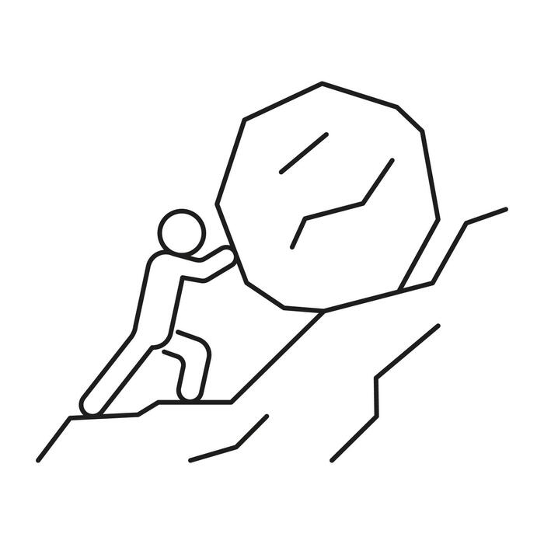


Based on the first half of the session, what challenges might someone with poor executive functioning face when studying a GCSE curriculum?

Slide 17
GCSE Challenges for a student who struggles with EF:
Working out what skills are needed to answer a specific question
Working out what equipment is needed for an exam eg Calculator Maths Exam, Technology practical.
Getting started on a task or exam question, particularly without prompts.
Working out how long to spend on a task/how long you have left (how many marks allocated)
Working out how/where to start a task/piece of writing, even with an image prompt.
Working out what order to do tasks in
Working out what to do if you get stuck on a question
Remembering what to remember!
Knowing what information is important.
How to prioritise for revision.
Using information from your memory to do a task (working memory)
Being able to evaluate your own work
Learning from your mistakes
Knowing when to stop, especially when extra pages are provided.

Slide 18
Corley Academy GCSE (all subject) best practice strategies:
Explicitly teach revision skills, specific to each subject area.
Teach the relevance of skills and information learnt- why it is important to them?
Teach students what certain question types mean eg. “Can you name the main characteristics of Macbeth’s personality?” requires more than the answer “yes”! (Explain, describe, compare, evaluate, state, identify)
Practise exam techniques in the appropriate places as it will be ‘on the day’ including access arrangements
Teach students to recognise when it is and isn’t appropriate to include special interests
Use of dividers and colour coded systems to compartmentalise curriculum areas by skill or topic
Refer to mark scheme to justify marks awarded: this is not ‘teaching to the test’
Ensure the student has a visual timetable suitable for their level of functioning.

Slide 19


Literacy-specific strategies
We are all teachers of literacy
The following strategies are not only based on autism best practice but on Rosenshine’s Principles of Instruction, adapted for our students.
They share common themes:
Clarity
Structure
Visual
Adaptive and personalized (TS5)
‘Process not product’

Slide 20
Visual cues and prompts
What?
- A photograph, clipart image or other visual (could just be a colour) which accompanies a text, instruction or resource. The photograph should be realistic where possible (e.g. no cars with eyes!)
Why?
Signals the key Literacy skill students need
Links language to images which helps language acquisition
Gives a context to a story: e.g. setting, genre
Reduces anxiety- predictable and manageable

Slide 21




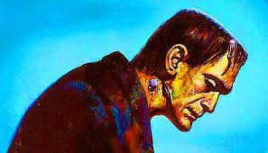

Examples:
Paired talk in an oracy task
Time expectations for a task (accompanied by a timer)
A change (planned or unplanned)
A context clue alongside an extract.
Also an emotional cue.
The requirement to write

Slide 22
Simple and clear texts
What?
This does not mean shying away from complex and challenging texts as this will restrict our students from being ‘GCSE ready’.
This means making it clear to read- not obstructing meaning through presentation.
At Corley Academy, we use Calibri for everything and aim to use double or 1.5 spacing.
Why?
Reduces sensory stimulation
Improves readability
Reduces cognitive load- the focus is on the question- no distractions.

Slide 24
Structure and Scaffolding
What?
Using ‘first, next and then’ to introduce a series of tasks, literacy processes or instructions.
Providing a writing frame for an extended task, ‘chunking’ tasks into manageable parts
Offering opening sentences or word banks.
Why?
Rosenshine’s ‘gradual release of responsibility’- breaking tasks into manageable steps
Students will need to understand parts of a text or concept in order to grasp the ‘whole’.
Manageable ‘chunks’ and ‘first’, ‘next’ and ‘then’ reassures students of progress (particularly in writing) and emphasizes the building or development of skills.

Slide 25





What will we do this lesson?
First, Mrs Foxon reads the text aloud and ‘notices’ conflict imagery in stanza 1.
Next, 5 minutes skimming and scanning for conflict imagery in stanzas 2 and 3.
Then,
Read and discuss poem
Questions on poem.

Slide 26
Comic strips and storyboards
What?
A comic or series of pictures which shows a plot in simple stages or images to explain part of a text or help them sequence a narrative.
Students can also be given a blank storyboard which they can use to plan their writing or show their understanding of a text.
Why?
Visual learning- helps students to organise ideas and sequence events

Slide 27
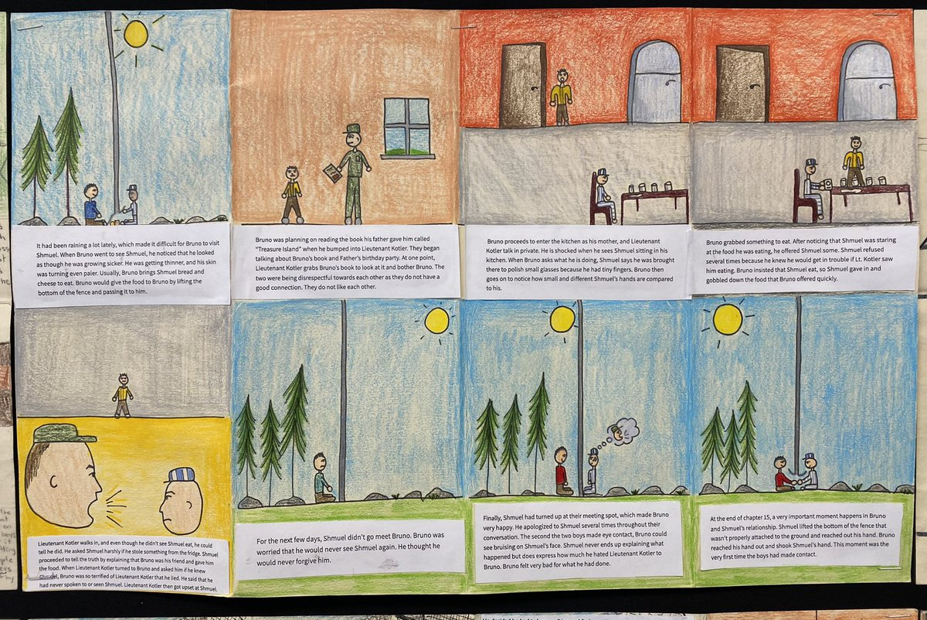



‘The Boy in the Striped Pyjamas’- an emotionally challenging text- as a storyboard
First | Next | Then
A simpler three step comic strip- ideal for short stories and poems. This can also be used for concepts across the curriculum.
Distinguishing what is said and what is felt. Making ‘masking’ accessible and linked to studies.

Slide 28
Build familiar into unfamiliar or difficult concepts- special interests
What?
Using a student’s special interests in the body of a spelling test, SPaG based activity or any text used to explore a new or challenging concept.
Why?
Autistic students often have a special interest and this can therefore mean that any inclusion of it in resources or texts can be a ‘way in’ or a ‘hook’.
This can be as simple as using an image linked to their interest next to a spelling test but works best if it is embedded (however tenuously!) into the content.

Slide 29
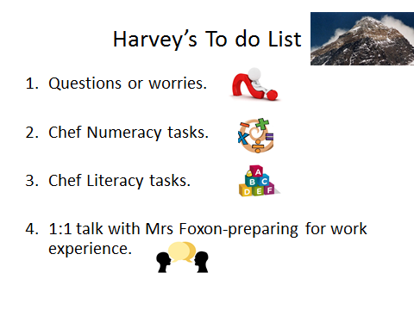
Add punctuation to the following paragraph:
Mum and dad were so happy with josh because he had won both trampoline competitions and collected bronze silver and gold in his football tournament after school they decided to take him to the odeon cinema in coventry to watch his favourite film the watchmen

Slide 30
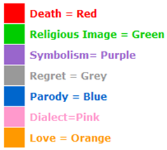
Colour coding
What?
Using a key to colour code techniques in a passage: e.g. poetic techniques, themes, persuasive techniques.
Students choose the colours that match their key and identify the elements in non-fiction and fiction texts.
This can also be used in self and peer assessment
Why?
Highly visual way to find techniques, comment on how frequently poets or writers use them and identify them in their own or others’ work.
Comfort comes from ‘matching’ and ‘sorting’.
At the end of the activity, the student can usually more accurately comment on the range of techniques used as it is seen at a glance. In terms of literature, students can see how a writer threads a particular theme throughout a passage.

Slide 31
Numeracy: Venn diagrams and character emotion graphs
What?
Students use venn diagrams to compare two texts or two characters, finding differences and common ground.
Students label a horizontal axis with the chapter names or key ‘moments’ in the text and the vertical axis with either a word (‘Happy’) or visual (☺) to represent feelings.
The feelings are then plotted against this.
Why?
Mathematical security of Venn diagram and its visual element
Challenging skill of comparison to be presented quickly and clearly
The venn diagram can be adapted appropriately- partly filled in, filled in with cloze activity or not filled in depending on ability.

Slide 32
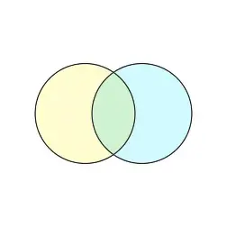
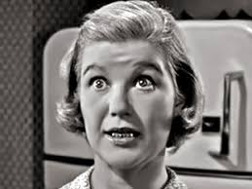
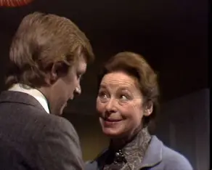
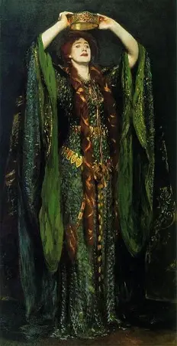

Numeracy-Literacy examples:
A Venn diagram comparing Mary Maloney and The Landlady in two short stories by Roald Dahl
A ‘power’ graph for Lady Macbeth in Shakespeare’s play- Act and Scene on horizontal axis and level of power (from weak to powerful on a scale of 0-10) on the vertical axis

Slide 33
Pace and processing time
What?
Pausing between questions or instructions when exposition is given verbally
Using timers to schedule specific ‘time out’ between tasks and monitoring the delivery speed of the voice.
This should not be confused with pace of progress.
Why?
Supports understanding- extra time means students process questions carefully
Reduces stress- slower pace allows focus without being rushed

Slide 34


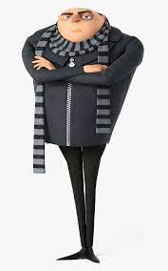
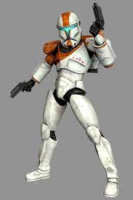

‘Write Now’- Week Four
In a primary school, a teacher is trying to explain the purpose of the nucleus in a cell. She describes it as being like the ‘boss’.
Using ideas from Marvel, Despicable Me or other ideas of your own, write down how the nucleus is like a boss or controller.
Sentence starters:
‘You can compare the nucleus to…’
‘A nucleus is similar to… because…’

Slide 35
Visuals for abstract concepts
What?
Using a visual to represent figurative language such as metaphors, similes, personification or alliteration makes something abstract more concrete.
A P.E.E. sandwich, for example, also identifies the need to develop a deeper level of analysis through a visual.
Why?
Autistic students can find most concepts hard to visualise but abstract concepts that have no familiarity or ‘grounding’ in their world can be challenging.
In this way, anything visual that supports something that cannot be ‘seen’ will reduce anxiety and clarify understanding.
Disclaimer- a metaphor or analogy can also pose challenges as it is not concrete so should be used only with preparatory learning and full explanation.

Slide 36


PEEL burger
P
The first piece of bread is your point about the question – introduce your first point in a couple of sentences.
Remember to use the PEEL burger paragraph to help structure your answer.
E
The middle of the burger must always be supported by two pieces of bread. Remember the quotation is your evidence and is condiment to you answer.
E
You must support your quotation. EXPLAIN how your quote supports your point. Without any explanation, your burger will have no meat (substance) to it. Especially if you ignore the effects of language!
L
Now you need to link your point back to the original question. Without this link, your burger will fall apart!

Slide 37
‘Bloom’s’ for reading, oracy or writing
What?
Using ‘Bloom’s Taxonomy’ of lower to higher order skills in terms of scaffolding reading tasks or challenge.
Start students with comprehension-based information retrieval, move towards asking them to describe or explain a concept and finally use the reading source as a springboard for students to create their own text (e.g. a diary entry as one of the characters).
Why?
Reducing anxiety is key- GCSE English exams are also often structured in this way; starting students with a task they can manage and building them towards more complexity or inference supports their self-confidence.
They learn to gradually ‘dig deeper’ into a text and that a text has layers.

Slide 38
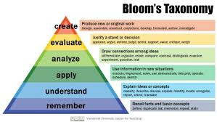
Example:
Where did Billy Weaver travel to?
Why did Billy Weaver think it was a good idea to walk ‘briskly’?
3. The living room seems inviting. Using evidence from the text, explain why.
4. Look at lines 24-48. In what ways does Roald Dahl present the Landlady as being unusual? Use evidence from the text in your response.
5. One student said, “The start and middle of this story foreshadows the sinister ending.” How far do you agree with this statement?
6. Imagine that you are Billy Weaver. You are in your bedroom shortly after drinking the tea (which tasted “faintly of bitter almonds”). Explain your thoughts, feelings and worries.

Slide 39


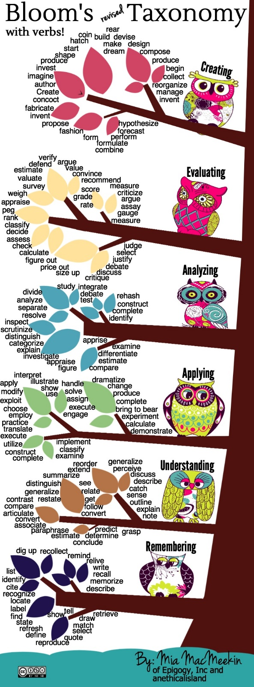
Reasoning
Talking Point Rules
Everyone must contribute to the discussion.
We should use the talking point sentence starters.
We should not interrupt somebody.
We should add, build and challenge other people’s points.
We should not say ‘Basically…’
We must not use the word ‘like’ unless making a comparison.
Tell me what your thinking was.
If you know that, what else do you know?
What can you work out from the information? How?
How can we test that?
Why is that right? How do you know?
Why is that bit important?

Slide 40
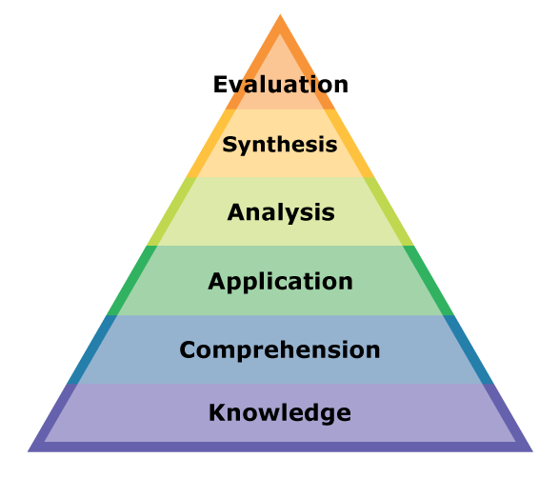
Considering all the evidence we can say that…
Talking Points
Having analysed the facts my conclusion would be…
I think…is more important because…
If we compare…with…we can conclude that…
Considering all the arguments…
The most valid point appears to be…
There is evidence that…
On the one hand…on the other hand…
It could suggest…however…
In that case…
The main ideas are..
It’s interesting that…
I partially agree because…
Thinking about…
In my opinion…
I contest…
I agree…
I disagree…
I think…

Slide 41
This session aimed to:
Improve our understanding of autistic learning behaviours
Understand how executive functioning impacts on learning
-------------------------------------------------------------------
Identify autism-specific challenges posed by a GCSE curriculum
Explore strategies to overcome barriers to a GCSE (focusing on literacy)

Slide 42

Just one thing…
One thing have you learned about autism that you did not know before?
or
One strategy or technique can you use in your teaching practice?
or
One way you can adapt your teaching approach to cater for autistic students sitting GCSEs?
Contact details:
Kate Foxon
k.foxon@corley.thrive.ac
If time, please add your reflections into the Chat function.

