Slide 1

Education and the importance of inclusion
Kulbir Shergill
Director of Social Inclusion
University of Warwick

Slide 2
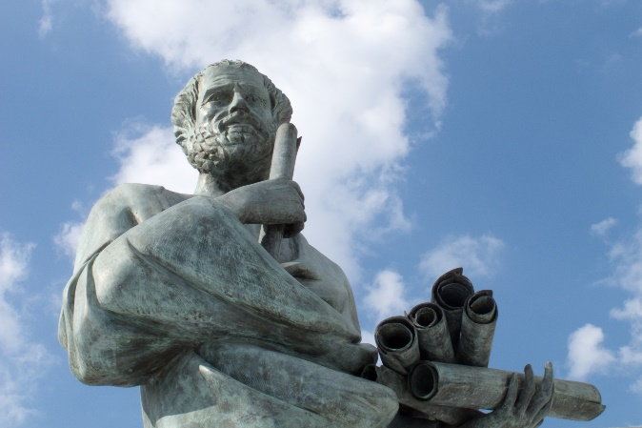
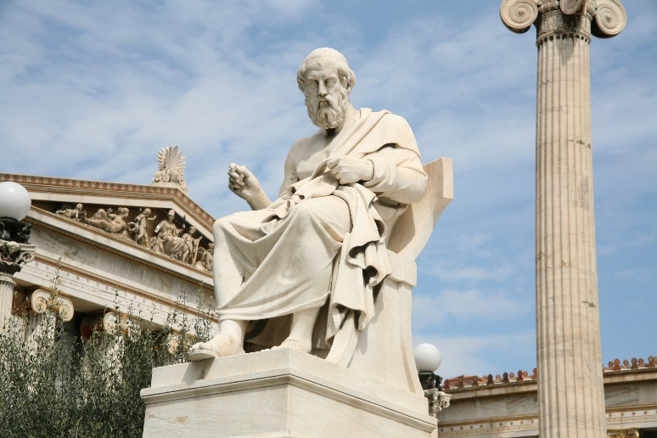
The Ancient Greeks on unconscious bias
‘People love those who are like themselves’
Nichomachean Ethics - Aristotle
‘Similarity begets friendship’
Phadedrus - Plato

Slide 3





Everyday micro-incivilities
Ignored and interrupted
Constantly criticised
Stereotypical judgements
Not giving eye contact
Not pronouncing name correctly

Slide 4
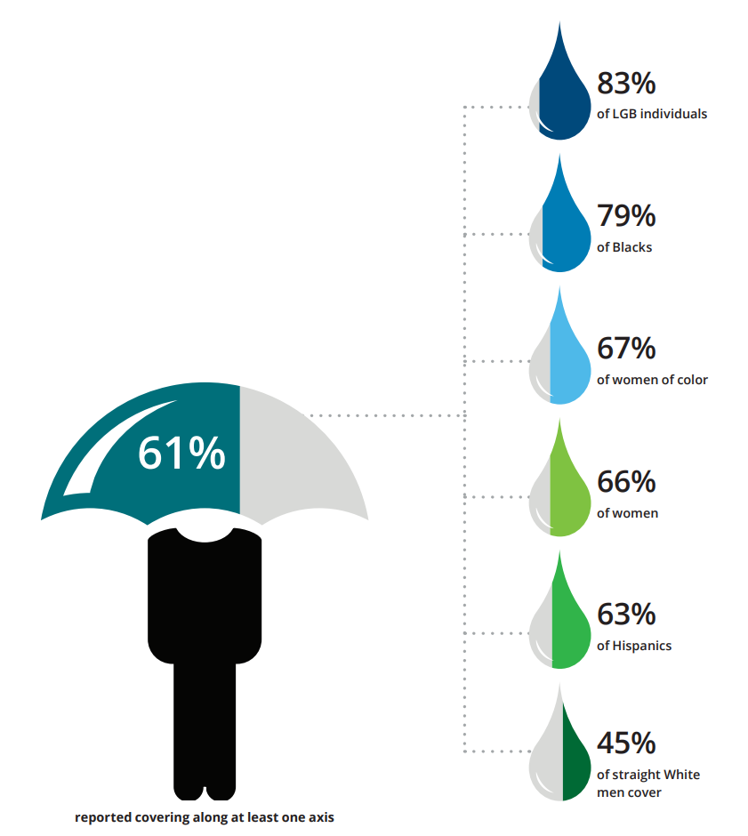
Covering at Work
Deloitte University

Slide 5




Covering – Four Types
Appearance-based
Advocacy-based
Affiliation-based
Association-based

Slide 6
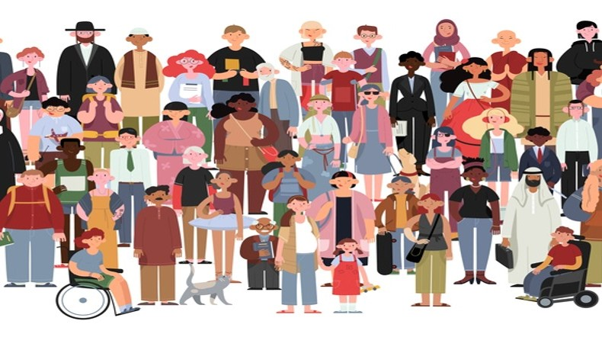
Satisfaction of Individual Needs
Belonging and Uniqueness

Slide 7
Inclusion…
… creating an atmosphere that values respects and intentionally engages differences.
An inclusive culture is one in which people feel comfortable, connected and supported with individuals who are similar, and also with those who are different.
Where they are free to express their opinion and can disagree because there’s a high level of trust among all group members.

Slide 8

Unconscious Bias

Slide 9
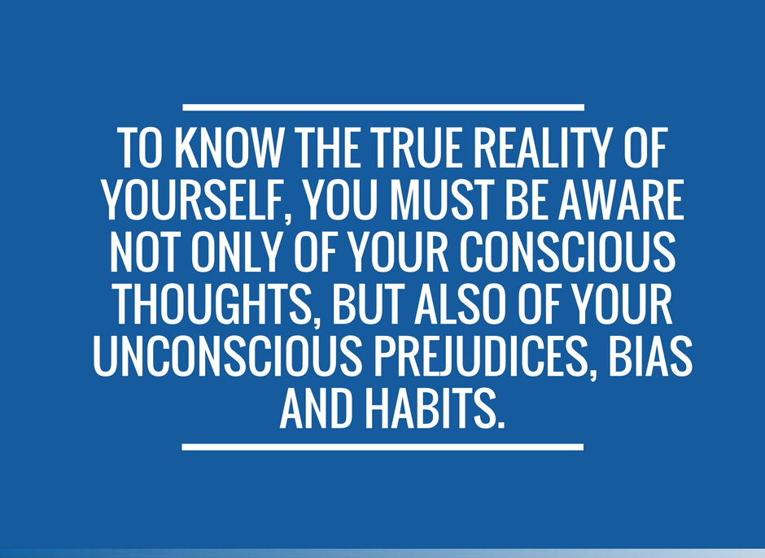
Reducing our biases
Personal events
Exposure and relationships
Empathy
Being aware of our biases

Slide 10

Interventions

Slide 11

Actions of Inclusive Leaders
Being an ally and never a bystander
Respectful of & understanding individuality
Nurture diverse talent
Understanding benefits of diversity and embedding inclusion

Slide 12

Being inclusive

