Slide 1

Getting to grips with subject specific mentoring at Warwick
Mentoring Conference 2023
Thursday September 28th

Slide 2
The Lead / Professional Mentor perspective
How confident are you in understanding of how the Warwick mentoring model works in practice, what makes mentoring successful, and how to identify an effective subject mentor?
What will you need to do to both support / QA your subject mentors in school?
What support would you value?

Slide 3




Practical shift from teacher to mentor
How will you manage the shift change from teacher to mentor?
Notes:
Challenge number one; Change of gear – teacher to mentor

Slide 4



How CTE Principles support Mentoring
Improvement: improve not prove
Trainee Agency: trainee-led instructional coaching approach – trainees are an active part of the process
Supportive: identify trainees who are not on track to achieve the TS by the end of programme to enable intervention and support (need sufficient information to inform this)
Dialogic: an entitlement to dialogue with expert colleagues /entitlement to expert mentoring and observation of expert colleagues
Clarity: shared expectation of expected progress AND of important principles e.g. WTV, expectations of support.
Purposeful - streamlined to ensure that assessment contributes to progress with a minimum of workload
CTE Principles of assessment
Notes:
the underpinning principles for the Warwick Mentoring Approach.

Slide 5

The subject mentor works with a trainee in weekly one-to-one sessions to gradually improve both their teaching skills and their teacher identity.
The level of support is matched to the trainees’ level of proficiency – working on a continuum of support and will involve the mentor, and other experts, modelling practice, providing opportunities for observation, providing instruction, data collection and most importantly the use of questioning.
Our model is an approach that maximises opportunities for mentees’ learning and growth by responding to their individual learning and support needs and, in doing so, employs a range of authoritative and/or mentee-centred moves as appropriate.

Slide 6
PUSH – PULL mentoring continuum
Myles Downey (2014)
PULL -
NON-DIRECTIVE
Listening to understand
Asking questions to raise awareness
Promoting reflection
Providing feedback
Guiding
Making suggestions
PUSH -
DIRECTIVE
Instructing
Notes:
Instructing –
Offering guidance –
Providing feedback – making suggestions – asking questions which rtaise awreness

Slide 7




Warwick’s Mentoring Model, based on Instructional Coaching (Knight, 2013)
Cycle to be repeated as new target set or target is adjusted to meet the needs of the trainee.
Analyse New / Current Reality
Set targets
Identify and explain teaching strategies – co-construct targets/goals
Provide support until targets are met (mentorship)
Notes:
Talk through each stage providing examples in practice.
CTE has taken the principles of Instructional Coaching, Jim Knight (2017) and has adapted the model to provide an ‘evidence-informed mentoring model’ to support trainee progress,
Instructional coaching is all about improving teaching and learning. The focus should be solely on the next steps that teachers can take to improve what they do in the classroom. The aim is that little-by-little, week by week, term
by term, trainees are building up their teaching skills and forming more effective teaching habits. This results in every teacher getting better at their own pace and in their own stage of development
So, how is this done?…. Through a dialogic approach, supporting trainees to meaningfully discuss what they do in the classroom each day and consider tangible next steps as to how they can improve.
Talk through each stage providing examples in practice.

Slide 8
Mentoring is relatively non-directive, with mentees supported to find their own solutions to issues they encounter.
There is a greater emphasis on professional growth and building on mentees’ strengths, focussing on the development
Development of the mentee’s knowledge, practice and pedagogy
Support for the mentee’s wellbeing
Induction into the organisation and the wider profession
Support for the mentees’ evolving teacher identity

Slide 9
Pause for thought…
Our model is an approach that maximises opportunities for mentees’ learning and growth by responding to their individual learning and support needs.
What will you do to support / ensure that your mentors are adapting their mentoring to support individual trainees?
Notes:
Amend slide to create a 10 minute task

Slide 10

Reality
Eyes
Ask
Listen
Telling people what we think of their performance doesn’t help them thrive and excel, and telling people how we think they should improve, actually hinders learning
Reality
Feedback fallacy (Buckingham and Goodall, 2019)
Notes:
Mentor guidance paperwork

Slide 11

Reality
Eyes
Ask
Listen
It is a fallacy that feedback contains useful information, and that this information is the magic ingredient that will accelerate someone’s learning.
Eyes
Learning rests on our grasp of what we’re doing well, not on what we’re doing poorly, and certainly not on someone else’s sense of what we’re doing poorly.
The ‘Landry’ Effect – focus on where and what they have done that has had a positive impact. It’s where they are most open to possibility, most creative, insightful and productive.
The Feedback Fallacy (2019)
Notes:
Conceptual Review of Mentoring, 2022
Collaborative – transformative type – building on mentee strengths
Tom Landry – visionary leadership in American Football – coaching teams to victory

Slide 12

Establishing the current reality
Trainee: Think about how you started a lesson
Trainee: Think about how you managed behaviour in a lesson
Use the ranking questions to guide reflection to establish reality.
Notes:
Refer mentors to mentor’s guide to the weekly form – ranking questions

Slide 13
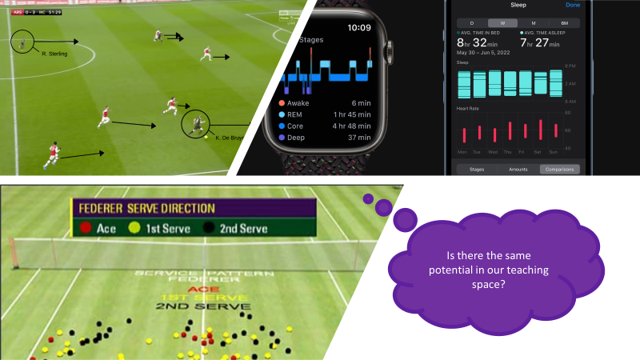
Gathering stats
Notes:
Examples in a sporting context -

Slide 14
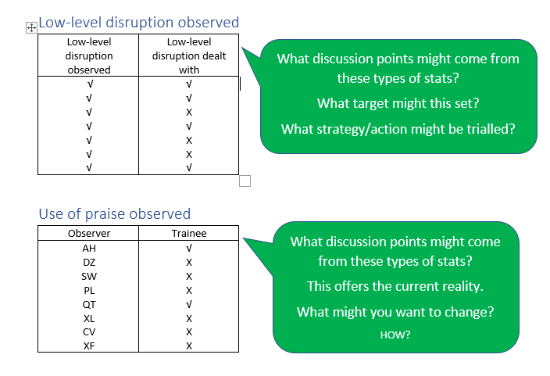

Slide 15
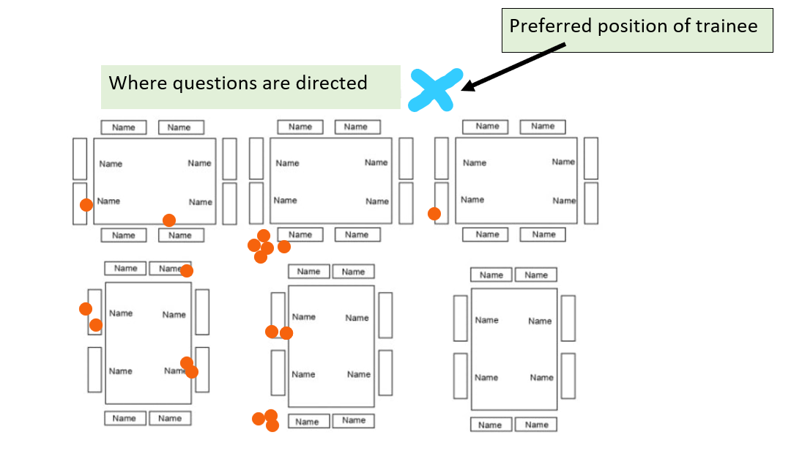
Notes:
Remember ‘Rough and Ready’! :)

Slide 16
Explore examples of stats collected in subject specific lesson observations.
Questions linked to activity:
What conclusions might you draw from this information?
What questions might you ask here to draw out reflection
How/where might you link this to PPU activities for further research/exploration/expert modelling
What types of stats would be valuable to track in the subject specific environment?
How does the weekly mentoring form support the dialogue?
What else?
Notes:
Explore examples of stats collected in subject specific environment – what conclusions might you draw from this information?

Slide 17

Reflective
Prompting Action
Visionary

Slide 18

Reality
Eyes
Ask
Listen
Ask
Notes:
Exploring – what and how – rather than why questions – question sort activity

Slide 19
Reflective
Are there any questions you do not like?
Prompting Action
Visionary

Slide 20
Why questions are not open questions!
Why questions imply judgement.
Why questions ask for definitive answers
Why questions are often a challenge not an invitation.
Why questions making the respondent defensive
Why questions seeks one true response which the respondent must take ownership for.
Focus on the what and the how
Notes:
What is it that attracts you to this option at this time?’
‘How did you arrive at this decision?’

Slide 21

Reality
Eyes
Ask
Listen
Feedback Fallacy, (2019)
We learn most when someone else pays attention to what’s working and asks us to cultivate it intelligently.
Listen
Conceptual review of mentoring (2022) – features of sustained productive mentor – mentee relationship includes high quality questioning and listening
Notes:
Shift from teacher to being the mentor – use the video of the guy – what makes a good listener

Slide 22
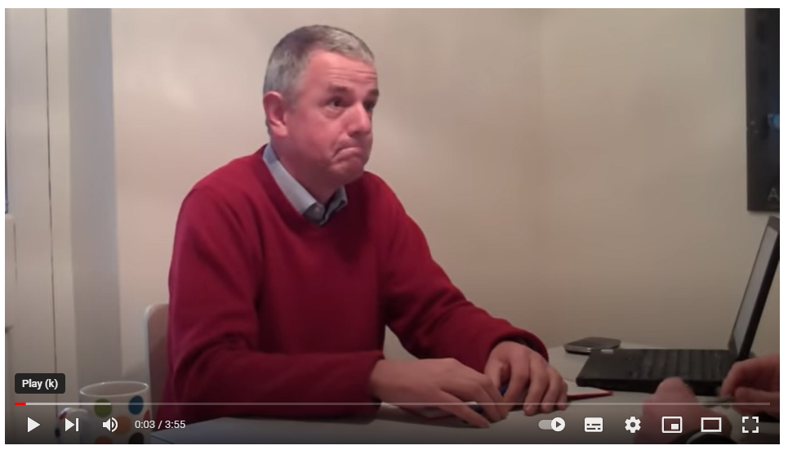
Listening to encourage thinking
Why might this person think they are doing an ok job at coaching?
Top 5 for successful active listening habits
Notes:
Include physical positioning and body language
https://www.youtube.com/watch?v=WrR_EgmUc3Q

Slide 23
Telling people what we think of their performance doesn’t help them thrive and excel, and telling people how we think they should improve, actually hinders learning
Reality
Eyes
Ask
Listen
Learning rests on our grasp of what we’re doing well, not on what we’re doing poorly, and certainly not on someone else’s sense of what we’re doing poorly.
Focus on the what and how and not the why that implies judgement.
We learn most when someone else pays attention to what’s working and asks us to cultivate it intelligently.
Notes:
Mentor guidance paperwork

Slide 24
Trainee learning
Instructional coaching model
through
R.E.A.L
Professional
Practice
Units
Mentor/teacher using expertise
School practice
University teaching
Improving outcomes for learners

Slide 25
Integrating the Trainee curriculum at Warwick
Being a subject mentor
Just, intellectually curious and creative

Slide 26
What subject specific stats might you gather?
Take your favourite questions.
How could you make them more subject specific.
What other questions might you ask?
Notes:
For PE – teacher talk, pupil activity, pupil thinking
Teacher talk quality – what is the narrative –thinking about the Ologies, the health bit the GROW bit
Time taken to get to learning destination

Slide 27
Exploring the PPUs with a subject lens

Slide 28
Your subject curriculum

Slide 29
Setting weekly targets
The focus is on changing the behaviours of the learners in the teaching space.

Slide 30
Creative Mentorship
Risk taking – looking beyond the curriculum

