Slide 1

Research is for Life –
Not Just for Christmas (Conferences)!
Research in Action Conference
15 December 2023

Slide 2

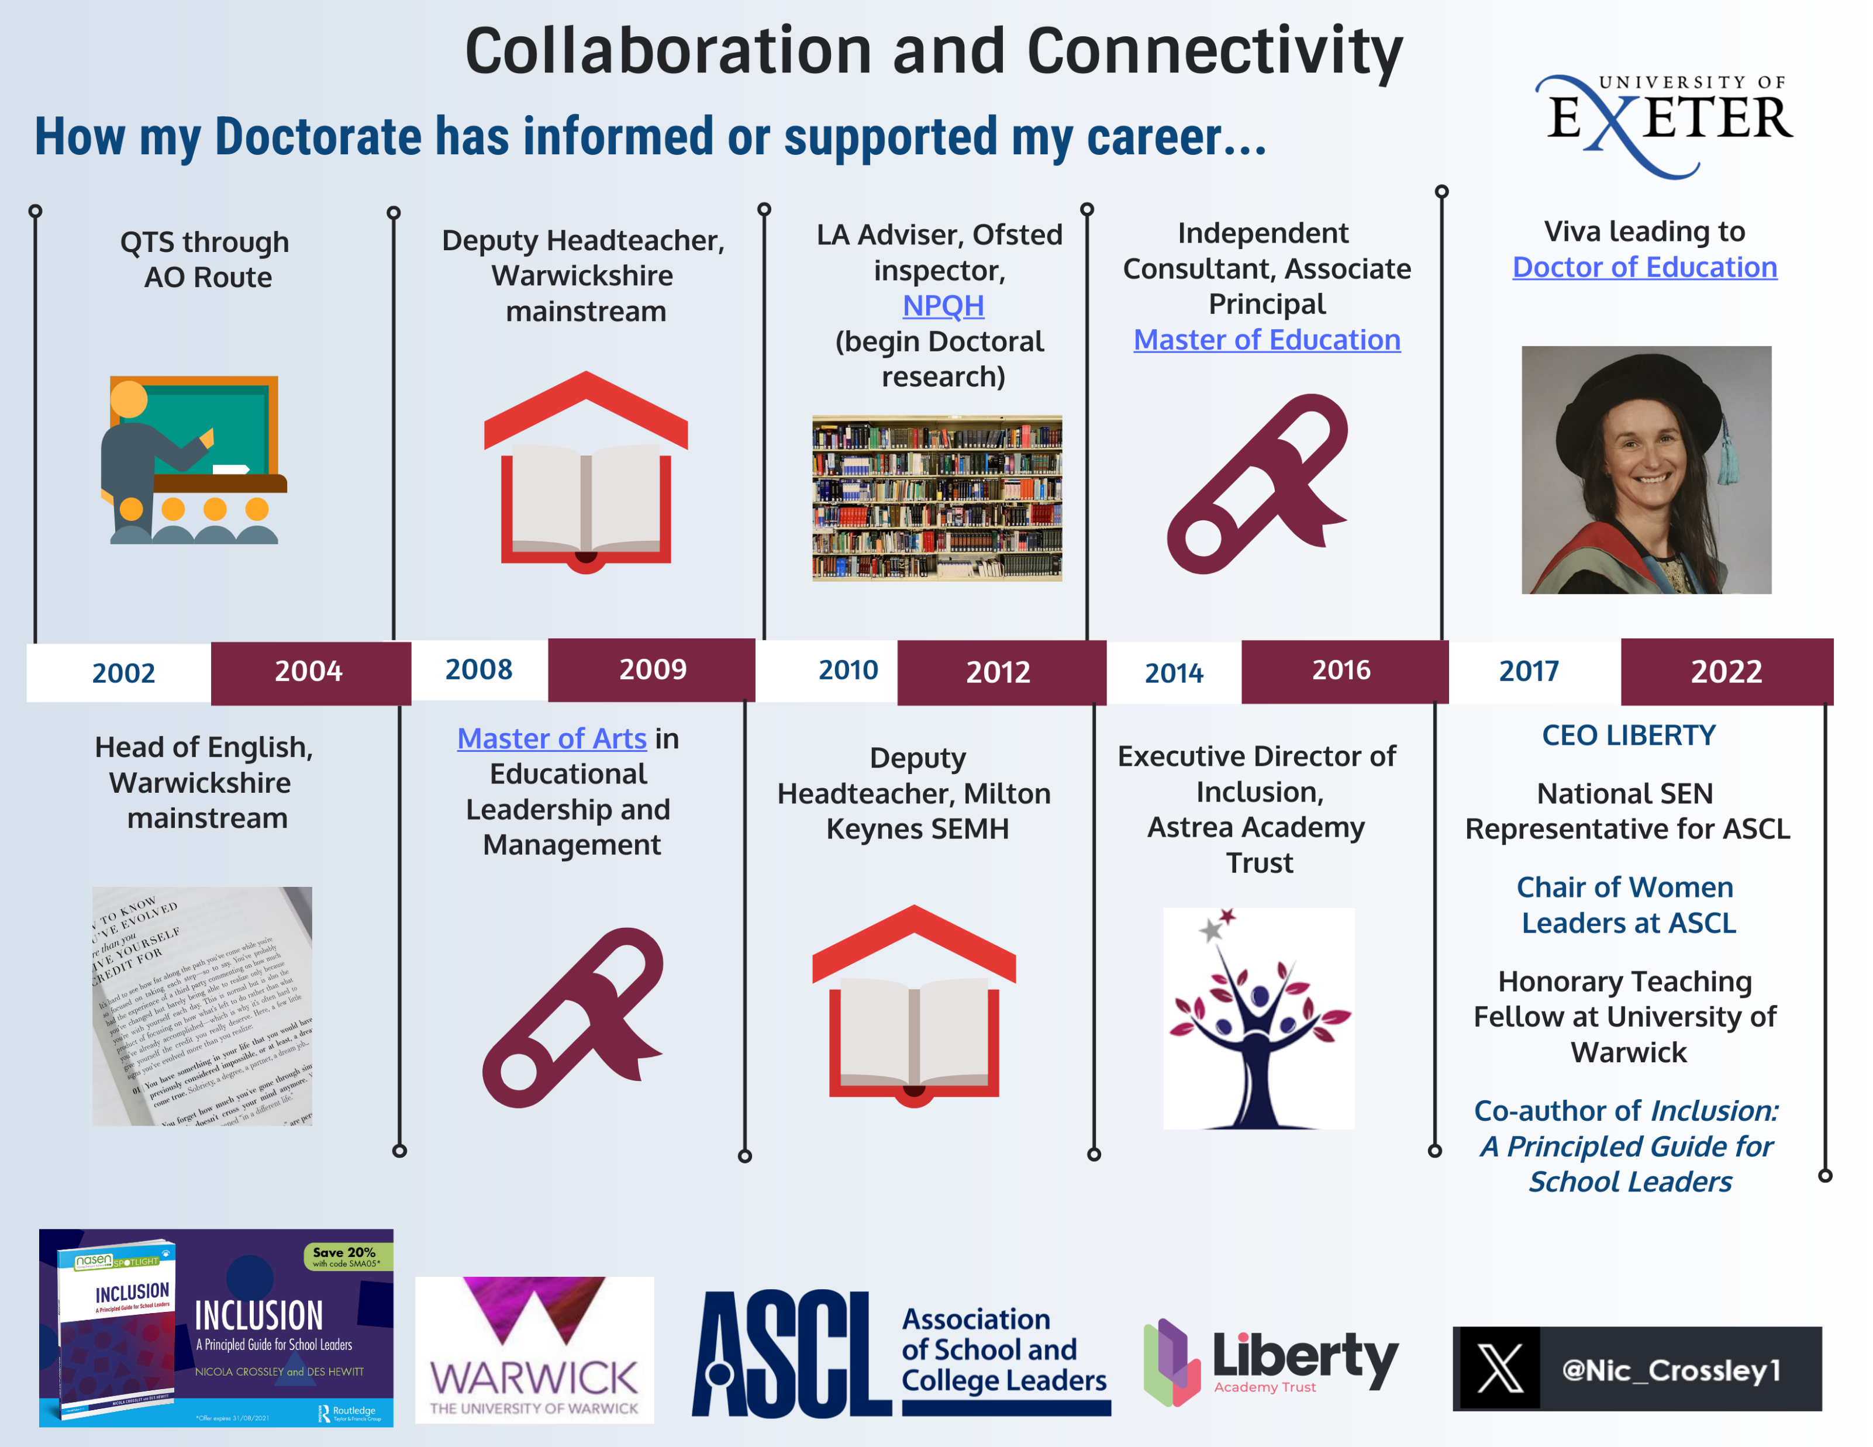
From Classroom Teacher to CEO

Slide 3
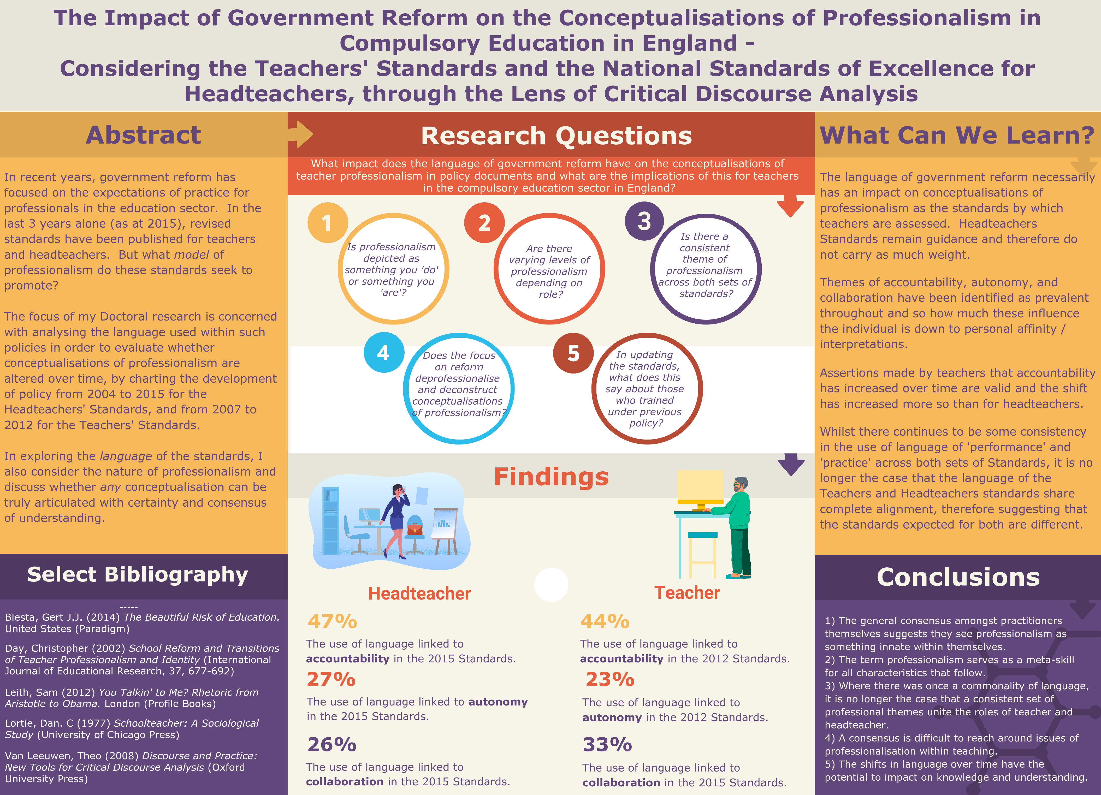
Doctoral Research

Slide 4




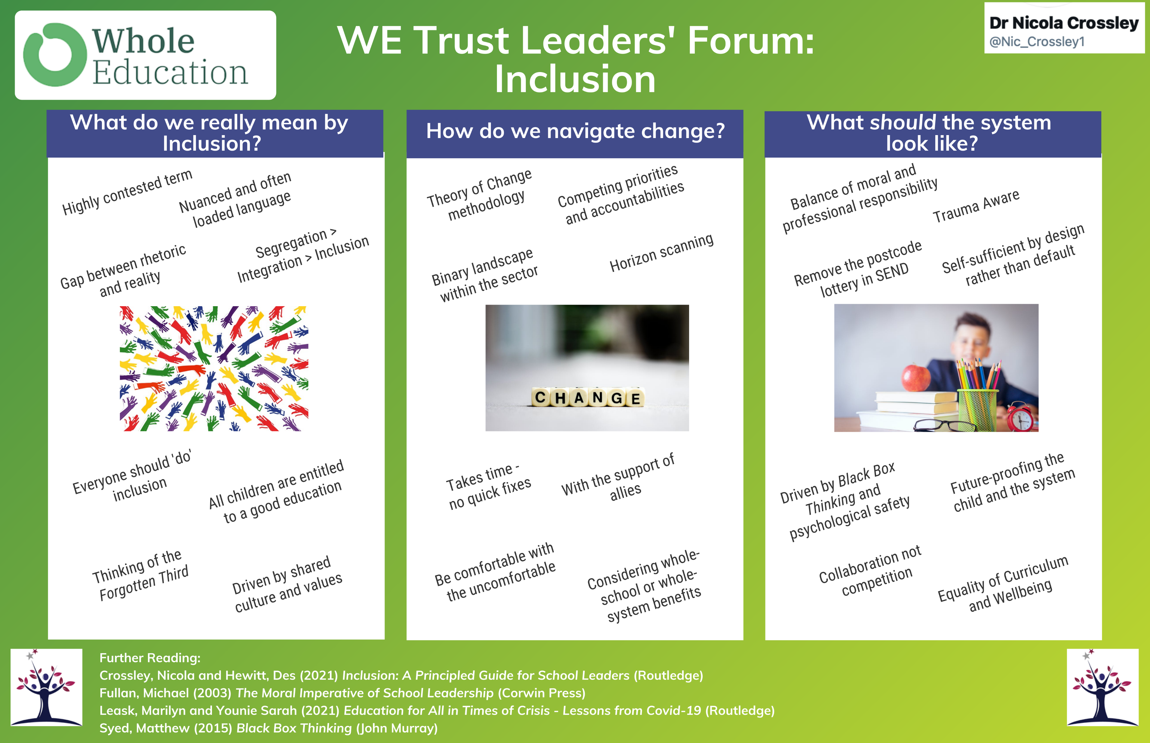

Speaking Opportunities
2016
2017
2019
2020
2021
2021

Slide 5

Developing a Research-Informed Culture

Slide 6
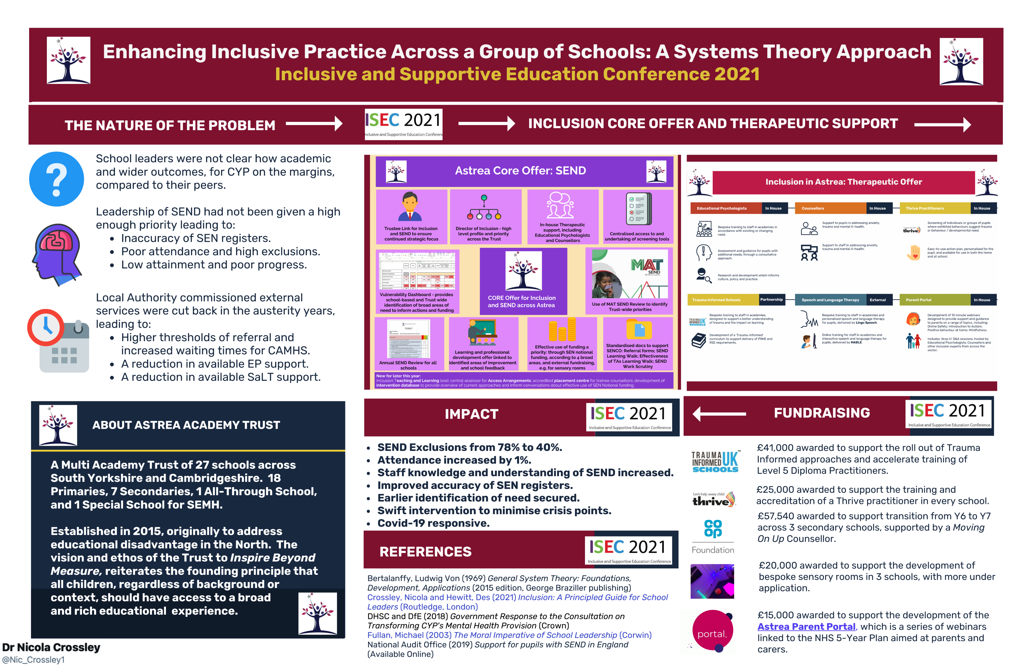
Undertaking Research (1)

Slide 7
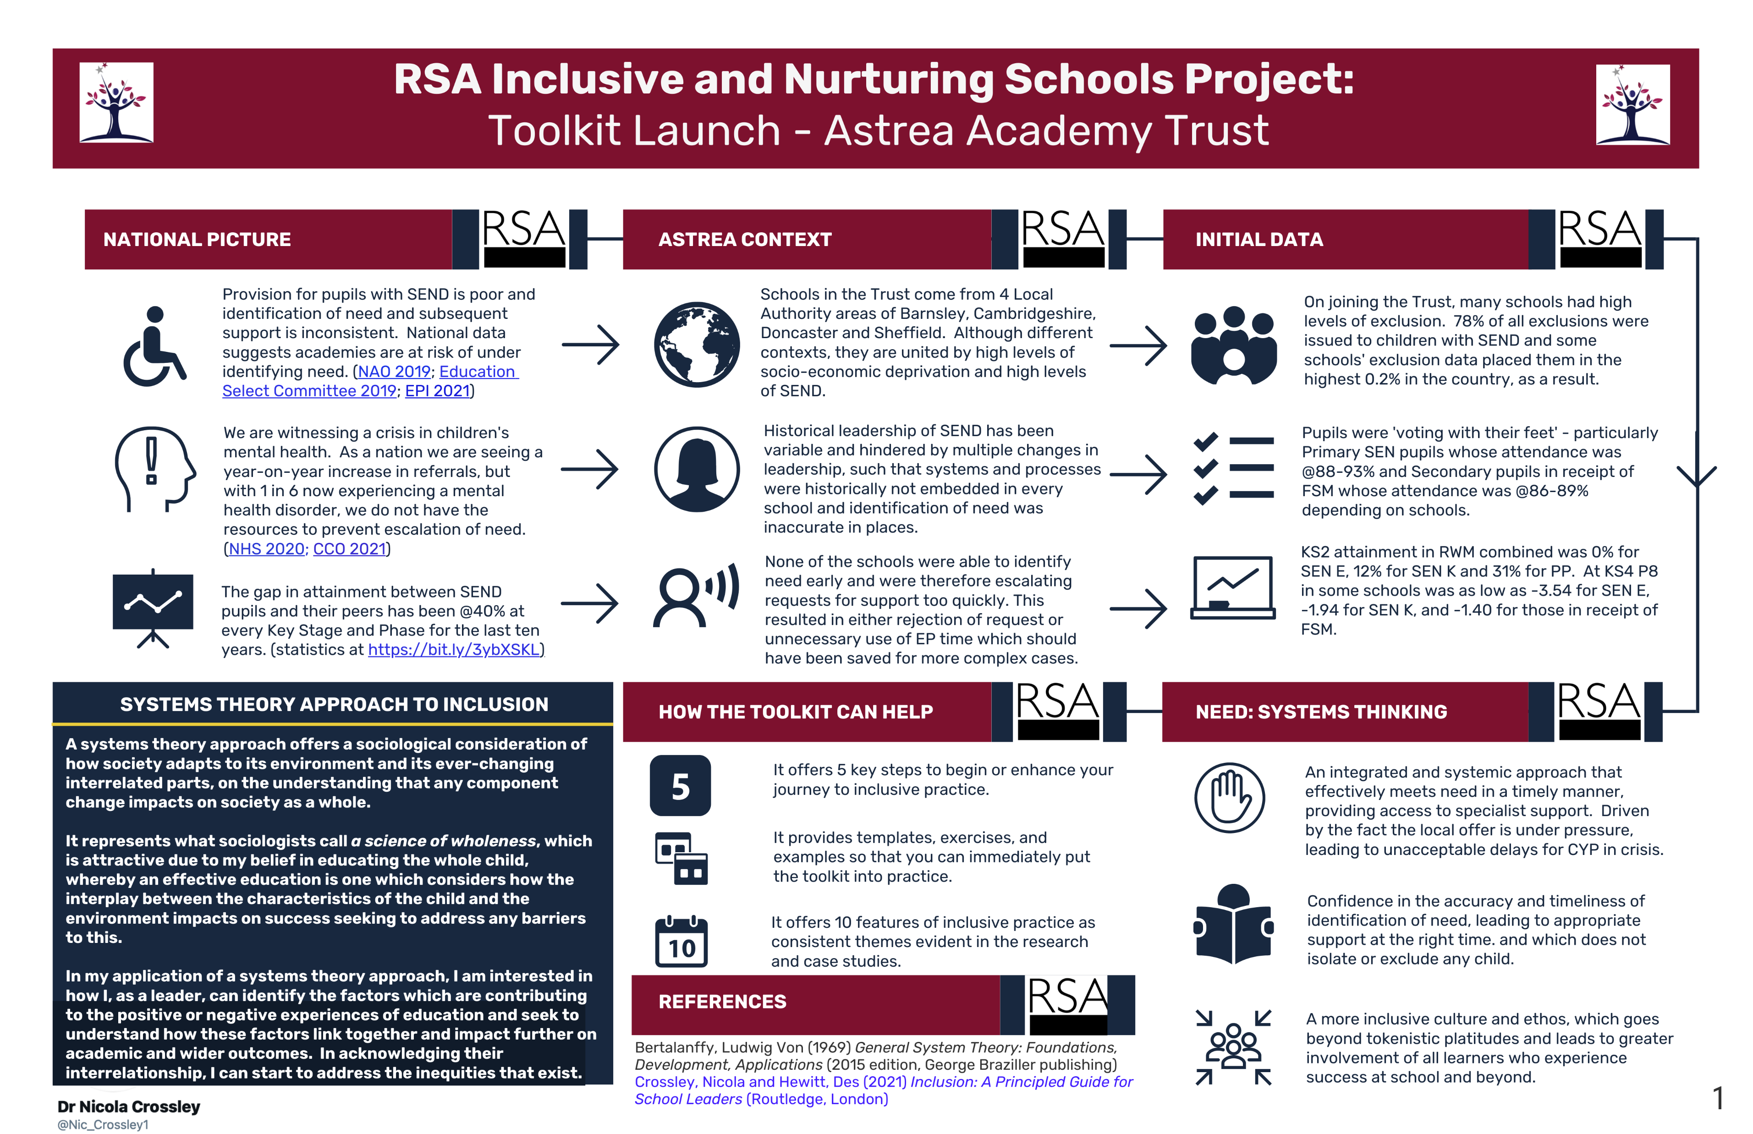
Undertaking Research (2)

Slide 8
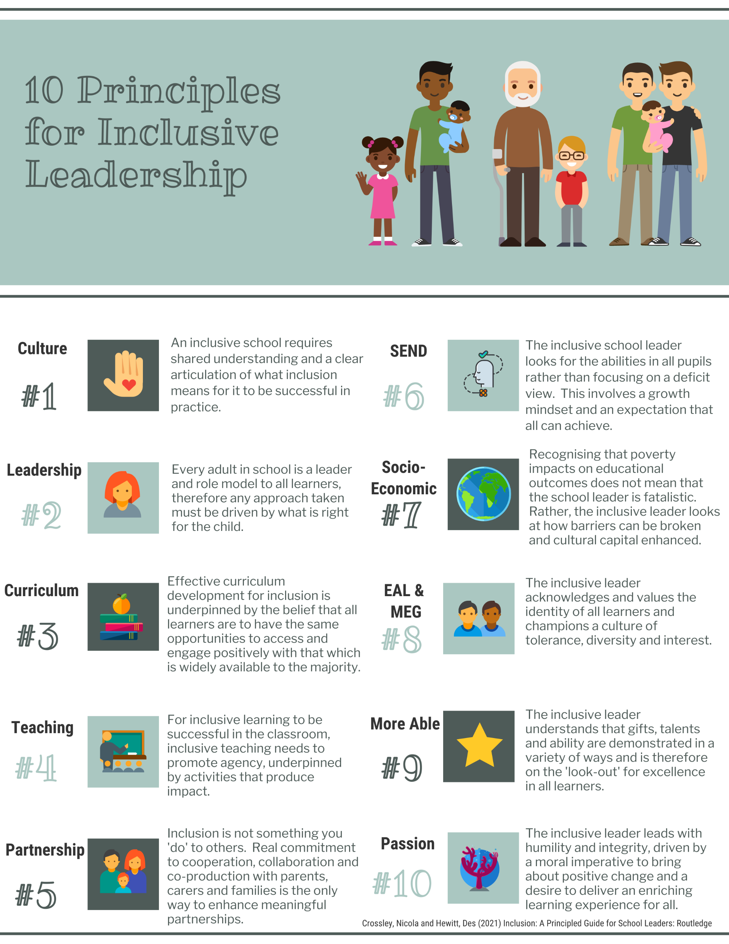
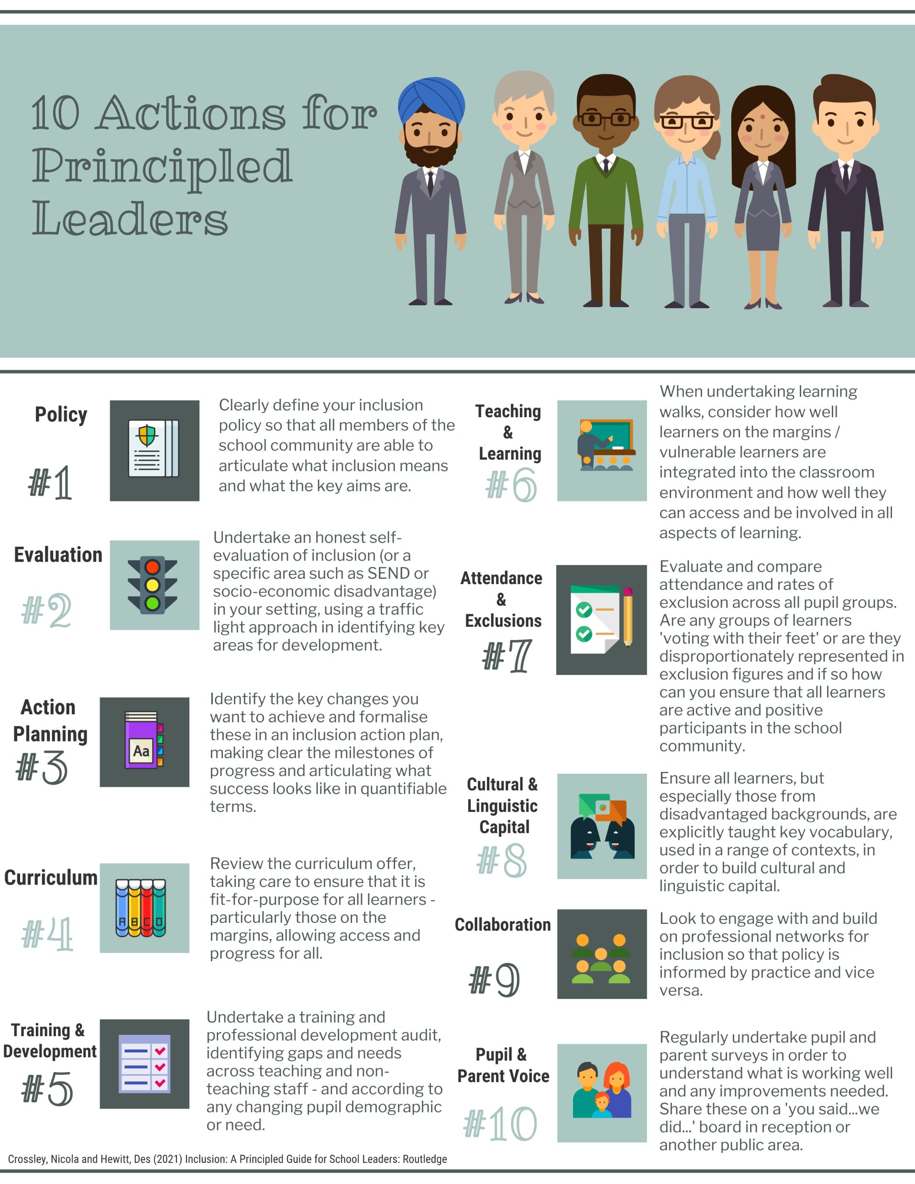

Research
in Print (1)

Slide 9
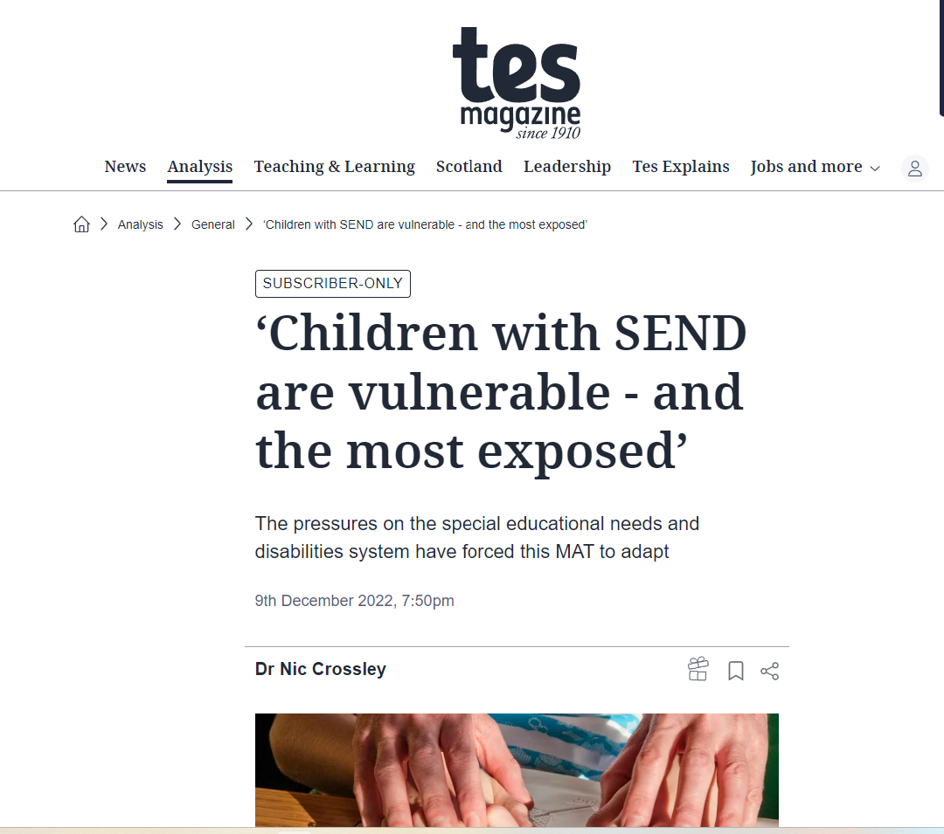

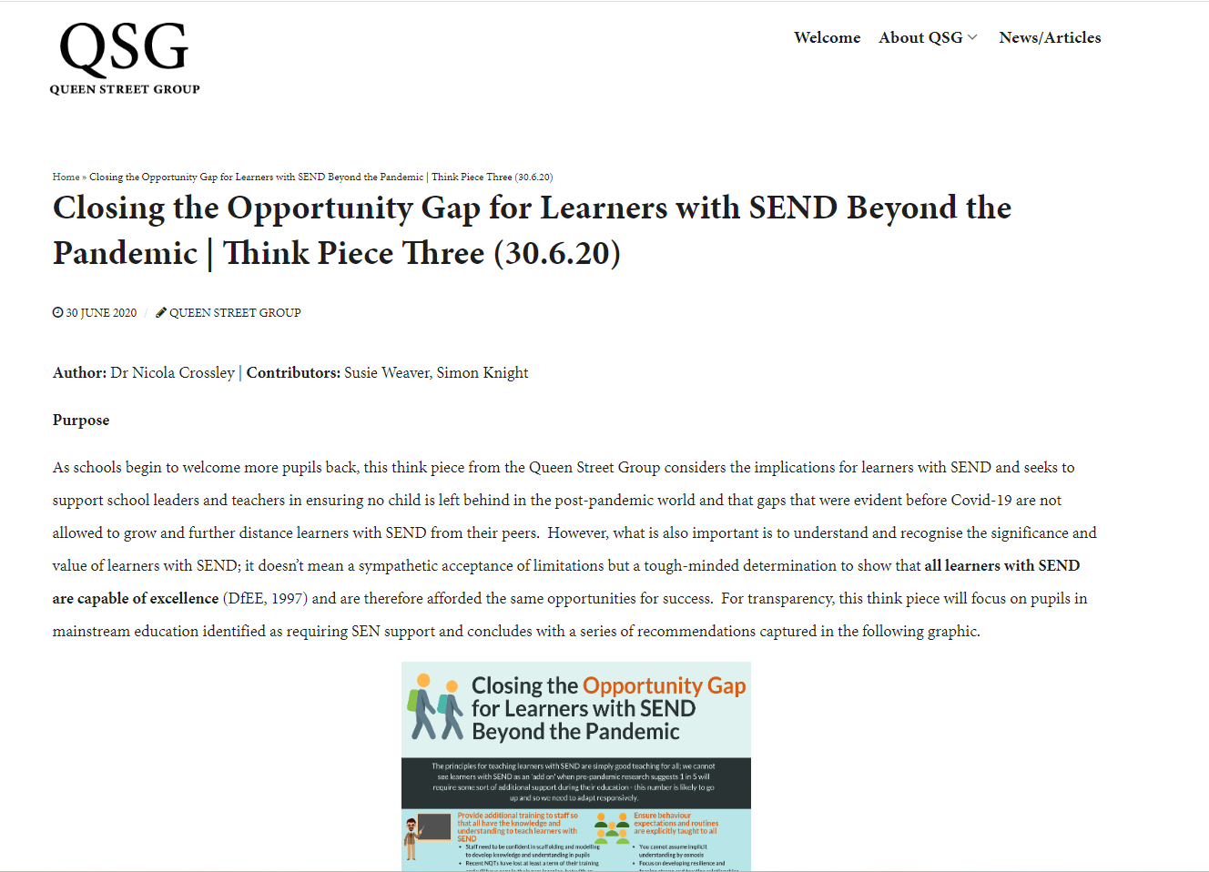
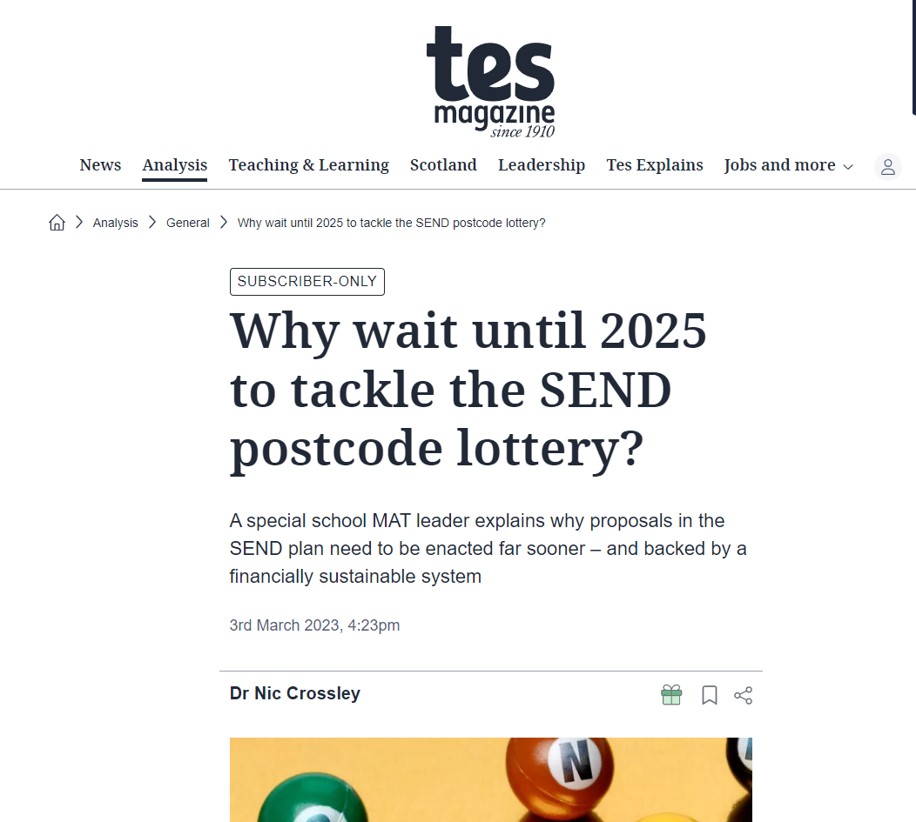
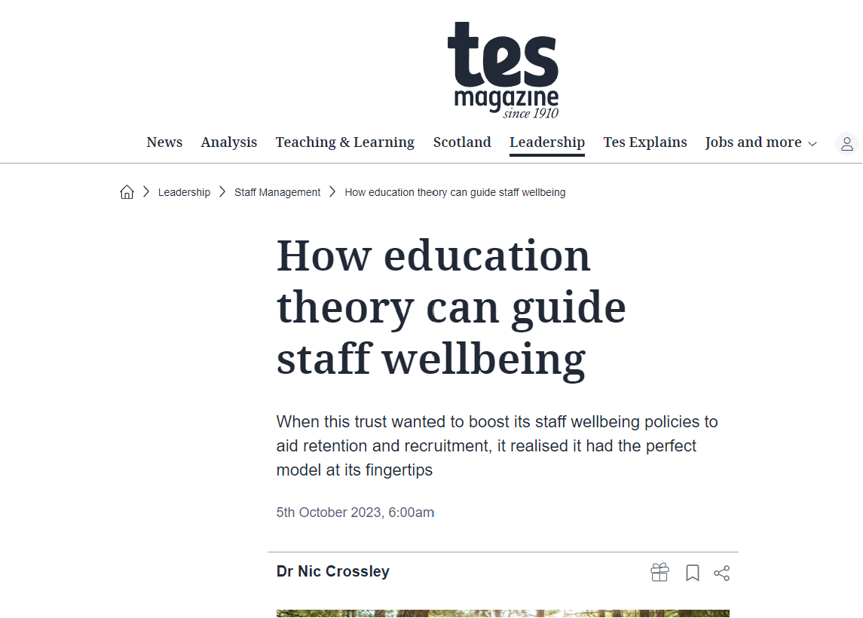
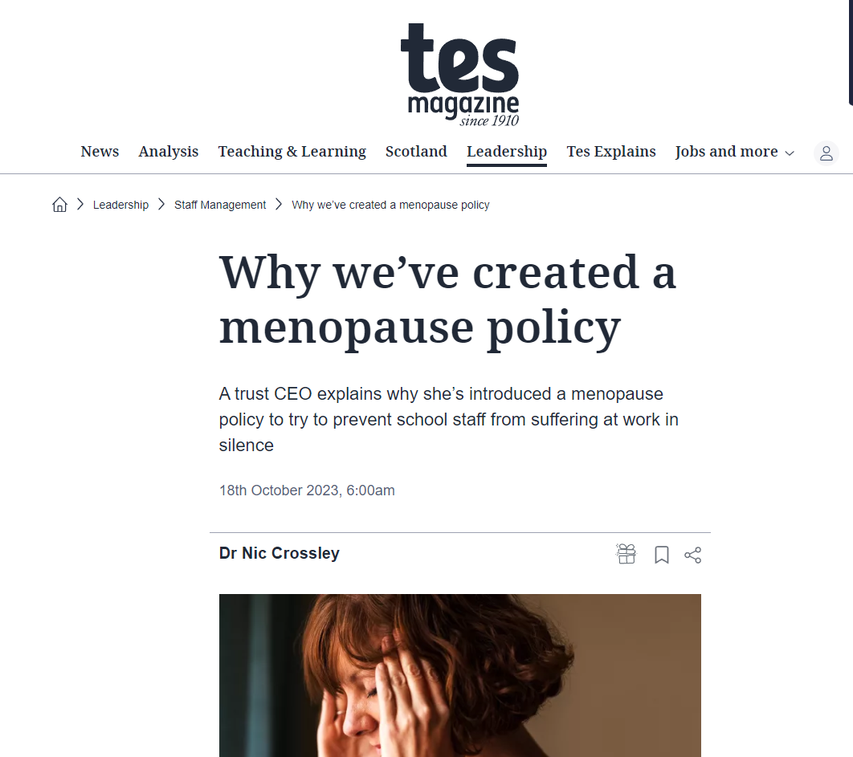
Research
in Print (2)

Slide 10
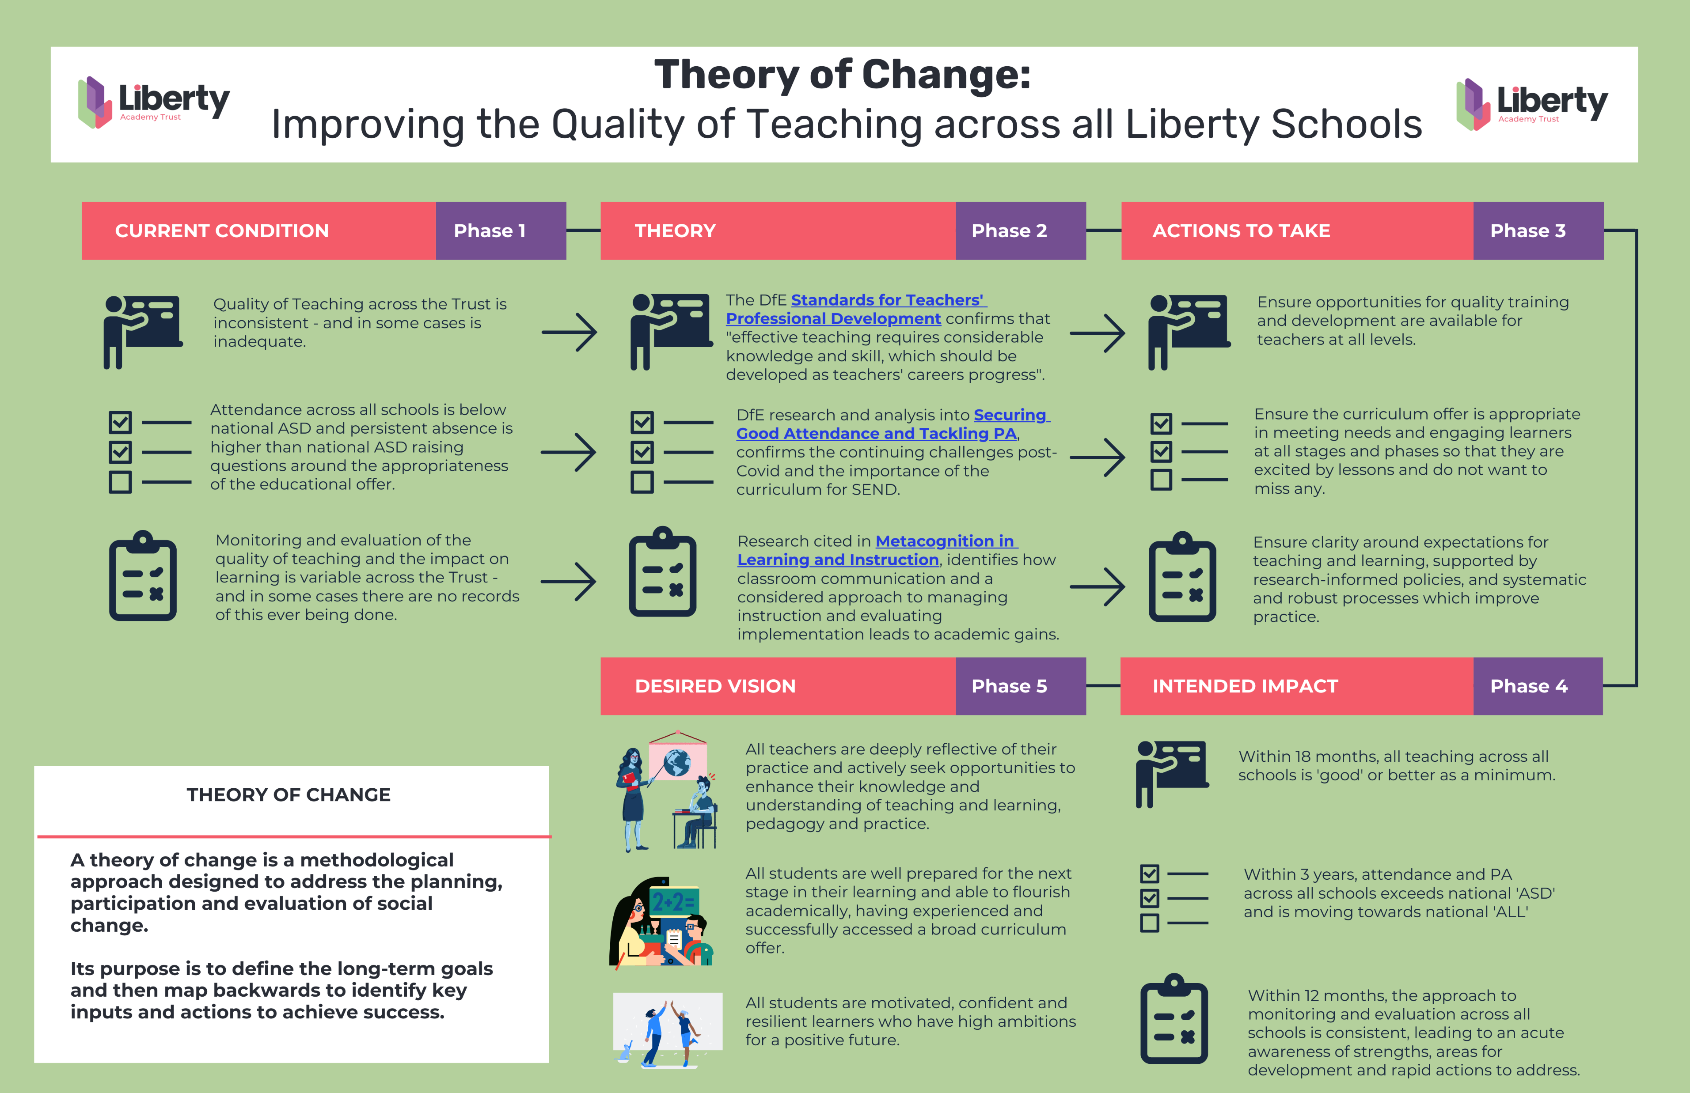
Undertaking Research (3)

Slide 11
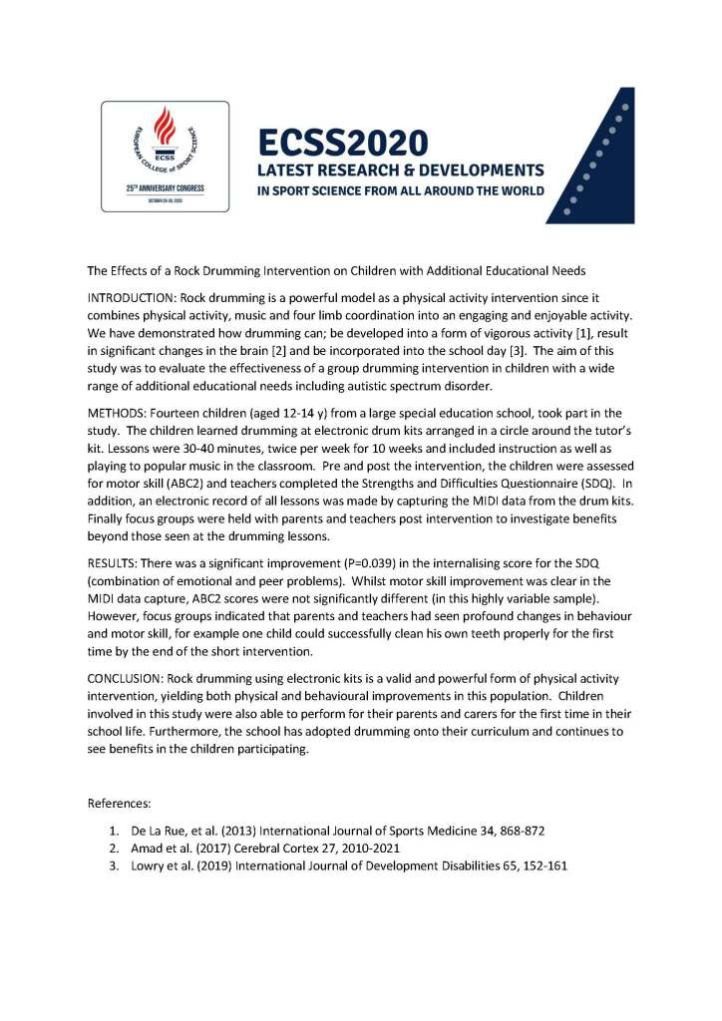

Next Research Project (2024-2026)
Undertaking Research (4)
Half-termly projects
Control group and research group
No prior experience of playing drums
Groups of 5 pupils
School Champion acts as link between academics and school
Drum tutor provided
Project ends with a performance
Qualitative data through semi-structured interviews of pupils, staff and families

Slide 12
Key Principles to Hold Onto
Closing Thoughts
Be curious and inquisitive about what’s going on in your classroom
Actively seek opportunities for collaboration
Don’t be afraid to share your research / ideas / thoughts more widely
Subscribe to either paid or free research journals and publications (BERA / EEF as examples)
Try to engage in research activity at least once a year

Slide 13



Thank you!
nicola.crossley@libertytrust.org.uk
@Nic_Crossley1
National SEN Representative for ASCL*
nicola.crossley@ascl.org.uk
* Association of School and College Leaders

