Slide 1
Instructional Coaching; student teacher learning; and how engaging in research can change your thinking
Chris Westwood (he/him/his)

Slide 2
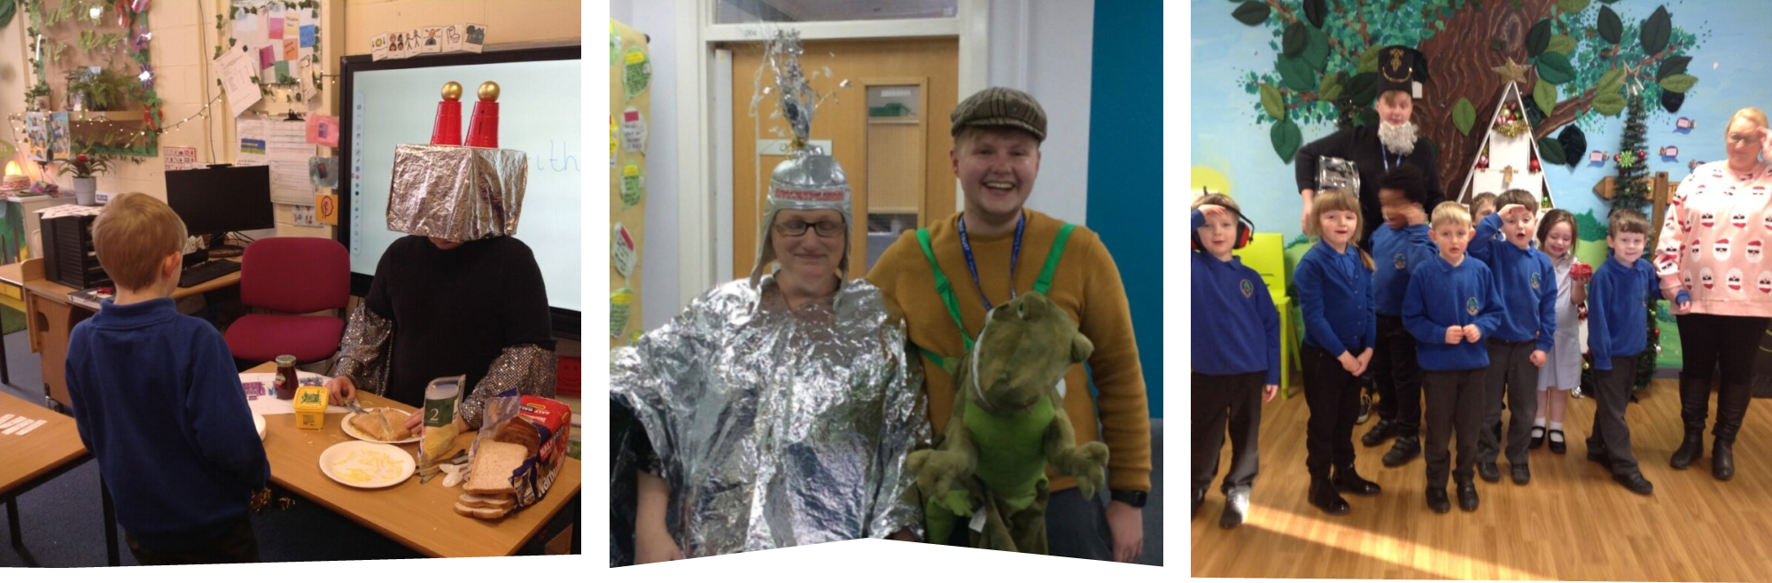
About me…
PGCE (Primary) 2016-2017
SEND teacher
Mentor for new-to-school teachers
Mentor for trainee teachers
Arts and MFL lead
MA Professional Education
NPQLTD

Slide 3
Today…
Find out what it is like to undertake MA research
Gain an insight into some methods and ways of thinking about research
Try out some analysis for yourselves
Gain some tips for how you can make Instructional Coaching work for you!

Slide 4

How can Instructional Coaching contribute to a student teacher’s professional learning?
How do the school-based mentor and student teacher interact over time?
How does the student teacher experience professional learning over time?
In what ways does Instructional Coaching contribute to this professional learning? In what ways does it hinder it?
What other factors may contribute to the student teachers’ professional learning?
2 participants
Primary PGCE

Slide 5


Phronesis
Is there value in Case Study research?
Thomas (2011)
Generalisable knowledge v. Exemplary knowledge
an example from which one’s experience, one’s phronesis, enables one to gather insight or understand a problem
How can we engage with research?
This Photo by Unknown Author is licensed under CC BY-SA-NC

Slide 6

Iterative Thematic inquiry
How was data analysed?
Morgan and nica (2020)
Themes are a tool for confronting the researcher’s preconceptions, and they continue to serve as a format for stating the results. (p.10)
Preconceived Themes
Building new beliefs through encounters
with the data (p.5)
Tentative Themes
Coding
Final Themes
This Photo by Unknown Author is licensed under CC BY-SA

Slide 7
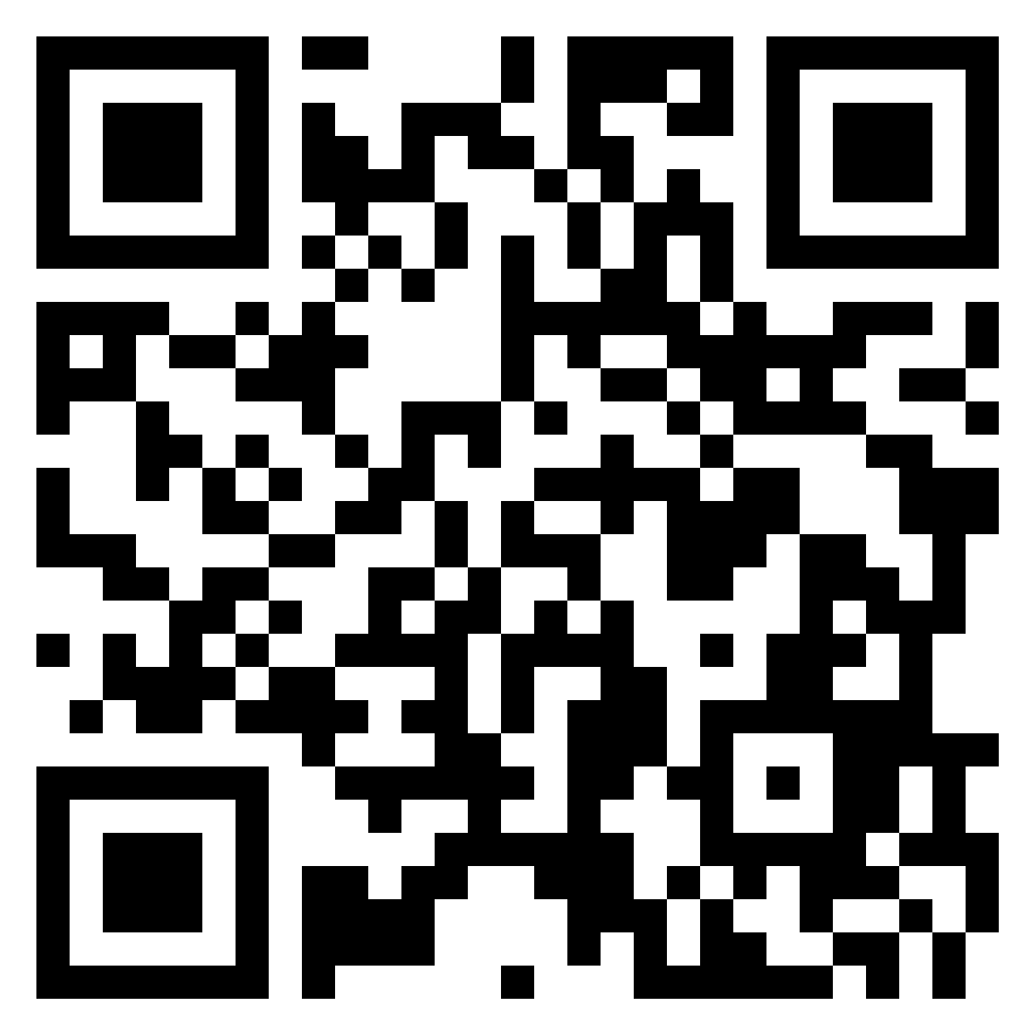


Identifying our preconceived Ideas…
https://padlet.com/westwoodchristopher/how-can-instructional-coaching-contribute-to-student-teacher-hffqaunh9prp7djr

Slide 8
Preconceived Themes
Quality of coaching conversation
Relationship
Relationship plays a key role: student teachers and mentors that have strong communication and meet each other’s expectations will succeed.
Both student teachers and mentors need sufficient understanding of Instructional Coaching for it to be successful.
Institutional Support
Professional Constraints
University X must provide meaningful support for student teachers and mentors. This will include sufficient training in Instructional Coaching and support from university staff.
Student teachers and mentors need sufficient time to engage in Instructional Coaching. They need support from the school. Performativity in the education sector could negatively impact student teacher learning.

Slide 9
Data…
Initial Document Analysis of materials produced for Student Teachers and School- Based Mentors by University X.
2 observations of mentor meetings, conducted in person.
4 interviews – 2 with each participant, conducted remotely – using video elicitation (Henry and Fetters, 2012)
Review Document.

Slide 10
Data…
SBM1: […] about that lesson - and you kind of said about not giving you feedback - so obviously feedback is really, really important and I think whether it's good feedback or, like, feedback that you're going to be disappointed with, it is important that you need to face that feedback.
ST1: Yeah just I didn't necessarily want to face it that day.
SBM1: [sim.] yeah yeah - then – yeah –
ST1: I didn't mean I don't wanna hear it ever –
SBM1: [sim.] ever [laughs]
ST1: I just meant that day.
SBM1: Yeah, yeah that's absolutely fine. So yeah - cos it doesn't matter - what you've got to remember - it doesn't matter how - whatever is going to be said all of this is about talking through –
ST1: It's beneficial, yeah.
SBM1: Yeah, it's all about talking through everything and helping you with what, what is good and what you can do to improve – [ST1 begins to cry] don't you dare start [laughs] so yeah something that you do need to kind of like think about [offers ST1 tissues].
ST1: I get upset -
SBM1: [to researcher] – I know she does.
ST1: because I'm so hard on myself that's why -
SBM1: Yeah but to be honest -
ST1: Yeah -
SBM1: Yesterday I gave you feedback and you didn't get upset at all, did you? So -
ST1: no, no -
SBM1: So think of that as progress.
ST1: No, no - it is because I'm so hard on myself and I'm so, like, I have to be perfect -
SBM1: Yeah, and nobody is. Nobody is at all.
(Observation 2)

Slide 11

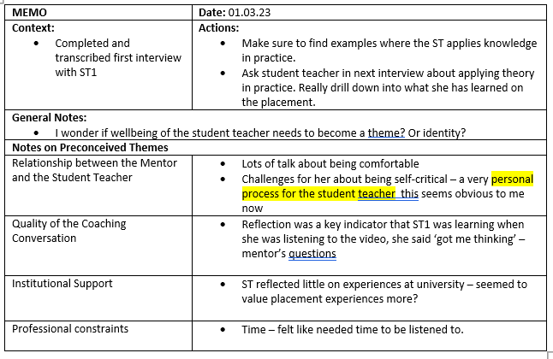
Memoing
At each iteration, existing beliefs are the basis for two kinds of action:
memoing that reflects on the current choice of themes and data
collection that tests those choices (Morgan and Nica, 2020, p.2)

Slide 12

Memoing
At each iteration, existing beliefs are the basis for two kinds of action:
memoing that reflects on the current choice of themes and data
collection that tests those choices (Morgan and Nica, 2020, p.2)
MEMO

Slide 13
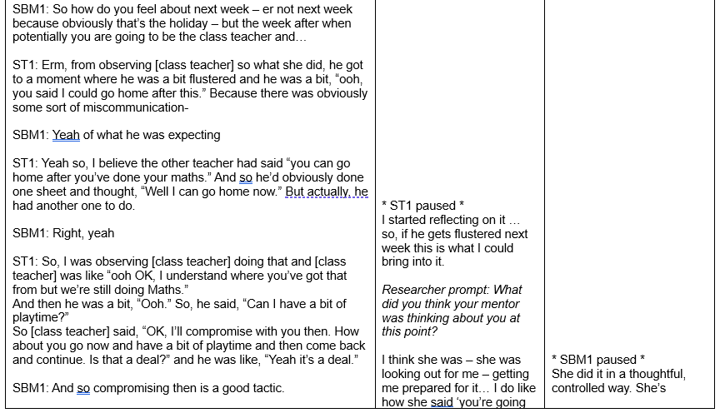
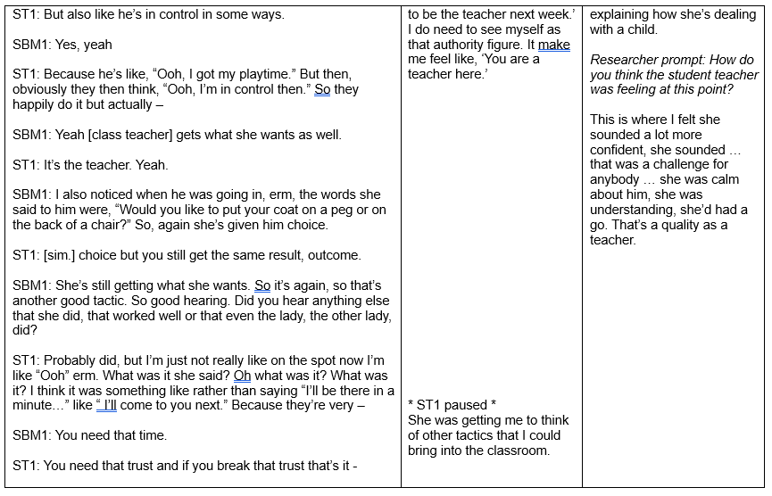
Data…
Relationship
Coaching
Learning

Slide 14
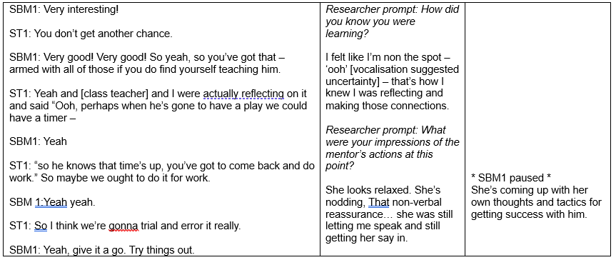

Data…
‘co-construction’
Lofthouse et al. (2010)

Slide 15

Student teacher learning
The Three-level model
(Korthagen, 2010)
Concrete Experiences
1. Gestalt
Reflection
Conscious and unconscious behaviours
2. Schema
Reflection
After reflection, the student teacher can create a schema – ‘I would do x again next time.’
Grounded in preconceptions, emotions, motivations
3. Theory
All learning starts in concrete experiences
After further reflection, student teacher may be able to logically order schemas to create theory or theory may be introduced

Slide 16
Student teacher learning
The Three-level model
(Korthagen, 2010)
Concrete Experiences
1. Gestalt
Reflection
Conscious and unconscious behaviours
2. Schema
Reflection
After reflection, the student teacher can create a schema – ‘I would do x again next time.’
Grounded in preconceptions, emotions, motivations
3. Theory
All learning starts in concrete experiences
After further reflection, student teacher may be able to logically order schemas to create theory or theory may be introduced
‘I wished I’d known that I’m not as confident when I don’t know the lesson like the back of my hand … your subject knowledge tends to come when you’re planning your lessons.’ (Interview 2, ST1)
‘There was the time, yesterday, I brought the timer into a different lesson… I found that it was gonna be useful in that lesson..’ (Interview 1, ST1)

Slide 17
Student teacher learning
The Three-level model
(Korthagen, 2010)
Concrete Experiences
1. Gestalt
Reflection
Conscious and unconscious behaviours
2. Schema
Reflection
After reflection, the student teacher can create a schema – ‘I would do x again next time.’
Grounded in preconceptions, emotions, motivations
3. Theory
All learning starts in concrete experiences
After further reflection, student teacher may be able to logically order schemas to create theory or theory may be introduced
‘I wished I’d known that I’m not as confident when I don’t know the lesson like the back of my hand … your subject knowledge tends to come when you’re planning your lessons.’ (Interview 2, ST1)
Level Reduction
‘There was the time, yesterday, I brought the timer into a different lesson… I found that it was gonna be useful in that lesson..’ (Interview 1, ST1)

Slide 18





Tentative themes
(Hobson and Maxwell, 2020)
Individuals
Relationship
Mentoring Substructures and Superstructures
Student teacher identity
Student teacher wellbeing
Student teacher attitude to and understanding of Instructional coaching
Mentor attitude to and understanding of Instructional Coaching
Expectations of counterpart
Perceptions of counterpart
Communication
Encouragement and support
Quality of Coaching conversation
Theory and practice
School structures
University structures
University documents
Access to training
Performativity (Ball, 2003)
Learning Student teacher learning AND Mentor learning (!)

Slide 19
Individuals
identity
‘I do like how she said “you’re going to be the class teacher next week.”
‘I do need to see myself as that authority figure
‘It made me feel like: “You are a teacher here.”
Wellbeing
What were you feeling?
‘I don’t know If I’m reading my body language the right way but I don’t know if I’m a bit nervous… I don’t know if its because I’d had such a positive and its ‘Ok when’s the negative going to come?’
‘I struggle to recognise I’ve got people around me.’
Does that affect you when you’re at school and at home?
‘Yes, I constantly feel like a burden.’
Understanding of and attitudes to instructional coaching
‘The first time that I had a go at following the coaching method with a student , I was like ‘yeah I get it.’
‘If you have someone telling you all the answers you’re not thinking for yourself.’
‘When they are able to assess their own performance accurately, saying why they did certain things, knowing where things were not done well and talking about how they would change things and why, then you can give them encouragement.’
‘It makes sense to me now.’

Slide 20
Individuals
Both the student teacher and the mentor understood coaching as a dialogue – with more onus on the student teacher to lead their own development.
identity
‘I do like how she said “you’re going to be the class teacher next week.”
‘I do need to see myself as that authority figure
‘It made me feel like: “You are a teacher here.”
Wellbeing
What were you feeling?
‘I don’t know If I’m reading my body language the right way but I don’t know if I’m a bit nervous… I don’t know if its because I’d had such a positive and its ‘Ok when’s the negative going to come?’
‘I struggle to recognise I’ve got people around me.’
Does that affect you when you’re at school and at home?
‘Yes, I constantly feel like a burden.’
As well as this, the participants brought their own gestalts to the mentoring relationship. The mentor spoke about how it is a process – ‘I am still learning’
Understanding of and attitudes to instructional coaching
‘The first time that I had a go at following the coaching method with a student , I was like ‘yeah I get it.’
‘If you have someone telling you all the answers you’re not thinking for yourself.’
‘When they are able to assess their own performance accurately, saying why they did certain things, knowing where things were not done well and talking about how they would change things and why, then you can give them encouragement.’
‘It makes sense to me now.’

Slide 21
Relationship
Expectations
perceptions
Encouragement and support
communication
Quality of coaching conversation

Slide 22
Relationship
Expectations
‘Where the coaching comes in … it’s that whole thing they’re prepared, they’ve thought about what you’ve said as targets or ways to improve their practise from previous observations and mentor meetings and showing progress in that area… they are being efficient teachers… they listen to feedback… When you’re talking, you pose a question and they can give you the answers that you would like to hear, They have a realistic view of where they are, what they did well, what was not done as well and have ideas of how they can improve their practise… I have one student who is so well organised, the chats show a maturity in what she’s saying and thinking.’
‘They also draw upon things they have learnt in university’
Understanding – again, gives balanced feedback – it’s friendly, you’re not going to open up to them if they’re shut off and rude.’
Understanding – again, gives balanced feedback – it’s friendly, you’re not going to open up to them if they’re shut off and rude.’

Slide 23
Relationship
perceptions
Body language/How do you think she wanted you to feel?
‘I think she wanted me to feel proud and confident and she wanted me to recognise that I have learned stuff.’
This is where I felt she was a lot more confident, she sounded … that was a challenge for anybody… She was calm about him, she was understanding, she’d had a go. That’s a quality as a teacher.'

Slide 24
Relationship
Encouragement and support
SBM1: And did you stay for… how many did you do?
ST1: I stayed for all of them.
SBM1: All of them!?
ST1: Yeah.
SBM1: Oh my goodness me! That’s… That’s… You deserve a medal for that then [laughs]
I tended to work with ST1 on herself… making her feel confident on what she was doing… that was the biggest focus… making her feel that ‘you’re doing well.’’

Slide 25
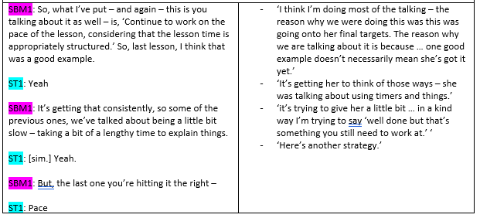
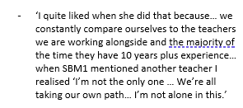
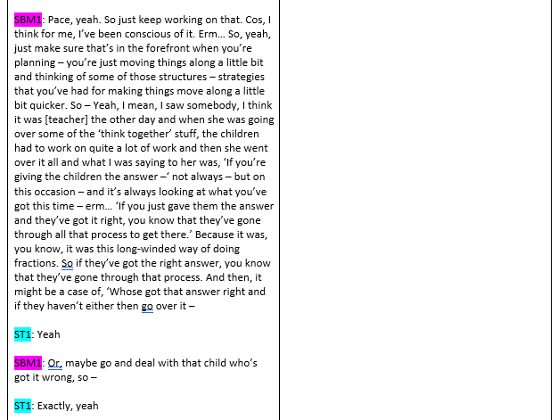
Relationship
Quality of coaching conversation
Interactions may not always be ‘coaching’ but that does not mean they are not valuable or do not contribute to student teacher learning.

Slide 26
Mentoring Substructures and Superstructures
Performativity
School substructures
University substructures

Slide 27
Mentoring Substructures and Superstructures
Performativity
SBM1: Have you come to any end of units or anything like that?
ST1: [shakes head]
SBM1: No… so that’s a shame – so, again, that might be something on your next practice. It would be good to get a bit more of assessment that you are – because obviously you’ll miss out on all of the official assessments –
ST1: [sim.] assessments
SBM1: Official assessments that go on. But again, we could add that on as a target.
ST1: Yeah, I’m at my next one for eight weeks, so hopefully I should have seen one or two perhaps.
SBM1: Mind you, we could always put it at the bottom of this as a target – make sure you’re using assessment and when you are, ask as many questions and see how it’s relevant.

Slide 28
Mentoring Substructures and Superstructures
Performativity
Seen often around target setting – perhaps this was because I saw weekly mentor meetings and not discussions following observations?
SBM1: Have you come to any end of units or anything like that?
ST1: [shakes head]
SBM1: No… so that’s a shame – so, again, that might be something on your next practice. It would be good to get a bit more of assessment that you are – because obviously you’ll miss out on all of the official assessments –
ST1: [sim.] assessments
SBM1: Official assessments that go on. But again, we could add that on as a target.
ST1: Yeah, I’m at my next one for eight weeks, so hopefully I should have seen one or two perhaps.
SBM1: Mind you, we could always put it at the bottom of this as a target – make sure you’re using assessment and when you are, ask as many questions and see how it’s relevant.

Slide 29
Mentoring Substructures and Superstructures
School substructures
‘The planning was done for me but also the children … I had the lower attainers, I only had 11 overall… so only five of those kids came from my morning registration group so only 5 of them I really knew… there was a constant changeover so I didn’t get to know the children as well.’

Slide 30
Mentoring Substructures and Superstructures
University substructures
Was this typical of your usual meetings?
The majority was typical however the [Review] targets was different … but normally when we come to weekly targets … either I’ve said what I wanted or we’ve discussed it … whereas this was kind of just given.’
Why do you think it was like that?
‘IT was a different document – it wasn’t quite seen as a mentoring activity.’

Slide 31
Mentoring Substructures and Superstructures
University substructures
Forms and documents – at first I thought these were stopping conversation but I later came to believe that they often guided conversation productiveli
Was this typical of your usual meetings?
The majority was typical however the [Review] targets was different … but normally when we come to weekly targets … either I’ve said what I wanted or we’ve discussed it … whereas this was kind of just given.’
Why do you think it was like that?
‘IT was a different document – it wasn’t quite seen as a mentoring activity.’

Slide 32
Final themes
(Hobson and Maxwell, 2020)
Individuals
Relationship
Mentoring Substructures and Superstructures
Student teacher identity
Student teacher wellbeing
Student teacher attitude to and understanding of Instructional coaching
Mentor attitude to and understanding of Instructional Coaching
Expectations of counterpart
Perceptions of counterpart
Communication
Encouragement and support
Quality of Coaching conversation
Theory and practice
School structures
University structures
University documents
Access to training
Performativity (Ball, 2003)
Learning Student teacher learning AND Mentor learning (!)

Slide 33
Discussion and Implications
Discussion of Findings
Each mentoring relationship is very personal. Mentors and student teachers bring their own prior knowledge, emotions and motivations (Gestalt) to the relationship.
Participants both expressed that they felt that they hadn’t seen many of the techniques and strategies discussed fully embedded in the student teacher’s practice. Learning was predominantly seen in the student teacher’s reflections. Perhaps there wasn’t enough time for these to go through level reduction and make changes to the student teacher’s gestalt.
Some core features of Instructional Coaching weren’t seen – modelling of specific strategies or using data and other concrete resources to analyse the current reality together. Mentors and student teachers have a different understandings of Instructional Coaching and experiences of using these techniques.
Different situations called for different modes of mentoring and coaching. At times, the mentor took on a supportive and encouraging stance; at others the mentor was more of a critical friend – asking questions about practice and encouraging reflection. Instructional Coaching on its own does not provide all of the answers for student teachers and their mentors.
MEMO

Slide 34


Tips
You and your mentor are both individuals with different needs, motivations and understandings.
Each student teacher is also an individual – facing own challenges
Strong, open communication is important
Understanding Coaching can help you to help yourself
Instructional Coaching does not provide all the answers!
Some things are out of your control – be aware of substructures and superstructures and how they affect you

Slide 35
THANK YOU
Chris Westwood
chris.westwood@warwick.ac.uk

