Slide 1
CTE 2023 Research in Action Conference Design Thinking in Action: Learner and Educator Perspectives
Dr Bo Kelestyn
Bo.Kelestyn@wbs.ac.uk

Slide 2
Jisc named design thinking one of the key capabilities for an HE leader in their 2030 strategy framework
Notes:
https://www.jisc.ac.uk/full-guide/digital-strategy-framework-for-university-leaders

Slide 3
Pearson are working on the Future of Design Education: a future proofed design education curriculum. Their ambition is to see students studying design qualifications in 2027
Notes:
https://www.pearson.com/en-gb/schools/subject-resources/extended-curriculum-btec/art-design-media/the-future-of-design-education.html#:~:text=Find%20out%20more-,Design%20perspectives,-A%20socially%20responsible

Slide 4
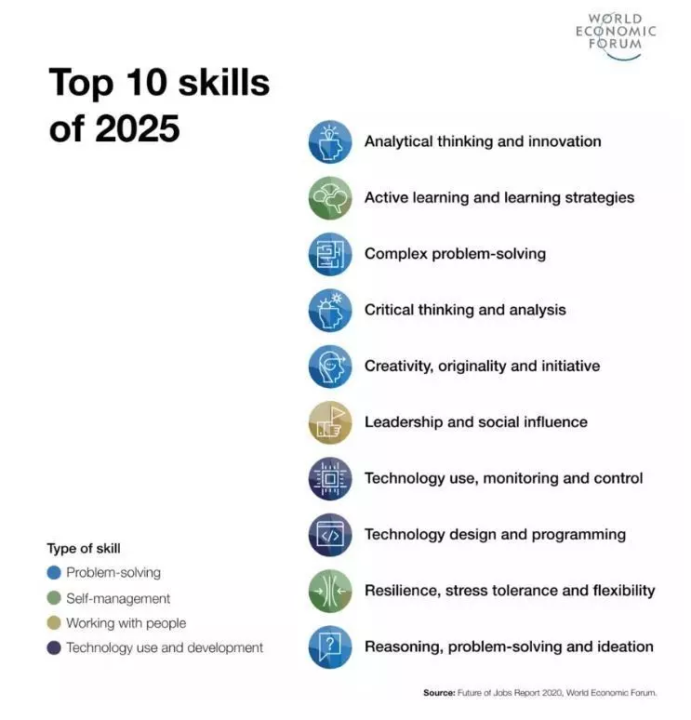
Notes:
https://www.weforum.org/agenda/2020/10/top-10-work-skills-of-tomorrow-how-long-it-takes-to-learn-them/

Slide 5
DT & HE
Needs democratisation
Threshold concept (Land, 2016)
Interdisciplinarity
Innovation
Skills and employability
Student experience
Student voice
Belonging & mattering
Notes:
https://ojs.lboro.ac.uk/DATE/article/view/2975

Slide 6

Design Thinking warm up activity
Come up with as many questions as you can about this pencil in 30 seconds.
Try for at least 10 questions—the crazier, the better.
Use Chat
Notes:
https://www.ideou.com/blogs/inspiration/10-activities-to-generate-better-ideas

Slide 7
What is Design Thinking?
The application of design practice and its related competencies beyond the context of design for and with those without design backgrounds (Chon & Sim, 2019, p. 189)

Slide 8
What is Design Thinking?
a way of finding human needs and creating new solutions using the tools and mindsets of design practitioners (Kelley & Kelley, 2013)

Slide 9
What is Design Thinking?
A social technology = blend of tools and insights, applied to a work process (Liedtka, 2020)

Slide 10
What is Design Thinking?
A social technology = blend of tools and insights, applied to a work process (Liedtka, 2020)

Slide 11
What is Design Thinking?
human centered design
methodology for innovating routinely
JUST DO IT (Reis, 2011)

Slide 12
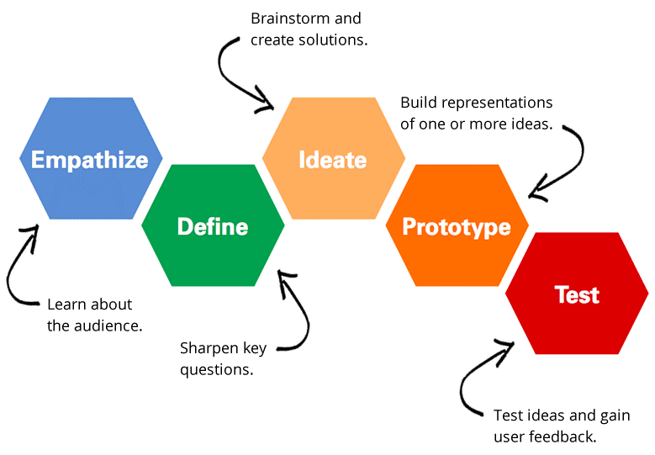
Key Steps
Notes:
E: Who am I making this for, what is their problem, who are these people, what do they do. Human centered: understanding the people. It is about gathering insights. Pause here and jot down a few ideas on how you might be able to gather these insights.
D: what are the needs, problems, challenges, insights that we can take? Turn it into insights
I: solutions, ideas, matches of solutions with insights that you gathered
P: taking and breaking down ideas, selecting a few that might be testable prototypes
T: real people, get feedback in real time, you go back to Define by gathering insights. Human centered – participatory.
Linear but often less linear and circular
It is a map which you might use to run sprints which are more prescriptive.
Research to rollout
Testing assumptions
DT is very iD and we do weave in economics, technology, marketing, etc, later down the line. It starts eith humans.

Slide 13
Critical lens: what Design Thinking is NOT
Just a method focused on the outcome, features or an object
A tool for consumerism
About artistic abilities
A one off activity = innovation theatre (Viki, 2020)
About hurdling
Urgency thinking (brown, 2017)
Notes:
Solve problems and create innovations that make impact, not about art or artistic abilities
Hurdling and focusing on code or product/features too much
Social technology – blend of tools and insights, applied to a work process.

Slide 14
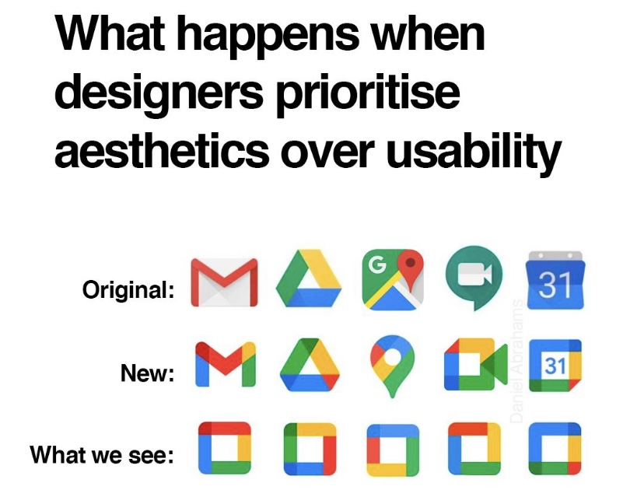

Slide 15
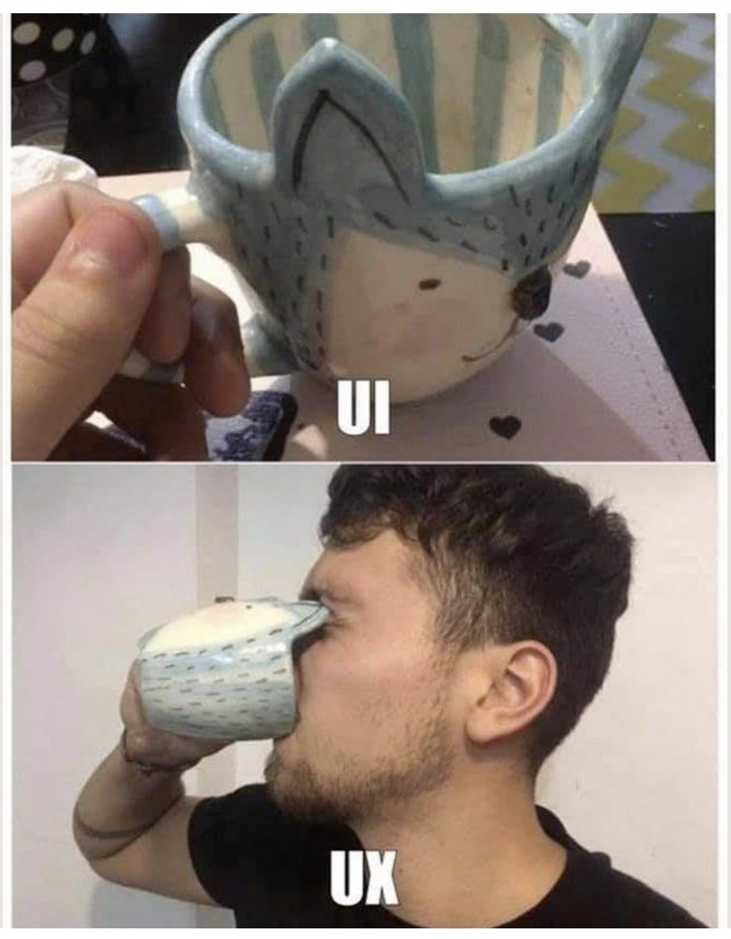

Slide 16
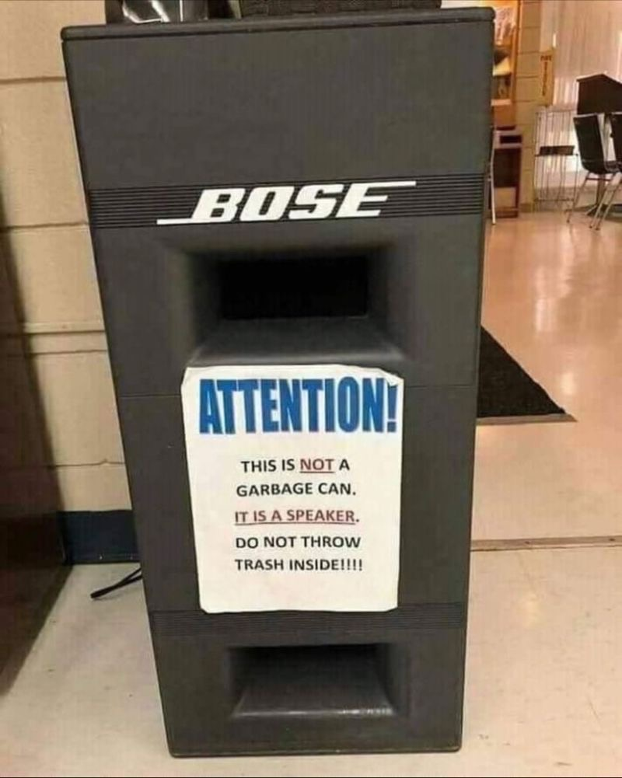

Slide 17
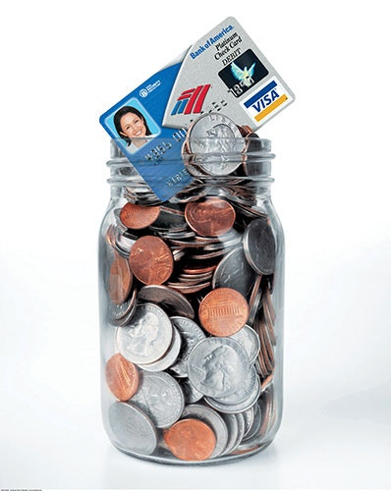
Bank of America: Keep the Change
https://www.bankofamerica.com/deposits/keep-the-change/
Notes:
Without any major breakthrough in past few decades, the banks in the early 2000s faced a critical problem - how to get consumer segments (particularly boomer-age women) to open new savings accounts.
Bank of America hired a design research firm that observed a dozen families and interviewed people on the streets.
Critical insight formed was that people round up their deposits as it was more convenient. And so was born their product “Keep The Change”.
Every time one buys something with a BofA Visa debit card, the bank rounds up the purchase to the nearest dollar & transfers the difference from your current into savings.
Keep The Change brought out a shift in mindset, seen as unique and offering real ‘human’ value. Within the first year of launch, 2.5 million customers signed up for Keep the Change. Over 700,000 opened new current accounts accounts and 1 million signed on for new savings accounts.

Slide 18
Bank of America: Keep the Change
Within the first year of launch:
2.5 million customers signed up for Keep the Change
over 700,000 opened new current accounts accounts
1 million signed on for new savings accounts.
Notes:
Without any major breakthrough in past few decades, the banks in the early 2000s faced a critical problem - how to get consumer segments (particularly boomer-age women) to open new savings accounts.
Bank of America hired a design research firm that observed a dozen families and interviewed people on the streets.
Critical insight formed was that people round up their deposits as it was more convenient. And so was born their product “Keep The Change”.
Every time one buys something with a BofA Visa debit card, the bank rounds up the purchase to the nearest dollar & transfers the difference from your current into savings.
Keep The Change brought out a shift in mindset, seen as unique and offering real ‘human’ value. Within the first year of launch, 2.5 million customers signed up for Keep the Change. Over 700,000 opened new current accounts accounts and 1 million signed on for new savings accounts.

Slide 19
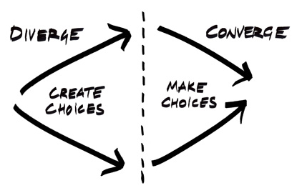
Divergent and convergent thinking
Notes:
https://www.youtube.com/watch?v=cmBf1fBRXms

Slide 20
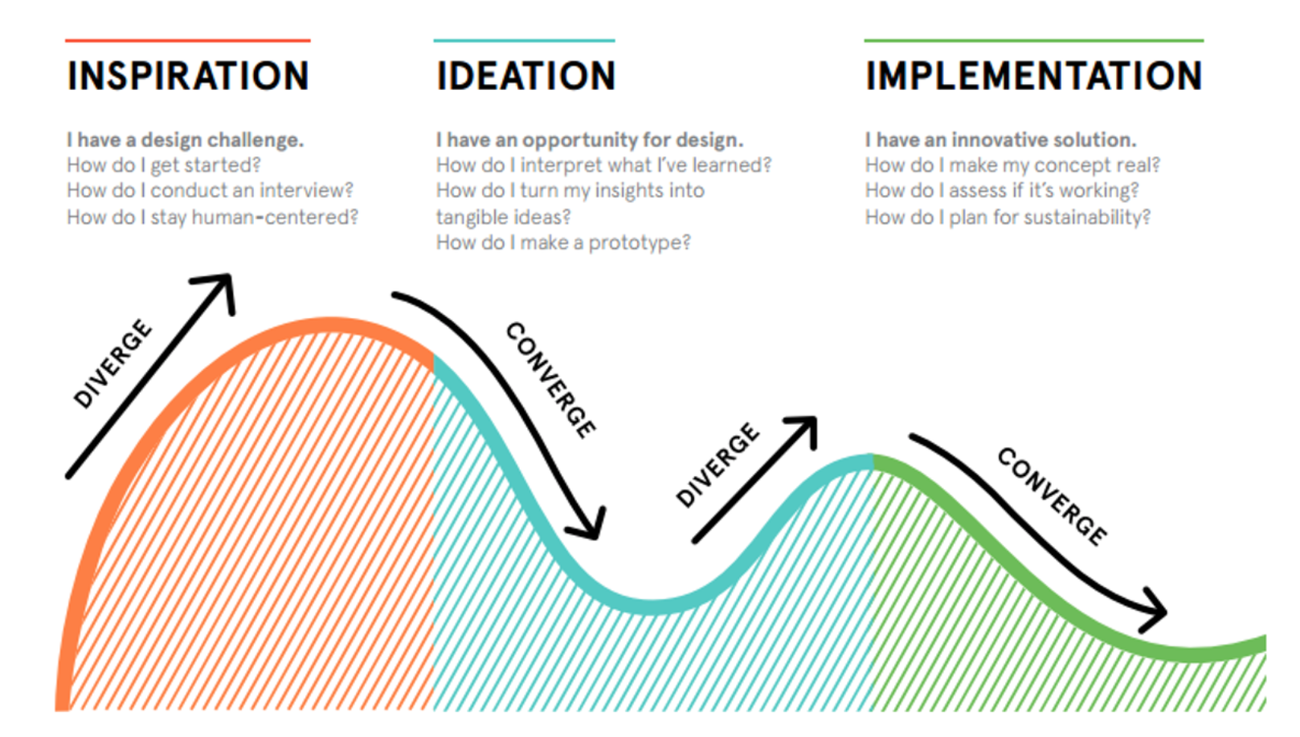
Design Kit by IDEO
Notes:
https://www.designkit.org

Slide 21
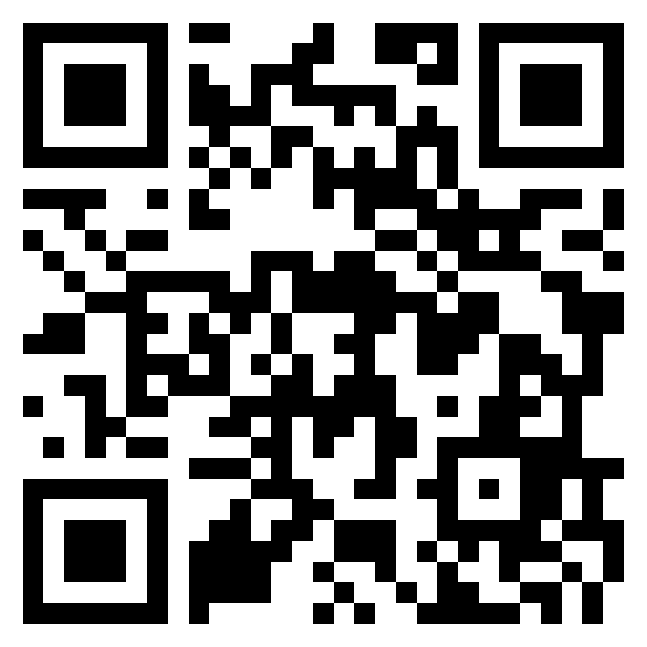
CTE 2023 Research in Action Conference Let’s pause and reflect
Dr Bo Kelestyn
Bo.Kelestyn@wbs.ac.uk
Notes:
https://warwick.padlet.org/bokelestyn/ria-design-thinking-in-action-xb1u34rg42pdjfg6

Slide 22
CTE 2023 Research in Action Conference The Warwick DT Award
Dr Bo Kelestyn
Bo.Kelestyn@wbs.ac.uk

Slide 23


Slide 24
Yuval Noah Harari on education
“Many pedagogical experts argue that schools should switch to teaching “the four Cs” – critical thinking, communication, collaboration and creativity. Most important of all will be the ability to deal with change, to learn new things and to preserve your mental balance in unfamiliar situations. In order to keep up with the world of 2050, you will need not merely to invent new ideas and products – you will above all need to reinvent yourself again and again.”
Notes:
Pedagogically Harari’s views seem sound- in the increased rigidity of our curriculum and assessments- where do we actually assess pupils on these important skills of communication, collaboration and creativity? Where are we teaching them resilience and flexibility?

Slide 25
T&L DT at Warwick University
Process
Tools
Mindset (IDEO)
Empathy
Optimism
Iteration
Creative Confidence
Critical thinking
Embracing Ambiguity
Learning from Failure

Slide 26
The Warwick DT Award so far
3 teachers delivered in 2 groupings of Year 8 students
Worked with a local charity Kissing it Better
Challenge: preserving memory
Accredited by EduQual (the first in the UK DT school qualification)
August 2023
102 students completed the Award
35 received distinctions
Notes:
Jan 2023 https://www.independentschoolsmagazine.co.uk/PDFs/january-2023.pdf

Slide 28
CTE 2023 Research in Action Conference UoWarwick Case Studies
Dr Bo Kelestyn
Bo.Kelestyn@wbs.ac.uk

Slide 29
Warwick Secret Challenge
Created in 2018
Led by Warwick Enterprise
3 hours f2f
1,5 hours online
30 students
Empathise-Define-Ideate
Delivered and facilitated by students (Innovation Fellows)

Slide 30

How it Works
Introduction to design thinking methodology
Introduction to the Challenge and problem statement
Design thinking mini sprint
Creative exercise
Mind mapping
Empathy mapping
Ideation
Student presentations and prize giving

Slide 31
Key insights
Engagement and problem solving ecosystem (Healey et al., 2014)
Develop innovative insights, solutions and ways to reframe problems
Distributed leadership
Student owned
Access without labels and emotional labour
Student facilitators

Slide 32
Warwick Employability (Sustainability) Challenge
70 participants
2 weeks
Fully online
Empathise-Define-Ideate-Prototype(-Test)
Delivered and facilitated by students (Innovation Fellows and Student Coaches)

Slide 33
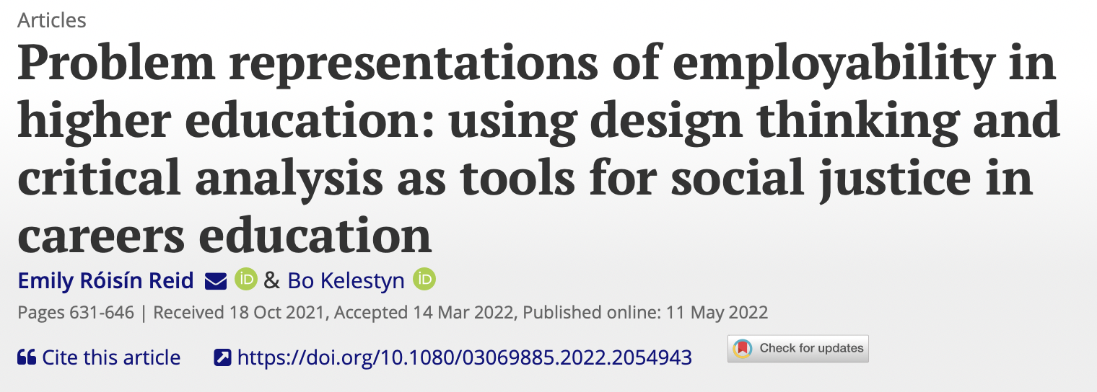
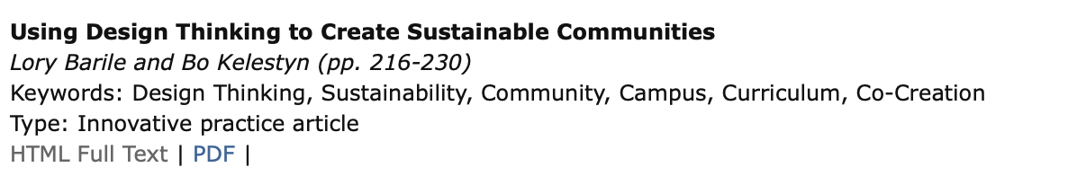
Notes:
https://www.tandfonline.com/doi/full/10.1080/03069885.2022.2054943
http://ijmar.org/current.html

Slide 34
Introduction to DT and the Challenge
Define in randomised teams (Mind map, Storytelling)
Ideation and Submissions
Reframe in Challenge teams (Empathy map, Problem reframing)
Daily check-ins and Friday drop-ins

Slide 35
Design Thinking and Student Engagement
Dialogue: co-creation and empathy
Student led
Building on cognitive diversity
Complexity is welcome
Challenges and changes student and staff perceptions
Asking what you want might not be enough
Ideas need space and diversity

Slide 36
Challenges
Closing the loop
Getting through all stages
Long term engagement
Timing
Facilitation skills

Slide 37
CTE 2023 Research in Action Conference Where to start?
Dr Bo Kelestyn
Bo.Kelestyn@wbs.ac.uk

Slide 38
It all starts with a question: the 4 Ws
Who has the problem: Who is the target user(s)?
What is the problem: Problems; pain points; tasks a user might want to achieve; what’s standing in their way?
Where does the problem present: Situation; context; what people are involved?
Why does it matter: Why does the problem need solving; what value might a solution bring? The 5 WHYs
If you obsess about HOW, you loose sight of WHY
Notes:
4Ws can help you hone in on your problem statement. Use 5WHYs to help you go deeper. 5WHYs is a common technique used to get to the bottom of an issue or to explore a statement in qualitative interview data collection.
For example, if you are working on understanding an issue of someone not eating healthy you might explore the question using 5WHYs as follows:
Why is she not eating healthily? Too many takeaways
Why does she order takeaway every day? Fridge and cupboards empty
Why are the fridge and cupboards empty? She hasn’t shopped in over a week Why hasn’t she been grocery shopping? She doesn’t have time Why doesn’t she have time? She works long hours and is exhausted

Slide 39
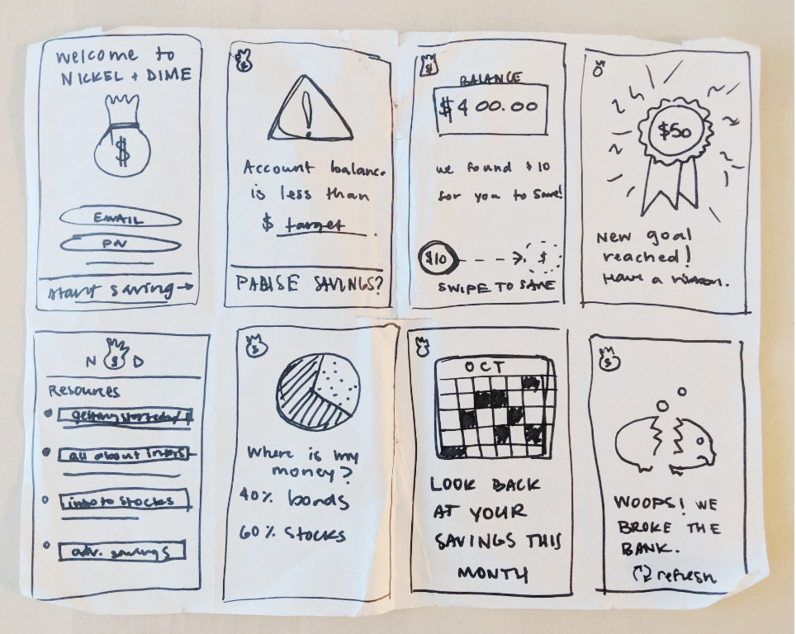
Ideate and iterate: Crazy 8s
What would be another good way to do … ?
Fold or line an A4 sheet to form 8 squares
60 secs each and 8 mins in total
Notes:
Individual exercise to iterate and improve your initial idea
https://designsprintkit.withgoogle.com/methodology/phase3-sketch/crazy-8s

Slide 40
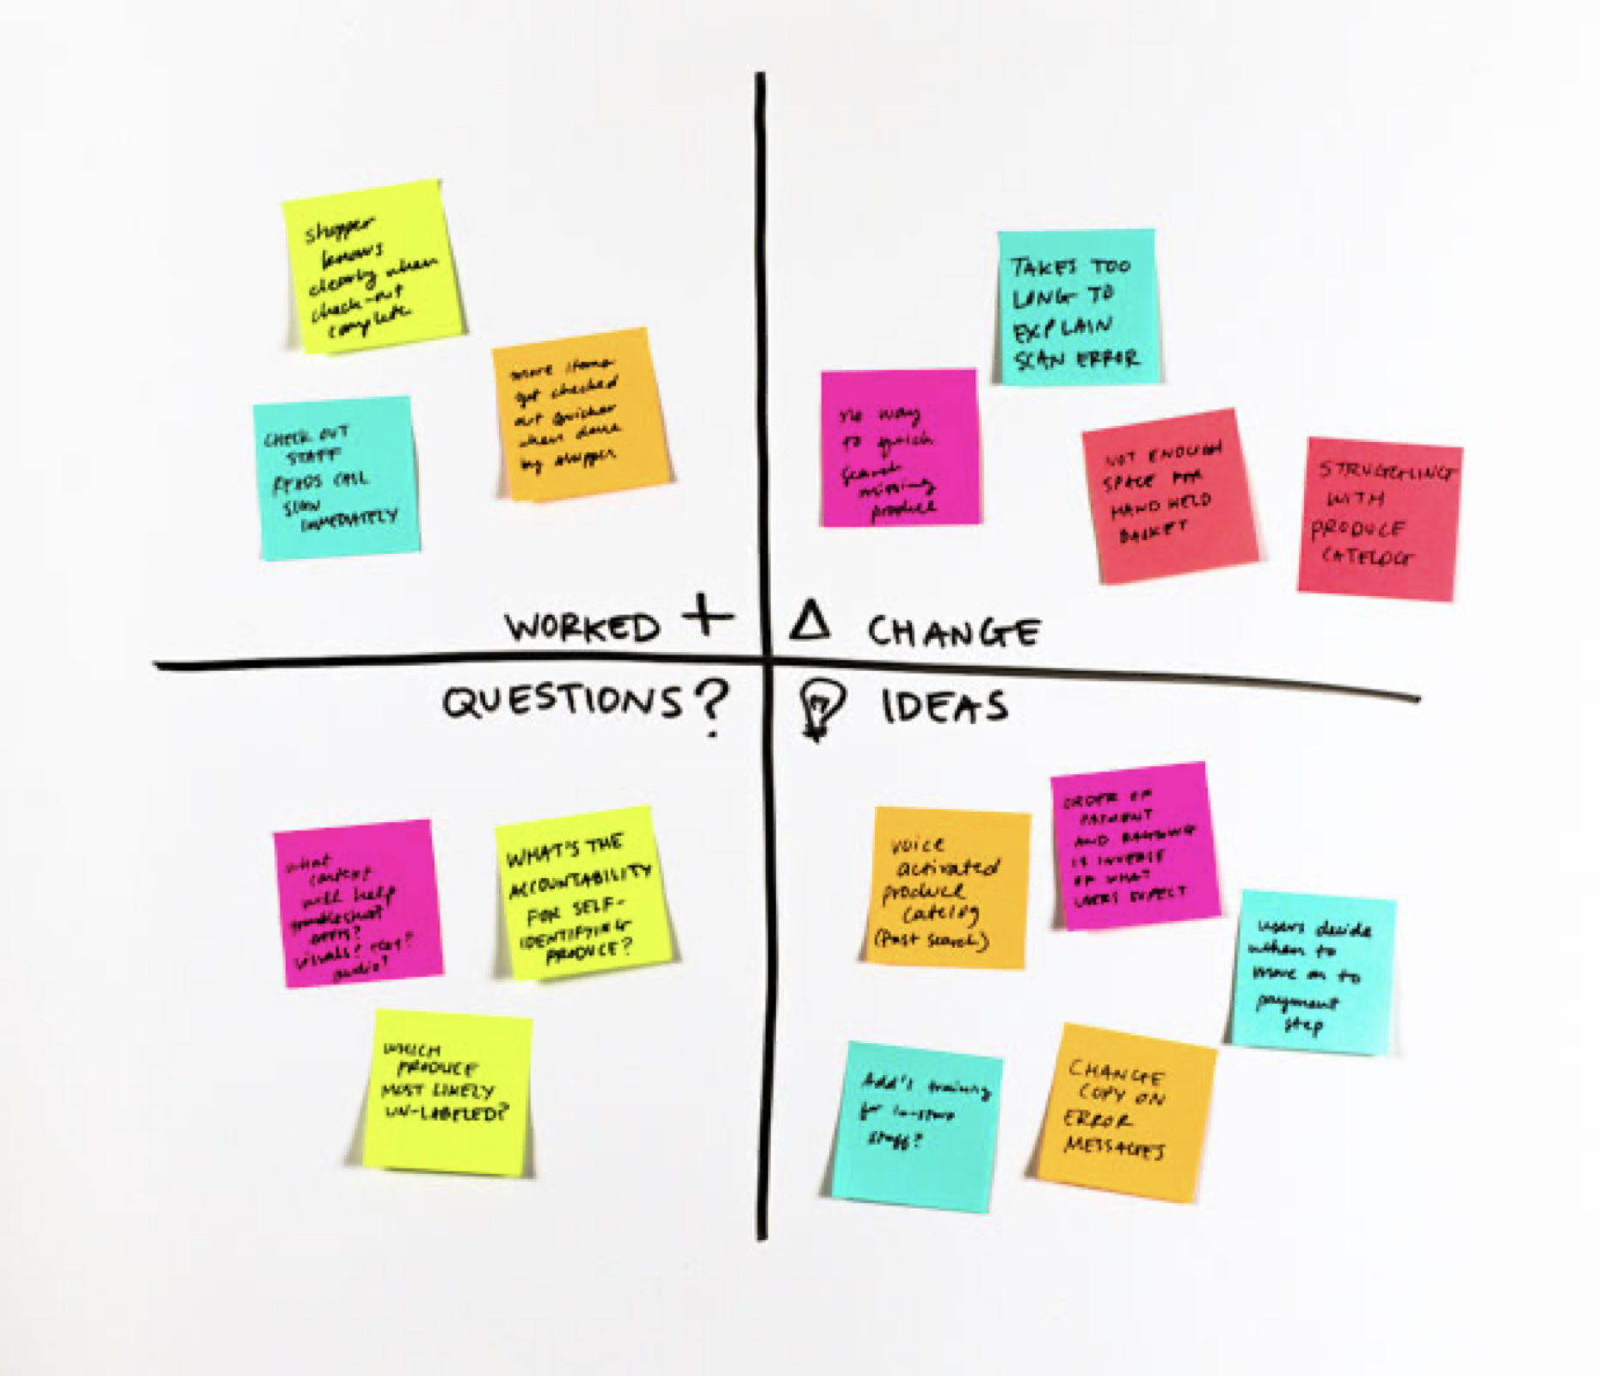
To make the most of diversity: Feedback grid
Likes: What do we like? What is worth mentioning?
Wishes: What wishes do we have? Constructive criticism?
Ideas: Which initial ideas and solutions have we found? Generated during the presentation?
Questions: What questions have cropped up?
Notes:
https://www.ibm.com/design/thinking/page/toolkit/activity/feedback-grid

Slide 41
We want to have certainties and no doubts—results and no experiments—without even seeing that certainties can arise only through doubt and results only through experiment.
Carl Jung

Slide 42
CTE 2023 Research in Action Conference THANK YOU ☺
Dr Bo Kelestyn
Bo.Kelestyn@wbs.ac.uk
Notes:
https://warwick.padlet.org/bokelestyn/ria-design-thinking-in-action-xb1u34rg42pdjfg6

