Slide 1

Surviving and Thriving in Difficult Classrooms
Louise Ansell
BA PGCE QTS MA
Currently undertaking my NPQSL in Leading Behaviour

Slide 2
A brief overview of me: Mum, teacher, examiner, vegan. An avid reader and advocate of social justice

Slide 3

School Bilton School
Context :
Made up of 10 schools
4 secondary
10 primary

Slide 4
Bilton
Non- selective 11-18
Progress 8
Interesting mix
800 on role in 2018 now at just under 1200 and we are at PAN in Year 7

Slide 5


My history
I started at Bilton in 2018 as a part time (0.5 English Teacher )
I am now the Lead on Academic Alternative Provision and am excited about the changes that we are starting to put in place to help and support pupils
I started when it was in RI
I have seen significant improvements and changes and as a
school we are now classed as “Good”

Slide 6
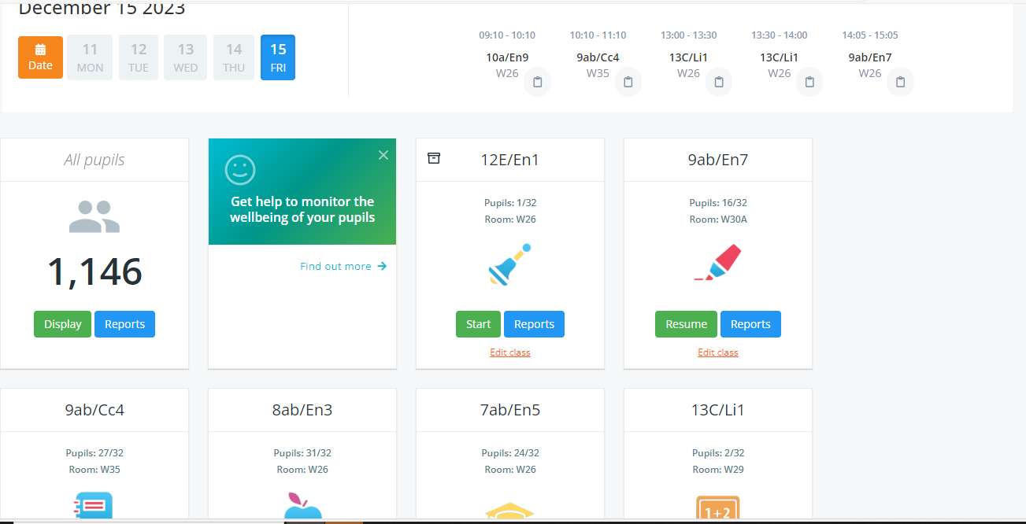
What about our behaviour policy ?
All the Secondary MATS use class charts which is an effective system which makes the life of a classroom teacher so much easier. We have a clear behaviour policy .
Be honest who has struggled with behaviour ?

Slide 7
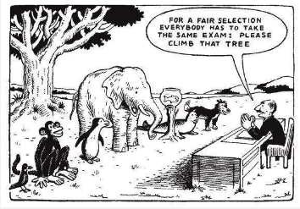

Slide 8
Whilst we have a robust system and a clear behaviour policy it does not mean that there are not issues The Bananarama Principle It ain’t what you do but the way that you do it !
What have we done ?
All teachers have their strengths and different skill sets and as practitioners we are all continually evolving and developing. Teachers are so important

Slide 9
Appraisal
Objective 3: Professional responsibilities: (Delete as appropriate for position within the school)
Teaching & Learning Bespoke CPD group – A clear, specific and measurable objective linked to Thursday morning bespoke CPD group. This will show evidence and impact of work undertaken in specific area.
HoD – A clear, specific and measurable objective demonstrating the development in subject pedagogy across department
TLR (other than HoD) / UPS holder – TLR holder: A clear, specific and measurable outcome that will contribute to the improvement progress of students at Bilton.
UPS 1 – Excellent classroom outcomes with evidence of outstanding practice / outcomes
UPS 2 – As UPS 1 but also making a significant and measurable contribution to the departments outcomes in which they mainly work.
UPS 3 – As UPS 1 and 2 but also making a measurable contribution and impact to the whole school outcomes.
Main Scale teacher – Beyond evidence gathered from lessons learned a clear, specific and measurable objective that clearly demonstrates an improvement in chosen aspects of T&L pedagogy such as inclusive classroom, literacy in the classroom, etc

Slide 10
Bespoke CPD. Teaching & Learning Bespoke CPD group – A clear, specific and measurable objective linked to Thursday morning bespoke CPD group. This will show evidence and impact of work undertaken in specific area.
How to succeed and survive in difficult classrooms
How do we use restorative practice to improve classroom behaviour?
How can we support students to write more independently and analytically?
The impact of timely interventions to increase academic attainment for POST 16 students
The impact of different approaches to stretch and challenge on the engagement of KS4 students of all abilities.
The impact of plenaries on planning and progress of lessons.

Slide 11
But what about behaviour ?
Teachers’ perceptions of disruptive behaviour in schools: a psychological perspective
Nash et al (2015) stated : “for the most troubled pupils, effective behaviour management at school necessitates a more nurturing and collaborative approach alongside current disciplinary policy”
This links in to how to Survive and Succeed in Difficult Classrooms

Slide 12
So what do I do ?
On a Thursday morning I lead on a Teaching and Learning Bespoke Group “How to Survive and Succeed in Difficult Classrooms “ and we use Paul Blum’s research as our basis for the action research which individuals adapt for their own classroom need
Staff chose which groups they wished to join based on need and some asked for direction and guidance of which to join

Slide 13
How do you get teachers to consider their own classrooms ?
By being reflective. All 12 teachers in my group were given a questionnaire and asked to honestly complete it

Slide 14
Teacher Survey (taken from Paul Blum)
In how many of your lessons (this week) have students exhibited the characteristics displayed in this guide. Use the checklist and grade your lessons against it
A: This behaviour never occurs in my lesson
B: This type of behaviour occasionally occurs in a few of my lessons
C: This type of behaviour occurs regularly in a few of my lessons
D: This type of behaviour is often displayed in my lessons
E: This type of behaviour and worse is displayed in most of my lessons

Slide 15
Teacher Survey
Students won't come into the room at the beginning of the lesson , take their coats off and sit down in a seat , without major interventions from the teacher (wasting at least 5 minutes of lesson time)
Small groups of students arrive late . They come in and immediately start talking to the class that they have been trying to settle . The whole process of sitting them down , giving out exercise books and getting coats off has to begin again
Whilst you are trying to begin the lesson s, students will continue conversations which are difficult to stop . This could be aggravated by their sitting fully turned away from you .
Students will get out of their seats without asking permission and go to talk or interfere with others in the room
Students will shout across the room , get out of their seats , hit other pupils or take their possessions . These students will often run in or out of the room , taking no notice of your instructions
Students will start talking to their neighbours as soon as you start to address the class or ask a question .
Students will shout out answers, or shout out comments or questions over your speech , which will spoil the momentum of your teaching . They often have to do with the “concepts you are trying to develop
Students will argue and insult each other, and this could lead at worst to a fight and at best to another round of heated quarrelling
Students bristle aggressively if asked to stop talking or interrupting the flow of a lesson . This is likely to get into verbal confrontation if your requests to stop interrupting persist . Trying to move from their friendship groups is certain to lead to “refusal” and open outright confrontation.
Students tear up their worksheets and throw the pieces on the floor or use the sheets to make darts or pellets to flick at other members of the class, or you . They flick ink and scribble over exercise books and textbooks. They send notes to each other torn out of exercise books or notebooks
Students eat sweets, crisps and chew gum all through the lesson . They discard wrappings on the floor or throw them in the general direction of the bin , where they pile up on the floor
Students write no more than a few lines during the ;lesson , certainly a lot less than they are capable of . Some are likely to ignore instructions to hand books in or take them home . The books will be left on the desk or the floor as pupils make a hasty exit for their next inter lesson rendezvous’
As the end of the lesson approaches , pupils will will start putting their coats on and packing their bags before you have asked them to. They will get out of their stars before the signal for the end of class and will walk around the room or out of it. You use a lot of energy trying to persuade them to return to their stars .
There is a general feeling of restlessness and “movement” in the room from the moment your lesson starts . Pupils fidget or loll on their chairs . They are so busy talking to each other that they find it difficult to focus on you .
Even worse, in some lessons –especially those before lunch or in the afternoon – there is an overall feeling that can only be described as a “semi frenzy”. People are falling out of their chairs , shouting at each other and Noone in particular , laughing and screaming as if drunk or hysterical . They are prone to abusing each other and starting a play or real fight . Ehen you talk personally to individuals in a quiet voice , they shout back their reply . Speaking to them is almost impossible.
What do you think the general consensus was ?

Slide 16
Good teachers and good teaching materials will not extinguish bad behaviour listed in the 15 points .Expertly planned lessons can be steam rolled by poorly motivated pupils
Brilliant teaching will usually contrast indifferent or poor teaching, but nothing will turn a class of nutters into angels
To survive and succeed you must stay calm , be positive and make small steps towards progress

Slide 17
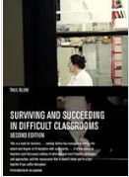
We meet every two weeks
1 : Questionnaire completed, and staff asked to consider the issues in their own classrooms
2 : Purposeful lessons. Classes discussed and consistency with support from colleagues
We are working through Blum’s text and use each chapter as a starting point

Slide 18

What are your biggest challenges ?

Slide 19
The biggest challenge
To get pupils into the mood to listen and to work
Consider the start of your lessons. What are the annoyance points ?
The vast majority are often ready and waiting for you to begin your lesson but can become bored and frustrated doing so
It is difficult to think positively when everything around you is frustratingly negative

Slide 20
Evidence & Impact
Evidence
Impact
Students are disruptive and chaotic at the beginning of lesson. How to change this ?
Environment. Lighting change . Starter displayed on board and sense of calm with clear symbols
Lost Learning time. Student and teacher becomes frustrated, and the environment becomes unpleasant and resentful.
Change in behaviours

Slide 21


Title: Assessment
Friday, 15 December 2023
LO: to recap rhetorical devices
LO: to write your assessment
LO: to evaluate your assessment
Starter
Answer the questions in full sentences in your books.
List THREE alternative words for ‘sad’
Define ‘destitute’
Define ‘deterrent’
Define ‘poverty’
List ONE way that education can lower crime rates
Notes:
Giving the impression something evil is going to happen

