Slide 1
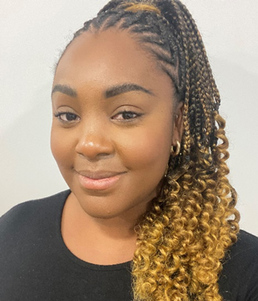
Can adopting positive student-teacher relationships with ethnic minority students improve classroom interactions? An Autoethnographic study of the students’ perspective, through the theoretical lens of a Black teacher.
Toyah Smikle-Mason
Secondary Science Teacher

Slide 2
“We came here to learn, we’re not here to be treated unequally, we just want to succeed, so if you treat us unfairly then we’re not going to listen and then we’ll have no chance of succeeding.”

Slide 3
Objectives
Reasons for the research.
Positive student-teacher relationships.
Research Process.
Key findings.
Future implications.

Slide 4
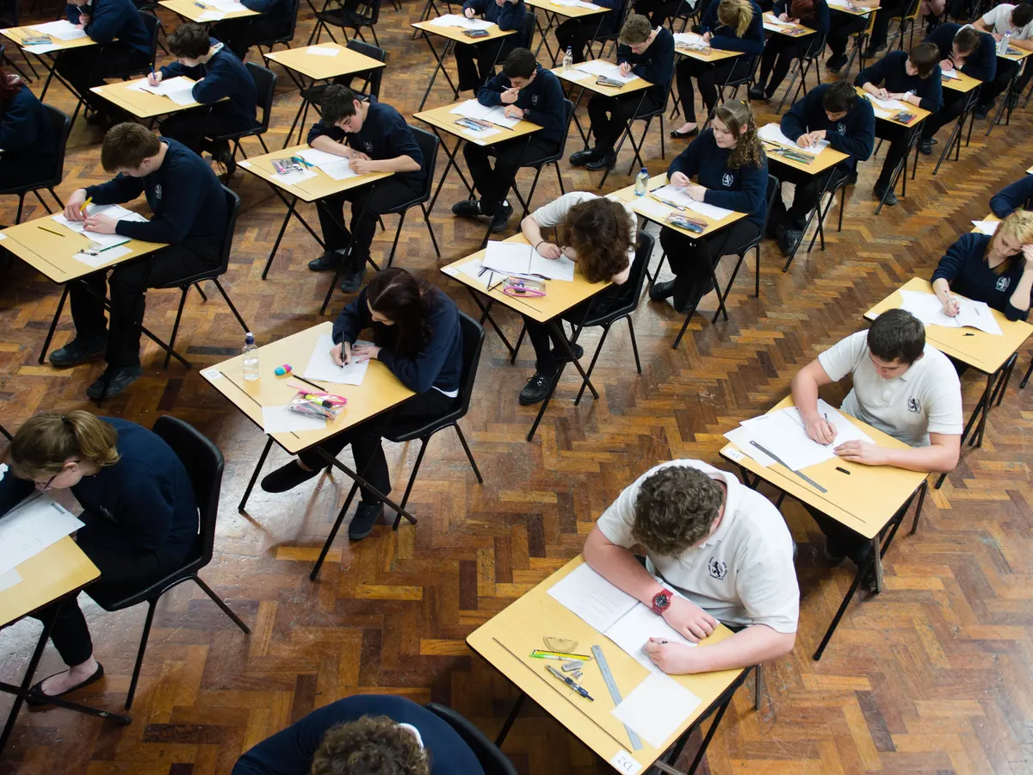
Reasons for the research | Attainment Gaps
To date there are inherent attainment gaps amongst ethnic minority students
GCSE Results
Indian and Chinese students persistently perform higher than their White counterparts.
Indian and Chinese students score significantly higher than their Black Caribbean and Pakistani counterparts.
Pakistani and Black African students now perform similarly to their White British counterparts.
KS2 - KS3 Results
Black students perform lower than the average pupil of other minority ethnic groups and are the lowest-attaining group at the end of Primary School.
The gap between Black Carribean girls and boys is one of the largest amongst minority ethnic groups (girls perform 7.5% better than boys).
Notes:
Gap caribbean girls and boys is the same at GCSE

Slide 5
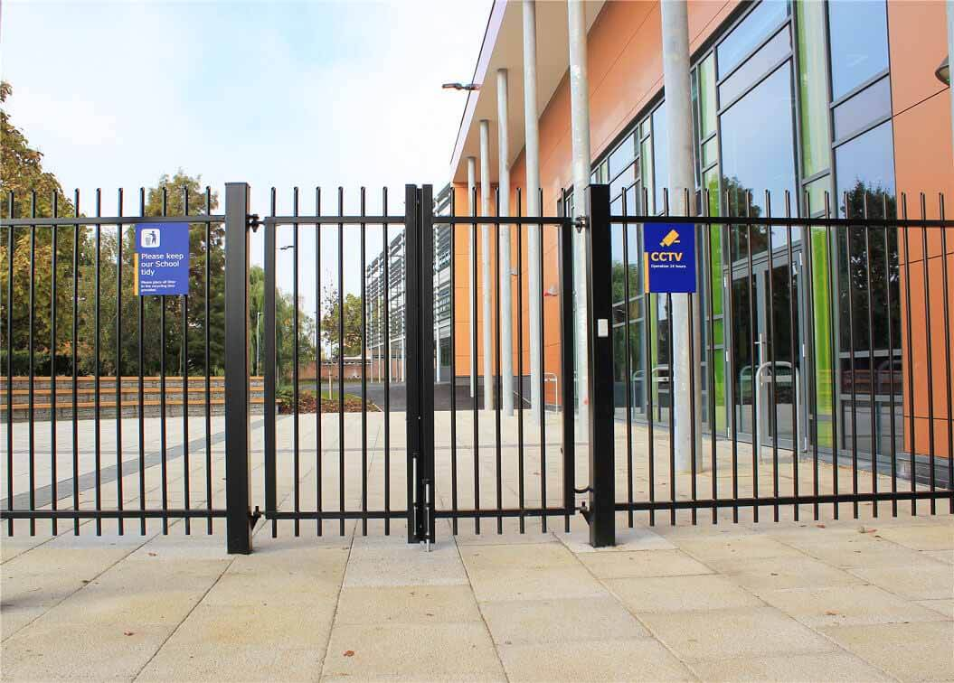
Reasons for the research | Factors
Students can be found disadvantaged in their ability to succeed socially and academically in a school environment.
Outside School Factors
Socio-economic factors; low-income households, poverty, under-resourced areas.
Absence rates, low parental involvement and low aspirations.
Pupils in deprived areas are more likely to attend schools with lower OFSTED ratings than economically advantaged students.
Notes:
In the UK there is a strong association between educational performance and social class.
School factors are thought to account for 8-15% of attainment differences (strand, 2014)
Austerity cuts have caused a decline in the ability to offer social and personal support - leading to prioritising and systematic disempowerment f young people in disadvantaged communities.
Students attending outstanding schools are commonly known to achieve higher than those in schools rated satisfactory or inadequiet
School factors - are said to hold a powerful influence (Hattie, 2008)

Slide 6

Reasons for the research | Factors
Students can be found disadvantaged in their ability to succeed socially and academically in a school environment.
Inside School Factors
Low teacher expectations
  Behaviour
  placing students in lower sets
  less positive feedback and praise.
Unconscious and conscious biases
  Harsh reprimands.
  Racist stereotypes and microaggressive terminology (aggressive, attitude, feisty, loud).
Lead to → hinder student success, low self-esteem, poor self-perception, and disengagement.
A teacher’ role is thought to be vital in improving outcomes for Black students as it shapes their school experience (Gershenson et al, 2016).
Notes:
Low teacher expectations are widely known to influence a students’ self perception and confidence It can interfere with student performance and may act as a self-fulfiling prophecy
The latter is echoed in US, England and other European countries
white Gypsy and Roma pupils, white irish travellers and mixed white & black exclusion rates are the highest

Slide 7
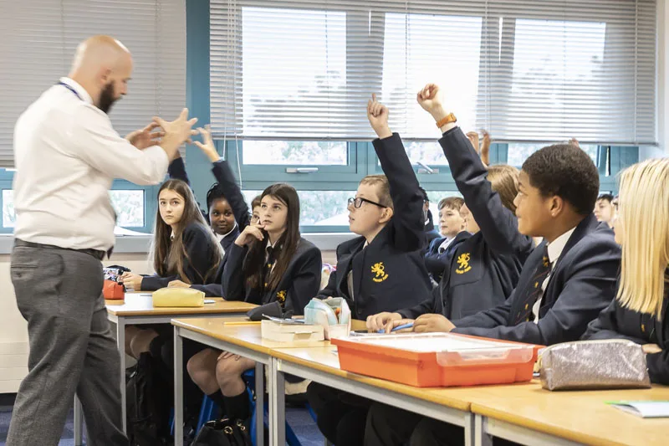
Positive Student-Teacher Relationships
The influence of the teacher holds weight in the classroom (Hattie, 2008).
Relationships are a foundational component of the child’s experience in school, and is an asset in promoting learning and engagement.
What is a positive student-teacher relationship?
‘Relationships that are non-directive, empathetic, warm and encourage thinking and learning’ (Roffey, 2012).
Improve academic outcomes.
Students holding their teachers in higher regard.
Creates a sense of belonging and connectedness.
Conducive to a productive learning environment.
Benefit the teachers’ occupational well-being.
Notes:
Teachers who excude these characteristics hold high expectations for students which results in students holding teachers in a higher regard and treating them with more respect.
Promotes acceptance and inclusion and can improve academic outcomes.
More so important in secondary schol - taught by multiple specialists, leads to fragmented interactions and increased professional distance.
Emotional involvement is tied into developing strs - emotional labour, poor behaviour can lead to stress and burnout in teachers. The whole thing can be a balancing act, but could be anecdotal.

Slide 8

Research Process
Autoethnography - An an active participant in the research.
positive and negative relational interactions.
Observational data on the students’ experience.
Reflexive diary - lesson interactions.
Focus Groups - 25 participants.
Key Questions
What the students’ believe positive and negative relationship attributes are.
Self prescribed attributes of a good student-teacher relationships.
How these relationships affect them.
Notes:
Confidentiality (irwin & Johnson, 2005).
3rd - did go on to find out whether they believe their ethnicity placed a factor.

Slide 9
Research Process
Method of Analysis: Thematic Analysis
Using the Braun & Clarke (2006) six-phase thematic analysis.
1
2
3
4
5
6
Data Set
Familiarisation
Data Coding
Initial Theme
Generation
Theme Development
& Review
Theme Refining, Defining & Naming
Writing Up

Slide 10
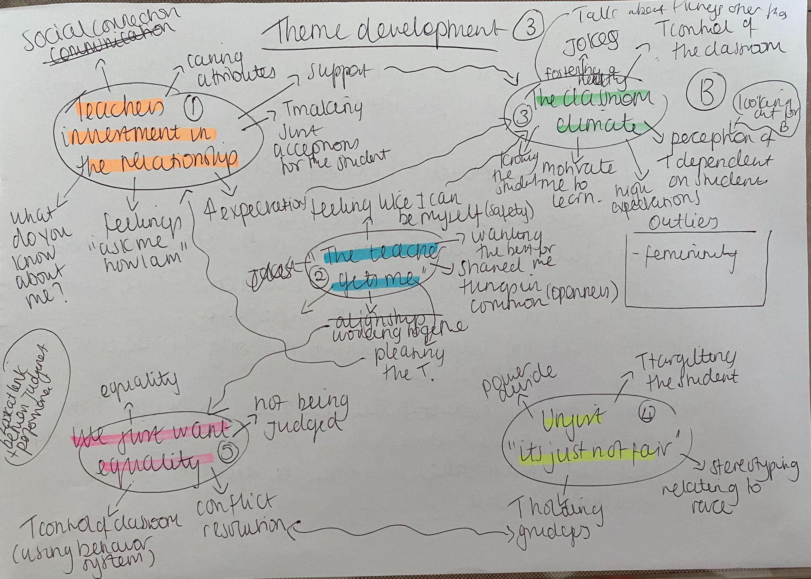

Slide 11
Key Findings
The final stage of the analysis resulted in three overarching themes.
Theme 1: We are a team and we both invest in the relationship.
Theme 2: I can be myself
Theme 3: We just want to be treated equally.
Notes:
Explain 6 phase
Put in flow chart and them chare

Slide 12
Theme 1: We are a team and we both invest in the relationship.
“When you like the teacher you don’t want them to be disappointed in you, so you try to work harder”
“A lot of time you feel really separated from your teachers, but like with her [...] you feel more likely to ask her questions”
Positive STRs were connected with the teacher’s ability:
Provide academic support
Regularly check work
Identify when students needed help
Students were then more open to answer questions and ask for help.
When teachers were warm, kind and caring it facilitated positive working environments. Which encouraged students to increase their engagement.
“If you have a better relationship with a teacher they’ll be more understanding of what you're doing and you’ll be better behaved with them.”
“You feel well supported to be able to go to them and ask for reassurance”
“ it makes me feel more motivated [...] like to learn more”

Slide 13
Theme 2: I can be myself.
Interpersonal relationships facilitated connectedness, a sense of belonging and acceptance.
Teacher’s present “small moments of care” (Leverette et al, 2012).
Relationships equally were beneficial for myself, allowing for a return on my ‘investment.’
Some students felt more comfortable around teacher’s who were ethnically matched. The inclusion and acceptance of their individuality raises the quality of the STR.
“Like some teachers can’t take a joke, but because of how you act I know I can say a joke”
“My teacher [...] he’s very relatable with us because he’s on trend [...] like with gaming and stuff”
They were all ecstatic and excited about their trip and rambled on [...] one exclaimed “Oh Miss I got you something.” He pulled out a triangular 3-way highlighter [...] I was so surprised. Then another ran forward “Miss look I got you this periodic table bag” it was lovely. I responded “Thanks so much”.
“I can be really loud. With teachers that are Black like me, [...] they tend to not be as bothered by laughter or a bit of chit chat between students”
“Yeah, you don’t really feel singled out [...] you feel like you can be yourself in the lesson”

Slide 14
Theme 3: We just want to be treated equally.
Students were critical of subtle disparities in the treatment they received and concerned about the low expectations held of them.
There were speculations that this was due to their ethnicity. And had a heightened awareness of it.
Leading to a reduction in their productively and perceived engagement in the lesson.
Student’s at times felt powerless, targeted and judged. Unresolved conflicts fragmented interactions and left room for ambivalence.
“Sometimes I feel like the teacher will talk differently to other people, but when they speak to ethnic people they start acting more strict and it’s like they are being unfair [...].”
“Sometimes people speak to me, like I don’t understand something, they talk to me really slow, like I’m dumb and it’s just really annoying.”
“Sometimes teachers decide to use the school rules to their advantage, to like, push against students”
“Sometimes I see [...] teachers expecting less of students of colour. Then I feel like, is this a self-fulfilling prophecy? Because sometimes they’re badly behaved pre-emptively. And sometimes I’m like, are you expecting them to do worse just because they’re Black or because they’re a person of colour and you don’t think they can do as well?”
“Like when they have favourites [...] I feel like if you are being targeted [...] you won’t be productive in the lesson”
“I heard a Black student walk through the door [...] all he was saying is ‘I haven’t done anything wrong’ and then the teacher said ‘why are you being so aggressive.’ And it wasn’t even aggressive at all.”
“When they treat me unfairly then for the next few lessons, i’ll kind of just not really care in class.”

Slide 15
Future Implications
Higher awareness of subconscious biases that we hld.
Training in conflict resolution with students.
Training in the importance of developing and maintaining positive STR’s.
Diversity training.
Calls for diversifying the profession.
Positive STR’s can positively impact the students’ school experience.
Increase their perceived engagement and desire to work hard.
Creates more room for compliant classrooms where students are on task.
Encourages pleasant interactions between teachers and students.
Negative STR’s can be impactful.
Reinforce racial biases.
Leave student’s feeling targeted, judged and disliked.

Slide 16
Questions

Slide 17
References & Useful Reading.
Archer-Banks, D. A. M., & Behar-Horenstein, L. S. (2012) Ogbu Revisited: Unpacking High-Achieving African American Girls’ High School Experiences. Urban Education, 47 (1): 198–223.
Braun, V. & Clarke, V. (2021) Thematic Analysis a Practical Guide. London: Sage
Demie F. (2022) Tackling teachers’ low expectations of Black Caribbean students in English schools. Equity in Education and Society, 1 (1): 32–49.
Gershenson, S., Holt, S., Papageorge, N. (2016). Who Believes in Me? The Effect of Student-Teacher Demographic Match on Teacher Expectations. Economics of Education Review. 52 (1): 209-224.
Hattie, J. (2008) Visible Learning: A synthesis of over 800 Meta-Analysis Relating to Achievement. London: Routledge.
Leverett, P., D’Costa, S. & Baxa, M. (2022) The Impact of Student–Teacher Relationships on Black Middle School Boys. School Mental Health 14: 254–265.
McGrath, K.F., Van Bergen, P. (2019). Attributions and emotional competence: Why some teachers experience close relationships with disruptive students (and others don’t). Teachers and Teaching Theory and Practice 25: 334-357.
Roffey, S. (2012). Developing Positive Relationships in Schools. In: Roffey, S. (eds) Positive Relationships: Evidence Based Practice across the World. Springer, Dordrecht: 154-162

