Slide 1
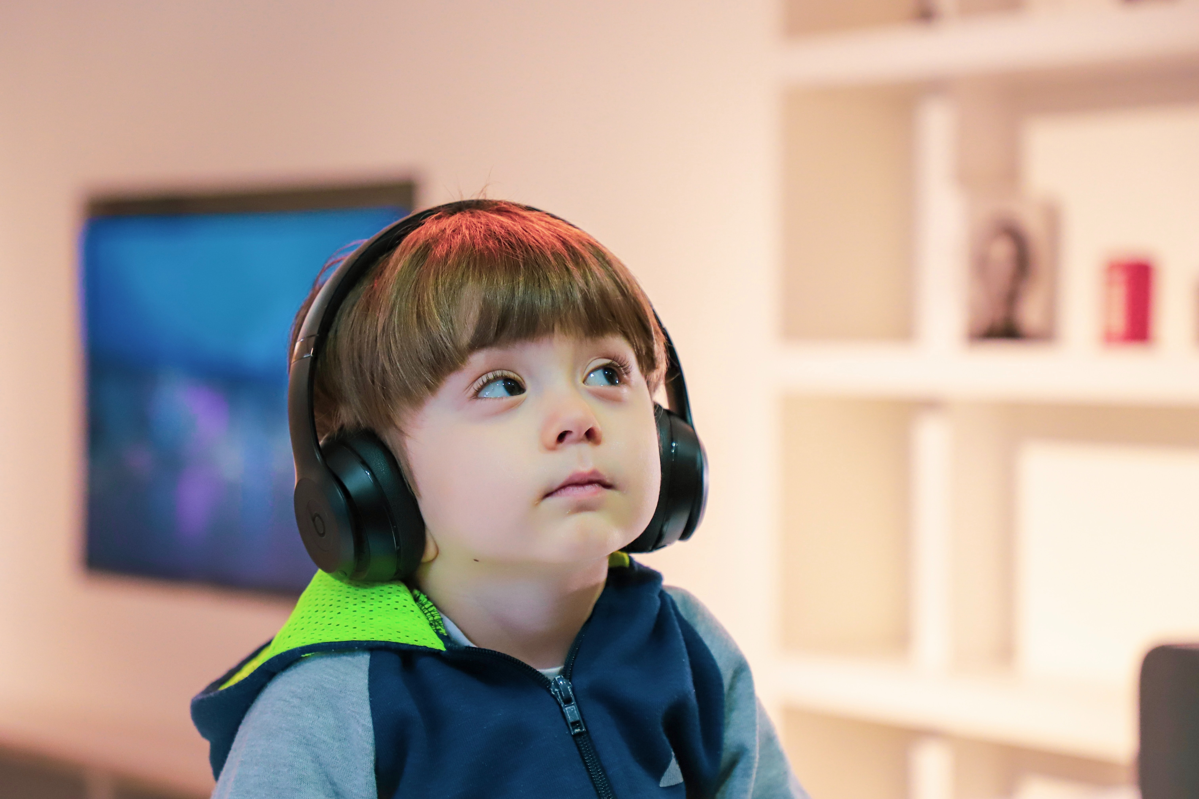

Helping non-speaking students to thrive in the classroom
Photo by Nathan Anderson on Unsplash

Slide 2

Dr Beverley Samways

Slide 3
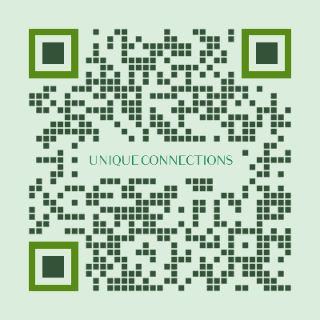



www.uniqueconnections.org.uk
/BeverleySamways
/uniqueconnections.org.uk

Slide 4

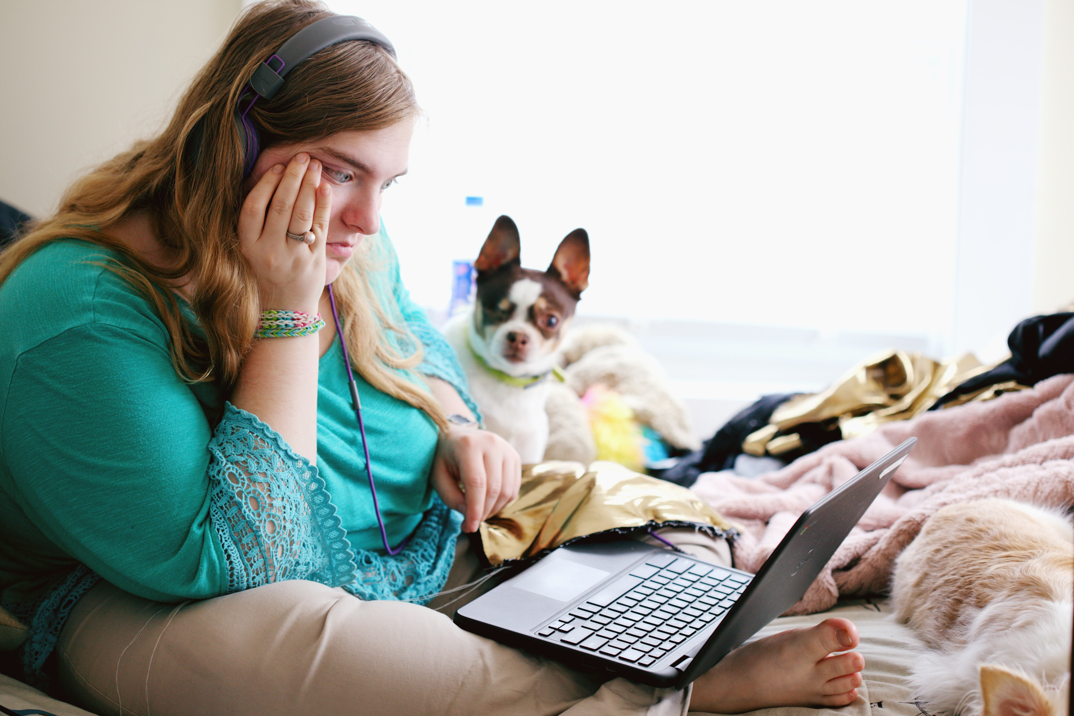
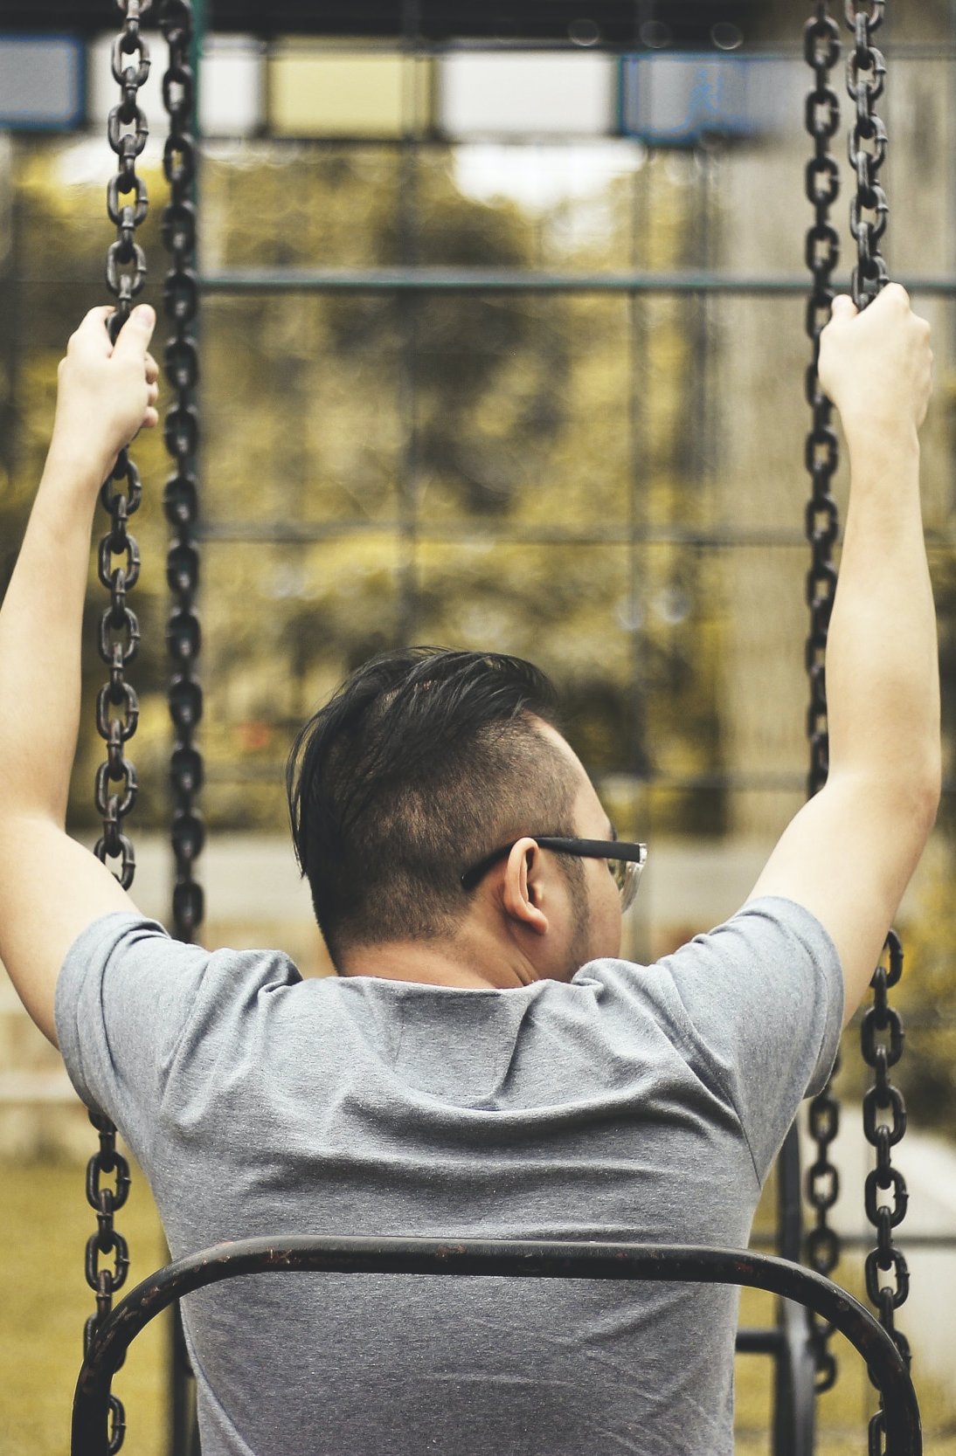
Image SLide
Non-spoken stories: an ethnographic account of the emotional lives of three teenagers with severe learning disabilities who sometimes self-injured.
Three teenagers
severe learning disabilities
autism
‘nonverbal’
a long history of self-injury.
Participant observation
180 hours
eight months

Slide 5
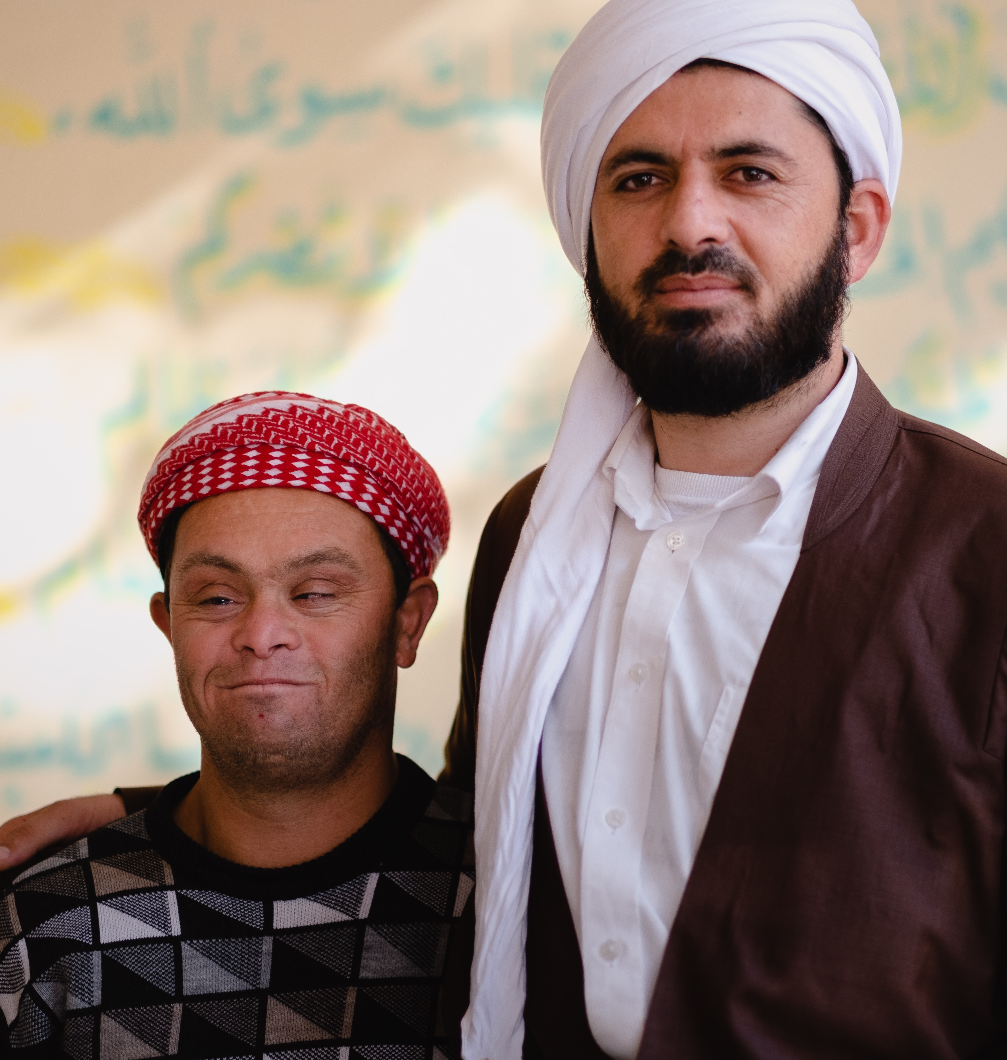
Overview
Intelligence / comprehension and non-speaking students
Connection and relationship with non-speaking students
Non-verbal communication with non-speaking students
Photo by Levi Meir Clancy on Unsplash

Slide 6

Reasons why a student might not speak
Learning disabilities
Autism
Physical disabilities
PMLD
Mental health

Slide 7
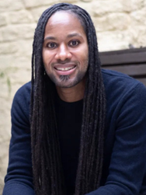
Speech and intelligence / comprehension
Absence of speech is NOT indicative of a person’s intelligence.
Professor Jason Ardey

Slide 8
The capacity to relate to each other is an essential part of what it means to be a human – though it can present variably.
We used to think that the ability to relate was learnt – but we now know differently….
Photo by Taksh on Unsplash

Slide 9
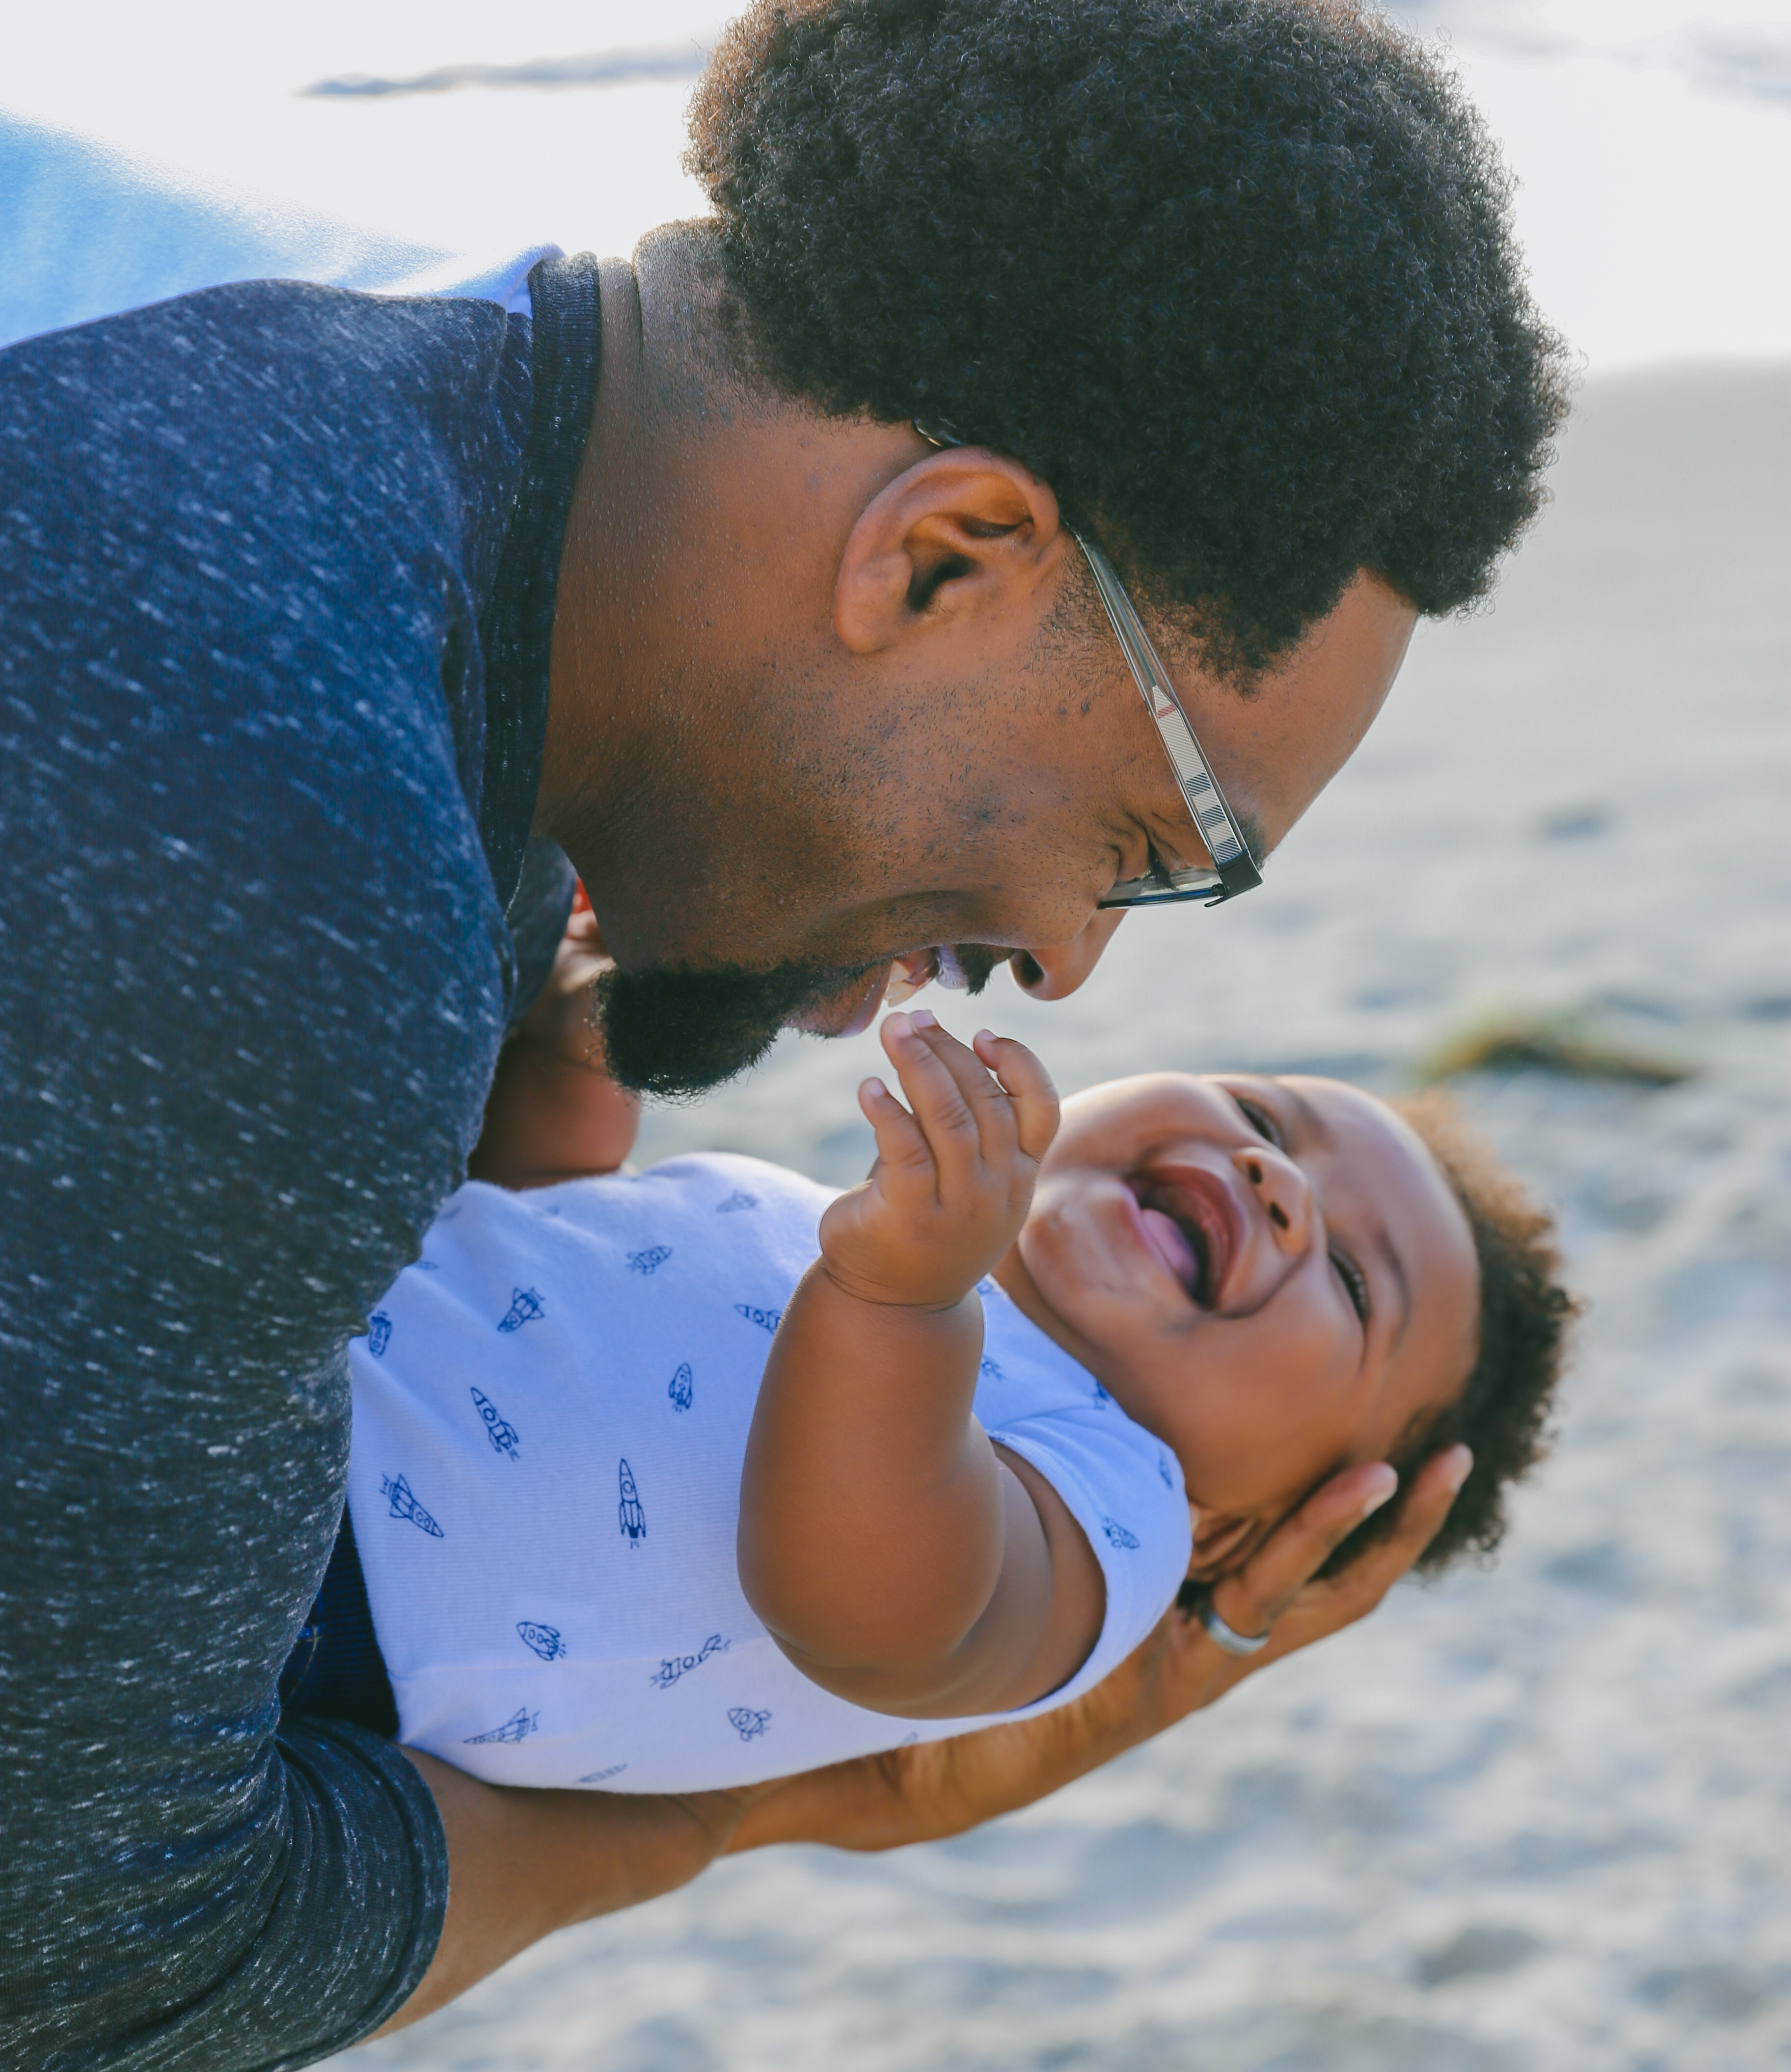
Imitation is a building block for relationships.
When do we learn to imitate?
From birth!
Photo by Lawrence Crayton on Unsplash

Slide 10
‘Infants, it appears, are born with motives and emotions for actions that sustain human intersubjectivity’ (Trevarthen, 2010)
Photo by Lawrence Crayton on Unsplash

Slide 11
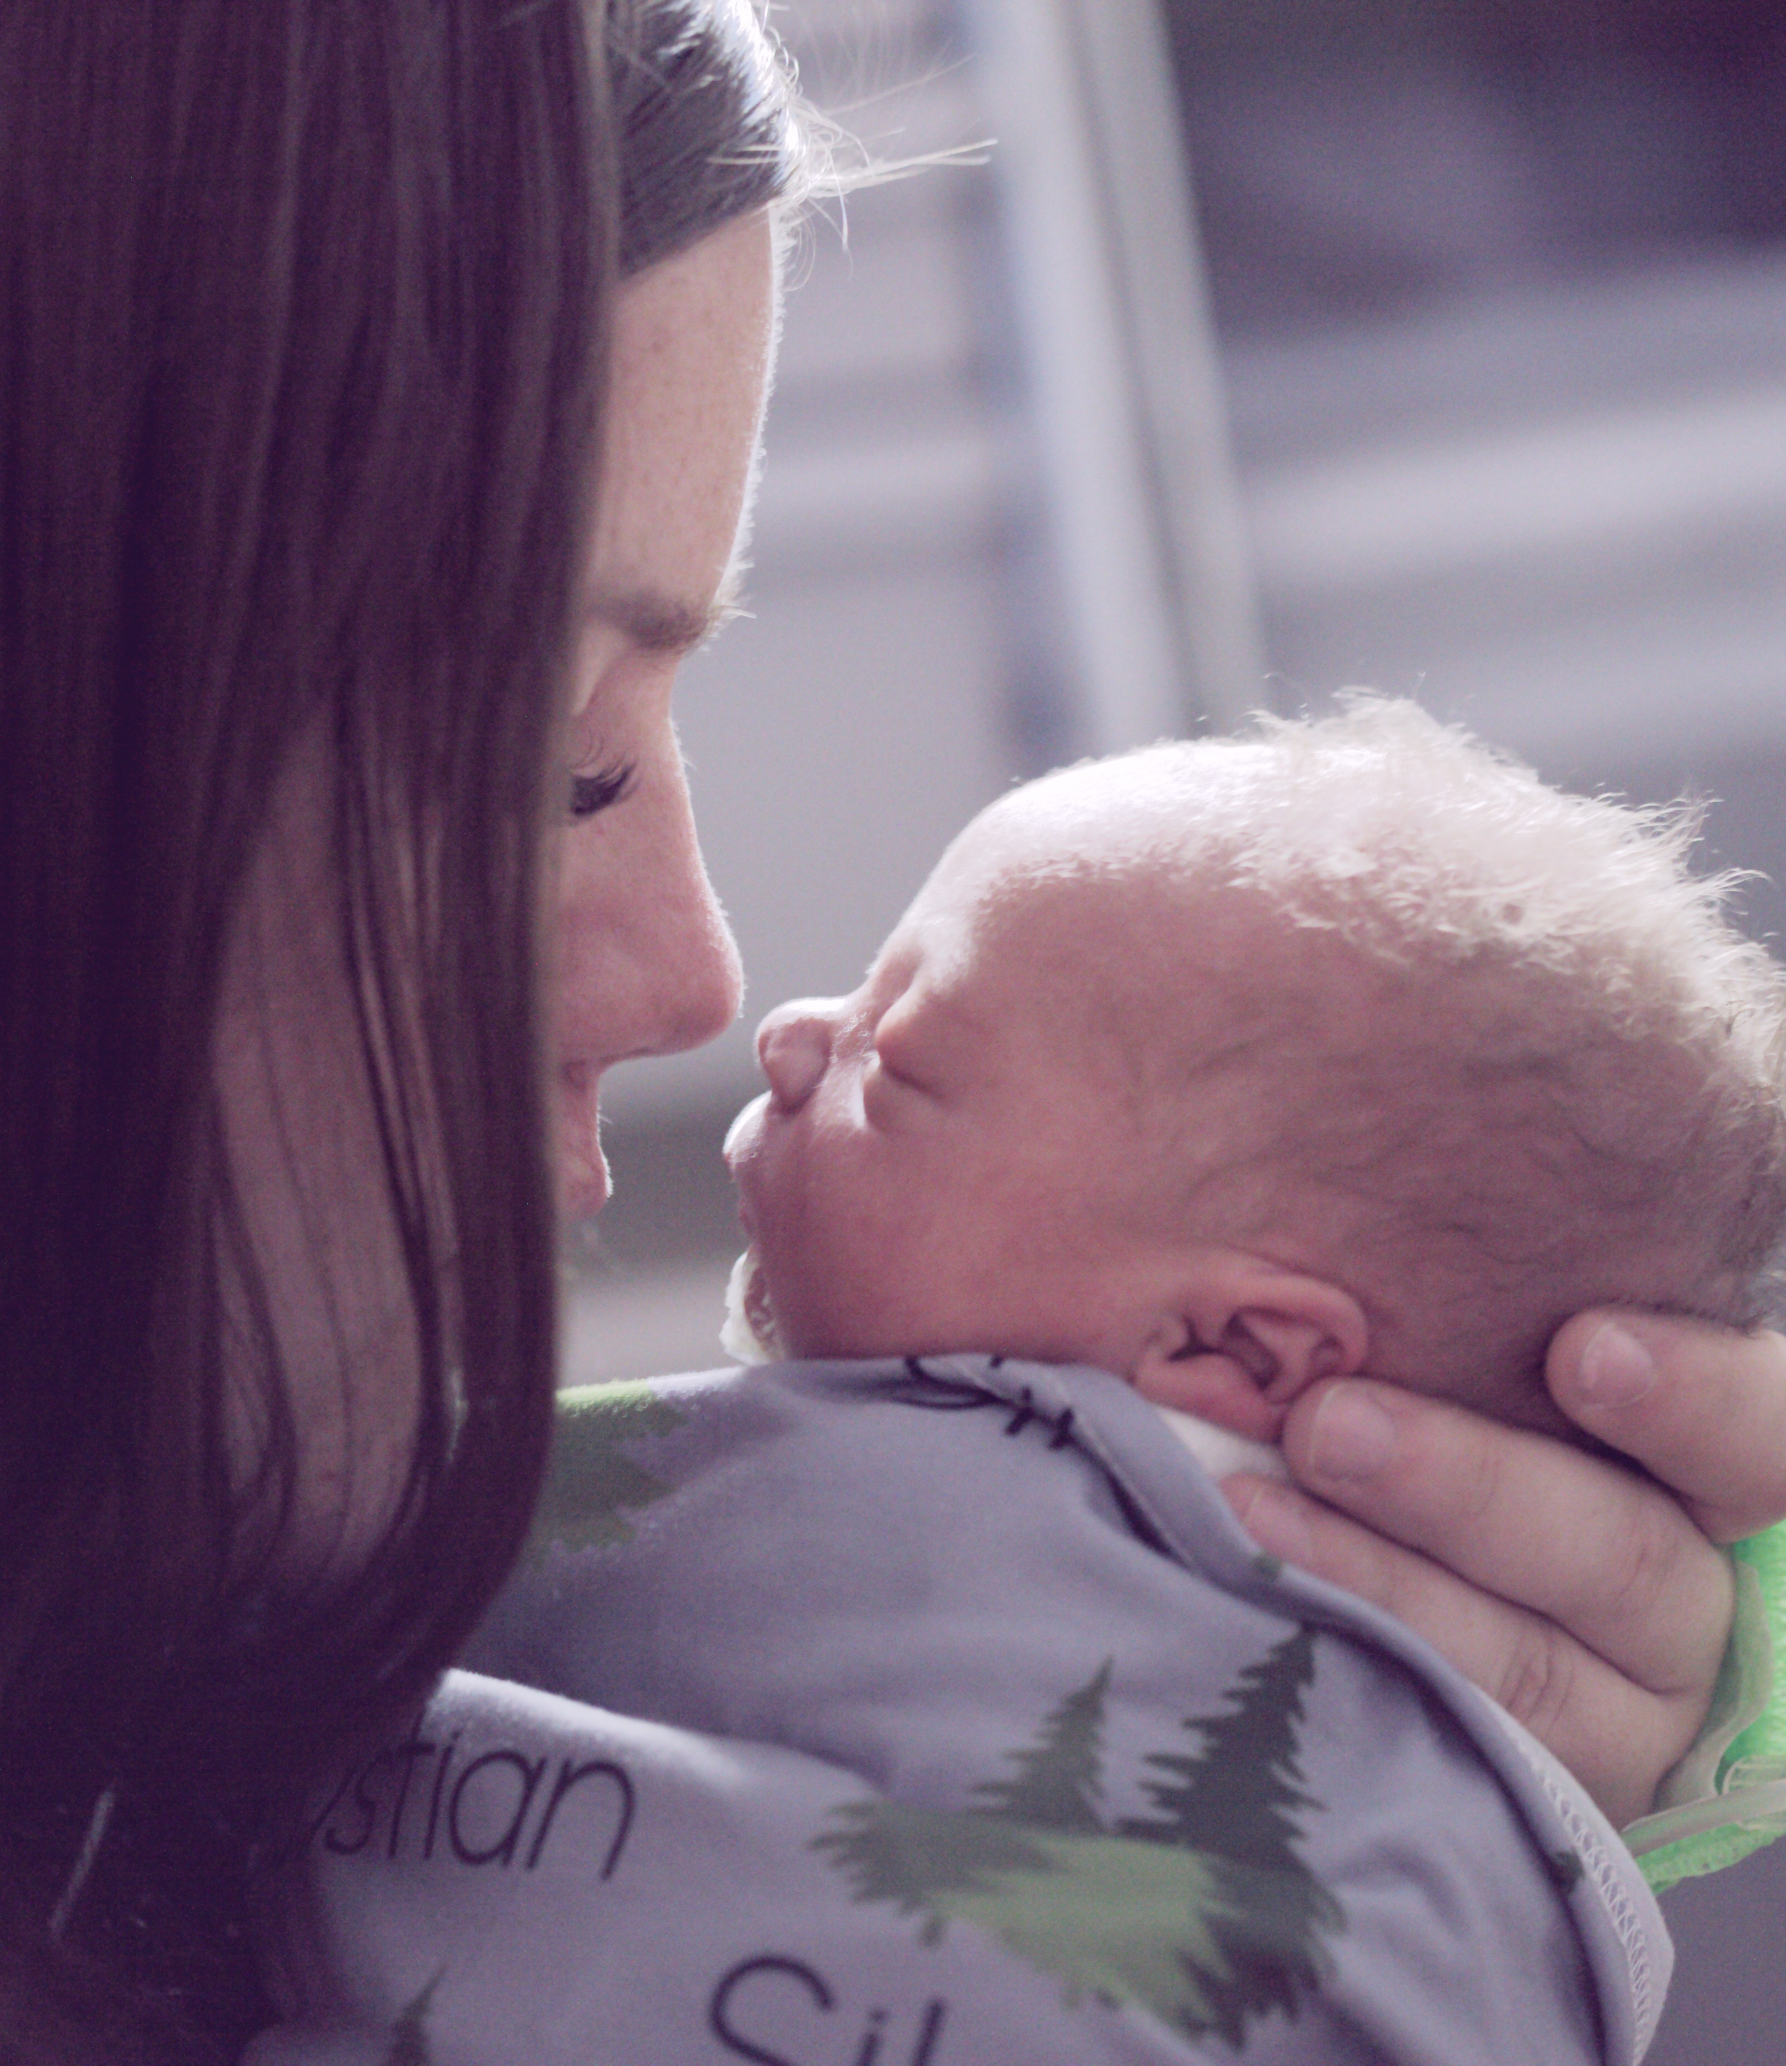
Humans are primed for relationships and interaction from birth.
Photo by Alexander Grey on Unsplash

Slide 12
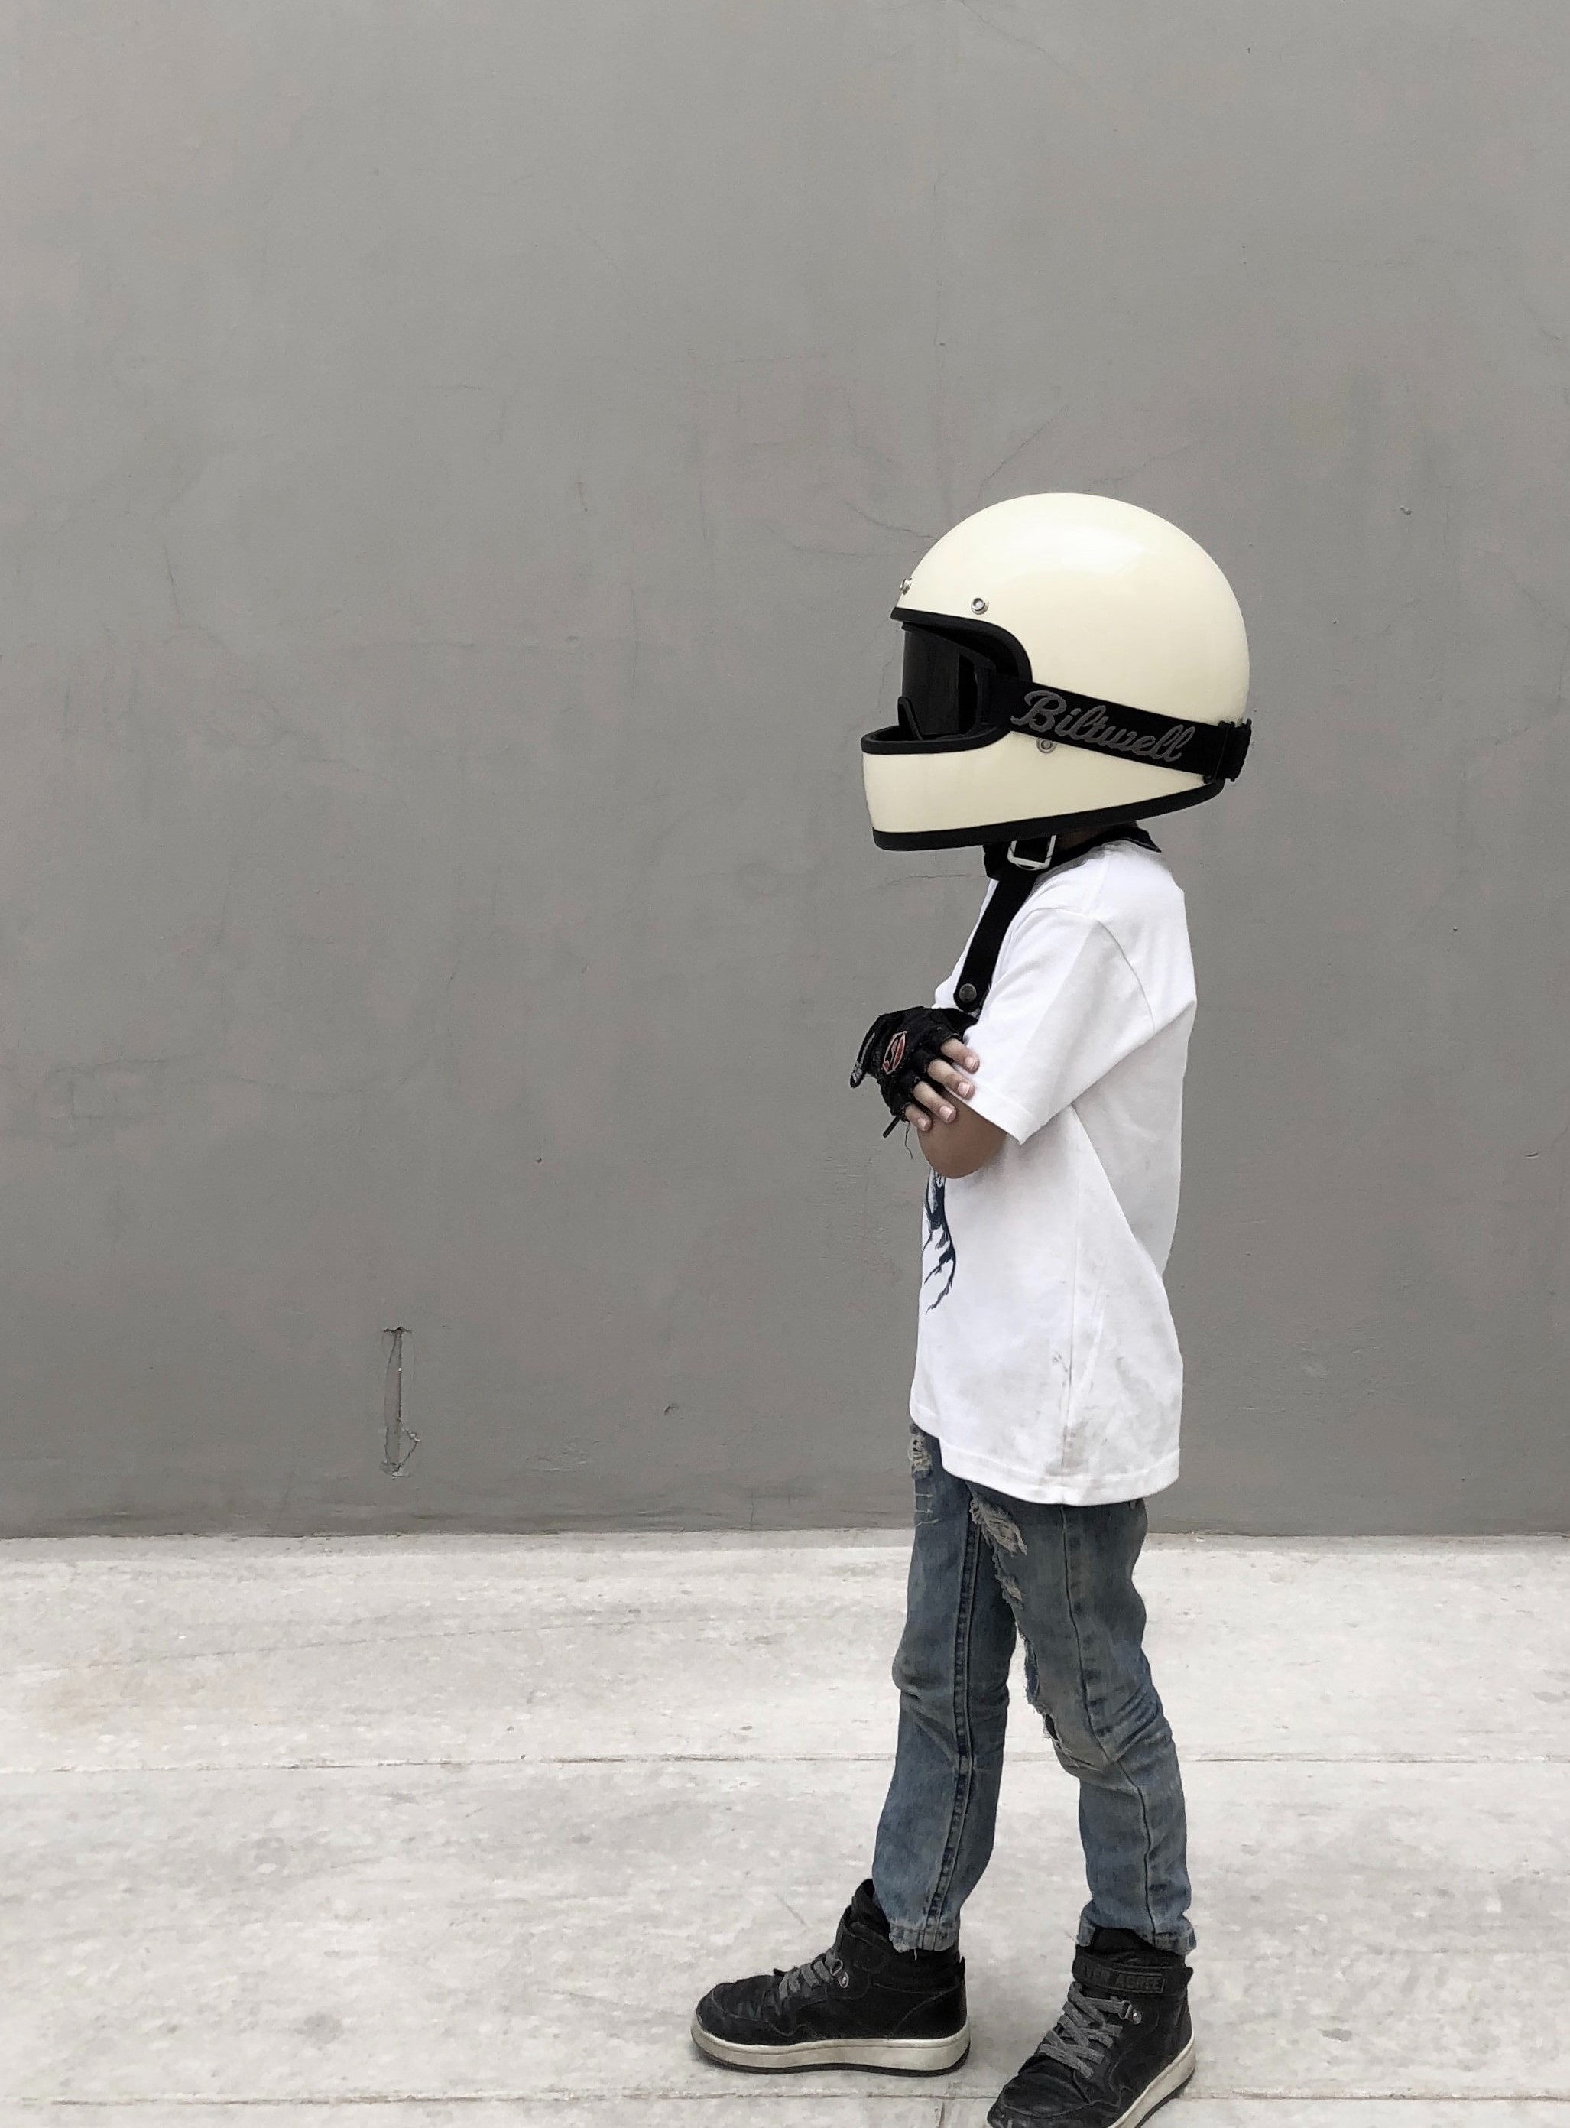
What is this important when thinking about someone with learning disabilities and autism who is non-speaking?
Because it so often doesn’t feel true.
And we have to remember that it is.
Photo by Aaron Torres on Unsplash

Slide 13


'all human beings, regardless of neurodevelopmental difference, have an inherent need for meaningful connection.' Alexis Quinn et al. (2023: 311).
Photo by anna Kolosyuk on Unsplash

Slide 14

Everyone is made for connection. No exceptions.
Photo by Chris Nagahama on Unsplash

Slide 15
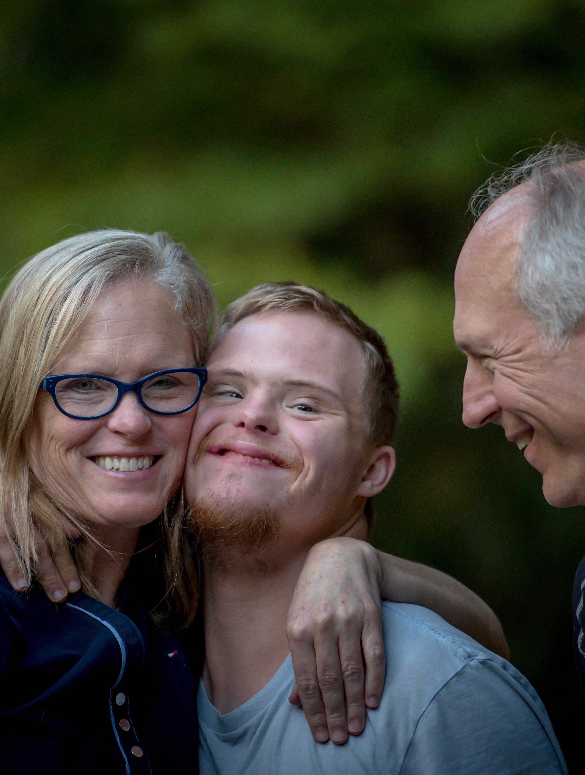
Communicating with non-speaking pupils
Re-learning
non-verbal communication
Photo by Nathan Anderson on Unsplash

Slide 16
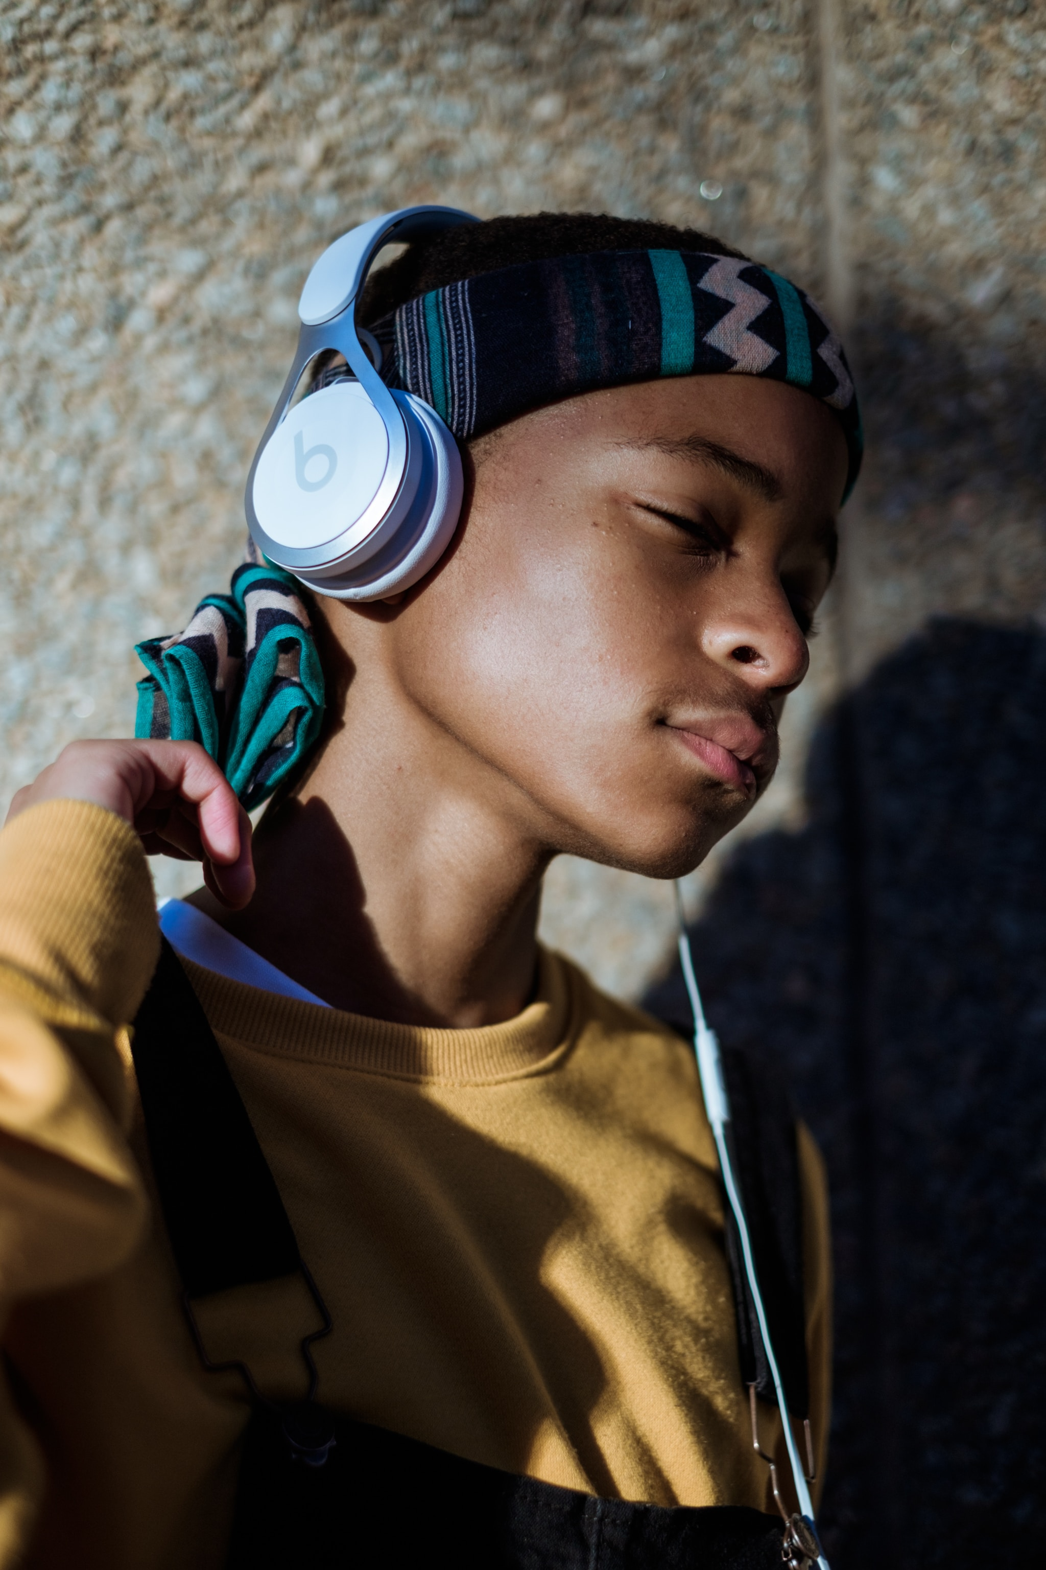
Final thought:
‘‘Being heard is so close to being loved that, for the average person, they are indistinguishable’ David Augsburger
Photo by Mpumelelo Macu on Unsplash

Slide 17
www.uniqueconnections.org.uk
Photo by anna Kolosyuk on Unsplash
Thanks for listening!

Slide 18
References and useful reading
Beail, N., Frankish, P. and Skelly, A. (2021) Trauma and intellectual disability. Acknowledgement, identification and intervention. West Sussex: Pavilion.
Borghus, A., Dokkedahl, S. and Elklit, A. (2020) Pilot study: undetected post-traumatic stress disorder symptoms among intellectually disabled. International journal of developmental disabilities, 66(1): 36-45.
Higashida N. (2013) The reason I jump: the inner voice of a thirteen-year-old boy with autism. New York: Random House.
Hulbert‐Williams, L. and Hastings, R.P. (2008) Life events as a risk factor for psychological problems in individuals with intellectual disabilities: a critical review. Journal of Intellectual Disability Research, 52(11): 883-895.

Slide 19
References and useful reading
Miller, D. and Brown, J. (2014) NSPCC ‘We have the right to be safe’. Protecting disabled children from abuse. [Online]. Available at: https://www.nspcc.org.uk/globalassets/documents/research-reports/right-safe-disabled-children-abuse-report.pdf
Quinn, A. (2018) Unbroken: Learning to live beyond diagnosis. UK: Trigger Publishing.
Samways, B., Heslop, P., & Dowling, S. (2022). Self-reported explanations for self-injury by people with intellectual disabilities: a systematic review of qualitative studies. International Journal of Developmental Disabilities, 1–15.
Tournier T, Hendriks AHC, Jahoda A, et al. (2020) Developing a logic model for the Triple-C intervention: a practice-derived intervention to support people with intellectual disability and challenging behaviour. Journal of Policy and Practice in Intellectual Disabilities 17(4): 297–307.
Van der Kolk, B. (2014) The body keeps the score. Mind, brain and body transformation of trauma. London: Penguin.

