Slide 1

Trainee teacher research in Early Reading (SSP) Intervention
Jo Dobb, Molly Stronge, Grace Thomas, Kirsty Weeks
The Centre for Teacher Education
Every child in every classroom deserves a great teacher every day

Slide 2
Research and Practice at CTE
Research informed department
Teaching rather than research led
PGCE intense course with many constraints
'Research what you teach and teach what you research'
Social Justice
Intellectual Curiosity
Creativity
Notes:
JD/KW 2 mins Constraints include DfE compliance, 1 year course, for Primaries this includes learning in all subjects – for Secondary includes working with multiple classes and applying learning in different contexts

Slide 3
Introduction to the Project
Small-scale research project
2023-2024 (2 year lead up)
2 CTE tutors and 2 Primary PGCE trainees
1 local Primary school – North Warwickshire
2 foci:
Potential impact of new SSP intervention available to schools
PGCE trainees engaging in small scale research during their ITT year
Social Justice
Intellectual Curiosity
Creativity
Notes:
GT 3 mins All trainees invited to take part

Slide 4
Chapter One*
Initially approached by the charity Chapter One
USA founded charity supporting early reading
Set up in Chicago 30 years ago
2 main elements:
Volunteer platform for 1:1 reading
Software to support basic reading skills
2017 Emma Bell established the programme in the UK
Volunteer programme now supports over 3000 children in low socio-economic areas in the UK
Social Justice
Intellectual Curiosity
Creativity
* Chapter One was formally known as Innovations for Learning
Notes:
JD 2min Approached in 2021 – KW will talk more about our involvement with them in a moment. Inequality in reading provision. Originally called Innovations for Learning – now Chapter one. volunteer platform = reading practise; software = supports reading teaching – decoding skills with some comprehension.
2017 – initially focussed on establishing the volunteer platform: Industry and business fund the programme and volunteers from within the company commit to 30mins per week of online reading with a child – they are the reading buddy.
Schools chosen are within low-socio economic areas (high FSM/PPG)
Links to WTV = we felt able to support

Slide 5
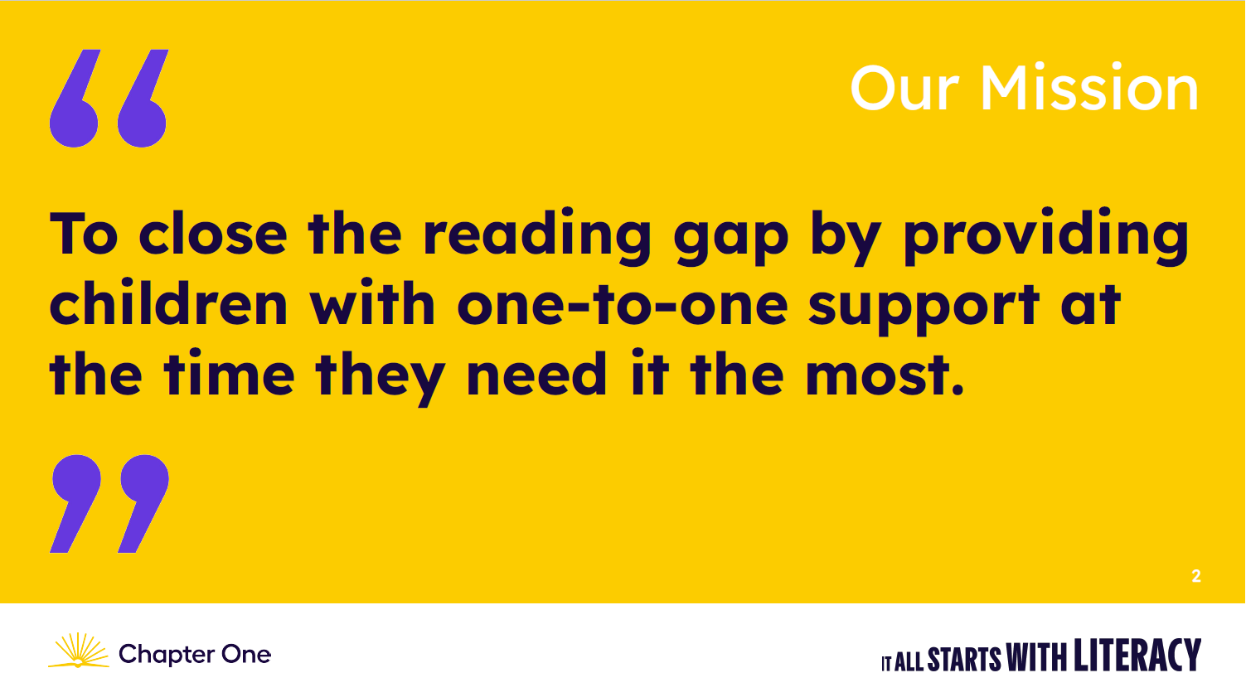
Chapter One*
Social Justice
Intellectual Curiosity
Creativity
* Chapter One was formally known as Innovations for Learning
Notes:
JD Links to WTV = keen to support

Slide 6
CTE Consultancy with Chapter One
Year one (2021-2022):
Development of the Technology tool for the UK
Kirsty and Jo worked with Emma and the USA-based technologists to move from analytic phonics to SSP
Year Two (2022-2023)
Pilot materials in two local partnership schools
Promising data emerged - 1 pilot school chose to fund for 23-24
Year Three (2023-2024):
IATL funding for small scale project involving CTE tutors and trainees
Social Justice
Intellectual Curiosity
Creativity
* Chapter One was formally known as Innovations for Learning
Notes:
KW 1minWith the volunteer programme established the next phase was to introduce and roll out the technology tool
Intro to the tech tool – Kirsty and Jo to explain what it does it and how

Slide 7
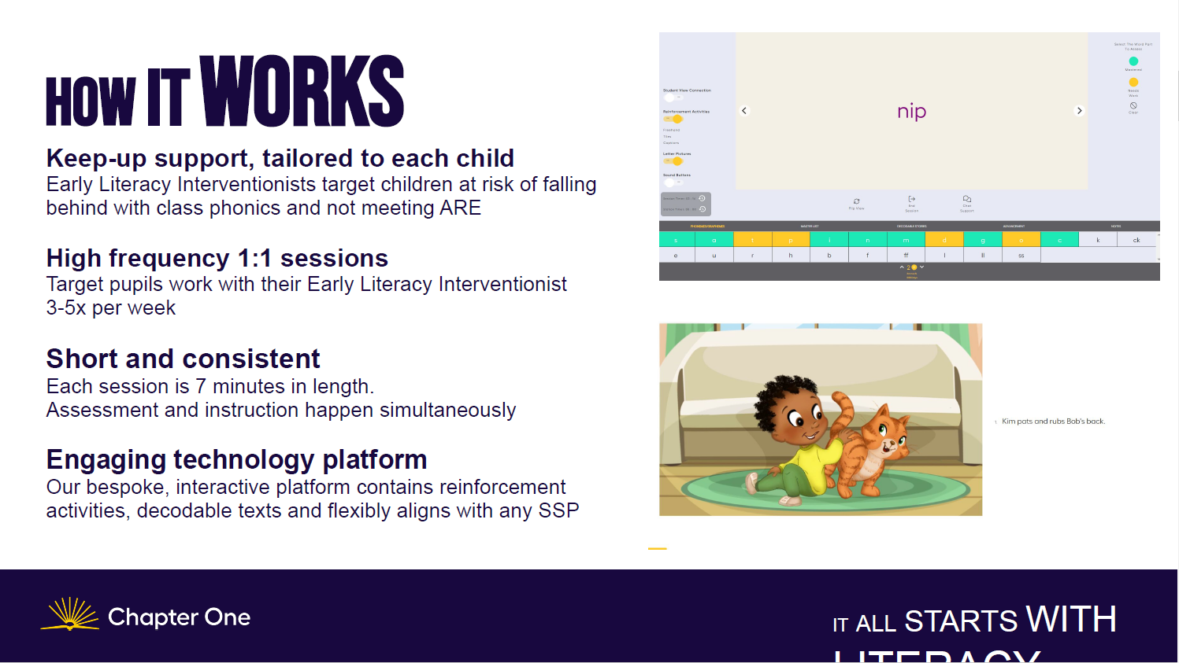
Relevance of SSP in ITE
Social Justice
Intellectual Curiosity
Creativity
Notes:
KW 2mins

Slide 8
IATL Funding
Institute for Advanced Teaching and Learning
Applications for funding and practical support for staff and students to develop an area of practice
Ethics approval required (HSSREC)
Focus on co-creation – tutors and trainees
Tutor role: securing funding and ethics, encouraging trainee autonomy around the WTVs
Trainee role: shaping and managing the development of the project in school
Social Justice
Intellectual Curiosity
Creativity
Notes:
JD 2min
The scheme provides funding and practical support to enable staff and students to develop an area of practice aligned with Warwick’s Education Strategy and IATL’s strategic priorities. The scheme emphasises student and staff co-creation and the sharing of learning with the University community, including (but not only) through project information and outputsLink opens in a new window hosted on the IATL website.
HSSREC: Humanities & Social Sciences Research Ethics Committee
Long process – very detailed with amendments – long process which delayed the project by a year (initially planned to research the pilot but ethics not back in time)
Roles – KW AND JD: this was an important aspect , that we didn't overtly suggest activities in a similar way to how we may do within the taught programme. We aimed to offer autonomy and opportunity for the trainees to really draw on the WTV of intellectual curiosity and creativity

Slide 9
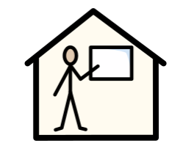
Context
Large Primary School
Location: North Warwickshire
Size: 3 form entry, Nursery to Year 6,
PP: 37.5% High EAL and SEND
SSP program: Little Wandle
Intervention: Runs throughout the day outside of the SSP session. There is flexibility to move children in and out of the intervention.
Social Justice
Intellectual Curiosity
Creativity
Notes:
Understanding demographic of the area different to both our experiences

Slide 10
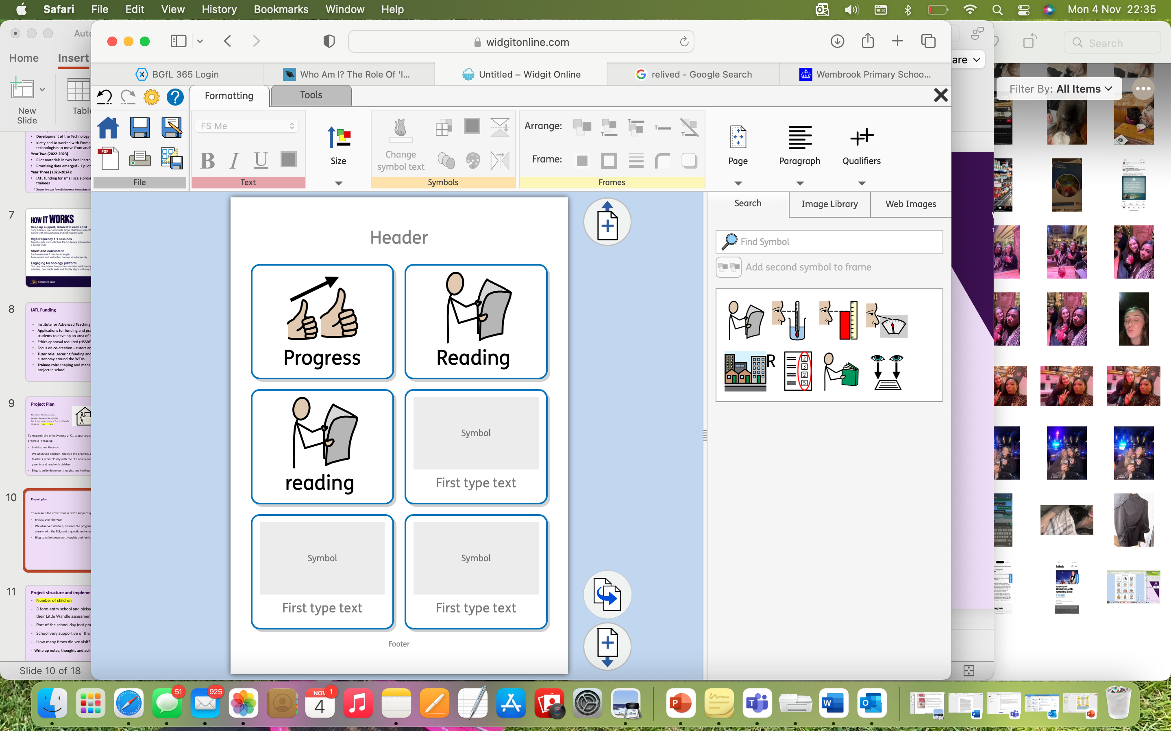
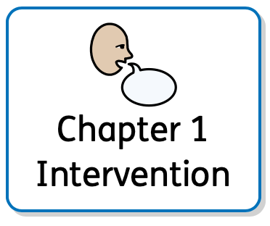
Project Structure
Plan | Implementation
6 visits | 6 visits to the school
observe children | Those who were receiving the intervention during their routine phonics lessons In both Reception and Year One Focusing on children’s interaction and understanding of the session.
observe the intervention in action | 15 sessions of the intervention taking place across a 6 month period, with R/Y1
interview teachers | Deputy Head Teacher x2 Intervention Lead ELI with and without the Deputy Head All staff members who worked in Reception and Year One in a group interview.
worked closely with the ELI | interviews, ongoing questioning and conversation and observations, information gathering about how the intervention worked and is implemented within school.
read with children | We read with 5 focus children who were receiving the Chapter One Intervention, some more than once This felt insufficient In hindsight we would have liked to have read with each at the beginning and at the end.
Capture our thoughts and feelings throughout the process | We captured our thoughts and feelings through an online blog where we recorded how we were finding the research project alongside completing our ITT. We created a poster to highlight our feelings throughout the process.
Notes:
Grace and Molly both read

Slide 11
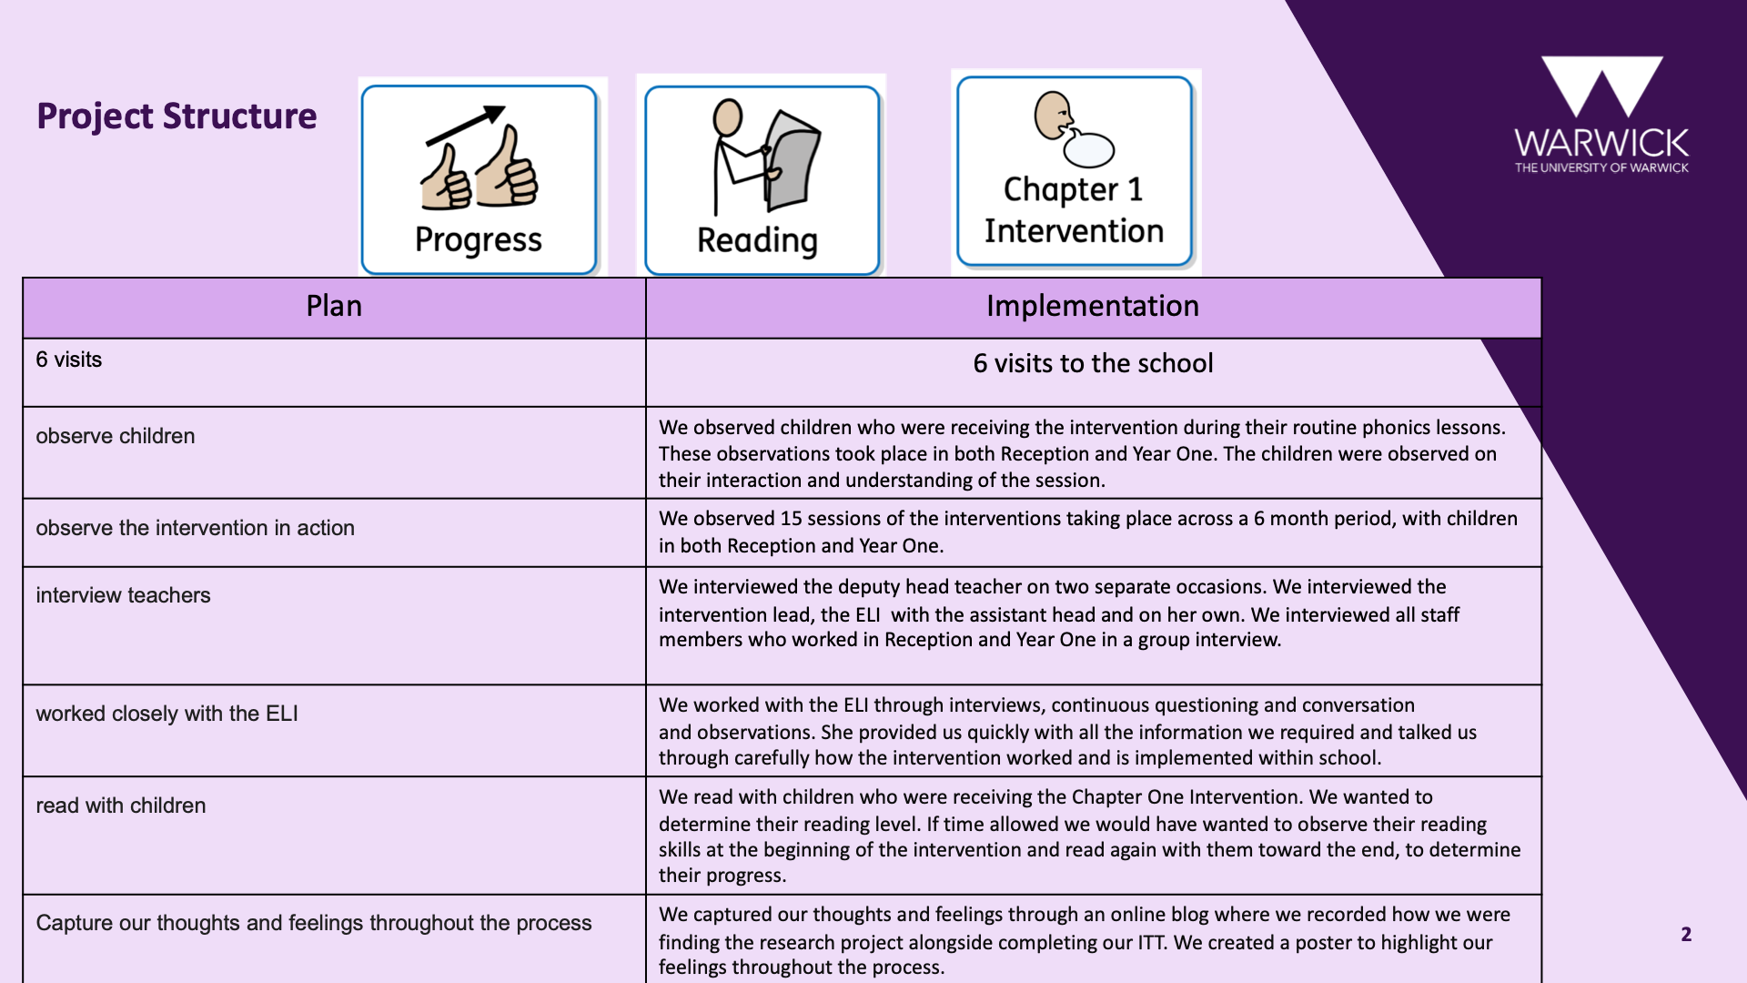
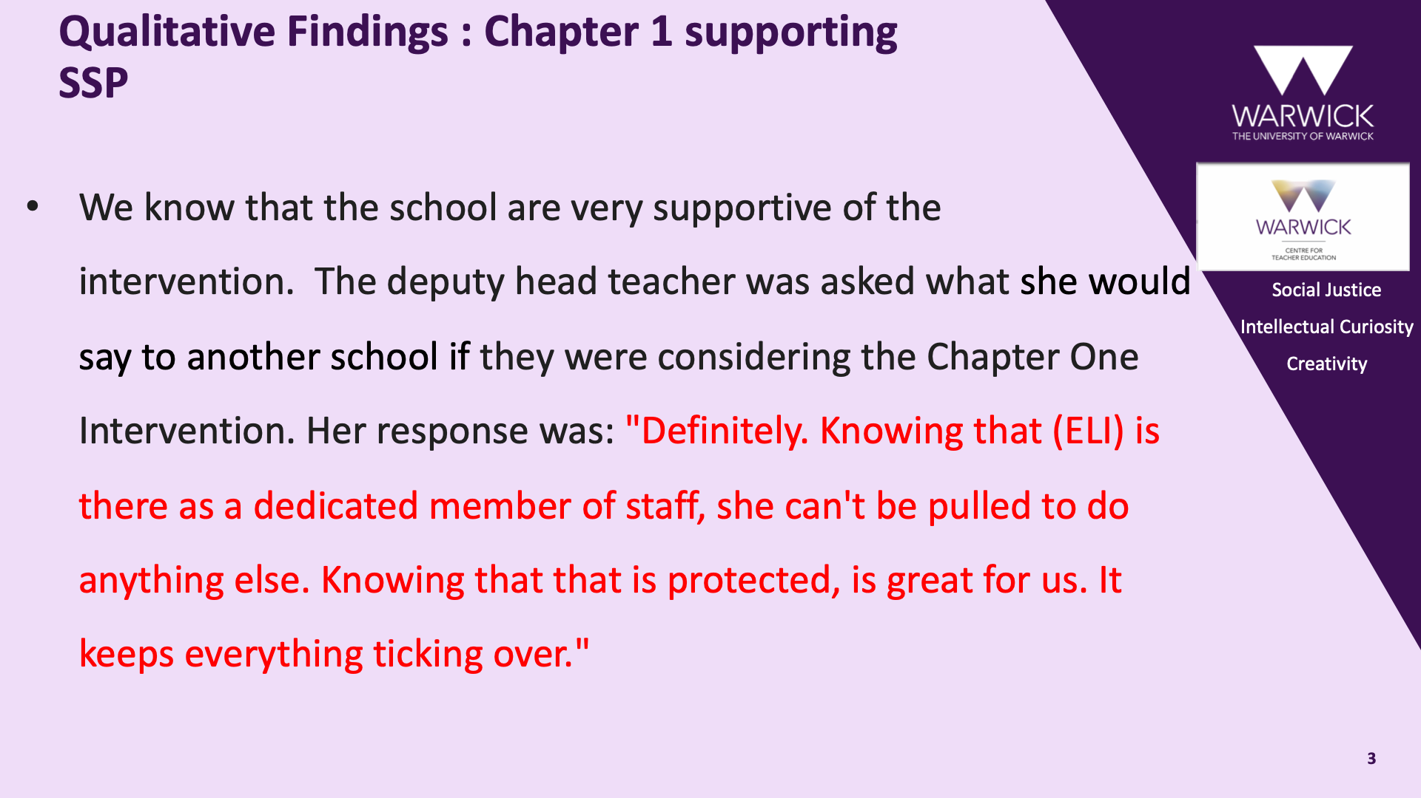
Context
Large Primary School
Location: North Warwickshire
Size: 3 form entry, Nursery to Year 6,
PP: 37.5% High EAL and SEND
SSP program: Little Wandle
Intervention: Runs throughout the day outside of the SSP session. There is flexibility to move children in and out of the intervention.
Social Justice
Intellectual Curiosity
Creativity
Notes:
MS 1minUnderstanding demographic of the area different to both our experiences

Slide 12
A dedicated member of staff is positive as it means they are protected by Chapter One. This means that they cannot be pulled to do any other cover that is required by the school, meaning that the intervention is always taking place without exception. This was a common selling point for all members of staff
Notes:
Grace

Slide 13
Because the intervention is only 7 minutes long, they are not losing a large amount of valuable learning time within other areas of the curriculum. The deputy head teacher told us "Children are not pulled from phonics or guided reading as it would not then be an intervention and would be counter productive."
Notes:
Molly

Slide 14
The ELI works with class teachers and is given the phonics groups based on Little Wandle data and knowledge/confidence level of the children
It’s a very fluid process
Children enjoyed the digital element of the intervention and the 1:1 time
Chapter 1 children appeared confident and engaged throughout the in class daily phonics lesson
Teachers commented on the positive impact on children’s self esteem and confidence in reading.
Notes:
Grace

Slide 15
Considerations
Budget – The intervention programme comes at a high cost. Is this feasible for most schools with current state of financial difficulties that most schools are facing. Is it a luxury rather than a necessity?
Same Implementation as whole school phonics scheme –
Chapter one was implemented at the same time as whole school phonics scheme. Does it help to show a true reflection on the impact that chapter one had on the children's progress?
Additional interventions were also taking place –
The new scheme ‘Little Wandle’ also had a new group intervention programme which was taking place in school. Some Chapter 1 children were sometimes in this group in addition to receiving the 1:1 chapter 1 intervention.
Notes:
Cant separate all the work the school do with interventions as they seemed to a strong intervention program with a intervention lead. They also have phonics intevention so this is also a contributing factor

Slide 16
Quantitative Outcomes in relation to Year 1
Children are chosen for Chapter 1 on the basis that they are at risk of falling behind.
It is designed as a ‘keep up’ not ‘catch up’ programme.
59% of children in the Y1 cohort had some intervention from Chapter 1 at some point of the year.
Year 1 cohort | Cohort of 42 trackable children* | 21 trackable children took part in Chapter 1 | 21 trackable children did not take part in Chapter 1
Average progress score for academic year from end of Reception to June Year 1 | +8.86% | +12.76% | +4.95%
Social Justice
Intellectual Curiosity
Creativity
At first glance the difference between the 2 groups looks stark, but the non-chapter 1 group will contain children with high and low attainment
*nb. only pupils with full data sets could be tracked: 42/81 pupils
Notes:
Trackable pupils – this low number could be due to transience, poor attendance (an issue for the school) and staff practice

Slide 17
Focusing data on Y1 groups within a given range
Year 1 cohort | Cohort of 42 trackable children | 21 children took part in Chapter 1 | 10 children whose Reception results were within the same range as the Chapter 1 group.
Average progress score for academic year from end of Reception to June Y1 | +8.86% | +12.76% Average Reception score 88% Average June Y1 score 99.7% | +8.2% Average Reception score 89.6% Average June Y1 score = 97.8%
Social Justice
Intellectual Curiosity
Creativity
Data suggests that Chapter 1 intervention is supporting stronger progress

Slide 18
'Keep up' not 'catch up'
Are the Y1 children involved in Chapter 1 keeping up with their 'on track' peers?
86% of the cohort achieved the pass mark.
Phonics screening check pass mark (32/40) | Trackable and non-trackable children | Trackable children | Non-trackable children
Non-Chapter 1 children (33) | 76% | 100% | 33%
Chapter 1 children (48) | 94% | 100% | 88%
The lowest attaining children all have some missing data
Evidence indicates that Chapter 1 intervention successfully supports this group of pupils.
Chapter 1 children on average performed better than their peers
Trackable Chapter 1 children are keeping up with their peers

Slide 19
Comparing Year on Year Data (Year 1 pupils)
In 2022-23 all the Y1 children involved in the Chapter 1 programme achieved a pass mark the Year 1 Phonics Screening Check.
Academic year | % cohort passing the Y1 screening check | Chapter 1 children achieving a pass mark | Children not involved in Chapter 1 achieving the pass mark
2022-23 | 89% | 100% (15 children) | 87% (74children)
2023-24 | 86% | 94% (48 children) | 76% (33 children)
The 22/23 children who did not pass were all ‘catch up’ children below the bar for the ‘keep up’ intervention
Includes trackable and non-trackable children including 3 non-trackable children who joined the intervention late and did not pass (6%)
Some of these children were involved in the new ‘catch up’ programme which was part of the newly introduced 'Little Wandle' scheme.
Not all children passed. The children who did not all had missing data.

Slide 20
2022-23 - School 2: Further consideration of Chapter 1 impact
2022-23 results from a school where:
a) there is similar attendance which is below national average and
b) phonics teaching methods and use of a scheme is less consistent than in school 1.
Year 1 screening check | Cohort achieving pass mark (26 in cohort) | % of Chapter 1 children achieving a pass mark (12) | % of trackable children not involved in Chapter 1 (14)
2022-23 | 65% | 92% | 57%

Slide 21
Quantitative Outcomes in relation to Reception Classes
Reception cohort Decodable words | Cohort of 58 trackable children | 9 children took part in Chapter 1 | 49 children did not take part in Chapter 1 .
Average progress score for academic year from end of Aut 1 (Oct) to end of Summer 2(July) | +26.3 | +32.5 | +25.1
Social Justice
Intellectual Curiosity
Creativity
There was a limited range of outcome in relation to GPCs. All pupils were making similar progress.
At first glance the difference between the 2 groups looks stark, but the non-chapter 1 group will contain children with low and high attainment

Slide 22
Outcomes in relation to Chapter One
Reception cohort Decodable words | Cohort of 58 trackable children | 9 children took part in Chapter 1 | 23 children whose Aut1 results were within the same range as the Chapter 1 group.
Average progress score for academic year from end of Aut 1 (Oct) to end of Summer 2(July) | +26.3% | +32.5% | +25.5%
Social Justice
Intellectual Curiosity
Creativity
This is showing that Chapter 1 may be having a sizable impact in the Reception year in regard to decodable words.

Slide 23
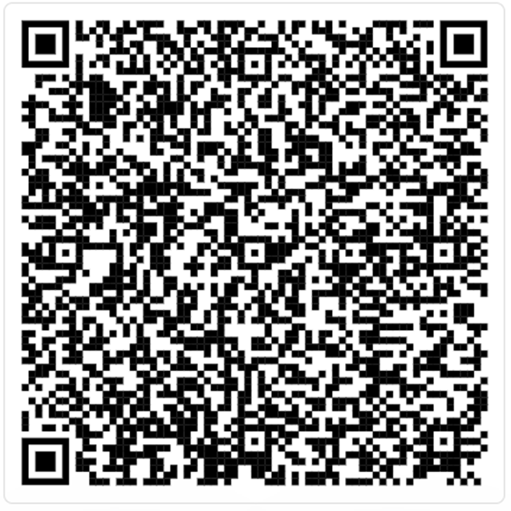
Impact of action research for ITE trainees
Social Justice
Intellectual Curiosity
Creativity
Open in slide show mode to see the poster output capturing outcomes in relation to the 'impact of action research for ITE trainees'.

Slide 24
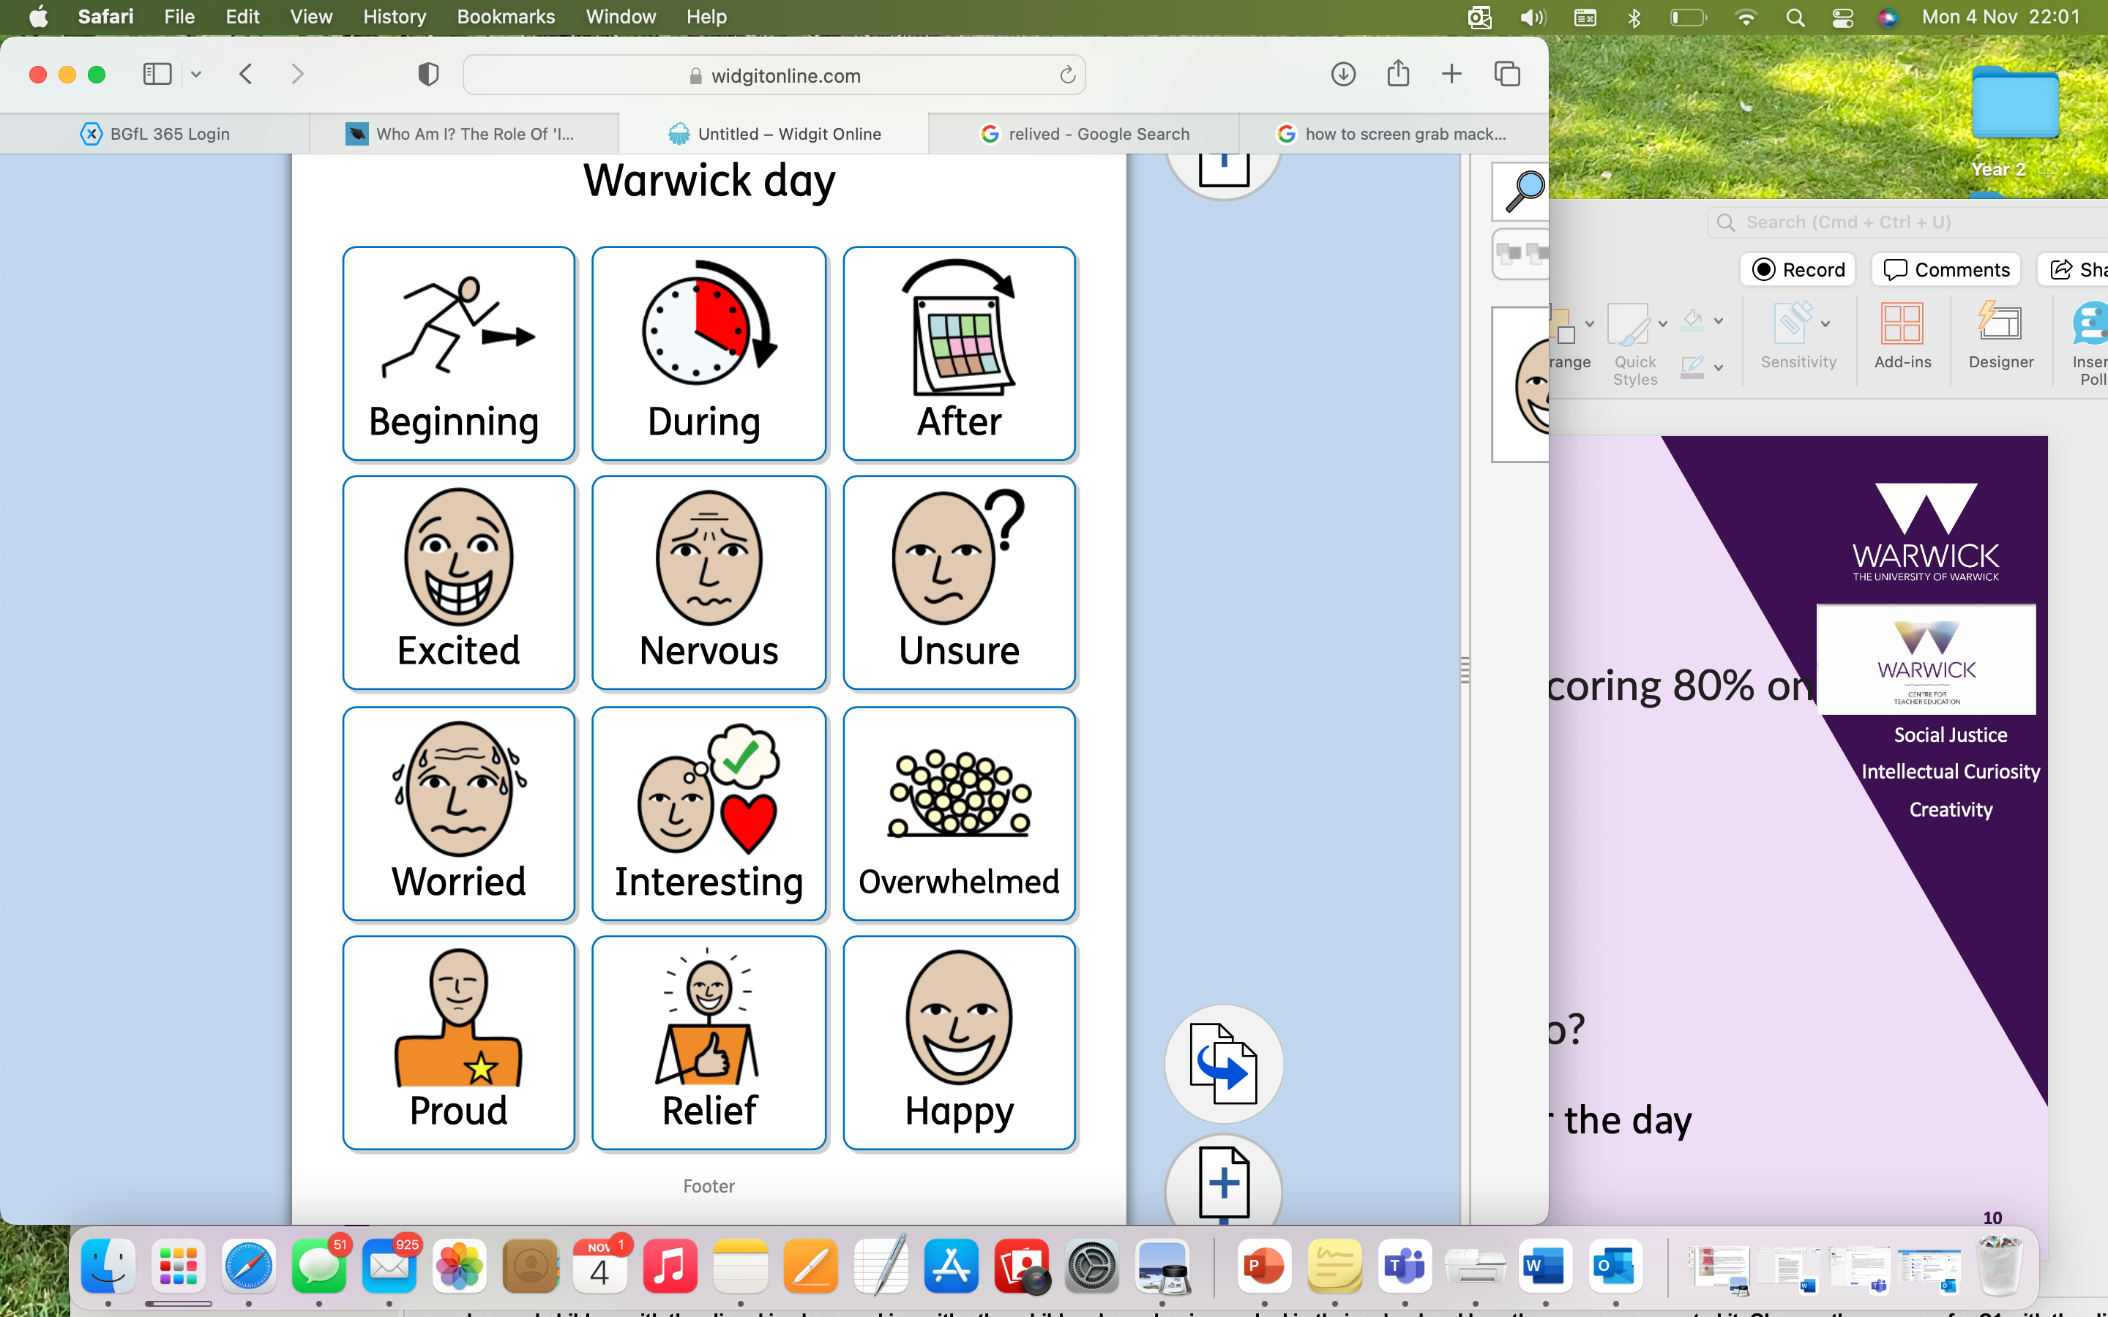
Feelings throughout the process
Notes:
MS 2minExcited for what the project was going to be about, learning more about phonics as we had initially started pgce. Excited for how it might look to future employees, for what it would mean for professional development and what we can bring to the researcher role.
Nervous- that feeling already of imposter syndrome “82% of industry professionals report having self-doubt or personal incompetence (Bravata et al., 2020).” Am I capable of this? Am I academic enough?
Unsure? Am I going to be able to cope? Is it going to be too much with teaching and what is the expectation of the reaseach project going to look like- as well as part time job/ PGCE/ Children at home

Slide 25
Feelings throughout the process
Notes:
MS/Gt 4minWorried: a lot of it was are we doing it right, we had guidance but made the project our own so constant questioning of ourselves. Organising meetings with university tutors and ourselves to sort out what we want to do how we want to spend out time. Lots of emails and messages exchanged between the two and four of us
Interesting: finding out about a difference school, different demographic, comparing it with our own placement experiences of phonics, the actual research is interesting?
Overwhelmed: almost feeling like you have two heads a PGCE head and a researcher head and finding it difficult to do placement, assignments, university tasks, applying for jobs, viewing schools and researching. Sometimes it could feel too much and we felt best to focus on the research on the days that we went to the school.

Slide 26
Feelings throughout the process
Notes:
GT/MS 3 minAfter there are a lot more positive thought:
Proud of what we achieved that we did cope and get through and personal growth, subject knowledge growth, more organised people
Releif that we did it we were resilient through being unsure and actually got through it
Happy that we did complete it: placement / schools are interested and it was a good talking point in our interviews

Slide 27
Final Words and Q&A
USA longitudinal study found children involved in the intervention made 4 times the progress of a control group.
USA context is different (no country wide early reading approach)
Year 4: continue to work with Chapter One as they consider roll out to more UK schools
Social Justice
Intellectual Curiosity
Creativity

Slide 28

Social Justice
Intellectual Curiosity
Creativity
Every child in every classroom deserves a great teacher every day

