Slide 1
Bringing history to life in the classroom: An exploration of how the study of visual and aural artefacts can give voice to the forgotten and disenfranchised.
Dr Alison Morgan
Research in Action Conference 2024

Slide 2
Teacher as Researcher
‘“Let No Man Write my Epitaph”: The Contributions of Percy Shelley, Thomas Moore and Robert Southey in the Memorialisation of Robert Emmet, Irish Studies Review (2014), pp. 285-303.
‘“God Save Our Queen!” Percy Bysshe Shelley and Radical Appropriations of the British National Anthem’, Romanticism (2014), pp.60-72
‘Starving Mothers and Murdered Children in Cultural Representations of Peterloo’, Manchester Region History Review (2014), ed. Robert Poole, pp. 65-78.
Ballads and Songs of Peterloo, Manchester University Press (2018).
‘” Song of the Slaughter”: The Poetry and Music of Peterloo’. Old Songs, New Discoveries: Selected Papers from the 2018 Folk Song Conference, The Ballad Partners (2019), ed. Steve Roud and David Atkinson, pp. 115-130.
‘From Pantomime to Peterloo: ‘Hearts of Oak’ and the Contest for Englishness in Songs of Protest’, Transactions of the Historic Society of Lancashire and Cheshire (2019).
’”Rise Now From Your Slumber”: Ballads and Songs of Peterloo’. Keats-Shelley Review (2021)
“’Britain Now Your Voices Join”: The Legacy of Peterloo in Song’. Romanticism on the Net (2021)
‘Our Subversive Voice’: The History and Politics of the English Protest Song (2022)
‘”Sons of Freedom”: John Stafford, his “Ashton Election” Ballad and the Radical Public Sphere’, Boydell and Brewer, forthcoming
Notes:
Interdisciplinarity, intertextuality, subject research – expertise. CPD – English, history
Collaborative research.

Slide 3
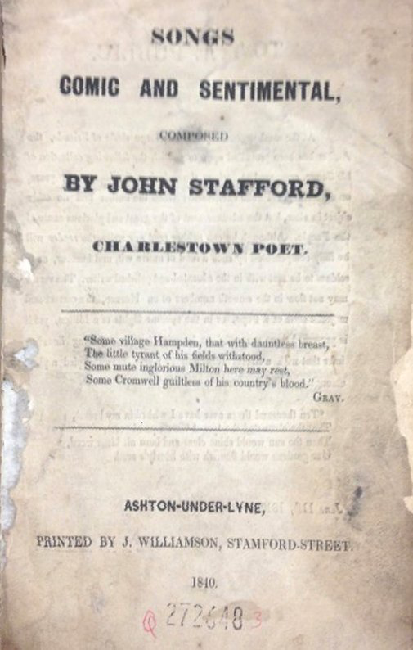
Teacher as Researcher: Current Project
John Stafford’s Life and Legacy in Song (book, forthcoming)
Notes:
Interdisciplinarity, intertextuality, subject research – expertise. CPD – English, history
Collaborative research.

Slide 4
What is critical theory and how can it support and enhance learning?

Slide 5
How can feminist and new historicist theory support and enhance learning?

Slide 6
Feminism
Proliferation of Feminist theories in recent decades, e.g. fourth-wave feminism
Female experience cannot be explored in isolation from race, class, psychology or sexuality.
The feminist movement of the 1960s and 1970s brought to the fore the ways in which women are and have been repressed within a patriarchal society.
Radical and liberal Feminism began to part company in the 1980s and the establishment of two wings of Feminist criticism began to emerge.
‘Constructionist’ Feminism argues that gender for both men and women is socially constructed. Closely linked to Marxism
‘Essentialist’ Feminists contend that gender is based on natural differences between men and women. We can see these argument plays out today in the debate surrounding transgender women. Essentialists took inspiration from Post-Structuralism.
Notes:
4th wave feminism – c. 2010 – focus on online activism and intersectionality (race, gender, class, sexuality). Reaction against earlier forms of feminism, seem as being exclusive rather than inclusive. Also reaction against misogyny and anti-feminist backlashes, especially online.

Slide 7
New Historicism
Coined in the 1980s by Stephen Greenblatt;
Builds on the older theory of Historicism which espouses that historical context should be central to the study of texts (Marxism is key to this idea).
New Historicism also incorporates some Structuralist ideas, including the view that historical sources should also be treated as texts and the ways in which meaning is constructed by them considered.
Foucault was instrumental in the treatment of history as discourse: an inherently unstable form through which meaning is mediated.
A New Historicist reads all texts in the same way, whether factual or fictional and explores their shared features. Texts are viewed both diachronically (across time) and synchronically (contemporarily).
Many other theories, such as Feminism and Postcolonialism necessitate a Historicist reading of texts and, in particular, the analysis of power.

Slide 8
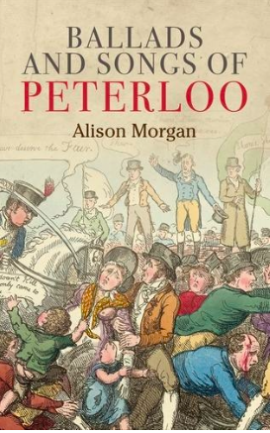

Notes:
Using my research into Peterloo as a case study

Slide 9

Notes:
Film trailer https://www.youtube.com/watch?v=Dj5h1kKjVYc
What do you know about Peterloo?

Slide 10
Peterloo and women
Popularity of female reform societies in North West post 1815
18 people killed – 4 women & 1 child
654 recorded casualties – 168 women
12% of those present were women, mostly from the working class
25% of casualties were women
Notes:
What conclusions do you draw from this?

Slide 11
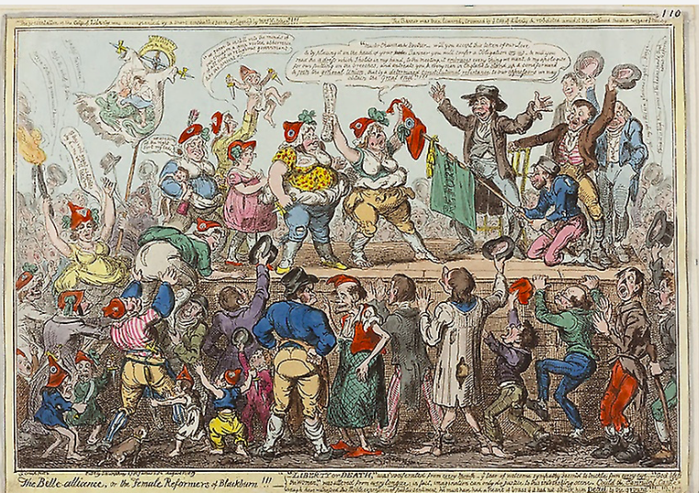
The Belle Alliance or the Female Reformers of Blackburn (1819) by George Cruikshank
Notes:
Exploration of representation of women

Slide 12
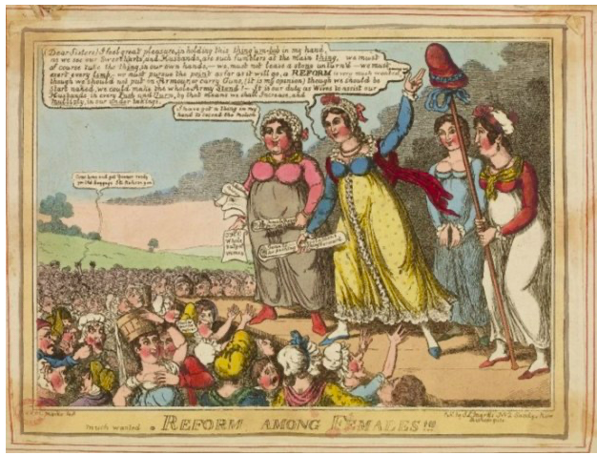
Much Wanted A Reform Among Females (1819) by J.L. Marks

Slide 13
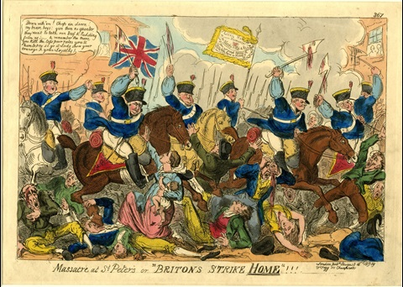
Massacre at St. Peter’s, or “Britons Strike Home” !!! (1819) by George Cruikshank.
Notes:
Trainees to be shown the following slides and consider the representation of women. How art becomes iconography

Slide 14
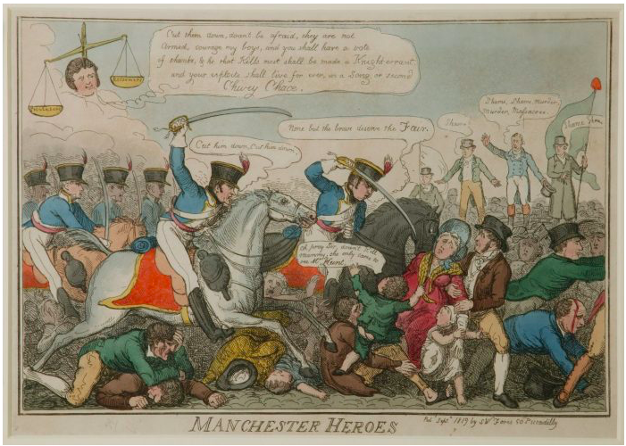
Manchester Heroes (1819) by George Cruikshank

Slide 15
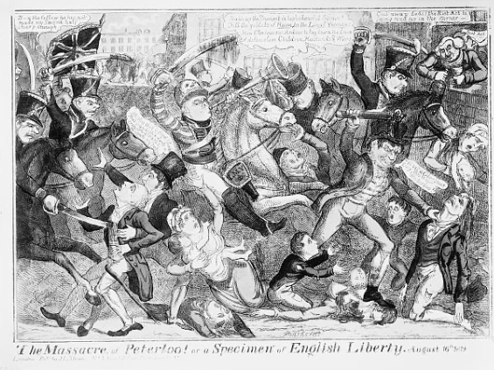
The Massacre at Peterloo (1819) by J.L. Marks

Slide 16
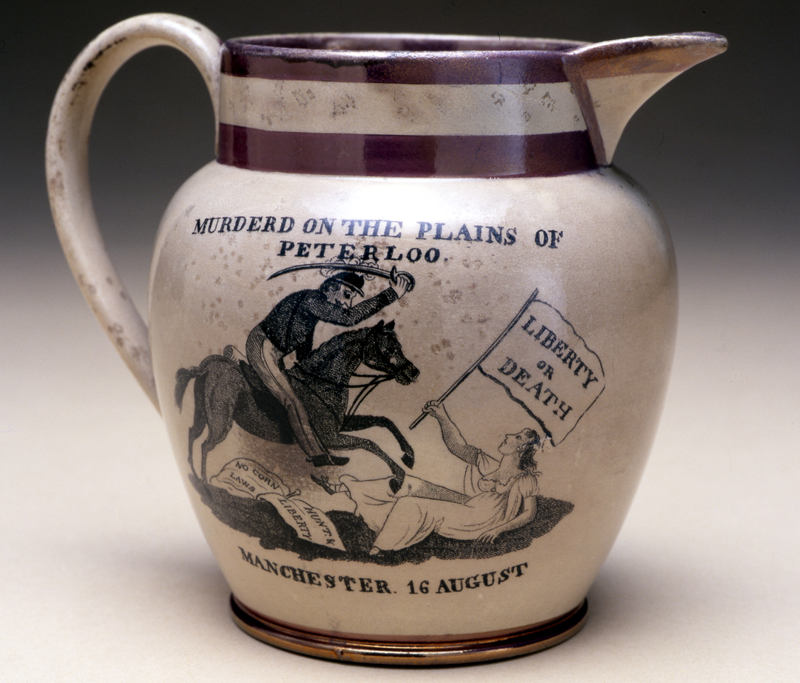
Peterloo Jug, Herculaneum Pottery (1819), Manchester Art Gallery

Slide 17
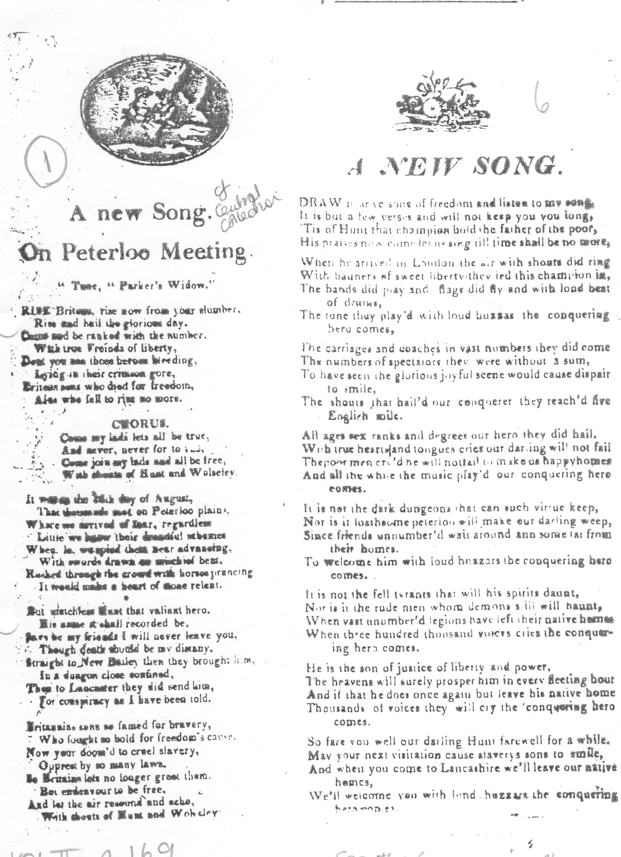

Manchester Central Library Collection of Ballads

Slide 18
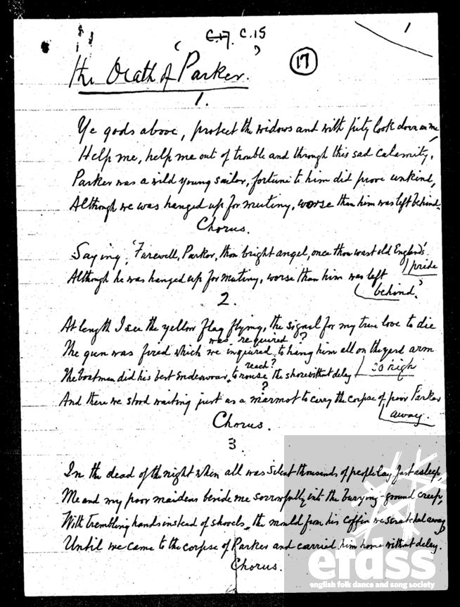
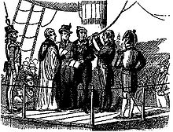
The Death of Parker
Vaughan Williams Memorial Library

Slide 19
Peterloo and social class
Economic recession post Napoleonic Wars
Repressive Tory government
60,000 present
Campaigning for universal male suffrage
Thousands of spinners and weavers
Manchester and Salford Yeomanry Cavalry – middle class
Magistrates – middle class
E.P. Thompson ‘class war’

Slide 20
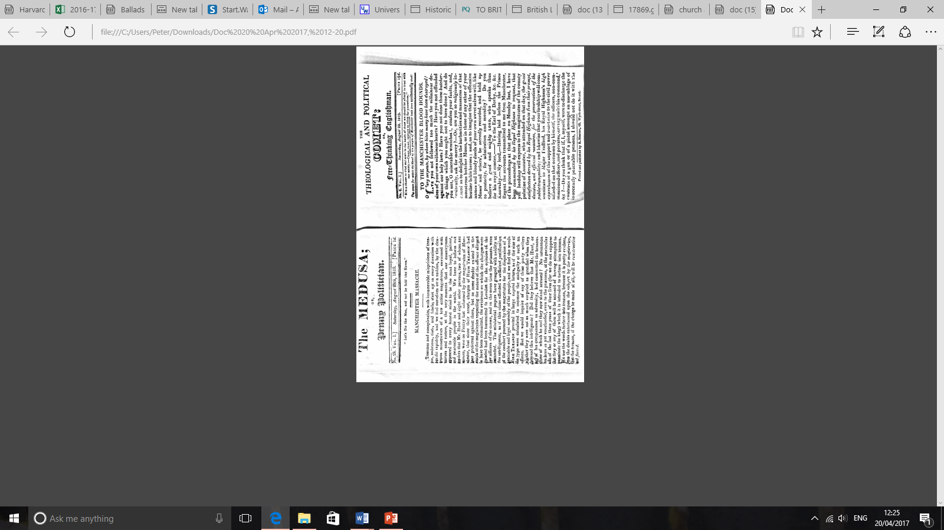

Slide 21
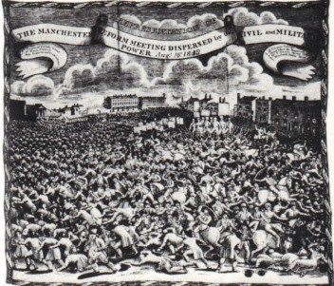
Representation of the Manchester Reform Meeting Dispersed by the Civil and Military Power. August 16, 1819 John Slack

Slide 22
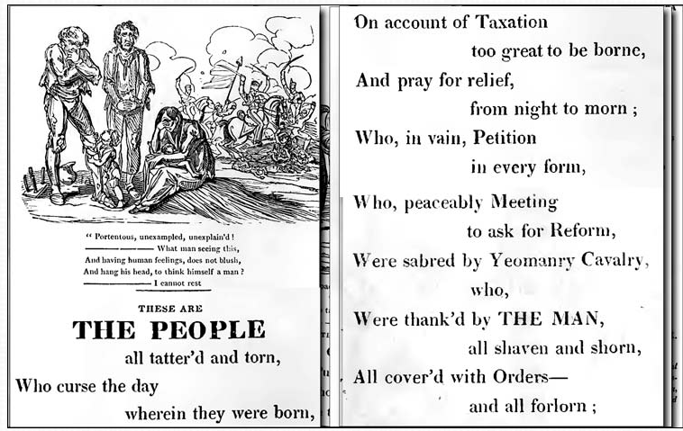
The Political House that Jack Built (1819) by William Hone & George Cruikshank

Slide 23
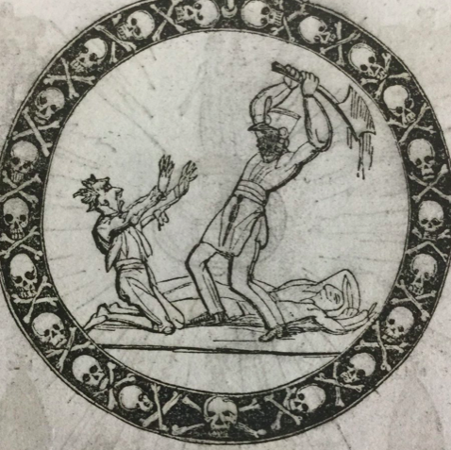
A Slap at Slop and the Bridge Street Gang (1821) William Hone and George Cruikshank

Slide 24
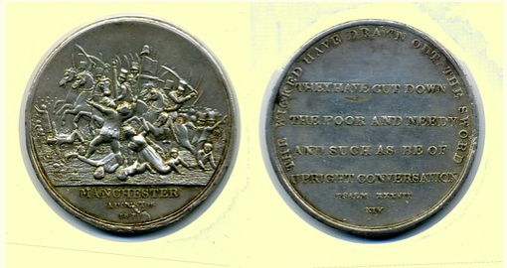
Peterloo Commemorative Medal (1819)
Notes:
THE WICKED HAVE DRAWN OUT THE SWORD/ THEY HAVE CUT DOWN/ THE POOR AND NEEDY/ AND SUCH AS BE OF/ UPRIGHT CONVERSATION/ PSALM XXX VII/ XIV

Slide 25
‘Peterloo’ Manchester Observer (13 November 1819)
The heroic muse no more shall boast,
The mighty deeds of Waterloo;
But, this henceforth shall be the toast,
The glorious feats of Peterloo.
Fame, sound thy trump with loud applause,
For men so generous, brave and true,
For men who fought without a cause,
All on the plain of Peterloo.
Tell us no more of Wellington,
Nor of his warlike conquering crew;
How dim the glory of their sun,
Before the blaze of Peterloo.
They madly sought a foreign shore,
And foreign armies to subdue,
But these more brave, with British gore
Deep ting’d the plains of Peterloo.
To face the brave was the delight
Which former British heroes knew;
To combat those who could not fight;
Was all the pride of Peterloo.
Man once was wont to fight with man,
But these would sabre woman too,
So high their matchless courage ran,
On the great day of Peterloo.

Slide 26
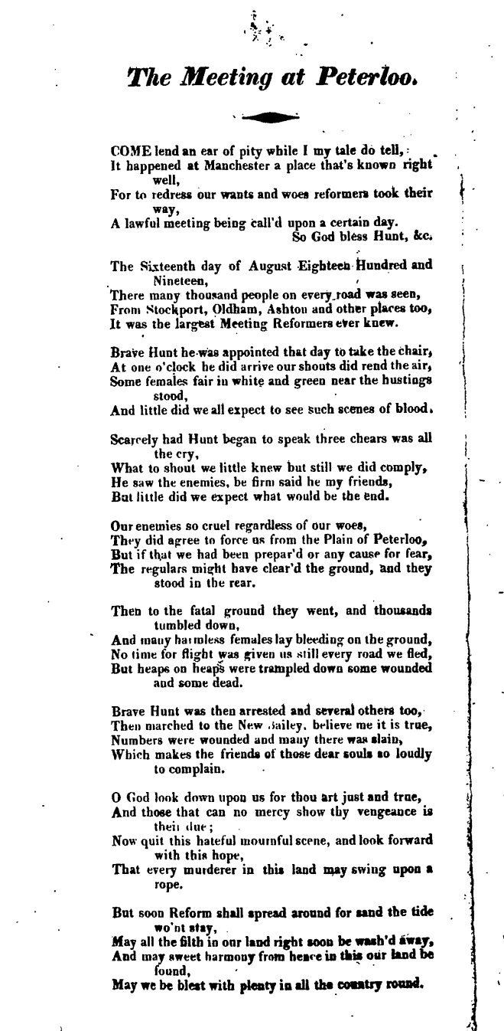
ballads.bodleian.ox.ac.uk

Slide 27
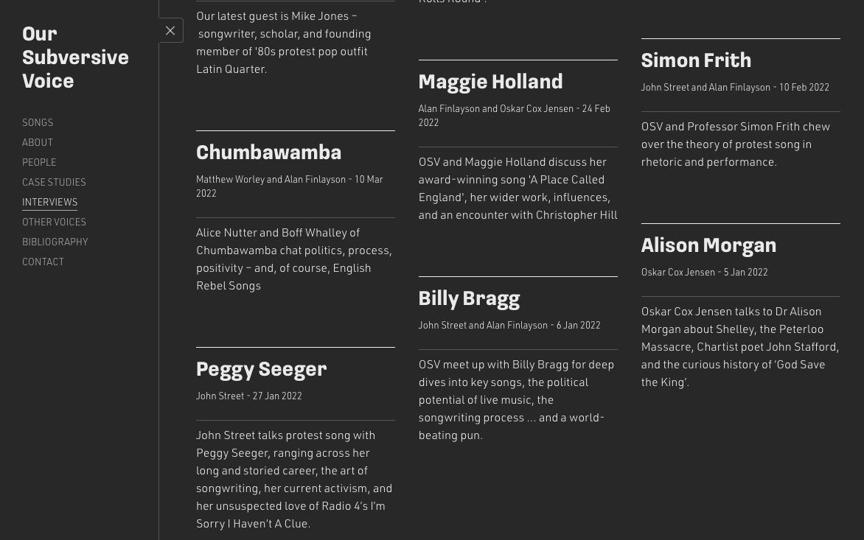
Notes:
https://oursubversivevoice.com/interview/alison-morgan/

