Slide 1

Simon Dougherty
Senior Lecturer
PGCE Physical Education
MA Education

Slide 2
MA Education
Dissertation Title:
How do trainee teachers experience and observe homophobia in boys’ secondary PE?
Aim of the research
To understand PGCE Trainee Teacher experiences of Homophobia in boys’ secondary PE

Slide 3
Summary
The idea that PE departments are both heteronormative and homophobic
Male PE teachers are socialised into ways of thinking and doing.
Difficult to challenge and can become a taken-for-granted and unnoticed norm – entrenched in teachers’ thinking and practices.
Makes it a difficult environment for LGBTQ+ pupils and staff.
Notes:
This article builds upon seminal work by Connell (2000) who published The Men and the Boys. Connell looks at how schools shape masculinities, and how men's health issues and attempts to combat violence are linked to men's gender conduct. None of this is 'local' anymore. Men, like women, are influenced by gender patterns on a world scale.

Slide 4

Question?
What sport am I thinking of?
The sport is played between 2 teams on a rectangular court.
To score points each team attack their opponents end where there is a hoop to shoot into.

Slide 5
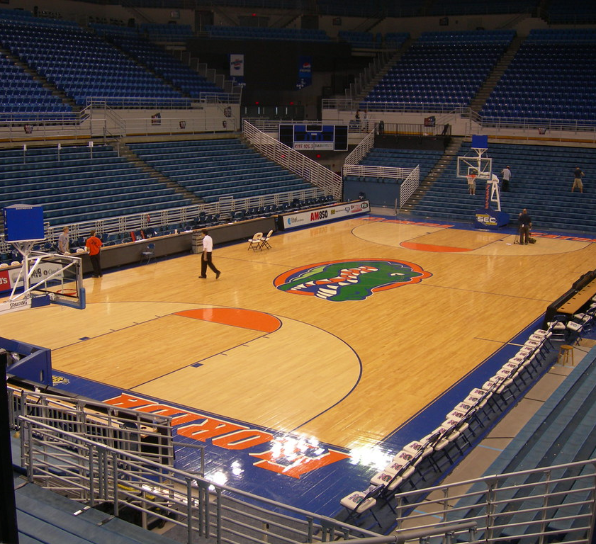
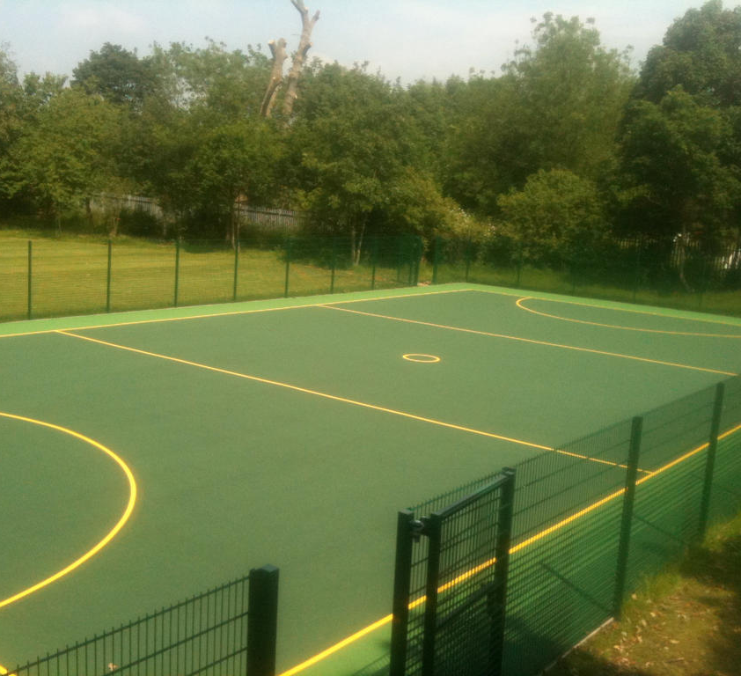

Basketball v Netball

Slide 6
Heteronormative and Homophobic
The idea that PE departments are both heteronormative and homophobic.
Compulsory heterosexuality is very evident in PE through implicit and explicit messages. Implicit messages are often harder to notice as they can be products of traditional ways of thinking and using language. Harmful implicit messages can be found through the use of heteronormative assumptions made in daily interactions with colleagues and students (e.g. all men are expected to be tough and strong)
(Walton-Fisette et al, 2020)

Slide 7
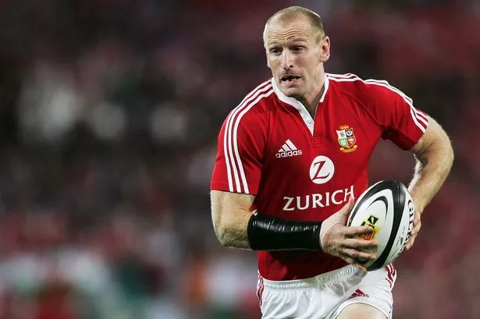
Consequently, male PE teachers are socialised into these ways of thinking and doing.
Since heterosexual masculinity is expressed and reinforced through displays of physical strength, sporting ability, and body appearance; heterosexual masculinity is in turn posited as a driver of homophobia (Robertson, 2003)

Slide 8
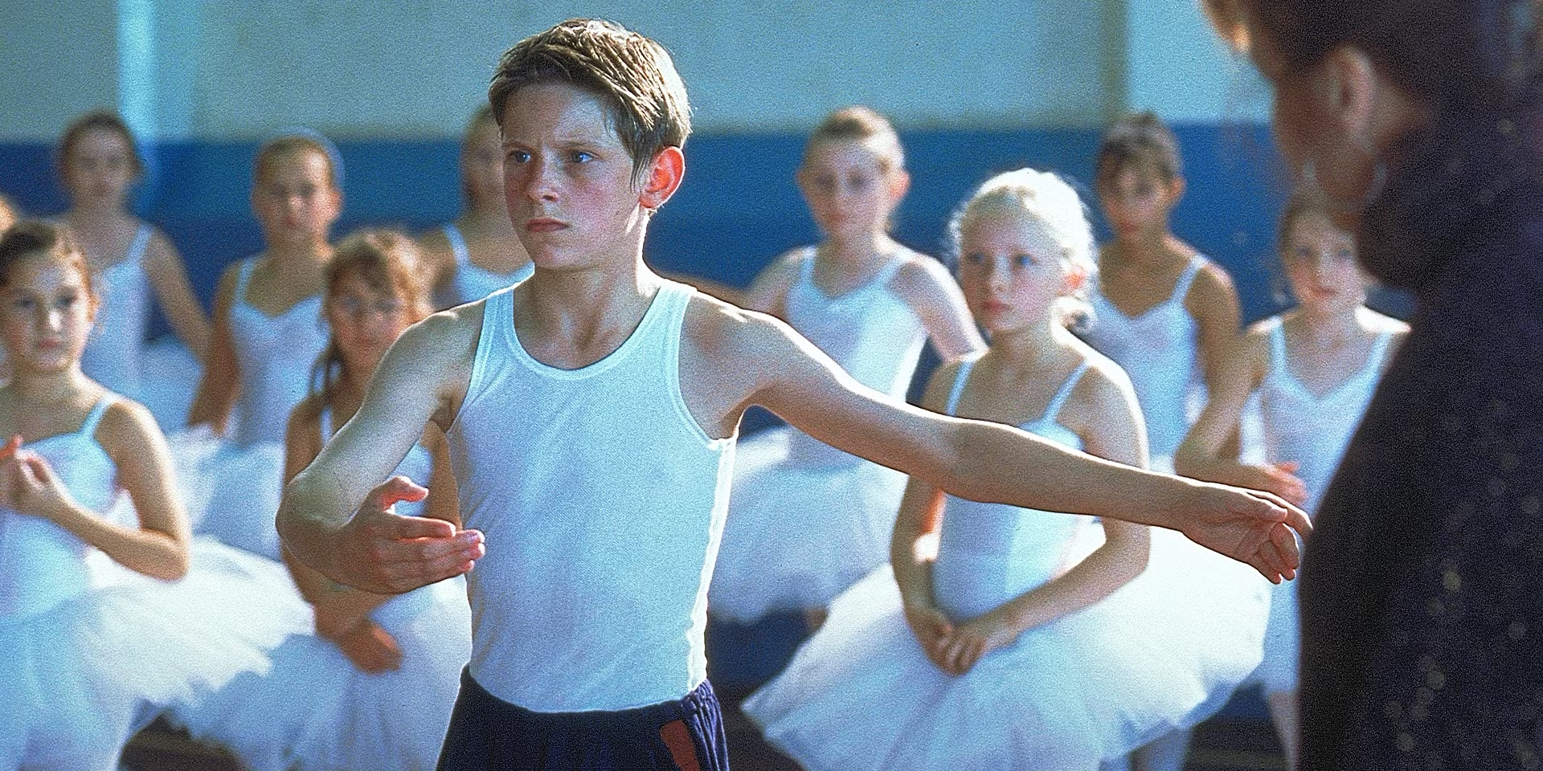
Billy Elliot
Indeed, gay men are viewed as the antithesis of heterosexual physical and sporting ideals and stereotyped as walking and talking in a physically effeminate way, and looking physically effeminate
(Herek, 1988; Messner, 1992).
Notes:
Play You Tube clip
https://www.youtube.com/watch?v=kSBsQzkBm5A

Slide 9
Homophobia
It’s logical that high levels of homophobia would exist in sport and physical education programs (Morrow& Gill, 2003).
O’Brien et al (2013) explored the relationship between university students’ physical/sporting identity and athletic self-concept-related constructs and homophobia. Findings showed that anti-gay and anti-lesbian prejudice was greater in PE students than it was among non-PE students. Findings that physical/sporting attributes and identities are related to greater homophobia is consistent with suggestions that homophobia is closely linked with physical characteristics central to masculinity and males, rather than femininity and females.

Slide 10
‘Miss, you're so gay.’ Queer stories from trainee teachers
(Nixon & Givens, 2004)
Further evidence of the past enforcement of patriarchy on the campus where this
research is based is provided by a final year PE student studying in the mid-1990s,
who worked `undercover' observing and analysing the behaviour of his own peers. His
unpublished undergraduate dissertation makes similar claims about a sub-culture
whose distinct language and strong sense of group identity was enhanced by highly
competitive behaviour on and off the sports' field, and by initiation rites centred
around alcohol and the stories of (hetero)sexual exploits. The rules were enforced by
physical and verbal pressure to conform within a rigid hierarchy, with the ultimate
threat being summary exclusion from the prized group. Homophobia and
heterosexism were elements in the controlling of masculinity's boundaries.

Slide 11

Section 28
Section 28 was a clause in the Local Government Act 1988 that prohibited local authorities from promoting homosexuality: Intentionally promoting homosexuality, Publishing material that promotes homosexuality, and Promoting the acceptability of homosexuality in schools.
(United Kingdom,1988)
Now that Section 28 is finally repealed (2003), a more open attitude to the discussion of sexuality will be possible in classrooms and the concept of sexuality education will be re-opened for debate. PE produces a uniquely aversive culture which can be challenged. (Nixon & Givens,2004)

Slide 12
The Data Collection
The research will review through the lens and experiences of Secondary PGCE PE trainee teachers who will be embedded within school PE departments, therefore enabling them to draw on their lived experiences and perceptions of homophobia within boys’ physical education. The data collection will guide the narrative around social justice to recognise how inclusive schools actually are when relating to LGBTQ+ issues and what education needs to be suggested to challenge homophobia in PE.
Ethical approval will be sought.
Timeline Jan-Apr 2025
Dissertation Submission Sept 2025

Slide 13
Qualitative interviews exploration
Curriculum delivery
Extra-curricular delivery
Department culture
Dynamics of school/dept/classes
Observations of pupils/staff/parents

Slide 14
Aim is to explore through ‘storytelling’
Narrative Inquiry approach
Thematic analysis of data

Slide 15
Any Questions?
Any Comments?
Any Suggestions?

Slide 16
References
Billy Elliot (2000) Directed by Stephen Daldry [Film]. UK: Universal Pictures.
Herek, G. M. (1988). Heterosexuals’ attitudes toward lesbians and gay men: Correlates and gender differences. Journal of Sex Research, 25, 451–477.
Messner, M. (1992). Power at play: Sports and the problem of masculinity. Boston, MA: Beacon Press
Morrow, R. G., & Gill, D. L. (2003). Perceptions of homophobia and heterosexism in physical education. Research Quarterly for Exercise and Sport, 74,205–214
Nixon, D & Givens, N (2004) ‘Miss, you're so gay.’ Queer stories from trainee teachers, Sex Education, 4:3, 217-237, DOI: 10.1080/1468181042000243321
O’Brien, K. S., Shovelton, H., & Latner, J. D. (2013). Homophobia in physical education and sport: The role of physical/sporting identity and attributes, authoritarian aggression, and social dominance orientation. International Journal of Psychology , 48 (5), 891– 899.
Robertson, S. (2003). ‘If I let a goal in, I’ll get beat up’: Contradictions in masculinity, sport and health. Health Education Research, 18, 706–716
United Kingdom. (1988) Local Government Act 1988, Section 28, c. 9. Available at: https://www.legislation.gov.uk/ukpga/1988/9/section/28 (Accessed: [16 November 2024]).
Walton-Fisette, JL, Sutherland, S, & Hill, J (eds) 2020, Teaching about Social Justice Issues in Physical Education, Information Age Publishing, Incorporated, Charlotte, NC. Available from: ProQuest Ebook Central. [16 November 2024].

