Slide 1
Is the SPELL Framework as Magical as it Sounds? Exploring Its Effectiveness in Supporting Autistic Students.
A presentation of the evidence supporting application of the SPELL framework in schools.
Grace Muirhead

Slide 2

Introduction
Completed the Postgraduate Certificate in Professional Education
Experience working in an autism-specialist schools and mainstream primary school
Currently undertaking my Masters in Child Development and Wellbeing in Practice
(Disclaimer – this is not SPELL training)

Slide 3
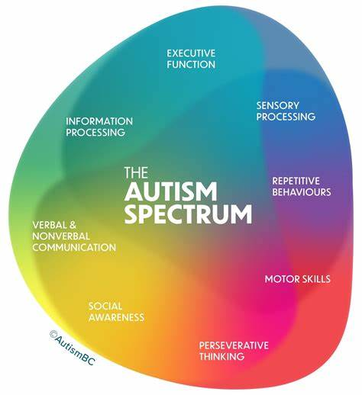
Autism in schools
Is a lifelong developmental disorder (APA, 2013)
Autism as a spectrum
Language has distanced from words like “impairment” “high-functioning” “low-functioning”
Person first language (Kenny et al., 2016)

Slide 4
What is the SPELL FRAMEWORK?
Structure
Positive expectations and approaches
Empathy
Low arousal
Links
National Autistic Society

Slide 5



structure
Structure and predictability aids personal autonomy and reduces anxiety (National Autistic Society, no date).
Scientific investigations suggest that differences in prediction skills may underlie autistic individuals need for certainty (Gomot & Wicker, 2012; Cannon et al., 2021).
Creating structure can be used in mainstream classrooms to promote inclusion ☺

Slide 6
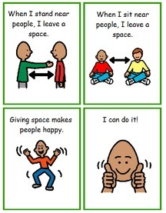
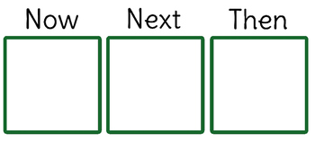


applications
Now and next boards
Sand timers
Visual timetables
Social stories

Slide 7

Positive approaches and expectations
Reinforcing self-esteem and self-confidence
Understanding a student's key interests and strengths
Murray et al. (2005) Monotropism theory suggest professionals should make tasks and social connections meaningful by basing them on individuals' interests.
Little empirical support for this element – perhaps due to ethics.

Slide 8
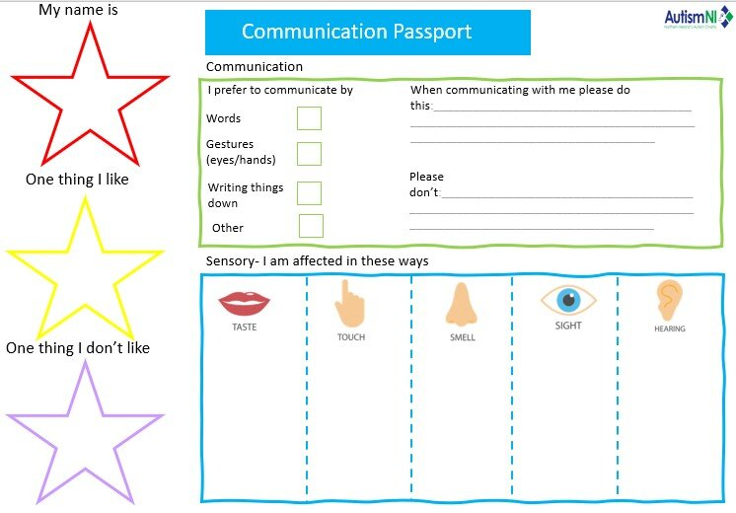
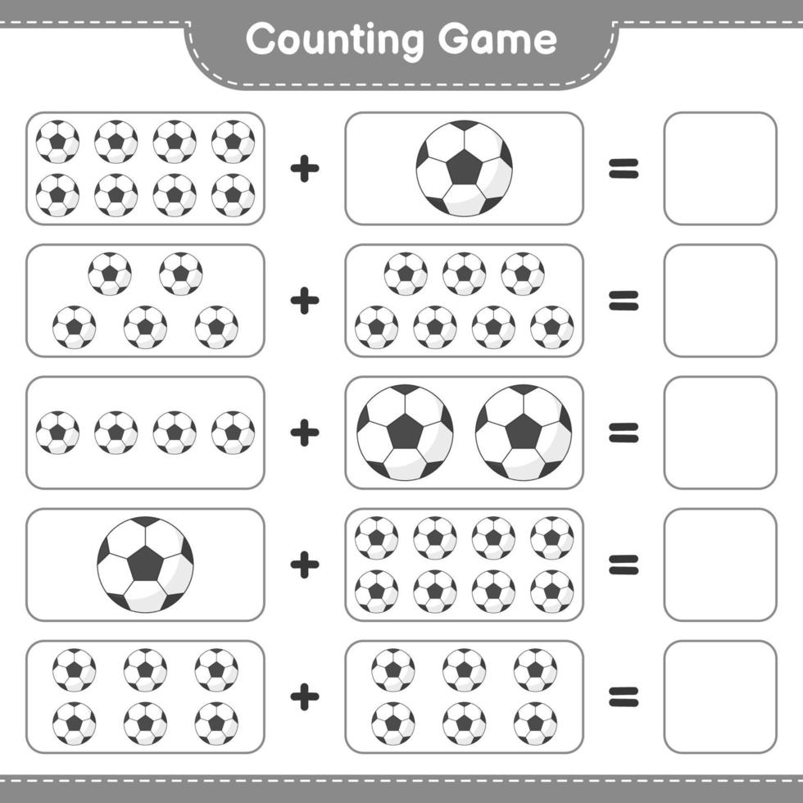
APPLICATIONS
All about me! Communication passports
Tailored activities to interests

Slide 9
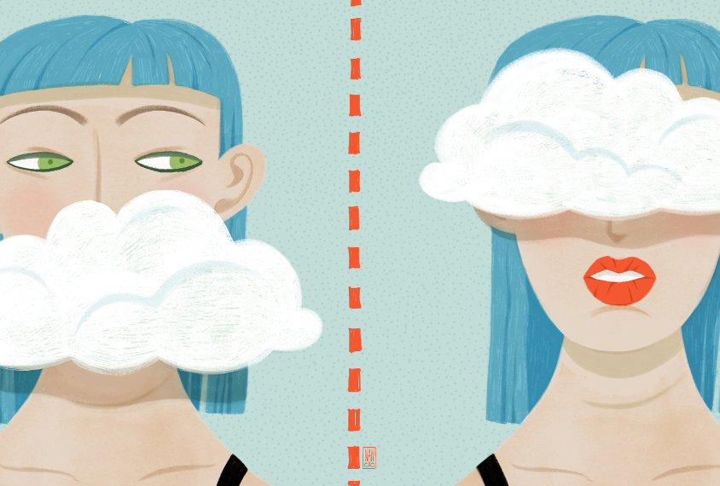
EMPATHY
Autistic people are often stereotyped as unsociable and unempathetic – often stemming from historical perspectives (Kanner, 1943).
Recent research shows that autistic people exhibit a strong desire to develop friendships but are obstructed by social challenges (Black et al., 2022).
Milton’s (2012) Double empathy problem offers insight into the autistic experience of empathy.
Most important element of SPELL (in my opinion!)
Visual representation of the double empathy problem

Slide 10

considerations
Take time to understand the autistic person.
Use their preferred communication style.
“Sit still and face the front” Doesn’t work for everyone .
Neuroaffirmative approaches.

Slide 11
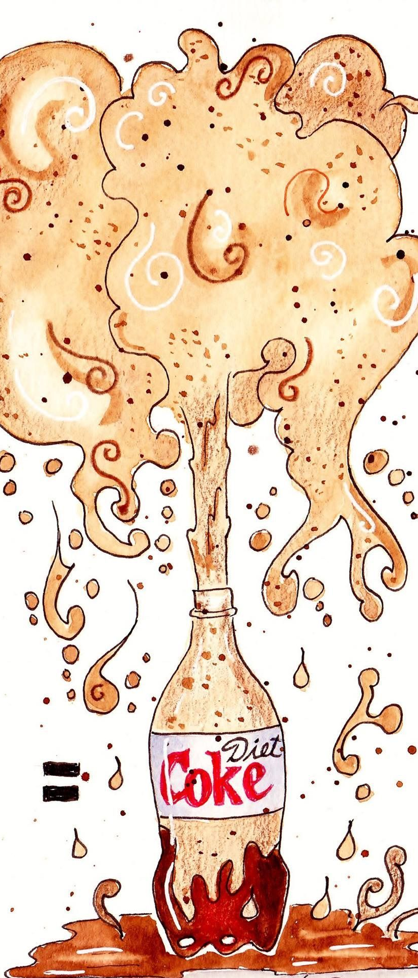
Low arousal
Calm and ordered environments and approaches
Bradley & Caldwell, 2013:
Autistic people can experience sensory differences because of differences in neurobiology and brain processing
Hyper/ Hyposensitivity to light, sound, taste, touch, and smell.
Can result in overload or shutdown.
Strategies fundamentally rely on reducing unwanted sensory stimuli.

Slide 12
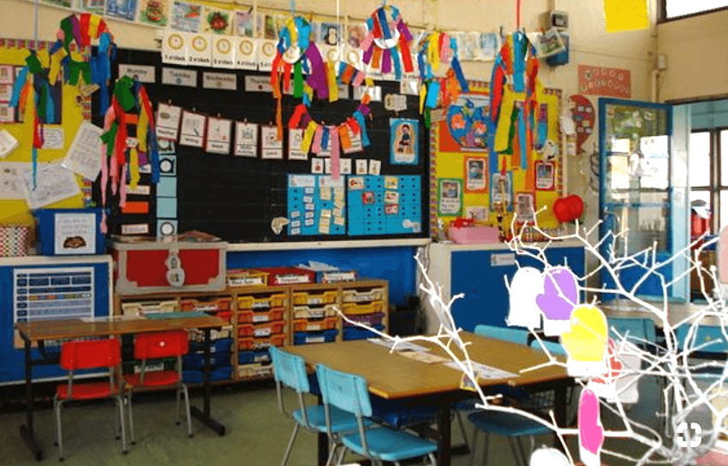
applications
Reduce verbal demands
Hanley et al. (2015):
Presence of high visual displays had impacts on learning for autistic and non-autistic students
Low arousal classrooms
Low arousal areas
Example of a high visual arousal classroom

Slide 13

links
The Lamb enquiry (2009) – parental involvement and confidence in schools is typically lower in parents of SEND children.
Regular conversations with a key contact in schools increased home/ school relationships (Lendrum et al., 2015)
Evidence supporting this element of SPELL is strong
School
Parent/ carer
External agencies

Slide 14
AUTISM LITERATURE
Top Priorities
Mental health and wellbeing
Support services
Bottom Priorities
Genetics
Treatments and interventions
Knowledge of autism
Causes of autism
Further investigation of the SPELL framework is needed
Challenges faced by researchers:
Ethical considerations
Funding for autism research is heavily allocated to biological and genetic studies (Harris et al., 2021)
Consider research conducted WITH autistic people not TO them (autistic researchers, autistic participants)
Autistic people’s research priorities (Cage et al., 2024)

Slide 15

CONCLUSIONS
Structure, empathy and links have the most support within the literature
Research does provide support for the strategies discussed in this presentation
SPELL provides a useful framework for supporting autistic students
The significance of Why?

Slide 16

Questions?

